Slide 1
CPE 150: Introduction to Programming
Chapter 4: Arrays
Copyright notice: 1- care has been taken to use only those web images deemed by the instructor to be in the public domain. If you see a copyrighted image on any slide and are the copyright owner, please contact the instructor. It will be removed.
2- These slides are inspired, based, and modified with permission from the authors of the C++ How to Program (4th Edition) textbook

Slide 2
Topics To Be Covered In Chapter 4
4.1 Introduction 4.2 Arrays
4.3 Declaring Arrays
4.4 Examples Using Arrays
4.5 Passing Arrays to Functions
4.6 Sorting Arrays
4.7 Case Study: Computing Mean, Median and Mode Using Arrays
4.8 Searching Arrays: Linear Search and Binary Search
4.9 Multiple-Subscripted Arrays

Slide 3
4.1 Introduction
Arrays
This chapter introduces the important topic of data structures—collections of related data items.
Arrays are data structures consisting of related data items of the same type.
After discussing how arrays are declared, created and initialized, we present a series of practical examples that demonstrate several common array manipulations.

Slide 4
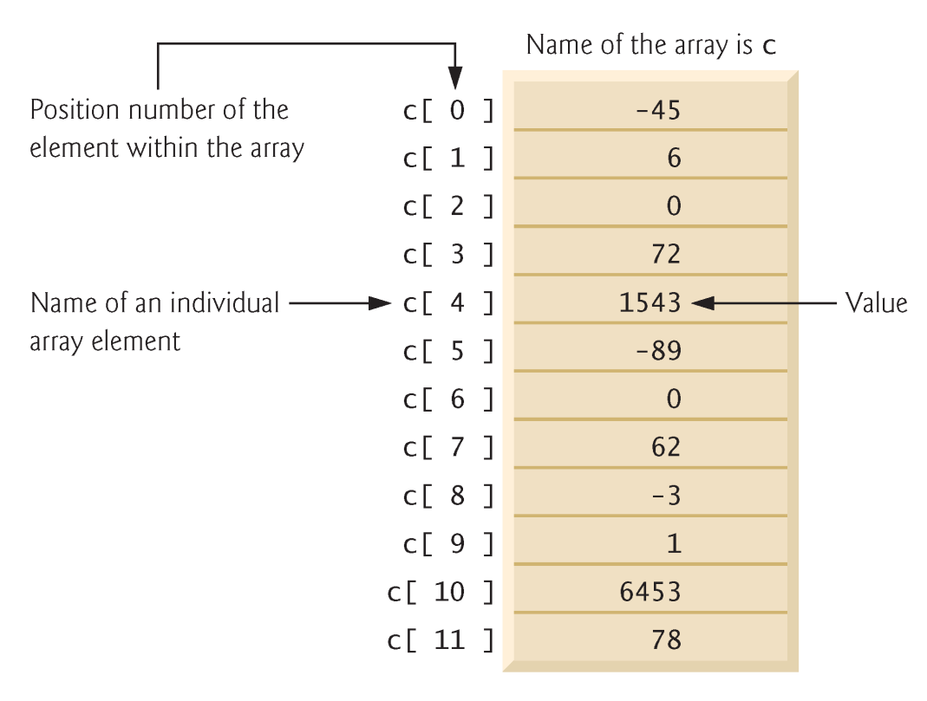
4.2 Arrays
Array
Consecutive group of memory locations
Same name and type (int, char, etc.)
To refer to an element
Specify array name and position number (index)
Format: arrayname[position number]
First element at position 0
n-element array c
c[0], c[1]… c[n - 1]
n-th element as position n-1

Slide 5
4.2 Arrays
Array elements like other variables
Assignment, printing for an integer array c
c[0] = 3;
cout << c[0];
Can perform operations inside subscript
c[5 – 2] same as c[3]

Slide 6
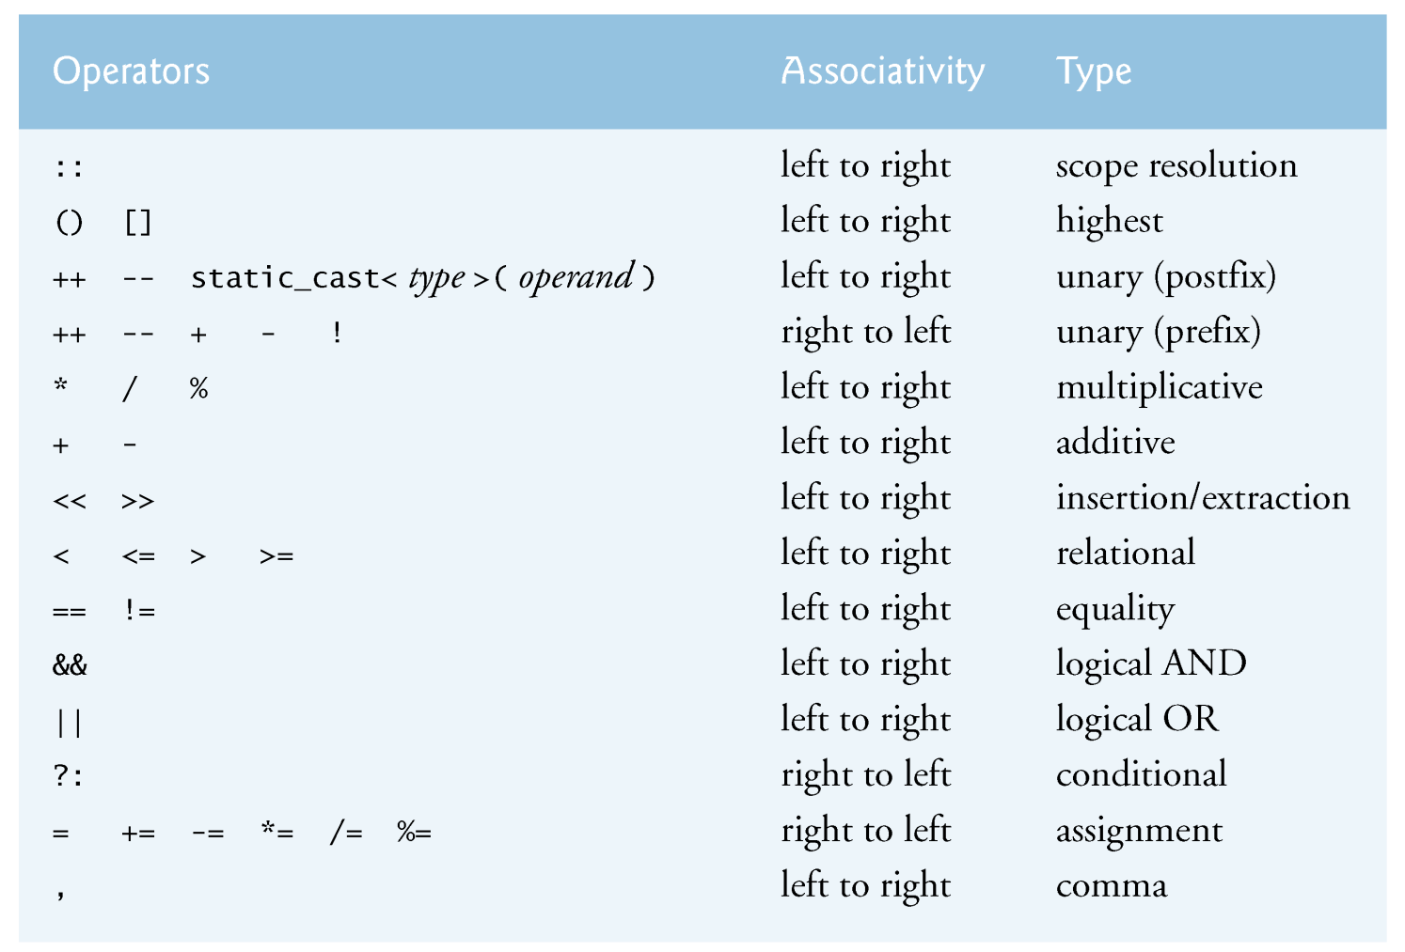

Slide 7
4.3 Declaring Arrays
When declaring arrays, specify
Name
Type of array
Any data type
Number of elements
type arrayName[ arraySize ];
int c[10]; // array of 10 integers
float d[3284]; // array of 3284 floats
Declaring multiple arrays of same type
Use comma separated list, like regular variables
int b[100], x[27];

Slide 8
4.4 Examples Using Arrays
Initializing arrays
For loop
Set each element
Initializer list
Specify each element when array declared
int n[5] = { 1, 2, 3, 4, 5 };
If not enough initializers, rightmost elements 0
If too many syntax error
To set every element to same value
int n[5] = { 0 };
If array size omitted, initializers determine size
int n[] = { 1, 2, 3, 4, 5 };
5 initializers, therefore 5 element array

Slide 9
1 // Fig. 4.3: fig04_03.cpp
2 // Initializing an array.
3 #include <iostream>
4
5 using std::cout;
6 using std::endl;
7
8 #include <iomanip>
9
10 using std::setw;
11
12 int main()
13 {
14 int n[ 10 ]; // n is an array of 10 integers
15
16 // initialize elements of array n to 0
17 for ( int i = 0; i < 10; i++ )
18 n[ i ] = 0; // set element at location i to 0
19
20 cout << "Element" << setw( 13 ) << "Value" << endl;
21
22 // output contents of array n in tabular format
23 for ( int j = 0; j < 10; j++ )
24 cout << setw( 7 ) << j << setw( 13 ) << n[ j ] << endl;
25
26 return 0; // indicates successful termination
27
28 } // end main
Declare a 10-element array of integers.
Initialize array to 0 using a for loop. Note that the array has elements n[0] to n[9].
Element Value
0 0
1 0
2 0
3 0
4 0
5 0
6 0
7 0
8 0
9 0

Slide 10
1 // Fig. 4.4: fig04_04.cpp
2 // Initializing an array with a declaration.
3 #include <iostream>
4
5 using std::cout;
6 using std::endl;
7
8 #include <iomanip>
9
10 using std::setw;
11
12 int main()
13 {
14 // use initializer list to initialize array n
15 int n[ 10 ] = { 32, 27, 64, 18, 95, 14, 90, 70, 60, 37 };
16
17 cout << "Element" << setw( 13 ) << "Value" << endl;
18
19 // output contents of array n in tabular format
20 for ( int i = 0; i < 10; i++ )
21 cout << setw( 7 ) << i << setw( 13 ) << n[ i ] << endl;
22
23 return 0; // indicates successful termination
24
25 } // end main
Note the use of the initializer list.
Element Value
0 32
1 27
2 64
3 18
4 95
5 14
6 90
7 70
8 60
9 37

Slide 11
4.4 Examples Using Arrays
Array size
Can be specified with constant variable (const)
const int size = 20;
Constants cannot be changed
Constants must be initialized when declared
Also called named constants or read-only variables

Slide 12
1 // Fig. 4.5: fig04_05.cpp
2 // Initialize array s to the even integers from 2 to 20.
3 #include <iostream>
4
5 using std::cout;
6 using std::endl;
7
8 #include <iomanip>
9
10 using std::setw;
11
12 int main()
13 {
14 // constant variable can be used to specify array size
15 const int arraySize = 10;
16
17 int s[ arraySize ]; // array s has 10 elements
18
19 for ( int i = 0; i < arraySize; i++ ) // set the values
20 s[ i ] = 2 + 2 * i;
21
22 cout << "Element" << setw( 13 ) << "Value" << endl;
23
24 // output contents of array s in tabular format
25 for ( int j = 0; j < arraySize; j++ )
26 cout << setw( 7 ) << j << setw( 13 ) << s[ j ] << endl;
27
28 return 0; // indicates successful termination
29
30 } // end main
Note use of const keyword. Only const variables can specify array sizes.
The program becomes more scalable when we set the array size using a const variable. We can change arraySize, and all the loops will still work (otherwise, we’d have to update every loop in the program).
Element Value
0 2
1 4
2 6
3 8
4 10
5 12
6 14
7 16
8 18
9 20

Slide 13
1 // Fig. 4.6: fig04_06.cpp
2 // Using a properly initialized constant variable.
3 #include <iostream>
4
5 using std::cout;
6 using std::endl;
7
8 int main()
9 {
10 const int x = 7; // initialized constant variable
11
12 cout << "The value of constant variable x is: "
13 << x << endl;
14
15 return 0; // indicates successful termination
16
17 } // end main
Proper initialization of const variable.
The value of constant variable x is: 7

Slide 14
1 // Fig. 4.7: fig04_07.cpp
2 // A const object must be initialized.
3
4 int main()
5 {
6 const int x; // Error: x must be initialized
7
8 x = 7; // Error: cannot modify a const variable
9
10 return 0; // indicates successful termination
11
12 } // end main
Uninitialized const results in a syntax error. Attempting to modify the const is another error.
d:\cpphtp4_examples\ch04\Fig04_07.cpp(6) : error C2734: 'x' : const object must be initialized if not extern
d:\cpphtp4_examples\ch04\Fig04_07.cpp(8) : error C2166:
l-value specifies const object

Slide 15
1 // Fig. 4.8: fig04_08.cpp
2 // Compute the sum of the elements of the array.
3 #include <iostream>
4
5 using std::cout;
6 using std::endl;
7
8 int main()
9 {
10 const int arraySize = 10;
11
12 int a[ arraySize ] = { 1, 2, 3, 4, 5, 6, 7, 8, 9, 10 };
13
14 int total = 0;
15
16 // sum contents of array a
17 for ( int i = 0; i < arraySize; i++ )
18 total += a[ i ];
19
20 cout << "Total of array element values is " << total << endl;
21
22 return 0; // indicates successful termination
23
24 } // end main
Total of array element values is 55

Slide 16
1 // Fig. 4.9: fig04_09.cpp
2 // Histogram printing program.
3 #include <iostream>
5 using std::cout;
6 using std::endl;
8 #include <iomanip>
10 using std::setw;
11
12 int main()
13 {
14 const int arraySize = 10;
15 int n[ arraySize ] = { 19, 3, 15, 7, 11, 9, 13, 5, 17, 1 };
16
17 cout << "Element" << setw( 13 ) << "Value"
18 << setw( 17 ) << "Histogram" << endl;
19
20 // for each element of array n, output a bar in histogram
21 for ( int i = 0; i < arraySize; i++ ) {
22 cout << setw( 7 ) << i << setw( 13 )
23 << n[ i ] << setw( 9 );
24
25 for ( int j = 0; j < n[ i ]; j++ ) // print one bar
26 cout << '*';
27
28 cout << endl; // start next line of output
29
30 } // end outer for structure
31
32 return 0; // indicates successful termination
34 } // end main
Element Value Histogram
0 19 *******************
1 3 ***
2 15 ***************
3 7 *******
4 11 ***********
5 9 *********
6 13 *************
7 5 *****
8 17 *****************
9 1 *
Prints asterisks corresponding to size of array element, n[i].

Slide 17
1 // Fig. 4.10: fig04_10.cpp
2 // Roll a six-sided die 6000 times.
3 #include <iostream>
5 using std::cout;
6 using std::endl;
8 #include <iomanip>
10 using std::setw;
12 #include <cstdlib>
13 #include <ctime>
15 int main()
16 {
17 const int arraySize = 7;
18 int frequency[ arraySize ] = { 0 };
19
20 srand( time( 0 ) ); // seed random-number generator
21
22 // roll die 6000 times
23 for ( int roll = 1; roll <= 6000; roll++ )
24 ++frequency[ 1 + rand() % 6 ]; // replaces 20-line switch
25 // of Fig. 3.8
26
27 cout << "Face" << setw( 13 ) << "Frequency" << endl;
28
29 // output frequency elements 1-6 in tabular format
30 for ( int face = 1; face < arraySize; face++ )
31 cout << setw( 4 ) << face
32 << setw( 13 ) << frequency[ face ] << endl;
33
34 return 0; // indicates successful termination
35 } // end main
Remake of old program to roll dice. An array is used instead of 6 regular variables, and the proper element can be updated easily (without needing a switch).
This creates a number between 1 and 6, which determines the index of frequency[] that should be incremented.
Face Frequency
1 1003
2 1004
3 999
4 980
5 1013
6 1001

Slide 18
1 // Fig. 4.11: fig04_11.cpp
2 // Student poll program.
3 #include <iostream>
4
5 using std::cout;
6 using std::endl;
7
8 #include <iomanip>
9
10 using std::setw;
11
12 int main()
13 {
14 // define array sizes
15 const int responseSize = 40; // size of array responses
16 const int frequencySize = 11; // size of array frequency
17
18 // place survey responses in array responses
19 int responses[ responseSize ] = { 1, 2, 6, 4, 8, 5, 9, 7, 20 8, 10, 1, 6, 3, 8, 6, 10, 3, 8, 2, 7, 6, 5, 7, 6, 8, 21 6, 7, 5, 6, 6, 5, 6, 7, 5, 6, 4, 8, 6, 8, 10 };
22
23 // initialize frequency counters to 0
24 int frequency[ frequencySize ] = { 0 };
25
26 // for each answer, select value of an element of array
27 // responses and use that value as subscript in array
28 // frequency to determine element to increment
29 for ( int answer = 0; answer < responseSize; answer++ )
30 ++frequency[ responses[answer] ];
31
32 // display results
33 cout << "Rating" << setw( 17 ) << "Frequency" << endl;
34
35 // output frequencies in tabular format
36 for ( int rating = 1; rating < frequencySize; rating++ )
37 cout << setw( 6 ) << rating
38 << setw( 17 ) << frequency[ rating ] << endl;
39
40 return 0; // indicates successful termination
41
42 } // end main
responses[answer] is the rating (from 1 to 10). This determines the index in frequency[] to increment.
Rating Frequency
1 2
2 2
3 2
4 2
5 5
6 11
7 5
8 7
9 1
10 3

Slide 19
4.4 Examples Using Arrays
Strings (more in ch. 5)
Arrays of characters
All strings end with null ('\0')
Examples
char string1[] = "hello";
Null character implicitly added
string1 has 6 elements
char string1[] = { 'h', 'e', 'l', 'l', 'o', '\0’ };
Subscripting is the same
String1[ 0 ] is 'h'
string1[ 2 ] is 'l'

Slide 20
4.4 Examples Using Arrays
Input from keyboard
char string2[ 10 ];
cin >> string2;
Puts user input in string
Stops at first whitespace character
Adds null character
If too much text entered, data written beyond array
We want to avoid this (section 5.12 explains how)
Printing strings
cout << string2 << endl;
Does not work for other array types
Characters printed until null found

Slide 21
1 // Fig. 4_12: fig04_12.cpp
2 // Treating character arrays as strings.
3 #include <iostream>
4
5 using std::cout;
6 using std::cin;
7 using std::endl;
8
9 int main()
10 {
11 char string1[ 20 ], // reserves 20 characters
12 char string2[] = "string literal"; // reserves 15 characters
13
14 // read string from user into array string2
15 cout << "Enter the string \"hello there\": ";
16 cin >> string1; // reads "hello" [space terminates input]
17
18 // output strings
19 cout << "string1 is: " << string1
20 << "\nstring2 is: " << string2;
21
22 cout << "\nstring1 with spaces between characters is:\n";
23 // output characters until null character is reached
25 for ( int i = 0; string1[ i ] != '\0'; i++ )
26 cout << string1[ i ] << ' ';
27
28 cin >> string1; // reads "there"
29 cout << "\nstring1 is: " << string1 << endl;
31 return 0; // indicates successful termination
33 } // end main
Two different ways to declare strings. string2 is initialized, and its size determined automatically .
Examples of reading strings from the keyboard and printing them out.
Enter the string "hello there": hello there
string1 is: hello
string2 is: string literal
string1 with spaces between characters is:
h e l l o
string1 is: there

Slide 22
4.4 Examples Using Arrays
Recall static storage (chapter 3)
If static, local variables save values between function calls
Visible only in function body
Can declare local arrays to be static
Initialized to zero
static int array[3];
If not static
Created (and destroyed) in every function call

Slide 23
1 // Fig. 4.13: fig04_13.cpp
2 // Static arrays are initialized to zero.
3 #include <iostream>
5 using std::cout;
6 using std::endl;
7
8 void staticArrayInit( void ); // function prototype
9 void automaticArrayInit( void ); // function prototype
10
11 int main()
12 {
13 cout << "First call to each function:\n";
14 staticArrayInit();
15 automaticArrayInit();
16
17 cout << "\n\nSecond call to each function:\n";
18 staticArrayInit();
19 automaticArrayInit();
20 cout << endl;
22 return 0; // indicates successful termination
24 } // end main
26 // function to demonstrate a static local array
27 void staticArrayInit( void )
28 {
29 // initializes elements to 0 first time function is called
30 static int array1[ 3 ];
31
32 cout << "\nValues on entering staticArrayInit:\n";
33
34 // output contents of array1
35 for ( int i = 0; i < 3; i++ )
36 cout << "array1[" << i << "] = " << array1[ i ] << " ";
37
38 cout << "\nValues on exiting staticArrayInit:\n";
39
40 // modify and output contents of array1
41 for ( int j = 0; j < 3; j++ )
42 cout << "array1[" << j << "] = "
43 << ( array1[ j ] += 5 ) << " ";
44
45 } // end function staticArrayInit
46
Static array, initialized to zero on first function call.
Array data is changed; the modified values stay.

Slide 24
First call to each function:
Values on entering staticArrayInit:
array1[0] = 0 array1[1] = 0 array1[2] = 0
Values on exiting staticArrayInit:
array1[0] = 5 array1[1] = 5 array1[2] = 5
Values on entering automaticArrayInit:
array2[0] = 1 array2[1] = 2 array2[2] = 3
Values on exiting automaticArrayInit:
array2[0] = 6 array2[1] = 7 array2[2] = 8
Second call to each function:
Values on entering staticArrayInit:
array1[0] = 5 array1[1] = 5 array1[2] = 5
Values on exiting staticArrayInit:
array1[0] = 10 array1[1] = 10 array1[2] = 10
Values on entering automaticArrayInit:
array2[0] = 1 array2[1] = 2 array2[2] = 3
Values on exiting automaticArrayInit:
array2[0] = 6 array2[1] = 7 array2[2] = 8
47 // function to demonstrate an automatic local array
48 void automaticArrayInit( void )
49 {
50 // initializes elements each time function is called
51 int array2[ 3 ] = { 1, 2, 3 };
52
53 cout << "\n\nValues on entering automaticArrayInit:\n";
54
55 // output contents of array2
56 for ( int i = 0; i < 3; i++ )
57 cout << "array2[" << i << "] = " << array2[ i ] << " ";
58
59 cout << "\nValues on exiting automaticArrayInit:\n";
60
61 // modify and output contents of array2
62 for ( int j = 0; j < 3; j++ )
63 cout << "array2[" << j << "] = "
64 << ( array2[ j ] += 5 ) << " ";
65
66 } // end function automaticArrayInit
Automatic array, recreated with every function call.
Although the array is changed, it will be destroyed when the function exits and the changes will be lost.

Slide 25
4.5 Passing Arrays to Functions
Specify name without brackets
To pass array myArray to myFunction
int myArray[ 24 ];
myFunction( myArray, 24 );
Array size usually passed, but not required
Useful to iterate over all elements

Slide 26
4.5 Passing Arrays to Functions
Arrays passed-by-reference
Functions can modify original array data
Value of name of array is address of first element
Function knows where the array is stored
Can change original memory locations
Individual array elements passed-by-value
Like regular variables
square( myArray[3] );

Slide 27
4.5 Passing Arrays to Functions
Functions taking arrays
Function prototype
void modifyArray( int b[], int arraySize );
void modifyArray( int [], int );
Names optional in prototype
Both take an integer array and a single integer
No need for array size between brackets
Ignored by compiler
If declare array parameter as const
Cannot be modified (compiler error)
void doNotModify( const int [] );

Slide 28
1 // Fig. 4.14: fig04_14.cpp
2 // Passing arrays and individual array elements to functions.
3 #include <iostream>
4
5 using std::cout;
6 using std::endl;
7
8 #include <iomanip>
9
10 using std::setw;
11
12 void modifyArray( int [], int ); // appears strange
13 void modifyElement( int );
14
15 int main()
16 {
17 const int arraySize = 5; // size of array a
18 int a[ arraySize ] = { 0, 1, 2, 3, 4 }; // initialize a
19
20 cout << "Effects of passing entire array by reference:"
21 << "\n\nThe values of the original array are:\n";
22
23 // output original array
24 for ( int i = 0; i < arraySize; i++ )
25 cout << setw( 3 ) << a[ i ];
26
27 cout << endl;
28
29 // pass array a to modifyArray by reference
30 modifyArray( a, arraySize );
31
32 cout << "The values of the modified array are:\n";
33
34 // output modified array
35 for ( int j = 0; j < arraySize; j++ )
36 cout << setw( 3 ) << a[ j ];
37
38 // output value of a[ 3 ]
39 cout << "\n\n\n"
40 << "Effects of passing array element by value:"
41 << "\n\nThe value of a[3] is " << a[ 3 ] << '\n';
42
43 // pass array element a[ 3 ] by value
44 modifyElement( a[ 3 ] );
45
46 // output value of a[ 3 ]
47 cout << "The value of a[3] is " << a[ 3 ] << endl;
48
49 return 0; // indicates successful termination
50
51 } // end main
Pass array name (a) and size to function. Arrays are passed-by-reference.
Syntax for accepting an array in parameter list.
Pass a single array element by value; the original cannot be modified.

Slide 29
52
53 // in function modifyArray, "b" points to
54 // the original array "a" in memory
55 void modifyArray( int b[], int sizeOfArray )
56 {
57 // multiply each array element by 2
58 for ( int k = 0; k < sizeOfArray; k++ )
59 b[ k ] *= 2;
60
61 } // end function modifyArray
62
63 // in function modifyElement, "e" is a local copy of
64 // array element a[ 3 ] passed from main
65 void modifyElement( int e )
66 {
67 // multiply parameter by 2
68 cout << "Value in modifyElement is "
69 << ( e *= 2 ) << endl;
70
71 } // end function modifyElement
Although named b, the array points to the original array a. It can modify a’s data.
Effects of passing entire array by reference:
The values of the original array are:
0 1 2 3 4
The values of the modified array are:
0 2 4 6 8
Effects of passing array element by value:
The value of a[3] is 6
Value in modifyElement is 12
The value of a[3] is 6
Individual array elements are passed by value, and the originals cannot be changed.

Slide 30
1 // Fig. 4.15: fig04_15.cpp
2 // Demonstrating the const type qualifier.
3 #include <iostream>
4
5 using std::cout;
6 using std::endl;
7
8 void tryToModifyArray( const int [] ); // function prototype
9
10 int main()
11 {
12 int a[] = { 10, 20, 30 };
13
14 tryToModifyArray( a );
15
16 cout << a[ 0 ] << ' ' << a[ 1 ] << ' ' << a[ 2 ] << '\n';
17
18 return 0; // indicates successful termination
19
20 } // end main
21
22 // In function tryToModifyArray, "b" cannot be used
23 // to modify the original array "a" in main.
24 void tryToModifyArray( const int b[] )
25 {
26 b[ 0 ] /= 2; // error
27 b[ 1 ] /= 2; // error
28 b[ 2 ] /= 2; // error
29
30 } // end function tryToModifyArray
Array parameter declared as const. Array cannot be modified, even though it is passed by reference.
d:\cpphtp4_examples\ch04\Fig04_15.cpp(26) : error C2166: l-value specifies const object
d:\cpphtp4_examples\ch04\Fig04_15.cpp(27) : error C2166: l-value specifies const object
d:\cpphtp4_examples\ch04\Fig04_15.cpp(28) : error C2166: l-value specifies const object

Slide 31
4.6 Sorting Arrays
Sorting data
Important computing application
Virtually every organization must sort some data
Massive amounts must be sorted
Bubble sort (sinking sort)
Several passes through the array
Successive pairs of elements are compared
If increasing order (or identical), no change
If decreasing order, elements exchanged
Repeat these steps for every element

Slide 32
4.6 Sorting Arrays
Example:
Go left to right, and exchange elements as necessary
One pass for each element
Original: 3 4 2 7 6
Pass 1: 3 2 4 6 7 (elements exchanged)
Pass 2: 2 3 4 6 7
Pass 3: 2 3 4 6 7 (no changes needed)
Pass 4: 2 3 4 6 7
Pass 5: 2 3 4 6 7
Small elements "bubble" to the top (like 2 in this example)

Slide 33
4.6 Sorting Arrays
Swapping variables
int x = 3, y = 4;
y = x;
x = y;
What happened?
Both x and y are 3!
Need a temporary variable
Solution
int x = 3, y = 4, temp = 0;
temp = x; // temp gets 3
x = y; // x gets 4
y = temp; // y gets 3

Slide 34
1 // Fig. 4.16: fig04_16.cpp
2 // This program sorts an array's values into ascending order.
3 #include <iostream>
4
5 using std::cout;
6 using std::endl;
7
8 #include <iomanip>
9
10 using std::setw;
11
12 int main()
13 {
14 const int arraySize = 10; // size of array a
15 int a[ arraySize ] = { 2, 6, 4, 8, 10, 12, 89, 68, 45, 37 };
16 int hold; // temporary location used to swap array elements
17
18 cout << "Data items in original order\n";
19
20 // output original array
21 for ( int i = 0; i < arraySize; i++ )
22 cout << setw( 4 ) << a[ i ];
23
24 // bubble sort
25 // loop to control number of passes
26 for ( int pass = 0; pass < arraySize - 1; pass++ )
27
28 // loop to control number of comparisons per pass
29 for ( int j = 0; j < arraySize - 1; j++ )
30
31 // compare side-by-side elements and swap them if
32 // first element is greater than second element
33 if ( a[ j ] > a[ j + 1 ] ) {
34 hold = a[ j ];
35 a[ j ] = a[ j + 1 ];
36 a[ j + 1 ] = hold;
37
38 } // end if
40 cout << "\nData items in ascending order\n";
42 // output sorted array
43 for ( int k = 0; k < arraySize; k++ )
44 cout << setw( 4 ) << a[ k ];
45
46 cout << endl;
48 return 0; // indicates successful termination
50 } // end main
Do a pass for each element in the array.
If the element on the left (index j) is larger than the element on the right (index j + 1), then we swap them. Remember the need of a temp variable.
Data items in original order
2 6 4 8 10 12 89 68 45 37
Data items in ascending order
2 4 6 8 10 12 37 45 68 89

Slide 35
4.7 Computing Mean, Median and Mode Using Arrays
Mean
Average (sum/number of elements)
Median
Number in middle of sorted list
1, 2, 3, 4, 5 (3 is median)
If even number of elements, take average of middle two
Mode
Number that occurs most often
1, 1, 1, 2, 3, 3, 4, 5 (1 is mode)

Slide 36
1 // Fig. 4.17: fig04_17.cpp
2 // This program introduces the topic of survey data analysis.
3 // It computes the mean, median, and mode of the data.
4 #include <iostream>
5
6 using std::cout;
7 using std::endl;
8 using std::fixed;
9 using std::showpoint;
10
11 #include <iomanip>
12
13 using std::setw;
14 using std::setprecision;
15
16 void mean( const int [], int );
17 void median( int [], int );
18 void mode( int [], int [], int );
19 void bubbleSort( int[], int );
20 void printArray( const int[], int );
21
22 int main()
23 {
24 const int responseSize = 99; // size of array responses
25
26 int frequency[ 10 ] = { 0 }; // initialize array frequency
27
28 // initialize array responses
29 int response[ responseSize ] =
30 { 6, 7, 8, 9, 8, 7, 8, 9, 8, 9,
31 7, 8, 9, 5, 9, 8, 7, 8, 7, 8,
32 6, 7, 8, 9, 3, 9, 8, 7, 8, 7,
33 7, 8, 9, 8, 9, 8, 9, 7, 8, 9,
34 6, 7, 8, 7, 8, 7, 9, 8, 9, 2,
35 7, 8, 9, 8, 9, 8, 9, 7, 5, 3,
36 5, 6, 7, 2, 5, 3, 9, 4, 6, 4,
37 7, 8, 9, 6, 8, 7, 8, 9, 7, 8,
38 7, 4, 4, 2, 5, 3, 8, 7, 5, 6,
39 4, 5, 6, 1, 6, 5, 7, 8, 7 };
40
41 // process responses
42 mean( response, responseSize );
43 median( response, responseSize );
44 mode( frequency, response, responseSize );
45
46 return 0; // indicates successful termination
47
48 } // end main
49

Slide 37
50 // calculate average of all response values
51 void mean( const int answer[], int arraySize )
52 {
53 int total = 0;
54
55 cout << "********\n Mean\n********\n";
56
57 // total response values
58 for ( int i = 0; i < arraySize; i++ )
59 total += answer[ i ];
60
61 // format and output results
62 cout << fixed << setprecision( 4 );
63
64 cout << "The mean is the average value of the data\n"
65 << "items. The mean is equal to the total of\n"
66 << "all the data items divided by the number\n"
67 << "of data items (" << arraySize
68 << "). The mean value for\nthis run is: "
69 << total << " / " << arraySize << " = "
70 << static_cast< double >( total ) / arraySize
71 << "\n\n";
72
73 } // end function mean
74
75 // sort array and determine median element's value
76 void median( int answer[], int size )
77 {
78 cout << "\n********\n Median\n********\n"
79 << "The unsorted array of responses is";
80
81 printArray( answer, size ); // output unsorted array
82
83 bubbleSort( answer, size ); // sort array
84
85 cout << "\n\nThe sorted array is";
86 printArray( answer, size ); // output sorted array
87
88 // display median element
89 cout << "\n\nThe median is element " << size / 2
90 << " of\nthe sorted " << size
91 << " element array.\nFor this run the median is "
92 << answer[ size / 2 ] << "\n\n";
93
94 } // end function median
95
Sort array by passing it to a function. This keeps the program modular.
We cast to a double to get decimal points for the average (instead of an integer).

Slide 38
96 // determine most frequent response
97 void mode( int freq[], int answer[], int size )
98 {
99 int largest = 0; // represents largest frequency
100 int modeValue = 0; // represents most frequent response
101
102 cout << "\n********\n Mode\n********\n";
103
104 // initialize frequencies to 0
105 for ( int i = 1; i <= 9; i++ )
106 freq[ i ] = 0;
107
108 // summarize frequencies
109 for ( int j = 0; j < size; j++ )
110 ++freq[ answer[ j ] ];
111
112 // output headers for result columns
113 cout << "Response" << setw( 11 ) << "Frequency"
114 << setw( 19 ) << "Histogram\n\n" << setw( 55 )
115 << "1 1 2 2\n" << setw( 56 )
116 << "5 0 5 0 5\n\n";
117
118 // output results
119 for ( int rating = 1; rating <= 9; rating++ ) {
120 cout << setw( 8 ) << rating << setw( 11 )
121 << freq[ rating ] << " ";
122
123 // keep track of mode value and largest fequency value
124 if ( freq[ rating ] > largest ) {
125 largest = freq[ rating ];
126 modeValue = rating;
127
128 } // end if
129
130 // output histogram bar representing frequency value
131 for ( int k = 1; k <= freq[ rating ]; k++ )
132 cout << '*';
133
134 cout << '\n'; // begin new line of output
135
136 } // end outer for
137
138 // display the mode value
139 cout << "The mode is the most frequent value.\n"
140 << "For this run the mode is " << modeValue
141 << " which occurred " << largest << " times." << endl;
142
143 } // end function mode
The mode is the value that occurs most often (has the highest value in freq).

Slide 39
144
145 // function that sorts an array with bubble sort algorithm
146 void bubbleSort( int a[], int size )
147 {
148 int hold; // temporary location used to swap elements
150 // loop to control number of passes
151 for ( int pass = 1; pass < size; pass++ )
152
153 // loop to control number of comparisons per pass
154 for ( int j = 0; j < size - 1; j++ )
155
156 // swap elements if out of order
157 if ( a[ j ] > a[ j + 1 ] ) {
158 hold = a[ j ];
159 a[ j ] = a[ j + 1 ];
160 a[ j + 1 ] = hold;
161
162 } // end if
164 } // end function bubbleSort
165
166 // output array contents (20 values per row)
167 void printArray( const int a[], int size )
168 {
169 for ( int i = 0; i < size; i++ ) {
171 if ( i % 20 == 0 ) // begin new line every 20 values
172 cout << endl;
173
174 cout << setw( 2 ) << a[ i ];
176 } // end for
178 } // end function printArray
********
Mean
********
The mean is the average value of the data
items. The mean is equal to the total of
all the data items divided by the number
of data items (99). The mean value for
this run is: 681 / 99 = 6.8788
********
Median
********
The unsorted array of responses is
6 7 8 9 8 7 8 9 8 9 7 8 9 5 9 8 7 8 7 8
6 7 8 9 3 9 8 7 8 7 7 8 9 8 9 8 9 7 8 9
6 7 8 7 8 7 9 8 9 2 7 8 9 8 9 8 9 7 5 3
5 6 7 2 5 3 9 4 6 4 7 8 9 6 8 7 8 9 7 8
7 4 4 2 5 3 8 7 5 6 4 5 6 1 6 5 7 8 7
The sorted array is
1 2 2 2 3 3 3 3 4 4 4 4 4 5 5 5 5 5 5 5
5 6 6 6 6 6 6 6 6 6 7 7 7 7 7 7 7 7 7 7
7 7 7 7 7 7 7 7 7 7 7 7 7 8 8 8 8 8 8 8
8 8 8 8 8 8 8 8 8 8 8 8 8 8 8 8 8 8 8 8
9 9 9 9 9 9 9 9 9 9 9 9 9 9 9 9 9 9 9
The median is element 49 of
the sorted 99 element array.
For this run the median is 7

Slide 40
********
Mode
********
Response Frequency Histogram
1 1 2 2
5 0 5 0 5
1 1 *
2 3 ***
3 4 ****
4 5 *****
5 8 ********
6 9 *********
7 23 ***********************
8 27 ***************************
9 19 *******************
The mode is the most frequent value.
For this run the mode is 8 which occurred 27 times.

Slide 41
4.8 Searching Arrays: Linear Search and Binary Search
Search array for a key value
Linear search
Compare each element of array with key value
Start at one end, go to other
Useful for small and unsorted arrays
Inefficient
If search key not present, examines every element

Slide 42
1 // Fig. 4.19: fig04_19.cpp
2 // Linear search of an array.
3 #include <iostream>
4
5 using std::cout;
6 using std::cin;
7 using std::endl;
8
9 int linearSearch( const int [], int, int ); // prototype
10
11 int main()
12 {
13 const int arraySize = 100; // size of array a
14 int a[ arraySize ]; // create array a
15 int searchKey; // value to locate in a
16
17 for ( int i = 0; i < arraySize; i++ )// create data
18 a[ i ] = 2 * i;
19
20 cout << "Enter integer search key: ";
21 cin >> searchKey;
22
23 // attempt to locate searchKey in array a
24 int element = linearSearch( a, searchKey, arraySize );
25
26 // display results
27 if ( element != -1 )
28 cout << "Found value in element " << element << endl;
29 else
30 cout << "Value not found" << endl;
31
32 return 0; // indicates successful termination
33
34 } // end main
35
36 // compare key to every element of array until location is
37 // found or until end of array is reached; return subscript of
38 // element if key or -1 if key not found
39 int linearSearch( const int array[], int key, int sizeOfArray )
40 {
41 for ( int j = 0; j < sizeOfArray; j++ )
42
43 if ( array[ j ] == key ) // if found,
44 return j; // return location of key
45
46 return -1; // key not found
47
48 } // end function linearSearch
Takes array, search key, and array size.
Enter integer search key: 36
Found value in element 18
Enter integer search key: 37
Value not found

Slide 43
4.8 Searching Arrays: Linear Search and Binary Search
Binary search
Only used with sorted arrays
Compare middle element with key
If equal, match found
If key < middle
Repeat search on first half of array
If key > middle
Repeat search on last half
Very fast
There will be a lab task asking to implement a binary search.

Slide 44
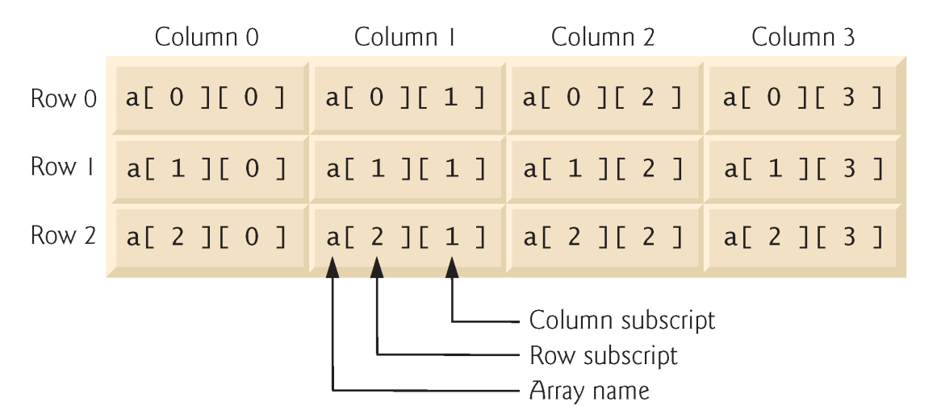
4.9 Multiple-Subscripted Arrays
Multiple subscripts
a[ i ][ j ]
Tables with rows and columns
Specify row, then column
“Array of arrays”
a[0] is an array of 4 elements
a[0][0] is the first element of that array

Slide 45
4.9 Multiple-Subscripted Arrays
To initialize
Default of 0
Initializers grouped by row in braces
int b[ 2 ][ 2 ] = { { 1, 2 }, { 3, 4 } };
int b[ 2 ][ 2 ] = { { 1 }, { 3, 4 } };
Row 0
1 2
3 4
Row 1
Row 0
Row 1
1 0
3 4

Slide 46
4.9 Multiple-Subscripted Arrays
Referenced like normal
cout << b[ 0 ][ 1 ];
Outputs 0
Cannot reference using commas
cout << b[ 0, 1 ];
Syntax error
Function prototypes
Must specify sizes of subscripts
First subscript not necessary, as with single-scripted arrays
void printArray( int [][ 3 ] );
1 0
3 4

Slide 47
1 // Fig. 4.22: fig04_22.cpp
2 // Initializing multidimensional arrays.
3 #include <iostream>
4
5 using std::cout;
6 using std::endl;
7
8 void printArray( int [][ 3 ] );
9
10 int main()
11 {
12 int array1[ 2 ][ 3 ] = { { 1, 2, 3 }, { 4, 5, 6 } };
13 int array2[ 2 ][ 3 ] = { 1, 2, 3, 4, 5 };
14 int array3[ 2 ][ 3 ] = { { 1, 2 }, { 4 } };
15
16 cout << "Values in array1 by row are:" << endl;
17 printArray( array1 );
18
19 cout << "Values in array2 by row are:" << endl;
20 printArray( array2 );
21
22 cout << "Values in array3 by row are:" << endl;
23 printArray( array3 );
24
25 return 0; // indicates successful termination
26
27 } // end main
28
29 // function to output array with two rows and three columns
30 void printArray( int a[][ 3 ] )
31 {
32 for ( int i = 0; i < 2; i++ ) { // for each row
33
34 for ( int j = 0; j < 3; j++ ) // output column values
35 cout << a[ i ][ j ] << ' ';
36
37 cout << endl; // start new line of output
38
39 } // end outer for structure
40
41 } // end function printArray
For loops are often used to iterate through arrays. Nested loops are helpful with multiple-subscripted arrays.
Note the format of the prototype.
Note the various initialization styles. The elements in array2 are assigned to the first row and then the second.
Values in array1 by row are:
1 2 3
4 5 6
Values in array2 by row are:
1 2 3
4 5 0
Values in array3 by row are:
1 2 0
4 0 0

Slide 48
4.9 Multiple-Subscripted Arrays
Next: program showing initialization
After, program to keep track of students grades
Multiple-subscripted array (table)
Rows are students
Columns are grades
Quiz1
Quiz2
Student0
95 85
89 80
Student1

Slide 49
1 // Fig. 4.23: fig04_23.cpp
2 // Double-subscripted array example.
3 #include <iostream>
4
5 using std::cout;
6 using std::endl;
7 using std::fixed;
8 using std::left;
9
10 #include <iomanip>
11
12 using std::setw;
13 using std::setprecision;
14
15 const int students = 3; // number of students
16 const int exams = 4; // number of exams
17
18 // function prototypes
19 int minimum( int [][ exams ], int, int );
20 int maximum( int [][ exams ], int, int );
21 double average( int [], int );
22 void printArray( int [][ exams ], int, int );
23
24 int main()
25 {
26 // initialize student grades for three students (rows)
27 int studentGrades[ students ][ exams ] =
28 { { 77, 68, 86, 73 },
29 { 96, 87, 89, 78 },
30 { 70, 90, 86, 81 } };
31
32 // output array studentGrades
33 cout << "The array is:\n";
34 printArray( studentGrades, students, exams );
35
36 // determine smallest and largest grade values
37 cout << "\n\nLowest grade: "
38 << minimum( studentGrades, students, exams )
39 << "\nHighest grade: "
40 << maximum( studentGrades, students, exams ) << '\n';
41
42 cout << fixed << setprecision( 2 );
44 // calculate average grade for each student
45 for ( int person = 0; person < students; person++ )
46 cout << "The average grade for student " << person
47 << " is "
48 << average( studentGrades[ person ], exams )
49 << endl;
50
51 return 0; // indicates successful termination
52
53 } // end main
Determines the average for one student. We pass the array/row containing the student’s grades. Note that studentGrades[0] is itself an array.

Slide 50
70
71 // find maximum grade
72 int maximum( int grades[][ exams ], int pupils, int tests )
73 {
74 int highGrade = 0; // initialize to lowest possible grade
75
76 for ( int i = 0; i < pupils; i++ )
77
78 for ( int j = 0; j < tests; j++ )
79
80 if ( grades[ i ][ j ] > highGrade )
81 highGrade = grades[ i ][ j ];
82
83 return highGrade;
84
85 } // end function maximum
86
87 // determine average grade for particular student
88 double average( int setOfGrades[], int tests )
89 {
90 int total = 0;
91
92 // total all grades for one student
93 for ( int i = 0; i < tests; i++ )
94 total += setOfGrades[ i ];
95
96 return static_cast< double >( total ) / tests; // average
97
98 } // end function maximum
99
100 // Print the array
101 void printArray( int grades[][exams], int pupils, int tests)
102 {
103 // set left justification and output column heads
104 cout << left << " [0] [1] [2] [3]";
105
106 // output grades in tabular format
107 for ( int i = 0; i < pupils; i++ ) {
109 // output label for row
110 cout << "\nstudentGrades[" << i << "] ";
112 // output one grades for one student
113 for ( int j = 0; j < tests; j++ )
114 cout << setw( 5 ) << grades[ i ][ j ];
115
116 } // end outer for
118 } // end function printArray
The array is:
[0] [1] [2] [3]
studentGrades[0] 77 68 86 73
studentGrades[1] 96 87 89 78
studentGrades[2] 70 90 86 81
Lowest grade: 68
Highest grade: 96
The average grade for student 0 is 76.00
The average grade for student 1 is 87.50
The average grade for student 2 is 81.75

