Slide 1
CPE 150: Introduction to Programming
Chapter 5: Pointers and Strings
Copyright notice: 1- care has been taken to use only those web images deemed by the instructor to be in the public domain. If you see a copyrighted image on any slide and are the copyright owner, please contact the instructor. It will be removed.
2- These slides are inspired, based, and modified with permission from the authors of the C++ How to Program (4th Edition) textbook

Slide 2
Topics To Be Covered In Chapter 5
5.1 Introduction 5.2 Pointer Variable Declarations and Initialization 5.3 Pointer Operators 5.4 Calling Functions by Reference 5.6 Bubble Sort Using Pass-by-Reference 5.7 Pointer Expressions and Pointer Arithmetic 5.8 Relationship Between Pointers and Arrays 5.X Dynamic Memory Allocation

Slide 3
5.1 Introduction
Pointers
Powerful, but difficult to master
Simulate pass-by-reference
Close relationship with arrays and strings

Slide 4
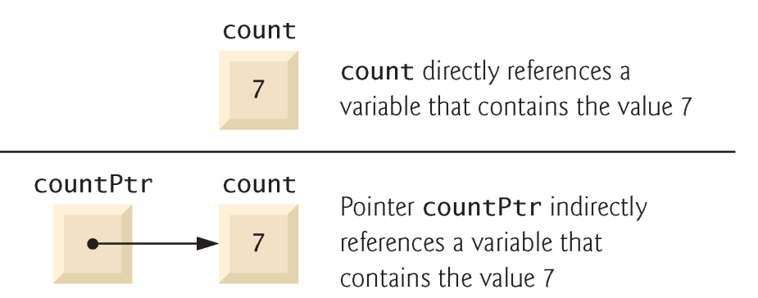
5.2 Pointer Variable Declarations and Initialization
Pointer variables
Contain memory addresses as values
Normally, variable contains specific value (direct reference)
Pointers contain address of variable that has specific value (indirect reference)
Indirection
Referencing value through pointer
Pointer declarations
* indicates variable is pointer
int *myPtr;
declares pointer to int, pointer of type int *
Multiple pointers require multiple asterisks
int *myPtr1, *myPtr2;

Slide 5
5.2 Pointer Variable Declarations and Initialization
Can declare pointers to any data type
Pointer initialization
Initialized to 0, NULL, or address
0 or NULL points to nothing

Slide 6
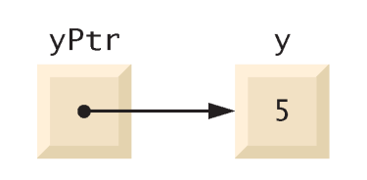
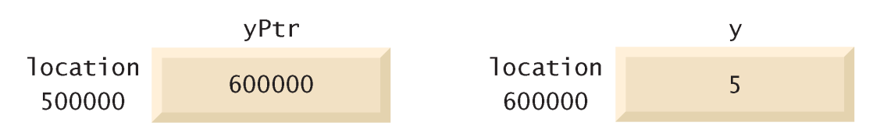
5.3 Pointer Operators
& (address operator)
Returns memory address of its operand
Example
int y = 5; int *yPtr; yPtr = &y; // yPtr gets address of y
yPtr “points to” y
address of y is value of yptr

Slide 7
5.3 Pointer Operators
* (indirection/dereferencing operator)
Returns synonym for object its pointer operand points to
*yPtr returns y (because yPtr points to y).
dereferenced pointer is lvalue
*yptr = 9; // assigns 9 to y
* and & are inverses of each other

Slide 8
1 // Fig. 5.4: fig05_04.cpp
2 // Using the & and * operators.
3 #include <iostream>
4
5 using std::cout;
6 using std::endl;
7
8 int main()
9 {
10 int a; // a is an integer
11 int *aPtr; // aPtr is a pointer to an integer
12
13 a = 7;
14 aPtr = &a; // aPtr assigned address of a
15
16 cout << "The address of a is " << &a
17 << "\nThe value of aPtr is " << aPtr;
18
19 cout << "\n\nThe value of a is " << a
20 << "\nThe value of *aPtr is " << *aPtr;
21
22 cout << "\n\nShowing that * and & are inverses of "
23 << "each other.\n&*aPtr = " << &*aPtr
24 << "\n*&aPtr = " << *&aPtr << endl;
25
26 return 0; // indicates successful termination
27
28 } // end main
The address of a is 0012FED4
The value of aPtr is 0012FED4
The value of a is 7
The value of *aPtr is 7
Showing that * and & are inverses of each other.
&*aPtr = 0012FED4
*&aPtr = 0012FED4
* and & are inverses; same result when both applied to aPtr
* and & are inverses of each other

Slide 9
5.4 Calling Functions by Reference
3 ways to pass arguments to function
Pass-by-value
Pass-by-reference with reference arguments
Pass-by-reference with pointer arguments
return can return one value from function
Arguments passed to function using reference arguments
Modify original values of arguments
More than one value “returned”

Slide 10
5.4 Calling Functions by Reference
Pass-by-reference with pointer arguments
Simulate pass-by-reference
Use pointers and indirection operator
Pass address of argument using & operator
Arrays not passed with & because array name already pointer
* operator used as alias/nickname for variable inside of function

Slide 11
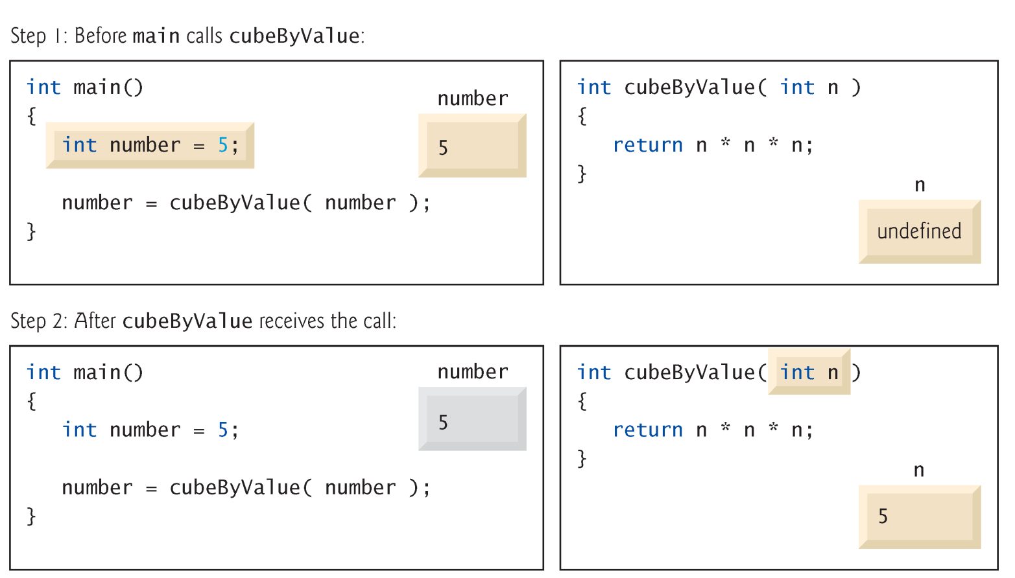
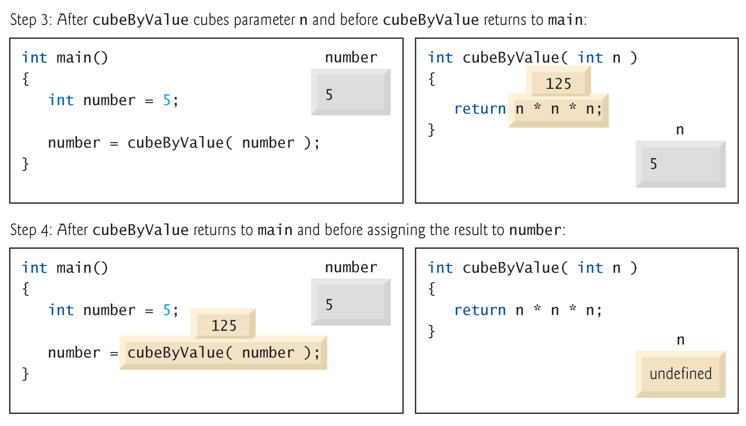
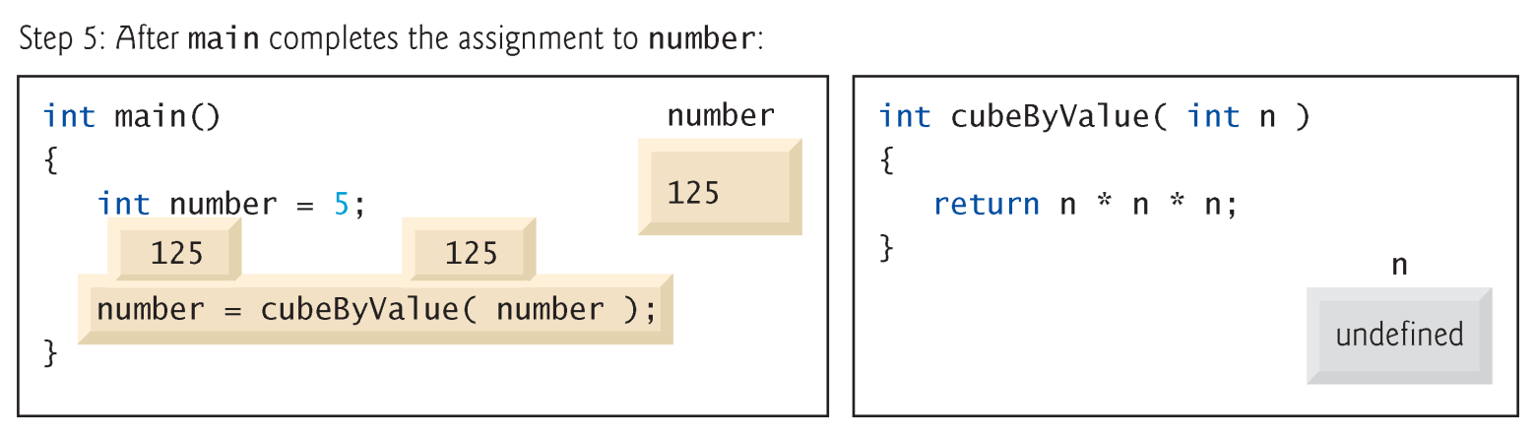
1 // Fig. 5.6: fig05_06.cpp
2 // Cube a variable using pass-by-value.
3 #include <iostream>
5 using std::cout;
6 using std::endl;
7
8 int cubeByValue( int ); // prototype
9
10 int main()
11 {
12 int number = 5;
14 cout << "The original value of number is " << number;
16 // pass number by value to cubeByValue
17 number = cubeByValue( number );
18
19 cout << "\nThe new value of number is " << number << endl;
20
21 return 0; // indicates successful termination
23 } // end main
24
25 // calculate and return cube of integer argument
26 int cubeByValue( int n )
27 {
28 return n * n * n; // cube local variable n and return result
30 } // end function cubeByValue
Pass number by value; result returned by cubeByValue
Cubes and returns local variable n
cubeByValue receives parameter passed-by-value
The original value of number is 5
The new value of number is 125

Slide 12
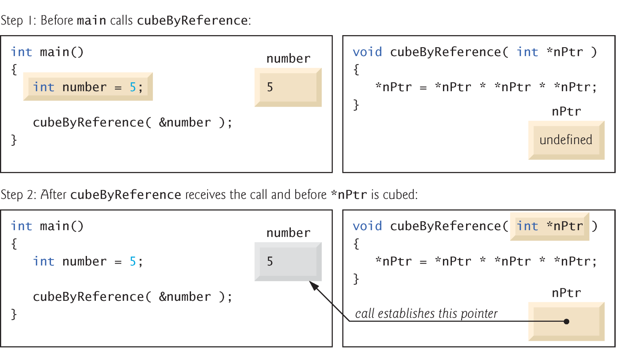
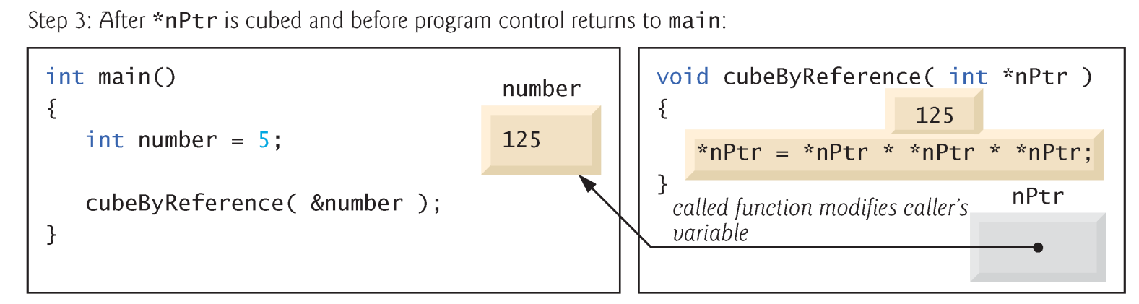
1 // Fig. 5.7: fig05_07.cpp
2 // Cube a variable using pass-by-reference with a pointer argument.
4 #include <iostream>
6 using std::cout;
7 using std::endl;
8
9 void cubeByReference( int * ); // prototype
10
11 int main()
12 {
13 int number = 5;
15 cout << "The original value of number is " << number;
16
17 // pass address of number to cubeByReference
18 cubeByReference( &number );
19
20 cout << "\nThe new value of number is " << number << endl;
21
22 return 0; // indicates successful termination
24 } // end main
25 // calculate cube of *nPtr; modifies variable number in main
27 void cubeByReference( int *nPtr )
28 {
29 *nPtr = *nPtr * *nPtr * *nPtr; // cube *nPtr
30
31 } // end function cubeByReference
Prototype indicates parameter is pointer to int
Apply address operator & to pass address of number to cubeByReference
Modify and access int variable using indirection operator *
cubeByReference modified variable number
cubeByReference receives address of int variable,
i.e., pointer to an int
The original value of number is 5
The new value of number is 125

Slide 13
5.6 Bubble Sort Using Pass-by-Reference
Implement bubbleSort using pointers
Want function swap to access array elements
Individual array elements: scalars
Passed by value by default
Pass by reference using address operator &

Slide 14
1 // Fig. 5.15: fig05_15.cpp
2 // This program puts values into an array, sorts the values into
3 // ascending order, and prints the resulting array.
4 #include <iostream>
6 using std::cout;
7 using std::endl;
8
9 #include <iomanip>
11 using std::setw;
12
13 void bubbleSort( int *, const int ); // prototype
14 void swap( int *, int * ); // prototype
15
16 int main()
17 {
18 const int arraySize = 10;
19 int a[ arraySize ] = { 2, 6, 4, 8, 10, 12, 89, 68, 45, 37 };
20
21 cout << "Data items in original order\n";
23 for ( int i = 0; i < arraySize; i++ )
24 cout << setw( 4 ) << a[ i ];
25
26 bubbleSort( a, arraySize ); // sort the array
27
28 cout << "\nData items in ascending order\n";
30 for ( int j = 0; j < arraySize; j++ )
31 cout << setw( 4 ) << a[ j ];
33 cout << endl;
35 return 0; // indicates successful termination
37 } // end main

Slide 15
39 // sort an array of integers using bubble sort algorithm
40 void bubbleSort( int *array, const int size )
41 {
42 // loop to control passes
43 for ( int pass = 0; pass < size - 1; pass++ )
44
45 // loop to control comparisons during each pass
46 for ( int k = 0; k < size - 1; k++ )
47
48 // swap adjacent elements if they are out of order
49 if ( array[ k ] > array[ k + 1 ] )
50 swap( &array[ k ], &array[ k + 1 ] );
51
52 } // end function bubbleSort
53
54 // swap values at memory locations to which
55 // element1Ptr and element2Ptr point
56 void swap( int * element1Ptr, int * element2Ptr )
57 {
58 int hold = *element1Ptr;
59 *element1Ptr = *element2Ptr;
60 *element2Ptr = hold;
61
62 } // end function swap
Receives size of array as argument; declared const to ensure size not modified.
Declare as int *array (rather than int array[]) to indicate function bubbleSort receives single-subscripted array.
Pass arguments by reference, allowing function to swap values at memory locations.
Data items in original order
2 6 4 8 10 12 89 68 45 37
Data items in ascending order
2 4 6 8 10 12 37 45 68 89

Slide 16
5.6 Bubble Sort Using Pass-by-Reference
sizeof
Unary operator returns size of operand in bytes
For arrays, sizeof returns
( size of 1 element ) * ( number of elements )
If sizeof( int ) = 4, then
int myArray[10];
cout << sizeof(myArray);
will print 40
sizeof can be used with
Variable names
Type names
Constant values

Slide 17
1 // Fig. 5.16: fig05_16.cpp
2 // Sizeof operator when used on an array name
3 // returns the number of bytes in the array.
4 #include <iostream>
5
6 using std::cout;
7 using std::endl;
8
9 size_t getSize( double * ); // prototype
10
11 int main()
12 {
13 double array[ 20 ];
14
15 cout << "The number of bytes in the array is "
16 << sizeof( array );
17
18 cout << "\nThe number of bytes returned by getSize is "
19 << getSize( array ) << endl;
20
21 return 0; // indicates successful termination
22
23 } // end main
24
25 // return size of ptr
26 size_t getSize( double *ptr )
27 {
28 return sizeof( ptr );
29
30 } // end function getSize
Operator sizeof applied to an array returns total number of bytes in array.
The number of bytes in the array is 160
The number of bytes returned by getSize is 4
Function getSize returns number of bytes used to store array address.

Slide 18
1 // Fig. 5.17: fig05_17.cpp
2 // Demonstrating the sizeof operator.
3 #include <iostream>
4
5 using std::cout;
6 using std::endl;
7
8 int main()
9 {
10 char c;
11 short s;
12 int i;
13 long l;
14 float f;
15 double d;
16 long double ld;
17 int array[ 20 ];
18 int *ptr = array;
19
20 cout << "sizeof c = " << sizeof c
21 << "\tsizeof(char) = " << sizeof( char )
22 << "\nsizeof s = " << sizeof s
23 << "\tsizeof(short) = " << sizeof( short )
24 << "\nsizeof i = " << sizeof i
25 << "\tsizeof(int) = " << sizeof( int )
26 << "\nsizeof l = " << sizeof l
27 << "\tsizeof(long) = " << sizeof( long )
28 << "\nsizeof f = " << sizeof f
29 << "\tsizeof(float) = " << sizeof( float )
30 << "\nsizeof d = " << sizeof d
31 << "\tsizeof(double) = " << sizeof( double )
32 << "\nsizeof ld = " << sizeof ld
33 << "\tsizeof(long double) = " << sizeof( long double )
34 << "\nsizeof array = " << sizeof array
35 << "\nsizeof ptr = " << sizeof ptr
36 << endl;
37
38 return 0; // indicates successful termination
40 } // end main
Operator sizeof can be used on variable name.
Operator sizeof can be used on type name.
sizeof c = 1 sizeof(char) = 1
sizeof s = 2 sizeof(short) = 2
sizeof i = 4 sizeof(int) = 4
sizeof l = 4 sizeof(long) = 4
sizeof f = 4 sizeof(float) = 4
sizeof d = 8 sizeof(double) = 8
sizeof ld = 8 sizeof(long double) = 8
sizeof array = 80
sizeof ptr = 4

Slide 19
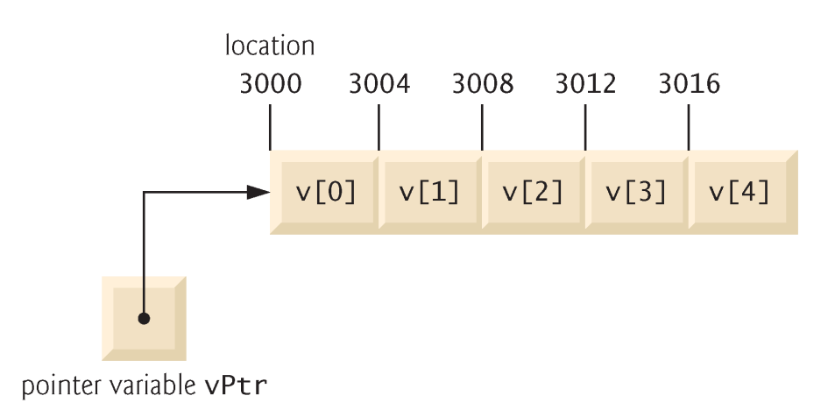

5.7 Pointer Expressions and Pointer Arithmetic
Pointer arithmetic
Increment/decrement pointer (++ or --)
Add/subtract an integer to/from a pointer( + or += , - or -=)
Pointers may be subtracted from each other
Pointer arithmetic meaningless unless performed on pointer to array
5 element int array on a machine using 4 byte ints
vPtr points to first element v[ 0 ], which is at location 3000
vPtr = 3000
vPtr += 2; sets vPtr to 3008
vPtr points to v[ 2 ]

Slide 20
5.7 Pointer Expressions and Pointer Arithmetic
Subtracting pointers
Returns number of elements between two addresses
vPtr2 = v[ 2 ]; vPtr = v[ 0 ]; vPtr2 - vPtr == 2
Pointer assignment
Pointer can be assigned to another pointer if both of same type.

Slide 21
5.7 Pointer Expressions and Pointer Arithmetic
Pointer comparison
Use equality and relational operators
Comparisons meaningless unless pointers point to members of same array
Compare addresses stored in pointers
Example: could show that one pointer points to higher numbered element of array than other pointer
Common use to determine whether pointer is 0 (does not point to anything)

Slide 22
5.8 Relationship Between Pointers and Arrays
Arrays and pointers closely related
Array name like constant pointer
Pointers can do array subscripting operations
Accessing array elements with pointers
Element b[ n ] can be accessed by *( bPtr + n )
Called pointer/offset notation
Addresses
&b[ 3 ] same as bPtr + 3
Array name can be treated as pointer
b[ 3 ] same as *( b + 3 )
Pointers can be subscripted (pointer/subscript notation)
bPtr[ 3 ] same as b[ 3 ]

Slide 23
1 // Fig. 5.20: fig05_20.cpp
2 // Using subscripting and pointer notations with arrays.
3
4 #include <iostream>
5
6 using std::cout;
7 using std::endl;
8
9 int main()
10 {
11 int b[] = { 10, 20, 30, 40 };
12 int *bPtr = b; // set bPtr to point to array b
13
14 // output array b using array subscript notation
15 cout << "Array b printed with:\n"
16 << "Array subscript notation\n";
17
18 for ( int i = 0; i < 4; i++ )
19 cout << "b[" << i << "] = " << b[ i ] << '\n';
20
21 // output array b using the array name and
22 // pointer/offset notation
23 cout << "\nPointer/offset notation where "
24 << "the pointer is the array name\n";
25
26 for ( int offset1 = 0; offset1 < 4; offset1++ )
27 cout << "*(b + " << offset1 << ") = "
28 << *( b + offset1 ) << '\n';
29
30 // output array b using bPtr and array subscript notation
31 cout << "\nPointer subscript notation\n";
32
33 for ( int j = 0; j < 4; j++ )
34 cout << "bPtr[" << j << "] = " << bPtr[ j ] << '\n';
35
36 cout << "\nPointer/offset notation\n";
37
38 // output array b using bPtr and pointer/offset notation
39 for ( int offset2 = 0; offset2 < 4; offset2++ )
40 cout << "*(bPtr + " << offset2 << ") = "
41 << *( bPtr + offset2 ) << '\n';
42
43 return 0; // indicates successful termination
44
45 } // end main
Using array name and pointer/offset notation.
Using pointer subscript notation.
Using array subscript notation.
Using bPtr and pointer/offset notation.

Slide 24
Array b printed with:
Array subscript notation
b[0] = 10
b[1] = 20
b[2] = 30
b[3] = 40
Pointer/offset notation where the pointer is the array name
*(b + 0) = 10
*(b + 1) = 20
*(b + 2) = 30
*(b + 3) = 40
Pointer subscript notation
bPtr[0] = 10
bPtr[1] = 20
bPtr[2] = 30
bPtr[3] = 40
Pointer/offset notation
*(bPtr + 0) = 10
*(bPtr + 1) = 20
*(bPtr + 2) = 30
*(bPtr + 3) = 40

Slide 25
1 // Fig. 5.21: fig05_21.cpp
2 // Copying a string using array notation
3 // and pointer notation.
4 #include <iostream>
5
6 using std::cout;
7 using std::endl;
8
9 void copy1( char *, char * ); // prototype
10 void copy2( char *, char * ); // prototype
11
12 int main()
13 {
14 char string1[ 10 ];
15 char *string2 = "Hello";
16 char string3[ 10 ];
17 char string4[] = "Good Bye";
18
19 copy1( string1, string2 );
20 cout << "string1 = " << string1 << endl;
21
22 copy2( string3, string4 );
23 cout << "string3 = " << string3 << endl;
24
25 return 0; // indicates successful termination
26
27 } // end main
28
29 // copy s2 to s1 using array notation
30 void copy1( char *s1, char *s2 )
31 {
32 for ( int i = 0; ( s1[ i ] = s2[ i ] ) != '\0'; i++ )
33 ; // do nothing in body
34
35 } // end function copy1
36
37 // copy s2 to s1 using pointer notation
38 void copy2( char *s1, char *s2 )
39 {
40 for ( ; ( *s1 = *s2 ) != '\0'; s1++, s2++ )
41 ; // do nothing in body
42
43 } // end function copy2
Use array subscript notation to copy string in s2 to character array s1.
Use pointer notation to copy string in s2 to character array in s1.
Increment both pointers to point to next elements in corresponding arrays.
string1 = Hello
string3 = Good Bye

Slide 26
5.X Dynamic Memory Allocation
Static Data: Memory allocation exists throughout execution of program
Automatic Data: Automatically created at function entry, resides in activation frame of the function, and is destroyed when returning from function
Dynamic Data: Explicitly allocated and deallocated during program execution by C++ instructions written by programmer
Allocation of Memory:
Static Allocation: Allocation of memory space at compile time.
Dynamic Allocation: Allocation of memory space at run time.

Slide 27
5.X Dynamic Memory Allocation
Dynamic allocation is useful when
Arrays need to be created whose extent is not known until run time
Complex structures of unknown size and/or shape need to be constructed as the program runs
Pointers need to be used for dynamic allocation of memory
Use the operator new to dynamically allocate space
Use the operator delete to later free this space

Slide 28
5.X The new Operator
If memory is available, the new operator allocates memory space for the requested object/array, and returns a pointer to (address of) the memory allocated.
If sufficient memory is not available, the new operator returns NULL.
The dynamically allocated object/array exists until the delete operator destroys it.

Slide 29
5.X The delete Operator
The delete operator deallocates the object or array currently pointed to by the pointer which was previously allocated at run-time by the new operator.
The freed memory space is returned to Heap
The pointer is then considered unassigned
If the value of the pointer is NULL there is no effect.

Slide 30
1 // Dynamically allocating a integer pointer
2 #include <iostream>
3
4 using std::cout;
5 using std::endl;
6
7 int main()
8 {
9 int *ptr;
10 // dynamically allocate memory for the pointer
11 ptr = new int;
12 *ptr = 22;
13 cout << ”The value for the allocated pointer is: " << *ptr << endl;
14 // delete/free the allocated memory for the pointer.
15 delete ptr;
16 ptr = NULL;
17 return 0;
18 } // end main
ptr
ptr
NULL
ptr
22
ptr
?
ptr
NULL
The value for the allocated pointer is: 22

Slide 31
5.X Dynamic Allocation/Deallocation of Arrays
Use the [IntExp] on the new statement to create an array of objects instead of a single instance.
On the delete statement use [] to indicate that an array of objects is to be deallocated.

Slide 32
1 // Dynamically allocating array of integers
2 #include <iostream>
3 using namespace std;
4
5 int main()
6 {
7 int* grades = NULL;
8 int numberOfGrades;
9 cout << ”Enter the number of grades: “;
10 cin >> numberOfGrades;
11
12 grades = new int[numberOfGrades];
13 for (int i = 0; i < numberOfGrades; i++)
14 {
15 cout << ”Enter grade (” << i + 1 << ”) : ”;
16 cin >> grades[i];
17 }
18 cout << ”The entered grades are:” << endl;
19 for (int j = 0; j < numberOfGrades; j++)
20 cout << grades[j] << ” ” ;
21
22 delete [] grades;
23 grades = NULL;
24 return 0;
25 } // end main
Enter the number of grades: 3
Enter grade (1) : 50
Enter grade (2) : 34
Enter grade (3) : 0
The entered grades are:
50 34 0

Slide 33
1 // Dynamically allocating two-dimensional array of integers
2 #include <iostream>
3 using std::cout;
4 using std::endl;
5 int main()
6 {
7 int** grades = NULL;
8 int numberOfStudents, numberOfCourses;
9 cout << ”Enter the number of students: “;
10 cin >> numberOfStudents;
11 cout << ”Enter the number of courses: “;
12 cin >> numberOfCourses;
13 grades = new int*[numberOfStudents];
14 for (int i = 0; i < numberOfStudents; i++)
15 grades[i] = new int[numberOfCourses];
16 for (int i = 0; i < numberOfStudents; i++)
17 {
18 cout << ”Enter grades for student (” << i + 1 << ”): ” << endl;
19 for (int j = 0; j < numberOfCourses; j++)
14 {
15 cout << ” Enter grade (” << j + 1 << ”): ”;
16 cin >> grades[j];
17 }
17 }
18 cout << ”Grades for all students are:” << endl;
13 for (int i = 0; i < numberOfStudents; i++)
14 {
15 cout << ”Student (” << i + 1 << ”):” << endl;
13 for (int j = 0; j < numberOfCourses; j++)
15 cout << ” Grade (” << j + 1 << ”): ”
15 << grades[i][j] << endl;
17 }
13 for (int i = 0; i < numberOfStudents; i++)
22 delete [] grades[i];
22 delete [] grades;
23 grades = NULL;
24 return 0;
25 } // end main
Grades for all students are:
Student (1):
Grade (1): 100
Grade (2): 50
Grade (3): 59
Student (2):
Grade (1): 60
Grade (2): 70
Grade (3): 89
Enter the number of students: 2
Enter the number of courses: 3
Enter grades for student (1):
Enter grade (1): 100
Enter grade (2): 50
Enter grade (3): 59
Enter grades for student (2):
Enter grade (1): 60
Enter grade (2): 70
Enter grade (3): 89

