Slide 1

Continue testing?
OR
Help with ATDD?

Slide 2
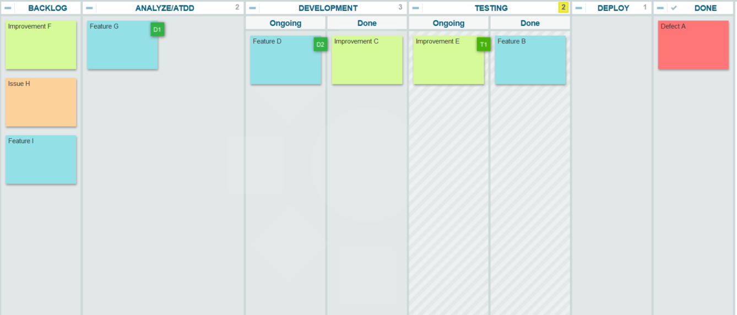

Continue testing?
OR
Help with ATDD?

