Slide 1

Data engineering bootcamp – cohort 2
Use imagery from the JLR HUB – thejlrhub.com
End of week 6 – technical update
Ajay Taneja 21 October 2022
Notes:
Select one of these pre-defined front pages and delete the rest. This document will be updated regularly to ensure product images are current.
Please note that for all internal presentations you must use the dual brand template, even if your content is single brand. Only use the single brand template
for external presentations, product launches or brand immersion events.

Slide 2
Data Engineering Bootcamp
Agenda
Technical Topics overview
About the Mini Project
Demonstration
ER Diagram
Code architecture overview
Demo (Application | Unit tests)

Slide 3
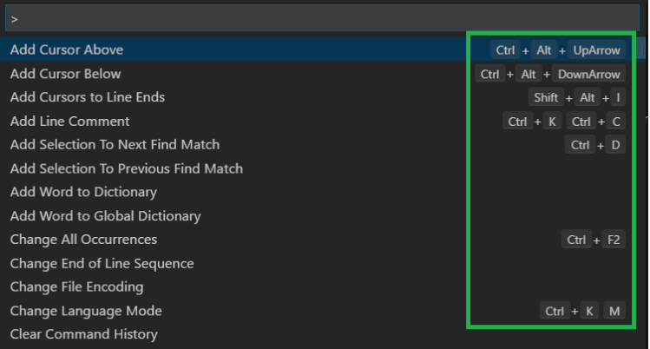
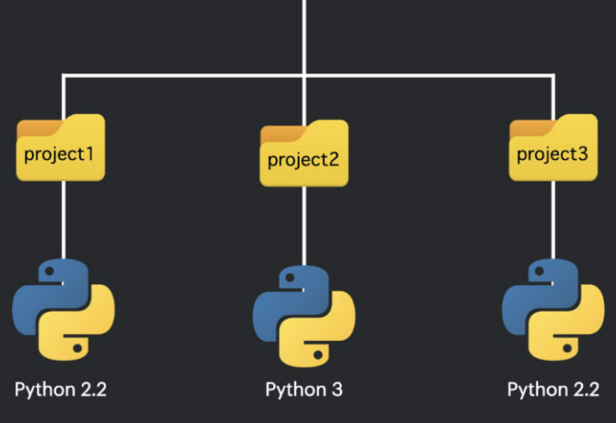
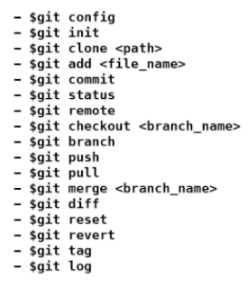
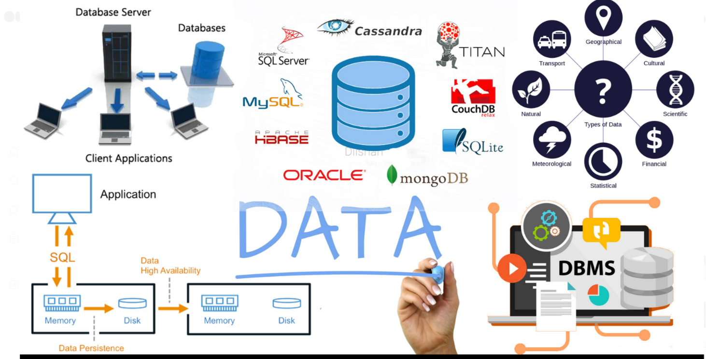

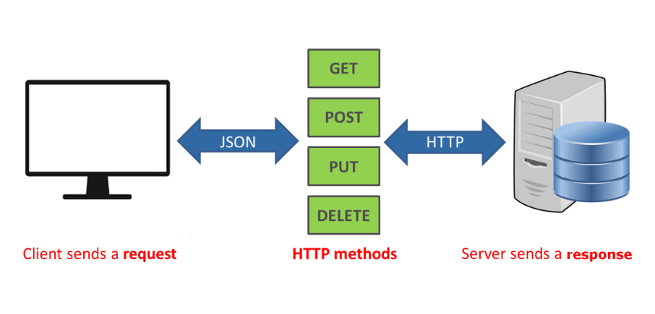

About the Bootcamp
Technical topics overview
Fundamentals of Programming
VS Code: Shortcuts | Tips and Tricks
Python Ecosystem | Modules, Unit-tests, OOPS concepts
Virtual Environment
Data Persistence : Text files | JSON files | SQL Database
GIT
Databases | SQL | PyMySQL
APIs, Data Visualisation, Data Normalisation
data visualization
APIs acts as a mediator between users (clients) and resources (servers).
Notes:
Titles – JLR EMERIC SEMI BOLD 18pt – ALL CAPS
Subtitles – JLR EMERIC 18pt – ALL CAPS
Body copy – JLR Emeric ExtraLight 16pt – sentence case

Slide 4




Data Engineering Bootcamp
About the MINI project
Café launched by your client
Offering lunches and refreshments
Construct a software application to help log and track orders
Collection of products, couriers, orders
Data Persistence
Command line interface

Slide 5
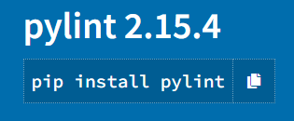
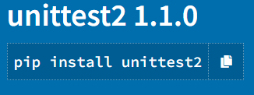
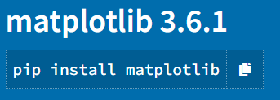
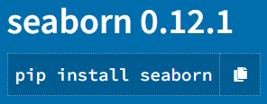
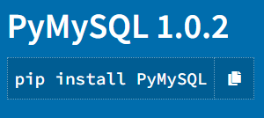
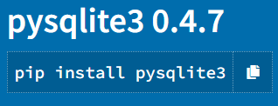

Data Engineering Bootcamp
Tools and libraries (mini project)
Python
RDBMS – MySQL
Major libraries:
pylint, unittest
pymysql
matplotlib, seaborn
Version control
GIT

Slide 6
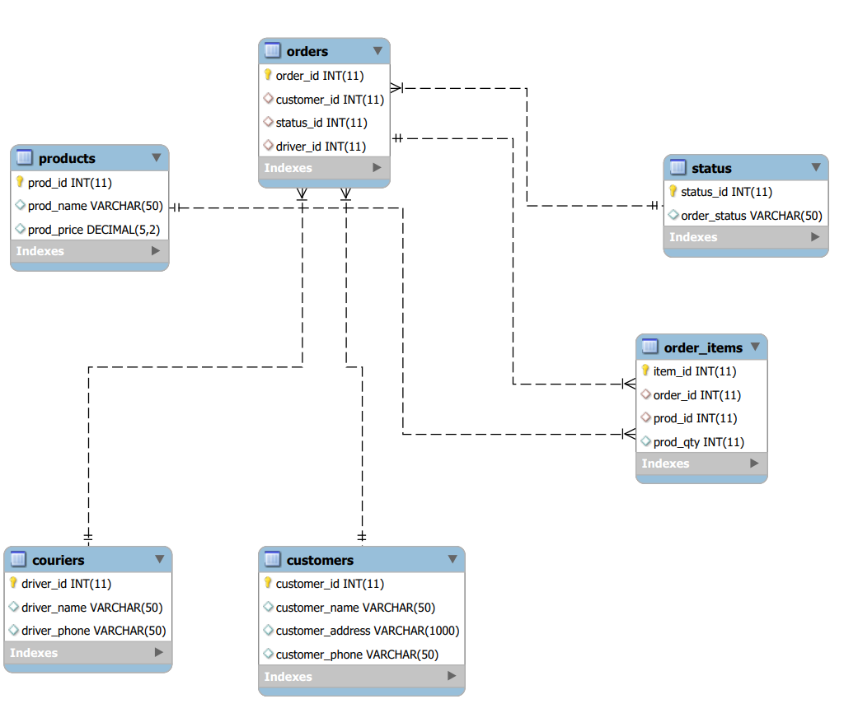
Data Engineering Bootcamp
Mini project: entity relationship diagram
Application to log orders
Collection of products, couriers, orders
Design schema

Slide 7
orders
status
products
order items
couriers
customers

Slide 8
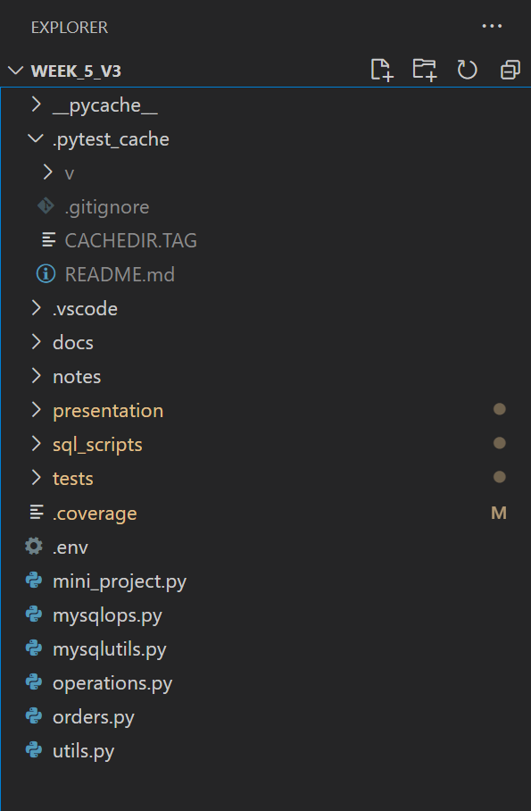
Data Engineering Bootcamp
Code architecture
Modules:
main module (main flow of the code)
mysqlops.py module (for sql operations and functions)
mysqlutils.py – generic pysql functions that can be re-used
utils.py – generic functions that can be re-used
operations.py
orders.py
Let’s go to VS code now!

Slide 9
Data Engineering Bootcamp
Thank-you
Why the course was special to me!
Any questions?

