Slide 1

Movie Box Office Analysis
Anthony Tang
Anish Tendolkar
Ashley Jackson
Vincent Tran

Slide 2
Contents
Terminology
Hypothesis
Data Collection
Data Selection & Cleaning
Data Analyses
Conclusion

Slide 3
Terminology
Box Office
Domestic + Foreign = Worldwide
Reviews (Scores)
IMDb Rating (audience)
Metascore (critic)
Rating
G, PG, PG-13, R

Slide 4
Hypothesis
Box Office can be affected by many factors. We examined:
Reviews
Genre
Studio
Movie budget
Ratings
Notes:
Elaborate why we chose each category and how it could affect box office

Slide 5
Data Collection
OMDb- API
Reviews
Genre
Studio
Ratings
StatCrunch- csv file
Movie title
Budget
Box Office
Notes:
OMDb is an open movie database that sources info from other movie websites: imbd, rotten tomatoes, and Wikipedia.

Slide 6
Data Selection
Original csv file: more than 5000 titles
Select years 2010-2016 (down to 1600 titles)
Select top 500 titles by highest worldwide box office (API call limit)
25 titles got no match from API (final number of movies is 475)
Notes:
Choosing our topic
-Initially chose flights and changed to movies

Slide 7
Data Cleaning
Wrong data types
IMDb rating & Metascore: change string to numeric
Different numeric scales
IMDb rating & Metascore: normalization
Multiple values
Genre: break into multiple rows
Bad entry
Production studio: grouping (spelled differently, long vs. short form, etc.)
Missing values
Rating: drop movies that are not rated

Slide 8
Data Analyses
1. Do audience (IMDb rating) and critics (Metascore) have different tastes on movies? Does good/bad review affect the (worldwide) box office of a movie?
2. What are the most/least favorable genres based on box office? What are the similarities and differences between domestic and foreign markets?
3. What are the market shares by studio? How is the domestic market compared to the foreign?
4. What's the correlation between a movie's budget and its (worldwide) box office? Which MPAA rating is most/least profitable?

Slide 9
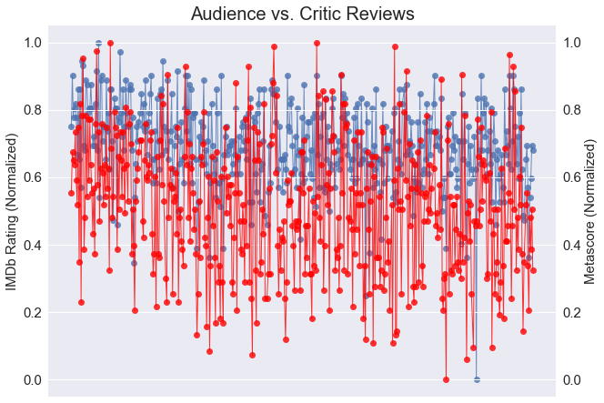
Notes:
-Audience generally give higher ratings than critics

Slide 10
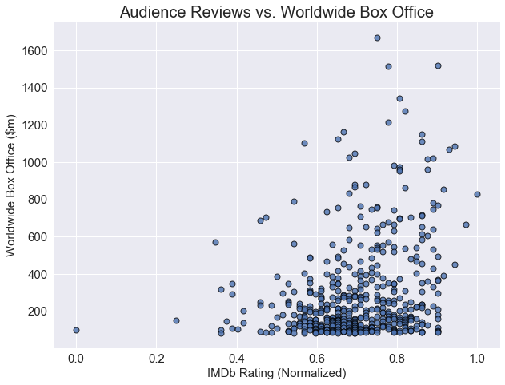
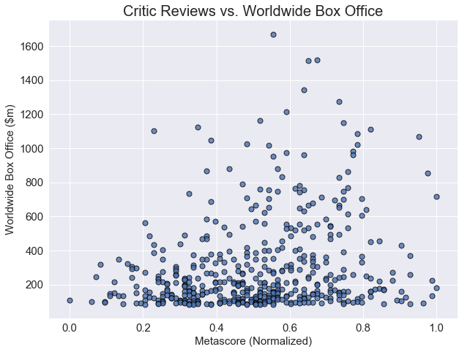
Notes:
-side by side comparison of box office across reviews
Normalized the ratings (Max-min)
Audience generally like movies with low box office
There was no relationship among critic reviews and box office

Slide 11
Data Analyses
1. Do audience (IMDb rating) and critics (Metascore) have different tastes on movies? Does good/bad review affect the (worldwide) box office of a movie?
2. What are the most/least favorable genres based on box office? What are the similarities and differences between domestic and foreign markets?
3. What are the market shares by studio? How is the domestic market compared to the foreign?
4. What's the correlation between a movie's budget and its (worldwide) box office? Which MPAA rating is most/least profitable?

Slide 12
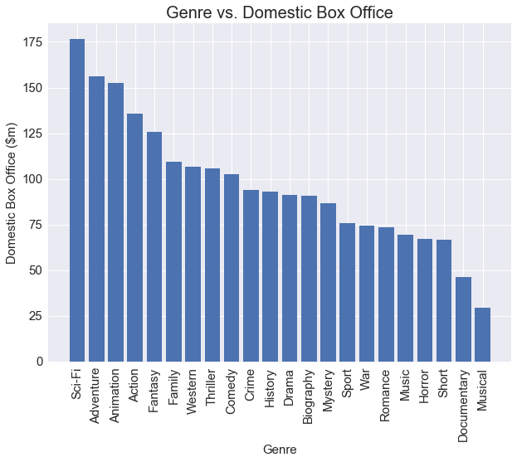
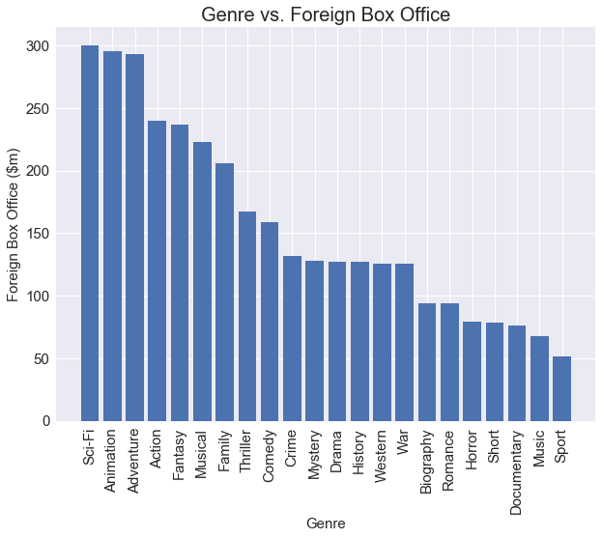
Notes:
Compares top 5 genres in domestic and foreign
Similarities in genre success across regions
Notable difference are musicals: Last in US and top 6 in foreign

Slide 13
Data Analyses
1. Do audience (IMDb rating) and critics (Metascore) have different tastes on movies? Does good/bad review affect the (worldwide) box office of a movie?
2. What are the most/least favorable genres based on box office? What are the similarities and differences between domestic and foreign markets?
3. What are the market shares by studio? How is the domestic market compared to the foreign?
4. What's the correlation between a movie's budget and its (worldwide) box office? Which MPAA rating is most/least profitable?

Slide 14
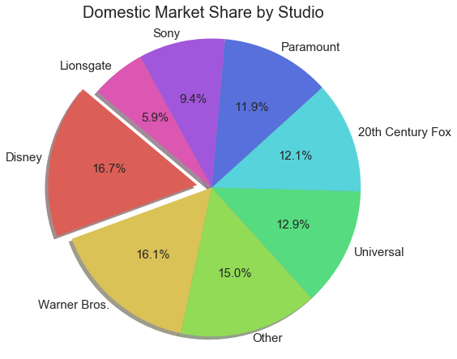
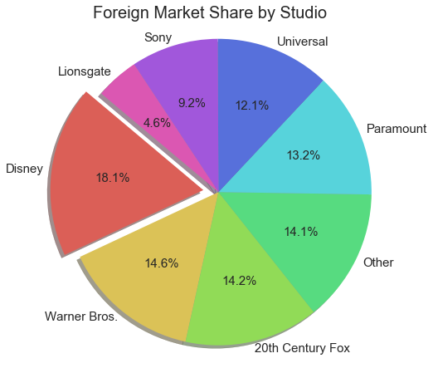
Notes:
Found the top 6 studies across all movies
-Disney, Warner, and Sony are top 3 and are similar across regions

Slide 15
Data Analyses
1. Do audience (IMDb rating) and critics (Metascore) have different tastes on movies? Does good/bad review affect the (worldwide) box office of a movie?
2. What are the most/least favorable genres based on box office? What are the similarities and differences between domestic and foreign markets?
3. What are the market shares by studio? How is the domestic market compared to the foreign?
4. What's the correlation between a movie's budget and its (worldwide) box office? Which MPAA rating is most/least profitable?

Slide 16
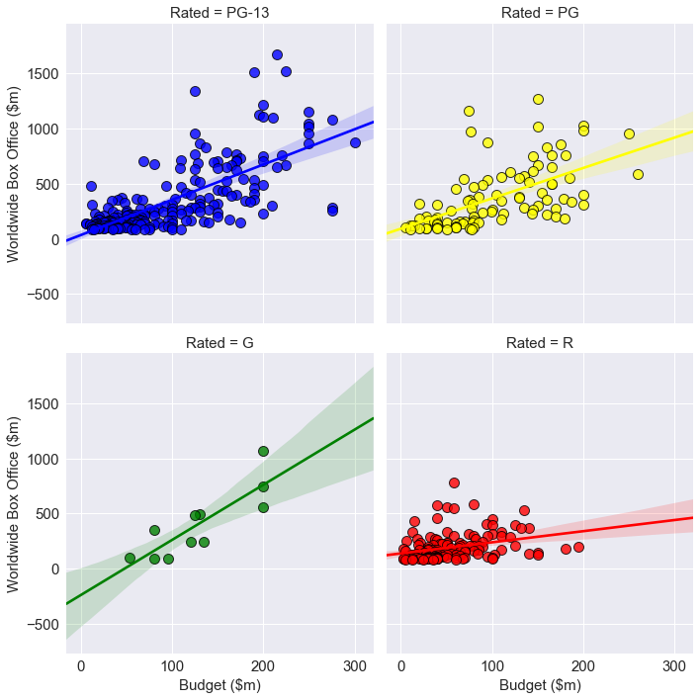
Notes:
-shows how profitable movies are across four different ratings

Slide 17
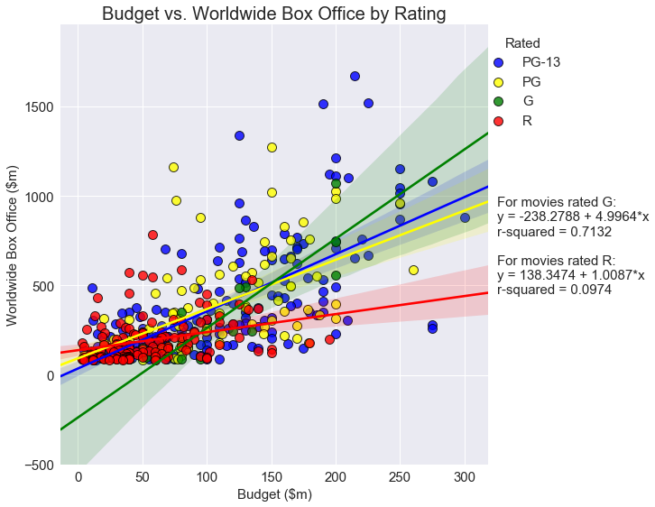
Notes:
-shows that general rating was most profitable
-R rating was least profitable

Slide 18
Conclusion
Audience and critics have different tastes in movies.
Some audience don’t go to movies based on reviews.
Sci-fi, Adventure and Animation genres yields high box offices across all regions.
Disney, Warner, and Sony are most successful in making movies across all regions.
Movies that are rated G have higher box office revenue than rated R movies.

Slide 19

Thank you!

