Slide 1
Computer Organization & Design The Hardware/Software Interface
计算机组成与设计
Chapter 2 – Part II
Instructions ：Language of the Machine
刘海风
Asso. Prof. Haifeng Liu
College of Computer Science and Technology, Zhejiang University
haifengliu@zju.edu.cn

Slide 2
2.8 Communicating with People Beyond Numbers
ASCII ( American Standard Code for Information Interchange )
Instructions for moving bytes in MIPS
Load byte ( lb ): lb $t0, 0($sp) # read byte from source
Store byte ( sb ): sb $t0, 0($sp) # write byte to destination
Three choices for representing a string
Place the length of the string in the first position
An accompanying variable which indicate the length
A character in the last position to mark the end of a string
C uses the third choice
Terminate a string with a byte whose value is 0 ( null in ASCII )

Slide 3
Example 2.17 Compiling a string copy procedure
( Assume: base addresses for x and y -- $a0 and $a1 i -- $s0 )
C code：Y→X
void strcpy ( char x[ ] , char y[ ] )
{ int i ;
i = 0 ;
while ( ( x[ i ] = y[ i ] ) !=“\ 0” ) /* copy and test byte */
i += 1 ;
}
MIPS assembly code:
strcpy: sub $sp, $sp, 4 # adjust stack for 1 more item
sw $s0, 0($sp) # save $s0
add $s0, $zero, $zero # i = 0 + 0
L1: add $t1, $a1, $s0 # address of y[ i ] in $t1
lb $t2, 0($t1) # $t2 = y [ i ]
add $t3, $a0, $s0 # address of x[ i ] in $t3
sb $t2, 0($t3) # x[ i ] = y[ i ]

Slide 4
addi $s0, $s0, 1 # i = i + 1
bne $t2, $zero, L1 # if y[ i ] != 0, go to L1
lw $s0, 0($sp) # y[ i ] = = 0: end of string;
# restore old $s0
add $sp, $sp, 4 # pop 1 word off stack
jr $ra # return
Optimization for example 2.17
strcpy is a leaf procedure
Allocate i to a temporary register $t0
For a leaf procedure
The compiler exhausts all temporary registers
Then use the registers it must save

Slide 5
2.9 MIPS Addressing for 32-Bit Immediate and Addresses
32-Bit Immediate addressing
most constants is short and fit into 16-bit field
Set upper 16 bits of a constants in a register with load upper immediate (lui)
lui $t0 , 255
Instruction
001111 | 00000 | 01000 | 0000 0000 1111 1111
Register |  |  | Filling with “0”
0000 0000 1111 1111 |  |  | 0000 0000 0000 0000

Slide 6
Example 2.19 Loading a 32-bit constant
The 32-bit constant:
0000 0000 0011 1101 0000 1001 0000 0000 (61*16⁴ + 2304=4000000)₁₀
MIPS code:
lui $s0, 61 # 61 _{decimal} = 0000 0000 0011 1101 _{binary}
(The value of $s0 afterward is: 0000 0000 0011 1101 0000 0000 0000 0000)
addi $s0, $s0, 2304 # 2304 _{decimal} = 0000 1001 0000 0000 _{binary}
(The value of $s0 afterward is: 0000 0000 0011 1101 0000 1001 0000 0000)
Note：Why does it need two steps?
The reserved register $at for the assembler

Slide 7
Addressing in branches and jumps
For jumps: J-format
Example:
j 10000 # go to location 10000
| 2 | 10000 |
6 bits 26 bits
Pseudo-direct addressing
26 bits of the instruction concatenated with the upper 4 bits of PC
For branches:
Example:
bne $s0, $s1, Exit # go to Exit if $s0 != $s1
| 5 | 16 | 17 | Exit |
6 bits 5 bits 5 bits 16 bits
PC-relative addressing
PC = (PC + 4) + Branch address

Slide 8
Example 2.20 Show branch offset in machine language
C language: while (save[i]==k) i=i+j; MIPS assembler code in Example 2.12:
Loop: add $t1, $s3, $s3 # temp reg $t1 = 2 * i
add $t1, $t1, $t1 # temp reg $t1 = 4 * i
add $t1, $t1, $s6 # $t1 = address of save[i]
lw $t0, 0($t1) # temp reg $t0 = save[i]
bne $t0, $s5, Exit # go to Exit if save[i] != k
add $s3, $s3, $s4 # i = i + j
j Loop # go to Loop
Exit:

Slide 9
Assembled instructions and their addresses:
80000 | 0 | 19 | 19 | 9 | 0 | 32 |
80004 | 0 | 9 | 9 | 9 | 0 | 32 |
80008 | 0 | 9 | 22 | 9 | 0 | 32 |
80012 | 35 | 9 | 8 | 0 |
80016 | 5 | 8 | 21 | 2 (8) |
80020 | 0 | 19 | 20 | 19 | 0 | 32 |
80024 | 2 | 20000 (80000) |
80028 . . .
80028 – 80020 =8
Modification:
All MIPS instructions are 4 bytes long
PC-relative addressing refers to the number of words
The address field at 80016 above should be 2 instead of 8
Loop:
add
add
add
Lw
bne
add
j
Exit:
PC+4+offset=80028

Slide 10
While branch target is far away
Inserts an unconditional jump to target
Invert the condition so that the branch decides whether to skip the jump
Example 2.21 Branching far away
Given a branch:
beq $s0, $s1, L1
Rewrite it to offer a much greater branching distance:
bne $s0, $s1, L2
j L1
L2:

Slide 11
MIPS addressing summary
Register addressing:
add $s0,$s0,$s0
Base or displacement addressing:
lw $s1,0($s0)
Immediate addressing:
addi $s0,$s0,4
PC-relative addressing:
beq $s0,$s1,L1
Pseudodirect addressing:
j Address1

Slide 12
Five MIPS addressing modes

Slide 13
Example 2.22 Decoding machine code
Machine instruction
( Bits: 31 28 26 5 2 0 )
0000 0000 1010 1111 1000 0000 0010 0000
Decoding
Determine the operation from opcode
op: 000000 → R-format instruction
op rs rt rd shamt funct
| 000000 | 00101 | 01111 | 10000 | 00000 | 100000 |
funct: 100000 → add instruction
Determine other fields
rs: $a1; rt: $t7; rd: $s0 p135-P136
Show the assembly instruction
add $s0, $a1, $t7 (Note: add rd,rs,rt)

Slide 14
Summary of MIPS architecture in Chapter 2
MIPS instruction format
MIPS operands
MIPS assembly language
Arithmetic
add add $s1, $s2, $s3
subtract sub $s1, $s2, $s3
add immediate addi $s1, $s2, -3 (Note:subi does not exist)
Name | Fields |  |  |  |  |  | Comments
Field size | 6bits | 5bits | 5bits | 5bits | 5bits | 6bits | All MIPS instruction 32 bits
R-format | op | rs | rt | rd | shamt | funct | Arithmetic instruction format
i-format | op | rs | rt | address/immediate |  |  | Transfer,branch,imm. format
J-format | op | target address (word) |  |  |  |  | Jump instruction format
Name | Example
32 registers | $s0~$s7, $t0~$t9,$zero, $a0~$a3, $v0~$v1, $gp $fp, $gp, $ra, $at
Mem words | | Memory[0], Memory[4], Memory[4], . . . , Memory[4294967292]

Slide 15
Data transfer
load word lw $s1, 100($s2)
store word sw $s1, 100($s2)
load byte lb $s1, 100($s2)
store byte sb $s1, 100($s2)
load upper immediate lui $s1, 100
Conditional branch
branch on equal beq $s1, $s2, 25
branch on not equal bne $s1, $s2, 25
set on less than slt $s1, $s2, $s3
set on less than immediate slti $s1, $s2, 100
Unconditional jump
jump j 2500
jump register jr $ra
jump and link jal 2500
(Why not beqi?)

Slide 16
Tips on Assembler
Principle：
It’s not requisite to obey the conventions
Example
Jump back from procedure instead of using Jr ra
Jump into or out of a procedure directly.
What could you do if there are more than 4 parameters for the procedure?
Push the parameters into the stack before Jal and then pop it out in the procedure.
Use free register to transfer the parameter

Slide 17
2.10 Translanting and starting a Program
A translation hierarchy

Slide 18
Start a C program in a file on disk to run
object file
Compiling
C program → assembly language program
Assembling
Assembly language program → machine language module
pseudoinstructions
move $t0,$t1 # register St0 gets register $t1
add $t0,$zero, $t1 # register St0 gets 0+register $t1
Symbol table
A table that matches name of labels to the addresses of the memory words that instructions occupy.

Slide 19
Object file of UNIX (six distinct pieces)
object file header—size and position of the other pieces
Text segment
static data segment and dynamic data
The relocation information -- Identifies absolute addresses of instruction and data words when the program is loaded into memory
Symbol table
debugging information
Object file header
 | Name | Procedure A
 | Text size | 100_{hex}
 | Data size | 20_{hex}
Text segment | Address | instruction
 | 0 | lw $a0, 0($gp)
 | 4 | jal 0
 | …… | --
Data segment | 0 | (X)
 | …… | ……
Relocation information | Address | Instruction type | Dependency
 | 0 | Lw | X
 | 4 | jal | B
Symbol table | label | Address
 | X | --
 | B | --

Slide 20
Linking
Object modules(including library routine) → executable program
3 step of Link
Place code and data modules symbolically in memory
Determine the addresses of data and instruction labels
Patch both the internal and external references (Address of invoke)
MIPS memory allocation for program and data
Link object file A & B
$sp
7fff fffc_{hex}
0000000000000000 0111111111111111 + 2¹⁵⁻1
0001000000000000 1000000000000000
1111111111111111 1000000000000000 -2¹⁵
Stack
+
0001000000000000 0000000000000000
Dynamic data
$gp
1000 8000_{hex}
Static data
1000 0000_{hex}
Text
PC
0040 0000_{hex}
Reserved
0

Slide 21
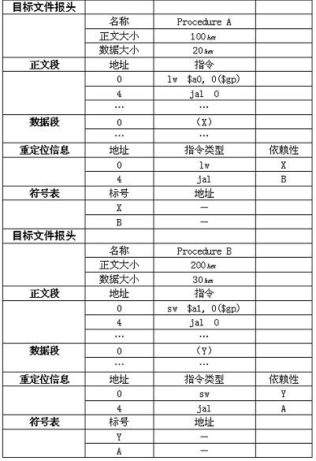
Example 2.23 Linking object files
21

Slide 22
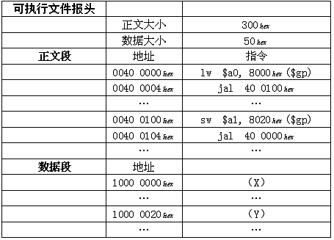
微机的执行文件：
Com
Exe
PE
Address of X:
1000 8000 + FFFF 8000 = 1000 0000
Address of Y:
1000 8000 + FFFF 8020 = 1000 0020
22

Slide 23
Loading
Determine size of text and data segments
Create an address space large enough
Copy instructions and data from executable file to memory
Copy parameters (if any) to the main program onto the stack
Initialize registers and set $sp to the first free location
Jump to a start-up routine

Slide 24
执行文件与进程
执行文件
在硬盘上，非执行态
如病毒样本
进程
转载到内存
可以细分为多个可以并发执行的线程
如激活态病毒
如何看进程: 任务管理器
24

Slide 25
计算机任何动作都是程序设计的
病毒
组成：感染能力（自我复制），隐藏，破坏能力
一个简单的
感染：看到一个执行程序，就把病毒程序拷贝到执行程序最后，程序启动时加一条无条件跳转指令，跳到病毒处，病毒程序执行完成跳回首地址后
隐藏：把执行程序拆封为n个，运行时组装为一体
破坏：随便
程序都需要消耗内存
System idle 也是程序，也消耗内存
25

Slide 26
EXE文件转移
把EXE的代码段中的一个字节写成00
在运行时，用计算结果(或其他来源)写入该位置
作用：防拷贝
参考：经典的针孔加密方法
用针在磁盘上打孔，则该扇区的属性为坏块，以此为正版标记
如果是磁盘拷贝的，则该块为CRC校验错误
26

Slide 27
EXE文件加密
输入密码才能执行该文件？
普通的方法，先读密码，验证后判断是否继续
问题：简单的修改执行文件即可破解
一般方法：
第一段代码是密码验证
若通过，则解密后续代码
解密后长度=加密前，简单
随便压缩
高级方法：
分段加密，前一段的中间结果作为后续的解密用的密钥
27

Slide 28
2.13 A C Sort Example to Put it All Together
Three general steps for translating C procedures
Allocate registers to program variables
Produce code for the body of the procedures
Preserve registers across the procedures invocation
Procedure swap
C code
swap ( int v[ ] , int k )
{
int temp ;
temp = v[ k ] ;
v[ k ] = v[ k + 1 ] ;
v[ k + 1 ] = temp ;
}

Slide 29
Register allocation for swap
v ---- $a0 k ---- $a1 temp ---- $t0
swap is a leaf procedure, nothing to preserve
MIPS code for the procedure swap
Procedure body
swap: sll $t1, $a1, 2 # $t1 = k * 4
add $t1, $a0, $t1 # $t1 = v + ( k * 4 )
# $t1 has the address of v[ k ]
lw $t0, 0($t1) # $t0 ← v[ k ]
lw $t2, 4($t1) # $t2 ← v[ k + 1 ]
sw $t2, 0($t1) # v[k+1]) → v[ k ]
sw $t0, 4($t1) # v[k] → v[ k + 1 ]
Procedure return
jr $ra # return to calling routine

Slide 30
Procedure sort
C code
sort ( int v[ ] , int n )
{ int i , j ;
for ( i = 0 ; i < n ; i + = 1 ) {
for ( j = i - 1 ; j >= 0 && v[j] > v[j+1] ; j- = 1 )
swap ( v , j ) ;
}
}
Register allocation for sort
v -- $a0 n -- $a1 i -- $s0 j -- $s1
Passing parameters in sort
Preserving registers in sort
$ra , $s0, $s1, $s2, $s3
If V[0]> V[1]
V[0]
V[1]
V[2]
……
V[n-1]
i
j

Slide 31
Code for the procedure sort
Saving registers
sort: addi $sp, $sp, -20 # make room on stack for 5 registers
sw $ra, 16($sp) # save $ra on stack
sw $s3, 12($sp) # save $s3 on stack
sw $s2, 8($sp) # save $s2 on stack
sw $s1, 4($sp) # save $s1 on stack
sw $s0, 0($sp) # save $s0 on stack
Procedure body{Outer loop {Inner loop} }
Restoring registers
exit1: lw $s0, 0($sp) # restore $s0 from stack
lw $s1, 4($sp) # restore $s1 from stack
lw $s2, 8($sp) # restore $s2 from stack
lw $s3, 12($sp) # restore $s3 from stack
lw $ra, 16($sp) # restore $ra from stack
addi $sp, $sp, 20 # restore stack pointer
Procedure return
jr $ra # return to calling routine

Slide 32
Code for Procedure body
Outer loop—first for loop
for ( i = 0 ; i < n ; i + = 1 ) {
Move parameters
move $s2, $a0 # $s2 ← $a0 ($a0: base address)
move $s3, $a1 # $s3 ← $a1 ($a1: array size)
Outer loop
move $s0, $zero # $s0 ← $zero ( i = 0)
for1tst: slt $t0, $s0, $s3 # test if $s0 >= $s3 (i >= n)
beq $t0, $zero, exit1 # go to exit1 if $s0 >= $s3 (i >= n)
………………
（body of first for loop is second for loop）
………………
exit2: addi $s0, $s0, 1 # i = i + 1
j for1tst # jump to test of outer loop
exit1:

Slide 33
Inner loop-- second for loop is body of first for loop
for ( j = i - 1 ; j >= 0 && v[j] > v[j+1] ; j- = 1 ){
addi $s1, $s0, -1 # j = i - 1
for2tst: slti $t0, $s1, 0 # test if j < 0
bne $t0, $zero, exit2 # go to exit2 if j < 0
sll $t1, $s1, 2 # $t1 = j * 4
add $t2, $s2, $t1 # $t2 = the address of v[j]
lw $t3, 0($t2) # $t3 = v[j]
lw $t4, 4($t2) # $t4 = v[j + 1]
slt $t0, $t4, $t3 # test if v[j+1]>=v[j]
beq $t0, $zero, exit2 # go to exit2 if v[j+1]>=v[j]
………………
（body of first for loop ）
………………
addi $s1, $s1, -1 # j = j - 1
j for2tst # jump to test of inner loop
exit2:

Slide 34
body of first for loop
Pass parameters and call
move $a0，$s2 # $a0←$s2 ($s2 : base address of the array )
move $a1，$s1 # $a1←$s1 ($a1← j)
Call function swap(int v[],int k)
jal swap # ($a0 might be changed in swap)
Notice: 1.Why are $a0 and $a1 saved? $a0 is the base of the array v. $a0 will be used repeatedly and might be(actually not here) changed by the procedure swap. $a1 is the size of the array v. $a1 will be used repeatedly and changed before the procedure swap is called. 2.Why are they not pushed to stack?
Register variable is faster
The Full Procedure

Slide 35
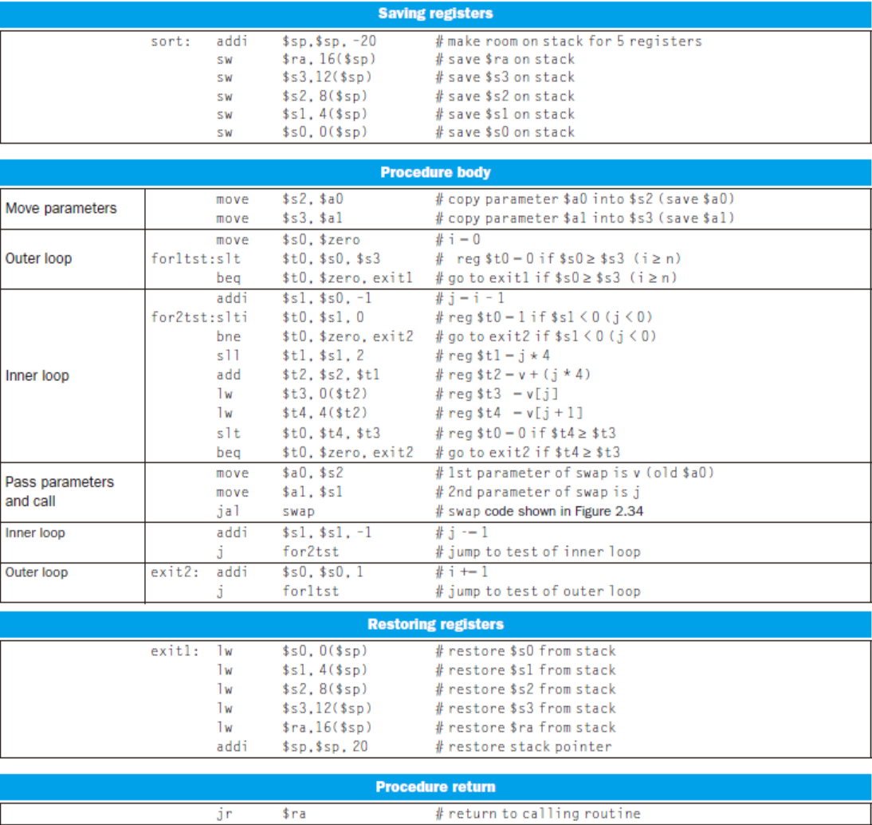

Slide 36
s0, t0
父函数保证：子函数能随便使用t0-t9，返回给父函数的时候，t0-t9可以随便改变
子函数保证：返回给父函数的时候，s0-s7保持父函数调用子函数的值
36

Slide 37
2.15 Arrays versus Pointers
Two C procedures
Array version
clear1 ( int array[ ], int size )
{ int i;
for ( i = 0 ; i < size ; i = i + 1 )
array[i] = 0;
}
Pointer version
clear2 ( int *array, int size )
{
int *p;
for ( p = &array[0] ; p < &array[size] ; p = p + 1 )
*p = 0;
}

Slide 38
Assembly code for clear-1 procedure (array version)
move $t0, $zero # i = 0
loop1: sll $t1, $t0, 2 # $t1 = i * 4
add $t2, $a0, $t1 # $t2 = address of array[ i ]
sw $zero, 0($t2) # array[ i ] = 0
addi $t0, $t0, 1 # i = i +1
slt $t3, $t0, $a1 # test if i < size
bne $t3, $zero, loop1 # if ( i < size ) go to loop1
jr $ra
This code works as long as size is greater than 0. (In this case,the loop will be executed once even though the value of the size parameter is invalid. Actually,size >0 must be checked at first)

Slide 39
Assembly code for clear-2 procedure (pointer version)
move $t0, $a0 # p = the start address of the array[]
sll $t1, $t1, 2 # $t1 = size * 4
add $t2, $a0, $t1 # $t2 = &array[size](address of array[size] )
loop2: sw $zero, 0($t0) # Memory[ p ] = 0
addi $t0, $t0, 4 # p = p + 4
slt $t3, $t0, $t2 # $t3 = (p < &array[size] )
bne $t3, $zero, loop2 # if ( p < &array[size] ) go to loop2
jr $ra
This code works as long as size is greater than 0.
Compare the two versions
Array version has the “multiply” and add inside loop
Pointer version reduces instructions/iteration from 6 to 4
For modern compliers, both ways are the same

Slide 40
2.16 Real Stuff: IA-32 Instructions
The IBM/Motorola PowerPC
Similarities with MIPS:
All instructions are 32 bits long
32 integer registers
Data transfer is possible only with loads and stores
Indexed addressing
MIPS code
add $t0, $a0, $s3 # $a0 has base of an array, $s3 is index
lw $t1, 0($t0) # $t1 gets Memory[$a0 + $s3]
Equivalent code in PowerPC
lw $t1, $a0 + $s3 # $t1 gets Memory[$a0 + $s3]
Update addressing
MIPS code
lw $t0, 4($s3) # $t0 = Memory[$s3 + 4]
addi $s3, $s3, 4 # $s3 = $s3 + 4
Equivalent code in PowerPC
lwu $t0, 4($s3) # $t0 = Memory[$s3 + 4] ; $s3 = $s3 + 4

Slide 41
Indexed and update addressing mode
41

Slide 42
Unique PowerPC instructions
Load multiple and store multiple
Instruction bc for loop
C code
for ( i = n ; i != 0 ; i = i - 1 ) { . . . }
MIPS instructions
Loop: . . .
addi $t0, $t0, -1 # $t0 = $t0 - 1
bne $t0, $zero, Loop # if $t0 != 0 go to Loop
PowerPC instructions
bc Loop, ctr != 0 # $ctr = $ctr - 1 ; if $ctr != 0 go to Loop
Problems with the complex instructions above
The instructions may not exactly match what the compiler needs
A common case may be slower than a simple sequence
42

Slide 43
The Intel 80x86
The milstones
1978 intel 8086
16-bit architecture
Is not considered a general-purpose register
1980 intel 8087 floating-point coprocessor
1982 80286 extended the 8086 architecture by
Increasing Address Space to 24 bits
Manipulate the protection model
1985 80386 extended the 80286 architecture
32-bit architecture with 32-bit registers
32-bit address space
Add paging support in addition to segmented addressing
Nearly a general-purpose register machine ?

Slide 44
1989~95 Higher performance
80486 in 1989
Pentium in 1992
Pentium Pro in 1995
1997 Expand Pentium and Pentium Pro with MMX
1999 Expand Pentium with SSE(SIMD) as Pentium III
8 separate registers ,double their width to 128 bits
Add a single-precision floating-point data type
4 32-bit floating-point operations can be performed in parallel
Cache prefetch instructions
2001 Intel Pentium 4
2003 A company other than Intel enhanced the IA-32 architecture
AMD
Executing all IA-32 instructions with 64-bit Address space & data
2004 Intel capitulates and embraces AMD64

Slide 45
80x86 registers and data addressing modes
80386 extended all 16-bit registers but segment ones to 32 bits
GPR ( general-purpose register )
Addressing modes
Register indirect
Based mode with 8- or 32-bit displacement
Base plus scaled index
Base plus scaled index with 8- or 32-bit displacement
80x86 integer operations
Data movement instructions
Arithmetic and logic instructions
Control flow
String instructions

Slide 46
IA-32 Register and Data Addressing Modes
Name | Register no. | Usage
$zero | 0 | The constant value 0
$v0-$v1 | 2-3 | Values for results and expression evaluation
$a0-$a3 | 4-7 | Arguments
$t0-$t7 | 8-15 | Temporaries
$s0-$s7 | 16-23 | Saved
$t8-$t9 | 24-25 | More temporaries
$gp | 28 | Global pointer
$sp | 29 | Stack pointer
$fp | 30 | Framer pointer
$ra | 31 | Return address

Slide 47
Instruction types for ALU & data transfer
Source/destination operand type | Second source operand
Register | Register
Register | Immediate
Register | Memory
Memory | Register
Memory | Immediate

Slide 48
Some typical IA-32 Integer Operations

Slide 49
Typical 80x86 instruction format
1Byte
5Bytes
3Bytes
1Bytes
5Bytes
6Bytes

Slide 50
2.18 Concluding Remarks
Two principles of stored-program computers
Use instructions as numbers
Use alterable memory for programs
Four design principles
Simplicity favors regularity
Smaller is faster
Make the common case fast
Good design demands good compromises
MIPS instruction set

Slide 51
2.19 History of Instruction Set Development
Accumulator Architectures
Only 1 register for arithmetic instructions: accumulator
Memory-based operand-addressing mode
Example 2.23 Compiling C code to accumulator instructions
C code: A = B + C ;
Accumulator instructions:
load AddressB # Acc = Memory[AddressB], or Acc = B
add AddressC # Acc = Acc + Memory[AddressC], or Acc = B + C
store AddressA # Memory[AddressA] = Acc, or A = B + C
Extended Accumulator Architectures

Slide 52
General-Purpose Register Architectures
Register-memory architecture
80386
IBM 360
Load-store or register-register architecture
CDC 6600
MIPS
DEC’s VAX architecture
Allow any combination of registers and memory operands
Memory-memory architecture
Example 2.24 Compiling C code to memory-memory instructions
C code: A = B + C;
instructions:
add AddressA, AddressB, AddressC

Slide 53
Compact Code and Stack Architectures
Variable-length instructions
To match the varying operand specifications
To minimize code size
Stack model of execution
All registers are abandon, so the instructions are short.
Push, pop
Example 2.25 Compiling C code to stack instructions
C code: A = B + C;
Stack instructions:
push AddressC # Top = Top+4; Stack[Top]=Memory[AddressC]
push AddressB # Top = Top+4; Stack[Top]=Memory[AddressB]
add # Stack[Top-4]= Stack[Top]+Stack[Top-4];Top=Top-4;
pop AddressA # Memoryp[AddressA]=Stack[Top]; Top=Top-4;

Slide 54
High-Level-Language Computer Architecture
Goal: hardware more like programming languages
Finally failed
Reduced Instruction Set Computer Architecture (RISC )
Fixed instruction lengths
Load-store instruction sets
Limited addressing modes
Limited operations
MIPS, Sun SPARC, Hewlett-Packard PA-RISC
IBM PowerPC, DEC Alpha

Slide 55
END

