Slide 1
Computer Organization & Design
The Hardware/Software Interface
计算机组成与设计
Chapter 5
The processor : Datapath and control
Haifeng Liu
College of Computer Science and Technology, Zhejiang University
haifengliu@zju.edu.cn

Slide 2
Computer Organization
Control unit
CPU
Path: multiplexors
ALU
Registers
……
Memory
Datapath
Computer
I/O interface

Slide 3
Contents of Chapter 5
5.1 Introduction & Logic Design Conventions
5.2 Building a datapath
5.3 A Simple Implementation Scheme
5.4 A Multicycle Implementation
5.5 Microprogramming
5.6 Exception

Slide 4
Teaching prototype: MIPS
What is the MIPS?
Microprocessor
without
Interlocked
Pipeline
Stages

Slide 5
5.1 Introduction
We‘ll look at an implementation of the MIPS
Simplified to contain only:
  memory-reference instructions: lw, sw
  arithmetic-logical instructions: add, sub, and, or, slt
  control flow instructions: beq, j
An Overview of the implementation
  For every instruction, the first two step are identical
    Fetch the instruction from the memory
    Decode and read the registers
  Next steps depend on the instruction class
    Memory-reference Arithmetic-logical branches
What are steps?
How many FUN.?

Slide 6
Simple Implementation
Include the functional units we need for each instruction
A
L
U
c
o
n
t
r
o
5
R
e
a
d
3
l
r
e
g
i
s
t
e
r
1
R
e
a
d
d
a
t
R
e
g
i
5
a
1
s
t
e
r
R
e
a
d
Z
e
r
r
o
e
g
i
s
t
n
u
m
b
e
r
s
e
r
2
R
e
g
i
s
t
e
r
s
D
a
t
5
W
r
a
A
L
U
A
L
U
i
t
e
r
e
s
u
l
r
t
Why do we need this stuff?
e
g
i
s
t
e
r
R
e
a
d
d
a
t
W
r
a
2
i
t
D
a
t
e
a
d
a
t
a
R
e
g
W
r
i
t
e
a
.
R
e
g
i
s
t
e
r
s
b
.
A
L
U

Slide 7
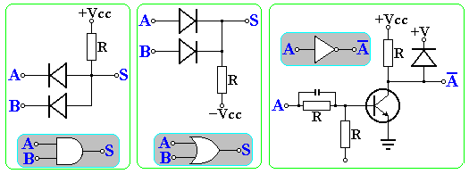
Basic elements
Basic logic gate。
  AND：S=A•B
  OR ：S=A+B
  NOT：S=~A
A | B | A•B | A+B | ~A
0 | 0 | 0 | 0 | 1
0 | 1 | 0 | 1 | 1
1 | 0 | 0 | 1 | 0
1 | 1 | 1 | 1 | 0

Slide 8
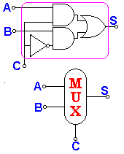
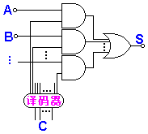
MUX
多路开关：有若干个输入，由控制端决定那一路输入将输出。
  经常是多路并行。
C | S
0 | A
1 | B

Slide 9
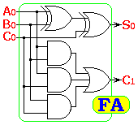
Adder
Half adder：
Full adder：S=A+B
  Input: A, B, C0. Output: Sum, CarryOut
  S = A ⊕ B ⊕ C
  C₊₁= A•B + B•C + C•A
A | 0 | 0 | 1 | 1
B | 0 | 1 | 0 | 1
S | 0 | 1 | 1 | 0
A | 0 | 0 | 1 | 1 | 0 | 0 | 1 | 1
B | 0 | 1 | 0 | 1 | 0 | 1 | 0 | 1
C | 0 | 0 | 0 | 0 | 1 | 1 | 1 | 1
S | 0 | 1 | 1 | 0 | 1 | 0 | 0 | 1
C₊₁ | 0 | 0 | 0 | 1 | 0 | 1 | 1 | 1

Slide 10
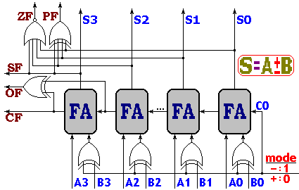
串行进位加法器
4位串行进位加法器：S=A+B
  各位串行进行。
  同时根据结果产生各种标记状态。
A
32
+
S=A+B
B
32
Operation

Slide 11
Adder
32-bit Adder
A
32
+
S=A+B
B
32
Operation

Slide 12
ALU
算术逻辑运算器ALU：即运算器
  5 Operations
  “Set on less than”：
  if A<B then Result=1；
  else Result=0。
Operation | Function
000 | And
001 | Or
010 | Add
110 | Sub
111 | Slt
Binvert
CarryIn
Operation
A
00
A
32
01
Result
Result
ALU
B
0
10
1
B
32
Less
11
3
CarryOut
Operation

Slide 13
ALU Control
ALUop与Func联合对ALU的控制

Slide 14
ALU Control
ALU控制：
  ALU由ALUcontrol控制：ALUcontrol由ALUop和指令的低6位(5-0)联合产生ALU控制码。
  这样的好处在于分级控制，对于用的最多的加、减操作，系统只需给出两位的ALUop即可。
A
32
zero
ALU
Result
B
32
32
Operation
3
ALU
control
Func
[5-0]
2
ALUop

Slide 15
REGISTER
Register
  State element。
  Can be controled by Write signal.
Write
Read：
Out=Register
In
Out
In
Out
Clock cycle
Write：
Register=In
Register
Register

Slide 16
Memory
存储器：
  可分为指令存储器与数据存储器；
  指令存储器设为只读；输入指令地址，输出指令。
  数据存储器可以读写，由MemRead和MemWrite控制。按地址读出数据输出，或将写数据写入地址所指存储器单元。
MemWrite
Instruction
Address
Address
Read
data
Instruction
Write
data
Instruction
memory
Data
memory
MemRead

Slide 17
D 触发器
S
C | D | S | R | Q(t + 1)
0 | X | X | X | hold
1 | 0 | 0 | 1 | Q=0：reset
1 | 1 | 1 | 0 | Q=1：reset
D
Q
C
Q
R
C | D | Q(t + 1)
0 | X | hold
1 | 0 | Q=0：reset
1 | 1 | Q=1：set
D
Q
C
Q
Truth table
Symbol of Latch

Slide 18
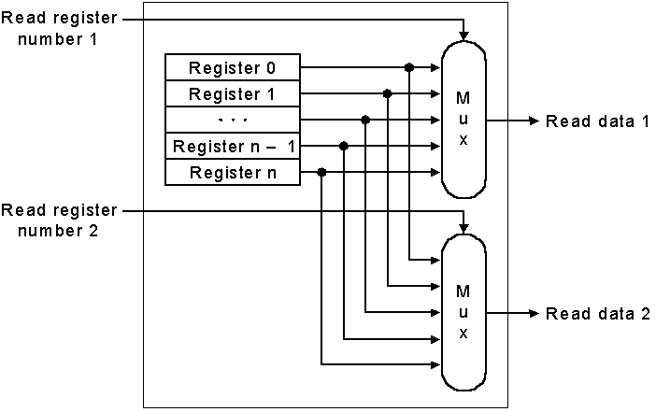
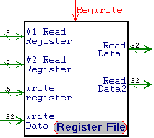
Register File
Register File：
  32 32-bit Registers；
  Input: 2 32-bit;
  Output: 32-bit data, 32-bit register number;
  Register write control。

Slide 19
Register File
Write Register:
  we still use the real clock to determine when to write
Write
0
C
1
Register
D
Register number
decoder
C
D
Register 1
n-1
n
C
Register n-1
D
C
Register n
Register data
D

Slide 20
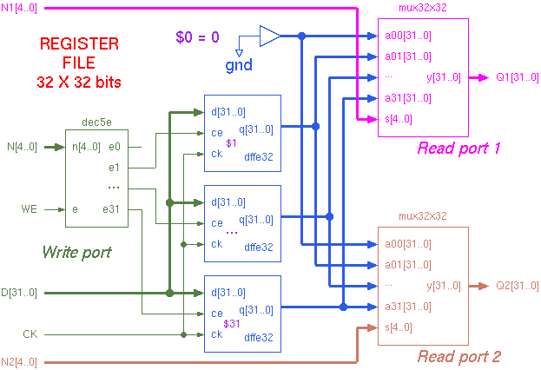
Register File

Slide 21
32×32bits寄存器组硬件描述
Module regs(clk, rst,reg_Rd_addr_A, reg_Rt_addr_B, reg_Wt_addr, wdata, we, rdata_A, rdata_B);
input clk, rst, we;
input [4:0] reg_Rd_addr_A, reg_Rt_addr_B, reg_Wt_addr;
input [31:0] wdata;
output [31:0] rdata_A, rdata_B;
reg [31:0] register [1:31]; // r1 - r31
integer i;
assign rdata_A = (reg_Rd_addr_A == 0)? 0 : register[reg_Rd_addr_A]; // read
assign rdata_B = (reg_Rt_addr_B == 0)? 0 : register[reg_Rt_addr_B]; // read
always @(posedge clk or posedge rst)
begin
if (rst==1) begin // reset
for (i=1; i<32; i=i+1)
register[i] <= 0;
end
else begin
if ((reg_Wt_addr != 0) && (we == 1)) // write
register[reg_Wt_addr] <= wdata;
end
end
endmodule

Slide 22
32个Register的功用
寄存器组有32个32位寄存器，其功用分配如下表：

Slide 23
The other elements
Sign Extend：
  将16位的补码表示的有符号立即数，扩展为32位。
  方法：只需重复符号位即可。
Shift：
  Shift 2 bits left。
  方法：将输入高移2位接输出，输出的低两位接0。
16
Sign
extend
32
D31
.
.
.
D16
D15
D14
.
.
.
D00
Shift
left 2
D31
D30
D29
.
.
.
.
.
.
D02
D01
D00
D31
D30
D29
.
.
.
.
.
.
D02
D01
D00
D15
D14
.
.
.
D00

Slide 24
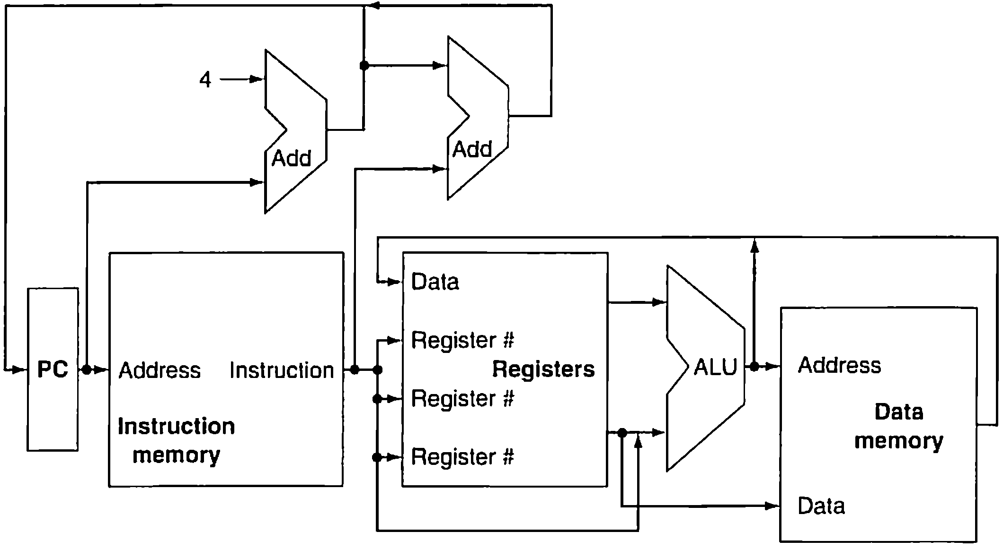
An abstract view of the implementation of MIPS

Slide 25
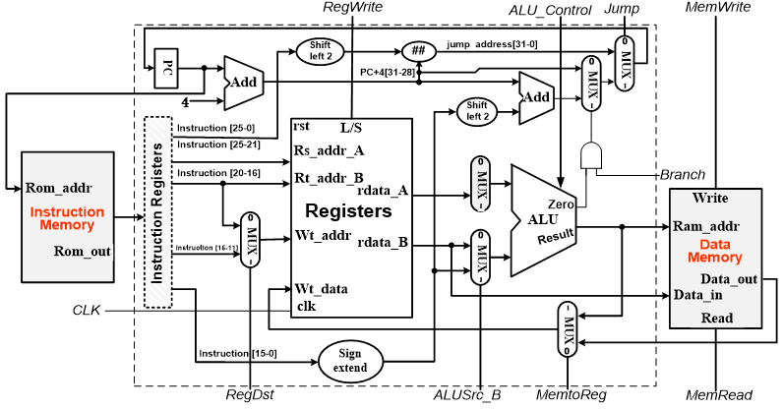
An abstract view of
Simple implementation of MIPS

Slide 26
Simple Implementation
An edge triggered methodology
Typical execution:
  read contents of some state elements,
  send values through some combinational logic
  write results to one or more state elements

Slide 27
Contents of Chapter 5
5.1 Introduction & Logic Design Conventions
5.2 Building a datapath
5.3 A Simple Implementation Scheme
5.4 A Multicycle Implementation
5.5 Microprogramming
5.6 Exception

Slide 28
Building a Datapath ……
Building The Elements
ALU & Registers

Slide 29
MIPS fields (format)
Field size | 6bits | 5bits | 5bits | 5bits | 5bits | 6bits | All MIPS instruction 32 bits
R-format | op | rs | rt | rd | shamt | funct | Arithmetic instruction format
i-format | op | rs | rt | Imm/Word address |  |  | Data transfer ,branch format
J-format | op | target address (word) |  |  |  |  | Uncondition-al jump
Must bear in mind !
Region: ±2¹⁵
op：basic operation of the instruction, traditionally called the opcode.
rs： the first register source operand.
rt： the second register source operand.
rd： the register destination operand.
shamt： shift amount.
funct： function,this field selects the specific variant of the operation in the op field.

Slide 30
The datapath there are ……
Name | Example | Comments
32 register | $s0-$s7,$t0-$t9, $zero, $a0-$a3,$v0-$v1,$sp,$ra | Fast locations for data. In MIPS, data must be in registers to perform arithmetic. Registers $s0-$s7 map to 16-23 and $t0-$t7 map to 8-15.
2³⁰ memory words | Memory[0] Memory[4] …Memory[4294967292] | Accessed only by data transfer instructions in MIPS. MIPS uses byte addr., so sequential word addr. Differ by 4. Memory holds data structures,arrays, and spilled registers.
Name | Register no. | Usage | Preserved on call
$zero | 0 | The constant value 0 | n,.a.
$v0-$v1 | 2-3 | Values for results and expression evaluation | no
$a0-$a3 | 4-7 | Arguments | no
$t0-$t7 | 8-15 | Temporaries | no
$s0-$s7 | 16-23 | Saved | yes
$t8-$t9 | 24-25 | More temporaries | no
$gp | 28 | Global pointer | yes
$sp | 29 | Stack pointer | yes
$fp | 30 | Framer pointer | yes
$ra | 31 | Return address | yes

Slide 31
MIPS assembly language
Category | Instruction | Example | Meaning | Comments
Arithmetic | add | Add $s1,$s2,$s3 | $s1=$s2 + $s3 | Three register operands
 | subtract | Sub $s1,$s2,$s3 | $s1=$s2－$s3 | Three register operands
Data transfer | load word | lw $1, 100($s2) | $s1=Memory[$s2+100] | Data from memory to register
 | store word | sw $s1, 100($s2) | Memory[$s2+100]=$s1 | Data from register to memory
logical | and | and $s1,$s2,$s3 | $s1=$s2 & $s3 | three reg. operands;bit-by-bit AND
 | or | or $s1,$s2,$s3 | $s1=$s2 | $s3 | three reg. operands;bit-by-bit OR
 | nor | nor $s1,$s2,$s3 | $s1=~($s2 | $s3) | three reg. operands;bit-by-bit NOR
 | and immediate | addi $s1,$s2,100 | $s1=$s2 & 100 | Bit-by-bit AND reg with constant
 | or immediate | ori $s1,$s2,100 | $s1=$s2 | 100 | Bit-by-bit OR reg with constant
 | shift left logical | sll $s1,$s2,10 | $s1=$s2 << 10 | Shift left by constant
 | shift right logical | srl $s1,$s2,10 | $s1=$s2 >> 10 | Shift right by constant
Conditional branch | branch on equal | beq $s1,$s2,L | If($s1==$s2) go to L | Equal test and branch
 | branch not eaqal | bne $s1,$s2,L | If($s1!=$s2) go to L | Not equal test and branch
 | set on less than | slt $s1,$s2,$s3 | If($s2<$s3) $s1=1 Else $s1=0 | Compare less than;used with beq, bne
 | set on less than immediate | slt $s1,$s2100 | If($s2<100) $s1=1 Else $s1=0 | Compare less than immediate; used with beq, bne
Uncondition-al jump | jump | j L | go to L | Jump to target address
 | jump register | jr $ra | go to $ra | For procedure return
 | jump and link | jal L | $ra=PC+4; go to L | For procedure call

Slide 32
ALU OP for MIPS machine language
Name | Format | Example |  |  |  |  |  | Comment
add | R | 0 | 18 | 19 | 17 | 0 | 32 | add $s1, $s2, $s3
sub | R | 0 | 18 | 19 | 17 | 0 | 34 | sub $s1, $s2, $s3
lw | I | 35 | 18 | 17 | 100 |  |  | lw $s1, 100($s2)
sw | I | 43 | 18 | 17 | 100 |  |  | sw $s1, 100($s2)
and | R | 0 | 18 | 19 | 17 | 0 | 36 | and $s1, $s2, $s3
or | R | 0 | 18 | 19 | 17 | 0 | 37 | or $s1, $s2, $s3
nor | R | 0 | 18 | 19 | 17 | 0 | 39 | nor $s1, $s2, $s3
addi | I | 12 | 18 | 17 | 100 |  |  | addi $s1, $s2,100
ori | I | 13 | 18 | 17 | 100 |  |  | ori $s1, $s2,100
beq | I | 4 | 17 | 18 | 25 |  |  | beq $s1, $s2,100
bne | I | 5 | 17 | 18 | 25 |  |  | bne $s1, $s2,100
slt | R | 0 | 18 | 19 | 17 | 0 | 42 | slt $s1, $s2,$s3
j | J | 2 | 2500 |  |  |  |  | j 10000(see section 2.9)
jr | R | 0 | 31 | 0 | 0 | 0 | 8 | j Sra
jal | J | 3 | 2500 |  |  |  |  | jar 10000(see section 2.9)
Field size |  | 6bits | 5bits | 5bits | 5bits | 5bits | 6bits | All MIPS instruction 32 bits
R-format | R | op | rs | rt | rd | shamt | funct | Arithmetic instruction format
i-format | I | op | rs | rt | address |  |  | Data transfer ,branch format

Slide 33
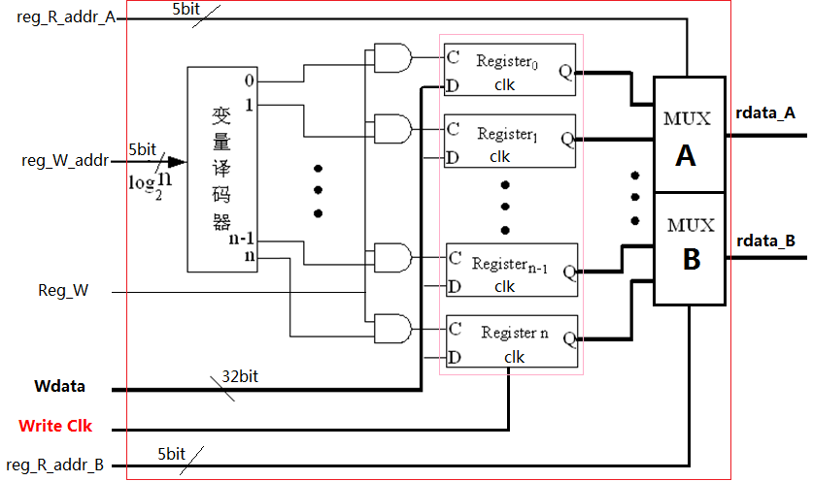
Register File--Built using D flip-flops
Register files
  Foundation element of Computer（Part of Datapath ）
  Aggregation of many Registers
  Register address、Control signals: Read/Write

Slide 34
Register File: Read-Output
Reg. address
  Output from the register
Data output
5 bits
32 bits
5 bits
5 bits
32 bits
32 bits
Reg. address

Slide 35
Register File: Write-Input
  Written to the register
Write signals
rd or rt
5 bits
Reg. address
32 bits

Slide 36
Description: 32×32bits Register files
Module regs(clk, rst,reg_Rd_addr_A, reg_Rt_addr_B, reg_Wt_addr, wdata, we, rdata_A, rdata_B);
input clk, rst, we;
input [4:0] reg_Rd_addr_A, reg_Rt_addr_B, reg_Wt_addr;
input [31:0] wdata;
output [31:0] rdata_A, rdata_B;
reg [31:0] register [1:31]; // r1 - r31
integer i;
assign rdata_A = (reg_Rd_addr_A == 0)? 0 : register[reg_Rd_addr_A]; // read
assign rdata_B = (reg_Rt_addr_B == 0)? 0 : register[reg_Rt_addr_B]; // read
always @(posedge clk or posedge rst)
begin
if (rst==1) begin // reset
for (i=1; i<32; i=i+1)
register[i] <= 0;
end
else begin
if ((reg_Wt_addr != 0) && (we == 1)) // write
register[reg_Wt_addr] <= wdata;
end
end
endmodule

Slide 37
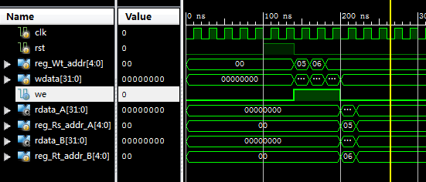
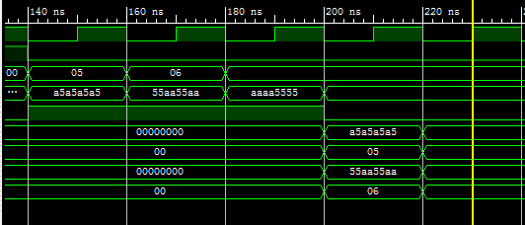
Reg-files Simulation

Slide 38
Building a Datapath ……
Data Stream of Datapath

Slide 39
Instruction execution in MIPS
Fetch :
  Take instructions from the instruction memory
  Modify PC to point the next instruction
Instruction decoding & Read Operand:
  Will be translated into machine control command
  Reading Register Operands, whether or not to use
Executive Control:
  Control the implementation of the corresponding ALU operation
Memory access:
  Write or Read data from memory
  Only LW/SW
Write results to register:
  If it is R-type instructions, ALU results are written to Rd
  If it is I-type instructions, Results are written to Rt

Slide 40
Instruction fetching three elements
Data Stream of Instruction fetching
How to connect? Who?
Read address
Instruction
PC
Add
Instruction
Memory
Instruction memory
Program counter
Adder

Slide 41
Instruction fetching unit
Instruction Register
  Can you omit it?
add
PC
4
CPU
Read address
Instruction
Instruction
Instruction
Memory

Slide 42
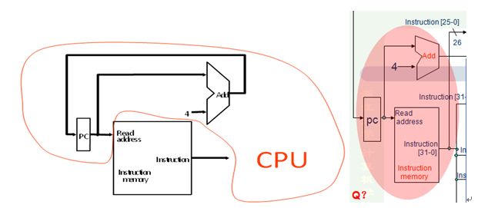
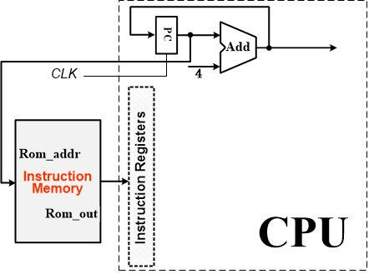
How simple is!
Why PC+4?

Slide 43
More Implementation Details
Abstract / Simplified View:

Slide 44
Path Built using Multiplexer
Data Stream of Instruction executing
R-type instruction Datapath
I-type instruction Datapath
  For ALU
  For memory
  For branch
J-type instruction Datapath
  For Jump
First, Look at the data flow within instruction execution

Slide 45
R type Instruction & Data stream
op(6)
Bnegate | op | function
0 | 00 | and
0 | 01 | Or
0 | 10 | Add
1 | 10 | Sub
1 | 11 | Slt
control
ALU operation
rs(5)
ALUC
bit₂₁₋₂₅
RegWrite
rt(5)
rs
Registers
3
Read reg. address1
bit₁₆₋₂₀
Read data1
rd(5)
rt
Read reg. address2
ALU
Zero
bit₁₁₋₁₅
rd
Write reg. address
ALU result
shamt
Read data2
Write data
32bits data
func(6)

Slide 46
I type Instruction & Data stream
lw $t0, 200($s2)
control
ALUop
ALUC
bit₂₁₋₂₅
RegWrite
3
ALU operation
rs
Registers
bit₁₆₋₂₀
Read reg. address1
Read data1
rt
Read reg. address2
ALU
Zero
MemWrite
op(6)
rs(5)
rt(5)
Immediate data
rt
Write reg. address
ALU result
address
Read data2
Write data
Read data
Data
Memory
bit₀₋₁₅
Sign
extend
Write data
32
MemRead
16
32bits data
lw $t0, 200($s2)
if $s2=1000，it will load word in element number 1200 to $t0

Slide 47
I type Instruction & Data stream of beq
PC+4 from instructiondatapath
control
ADD
To PC
Shift
left 2
bit₂₁₋₂₅
RegWrite
Branch
rs
Registers
bit₁₆₋₂₀
Read reg. address1
ALUC
Read data1
ALUop
op(6)
rs(5)
rt(5)
offset
rt
Read reg. address2
3
ALU operation
Write reg. address
ALU
Read data2
Zero
Write data
ALU result
Sign
extend
bit₀₋₁₅
16
32

Slide 48
J type Instruction
bit₂₅₋₀₀##00
PC+4[31:28]##bit₂₅₋₀₀##00
op(6)
Target address(26)
##
Shift left 2
28
bit₂₅₋₀₀
PC+4[31:28]
control
To PC
ADD
Shift
left 2
Jump
bit₂₁₋₂₅
RegWrite
Branch
rs
Registers
bit₁₆₋₂₀
Read reg. address1
Read data1
rt
Read reg. address2
3
ALU operation
J Loop
Write reg. address
ALU
Read data2
Zero
Write data
ALU result
Sign
extend
bit₀₋₁₅
16
32

Slide 49
Combine the datapath R & I type
PC
Read address
Instruction
ADD
MUX
ADD
4
To PC
Instruction
Shift
left 2
Instruction
Memory
RegWrite
bit₂₁₋₂₅
rs
Registers
3
Read reg. address1
ALU operation
Read data1
bit₁₆₋₂₀
rt
Read reg. address2
ALU
Zero
MenWrite
op(6)
rs(5)
rt(5)
Immediate data
MUX
rd
address
bit₁₁₋₁₅
Write reg. address
ALU result
Read data2
MUX
Read data
MUX
Write data
Data
Memory
bit₀₋₁₅
Sign
extend
Write data
32
MenRead
16
32bits data

Slide 50
Combine the datapath R & I type
PC
ADD
MUX
ADD
4
Shift
left 2
RegWrite
Instruction
bit₂₁₋₂₅
Registers
Read address
Read address1
3
ALU operation
Read data1
bit₁₆₋₂₀
Read address2
ALU
Zero
MenWrite
Instruction
MUX
ALU
result
address
bit₁₁₋₁₅
Write address
Read data2
MUX
Read data
MUX
Instruction
Memory
Write data
Data
Memory
bit₀₋₁₅
Sign
extend
Write data
32
MenRead
16
32bits data

Slide 51
Combine the datapath R & I type
PC
ADD
MUX
R
ADD
4
Shift
left 2
RegWrite
Instruction
bit₂₁₋₂₅
Registers
Read address
Read address1
3
ALU operation
Read data1
bit₁₆₋₂₀
Read address2
ALU
Zero
MenWrite
Instruction
MUX
ALU
result
address
bit₁₁₋₁₅
Write address
Read data2
MUX
Read data
MUX
Instruction
Memory
Write data
Data
Memory
bit₀₋₁₅
Sign
extend
Write data
32
MenRead
16
32bits data

Slide 52
Combine the datapath R & I type
PC
ADD
MUX
I-LW
ADD
4
Shift
left 2
RegWrite
Instruction
bit₂₁₋₂₅
Registers
Read address
Read address1
3
ALU operation
Read data1
bit₁₆₋₂₀
Read address2
ALU
Zero
MenWrite
Instruction
MUX
ALU
result
address
bit₁₁₋₁₅
Write address
Read data2
MUX
Read data
MUX
Instruction
Memory
Write data
Data
Memory
bit₀₋₁₅
Sign
extend
Write data
32
MenRead
16
32bits data

Slide 53
Combine the datapath R & I type
PC
ADD
MUX
I-SW
ADD
4
Shift
left 2
RegWrite
Instruction
bit₂₁₋₂₅
Registers
Read address
Read address1
3
ALU operation
Read data1
bit₁₆₋₂₀
Read address2
ALU
Zero
MenWrite
Instruction
MUX
ALU
result
address
bit₁₁₋₁₅
Write address
Read data2
MUX
Read data
MUX
Instruction
Memory
Write data
Data
Memory
bit₀₋₁₅
Sign
extend
Write data
32
MenRead
16
32bits data

Slide 54
Combine the datapath R & I type
PC
ADD
MUX
I-beq
ADD
4
Shift
left 2
RegWrite
Instruction
bit₂₁₋₂₅
Registers
Read address
Read address1
3
ALU operation
Read data1
bit₁₆₋₂₀
Read address2
ALU
Zero
MenWrite
Instruction
MUX
ALU
result
address
bit₁₁₋₁₅
Write address
Read data2
MUX
Read data
MUX
Instruction
Memory
Write data
Data
Memory
bit₀₋₁₅
Sign
extend
Write data
32
MenRead
16
32bits data

Slide 55
Contents of Chapter 5
5.1 Introduction and Logic design Conventions
5.2 Building a datapath
5.3 A Simple Implementation Scheme
5.4 A Multicycle Implementation
5.5 Microprogramming
5.6 Exception

Slide 56
Processor Design……
Controller Design
Next CLK
CTRL
Datapath
Memory

Slide 57
Building the Datapath & Controller
Use multiplexors to stitch them together
  There are 7+3 signals
Note : Page 306 F5.16

Slide 58
Building Controller
Analyse for cause and effect
Information comes from the 32 bits of the instruction
Selecting the operations to perform (ALU, read/write, etc.)
Controlling the flow of data (multiplexor inputs)
ALU's operation based on instruction type and function code
R-format instruction (add, sub, and, or, slt)
₃₁ ₂₁ | ₂₅ ₂₁ | ₂₅ ₁₆ | ₁₅ ₁₁ | ₁₀ ₆ | ₅ ₀
Op | Rs | Rt | Rd | Shamt | Funct
6 bits | 5bits | 5bits | 5bits | 5bits | 6bits
I-format instruction (lw, sw, beq)
Op | Rs | Rt | Immediate
6 bits | 5bits | 5bits | 16bits
J-format instruction (add, sub, and, or, slt)
Op | address
6 bits | 26bits

Slide 59
Instruction Code: Input P103
Operations comes from the OPcode of the instruction
Instruction Code
 |  | ₃₁ ₂₁ | ₂₅ ₂₁ | ₂₅ ₁₆ | ₁₅ ₁₁ | ₁₀ ₆ | ₅ ₀
add | R | 000000 | rs | rt | rd | 00000 | 100000
sub | R | 000000 | rs | rt | rd | 00000 | 100010
and | R | 000000 | rs | rt | rd | 00000 | 100100
or | R | 000000 | rs | rt | rd | 00000 | 100101
slt | R | 000000 | rs | rt | rd | 00000 | 101010
lw | I | 100011 | rs | rt | Immediate(displacement)
sw | I | 101011 | rs | rt | Immediate(displacement)
beq | I | 000100 | rs | rt | Immediate(offset)
j | J | 000010 | address

Slide 60
What should ALU do ?
e.g. what should the ALU do with these instructions
Example: lw $1, 100($2)
OP rs rt 16 bit displacement
ALU control input
3 –types
ALU op
lw
sw
R
(100011)35
2
1
100
00
00
10
(101011)43
2
1
100
000000(00)
rs(5)
rt(5)
rd(5)
shamt
func(6)
B negate | op | function
0 | 00 | and
0 | 01 | Or
0 | 10 | Add
1 | 10 | Sub
1 | 11 | Slt
Why is the code for subtract 110
and not 011?

Slide 61
Scheme of Controller
2-level decoder
op(6)
rs(5)
rt(5)
rd(5)
shamt
func(6)
First
Main
decoder
ALU
Decoder
Second
Defined at Chapter-3
ALU operation(3)
ALU op(2)
Defined
instruction op code
(6)
Signals for Other
Components
(7)
Defined

Slide 62
The ALU control is where and other signals(7)
Output signals
ALU OP
ALU Control
Instroction[5:0]

Slide 63
Signals for datapath Defined 7+2 control (p. 305)
Signal name | Effect when deasserted(=0) | Effect when asserted(=1)
RegDst | Select register destination number from the rt(20:16) when WR | Select register destination number from the rd(15:11) when WB
RegWrite | None | Register destination input is written with the value on the Write data input
ALUScr | The second ALU operand come from the second register file output (Read data 2) | The second ALU operand is the sign-extended lower 16 bits of the instruction..
PCSrc (Branch) | The PC is replaced by the output of the adder that computers the value PC+4 | The PC is replaced by the output of the adder that computers the branch target.
MemRead | None | Data memory contents designated by the address input are put on the Read data output.
MemWrite | None | Data memory contents designated by the address input are replaced by value on the Write data input.
MemtoReg | The value fed to register Write data input comes from the Alu | The value fed to the register Write data input comes from the data memory.

Slide 64
Our Simple Control Structure
All of the logic is combinational
We wait for everything to settle down, and the right thing to be done
  ALU might not produce right answer? right away
  we use write signals along with clock to determine when to write
Cycle time determined by length of the longest path
时钟下触发下一条指令
控制器
Instruction n
Instruction n+1
Datapath
Memory
We are ignoring some details like setup and hold times

Slide 65
Designing the Main Control Unit
First level
Main Control Unit function
  ALU op (2)
  Divided 7 control signals into 2 groups
    4 Mux
    3 R/W
LW | 00
SW | 00
Beq | 01
R-type | 10
ALU
control
ALU op (2)
RegDst
ALUScr
PCSrc
MemtoReg
Instruction op code (6)
Mux (4)
MemRead
MemWrite
RegWrite
R/W (3)

Slide 66
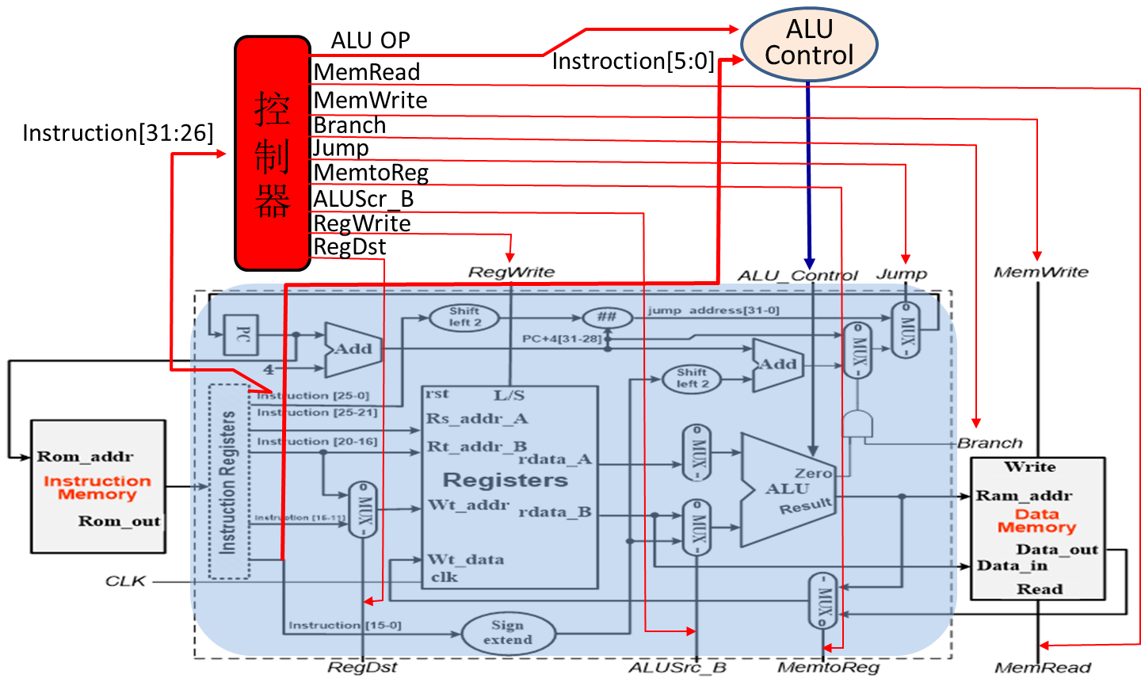
Truth Table for Main decoder
Instruction | RegDst | ALUSrc_B | MemtoReg | RegWrite | MemRead | MemWrite | Branch | ALU_{op1} | ALU_{op0}
R-format
LW
SW
beq
beq | X | 0 | X | 0 | 0 | 0 | 1 | 0 | 1
R-format | 1 | 0 | 0 | 1 | 0 | 0 | 0 | 1 | 0
LW | 0 | 1 | 1 | 1 | 1 | 0 | 0 | 0 | 0
SW | X | 1 | X | 0 | 0 | 1 | 0 | 0 | 0

Slide 67
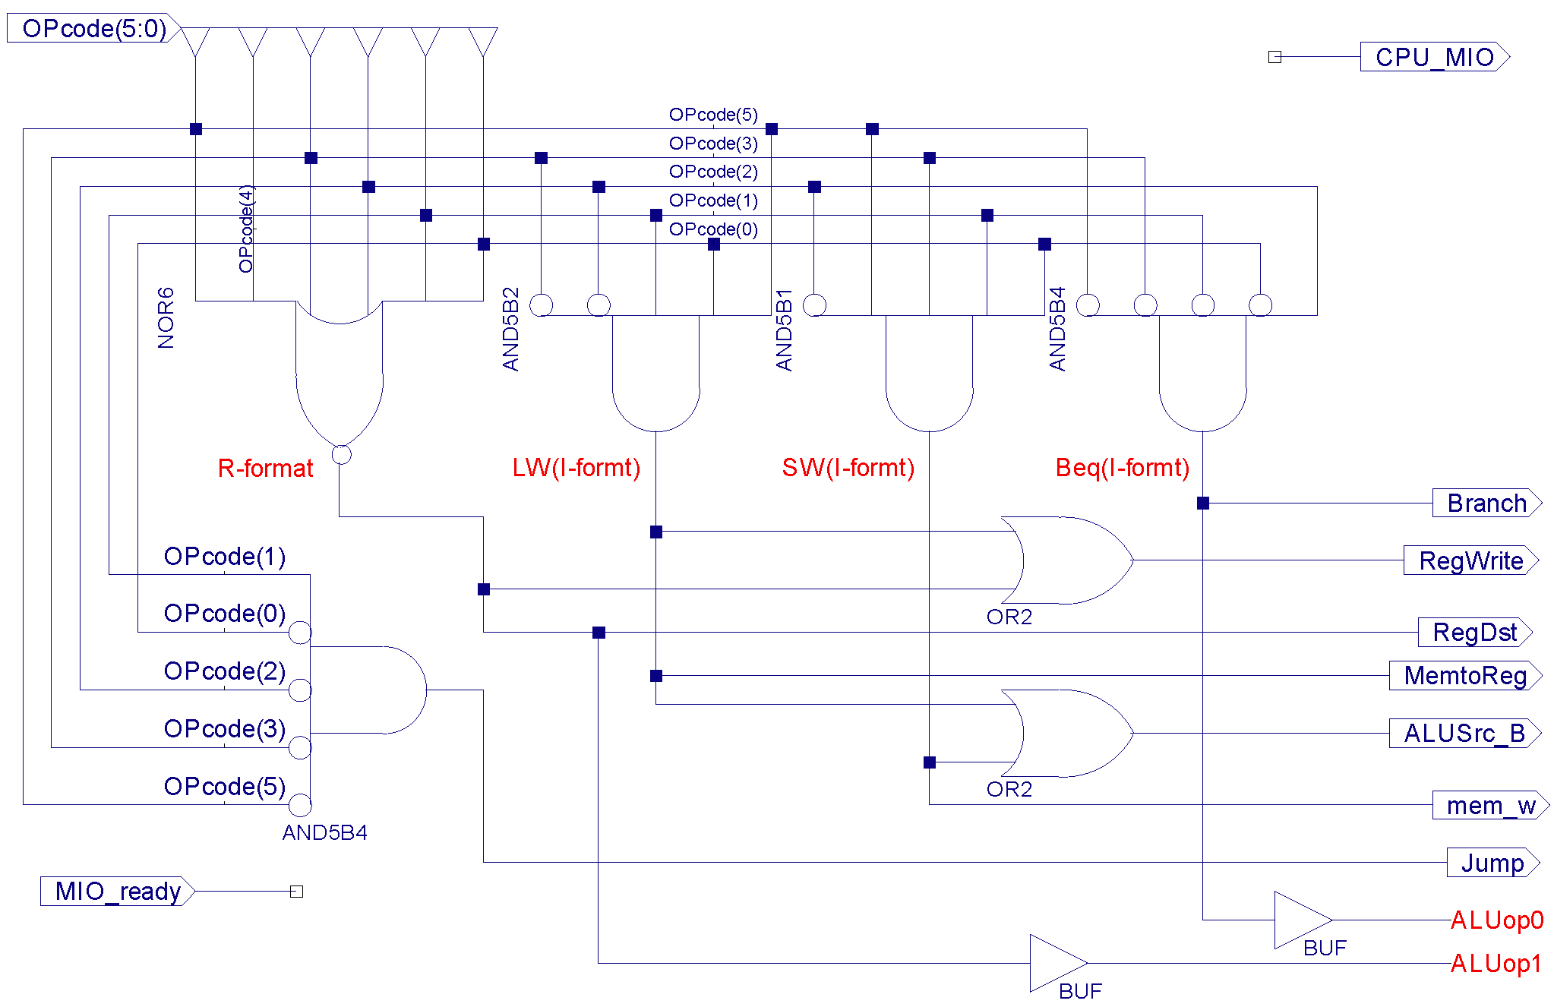
Truth tables & Circuitry of main Controller
Truth tables
输入 |  | 输出
Instruction | OPCode | RegDst | ALUSrcB | Memto-Reg | Reg Write | Mem Read | Mem Write | Branch | Jump | ALU_{Op1} | ALU _{Op0}
R-format | 000000 | 1 | 0 | 0 | 1 | 0 | 0 | 0 | 0 | 1 | 0
Lw(I-Type) | 100011 | 0 | 1 | 1 | 1 | 1 | 0 | 0 | 0 | 0 | 0
sw(I-Type) | 101011 | X | 1 | X | 0 | 0 | 1 | 0 | 0 | 0 | 0
beq(I-Type) | 000100 | X | 0 | X | 0 | 0 | 0 | 1 | 0 | 0 | 1
Jump | 000010 | X | X | X | 0 |  | 0 | 0 | 1 | X | X
Simple combinational logic
L/S 00
beq 01
R-type 10

Slide 68
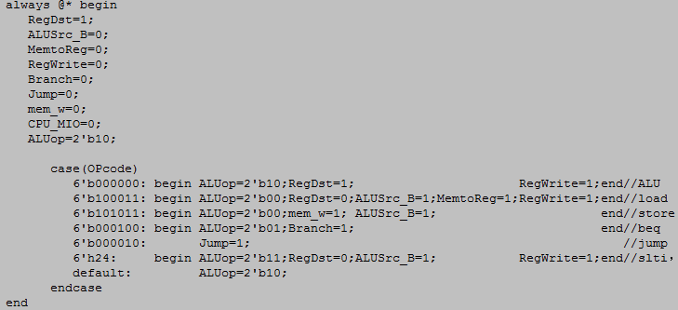
Main Controller Code

Slide 69
Designing the ALU decoder
Second level
Must describe hardware to compute 3-bit ALU control input
Instruction opcode | ALUop | Instruction operation | Funct field | Desired ALU action | ALU control Input
LW | 00 | Load word | xxxxxx | Load word | 0010
SW | 00 | Store word | xxxxxx | Store word | 0010
Beq | 01 | branch equal | xxxxxx | branch equal | 0110
R-type | 10 | add | 100000 | add | 0010
R-type | 10 | subtract | 100010 | subtract | 0110
R-type | 10 | AND | 100100 | AND | 0000
R-type | 10 | OR | 100101 | OR | 0001
R-type | 10 | Set on less than | 101010 | Set on less than | 0111
 | 10 | NOR | 100111 | NOR | 0100

Slide 70
Truth Table for ALU decoder
Describe it using a truth table (can turn into gates):
don’t care

Slide 71
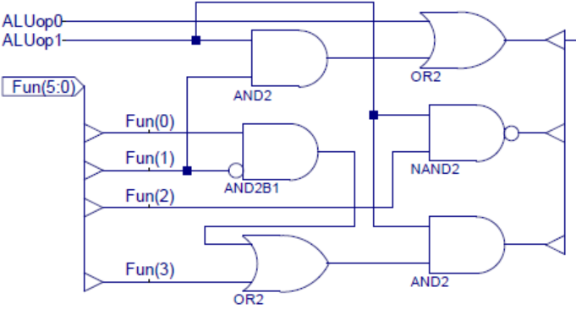
The ALU control signals -- logic circuit
F₁F₀
F₃F₂
F₁
0 | x | x | 1
0 | 0 | 1 | x
x | x | x | x
x | x | x | 1
F₁F₀
F₃F₂
F₂
1 | x | x | 1
0 | 0 | 0 | X
x | x | x | X
1 | x | x | 1
F₀F₁
F₁F₀
F₃F₂
0 | x | x | 0
0 | 1 | 0 | X
x | x | x | X
x | x | x | 1
F₃

Slide 72
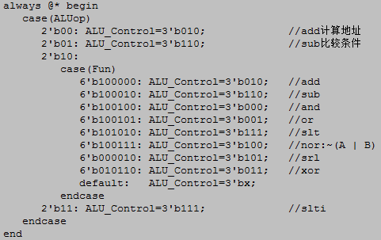
ALU Controller Code

Slide 73
The Datapath in operation for R-type
Instruction [25-0]
Shift
left 2
jump address[31-0]
0
M
U
X
1
1
M
U
X
0
26
28
PC+4[31-28]
Add
ALU
result
Shift
left 2
Add
4
Control
RegDst
Branch
MemRead
MemtoRead
ALUOp
MemWrite
ALUSrc
RegWrite
jump
Instruction [31-26]
pc
Read
address
Instruction
[31-0]
Instruction [25-21]
Read
register 1
Read
data 1
Instruction
memory
Instruction [20-16]
Zero
Read
register 2
ALU
Address
1
M
U
X
0
0
M
U
X
1
ALU
result
Read
data
Write
register
Read
data 2
0
M
U
X
1
add sub and or slt
R-type
Op | rs | rt | rd | shamt | Funct
Write
data
Data
memory
Instruction [15-11]
Registers
Write
data
I-type
Op | rs | rt | Immediate
16
Sign
extend
32
ALU
control
Instruction [15-0]
Jump-type
Op | address
Instruction [5-0]

Slide 74
The Datapath in operation for load
Instruction [25-0]
Shift
left 2
jump address[31-0]
0
M
U
X
1
1
M
U
X
0
26
28
PC+4[31-28]
Add
ALU
result
Shift
left 2
Add
4
Control
RegDst
Branch
MemRead
MemtoRead
ALUOp
MemWrite
ALUSrc
RegWrite
jump
Instruction [31-26]
pc
Read
address
Instruction
[31-0]
Instruction [25-21]
Read
register 1
Read
data 1
Instruction
memory
Instruction [20-16]
Zero
Read
register 2
ALU
Address
1
M
U
X
0
0
M
U
X
1
ALU
result
Read
data
load instruction
Write
register
Read
data 2
0
M
U
X
1
R-type
Op | rs | rt | rd | shamt | Funct
Write
data
Data
memory
Instruction [15-11]
Registers
Write
data
I-type
Op | rs | rt | Immediate
16
Sign
extend
32
ALU
control
Instruction [15-0]
Jump-type
Op | address
Instruction [5-0]

Slide 75
The Datapath in operation for store
Instruction [25-0]
Shift
left 2
jump address[31-0]
0
M
U
X
1
1
M
U
X
0
26
28
PC+4[31-28]
Add
ALU
result
Shift
left 2
Add
4
Control
RegDst
Branch
MemRead
MemtoRead
ALUOp
MemWrite
ALUSrc
RegWrite
jump
Instruction [31-26]
pc
Read
address
Instruction
[31-0]
Instruction [25-21]
Read
register 1
Read
data 1
Instruction
memory
Instruction [20-16]
Zero
Read
register 2
ALU
Address
1
M
U
X
0
0
M
U
X
1
ALU
result
Read
data
store instruction
Write
register
Read
data 2
0
M
U
X
1
R-type
Op | rs | rt | rd | shamt | Funct
Data
memory
Write
data
Instruction [15-11]
Registers
Write
data
I-type
Op | rs | rt | Immediate
Sign
extend
ALU
control
Instruction [15-0]
16
32
Jump-type
Op | address
Instruction [5-0]

Slide 76
The Datapath in operation for beq
Instruction [25-0]
Shift
left 2
jump address[31-0]
0
M
U
X
1
1
M
U
X
0
26
28
PC+4[31-28]
Add
ALU
result
Shift
left 2
Add
4
Control
RegDst
Branch
MemRead
MemtoRead
ALUOp
MemWrite
ALUSrc
RegWrite
jump
Instruction [31-26]
pc
Read
address
Instruction
[31-0]
Instruction [25-21]
Read
register 1
Read
data 1
Instruction
memory
Instruction [20-16]
Zero
Read
register 2
ALU
Address
1
M
U
X
0
0
M
U
X
1
ALU
result
Read
data
beq instruction
Write
register
Read
data 2
0
M
U
X
1
R-type
Op | rs | rt | rd | shamt | Funct
Write
data
Data
memory
Instruction [15-11]
Registers
Write
data
I-type
Op | rs | rt | Immediate
16
Sign
extend
32
ALU
control
Instruction [15-0]
Jump-type
Op | address
Instruction [5-0]

Slide 77
j instruction
instruction format
  j Label
Implementation
  pc = pc_{28~31} ## 26bits-address × 4
000010/2
26 bits address

Slide 78
The Datapath in operation for Jump
Instruction [25-0]
Shift
left 2
jump address[31-0]
0
M
U
X
1
1
M
U
X
0
26
28
PC+4[31-28]
Add
ALU
result
Shift
left 2
Add
4
Control
RegDst
Branch
MemRead
MemtoRead
ALUOp
MemWrite
ALUSrc
RegWrite
jump
Instruction [31-26]
pc
Read
address
Instruction
[31-0]
Instruction [25-21]
Read
register 1
Read
data 1
Instruction
memory
Instruction [20-16]
Zero
Read
register 2
ALU
Address
0
M
U
X
1
0
M
U
X
1
ALU
result
Read
data
jump instruction
Write
register
Read
data 2
0
M
U
X
1
R-type
Op | rs | rt | rd | shamt | Funct
Write
data
Data
memory
Instruction [15-11]
Registers
I-type
Op | rs | rt | Immediate
Write
data
16
Sign
extend
32
ALU
control
Instruction [15-0]
Jump-type
Op | address
Instruction [5-0]

Slide 79
Single Cycle Implementation performance for lw
Calculate cycle time assuming negligible delays except:
  memory (2ns), ALU and adders (2ns), register file access (1ns)
2ns
1+1=2ns
2ns
2ns

Slide 80
Performance in Single Cycle Implementation
Let’s see the following table:
Instruction class | Instruction memory | Register read | ALU | Data memory | Register write | Total
R-format | 2 | 1 | 2 |  | 1 | 6 ns
Load word | 2 | 1 | 2 | 2 | 1 | 8 ns
Store word | 2 | 1 | 2 | 2 |  | 7 ns
Branch | 2 | 1 | 2 |  |  | 5 ns
Jump | 2 |  |  |  |  | 2 ns
The conclusion:
  Different instructions needs different time.
  The clock cycle must meet the need of the slowest instruction. So, some time will be wasted.

Slide 81

The CPU Performance Equation
CPU _{time}=I CPI τ

Slide 82



Slide 83
CPU performance is dependent upon three characteristics:
  clock cycle (or rate)
  clock cycles per instruction
  and instruction count.
It is difficult to change one parameter in complete isolation from others because the basic technologies involved in changing each characteristic are interdependent:
  Clock cycle time—Hardware technology and organization
  Clock cycle time—Hardware technology and organization
  Instruction count—Instruction set architecture and compiler technology

Slide 84


MIPS (million instruction per second)
The bigger the MIPS, the faster the machine.
Three problems with MIPS:
    MIPS is dependent on the instruction set, making it difficult to compare MIPS of computers with different instruction sets.
  MIPS varies between programs on the same computer.
  Most importantly, MIPS can vary inversely to performance!

Slide 85
Single Cycle Problems
what if we had a more complicated instruction like floating point?
  If so, the waste of time will be more serious.
wasteful of area. The reason is the following:
  Let’s see the instruction ‘mult’. This instruction needs to use the ALU repeatedly.
  But, in the single cycle implementation, one ALU can be used only once in one clock cycle.
  So, the instruction ‘mult’ will need many ALUs. The CPU will be very large.

Slide 86
One Solution for Single Cycle Problems
One Solution:
  Use a smaller cycle time
  Let different instructions take different numbers of cycles
a Multicycle datapath:

Slide 87
END

