Slide 1
Accident Analysis for Airline Business Revenue
Atanu Basak

Slide 2
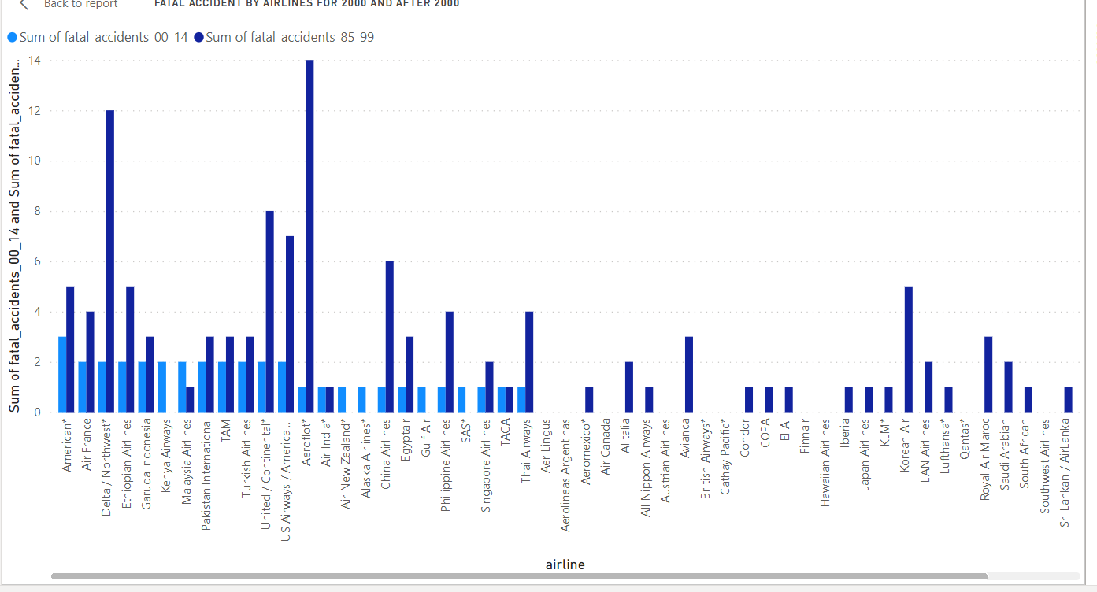
Airline Accident Analysis
When we do the accident analysis between two different year range, before 2000 and after 2000, the accident rates after 2000 are quite low compared to before 2000

Slide 3
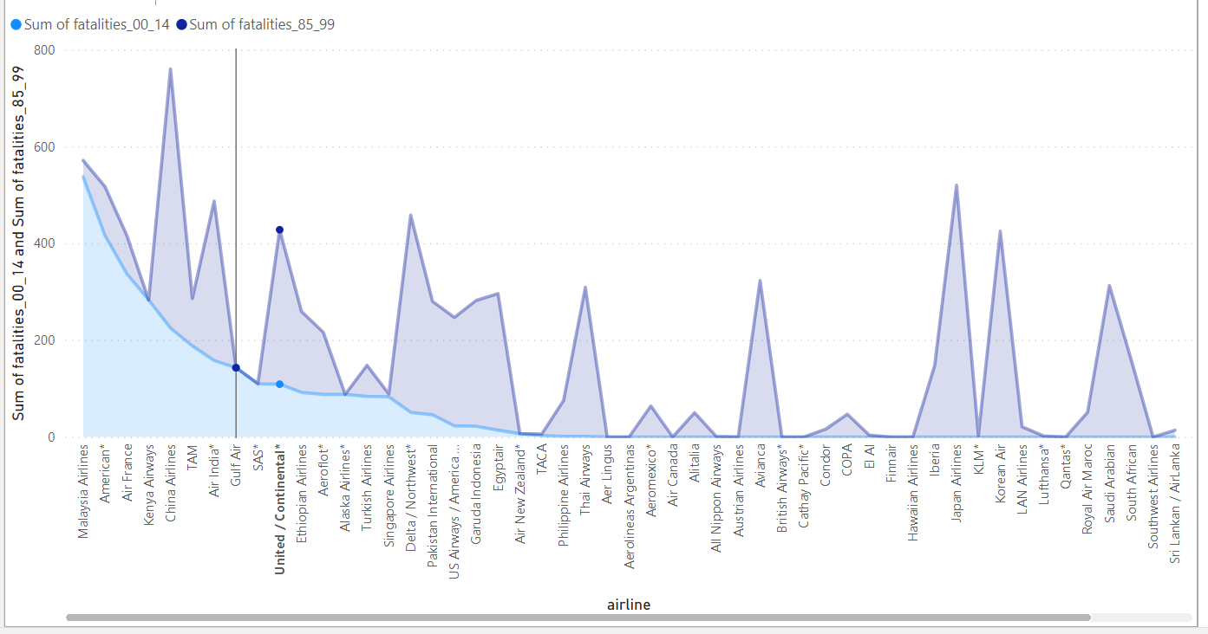
Fatality Analysis on Airlines
Similar scenario is there for fatality, is this diagram, it show the fatality for airline accidents before 2000 and after 2000, its quite high before 2000 and then it decreased after 2000.

Slide 4
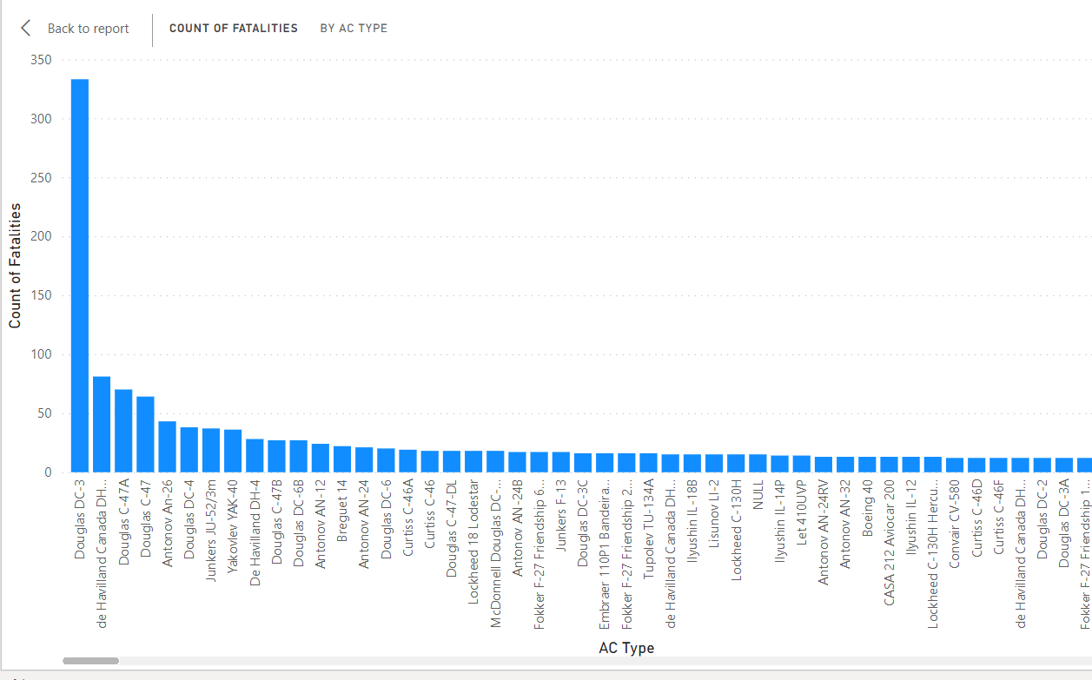
Impact of Air-Craft on Airline Accident
The Air-Craft plays a very important role, when we are talking about airline accidents. Not all Air-Crafts are of same quality. In this diagram a particular aircraft had a very high accident rate compared to others.

Slide 5
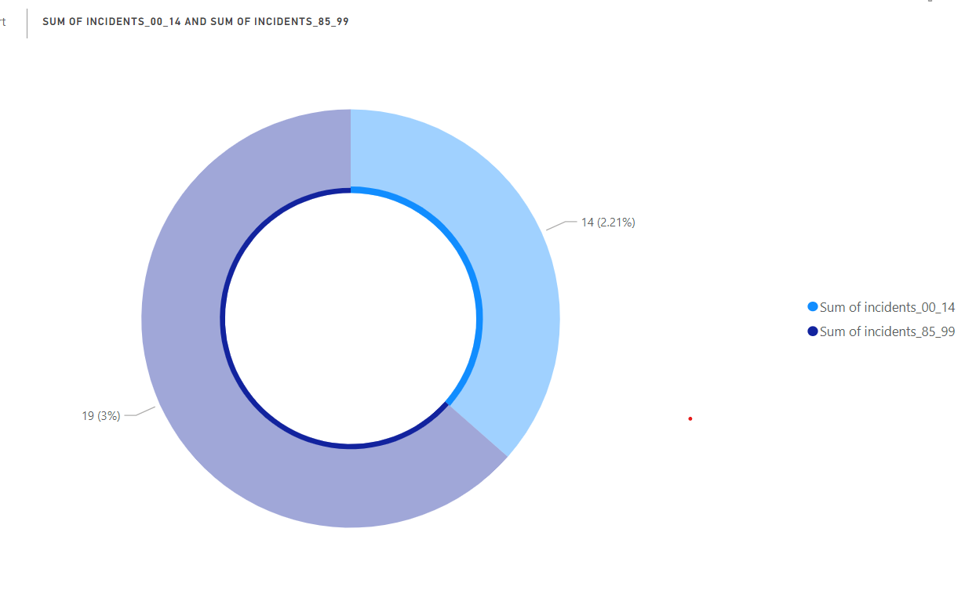
Airline Incidents
When we look at the airline incidents that happened before 2000 and after 2000, it shows the similar picture, the incident happening rates are quite high before 2000, after 2000 it got a huge improvement.

Slide 6
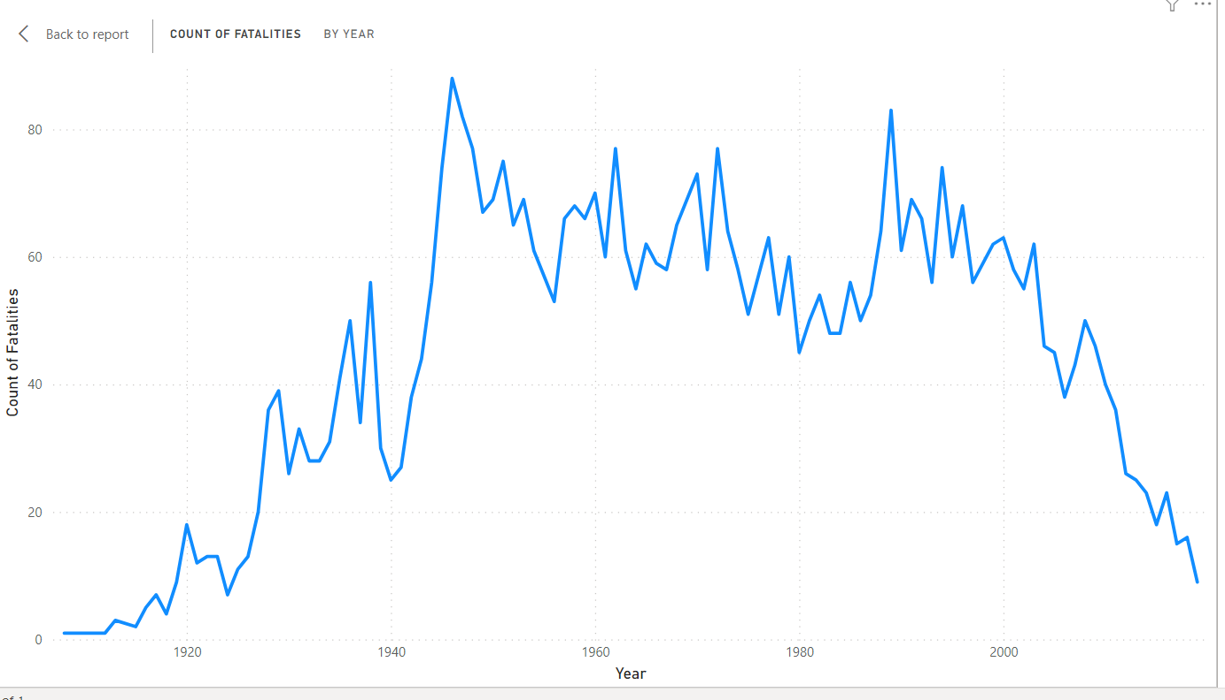
Fatality by year
This diagram shows the fatality by year from 1920. When we look at the overall diagram, the fatality rates quite increased in the middle, then slowly gradually decreased over the time starting from 1990 onwards.

Slide 7
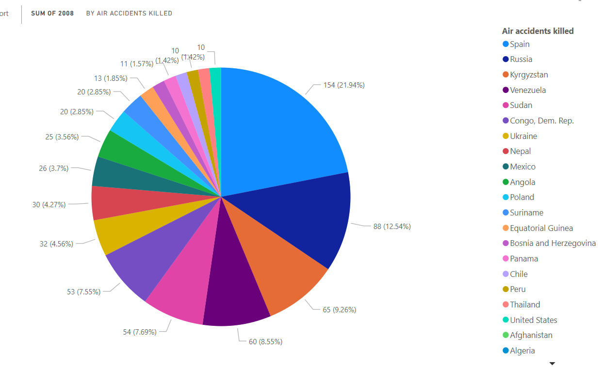
Accidents by Country
This diagram show the accident by country, the accident rate is not same for all countries. Some countries like Spain , Russia have very high rate of accident rate, where as other are quite low.

Slide 8
Conclusion
There is a huge industry for sales and revenue, for airline business, the accident counts and fatality counts are quite less, with the improvement of technology. All the above slides clearly show how improvement has been done on aircrafts and airline business. Its really a promising industry to grow fast.

