Slide 1
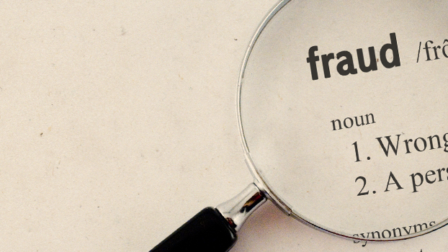
Fraud detection
Atanu Basak
This Photo by Unknown author is licensed under CC BY-NC-ND.

Slide 2
Business Problem
We do several transactions every day, in store to purchase things, in canteen for food, purchasing flight tickets etc. Transaction is involved everywhere. There are very minimum but some of the transactions that bank or credit card companies deal with are fraudulent. I am trying to fit a model on fraudulent transaction data, that I got in Kaggle.

Slide 3
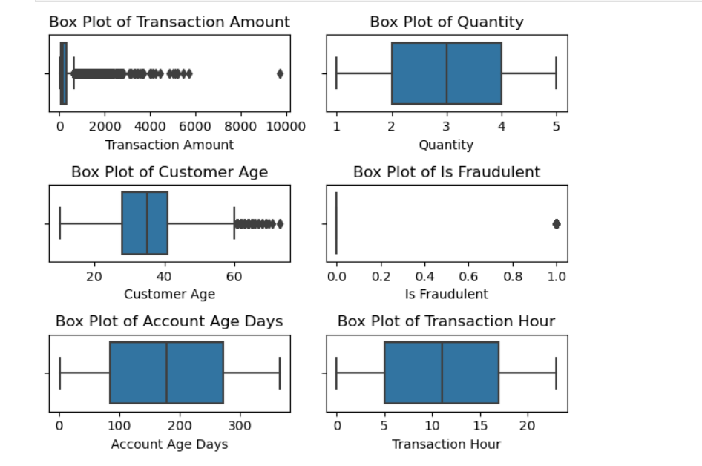
Numerical Feature Analysis
I plotted some box plots based on the numeric fields, among them I found the average quantity of transaction on only 3 and the amount of transaction is average around less than a thousand. The average days of accounts are around 200 days. The age of customer are average around 38. Lastly the transaction average hour is around 10AM, so major transaction happens between 8 am to 5PM.

Slide 4
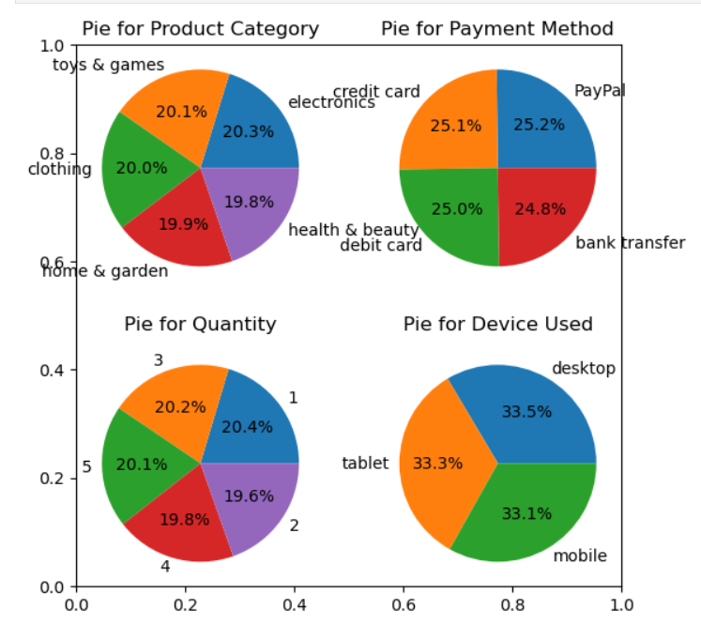
Categorical Feature Analysis
I also did some further analysis on categorical fields and plotted the PIE diagram for product category, payment methods, quantity and device used. All these categorical attributes are uniformly distributed among its category, that clearly shows in the pie diagram.

Slide 5
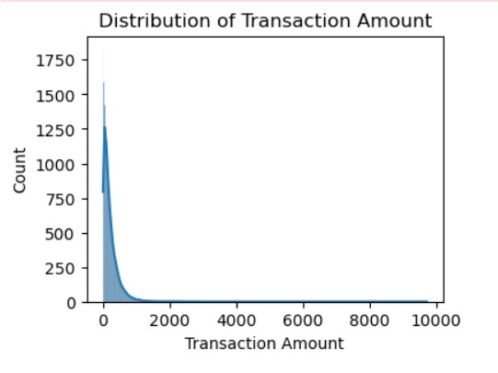
Transaction Amount
Here is the count distribution of transaction amount. Which shows most of the transaction are actually below 1000, there are very few transactions that are more than $2000.

Slide 6
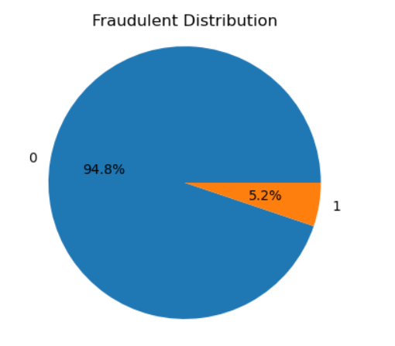
Fraud Distribution
The amount of frad is very low in the data, the pie diagram represents the same, only 5.2% records are identified as fraud.

Slide 7
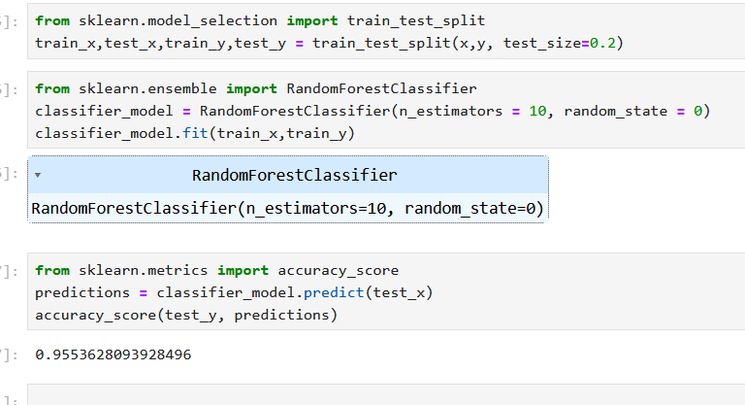
Model Fitting and Accuracy
I have split the data into 80/20 ratio for train and test, then fit the random forest classifier model on the train data. I have predicted the test data with the same model. I checked the accuracy of the model, which came as 95.53%, which means 95.53 % prediction on the test data are correct.

Slide 8
Ethical Assessment
‘Fraud’ is a very strong word, we have to be very careful and cautious before tagging a transaction with this flag, because its ways bring bad reputation to the customer. The transactions have personal identifiable information, so any false positives will bring bad reputation to the customer.
Another ethical concern is the reputation of banks and payment gateways like VISA, MASTERCARD, DISCOVERY etc., banks and payment gateways are very reputable organizations, any false positives may bring lots of questions on their security systems.

