Slide 1

HOUSE PRICE PREDICTION
ATANU BASAK

Slide 2
Business Problem
House Prices vary frequently, due to socio-economic factor changes. In is presentation I am trying to fit a model that will predict the price of the house depending on several factors.

Slide 3
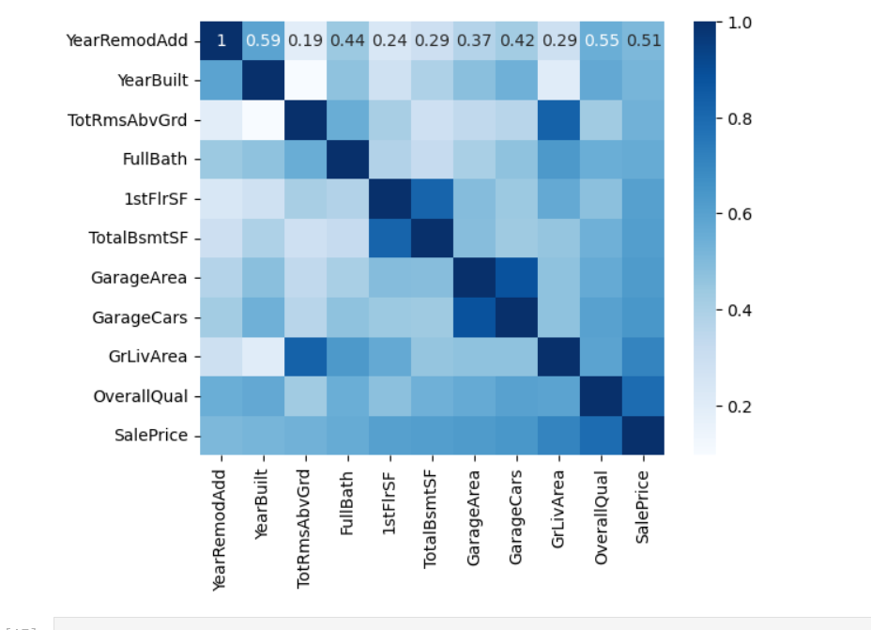
Numerical Feature Analysis
There are several numerical attributes are there, I have selected the variables, which has higher correlation with sales price.

Slide 4
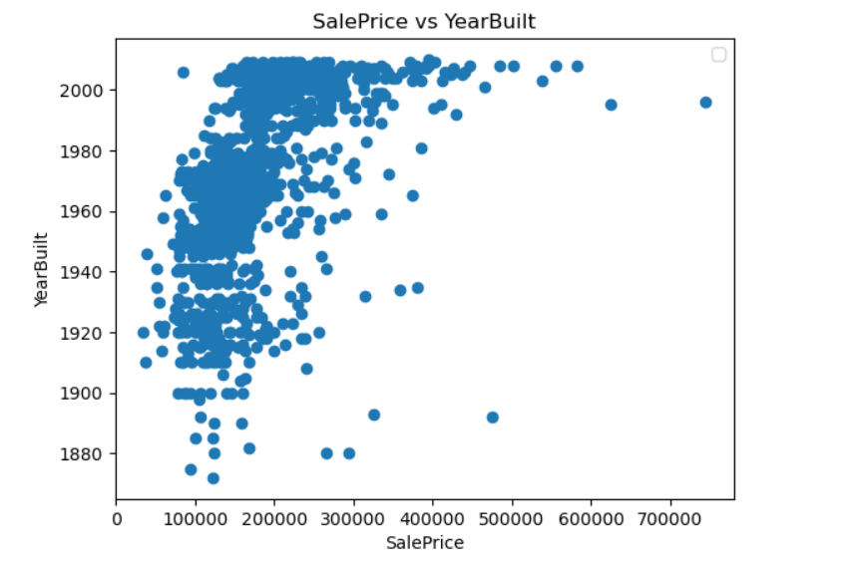
looking at the image, it clearly says year build has some effect but not completely drive the price of of the house.

Slide 5
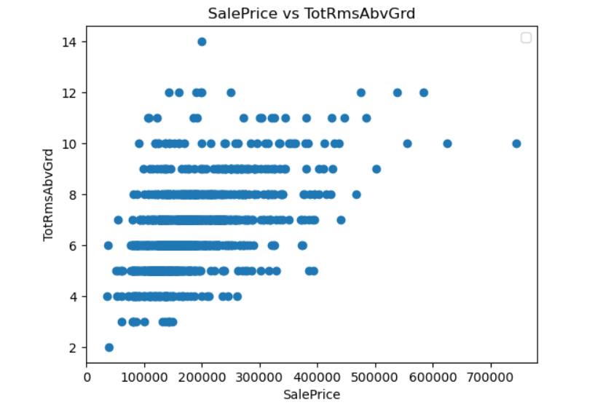
The number of rooms and number of full bathrooms have similar effects on house prices, if these increases, the house prices increase.

Slide 6
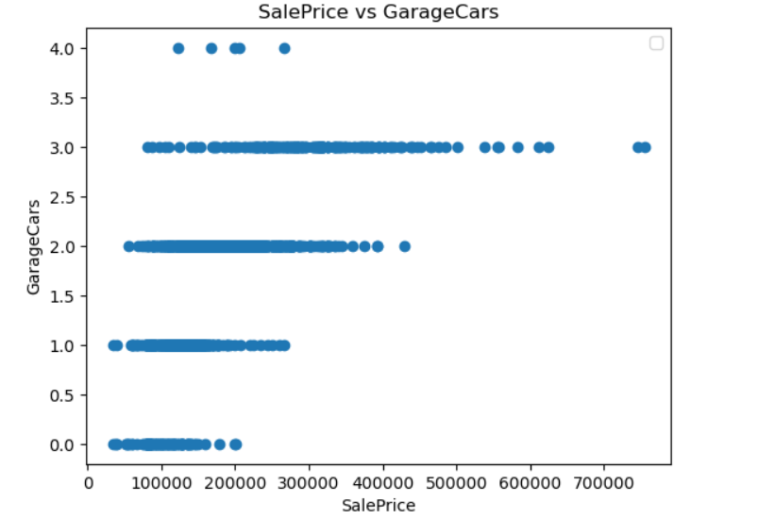
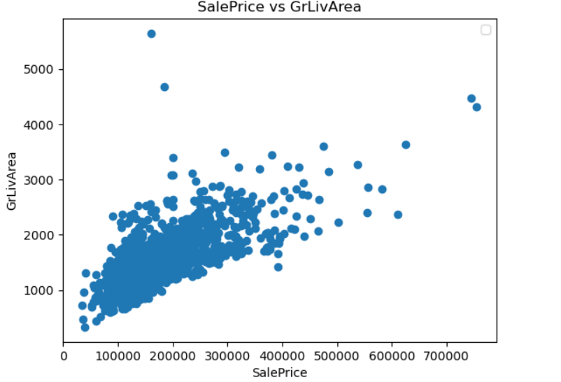
Sales Price relation with Garage and Living Area

Slide 7
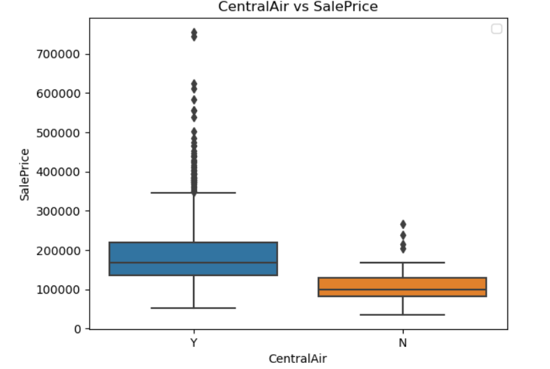
Houses with central air conditioning system have higher price value

Slide 8
XGBoost Regressor Model Fitting
We have split the model into 80 and 20 for train and test, then fit the XGBoost model into it after selecting some categorical and continuous variable. Then I test the model on test data. The R-squared Score came as 0.8852383252668263. Which means 88% of variance for the dependent variable can be explained by the independent variable in the model.

Slide 9
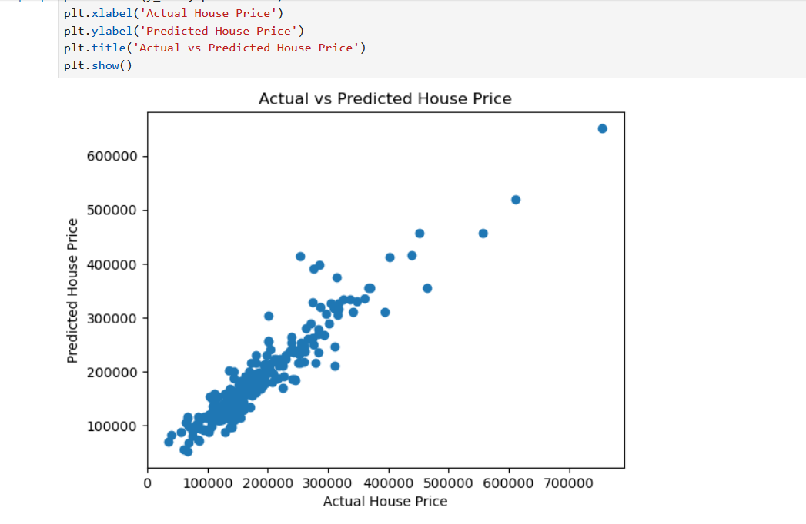
Model Accuracy
I have checked the accuracy of the model, but fitting the Actual vs Predicted House Price. Looking at the graph it looks like the fitting is quite accurate, as the predicted and actual house prices are similar. I can recommend this model showing the accuracy chart. This model can be used to predict the House Price.

Slide 10
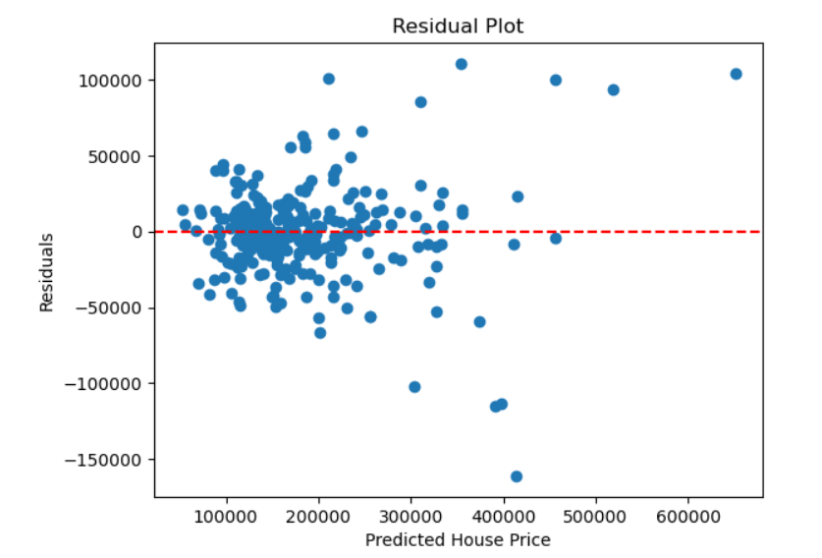
when a linear model is really a good fit, we expect to see no pattern in the residual plot. Our general principle when looking at residual plots, then, is that a residual plot with no pattern is good because it suggests that our use of a linear model is appropriate. In this case we are seeing the same, no pattern in the residual plot, so we can conclude that is a good fit.
Residual Plot

Slide 11
Ethical Assessment
There may be several ethical implications for house price perdition, as house price is an economic information, we must be very sure before publishing this in the outside world, there are several decisions, that can be made based on the estimated price. As the consumer knows the house that they want the prediction, consumers will have the address and other information about the location, now if the prediction came wrong, it would create a wrong impression about the locality and about the house. The owner of the house can be impacted by that.

