Slide 1
Computer Graphics 9:
Clipping In 3D

Slide 2
Contents
In today’s lecture we are going to have a look at some perspective view demos and investigate how clipping works in 3-D
  The clipping volume
  The zone labelling scheme
  3-D clipping
    Point clipping
    Line clipping
    Polygon clipping

Slide 3
3-D Clipping
Just like the case in two dimensions, clipping removes objects that will not be visible from the scene
The point of this is to remove computational effort
3-D clipping is achieved in two basic steps
  Discard objects that can’t be viewed
    i.e. objects that are behind the camera, outside the field of view, or too far away
  Clip objects that intersect with any clipping plane

Slide 4
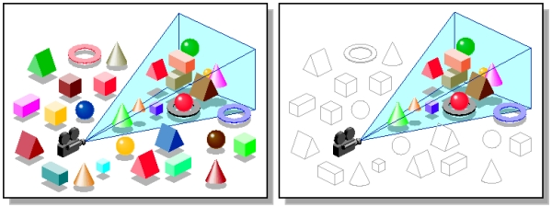
Discard Objects
Discarding objects that cannot possibly be seen involves comparing an objects bounding box/sphere against the dimensions of the view volume
  Can be done before or after projection

Slide 5
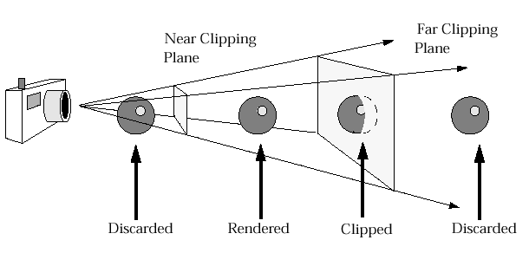
Clipping Objects
Objects that are partially within the viewing volume need to be clipped – just like the 2D case

Slide 6
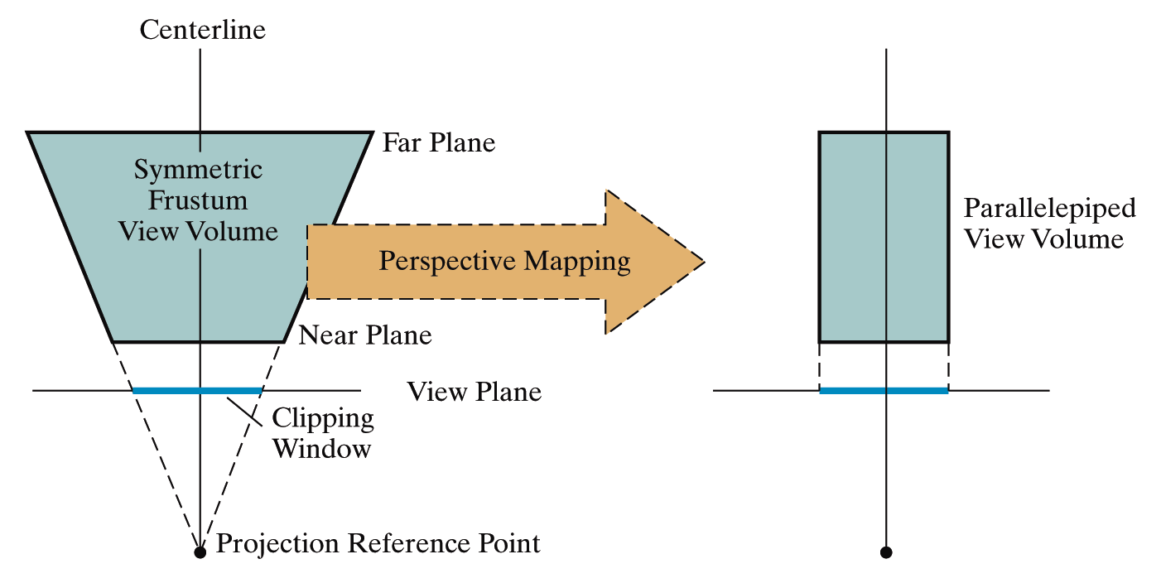
The Clipping Volume
After the perspective transformation is complete the frustum shaped viewing volume has been converted to a parallelopiped - remember we preserved all z coordinate depth information

Slide 7
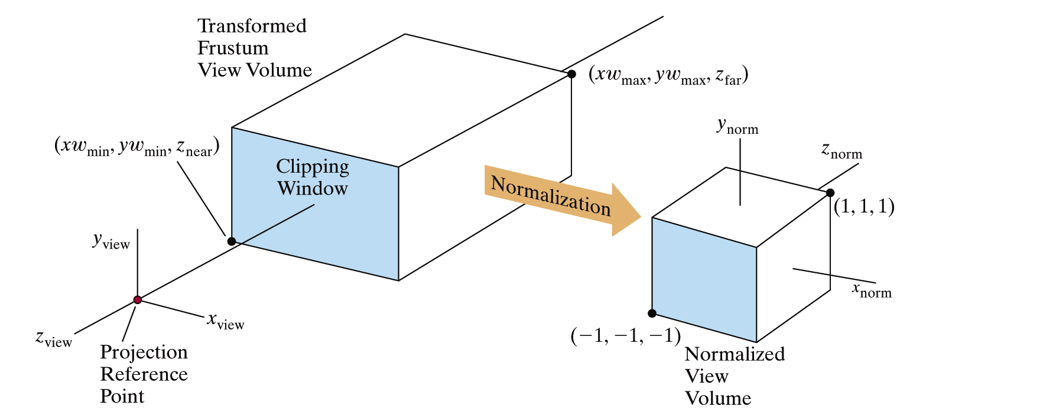
Normalisation
The transformed volume is then normalised around position (0, 0, 0) and the z axis is reversed

Slide 8
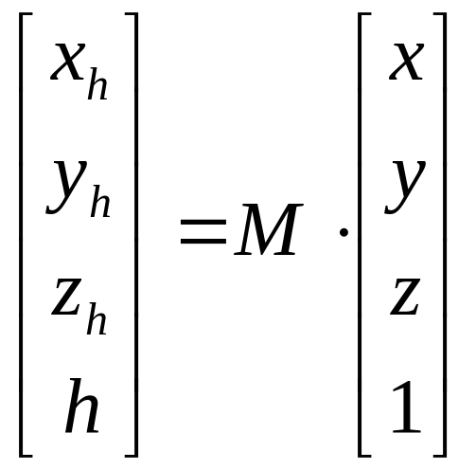
When Do We Clip?
We perform clipping after the projection transformation and normalisation are complete
So, we have the following:
We apply all clipping to these homogeneous coordinates

Slide 9
Dividing Up The World
Similar to the case in two dimensions, we divide the world into regions
This time we use a 6-bit region code to give us 27 different region codes
The bits in these regions codes are as follows:
bit 6 Far | bit 5 Near | bit 4 Top | bit 3 Bottom | bit 2 Right | bit 1 Left

Slide 10
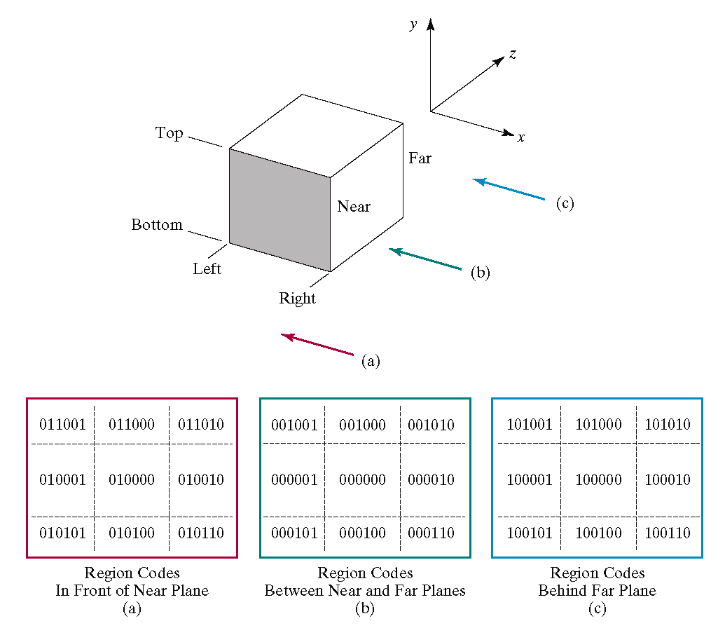
Region Codes

Slide 11
Point Clipping
Point clipping is trivial so we won’t spend any time on it

Slide 12
Line Clipping
To clip lines we first label all end points with the appropriate region codes
We can trivially accept all lines with both end-points in the [000000] region
We can trivially reject all lines whose end points share a common bit in any position
  This is just like the 2 dimensional case as these lines can never cross the viewing volume
  In the example that follows the line from P₃[010101] to P₄[100110] can be rejected

Slide 13
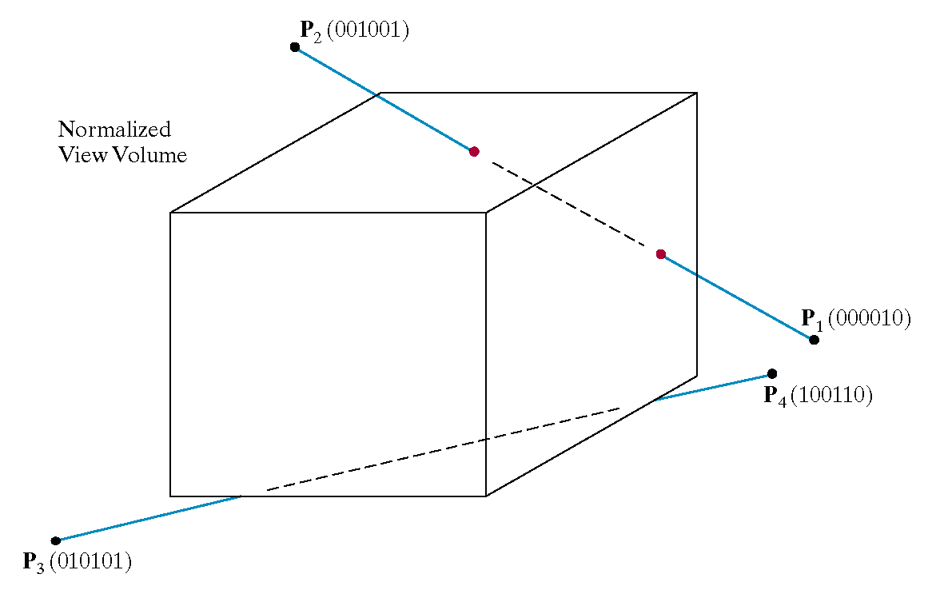
Line Clipping Example

Slide 14
3D Line Clipping Example
Consider the line P₁[000010] to P₂[001001]
Because the lines have different values in bit 2 we know the line crosses the right boundary

Slide 15
3D Line Clipping Example (cont…)
When then simply continue as per the two dimensional line clipping algorithm

Slide 16
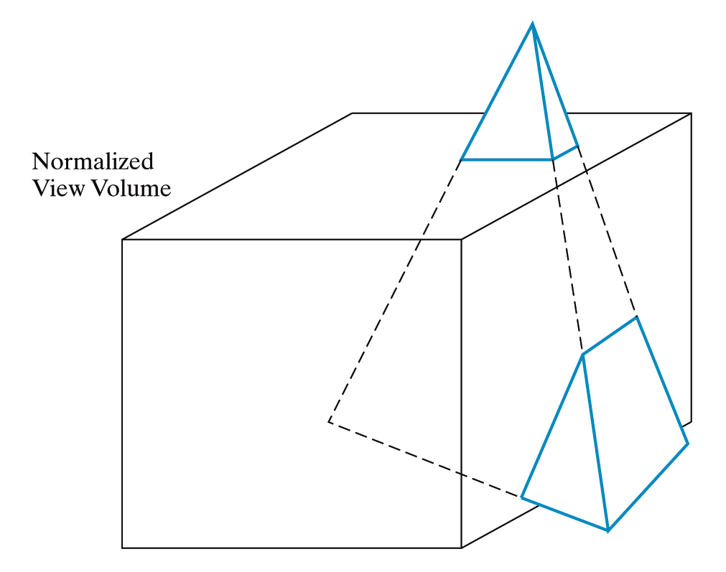
3D Polygon Clipping
However the most common case in 3D clipping is that we are clipping graphics objects made up of polygons

Slide 17
3D Polygon Clipping (cont…)
In this case we first try to eliminate the entire object using its bounding volume
Next we perform clipping on the individual polygons using the Sutherland-Hodgman algorithm we studied previously

Slide 18
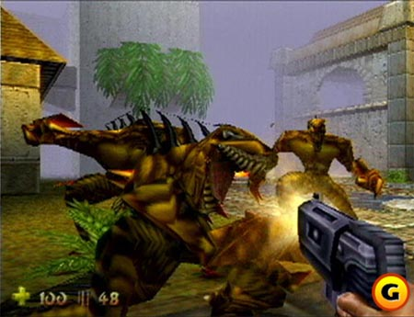
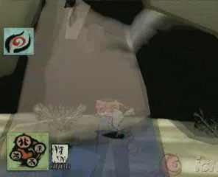
Cheating with Clipping Planes
For far clipping plane introduce something to obscure far away objects – fog
Make objects very near the camera transparent

Slide 19
Summary
In today’s lecture we examined how clipping is achieved in 3-D

