Slide 1
Computer Graphics 15:
More Surface Detection Methods

Slide 2
Contents
Today we will continue to look at visible surface detection methods:
  Depth-sorting method
  Other methods
We will also compare the different techniques we have studied and suggest when different techniques should be employed

Slide 3
Depth-Sorting Method
A visible surface detection method that uses both image-space and object-space operations
Basically, the following two operations are performed
  Surfaces are sorted in order of decreasing depth
  Surfaces are scan-converted in order, starting with the surface of greatest depth
The depth-sorting method is often also known as the painter’s method

Slide 4
Depth-Sorting Method (cont…)
First, assume that we are viewing along the z direction
All surfaces in the scene are ordered according to the smallest z value on each surface
The surface S at the end of the list is then compared against all other surfaces to see if there are any depth overlaps
If no overlaps occur then the surface is scan converted as before and the process repeats with the next surface

Slide 5
Depth Overlapping
z
z
z_{max}
z_{max}
S
S
z’_{max}
z_{min}
S’
z’_{max}
z_{min}
S’
z’_{min}
z’_{min}
x
x
No Depth Overlap
Depth Overlap

Slide 6
Depth-Sorting Method (cont…)
When there is depth overlap, we make the following tests:
  The bounding rectangles for the two surfaces do no overlap
  Surface S is completely behind the overlapping surface relative to the viewing position
  The overlapping surface is completely in front of S realtive to the viewing position
  The boundary edge projections of the two surfaces onto the view plane do not overlap

Slide 7
Depth-Sorting Method (cont…)
The tests are performed in the order listed and as soon as one is true we move on to the next surface
If all tests fail then we swap the orders of the surfaces

Slide 8
Other Techniques
There are a number of other techniques all based around are division
  BSP-Tree Method
  Area-Subdivision Method
  Octree Methods
Raycastig can also be used

Slide 9
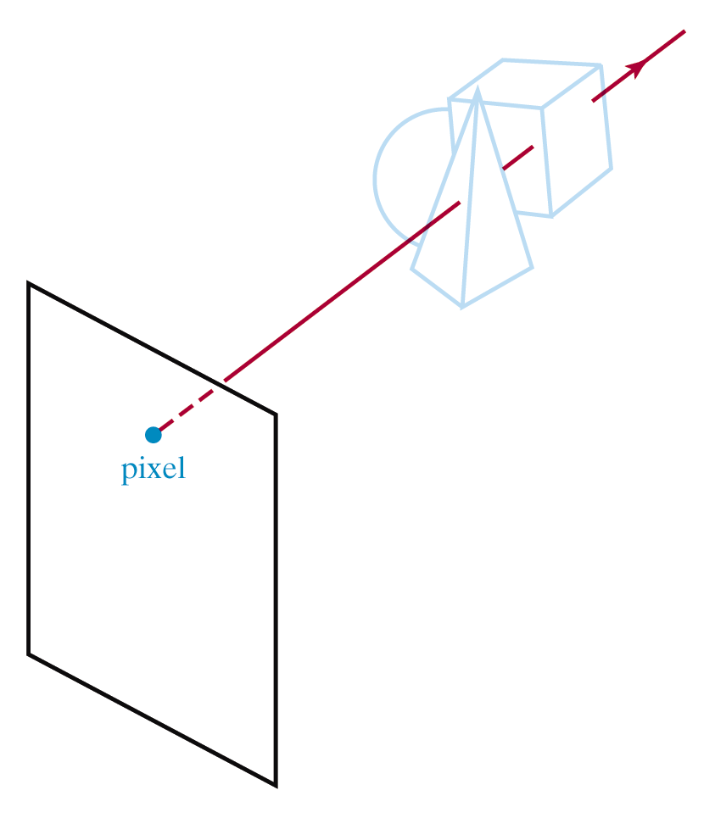
Ray-Casting

Slide 10
Comparison Of Visibility-Detection Methods
When few surfaces are present either the depth sorting algorithm or the BSP tree method tend to perform best
Scan-line also performs well in these situations – up to a several thousand polygon surfaces
The depth buffer method tends to scale linearly, so that for low numbers of polygons its performance is poor, but it is used for higher numbers of polygons.

Slide 11
Summary
We need to make sure that we only draw visible surfaces when rendering scenes

