Slide 1
CSE/PC/B/T/316 Computer Networks Topic 16- Transport Layer Process-to-Process Delivery: UDP
Sarbani Roy
sarbani.roy@jadavpuruniversity.in
Office: CC-5-7
Cell: 9051639328

Slide 2
PROCESS-TO-PROCESS DELIVERY
The transport layer is responsible for process-to-process delivery—the delivery of a packet, part of a message, from one process to another. Two processes communicate in a client/server relationship, as we will see later.
Topics discussed in this section:
Client/Server Paradigm Multiplexing and Demultiplexing
Connectionless Versus Connection-Oriented Service
Reliable Versus Unreliable
Three Protocols

Slide 3

Note
The transport layer is responsible for process-to-process delivery.

Slide 4
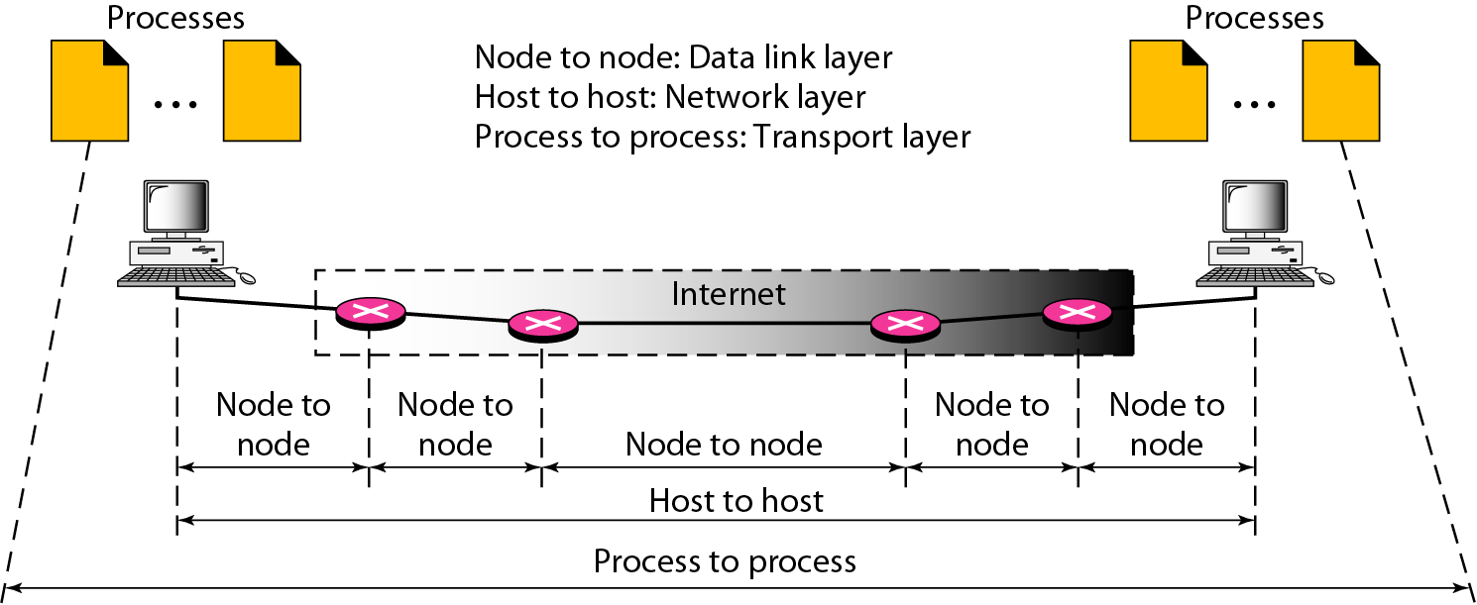
Types of data deliveries

Slide 5
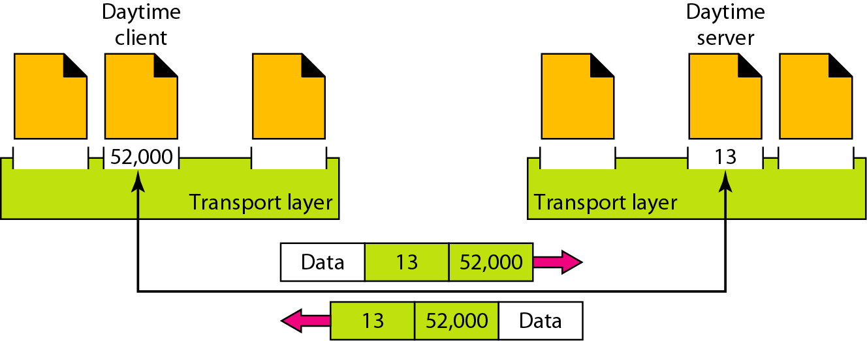
Port numbers

Slide 6
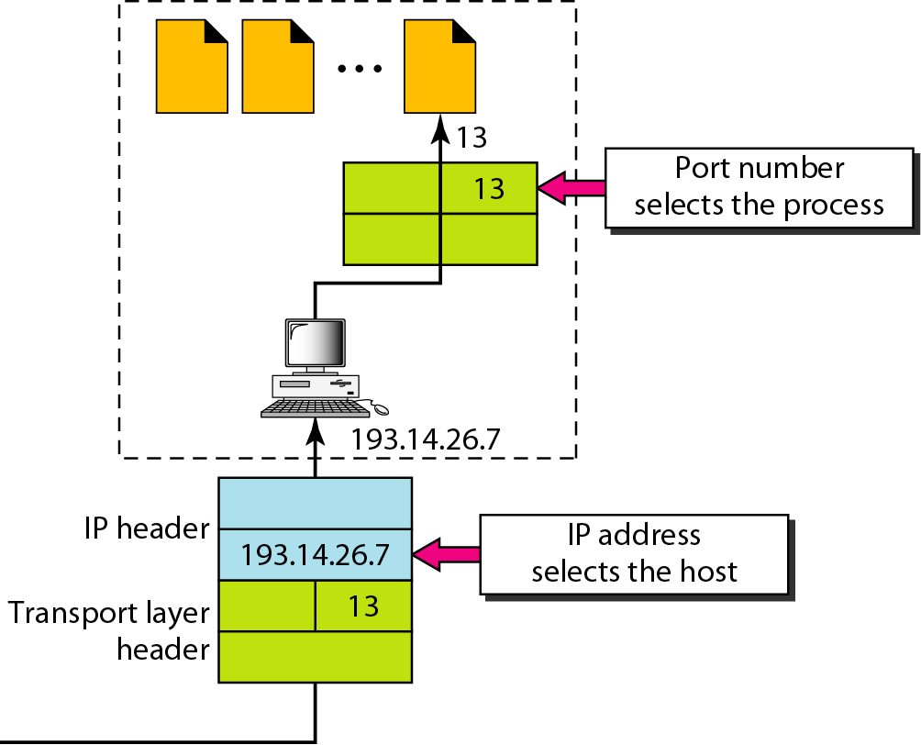
IP addresses versus port numbers

Slide 7
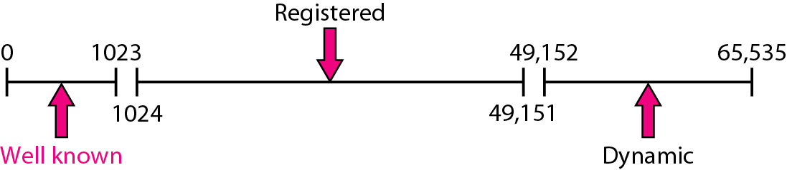
IANA ranges

Slide 8
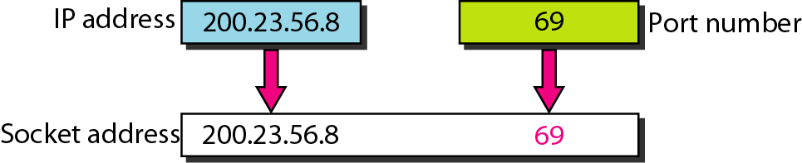
Socket address

Slide 9
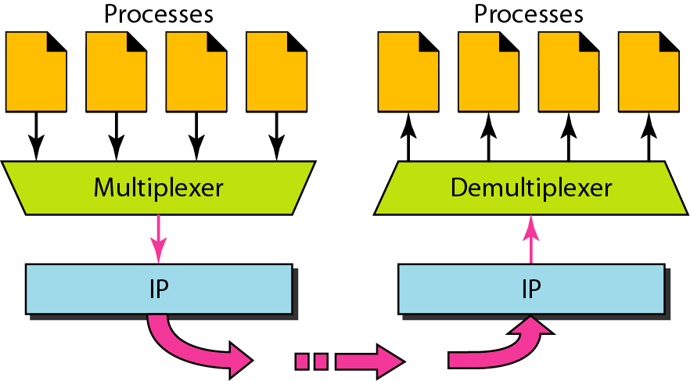
Multiplexing and demultiplexing

Slide 10
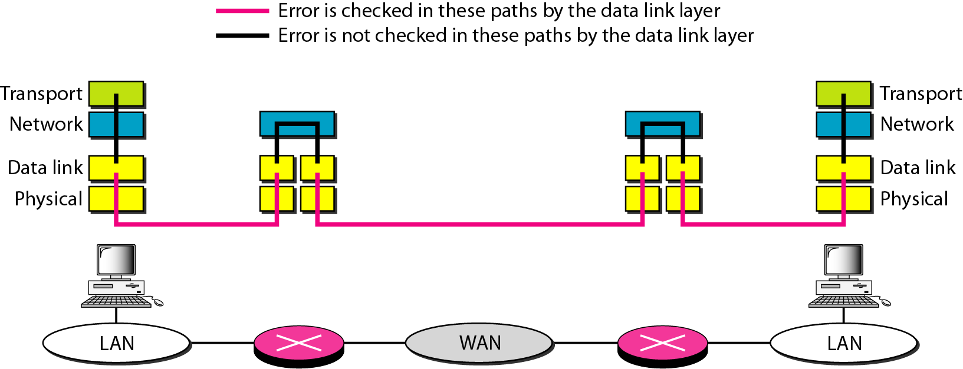
Error control

Slide 11
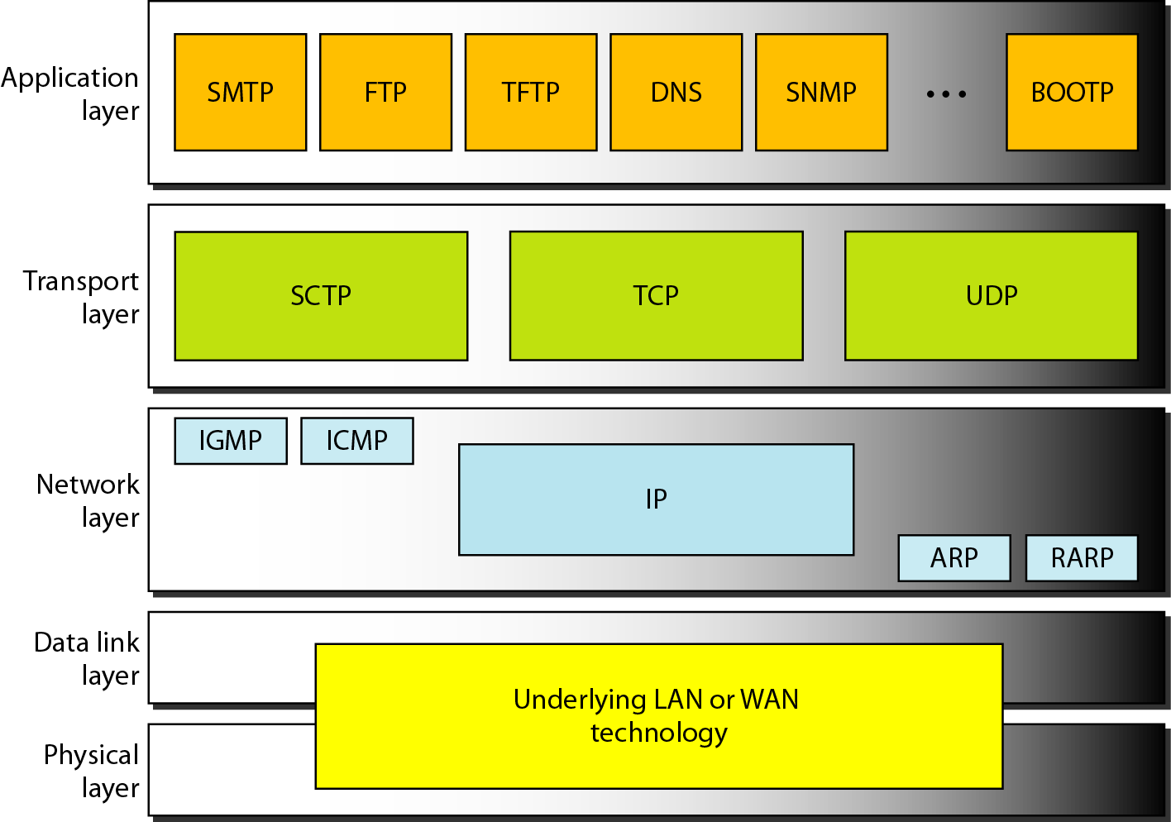
Position of UDP, TCP, and SCTP in TCP/IP suite

Slide 12
USER DATAGRAM PROTOCOL (UDP)
The User Datagram Protocol (UDP) is called a connectionless, unreliable transport protocol. It does not add anything to the services of IP except to provide process-to-process communication instead of host-to-host communication.
Topics discussed in this section:
Well-Known Ports for UDP User Datagram
Checksum
UDP Operation
Use of UDP

Slide 13
Well-known ports used with UDP

Slide 14
Example
In UNIX, the well-known ports are stored in a file called /etc/services. Each line in this file gives the name of the server and the well-known port number. We can use the
grep utility to extract the line corresponding to the desired application. The following shows the port for FTP. Note that FTP can use port 21 with either UDP or TCP.

Slide 15
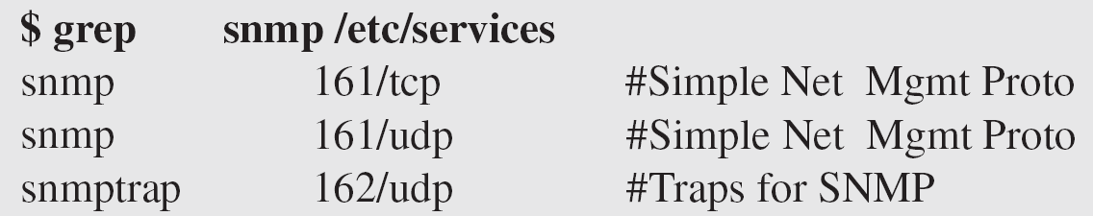
Example (continued)
SNMP uses two port numbers (161 and 162), each for a different purpose.

Slide 16
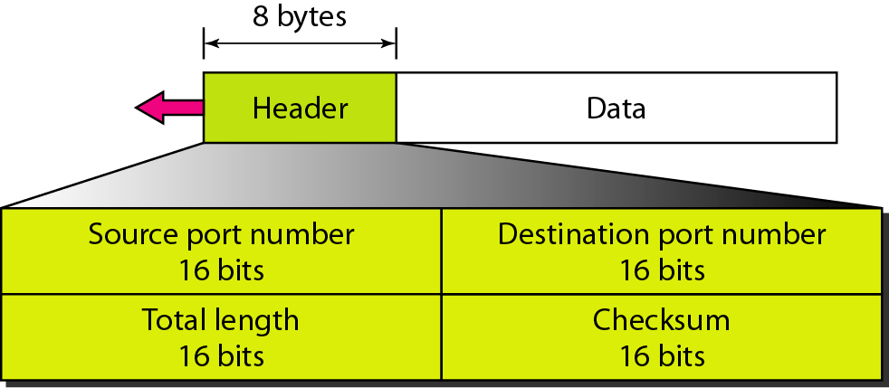
Figure User datagram format

Slide 17
Note
UDP length = IP length – IP header’s length

Slide 18
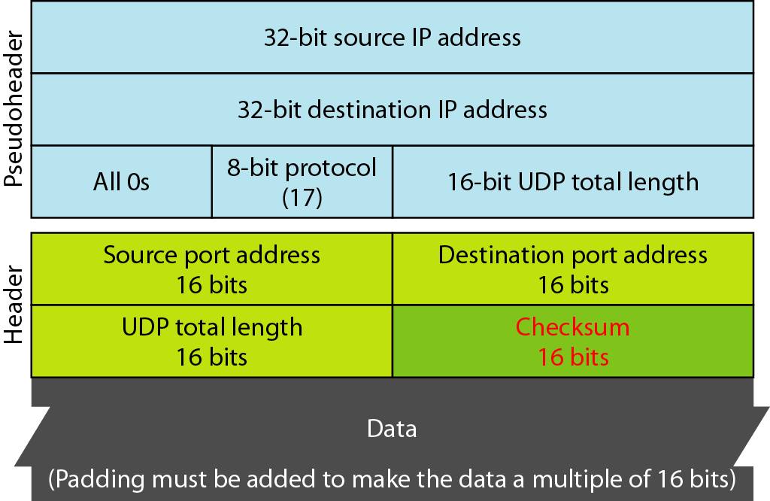
Figure Pseudoheader for checksum calculation

Slide 19
Example
Figure shows the checksum calculation for a very small user datagram with only 7 bytes of data. Because the number of bytes of data is odd, padding is added for checksum calculation. The pseudoheader as well as the padding will be dropped when the user datagram is delivered to IP.

Slide 20
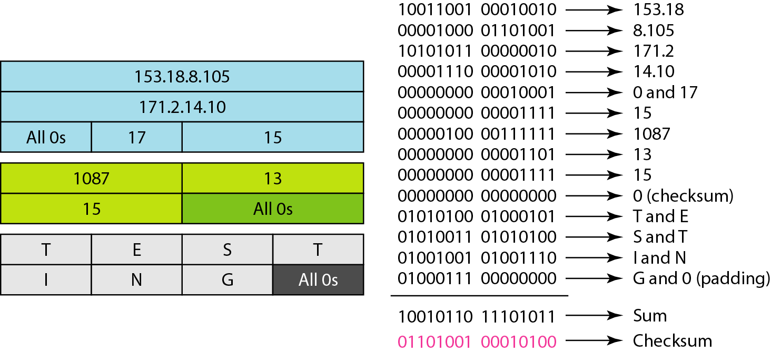
Figure Checksum calculation of a simple UDP user datagram

Slide 21
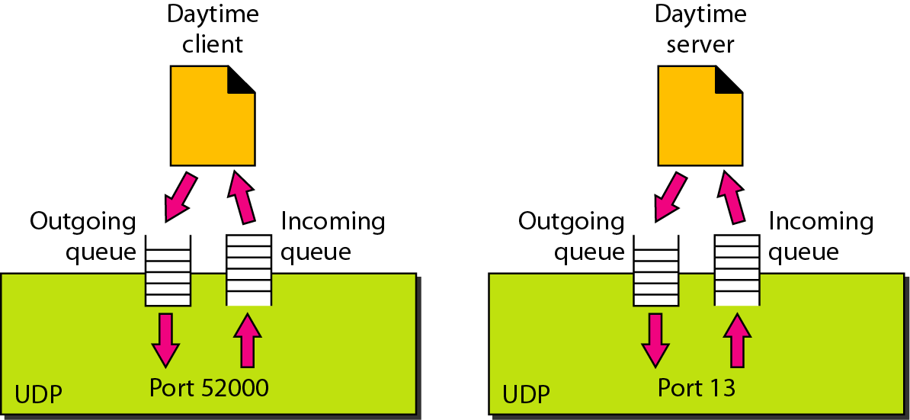
Figure Queues in UDP

Slide 22
Socket functional calls
socket (): Create a socket
bind(): bind a socket to a local IP address and port #
listen(): passively waiting for connections
connect(): initiating connection to another socket
accept(): accept a new connection
Write(): write data to a socket
Read(): read data from a socket
sendto(): send a datagram to another UDP socket
recvfrom(): read a datagram from a UDP socket
close(): close a socket (tear down the connection)

Slide 23
Internet Addressing Data Structure
#include <netinet/in.h>
/* Internet address structure */
struct in_addr {
u_long s_addr; /* 32-bit IPv4 address */
}; /* network byte ordered */
/* Socket address, Internet style. */
struct sockaddr_in {
u_char sin_family; /* Address Family */
u_short sin_port; /* UDP or TCP Port# */
/* network byte ordered */
struct in_addr sin_addr; /* Internet Address */
char sin_zero[8]; /* unused */
};
sin_family = AF_INET selects Internet address family

Slide 24
Byte Ordering
union {
u_int32_t addr; /* 4 bytes address */
char c[4];
} un;
/* 128.2.194.95 */
un.addr = 0x8002c25f;
/* c[0] = ? */
c[0] c[1] c[2] c[3]
Big Endian
Sun Solaris, PowerPC, ...
Little Endian
i386, alpha, ...
Network byte order = Big Endian
128
2
194
95
95
194
2
128

Slide 25
Byte Ordering Functions
Converts between host byte order and network byte order
‘h’ = host byte order
‘n’ = network byte order
‘l’ = long (4 bytes), converts IP addresses
‘s’ = short (2 bytes), converts port numbers
#include <netinet/in.h>
unsigned long int htonl(unsigned long int hostlong);
unsigned short int htons(unsigned short int hostshort);
unsigned long int ntohl(unsigned long int netlong);
unsigned short int ntohs(unsigned short int netshort);

Slide 26
UDP Server Example
For example: NTP daemon
What does a UDP server need to do so that a UDP client can connect to it?
NTP
daemon
Port 123
UDP
IP
Ethernet Adapter

Slide 27
Socket I/O: socket()
The UDP server must create a datagram socket…
int fd; /* socket descriptor */
if((fd = socket(AF_INET, SOCK_DGRAM, 0)) < 0) {
perror(“socket”);
exit(1);
}
socket returns an integer (socket descriptor)
fd < 0 indicates that an error occurred
AF_INET: associates a socket with the Internet protocol family
SOCK_DGRAM: selects the UDP protocol

Slide 28
Socket I/O: bind()
A socket can be bound to a port
int fd; /* socket descriptor */
struct sockaddr_in srv; /* used by bind() */
/* create the socket */
/* bind: use the Internet address family */
srv.sin_family = AF_INET;
/* bind: socket ‘fd’ to port 80*/
srv.sin_port = htons(80);
/* bind: a client may connect to any of my addresses */
srv.sin_addr.s_addr = htonl(INADDR_ANY);
if(bind(fd, (struct sockaddr*) &srv, sizeof(srv)) < 0) {
perror("bind"); exit(1);
}
Now the UDP server is ready to accept packets…

Slide 29
Socket I/O: recvfrom()
read does not provide the client’s address to the UDP server
int fd; /* socket descriptor */
struct sockaddr_in srv; /* used by bind() */
struct sockaddr_in cli; /* used by recvfrom() */
char buf[512]; /* used by recvfrom() */
int cli_len = sizeof(cli); /* used by recvfrom() */
int nbytes; /* used by recvfrom() */
/* 1) create the socket */
/* 2) bind to the socket */
nbytes = recvfrom(fd, buf, sizeof(buf), 0 /* flags */,
(struct sockaddr*) &cli, &cli_len);
if(nbytes < 0) {
perror(“recvfrom”); exit(1);
}

Slide 30
Socket I/O: recvfrom() continued...
nbytes = recvfrom(fd, buf, sizeof(buf), 0 /* flags */,
(struct sockaddr*) cli, &cli_len);
The actions performed by recvfrom
returns the number of bytes read (nbytes)
copies nbytes of data into buf
returns the address of the client (cli)
returns the length of cli (cli_len)
don’t worry about flags

Slide 31
UDP Client Example
How does a UDP client communicate with a UDP server?
2 UDP Clients
ports
UDP
IP
Ethernet Adapter

Slide 32
Socket I/O: sendto()
write is not allowed
Notice that the UDP client does not bind a port number
a port number is dynamically assigned when the first sendto is called
int fd; /* socket descriptor */
struct sockaddr_in srv; /* used by sendto() */
/* 1) create the socket */
/* sendto: send data to IP Address “128.2.35.50” port 80 */
srv.sin_family = AF_INET;
srv.sin_port = htons(80);
srv.sin_addr.s_addr = inet_addr(“128.2.35.50”);
nbytes = sendto(fd, buf, sizeof(buf), 0 /* flags */,
(struct sockaddr*) &srv, sizeof(srv));
if(nbytes < 0) {
perror(“sendto”); exit(1);
}

Slide 33
Review: UDP Client-Server Interaction
UDP Server
socket()
bind()
UDP Client
recvfrom()
socket()
blocks until datagram received from a client
sendto()
data request
data reply
sendto()
recvfrom()
close()
from UNIX Network Programming Volume 1, figure 8.1

Slide 34
TCP
TCP is a connection-oriented protocol; it creates a virtual connection between two TCPs to send data. In addition, TCP uses flow and error control mechanisms at the transport level.
Topics discussed in this section:
TCP Services TCP Features
Segment
A TCP Connection
Flow Control
Error Control

Slide 35
Table Well-known ports used by TCP

Slide 36
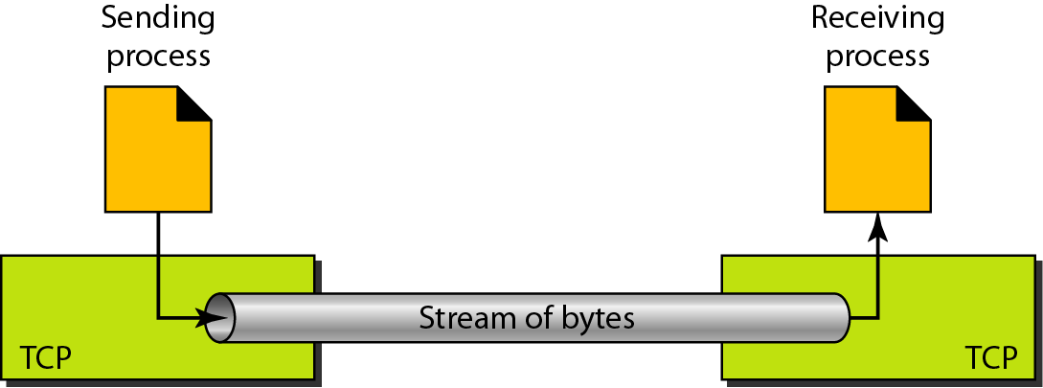
Figure Stream delivery

Slide 37
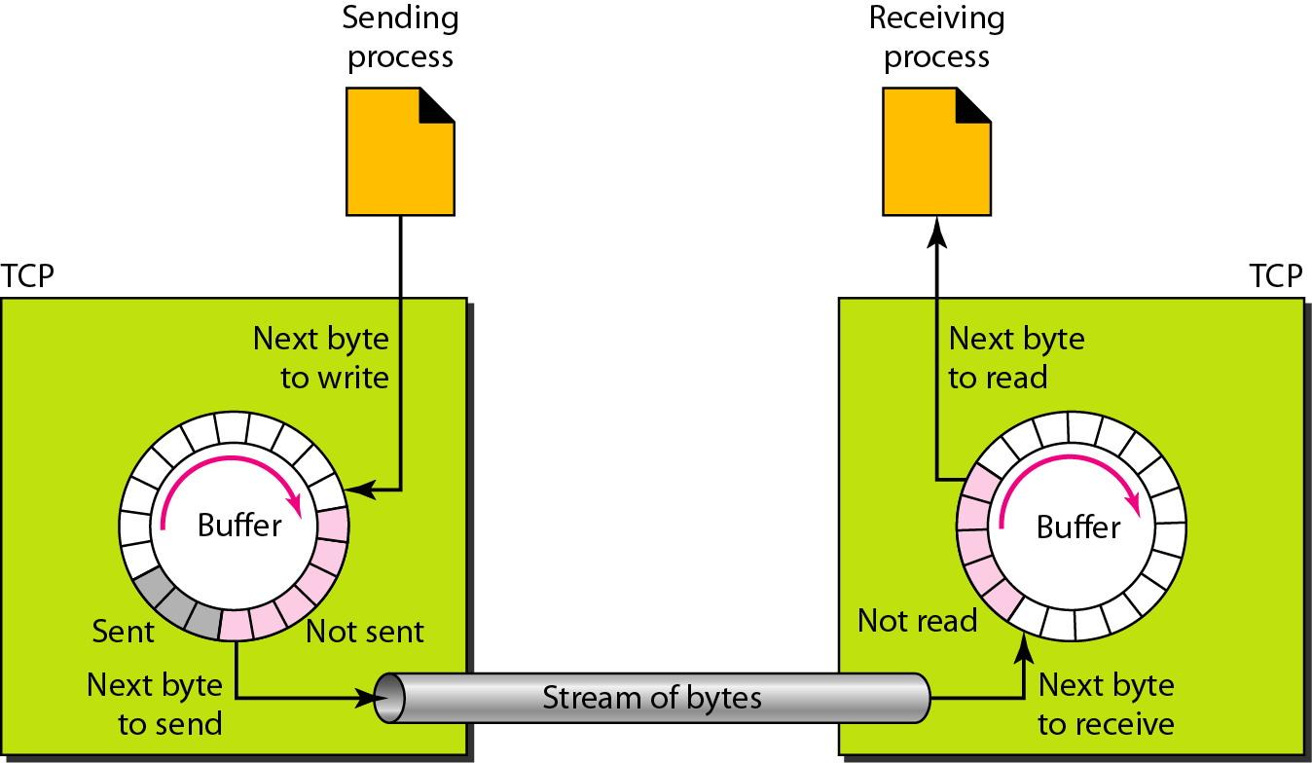
Figure Sending and receiving buffers

Slide 38
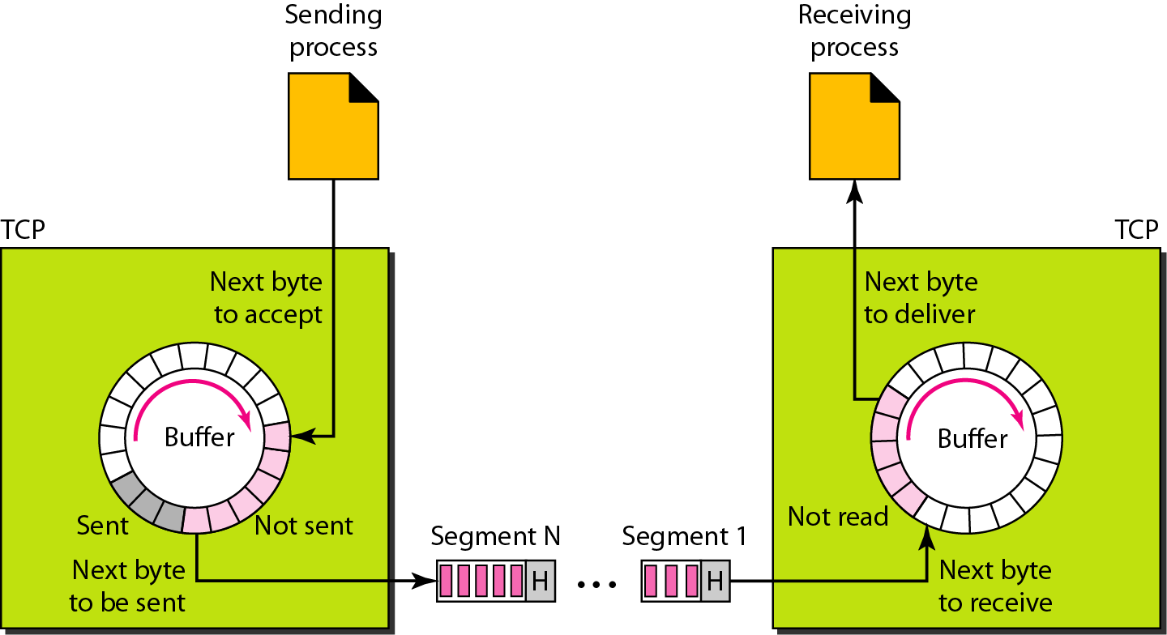
Figure TCP segments

Slide 39
Note
The bytes of data being transferred in each connection are numbered by TCP.
The numbering starts with a randomly generated number.

Slide 40
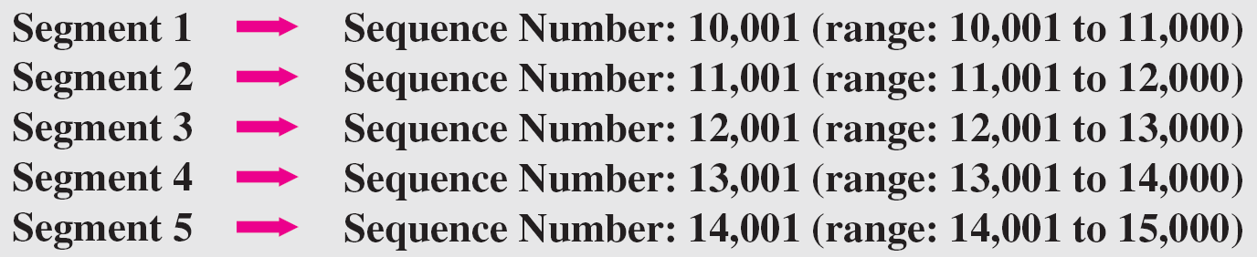
Example
The following shows the sequence number for each segment:

Slide 41
Note
The value in the sequence number field of a segment defines the
number of the first data byte contained in that segment.

Slide 42
Note
The value of the acknowledgment field in a segment defines
the number of the next byte a party expects to receive.
The acknowledgment number is cumulative.

Slide 43
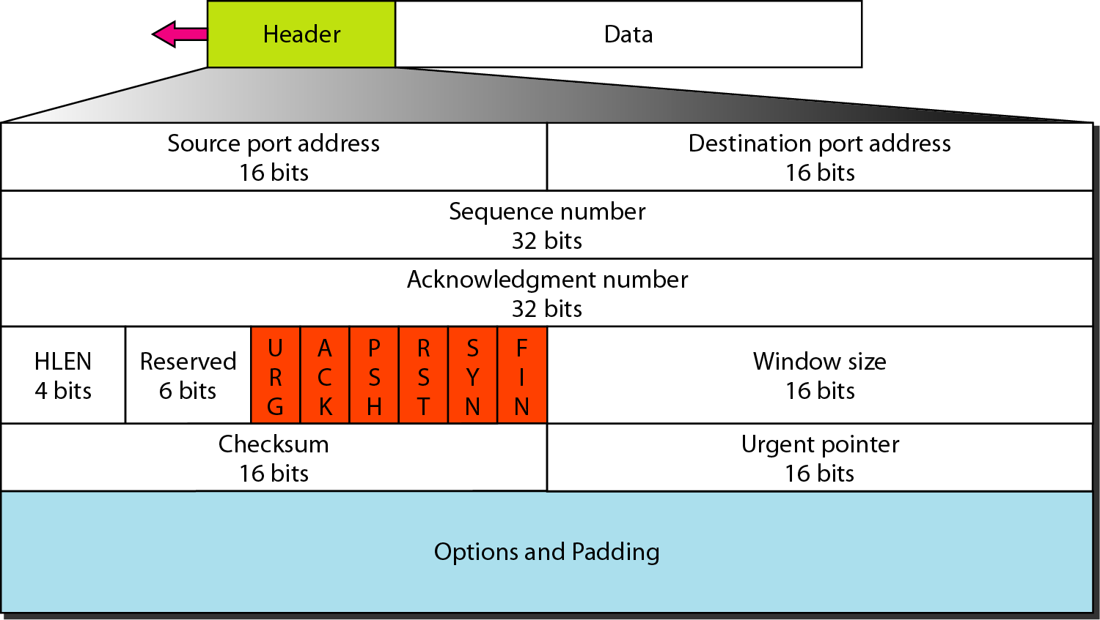
Figure TCP segment format

Slide 44
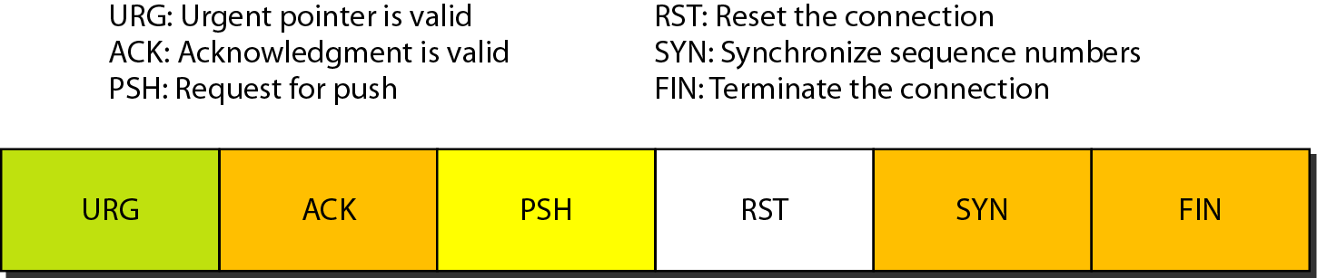
Figure Control field

Slide 45
Table Description of flags in the control field

Slide 46
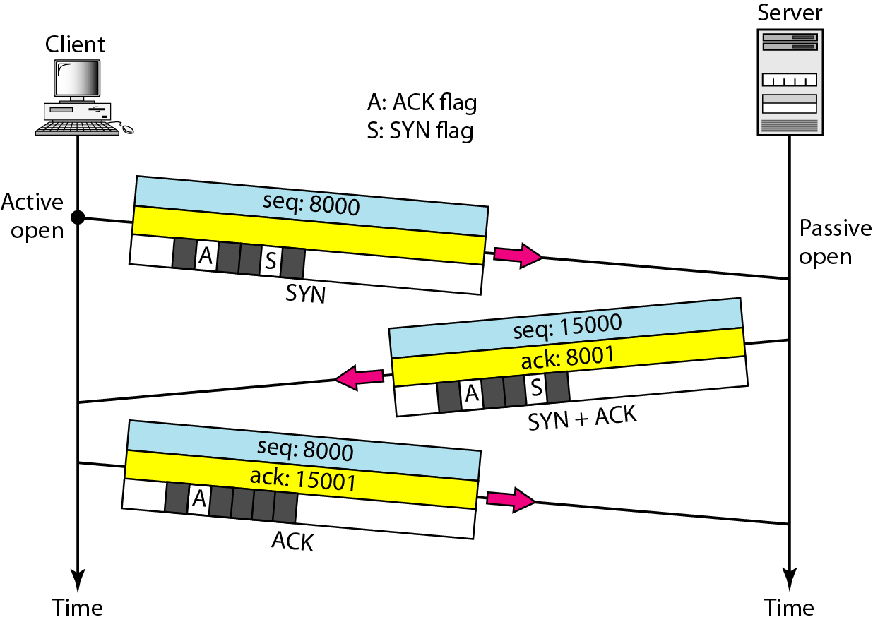
Figure Connection establishment using three-way handshaking

Slide 47
Note
A SYN segment cannot carry data, but it consumes one sequence number.

Slide 48
Note
A SYN + ACK segment cannot carry data, but does consume one sequence number.

Slide 49
Note
An ACK segment, if carrying no data, consumes no sequence number.

Slide 50
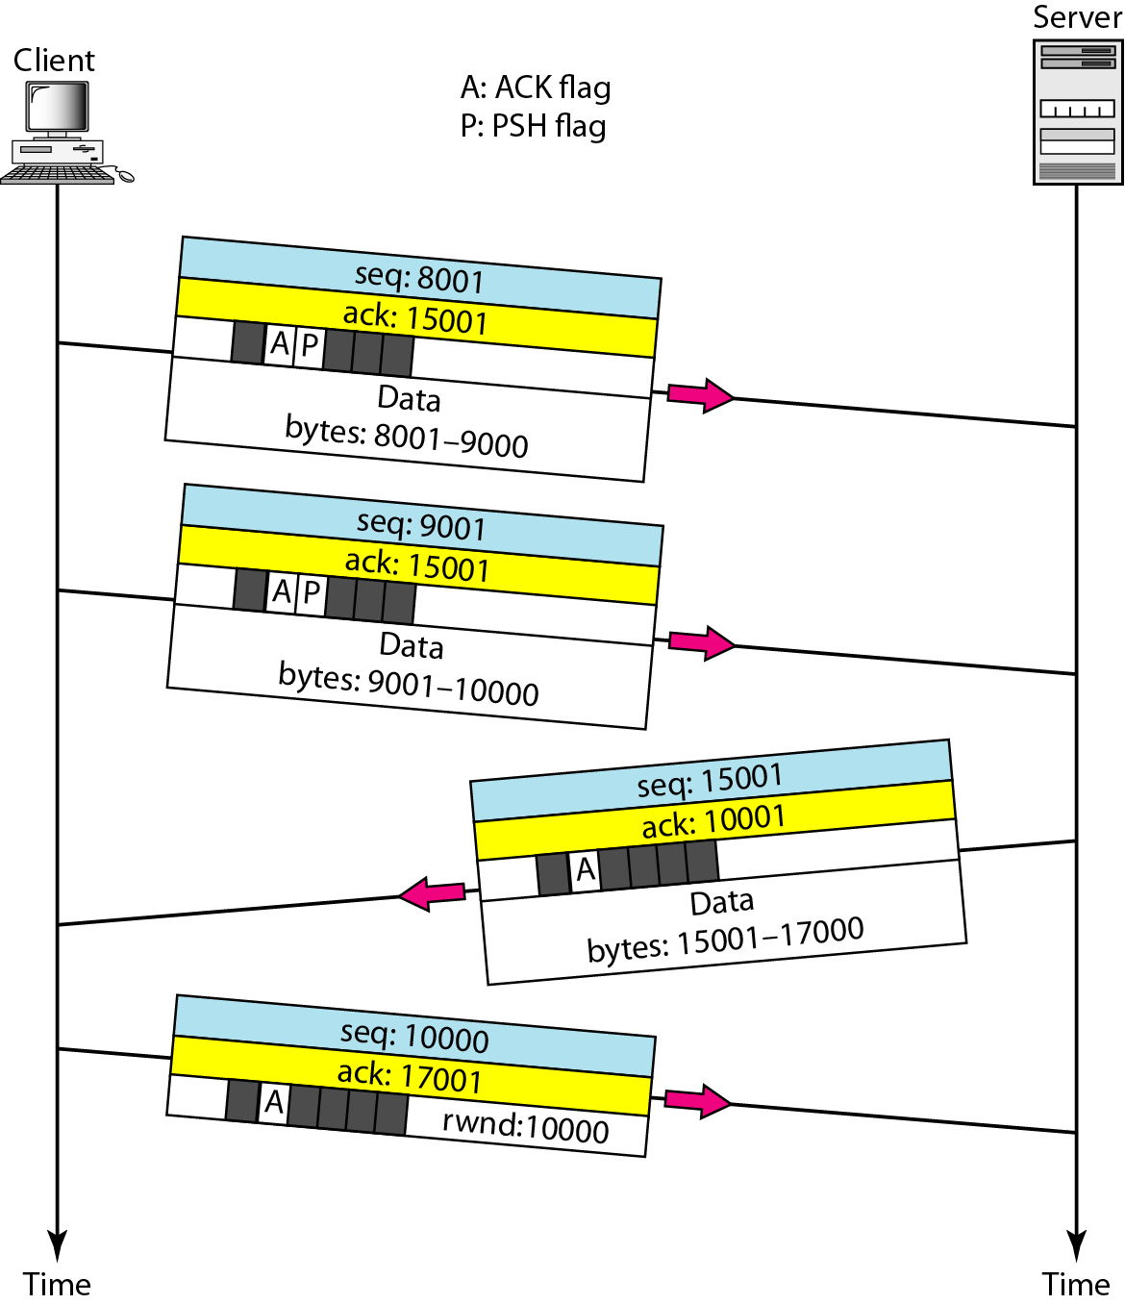
Figure Data transfer

Slide 51
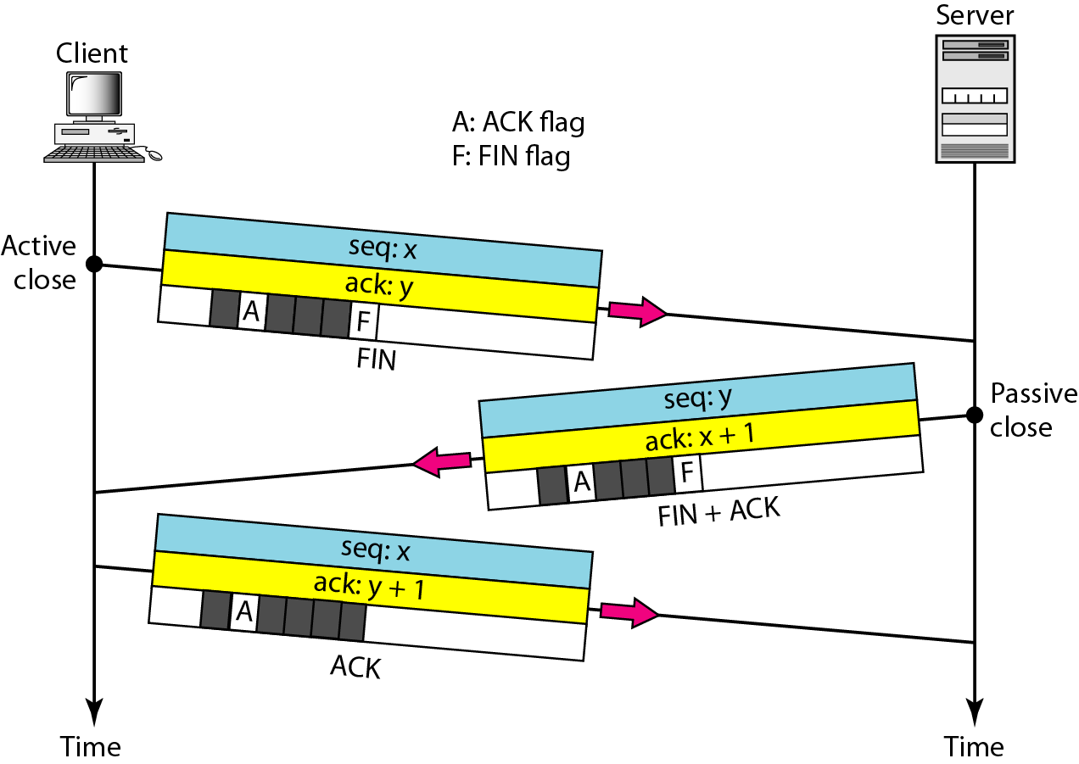
Figure Connection termination using three-way handshaking

Slide 52
Note
The FIN segment consumes one sequence number if it does not carry data.

Slide 53
Note
The FIN + ACK segment consumes one sequence number if it does not carry data.

Slide 54
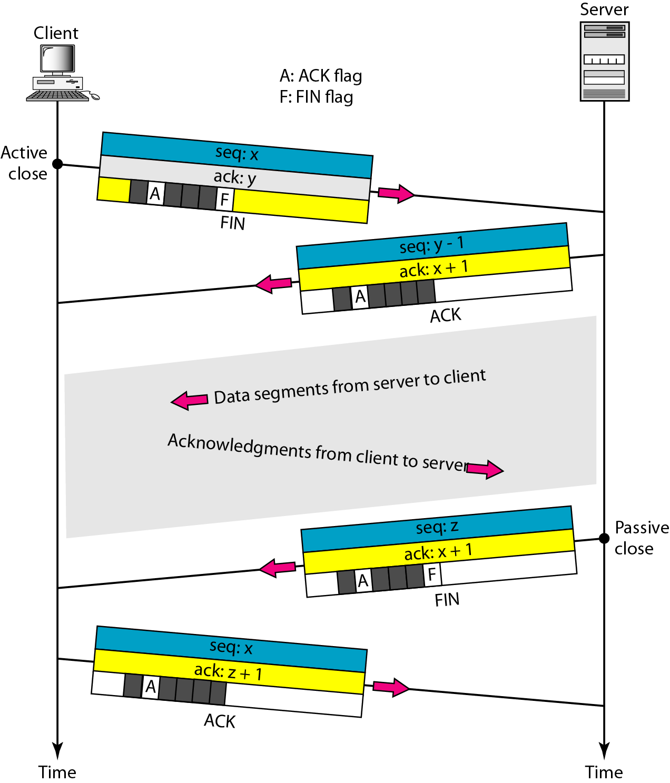
Figure Half-close

Slide 55
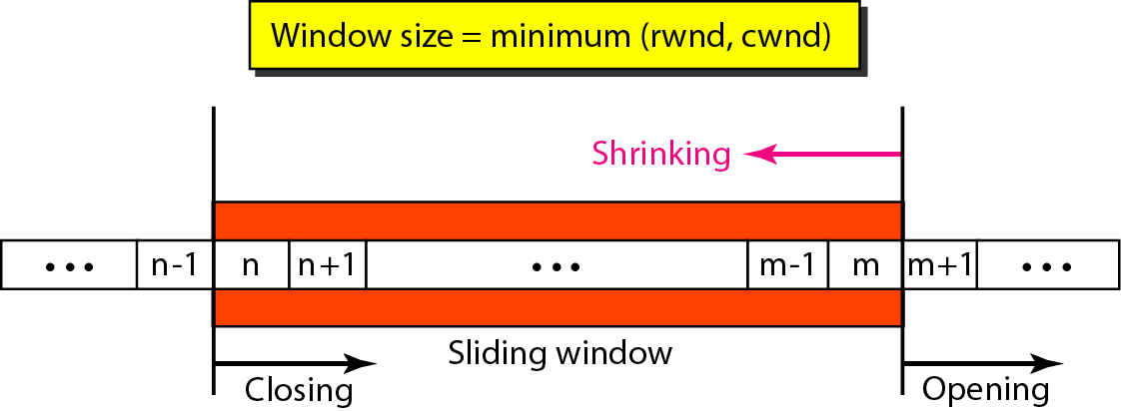
Figure Sliding window

Slide 56
Note
A sliding window is used to make transmission more efficient as well as
to control the flow of data so that the destination does not become
overwhelmed with data. TCP sliding windows are byte-oriented.

Slide 57
Example
What is the value of the receiver window (rwnd) for host A if the receiver, host B, has a buffer size of 5000 bytes and 1000 bytes of received and unprocessed data?
Solution
The value of rwnd = 5000 − 1000 = 4000. Host B can receive only 4000 bytes of data before overflowing its buffer. Host B advertises this value in its next segment to A.

Slide 58
Example
What is the size of the window for host A if the value of rwnd is 3000 bytes and the value of cwnd is 3500 bytes?
Solution
The size of the window is the smaller of rwnd and cwnd, which is 3000 bytes.

Slide 59
Example
Figure 23.23 shows an unrealistic example of a sliding window. The sender has sent bytes up to 202. We assume that cwnd is 20 (in reality this value is thousands of bytes). The receiver has sent an acknowledgment number of 200 with an rwnd of 9 bytes (in reality this value is thousands of bytes). The size of the sender window is the minimum of rwnd and cwnd, or 9 bytes. Bytes 200 to 202 are sent, but not acknowledged. Bytes 203 to 208 can be sent without worrying about acknowledgment. Bytes 209 and above cannot be sent.

Slide 60
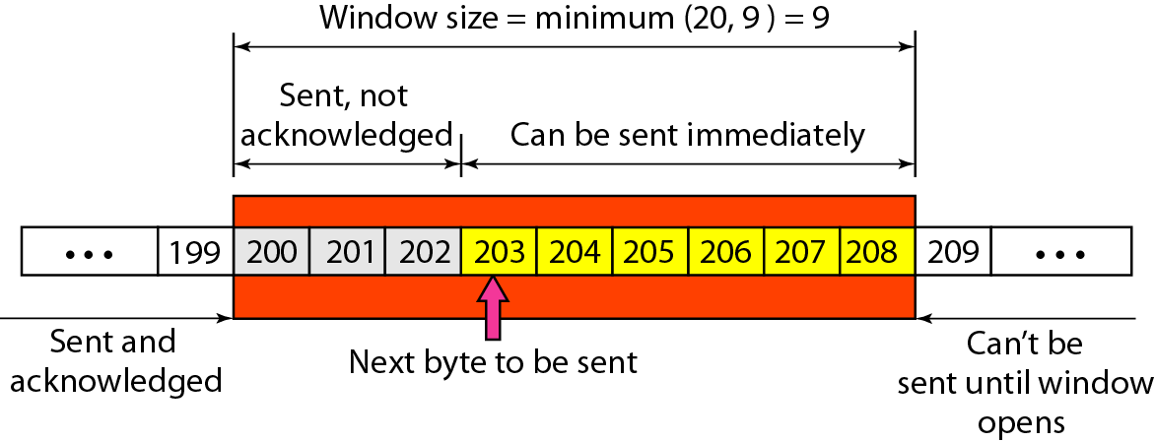
Figure Example

Slide 61
Note
Some points about TCP sliding windows:
❏ The size of the window is the lesser of rwnd and cwnd.
❏ The source does not have to send a full window’s worth of data.
❏ The window can be opened or closed by the receiver, but should not be shrunk.
❏ The destination can send an acknowledgment at any time as long as it does not result in a shrinking window.
❏ The receiver can temporarily shut down the window; the sender, however, can always send a segment of 1 byte after the window is shut down.

Slide 62
Note
ACK segments do not consume sequence numbers and are not acknowledged.

Slide 63
Note
In modern implementations, a retransmission occurs if the retransmission timer expires or three duplicate ACK segments have arrived.

Slide 64
Note
No retransmission timer is set for an ACK segment.

Slide 65
Note
Data may arrive out of order and be temporarily stored by the receiving TCP,
but TCP guarantees that no out-of-order segment is delivered to the process.

Slide 66
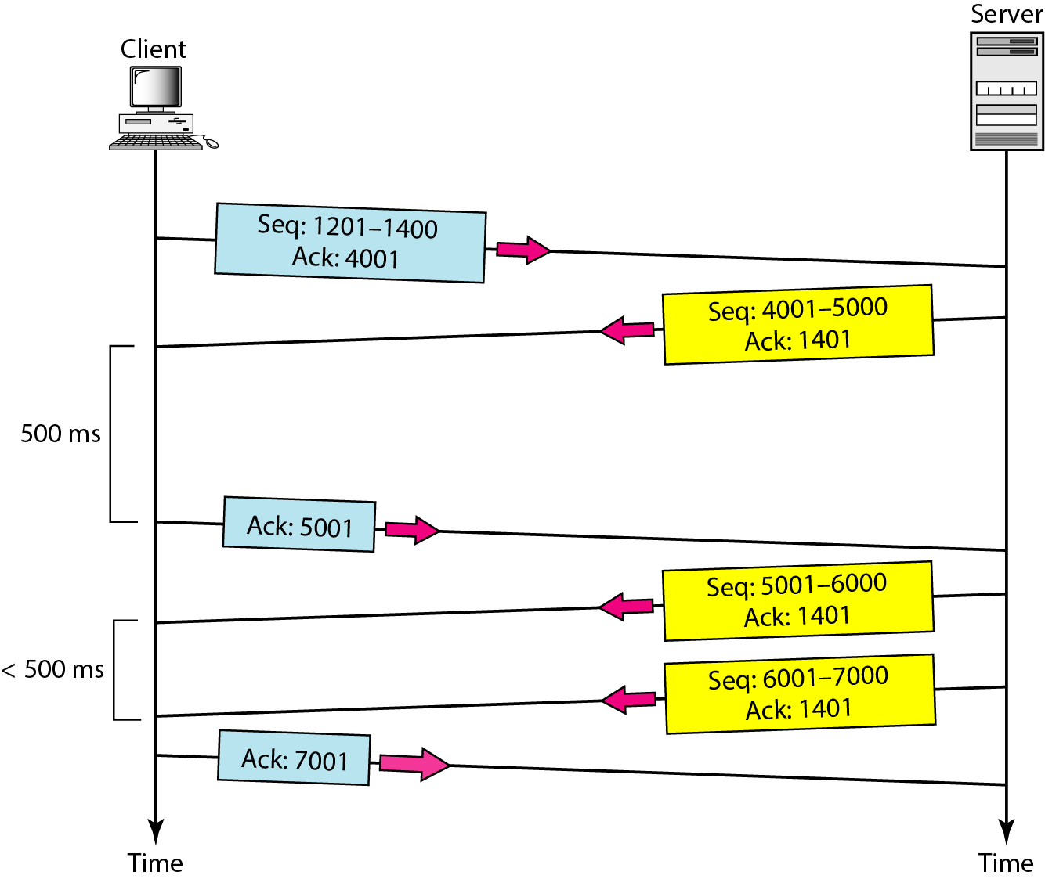
Figure Normal operation

Slide 67
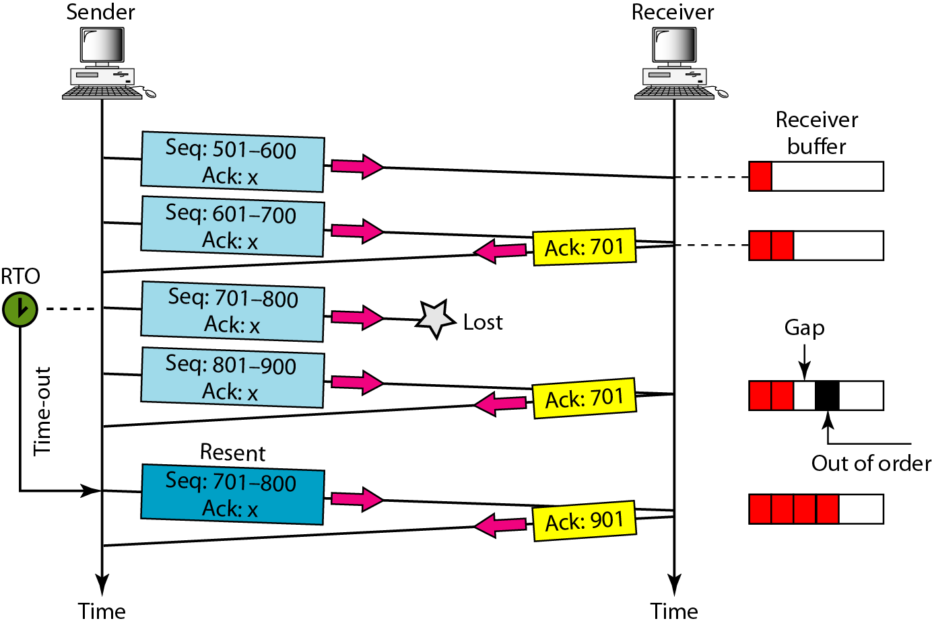
Figure Lost segment

Slide 68
Note
The receiver TCP delivers only ordered data to the process.

Slide 69
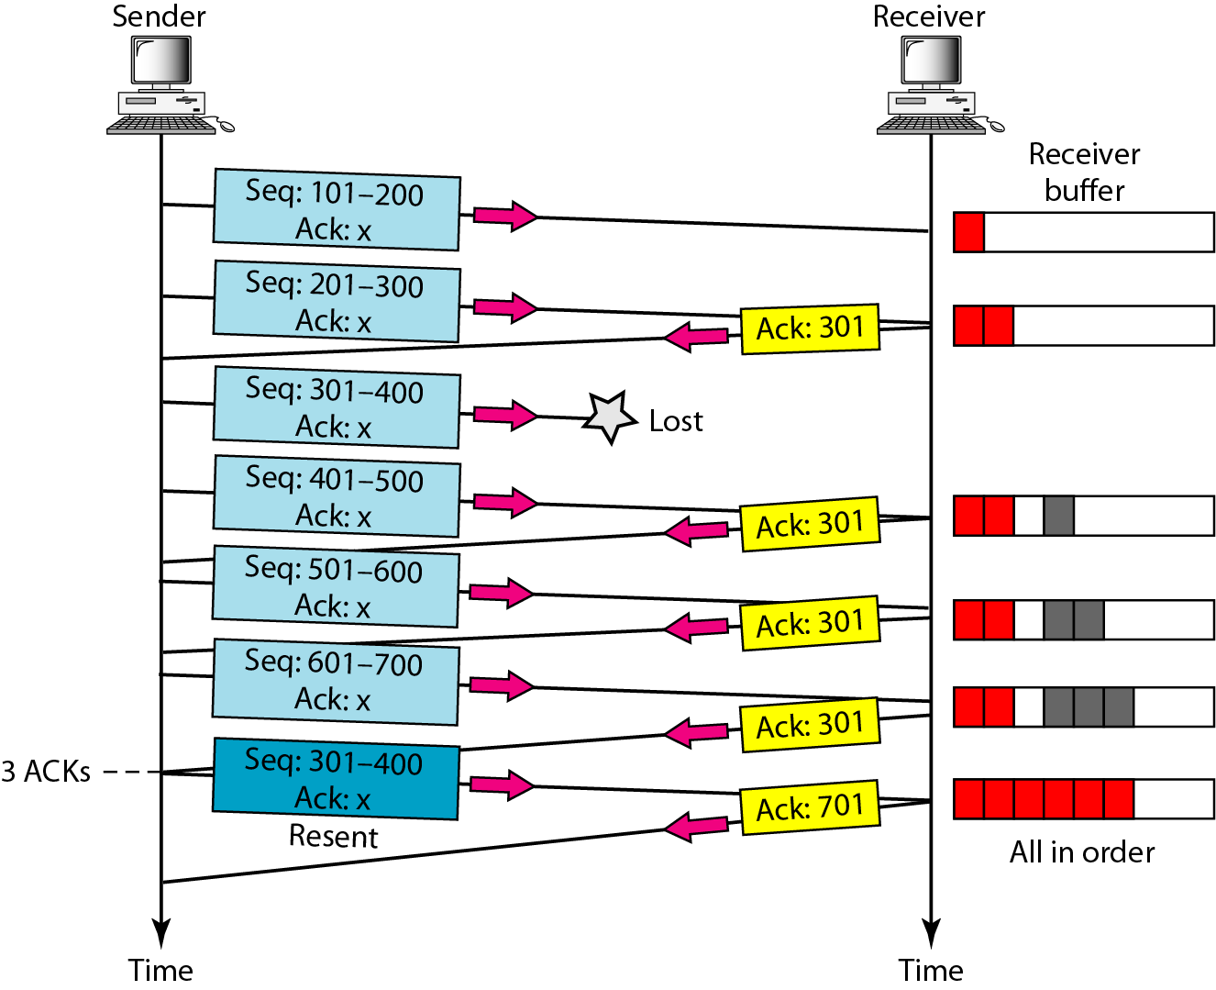
Figure Fast retransmission

Slide 70
SCTP
Stream Control Transmission Protocol (SCTP) is a new reliable, message-oriented transport layer protocol. SCTP, however, is mostly designed for Internet applications that have recently been introduced. These new applications need a more sophisticated service than TCP can provide.
Topics discussed in this section:
SCTP Services and Features
Packet Format
An SCTP Association
Flow Control and Error Control

Slide 71
Note
SCTP is a message-oriented, reliable protocol that combines the best features of UDP and TCP.

Slide 72
Table Some SCTP applications

Slide 73
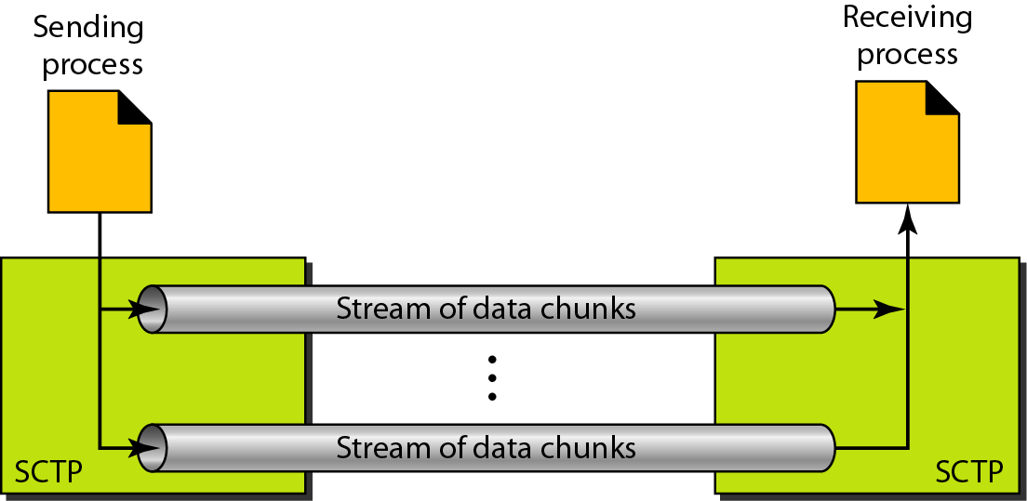
Figure Multiple-stream concept

Slide 74
Note
An association in SCTP can involve multiple streams.

Slide 75
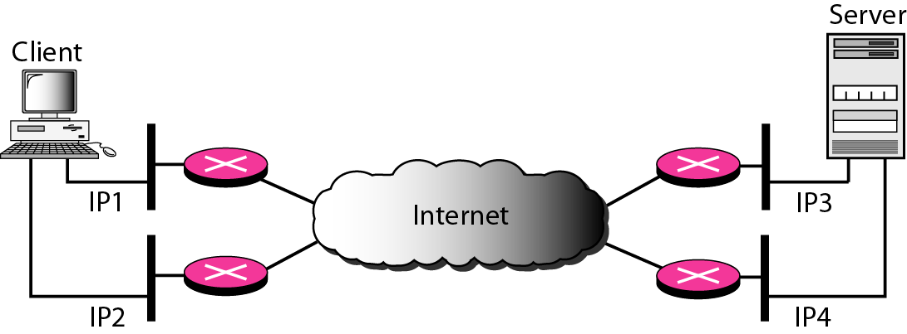
Figure Multihoming concept

Slide 76
Note
SCTP association allows multiple IP addresses for each end.

Slide 77
Note
In SCTP, a data chunk is numbered using a TSN.

Slide 78
Note
To distinguish between different streams, SCTP uses an SI.

Slide 79
Note
To distinguish between different data chunks belonging to the same stream, SCTP uses SSNs.

Slide 80
Note
TCP has segments; SCTP has packets.

Slide 81
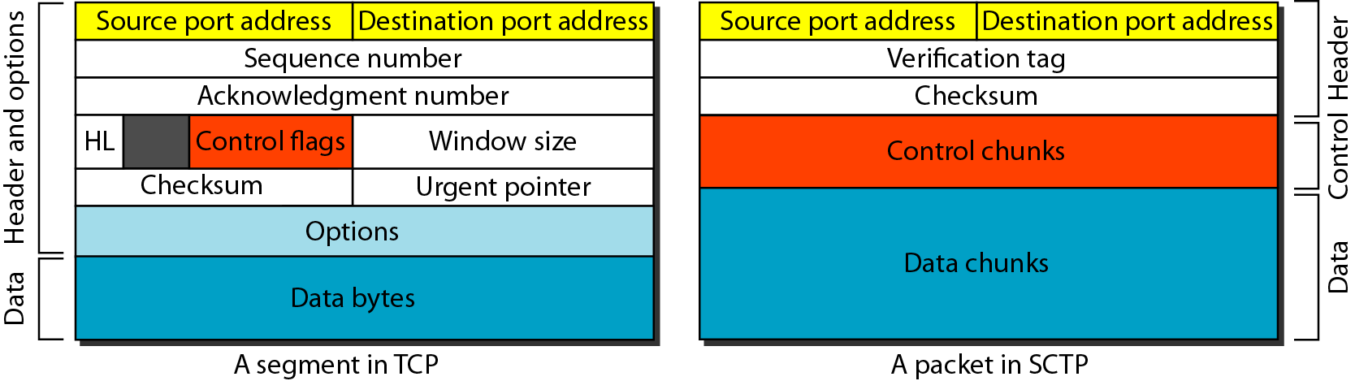
Figure Comparison between a TCP segment and an SCTP packet

Slide 82
Note
In SCTP, control information and data information are carried in separate chunks.

Slide 83
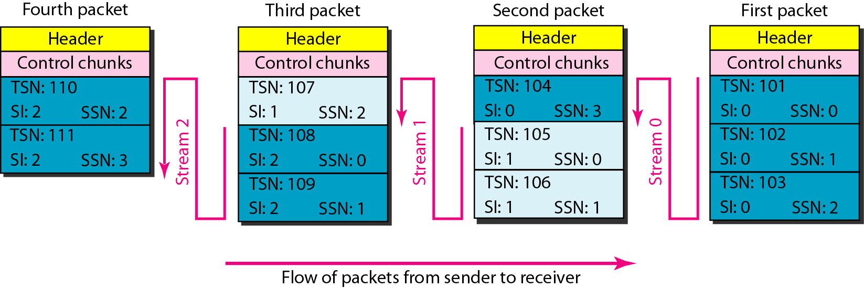
Figure Packet, data chunks, and streams

Slide 84
Note
Data chunks are identified by three items: TSN, SI, and SSN.
TSN is a cumulative number identifying the association; SI defines the stream; SSN defines the chunk in a stream.

Slide 85
Note
In SCTP, acknowledgment numbers are used to acknowledge only data chunks;
control chunks are acknowledged by other control chunks if necessary.

Slide 86
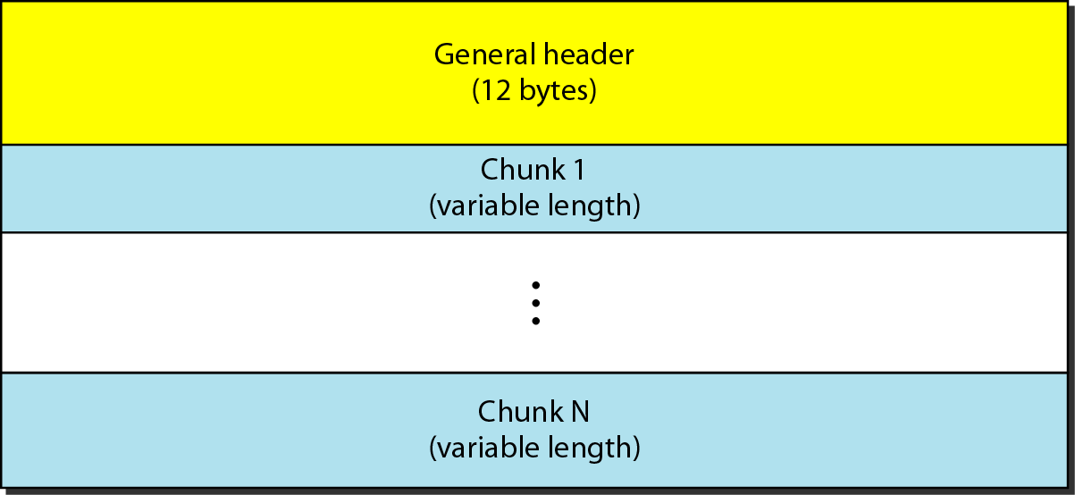
Figure SCTP packet format

Slide 87
Note
In an SCTP packet, control chunks come before data chunks.

Slide 88
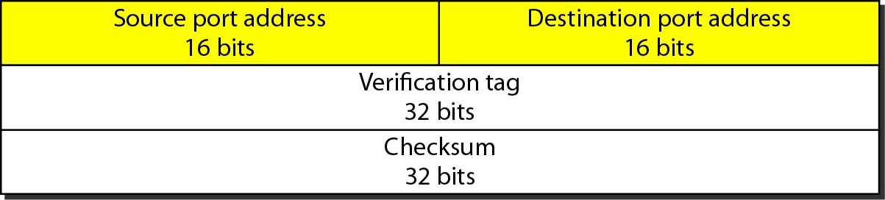
Figure General header

Slide 89
Table Chunks

Slide 90
Note
A connection in SCTP is called an association.

Slide 91
Note
No other chunk is allowed in a packet carrying an INIT or INIT ACK chunk.
A COOKIE ECHO or a COOKIE ACK chunk can carry data chunks.

Slide 92
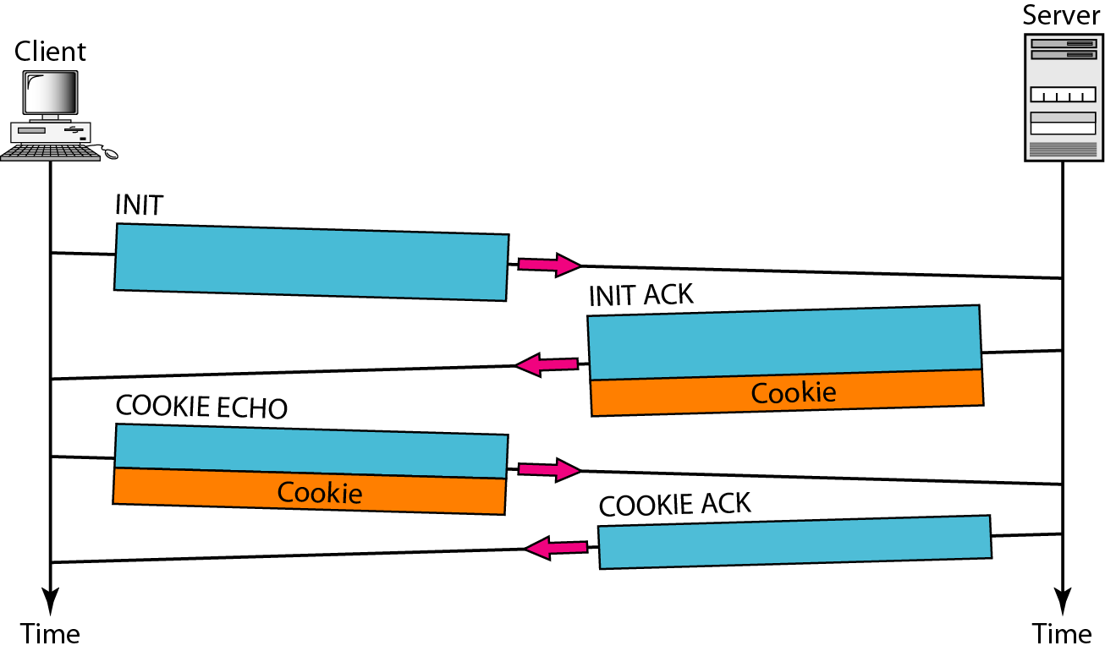
Figure Four-way handshaking

Slide 93
Note
In SCTP, only DATA chunks consume TSNs;
DATA chunks are the only chunks that are acknowledged.

Slide 94
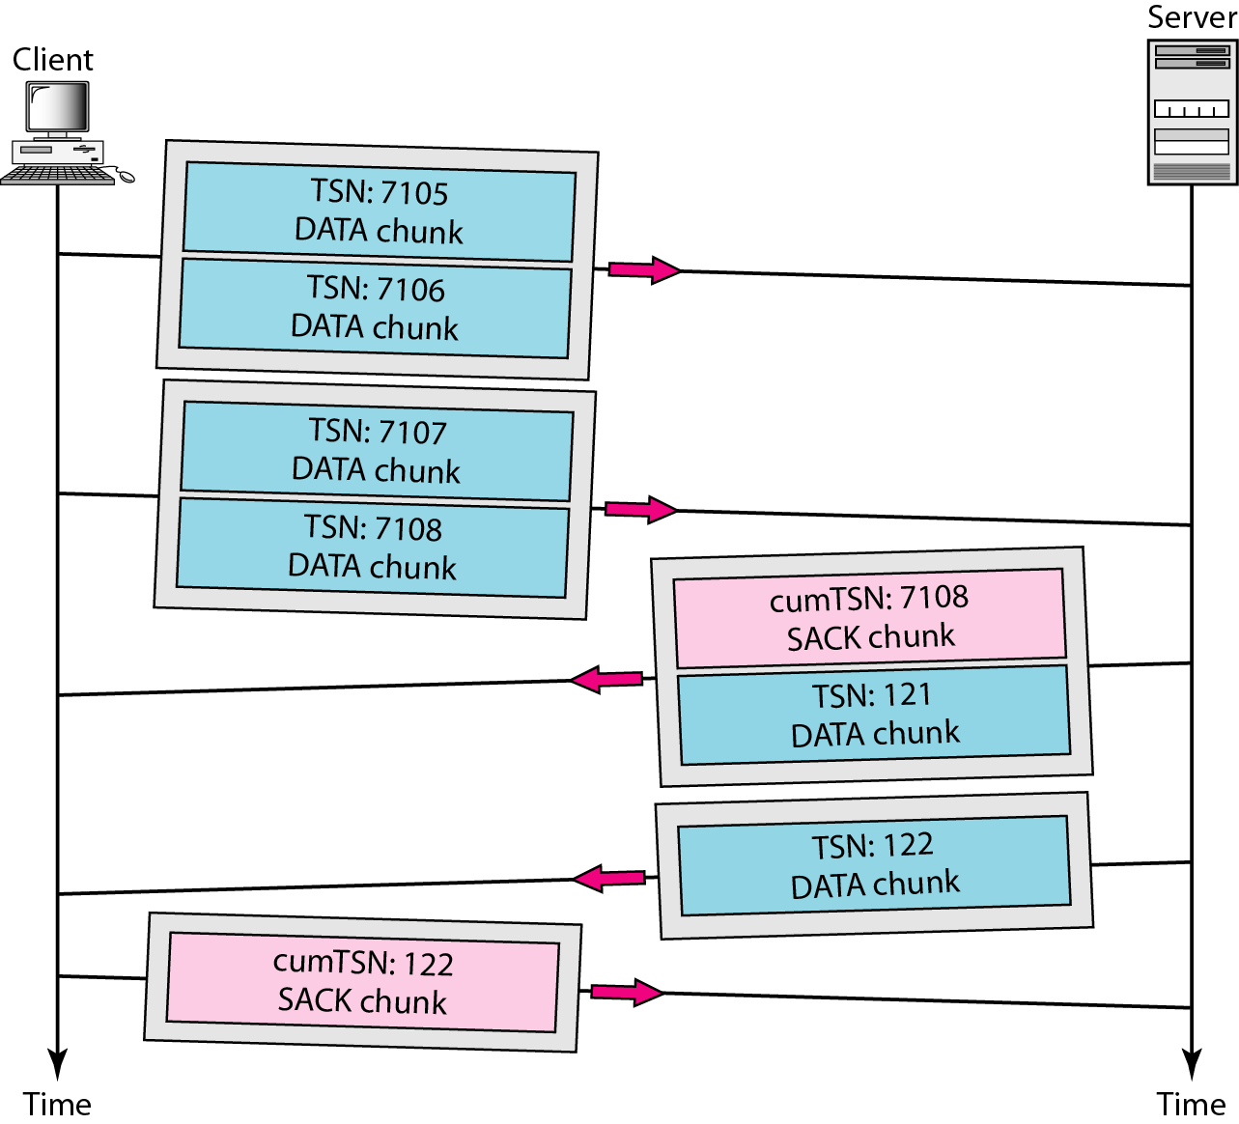
Figure 23.34 Simple data transfer

Slide 95
Note
The acknowledgment in SCTP defines the cumulative TSN, the TSN of the last data chunk received in order.

Slide 96
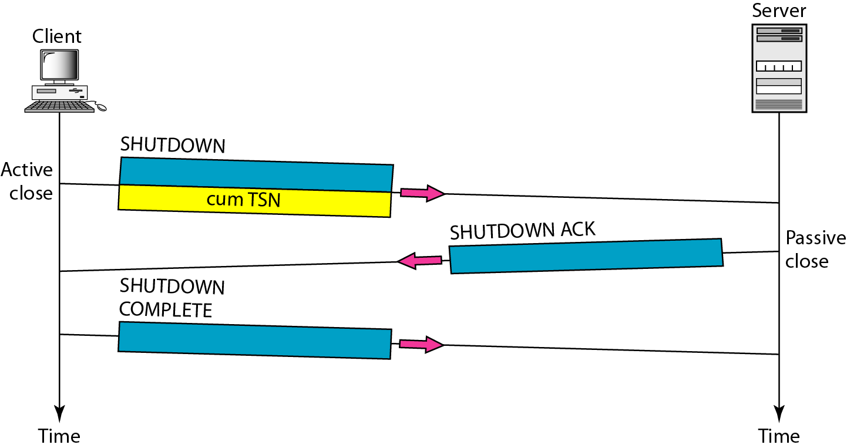
Figure Association termination

Slide 97
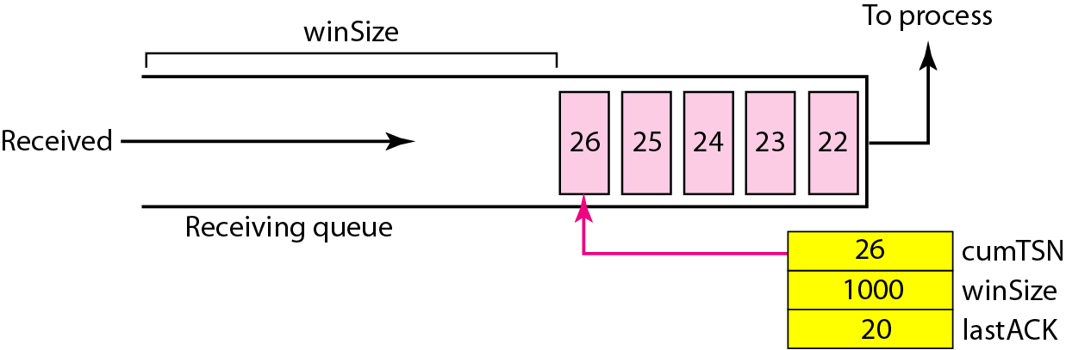
Figure Flow control, receiver site

Slide 98
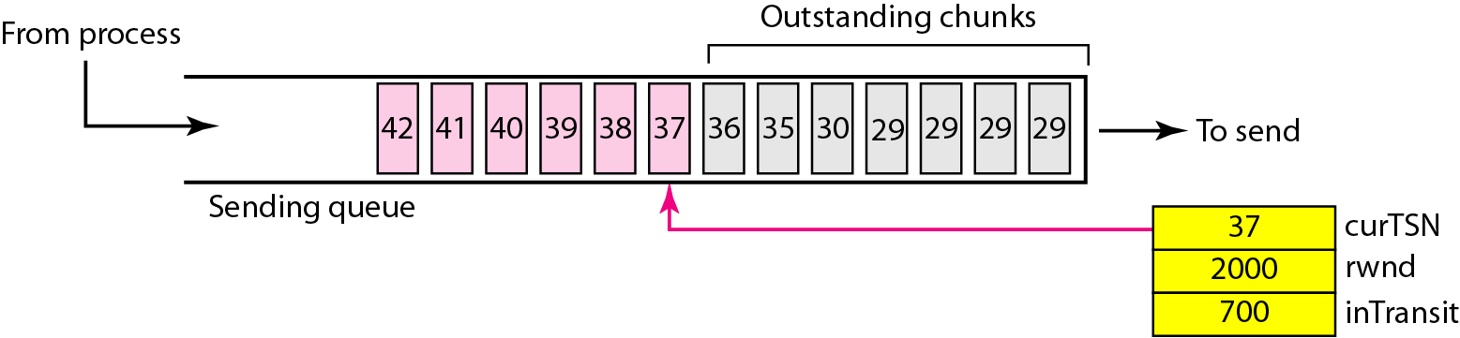
Figure Flow control, sender site

Slide 99
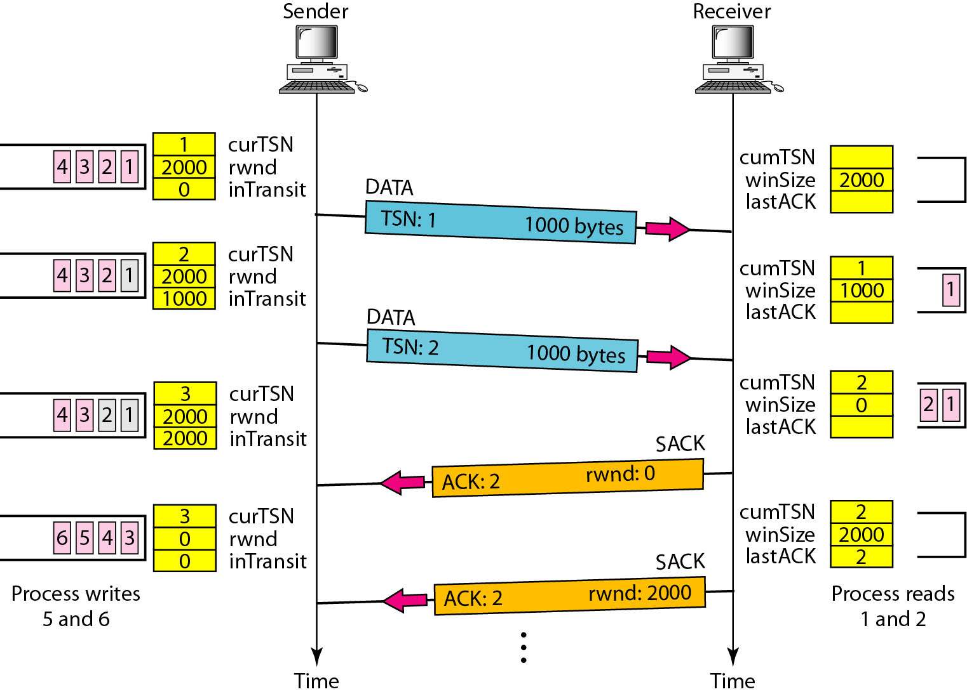
Figure Flow control scenario

Slide 100
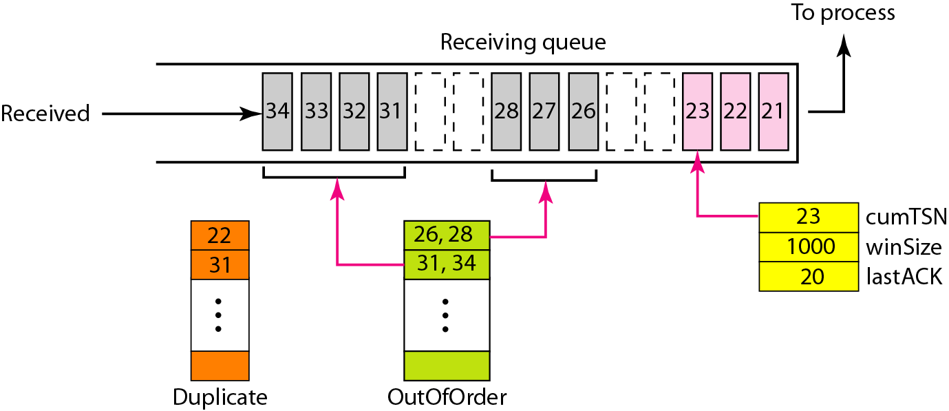
Figure Error control, receiver site

Slide 101
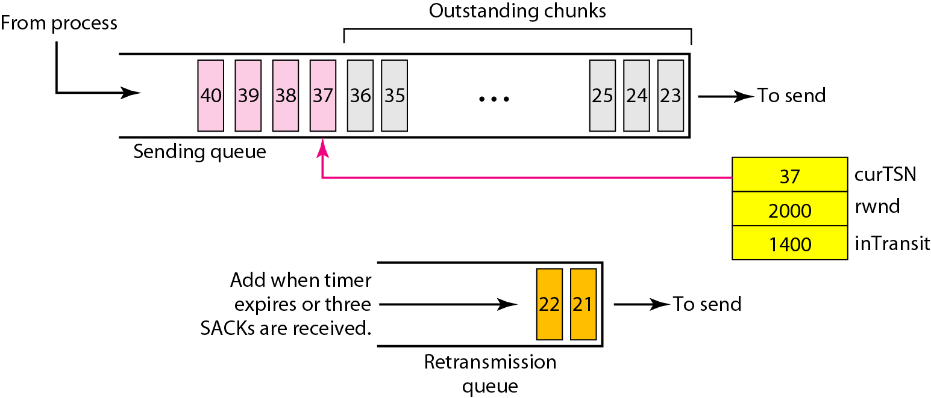
Figure Error control, sender site

