Slide 1
CSE/PC/B/T/316 Computer Networks Topic 17- Transport Layer Process-to-Process Delivery: TCP
Sarbani Roy
sarbani.roy@jadavpuruniversity.in
Office: CC-5-7
Cell: 9051639328

Slide 2
TCP
TCP is a connection-oriented protocol; it creates a virtual connection between two TCPs to send data. In addition, TCP uses flow and error control mechanisms at the transport level.
Topics discussed in this section:
TCP Services TCP Features
Segment
A TCP Connection
Flow Control
Error Control

Slide 3
Table Well-known ports used by TCP

Slide 4
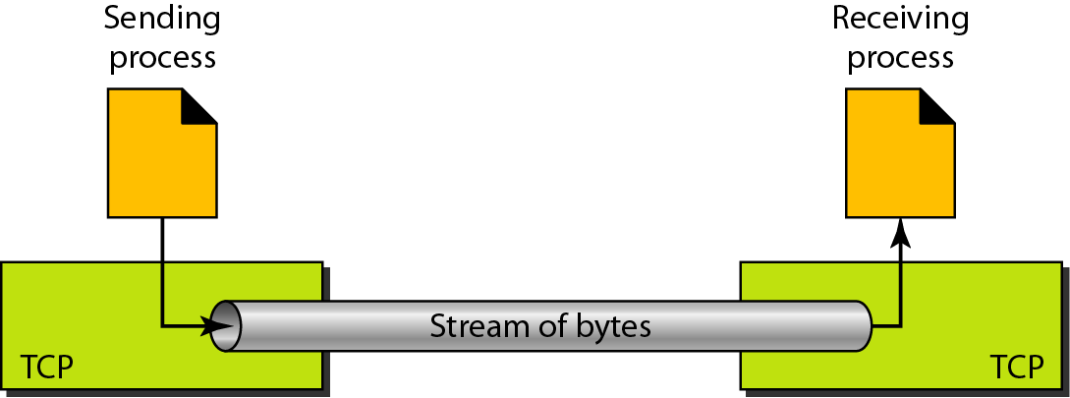
Figure Stream delivery

Slide 5
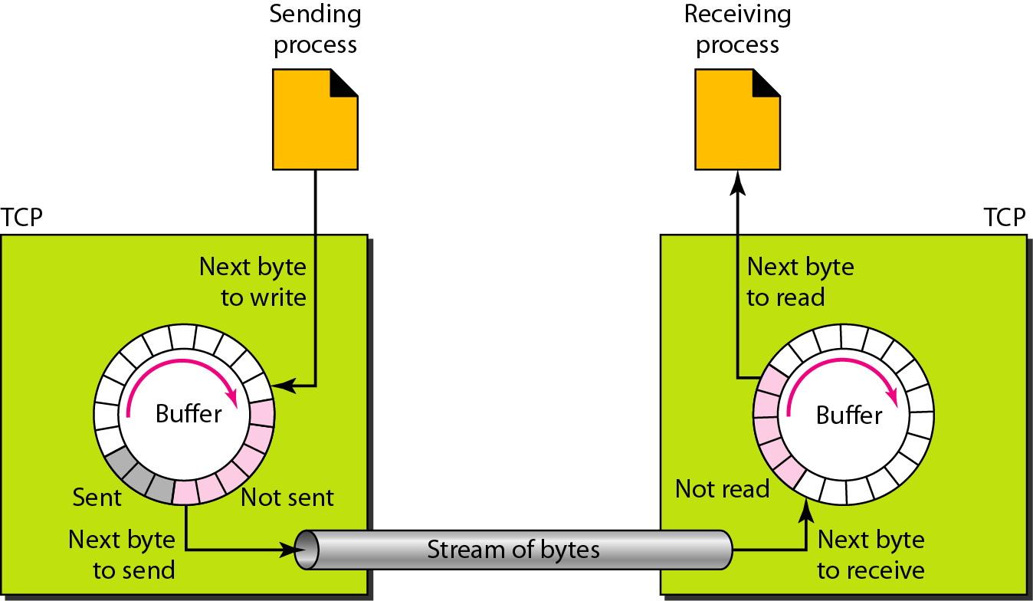
Figure Sending and receiving buffers

Slide 6
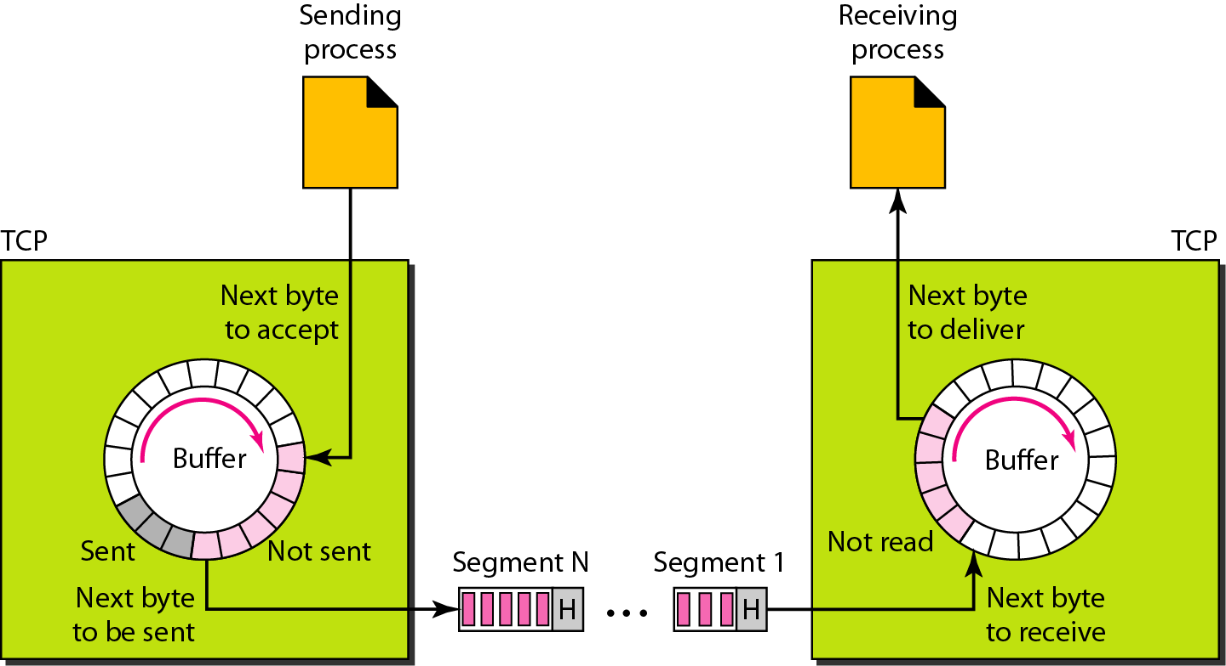
Figure TCP segments

Slide 7

Note
The bytes of data being transferred in each connection are numbered by TCP.
The numbering starts with a randomly generated number.

Slide 8
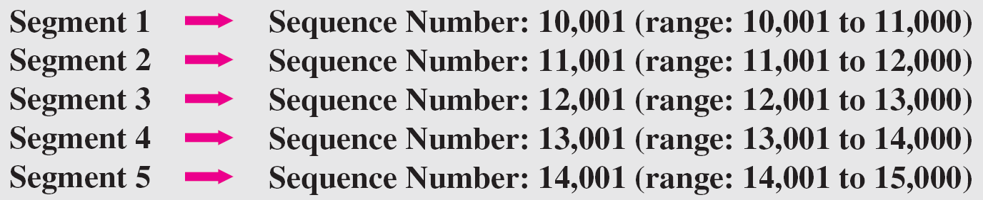
Example
The following shows the sequence number for each segment:

Slide 9
Note
The value in the sequence number field of a segment defines the
number of the first data byte contained in that segment.

Slide 10
Note
The value of the acknowledgment field in a segment defines
the number of the next byte a party expects to receive.
The acknowledgment number is cumulative.

Slide 11
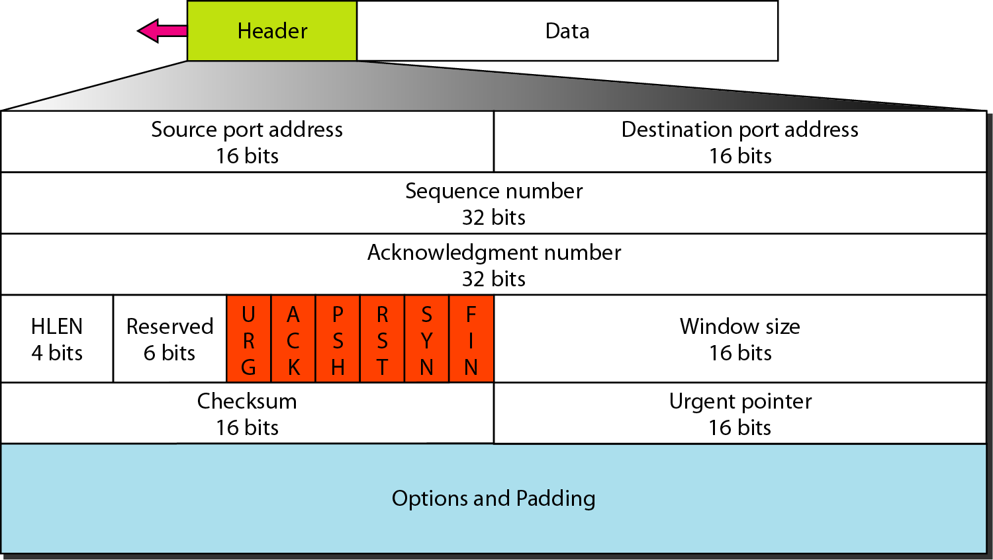
Figure TCP segment format

Slide 12
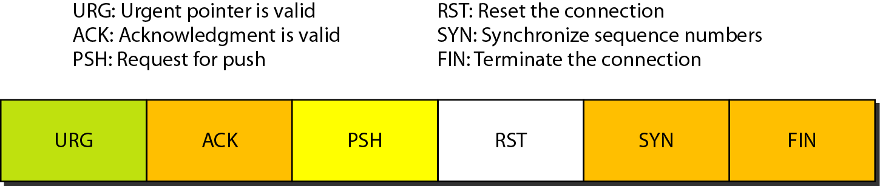
Figure Control field

Slide 13
Table Description of flags in the control field

Slide 14
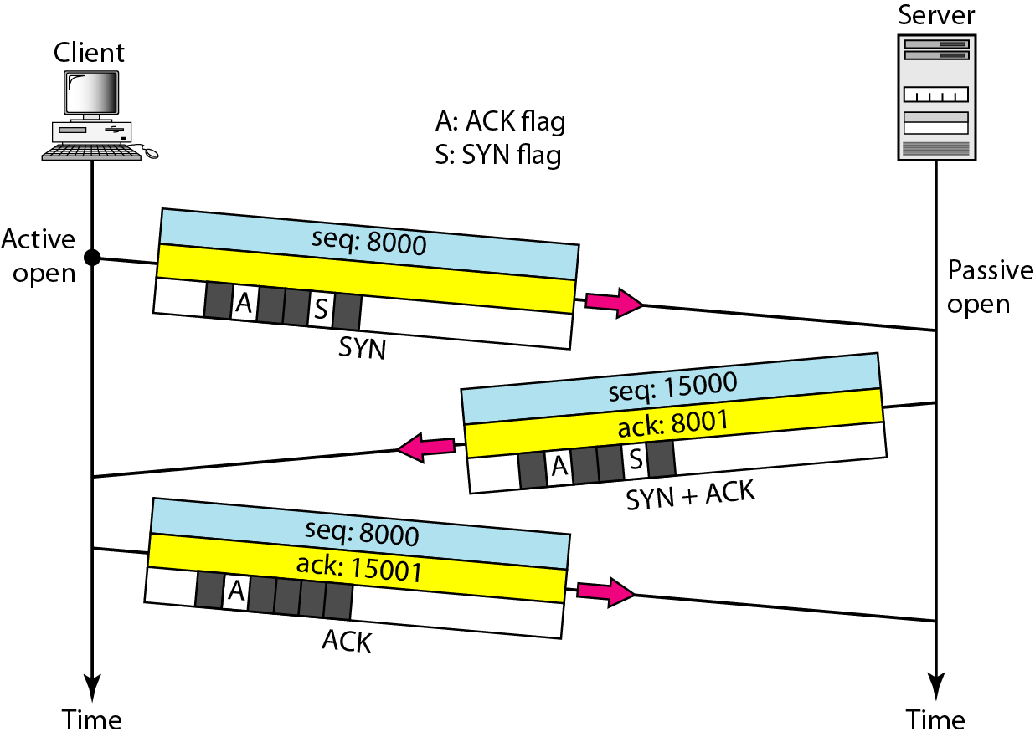
Figure Connection establishment using three-way handshaking

Slide 15
Note
A SYN segment cannot carry data, but it consumes one sequence number.

Slide 16
Note
A SYN + ACK segment cannot carry data, but does consume one sequence number.

Slide 17
Note
An ACK segment, if carrying no data, consumes no sequence number.

Slide 18
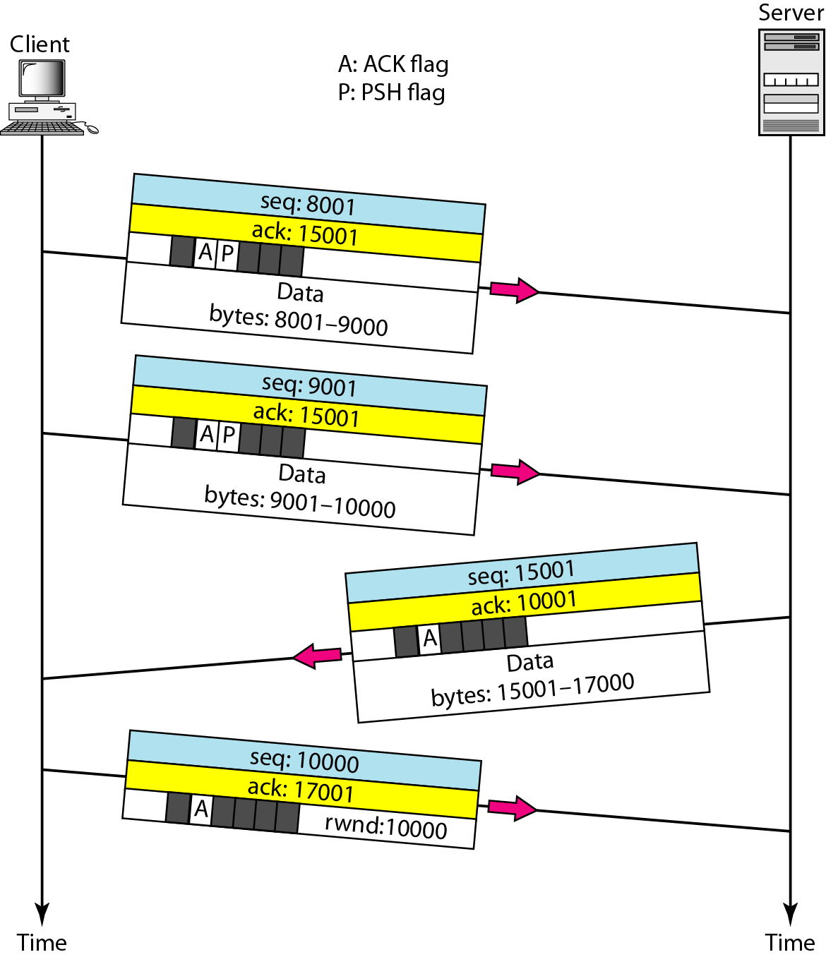
Figure Data transfer

Slide 19
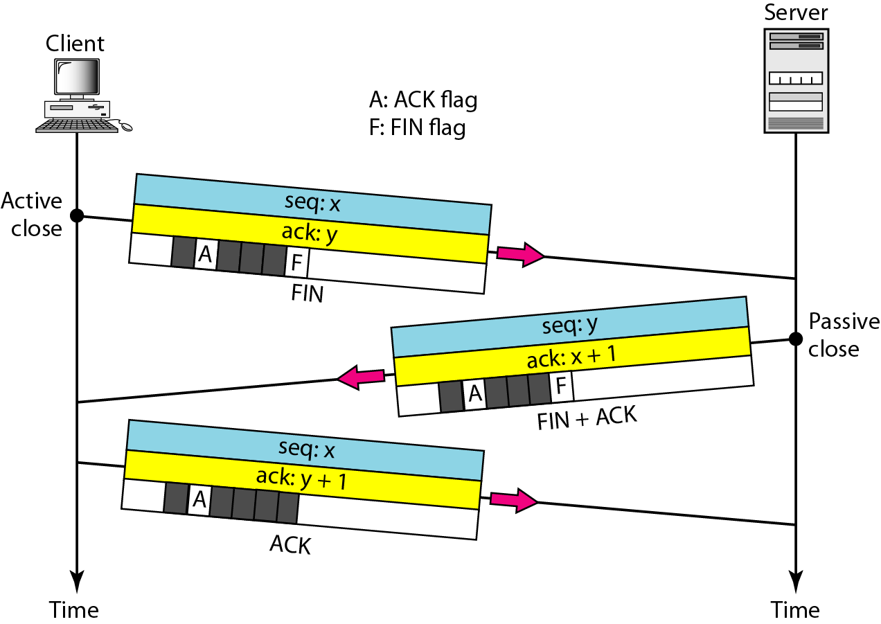
Figure Connection termination using three-way handshaking

Slide 20
Note
The FIN segment consumes one sequence number if it does not carry data.

Slide 21
Note
The FIN + ACK segment consumes one sequence number if it does not carry data.

Slide 22
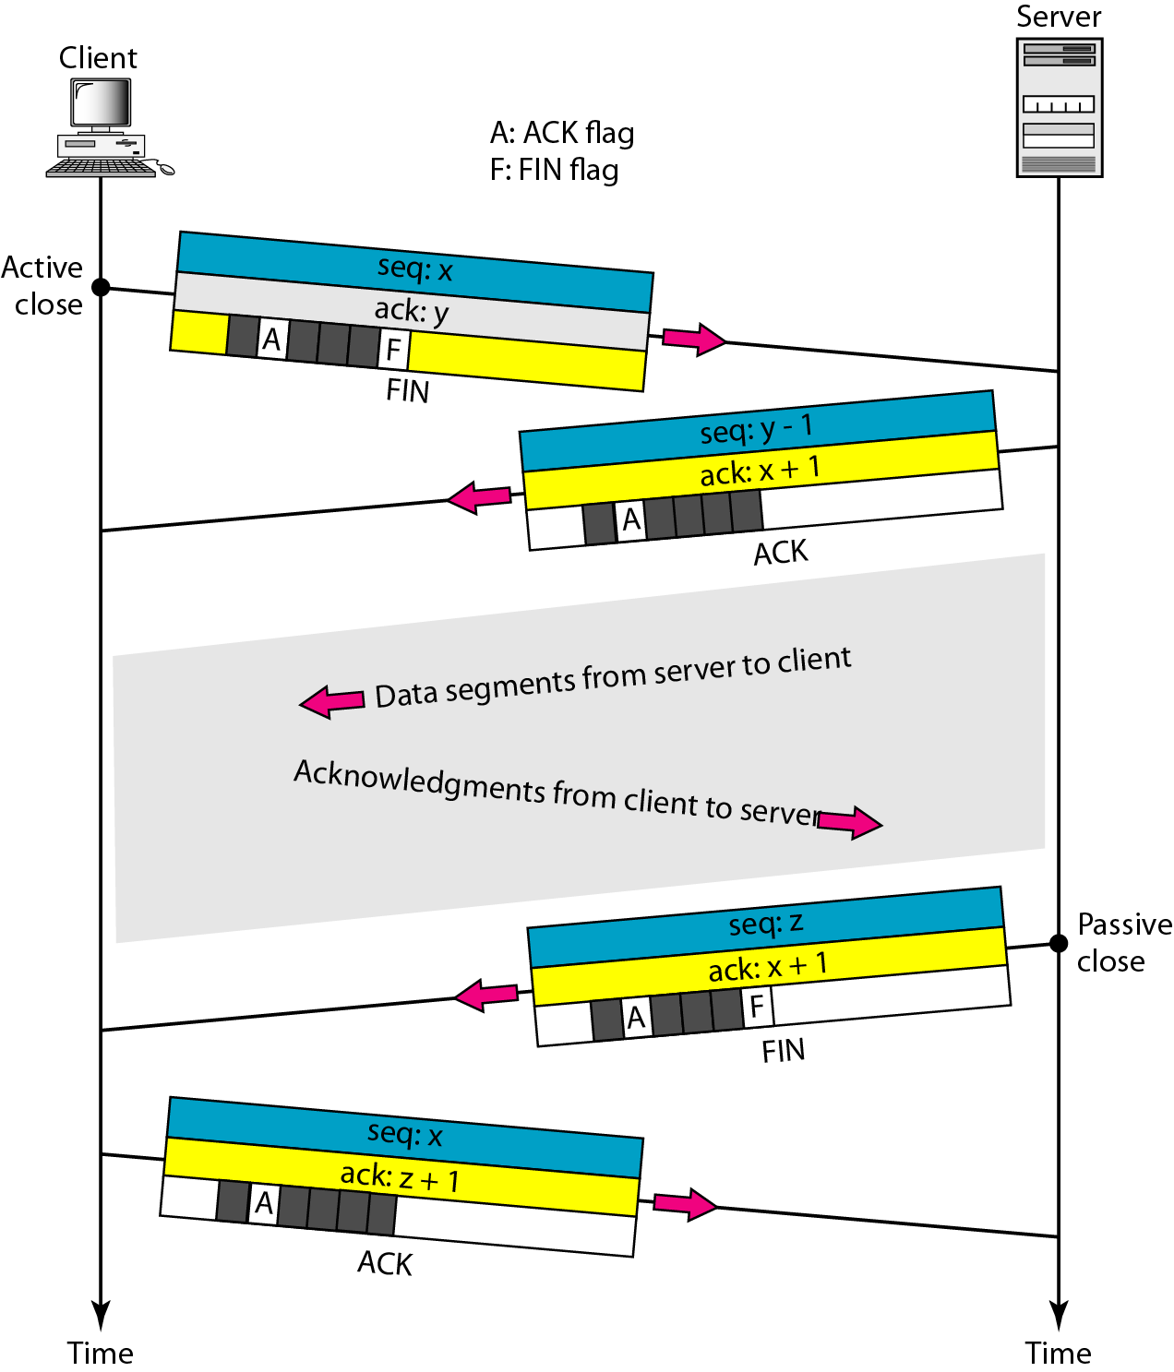
Figure Half-close

Slide 23
Flow Control
Sliding Window Protocol

Slide 24
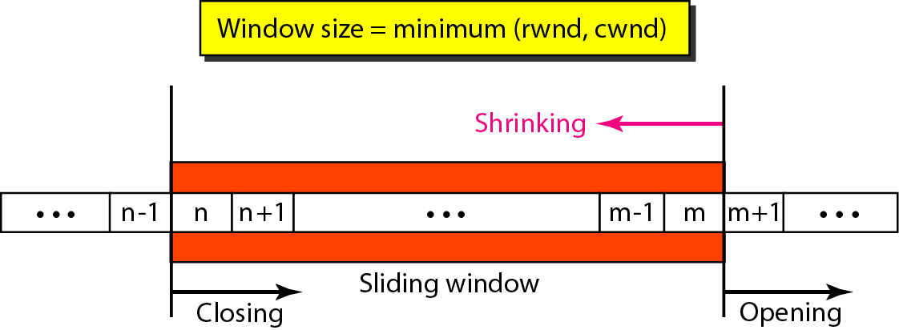
Figure Sliding window

Slide 25
Note
A sliding window is used to make transmission more efficient as well as
to control the flow of data so that the destination does not become
overwhelmed with data. TCP sliding windows are byte-oriented.

Slide 26
Example
What is the value of the receiver window (rwnd) for host A if the receiver, host B, has a buffer size of 5000 bytes and 1000 bytes of received and unprocessed data?
Solution
The value of rwnd = 5000 − 1000 = 4000. Host B can receive only 4000 bytes of data before overflowing its buffer. Host B advertises this value in its next segment to A.

Slide 27
Example
What is the size of the window for host A if the value of rwnd is 3000 bytes and the value of cwnd is 3500 bytes?
Solution
The size of the window is the smaller of rwnd and cwnd, which is 3000 bytes.

Slide 28
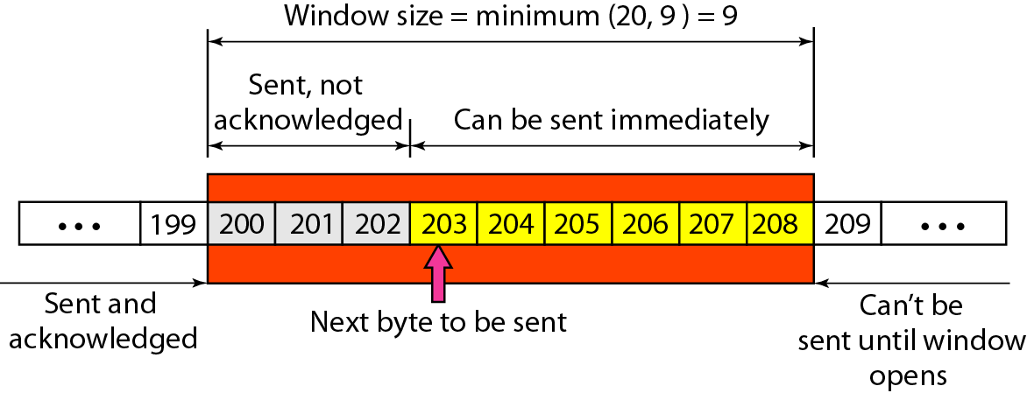
Example
Figure shows an unrealistic example of a sliding window. The sender has sent bytes up to 202. We assume that cwnd is 20 (in reality this value is thousands of bytes). The receiver has sent an acknowledgment number of 200 with an rwnd of 9 bytes (in reality this value is thousands of bytes). The size of the sender window is the minimum of rwnd and cwnd, or 9 bytes. Bytes 200 to 202 are sent, but not acknowledged. Bytes 203 to 208 can be sent without worrying about acknowledgment. Bytes 209 and above cannot be sent.

Slide 29
Note
Some points about TCP sliding windows:
❏ The size of the window is the lesser of rwnd and cwnd.
❏ The source does not have to send a full window’s worth of data.
❏ The window can be opened or closed by the receiver, but should not be shrunk.
❏ The destination can send an acknowledgment at any time as long as it does not result in a shrinking window.
❏ The receiver can temporarily shut down the window; the sender, however, can always send a segment of 1 byte after the window is shut down.

Slide 30
Error Control
Checksum
Acknowledgement
Retransmission
Retransmission after RTO
Retransmission after three duplicate ACK Segments
Out of order Segments
Lost segment
Fast retransmission

Slide 31
Note
ACK segments do not consume sequence numbers and are not acknowledged.

Slide 32
Note
In modern implementations, a retransmission occurs if the retransmission timer expires or three duplicate ACK segments have arrived.

Slide 33
Note
No retransmission timer is set for an ACK segment.

Slide 34
Note
Data may arrive out of order and be temporarily stored by the receiving TCP,
but TCP guarantees that no out-of-order segment is delivered to the process.

Slide 35
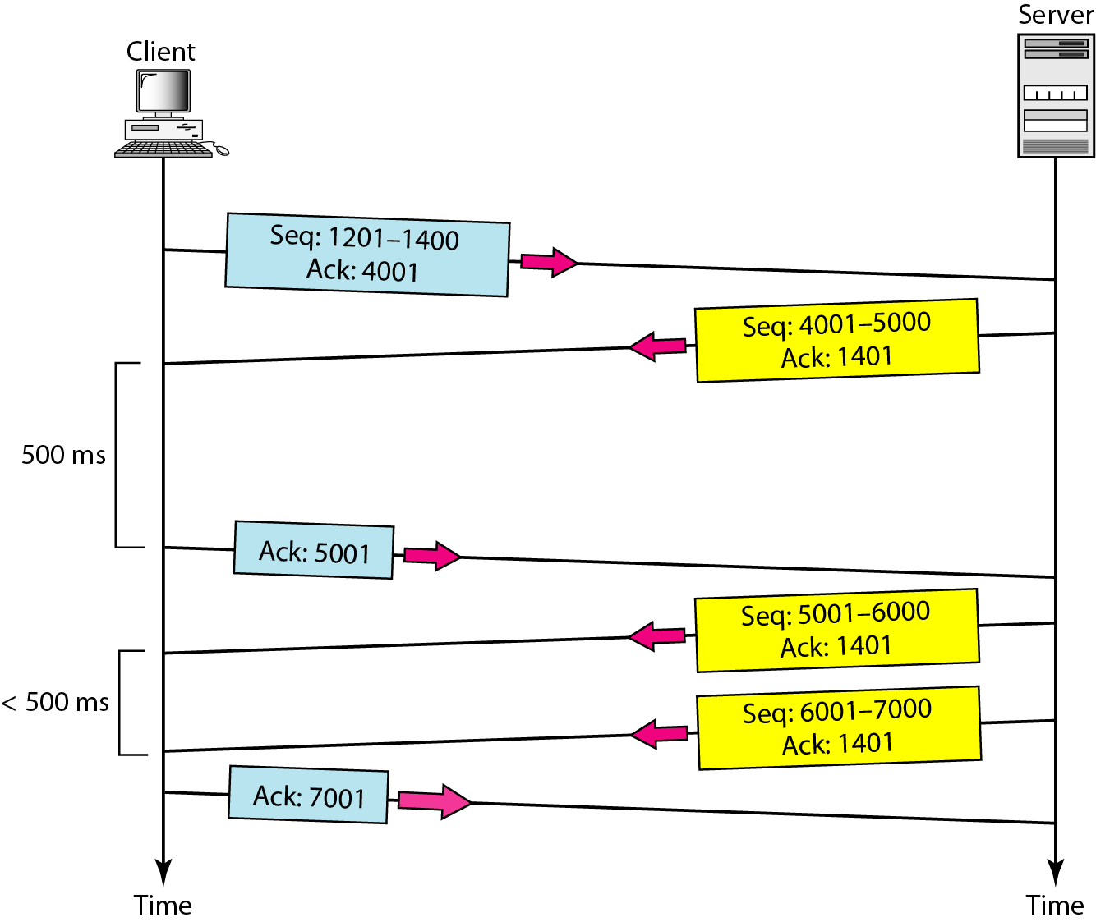
Figure Normal operation

Slide 36
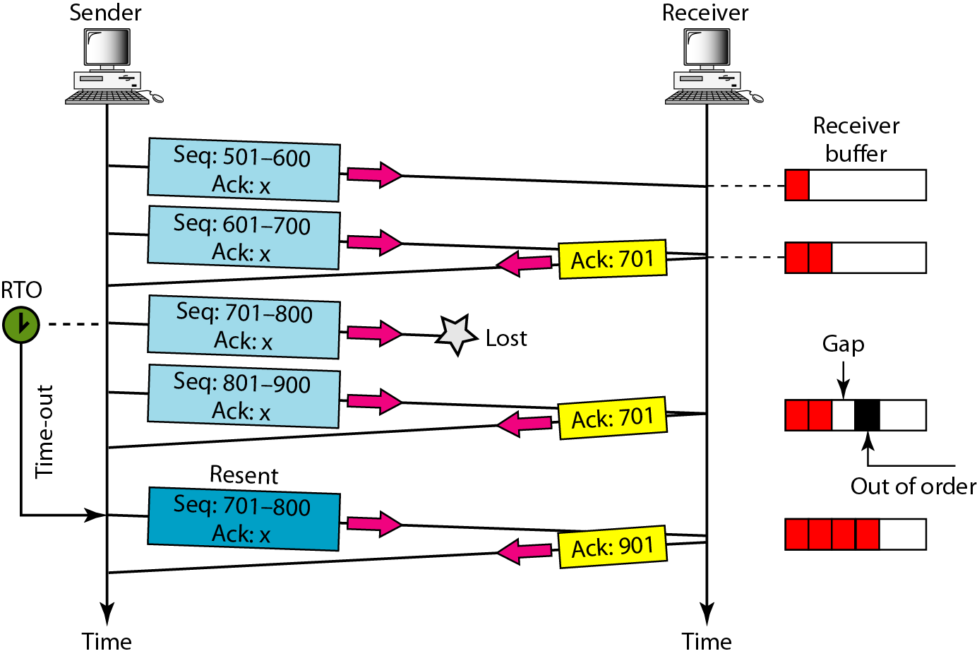
Figure Lost segment

Slide 37
Note
The receiver TCP delivers only ordered data to the process.

Slide 38
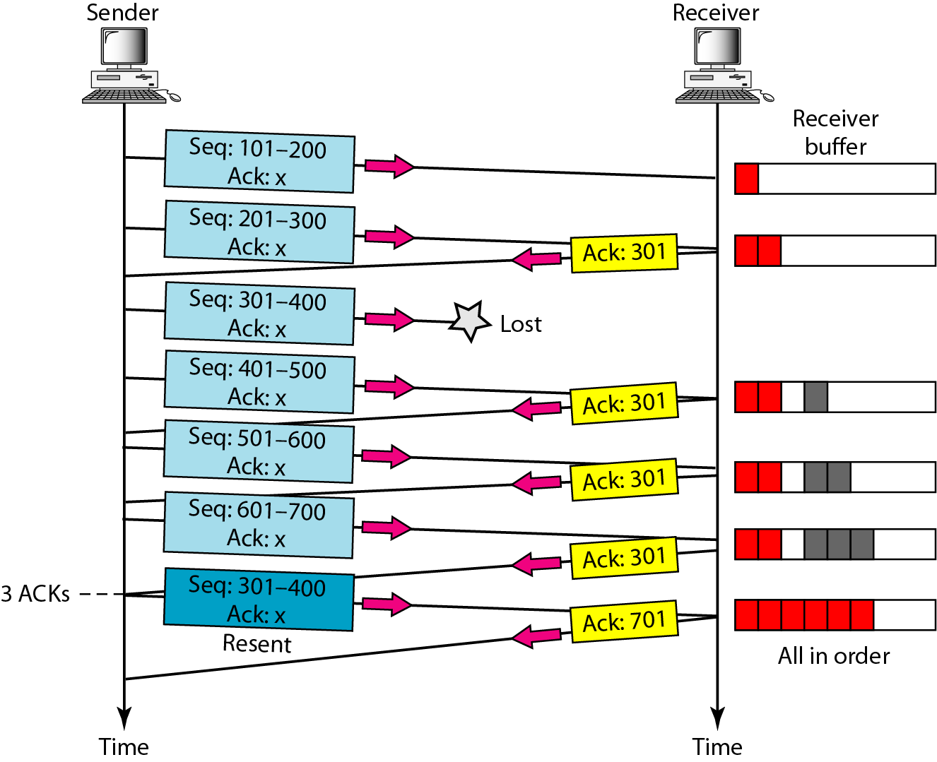
Figure Fast retransmission

Slide 39
Socket programming
Goal: learn how to build client/server applications that communicate using sockets
Socket API
introduced in BSD4.1 UNIX, 1981
explicitly created, used, released by apps
client/server paradigm
two types of transport service via socket API:
unreliable datagram
reliable, byte stream-oriented
socket
a host-local, application-created/owned,
OS-controlled interface (a “door”) into which
application process can both send and
receive messages to/from another (remote or
local) application process

Slide 40
Socket-programming using TCP
Socket: a door between application process and end-end-transport protocol (UDP or TCP)
TCP service: reliable transfer of bytes from one process to another
The application developer has the ability to fix a few TCP parameters, such as maximum buffer and maximum segment sizes.
controlled by
application
developer
controlled by
application
developer
process
process
socket
socket
TCP with
buffers,
variables
TCP with
buffers,
variables
controlled by
operating
system
controlled by
operating
system
internet
host or
server
host or
server

Slide 41
Sockets for server and client
Server
Welcoming socket
Welcomes some initial contact from a client.
Connection socket
Is created at initial contact of client.
New socket that is dedicated to the particular client.
Client
Client socket
Initiate a TCP connection to the server by creating a socket object. (Three-way handshake)
Specify the address of the server process, namely, the IP address of the server and the port number of the process.

Slide 42
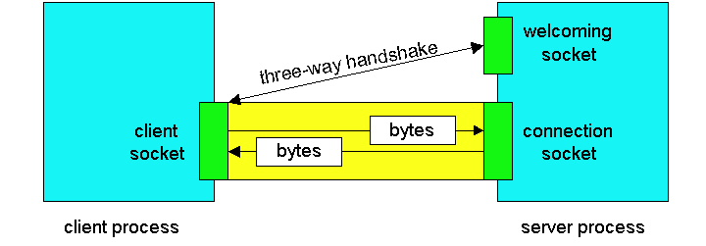
Sockets
Client socket, welcoming socket and connection socket

Slide 43
Socket programming with TCP
When client creates socket: client TCP establishes connection to server TCP
When contacted by client, server TCP creates new socket for server process to communicate with client
allows server to talk with multiple clients
Client must contact server
server process must first be running
server must have created socket that welcomes client’s contact
Client contacts server by:
creating client-local TCP socket
specifying IP address, port number of server process
application viewpoint
TCP provides reliable, in-order
transfer of bytes (“pipe”)
between client and server

Slide 44
Socket functional calls
socket (): Create a socket
bind(): bind a socket to a local IP address and port #
listen(): passively waiting for connections
connect(): initiating connection to another socket
accept(): accept a new connection
Write(): write data to a socket
Read(): read data from a socket
sendto(): send a datagram to another UDP socket
recvfrom(): read a datagram from a UDP socket
close(): close a socket (tear down the connection)

Slide 45
TCP Server
For example: web server
What does a web server need to do so that a web client can connect to it?
Web Server
Port 80
TCP
IP
Ethernet Adapter

Slide 46
TCP Client
For example: web client
How does a web client connect to a web server?
2 Web Clients
TCP
IP
Ethernet Adapter

Slide 47
Socket I/O: socket()
Since web traffic uses TCP, the web server must create a socket of type SOCK_STREAM
int fd; /* socket descriptor */
if((fd = socket(AF_INET, SOCK_STREAM, 0)) < 0) {
perror(“socket”);
exit(1);
}
socket returns an integer (socket descriptor)
fd < 0 indicates that an error occurred
AF_INET associates a socket with the Internet protocol family
SOCK_STREAM selects the TCP protocol

Slide 48
Socket I/O: bind()
A socket can be bound to a port
int fd; /* socket descriptor */
struct sockaddr_in srv; /* used by bind() */
/* create the socket */
srv.sin_family = AF_INET; /* use the Internet addr family */
srv.sin_port = htons(80); /* bind socket ‘fd’ to port 80*/
/* bind: a client may connect to any of my addresses */
srv.sin_addr.s_addr = htonl(INADDR_ANY);
if(bind(fd, (struct sockaddr*) &srv, sizeof(srv)) < 0) {
perror("bind"); exit(1);
}
Still not quite ready to communicate with a client...

Slide 49
Socket I/O: listen()
listen indicates that the server will accept a connection
int fd; /* socket descriptor */
struct sockaddr_in srv; /* used by bind() */
/* 1) create the socket */
/* 2) bind the socket to a port */
if(listen(fd, 5) < 0) {
perror(“listen”);
exit(1);
}
Still not quite ready to communicate with a client...

Slide 50
Socket I/O: accept()
accept blocks waiting for a connection
int fd; /* socket descriptor */
struct sockaddr_in srv; /* used by bind() */
struct sockaddr_in cli; /* used by accept() */
int newfd; /* returned by accept() */
int cli_len = sizeof(cli); /* used by accept() */
/* 1) create the socket */
/* 2) bind the socket to a port */
/* 3) listen on the socket */
newfd = accept(fd, (struct sockaddr*) &cli, &cli_len);
if(newfd < 0) {
perror("accept"); exit(1);
}
accept returns a new socket (newfd) with the same properties as the original socket (fd)
newfd < 0 indicates that an error occurred

Slide 51
Socket I/O: accept() continued...
struct sockaddr_in cli; /* used by accept() */
int newfd; /* returned by accept() */
int cli_len = sizeof(cli); /* used by accept() */
newfd = accept(fd, (struct sockaddr*) &cli, &cli_len);
if(newfd < 0) {
perror("accept");
exit(1);
}
How does the server know which client it is?
cli.sin_addr.s_addr contains the client’s IP address
cli.sin_port contains the client’s port number
Now the server can exchange data with the client by using read and write on the descriptor newfd.
Why does accept need to return a new descriptor?

Slide 52
Socket I/O: read()
read can be used with a socket
read blocks waiting for data from the client but does not guarantee that sizeof(buf) is read
int fd; /* socket descriptor */
char buf[512]; /* used by read() */
int nbytes; /* used by read() */
/* 1) create the socket */
/* 2) bind the socket to a port */
/* 3) listen on the socket */
/* 4) accept the incoming connection */
if((nbytes = read(newfd, buf, sizeof(buf))) < 0) {
perror(“read”); exit(1);
}

Slide 53
Dealing with IP Addresses
IP Addresses are commonly written as strings (“128.2.35.50”), but programs deal with IP addresses as integers.
Converting strings to numerical address:
struct sockaddr_in srv;
srv.sin_addr.s_addr = inet_addr(“128.2.35.50”);
if(srv.sin_addr.s_addr == (in_addr_t) -1) {
fprintf(stderr, "inet_addr failed!\n"); exit(1);
}
Converting a numerical address to a string:
struct sockaddr_in srv;
char *t = inet_ntoa(srv.sin_addr);
if(t == 0) {
fprintf(stderr, “inet_ntoa failed!\n”); exit(1);
}

Slide 54
Translating Names to Addresses
gethostbyname provides interface to DNS
Additional useful calls
gethostbyaddr – returns hostent given sockaddr_in
getservbyname
Used to get service description (typically port number)
Returns servent based on name
#include <netdb.h>
struct hostent *hp; /*ptr to host info for remote*/
struct sockaddr_in peeraddr;
char *name = “www.cs.cmu.edu”;
peeraddr.sin_family = AF_INET;
hp = gethostbyname(name)
peeraddr.sin_addr.s_addr = ((struct in_addr*)(hp->h_addr))->s_addr;

Slide 55
Socket I/O: connect()
connect allows a client to connect to a server...
int fd; /* socket descriptor */
struct sockaddr_in srv; /* used by connect() */
/* create the socket */
/* connect: use the Internet address family */
srv.sin_family = AF_INET;
/* connect: socket ‘fd’ to port 80 */
srv.sin_port = htons(80);
/* connect: connect to IP Address “128.2.35.50” */
srv.sin_addr.s_addr = inet_addr(“128.2.35.50”);
if(connect(fd, (struct sockaddr*) &srv, sizeof(srv)) < 0) {
perror(”connect"); exit(1);
}

Slide 56
Socket I/O: write()
write can be used with a socket
int fd; /* socket descriptor */
struct sockaddr_in srv; /* used by connect() */
char buf[512]; /* used by write() */
int nbytes; /* used by write() */
/* 1) create the socket */
/* 2) connect() to the server */
/* Example: A client could “write” a request to a server */
if((nbytes = write(fd, buf, sizeof(buf))) < 0) {
perror(“write”);
exit(1);
}

Slide 57
Review: TCP Client-Server Interaction
TCP Server
socket()
bind()
TCP Client
listen()
socket()
accept()
connection establishment
connect()
data request
read()
write()
data reply
write()
read()
close()
end-of-file notification
read()
close()
from UNIX Network Programming Volume 1, figure 4.1

