Slide 1
CSE/PC/B/T/316 Computer Networks Topic 4- Multiple Access Protocols (CSMA)
Sarbani Roy
sarbani.roy@jadavpuruniversity.in
Office: CC-5-7
Cell: 9051639328

Slide 2
Carrier Sense Multiple Access (CSMA)
To minimize the chance of collision and therefore, increase the performance, the CSMA method.
The chance of collision can be reduced if a station senses the medium before trying to use it.
CSMA requires that each station first listen to the medium (or check the state of the medium) before sending.
Based on the principle “Sense before transmit” or “Listen before talk”

Slide 3
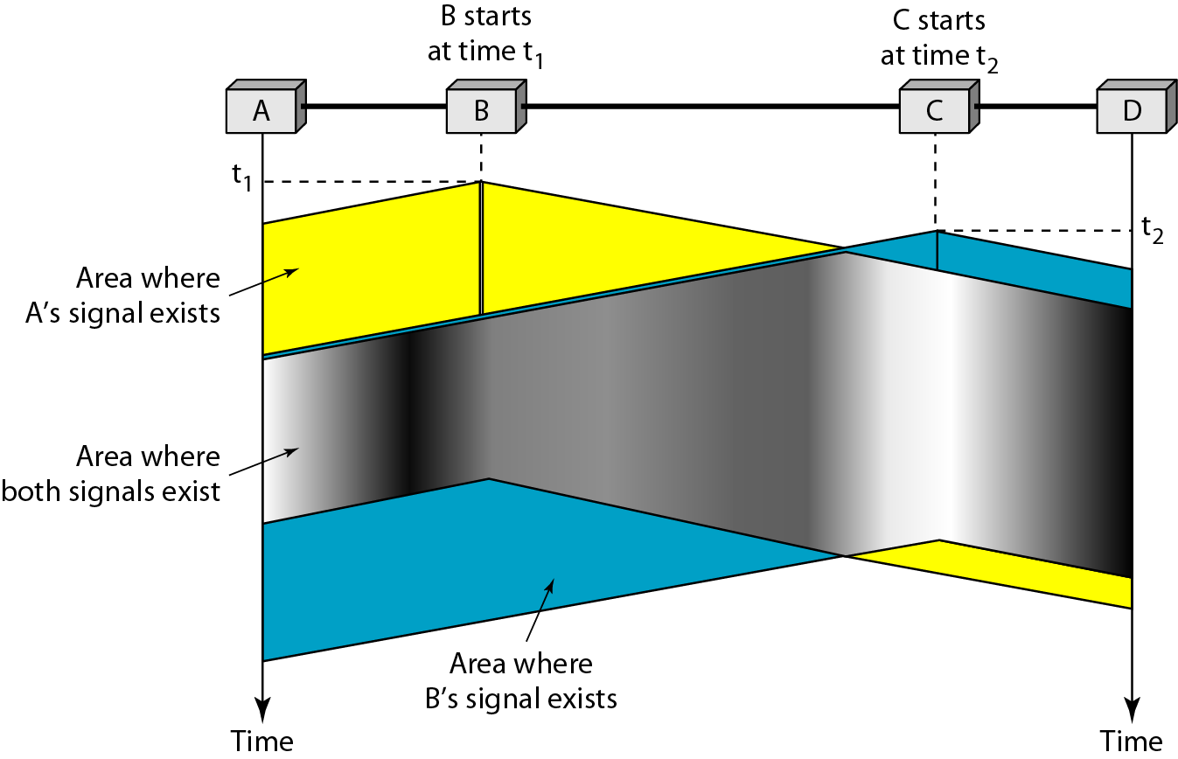
Space/time model of the collision in CSMA
t2 > t1
Area whers B’s Signal exists
Area whers C’s Signal exists

Slide 4
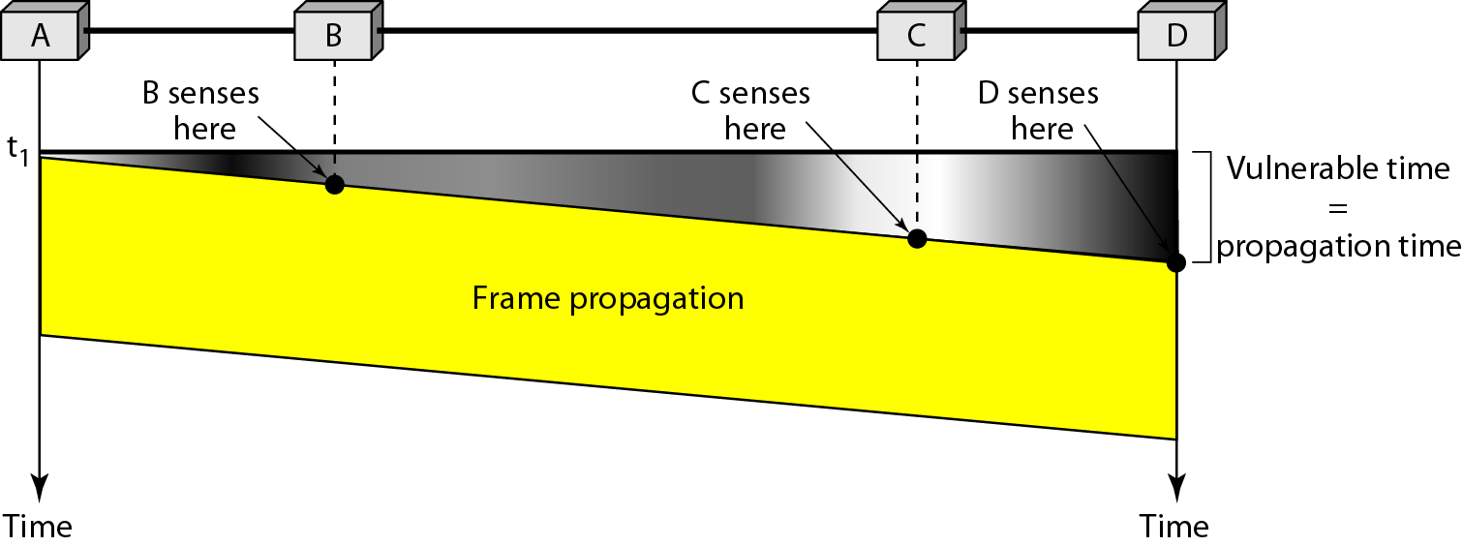
Vulnerable time in CSMA

Slide 5
Persistence methods
What should a station do if the channel is busy?
What should a station do if the channel is idle?
Three methods have been devised to answer these questions: the 1-persistent, the nonpersistent and the p-persistent method

Slide 6
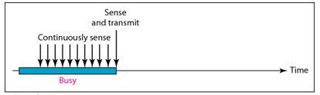
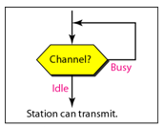
1-Persistent
The 1-persistent method is simple and straightforward. In this method, after the station finds the line idle, it sends its frame immediately (with probability 1). This method has the highest chance of collision because two or more stations may find the line idle and send their frames immediately. Ethernet uses this method

Slide 7
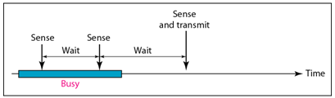
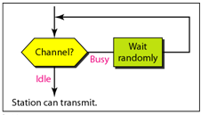
Nonpersistent
In the nonpersistent method, a station that has a frame to send senses the line. If the line is idle, it sends immediately. If the line is not idle, it waits for a random amount of time and then senses the line again. The non persistent approach reduces the chance of collision because it is unlikely that two or more stations will wait the same amount of time and retry to send simultaneously.
However, this method reduces the efficiency of the network because the medium remains idle when there may be stations with frames to send.

Slide 8
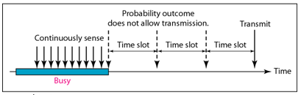
p-Persistent
The p-persistent method is used if the channel has time slots with a slot duration equal to or greater than the maximum propagation time. The p-persistent approach combines the advantage of the other two strategies. It reduces the chance of collision and improves efficiency. In this method, after the station finds the line idle it follows these steps:
1. with probability p, the station sends its frame.
2. with probability q=1-p, the station waits for the beginning of the next time slot and checks the line again.
a. if the line is idle, it goes to step 1.
b. if the line is busy, it acts as though a collision has occurred and uses the back-off procedure.

Slide 9
Algorithm of p–persistent CSMA
When a frame is ready, the transmitting station checks whether the channel is idle or busy.
If the channel is idle then it transmits the frame immediately.
If the channel is busy, the station waits and continually checks until the channel becomes idle.
When the channel becomes idle, the station transmits the frame with a probability p.
With a probability ( 1 – p ), the channel waits for next time slot. If the next time slot is idle, it again transmits with a probability p and waits with a probability ( 1 – p ).
The station repeats this process until either frame has been transmitted or another station has begun transmitting.
If another station begins transmitting, the station waits for a random amount of time and restarts the algorithm.

Slide 10
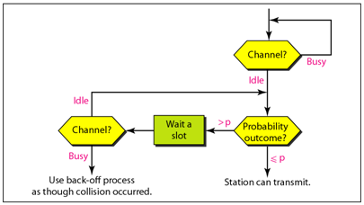
p-Persistent

Slide 11
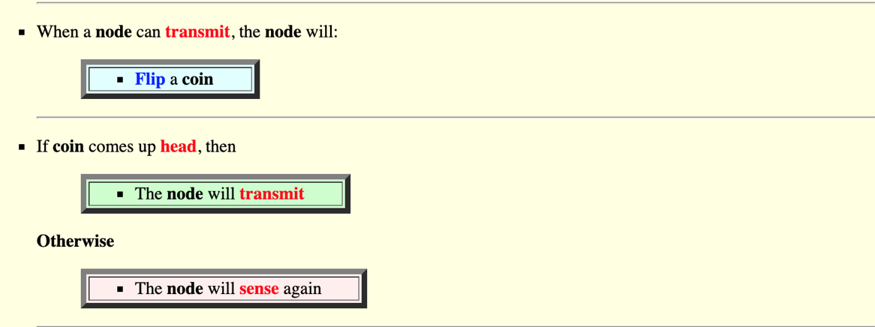
p-persistent

Slide 12
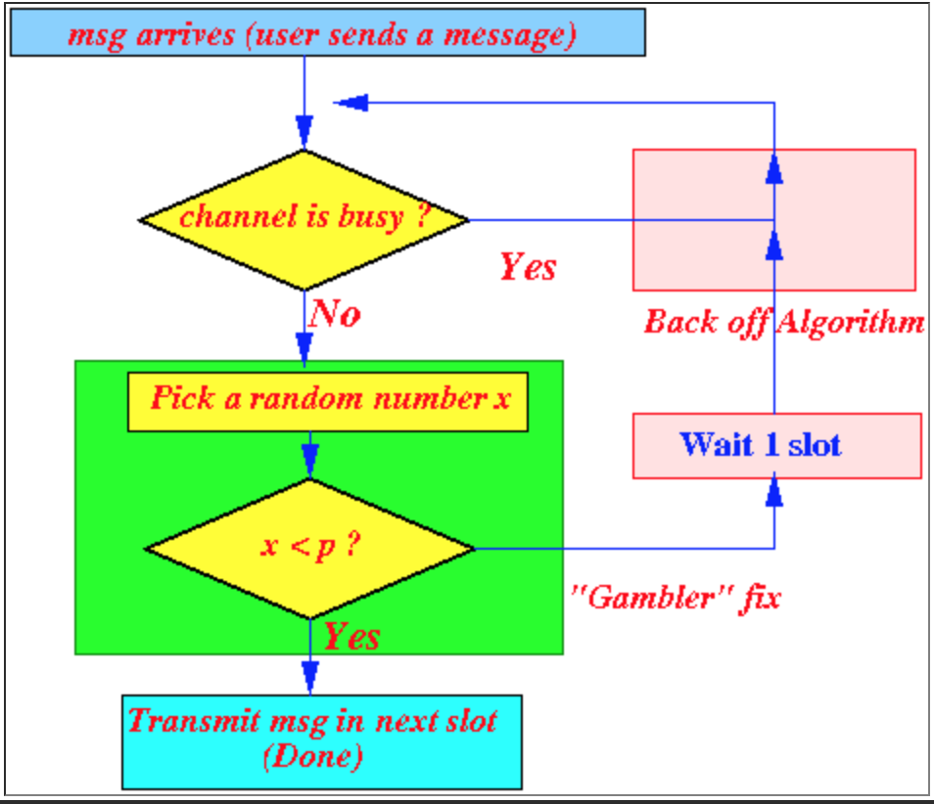

Slide 13
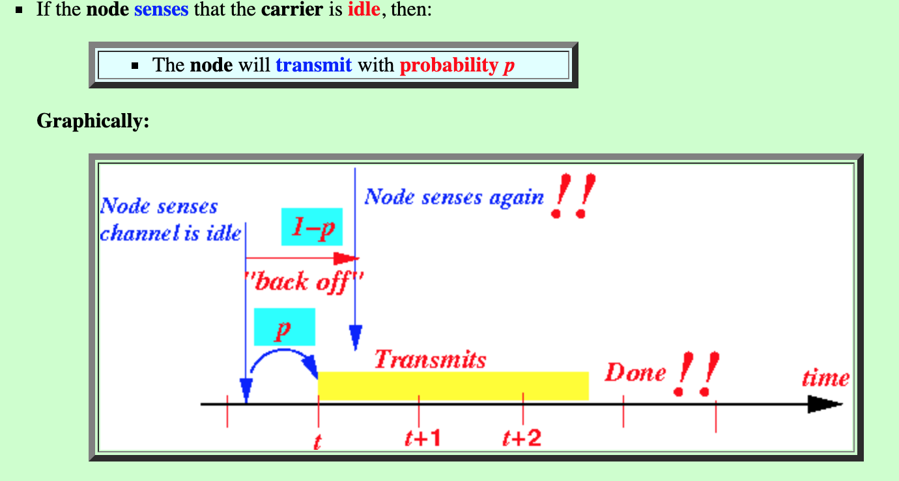

Slide 14
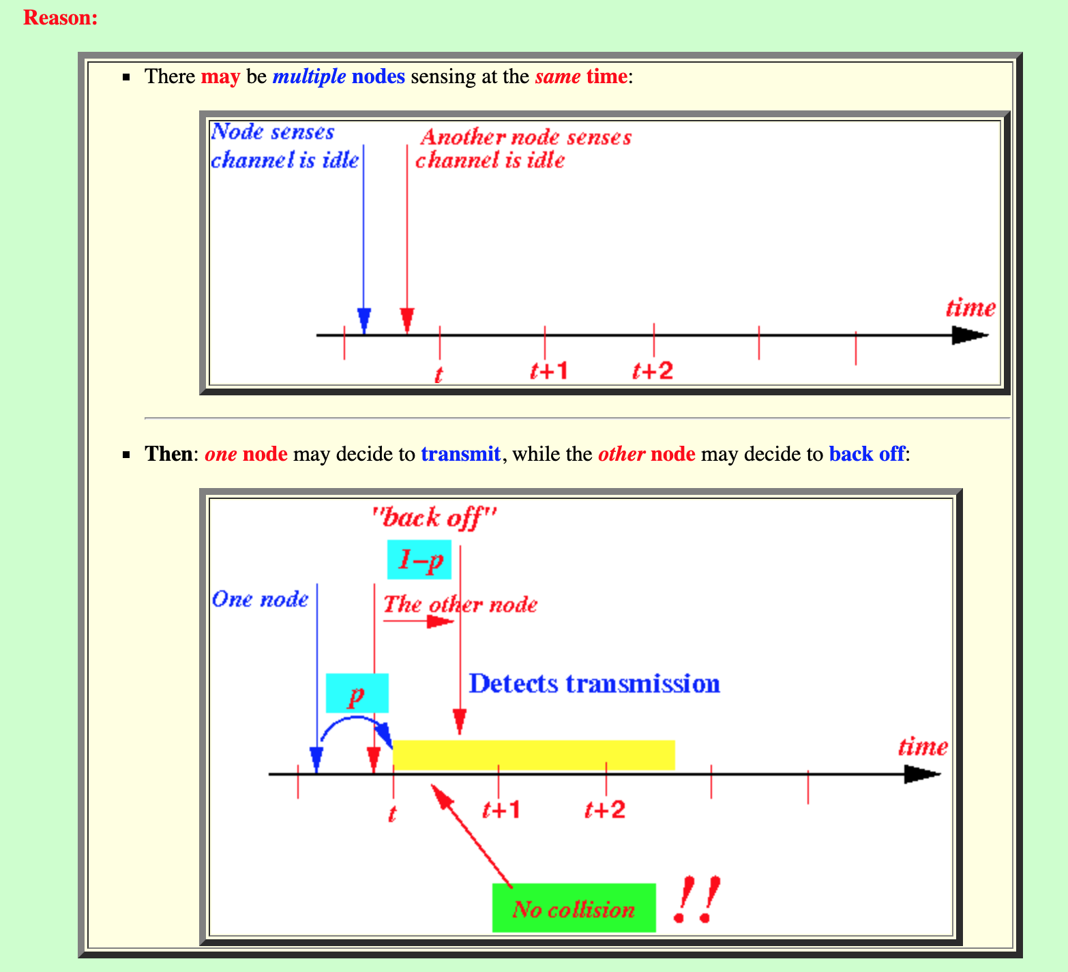

Slide 15
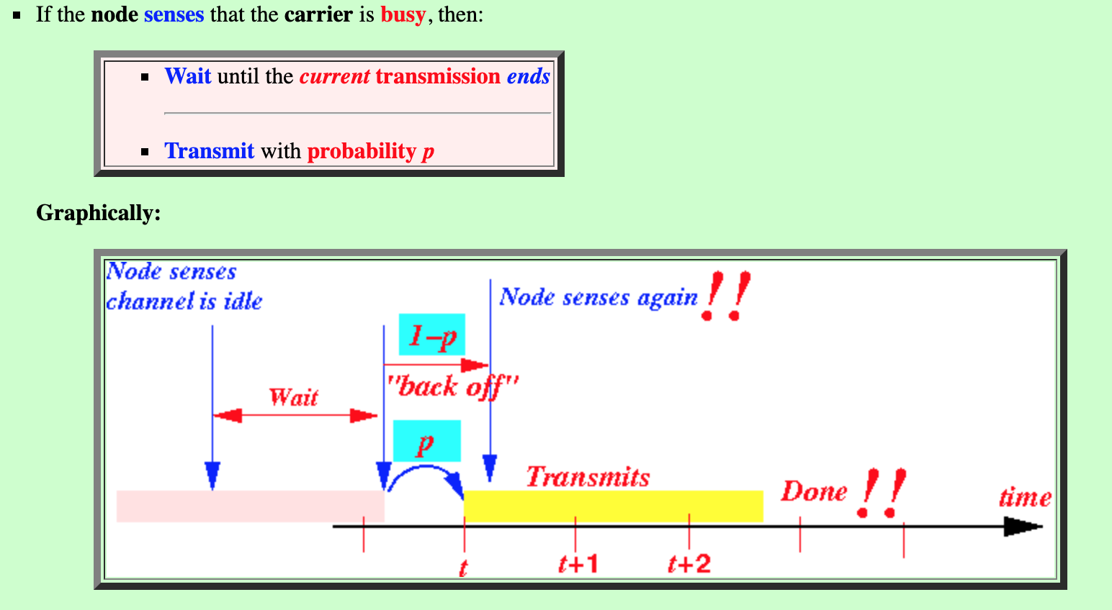

Slide 16
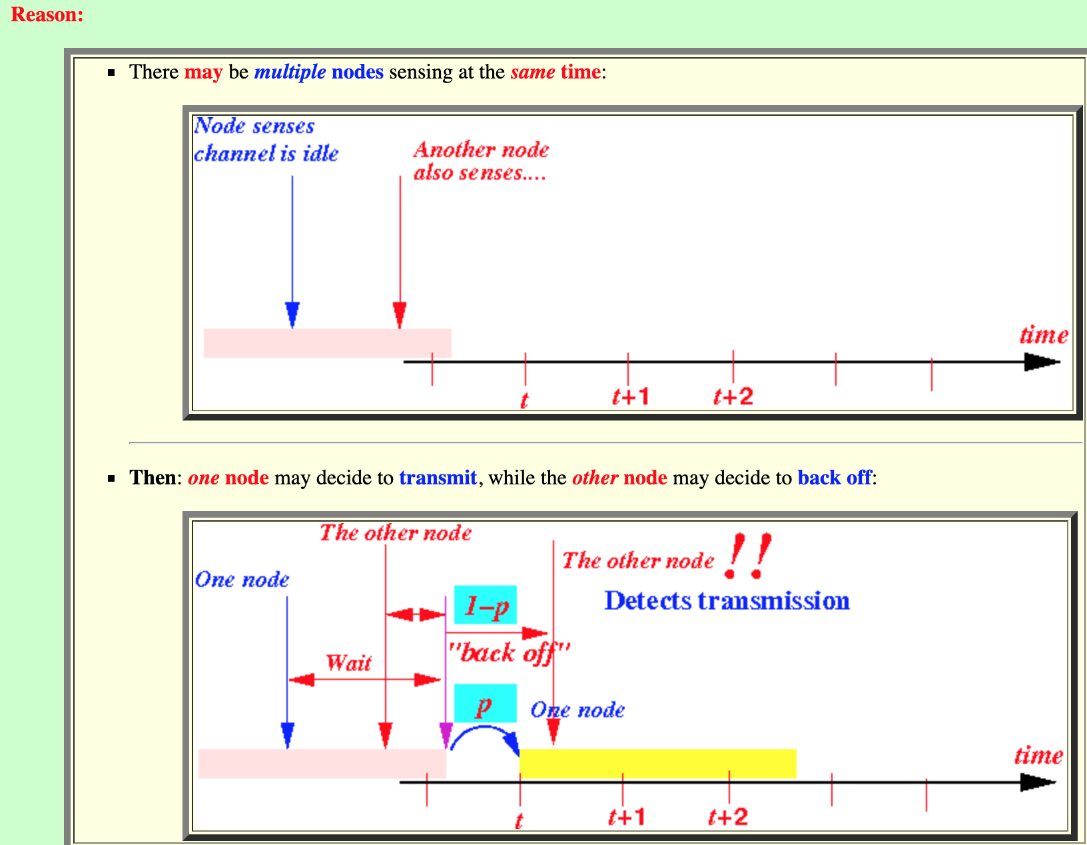

Slide 17
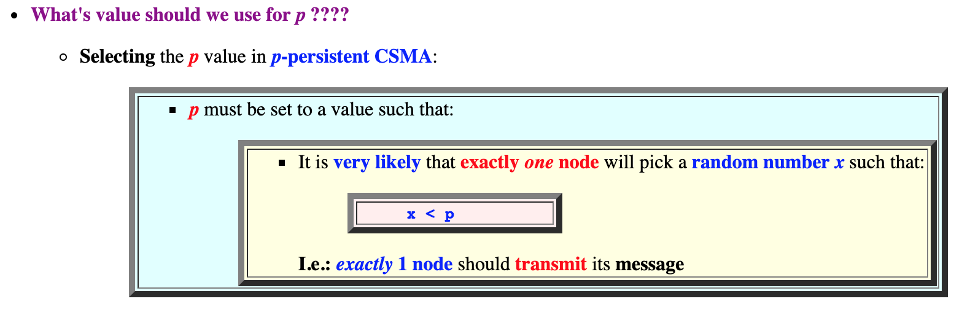

Slide 18
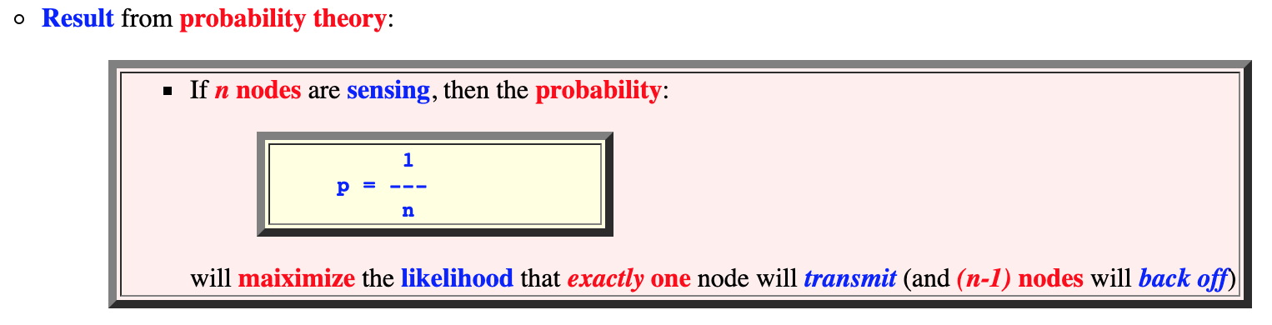

Slide 19
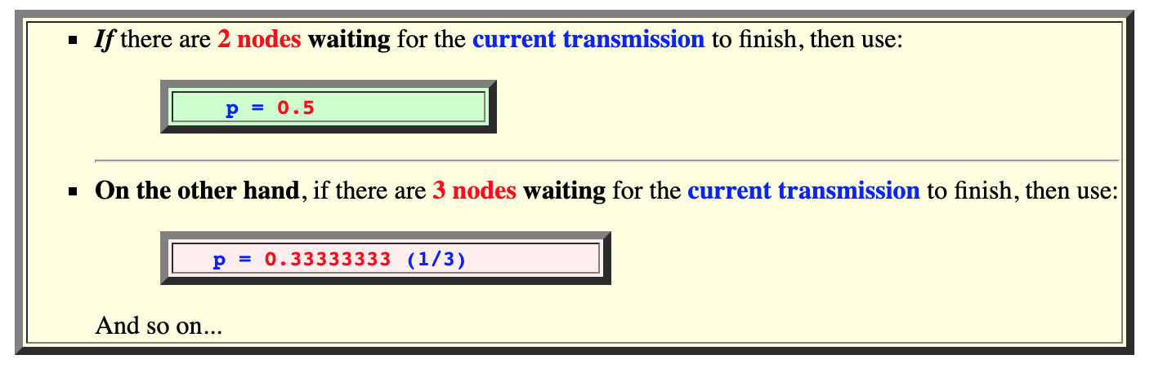

Slide 20
Advantage
P-persistent is the most efficient one.
It reduces the number of collisions considerably as compared to 1-persistent CSMA. The channel utilization is much better than non-persistent CSMA.

Slide 21
Throughput of p-persistent CSMA
For low/intermediate values of propagation delay and with p optimized, throughput of p-persistent CSMA lies between that of slotted and unslotted non-persistent CSMA
For long propagation delays, p-persistent CSMA throughput exceeds that of non-persistent CSMA

Slide 22
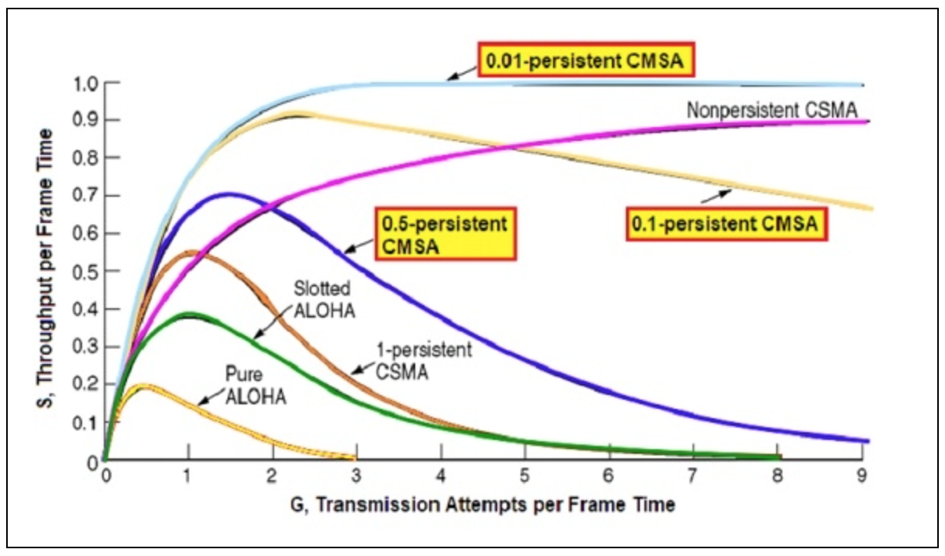
Comparison of Throughputs
The throughput of a network system is defined as the number of successful transmissions per frame time. The through put of p-persistent CMSA depends upon the value of p. In general, lower the value of p, greater the throughput. However, with lower values of p, channel utilization also reduces.

Slide 23
Problem in CSMA
The CSMA method does not specify the procedure following a collision.

Slide 24
CSMA with Collision Detection (CSMA/CD)
To overcome the problem of CSMA, CSMA with collision detection i.e., CSMA/CD augments the algorithm to handle the collision.
In CSMA/CD, a station monitors the medium after it sends a frame to see if the transmission was successful. If so, the station is done. If however, there is a collision the frame is sent again.

Slide 25
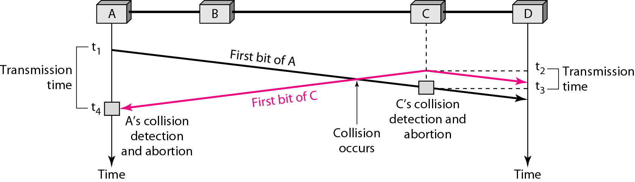
Collision of the first bit in CSMA/CD

Slide 26
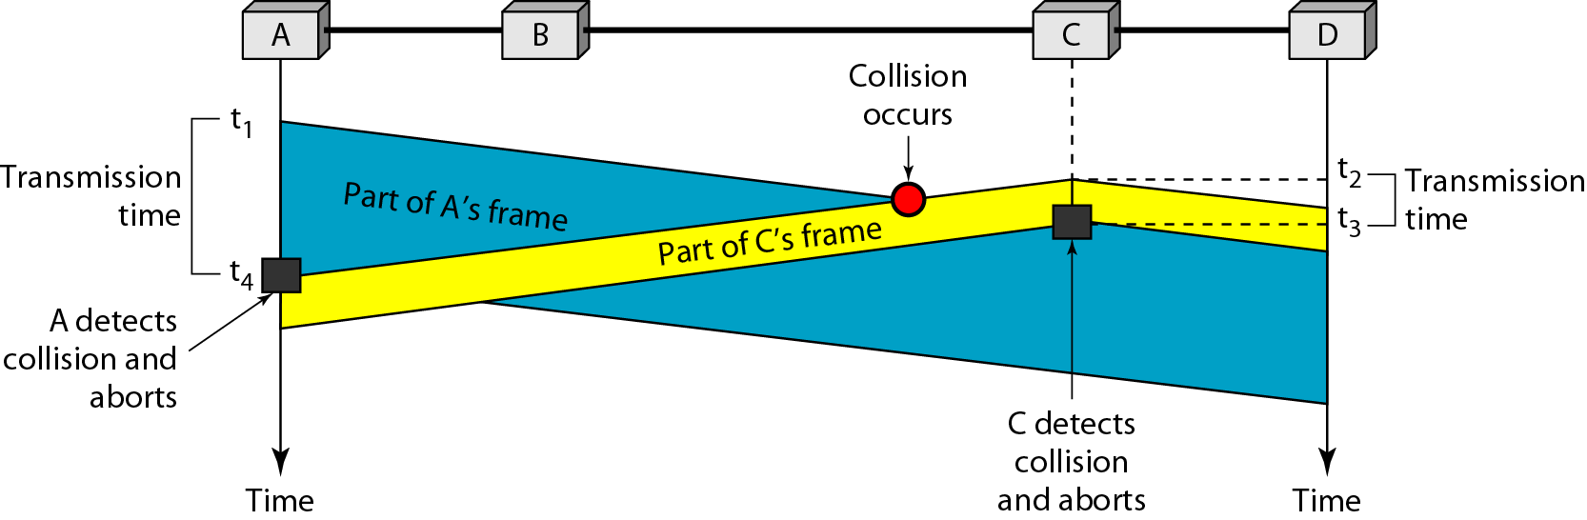
Collision and abortion in CSMA/CD

