Slide 1
CSE/PC/B/T/316 Computer Networks Topic 9- IEEE 802.15.1 Bluetooth
Sarbani Roy
sarbani.roy@jadavpuruniversity.in
Office: CC-5-7
Cell: 9051639328

Slide 2
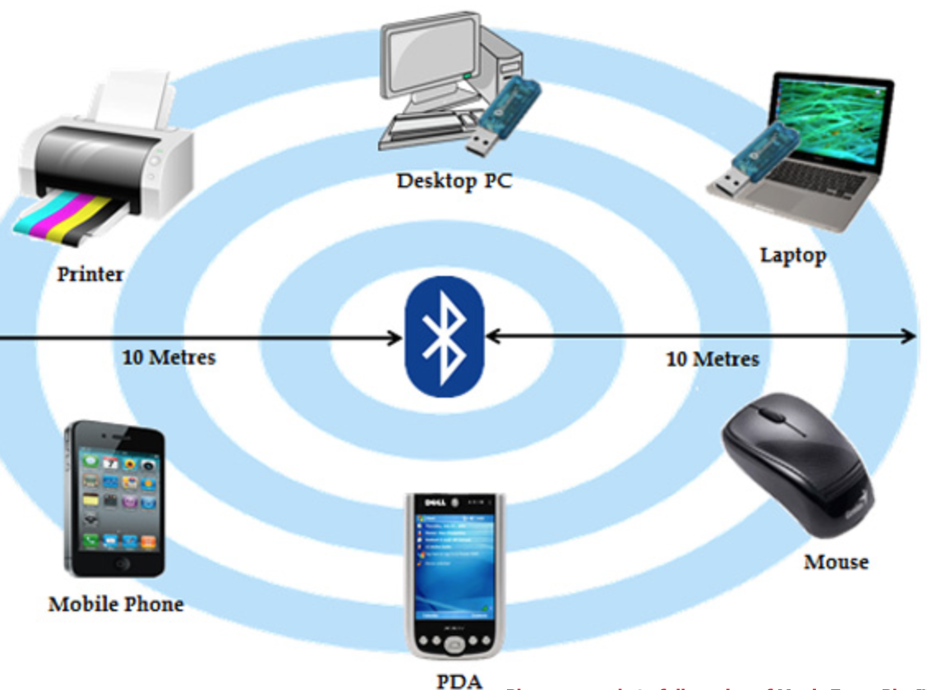
Bluetooth
Bluetooth is a wireless LAN technology 802.15 (Wireless Personal Area Network) designed to connect devices of different functions such as telephones, notebooks, computers, cameras, printers, coffee makers, and so on. A Bluetooth LAN is an ad hoc network, which means that the network is formed spontaneously.

Slide 3
Bluetooth Overview
Wireless technology for short-range voice and data communication
Devices can communicate with each other with wireless connectivity
Low-cost and low-power
Connects a wide range of computing and telecommunication devices
Expand communication capabilities
Provides a communication platform between a wide range of “smart” devices
Not limited to “line of sight” communication

Slide 4
Summary
Bluetooth is a global, RF-based (ISM band: 2.4 GHz), short-range, connectivity solution for portable, personal devices
it is not just a radio, it is an end-to-end solution
The Bluetooth spec comprises
a HW & SW protocol specification
usage case scenario profiles and interoperability requirements
IEEE 802.15.1 is working on standardizing the PHY and MAC layers in Bluetooth
More Info:
http://www.bluetooth.org
http://ieee802.org/15/pub/TG1.html

Slide 5
Products
Notebook PCs & desktop computers
Printers
PDAs
Other handheld devices
Cell phones
Wireless periperals:
Headsets
Cameras
Access Points
CD Player
TV/VCR/DVD
Telephone Answering Devices
Cordless Phones
Cars
Hands free calls

Slide 6
Connecting to Internet
Being able to gain access to the Internet by using “Bluetooth access points”
Access point is used as a gateway to the internet
Both the access point and the device are Bluetooth-enabled
An example of Service Discovery Protocol
Access point provides a service to the device

Slide 7
Bluetooth Specifications
Things that you must have:
Transceivers and Receivers that can send and receive data because they use Radio Waves.
MAC Address (Physical Address)
Burnt on the NIC card by the manufacturer.
PIN Number
To identify the user using the device.
A Piconet
A FHSS protocol

Slide 8
The Bluetooth network topology
Radio designation
Connected radios can be master or slave
Radios are symmetric (same radio can be master or slave)
Piconet
Master can connect to 7 simultaneous or 200+ inactive (parked) slaves per piconet
Each piconet has maximum capacity (1 MSPS (Mega Samples Per Second)
Unique hopping pattern/ID
Scatternet
Piconets can coexist in time and space
S
M
P
S
sb
S
P
P
sb
M
S

Slide 9
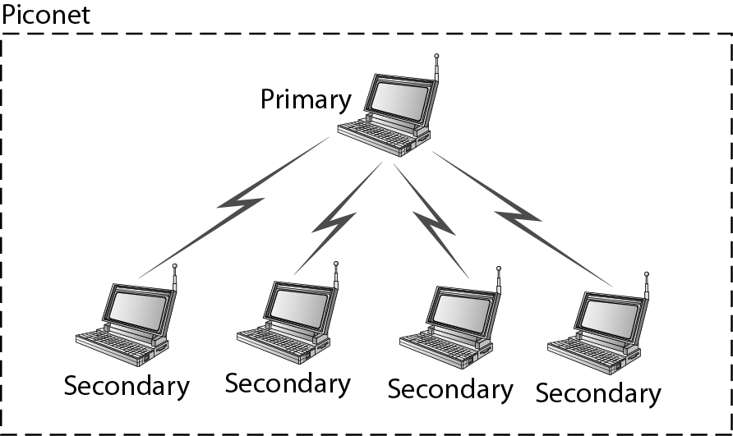
Piconet

Slide 10
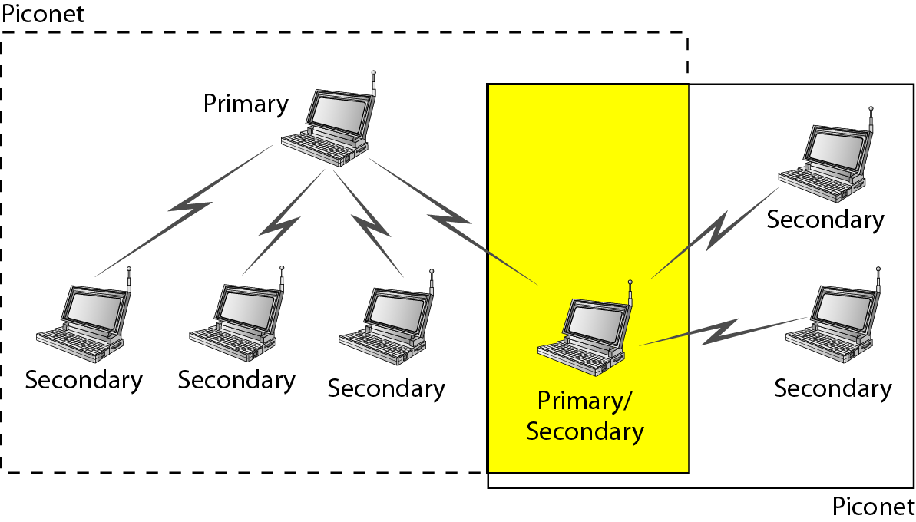
Scatternet

Slide 11
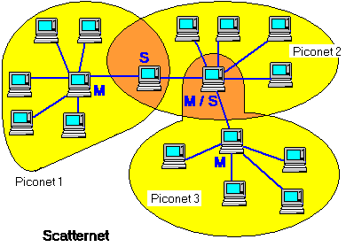
Establishing Piconets
Whenever there is a connection between two Bluetooth devices, a piconet is formed
Always 1 master and up to 7 active slaves
Any Bluetooth device can be either a master or a slave
Can be a master of one piconet and a slave of another piconet at the same time (scatternet)
All devices have the same timing and frequency hopping sequence

Slide 12
Scatternets
Formed by two or more Piconets
Master of one piconet can participate as a slave in another connected piconet
No time or frequency synchronization between piconets

Slide 13
The Piconet
D
A
E
B
C
All devices in a piconet hop together
To form a piconet: master gives slaves its clock and device ID
Hopping pattern determined by device ID (48-bit)
Phase in hopping pattern determined by Clock
Non-piconet devices are in standby
Piconet Addressing
Active Member Address (AMA, 3-bits)
Parked Member Address (PMA, 8-bits)
or

Slide 14
Inter-connected Piconets - The Scatternet
Complex
Access Point
LAN
Mobile Phone
Headset
Printer
Laptop
master
Laptop
Mouse
slave
master/slave

Slide 15
FHSS
Bluetooth devices use a protocol called (FHSS) Frequency-Hopping Spread Spectrum .
Uses packet-switching to send data.
Bluetooth sends packets of data on a range of frequencies.
In each session one device is a master and the others are slaves.
The master device decides at which frequency data will travel.

Slide 16
FHSS
Transceivers “hop” among 79 different frequencies in the 2.4 GHz baud at a rate of 1600 frequency hops per second.
The master device tells the slaves at what frequency data will be sent.
This technique allows devices to communicate with each other more securely.

Slide 17
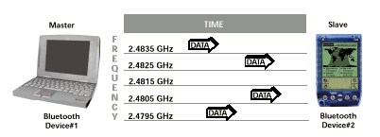
FHHS Example
Source: http://www.xircom.com

Slide 18
The Bluetooth protocols
Applications
Other
TCS
RFCOMM
SDP
Application Framework and Support
Data
Control
Host Controller Interface
Audio
L2CAP
Link Manager and L2CAP
Link Manager
Baseband
Radio & Baseband
RF
A hardware/software description
An application framework

Slide 19
Core Protocols
Radio: Specification of the air interface, i.e., frequencies, modulation, and transmit power
Baseband: Description of basic connection establishment, packet formats, timing, and basic QoS parameters
Link manager protocol: Link set-up and management between devices including security functions and parameter negotiation
Logical link control and adaptation protocol (L2CAP): Adaptation of higher layers to the baseband (connectionless and connection-oriented services
Service discovery protocol: Device discovery in close proximity plus querying of service characteristics

Slide 20
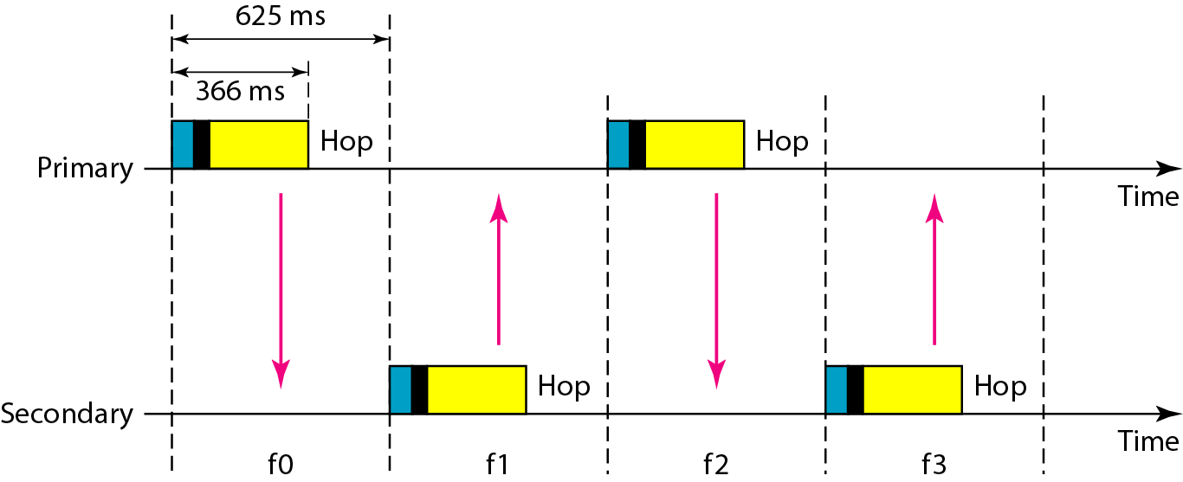
Single-secondary communication

Slide 21
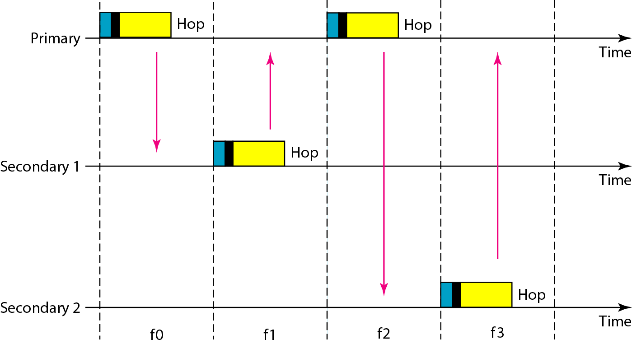
Multiple-secondary communication

Slide 22
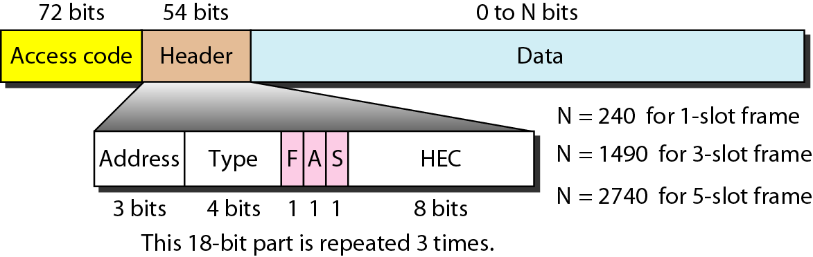
Frame format types

Slide 23
Access code
The access code consists of a 4 bit preamble, a synchronization field, and a trailer (if a packet header follows).
The 64-bit synchronization field is derived from the lower 24 bit of an address (lower address part, LAP).
If the access code is used for channel access (i.e., data transmission between a master and a slave or vice versa), the LAP is derived from the master’s globally unique 48-bit address.
In case of paging the LAP of the paged device is used.
If a Bluetooth device wants to discover other (arbitrary) devices in transmission range (general inquiry procedure) it uses a special reserved LAP.
Special LAPs can be defined for inquiries of dedicated groups of devices.

Slide 24
Packet header: address, type
This field contains typical layer 2 features: address, packet type, flow and error control, and checksum.
The 3-bit active member address represents the active address of a slave Active addresses are temporarily assigned to a slave in a piconet.
If a master sends data to a slave the address is interpreted as receiver address.
If a slave sends data to the master the address represents the sender address.
The zero value is reserved for a broadcast from the master to all slaves.
The 4-bit type field determines the type of the packet.

Slide 25
Packet header: flow, ARQN
A simple flow control mechanism for asynchronous traffic uses the 1-bit flow field.
If a packet is received with flow=0 asynchronous data, transmission must stop.
As soon as a packet with flow=1 is received, transmission may resume.
If an acknowledgement of packets is required, Bluetooth sends this in the slot following the data (using its time division duplex scheme).

Slide 26
Packet header: SEQN, HEC
A simple alternating bit protocol with a single bit sequence number SEQN and acknowledgement number ARQN can be used.
An 8-bit header error check (HEC) is used to protect the packet header.
The packet header is also protected by a one-third rate forward error correction (FEC) code because it contains valuable link information and should survive bit errors. Therefore, the 18-bit header requires 54 bits in the packet.

Slide 27
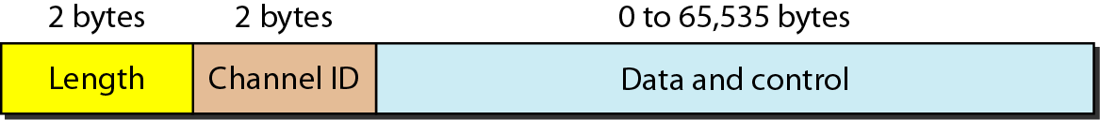
L2CAP data packet format

Slide 28
Baseband Layer
Provides in-order delivery of byte streams
Handles Frequency Hop Sequences for Synchronization and Transmission
Establishes Links
Synchronous Connection Oriented (SCO)
Asynchronous Connection-Less (ACL)
Provides functionality to determine nearby Bluetooth devices

Slide 29
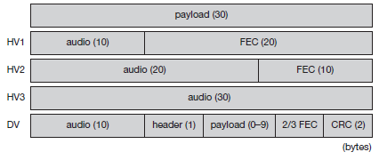
SCO
Classical telephone (voice) connections require symmetrical, circuit-switched, point-to-point connections.
For this type of link, the master reserves two consecutive slots (forward and return slots) at fixed intervals.
A master can support up to three simultaneous SCO links to the same slave or to different slaves.
A slave supports up to two links from different masters or up to three links from the same master.
Using an SCO link, three different types of single-slot packets can be used

Slide 30
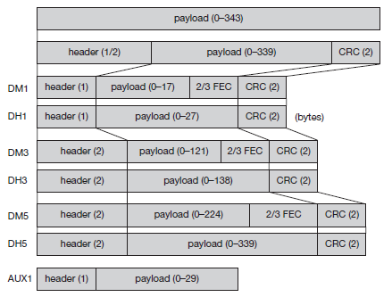
ACL
Typical data applications require symmetrical or asymmetrical (e.g., web traffic), packet-switched, point-to-multipoint transfer scenarios (including broadcast).
Here the master uses a polling scheme. A slave may only answer if it has been addressed in the preceding slot.
Only one ACL link can exist between a master and a slave.
For ACLs carrying data, 1-slot, 3-slot or 5-slot packets can be used

Slide 31
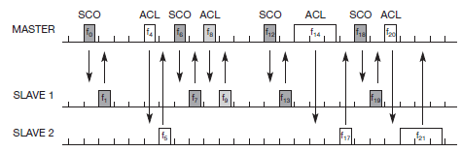
Example data transmission
The master always uses the even frequency slots, the odd slots are for the slaves.
In this example every sixth slot is used for an SCO link between the master and slave 1. The ACL links use single or multiple slots providing asymmetric bandwidth for connectionless packet transmission. This example again shows the hopping sequence which is independent of the transmission of packets.

Slide 32
Functional Overview
Standby
Waiting to join a piconet
Inquire
Ask about radios to connect to
Page
Connect to a specific radio
Connected
Actively on a piconet (master or slave)
Park/Hold
Low Power connected states

Slide 33
Link Manager Operation
Devices operate in standby mode by default until they become connected to a piconet
4 Connection Modes
Active
Hold
Park
Sniff
Modes allow devices to adjust power consumption, performance, and the number/role of participants in a piconet

Slide 34
Active Mode
Limited to 7 Active slaves for each master
Three bit address (AM_ADDR) given to each active slave
Unit actively participates on channel
Can receive communications in any given frame
Active slaves are polled by master for transmissions
Unit operates on high-power

Slide 35
Hold Mode
Frees slave to
Attend another Piconet
Perform scanning, paging, or inquiry operations
Move into low-power sleep
Unit keeps active member address
Unit does not support ACL packets on the channel but may support SCO packets
Master and slave agree on a one time hold duration after which the slave revives and synchronizes with channel traffic
Unit operates on low-power

Slide 36
Sniff Mode
Very similar to hold mode
Slave is freed for reoccurring fixed time intervals
Master can only communicate during arranged “sniff” time slots

Slide 37
Park Mode
Parked unit gives up active member address and is assigned
8 bit Parked member address (PM_ADDR) – allows master to unpark slave
8 bit Access request address (AR_ADDR) – allows slave to ask master to unpark it
Unit stays synchronized to channel
Operates in very low-power sleep

Slide 38
Park Mode (cont.)
Provides the ability to connect more than 7 devices to a master (8 bit PM_ADDR allows 255 parked devices)
Active and Parked slaves can be switched in and out to allow many connections to a single piconet

Slide 39
Bluetooth Security
There are three modes of security for Bluetooth access between two devices.
non-secure
service level enforced security
link level enforced security
Device security level
Trusted
untrusted
Service security level
Authorization and Authentication
Authentication only
Open to all devices

Slide 40
Bluetooth Security
The following are the three basic security services specified in the Bluetooth standard:
Authentication
verifying the identity of communicating devices. User authentication is not provided natively by Bluetooth.
Confidentiality
preventing information compromise caused by eavesdropping by ensuring that only authorized devices can access and view data.
Authorization
allowing the control of resources by ensuring that a device is authorized to use a service before permitting it to do so.

Slide 41
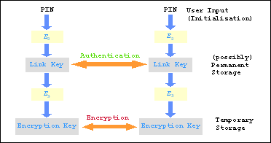
Security
Authentication and encryption is provided at the Link Manager layer.
The PIN is translated into a 128 bit link key which is used for authentication.
After authentication the radios will settle on a suitable length encryption key to be used.
Bluetooth relies on PIN codes to establish trusted relationships between devices.

