Slide 1
CSE/PC/B/T/316 Computer Networks Problems
Sarbani Roy
sarbani.roy@jadavpuruniversity.in
Office: CC-5-7
Cell: 9051639328

Slide 2
MAC and Connecting Devices

Slide 3
Problem
Determine the maximum length of the cable (in km) for transmitting data at a rate of 500 Mbps in an Ethernet LAN with frames of size 10,000 bits. Assume the signal speed in the cable to be 2,00,000 km/s.
A. 1
B. 2
C. 2.5
D. 5

Slide 4
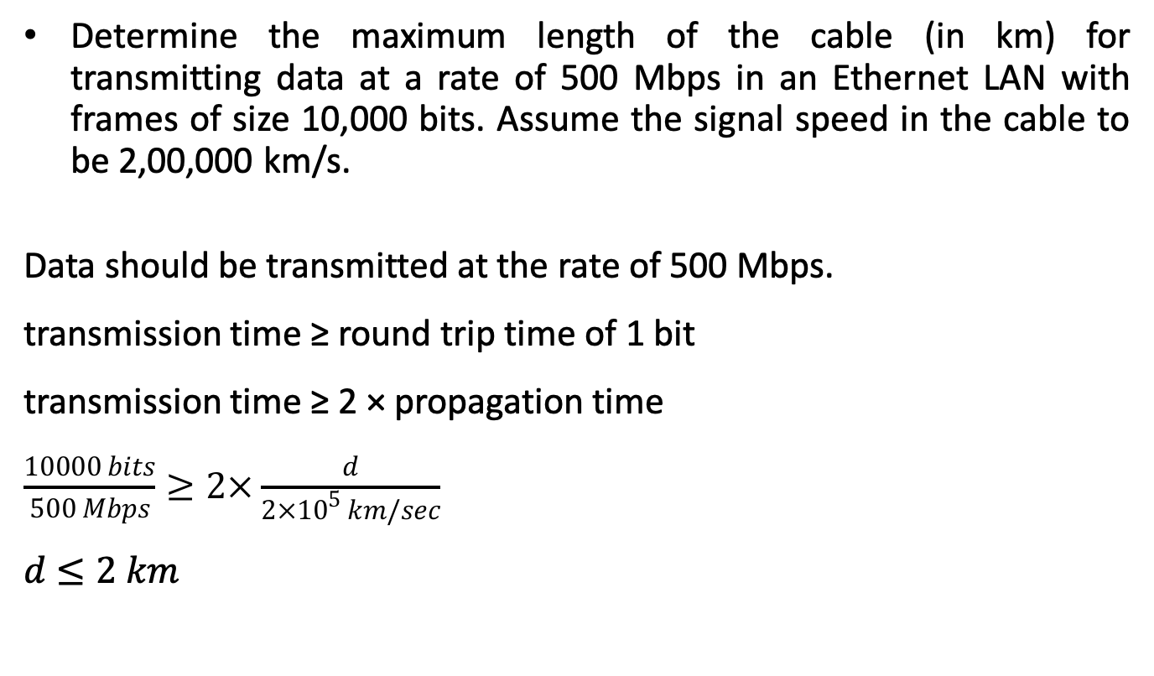
Solution
Determine the maximum length of the cable (in km) for transmitting data at a rate of 500 Mbps in an Ethernet LAN with frames of size 10,000 bits. Assume the signal speed in the cable to be 2,00,000 km/s.
Data should be transmitted at the rate of 500 Mbps.
transmission time ≥ round trip time of 1 bit
transmission time ≥ 2 × propagation time
$\frac{10000 bits}{500 Mbps}≥2×\frac{d}{2×{10}^{5} km/sec}$
$d≤2 km$

Slide 5
A certain population of ALOHA users manages to generate 70 request/sec. If the time is slotted in units of 50 msec, then channel load would be ….
Problem
A. 4.25
B. 3.5
C. 350
D. 450

Slide 6
Solution
A certain population of ALOHA users manages to generate 70 request/sec. If the time is slotted in units of 50 msec, then channel load would be…
Number of requests = 70 request/sec
Time slot unit = 50 msec
Number of time slots in 1 second = 1000/50 = 20
Channel Load = Number of requests in 1 sec / Number of slots in 1 sec = 70/20 = 3.5
Option (B) is correct.

Slide 7
Problem
A network has a data transmission bandwidth of 20 × 106 bits per second. It uses CSMA/CD in the MAC layer. The maximum signal propagation time from one node to another node is 40 microseconds. The minimum size of a frame in the network is _________ bytes.

Slide 8
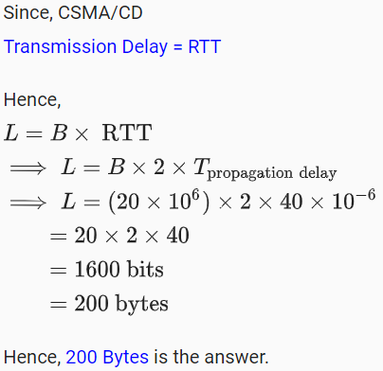
Solution
A network has a data transmission bandwidth of 20 × 10^6 bits per second. It uses CSMA/CD in the MAC layer. The maximum signal propagation time from one node to another node is 40 microseconds. The minimum size of a frame in the network is _________ bytes.

Slide 9
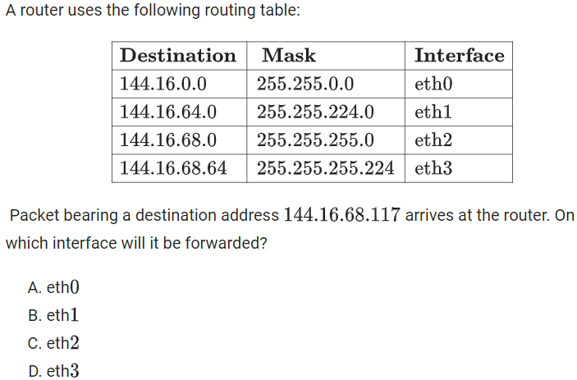
A router uses the following routing table:
Problem

Slide 10
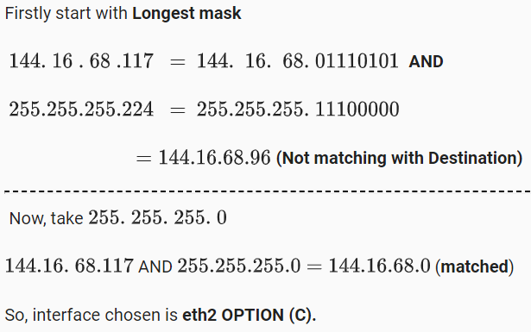
A router uses the following routing table:
Solution

Slide 11
Consider a network using the pure ALOHA medium access control protocol, where each frame is of length 1,000 bits. The channel transmission rate is 1 Mbps (=106 bits per second). The aggregate number of transmissions across all the nodes (including new frame transmissions and retransmitted frames due to collisions) is modelled as a Poisson process with a rate of 1,000 frames per second. Throughput is defined as the average number of frames successfully transmitted per second. The throughput of the network (rounded to the nearest integer) is________ A. 135 B. 140 C. 120 D. 130
Problem

Slide 12
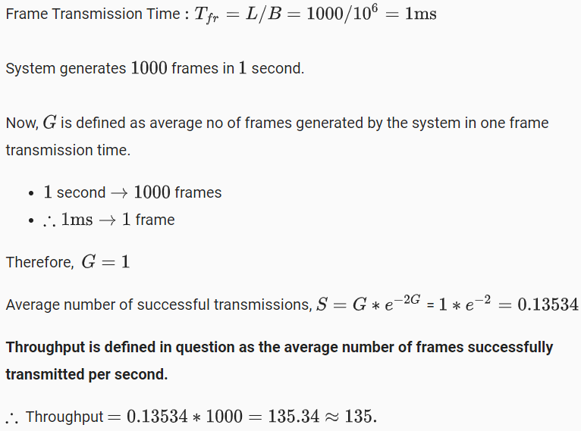
Solution

Slide 13
Network Layer

Slide 14
Problem
In an IPV4 packet, the value of HLEN is 1000 in binary. How many options are being carried by this packet?
10
11
12
13

Slide 15
Solution
The HLEN value is 8, i.e., the total number of bytes in the header is 8X4=32 bytes. Now the first 20 bytes are the base header and the next 12 bytes are the options.

Slide 16
Problem
An IPV4 packet has arrived with the first 8 bits as 01000010
The receiver discards the packet. Why?

Slide 17
Solution
There is an error in this packet. The 4 leftmost bits (0100) show the version, which is 4 and correct. The next 4 bits 0010 show an invalid header length (2X4=8). The minimum number of bytes in the header must be 20. The packet has been corrupted in transmission.

Slide 18
Problem
In an IPV4 packet the value of HLEN is 5, and the value of the total length field is 0x0028. How many bytes of data are being carried by this packet?
20
40
60

Slide 19
Solution
The HLEN value is 5 i.e., the total number of bytes in the header is (5X4=) 20 bytes that means no options. Now the total length is 0x0028 i.e., 40 bytes. So the packet is carrying (40-20=) 20 bytes data.

Slide 20
Problem
An IPV4 packet has arrived with the first few hexadecimal digits 0x45000028000100000102
How many hops can the packet travel before being dropped? Also find the data belong to what upper-layer protocol?
1, ICMP
1, IGMP
2, ICMP
2, IGMP

Slide 21
Solution
First we have to find the TTL field, so we skip 16 hexadecimal digits (8 bytes). The TTL value is 01 that means the packet can travel only one hop. After that its TTL value will be 0 and it will be dropped.
The protocol bit is the next byte i.e., 02, which means IGMP is the upper layer protocol.

Slide 22
Problem
A packet has arrived with an M bit value of 0. Is this the first fragment, the last fragment, or a middle fragment? Do we know if the packet was fragmented?

Slide 23
Solution
If the M bit is 0, it means that there are no more fragments; the fragment is the last one. However, we cannot say if the original packet was fragmented or not. A non-fragmented packet is considered the last fragment.

Slide 24
Problem
A packet has arrived with an M bit value of 1. Is this the first fragment, the last fragment, or a middle fragment? Do we know if the packet was fragmented?

Slide 25
Solution
If the M bit is 1, it means that there is at least one more fragment. This fragment can be the first one or a middle one, but not the last one. We don’t know if it is the first one or a middle one; we need more information (the value of the fragmentation offset). See also the next example.

Slide 26
Problem
A packet has arrived with an M bit value of 1 and a fragmentation offset value of zero. Is this the first fragment, the last fragment, or a middle fragment?

Slide 27
Solution
Because the M bit is 1, it is either the first fragment or a middle one. Because the offset value is 0, it is the first fragment.

Slide 28
Problem
A packet has arrived in which the offset value is 100. What is the number of the first byte? Do we know the number of the last byte?

Slide 29
Solution
To find the number of the first byte, we multiply the offset value by 8. This means that the first byte number is 800. We cannot determine the number of the last byte unless we know the length of the data.

Slide 30
Problem
A packet has arrived in which the offset value is 100, the value of HLEN is 5 and the value of the total length field is 100. What is the number of the first byte and the last byte?

Slide 31
Solution
The first byte number is 100 × 8 = 800. The total length is 100 bytes and the header length is 20 bytes (5 × 4), which means that there are 80 bytes in this datagram. If the first byte number is 800, the last byte number must be 879.

