Slide 1
CSE/PC/B/T/316 Computer Networks Topic 14 - Network Layer: Address Mapping, Error Reporting, and Multicasting
Sarbani Roy
sarbani.roy@jadavpuruniversity.in
Office: CC-5-7
Cell: 9051639328

Slide 2
ADDRESS MAPPING
The delivery of a packet to a host or a router requires two levels of addressing: logical and physical. We need to be able to map a logical address to its corresponding
physical address and vice versa. This can be done by using either static or dynamic mapping.
Topics discussed :
Mapping Logical to Physical Address
Mapping Physical to Logical Address

Slide 3
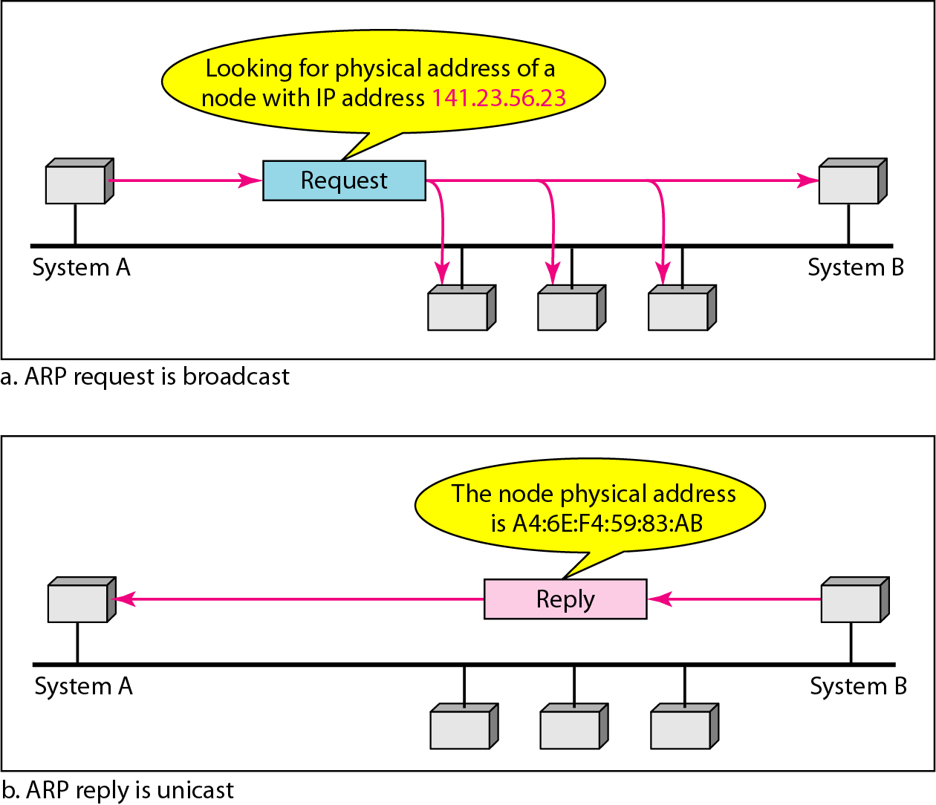
ARP operation

Slide 4
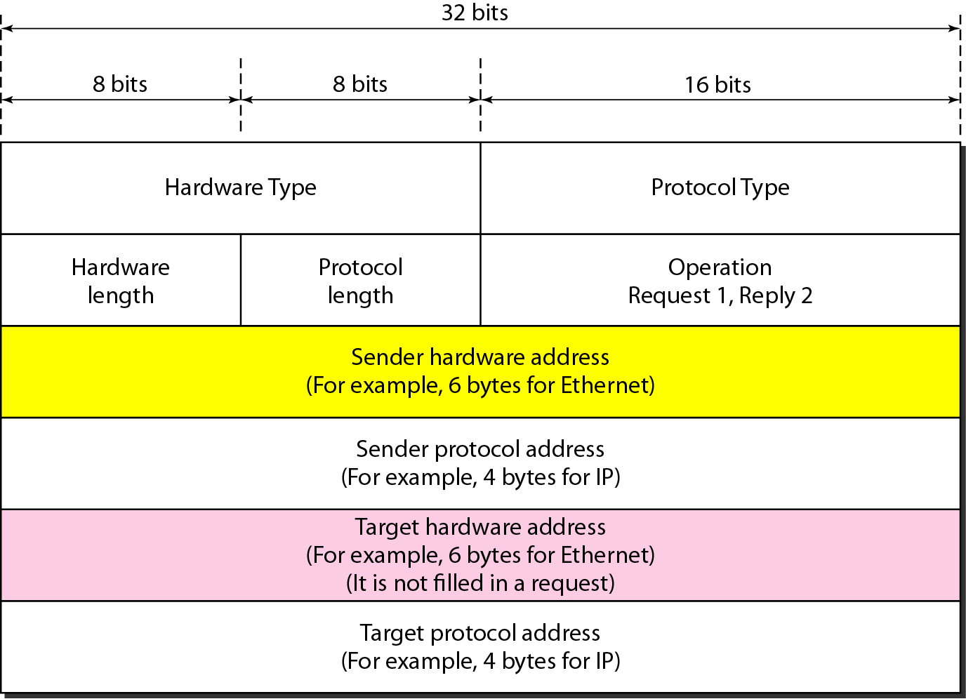
ARP packet

Slide 5
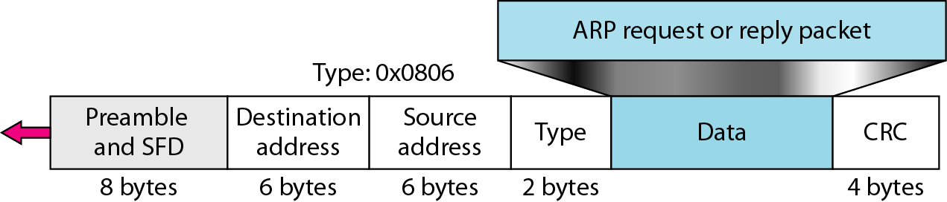
Encapsulation of ARP packet

Slide 6
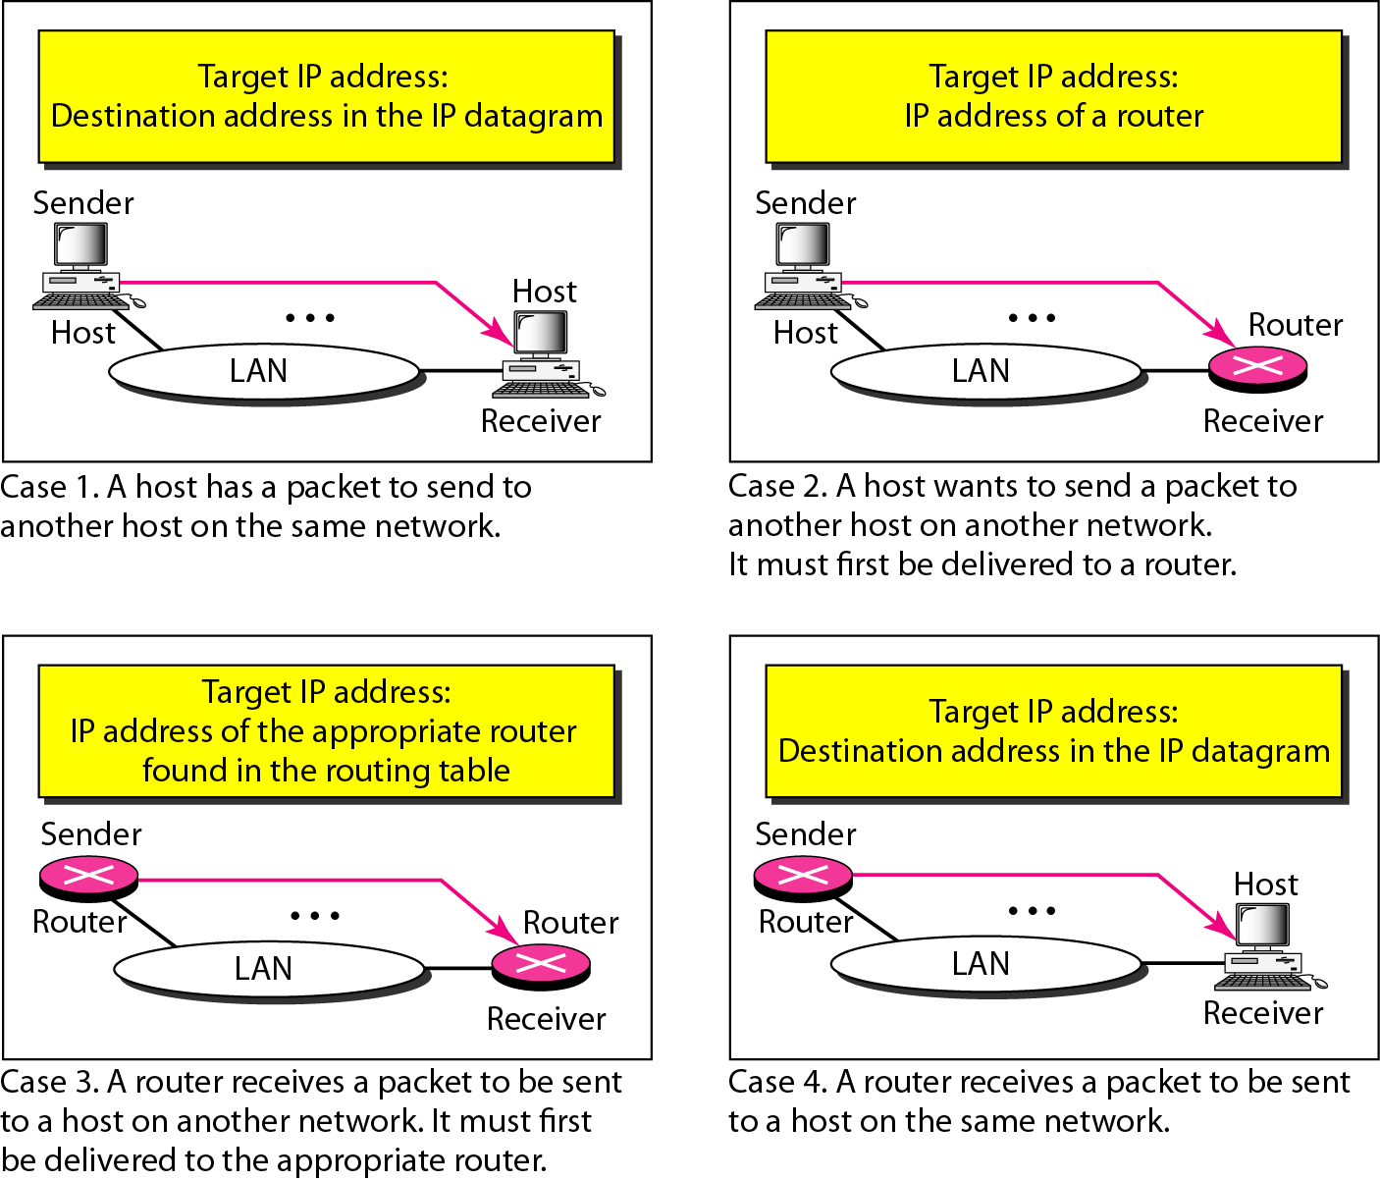
Four cases using ARP

Slide 7

Note
An ARP request is broadcast; an ARP reply is unicast.

Slide 8
Example
A host with IP address 130.23.43.20 and physical address B2:34:55:10:22:10 has a packet to send to another host with IP address 130.23.43.25 and physical address A4:6E:F4:59:83:AB. The two hosts are on the same Ethernet network. Show the ARP request and reply packets encapsulated in Ethernet frames.
Solution
Figure 21.5 shows the ARP request and reply packets. Note that the ARP data field in this case is 28 bytes, and that the individual addresses do not fit in the 4-byte boundary. That is why we do not show the regular 4-byte boundaries for these addresses.

Slide 9
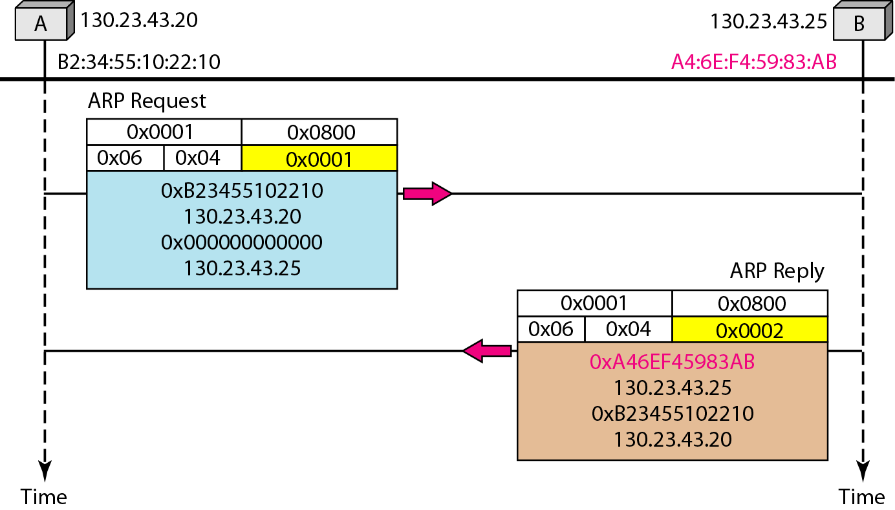
Example: an ARP request and reply

Slide 10
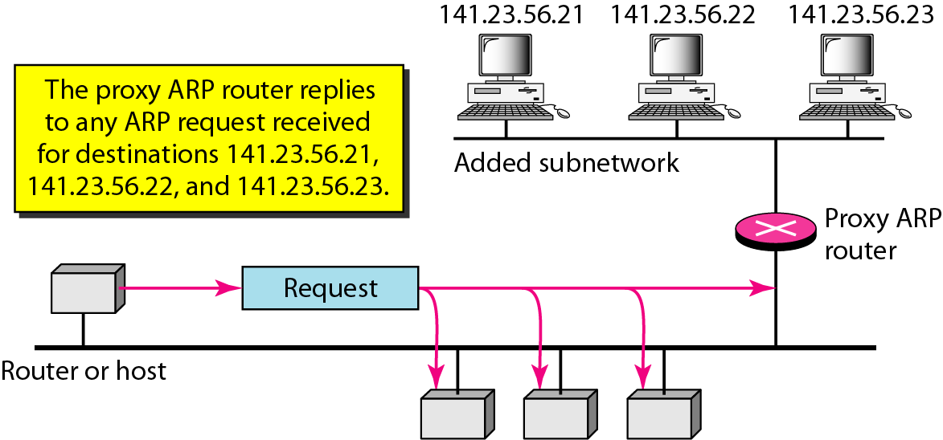
Proxy ARP

Slide 11
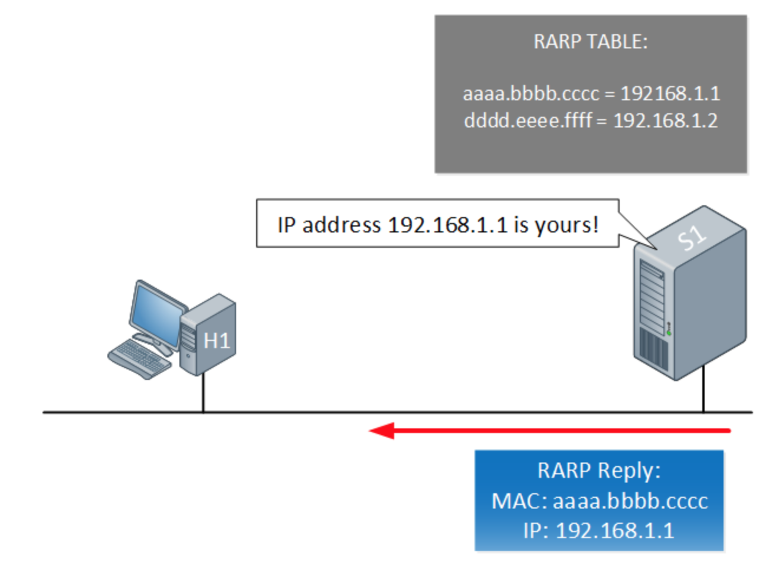
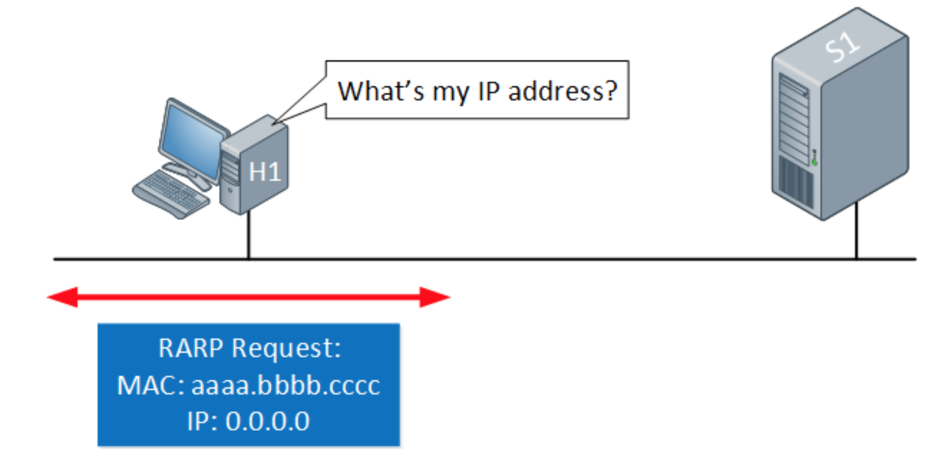
RARP
Diskless clients don't have a place to store there IP. RARP translates machines addresses into IP.
The client broadcasts a RARP packet with an Ethernet broadcast address, and it's own physical address in the data portion. The server responds by telling the client it's IP address.

Slide 12
BOOTP
BOOTP translates physical address into logical address
BOOTP uses IP packets
BOOTP is an application layer protocol
The client broadcasts a BOOTP packet with source and destination IP broadcast addresses (all 1's), and it's own physical address in the data portion. The server responds by telling the client it's actual IP address, and some other info. Note that the server must also send to a broadcast address, since there is no IP-> physical address mapping in the server's ARP cache yet, and the client won't yet respond to ARP requests (since it does not yet recognize it's IP address).

Slide 13
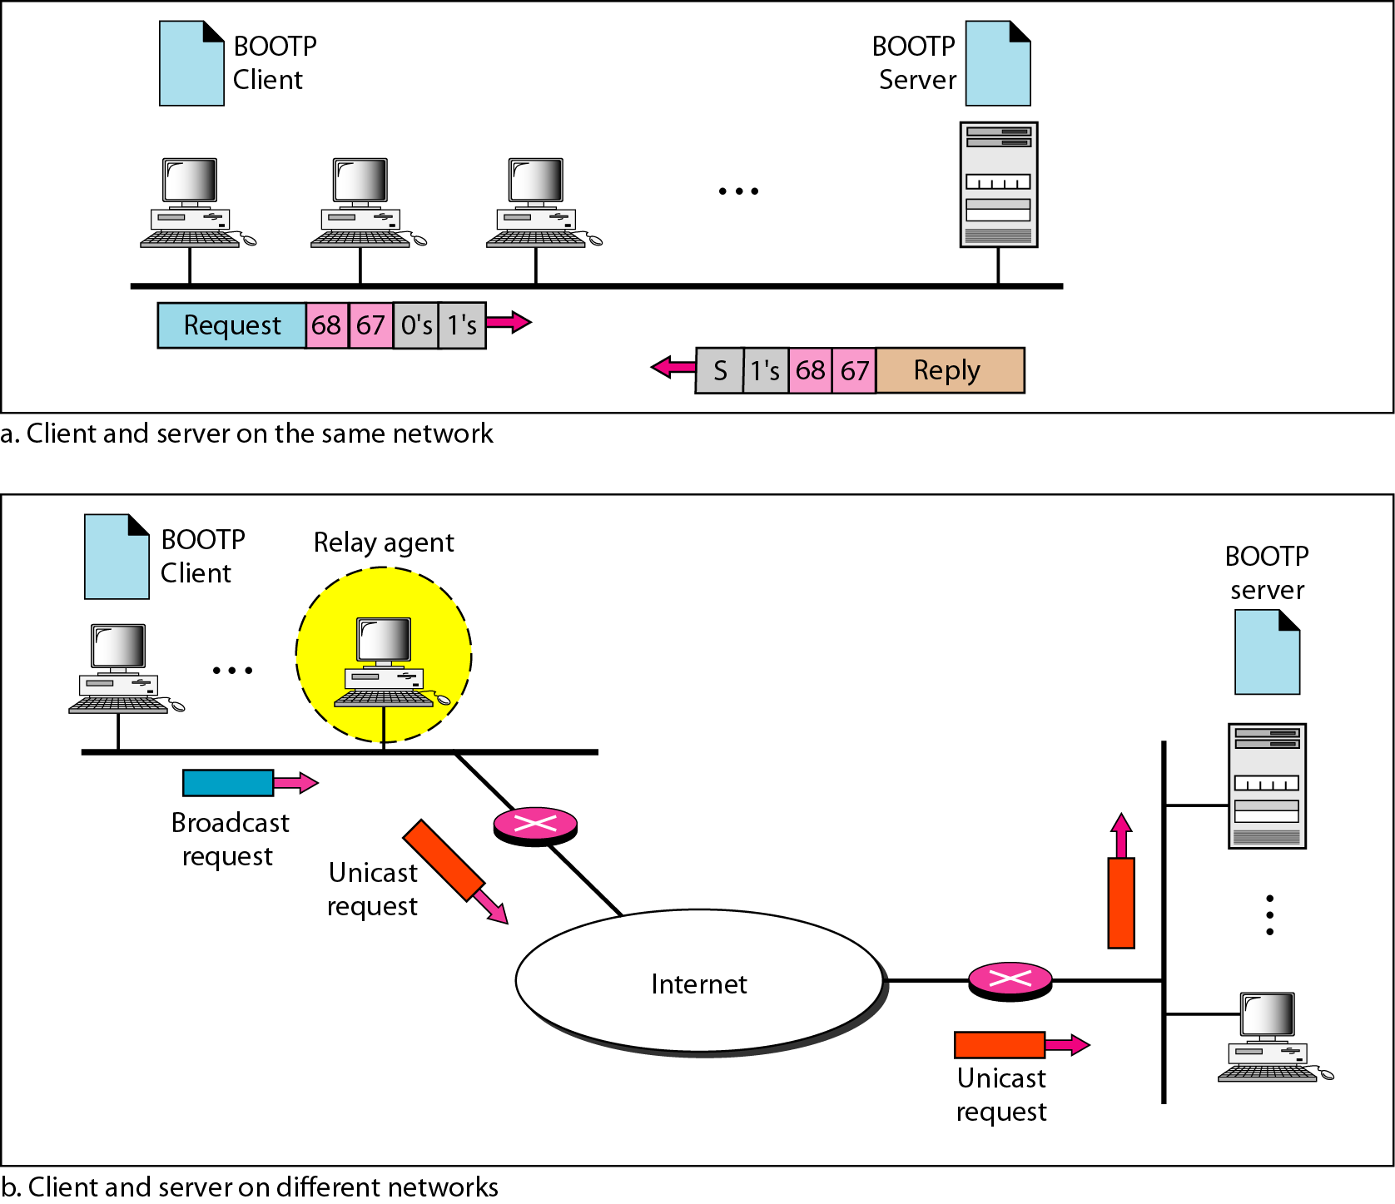
BOOTP client and server on the same and different networks

Slide 14
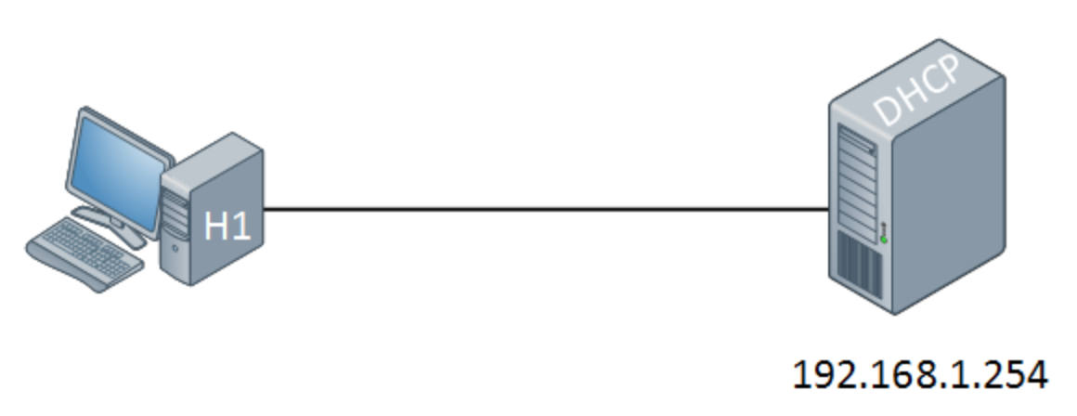
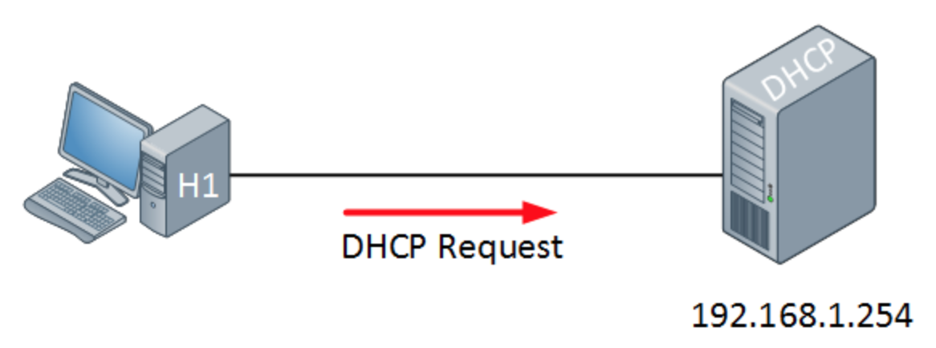
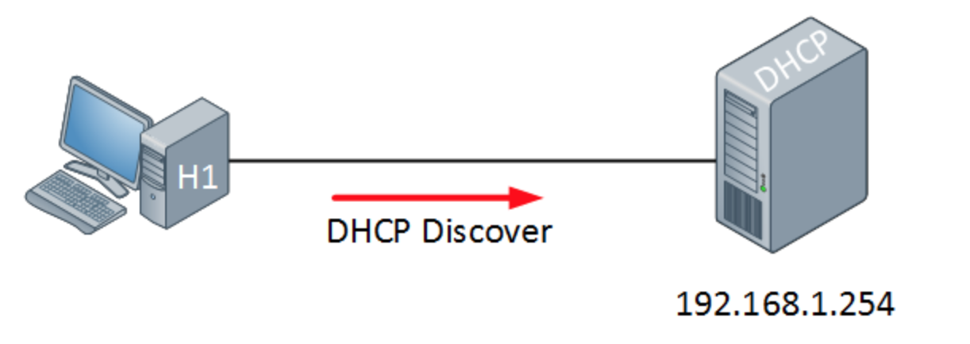
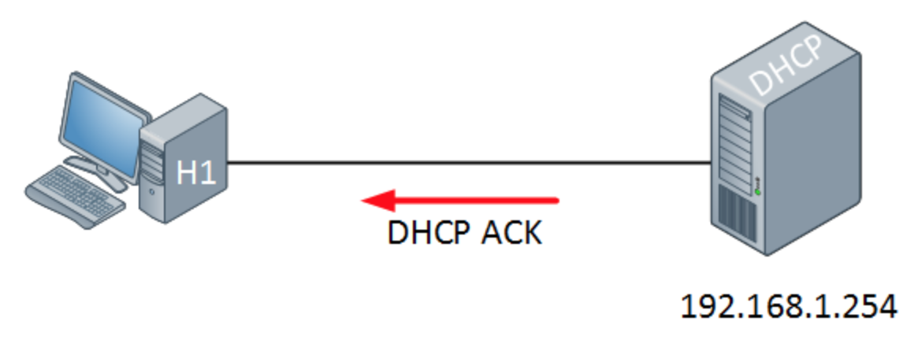
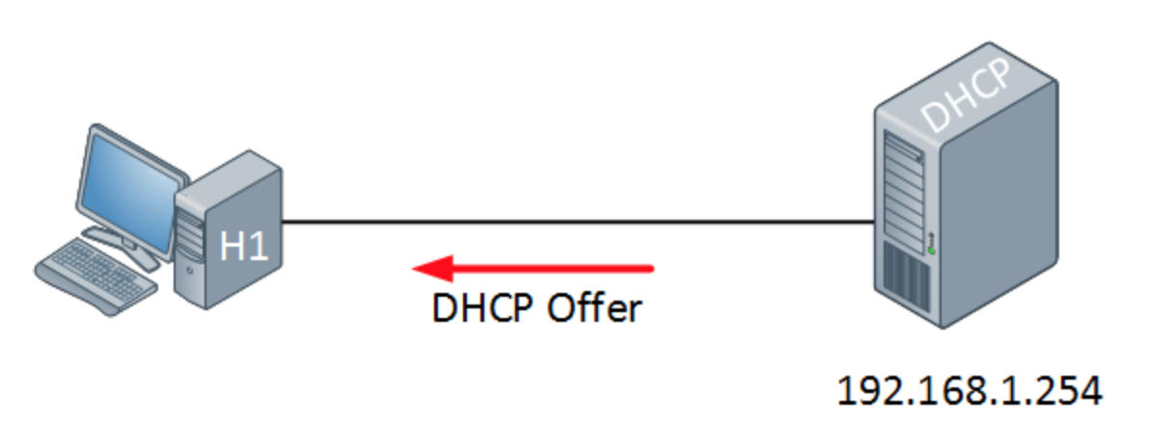
DHCP
IP addresses can be configured statically or dynamically. Normally we configure static IP addresses on network devices like routers, switches, firewalls and servers while we dynamically assign IP addresses to computers, laptops, tablets, smartphones etc. The dynamic method uses DHCP (Dynamic Host Configuration Protocol).

Slide 15
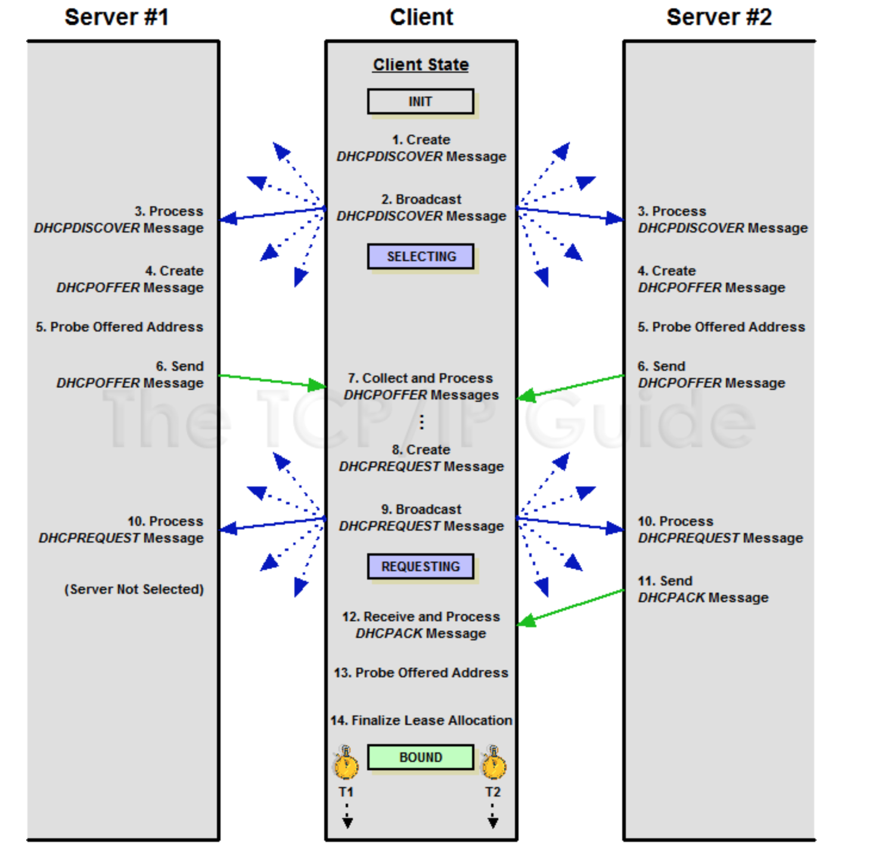
DHCP
Address renewal timer →
← Server rebinding timer

Slide 16
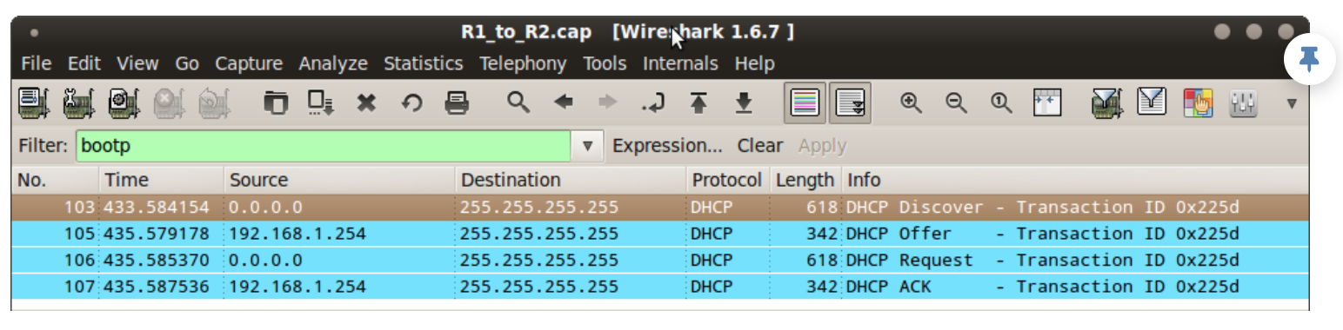

Slide 17
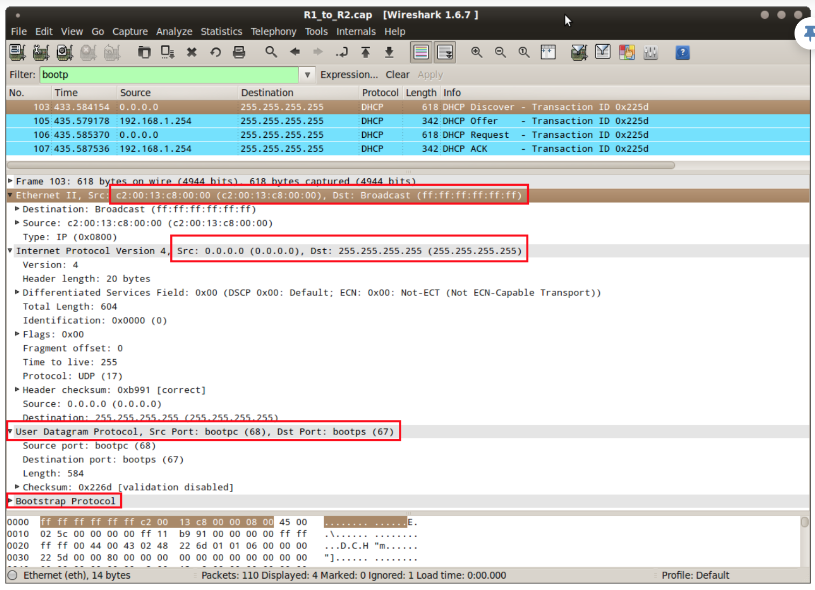

Slide 18
ICMP
The IP protocol has no error-reporting or error-correcting mechanism. The IP protocol also lacks a mechanism for host and management queries. The Internet Control Message Protocol (ICMP) has been designed to compensate for the above two deficiencies. It is a companion to the IP protocol.
Topics discussed :
Types of Messages Message Format Error Reporting and Query
Debugging Tools

Slide 19
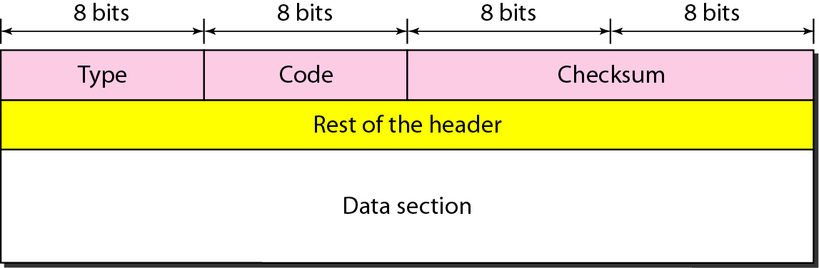
General format of ICMP messages

Slide 20
Note
ICMP always reports error messages to the original source.

Slide 21
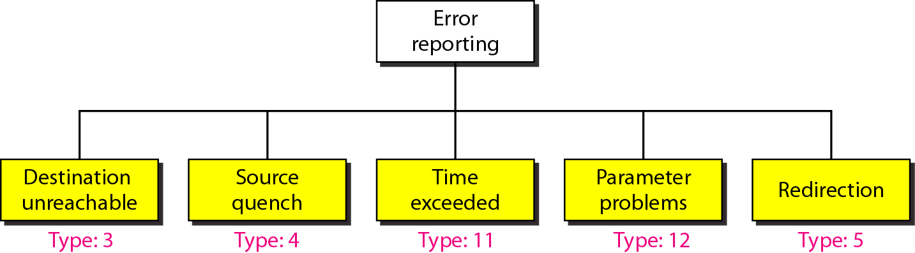
Error-reporting messages

Slide 22
Note
Important points about ICMP error messages:
❏ No ICMP error message will be generated in response to a datagram carrying an ICMP error message.
❏ No ICMP error message will be generated for a fragmented datagram that is not the first fragment.
❏ No ICMP error message will be generated for a datagram having a multicast address.
❏ No ICMP error message will be generated for a datagram having a special address such as 127.0.0.0 or 0.0.0.0.

Slide 23
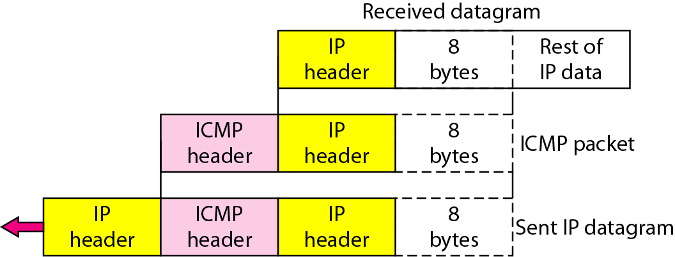
Contents of data field for the error messages

Slide 24
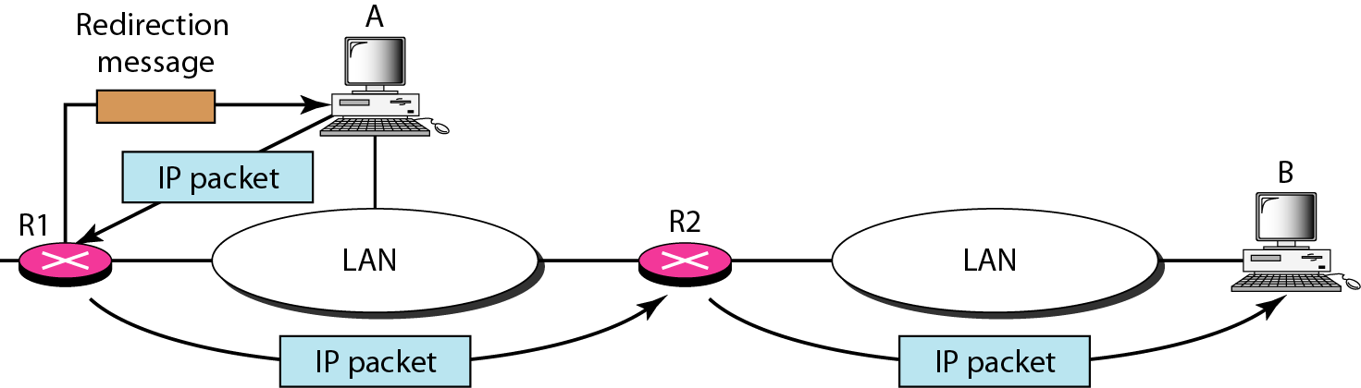
Redirection concept

Slide 25
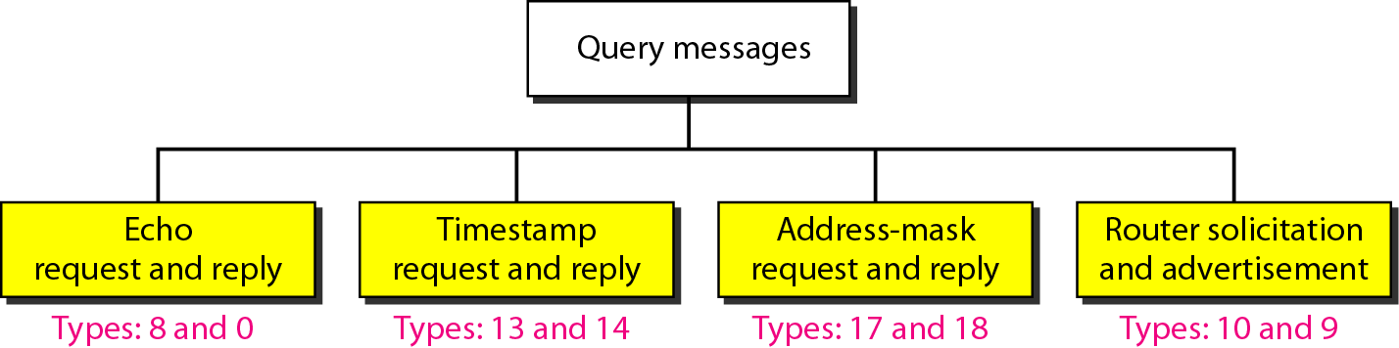
Query messages

Slide 26
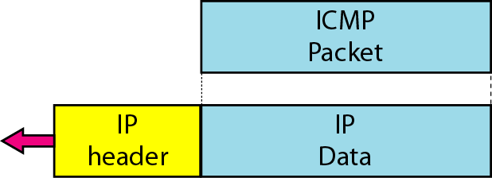
Encapsulation of ICMP query messages

Slide 27
Example
Figure below shows an example of checksum calculation for a simple echo-request message. We randomly chose the identifier to be 1 and the sequence number to be 9. The message is divided into 16-bit (2-byte) words. The words are added and the sum is complemented. Now the sender can put this value in the checksum field.

Slide 28
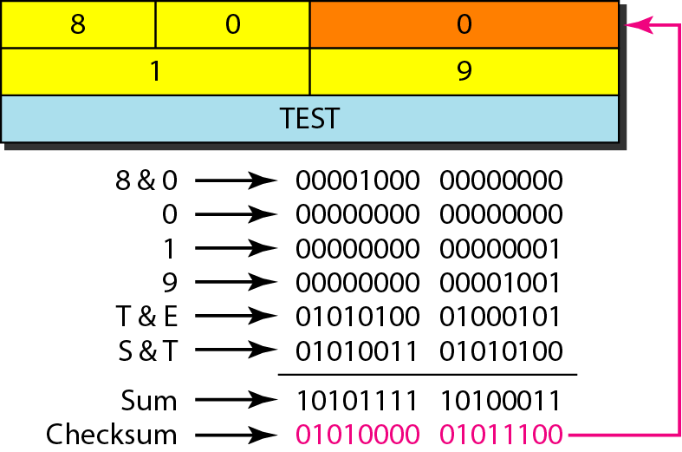
Example of checksum calculation

Slide 29
Example
We use the ping program to test the server fhda.edu. The result is shown on the next slide. The ping program sends messages with sequence numbers starting from 0. For each probe it gives us the RTT time. The TTL (time to live) field in the IP datagram that encapsulates an ICMP
message has been set to 62. At the beginning, ping defines the number of data bytes as 56 and the total number of bytes as 84. It is obvious that if we add 8 bytes of ICMP header and 20 bytes of IP header to 56, the result is 84. However, note that in each probe ping defines the number of bytes as 64. This is the total number of bytes in the ICMP packet (56 + 8).

Slide 30
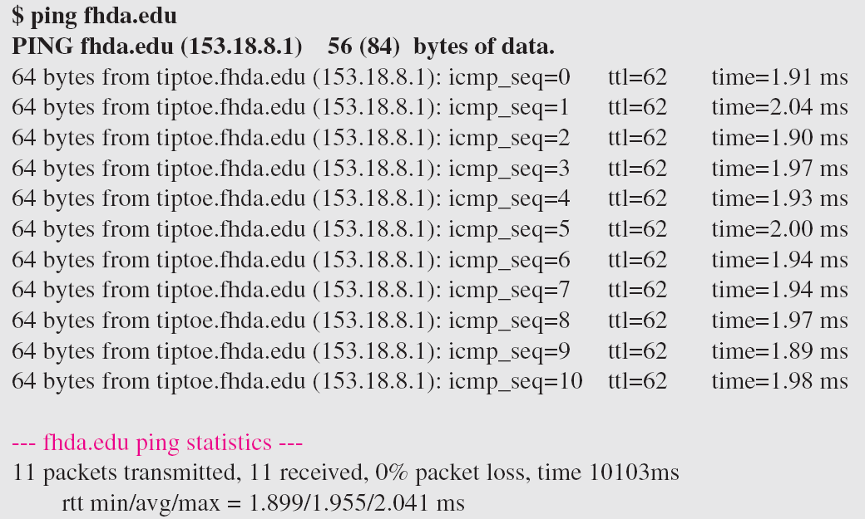
Example (continued)

Slide 31
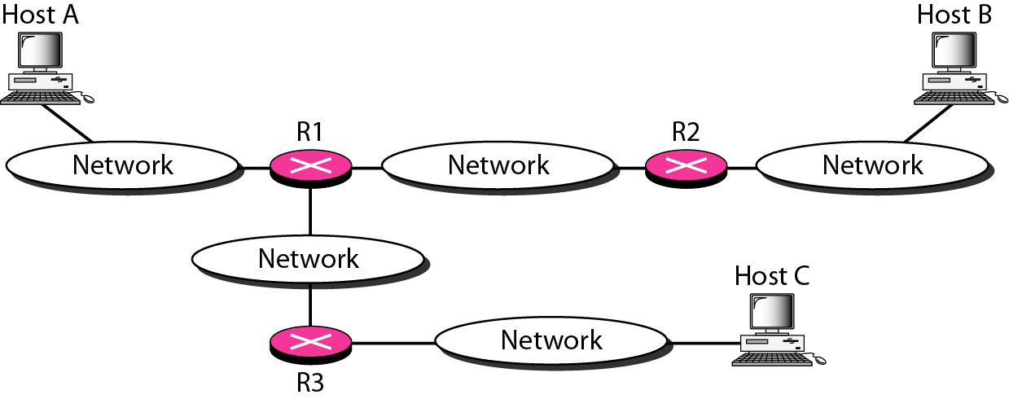
The traceroute program operation

Slide 32
Example
We use the traceroute program to find the route from the computer voyager.deanza.edu to the server fhda.edu. The following shows the result:
The unnumbered line after the command shows that the destination is 153.18.8.1. The packet contains 38 bytes: 20 bytes of IP header, 8 bytes of UDP header, and 10 bytes of application data. The application data are used by traceroute to keep track of the packets.

Slide 33
Example (continued)
The first line shows the first router visited. The router is named Dcore.fhda.edu with IP address 153.18.31.254. The first round-trip time was 0.995 ms, the second was 0.899 ms, and the third was 0.878 ms. The second line shows the second router visited. The router is named Dbackup.fhda.edu with IP address 153.18.251.4. The three round-trip times are also shown. The third line shows the destination host. We know that this is the destination host because there are no more lines. The destination host is the server fhda.edu, but it is named tiptoe.fhda.edu with the IP address 153.18.8.1. The three round-trip times are also shown.

Slide 34
Example
In this example, we trace a longer route, the route to xerox.com (see next slide). Here there are 17 hops between source and destination. Note that some round-trip times look unusual. It could be that a router was too busy to process the packet immediately.

Slide 35
Example

Slide 36
IGMP
The IP protocol can be involved in two types of communication: unicasting and multicasting. The Internet Group Management Protocol (IGMP) is one of the necessary, but not sufficient, protocols that is involved in multicasting. IGMP is a companion to the IP protocol.
Topics discussed in this section:
Group Management IGMP Messages and IGMP Operation
Encapsulation
Netstat Utility

Slide 37
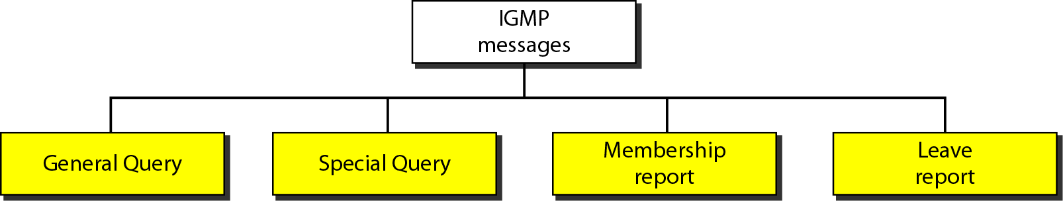
IGMP message types

Slide 38
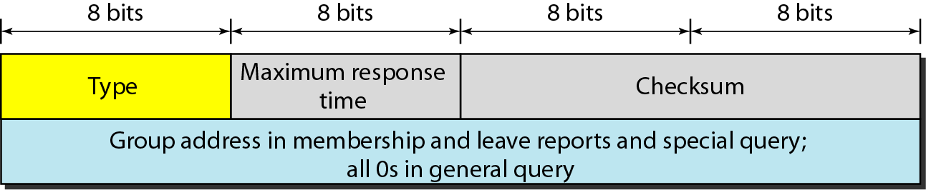
IGMP message format

Slide 39
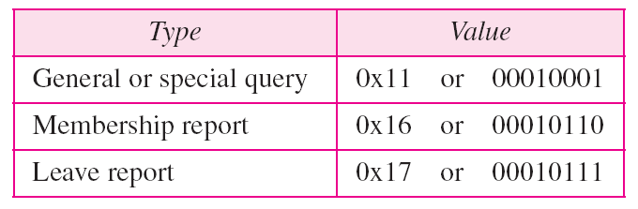
IGMP type field

Slide 40
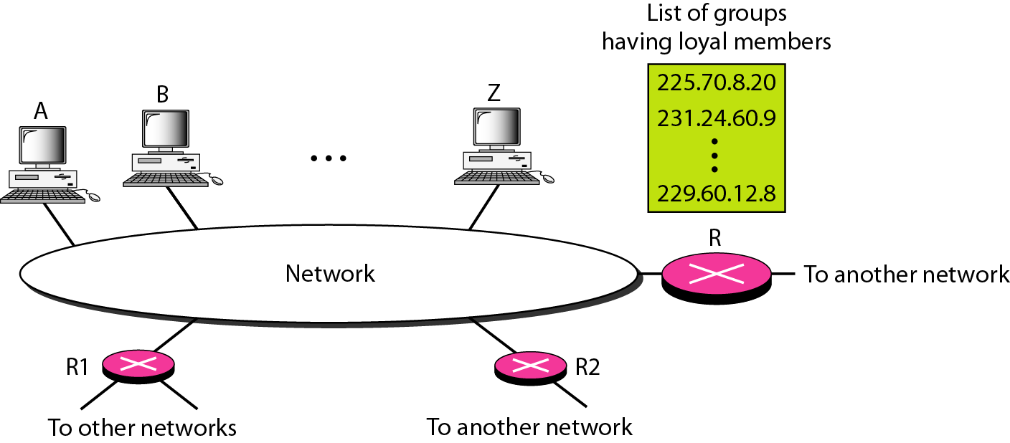
IGMP operation

Slide 41
Note
In IGMP, a membership report is sent twice, one after the other.

Slide 42
Note
The general query message does not define a particular group.

Slide 43
Example
Imagine there are three hosts in a network, as shown in Figure 21.19. A query message was received at time 0; the random delay time (in tenths of seconds) for each group is shown next to the group address. Show the sequence of report messages.
Solution
The events occur in this sequence:
a. Time 12: The timer for 228.42.0.0 in host A expires, and a membership report is sent, which is received by the router and every host including host B which cancels its timer for 228.42.0.0.

Slide 44
Example (continued)
b. Time 30: The timer for 225.14.0.0 in host A expires, and a membership report is sent which is received by the router and every host including host C which cancels its timer for 225.14.0.0.
c. Time 50: The timer for 238.71.0.0 in host B expires, and a membership report is sent, which is received by the router and every host.
d. Time 70: The timer for 230.43.0.0 in host C expires, and a membership report is sent, which is received by the router and every host including host A which cancels its timer for 230.43.0.0.

Slide 45
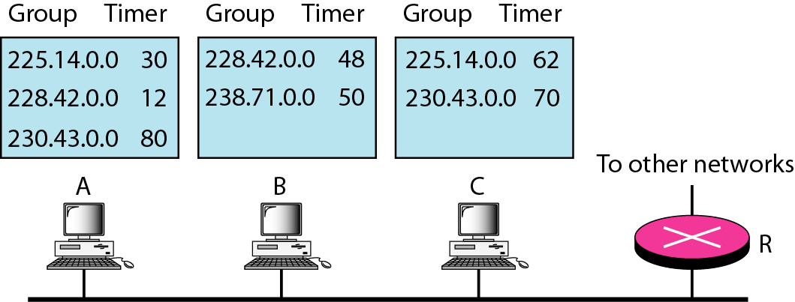
Example

Slide 46
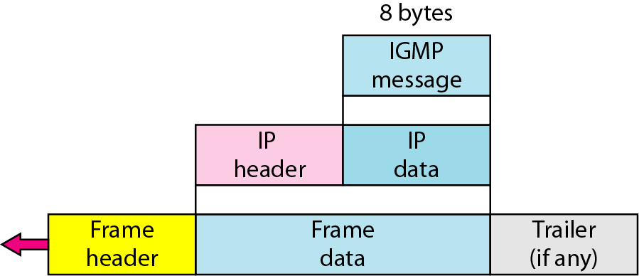
Encapsulation of IGMP packet

Slide 47
Note
The IP packet that carries an IGMP packet has a value of 1 in its TTL field.

Slide 48
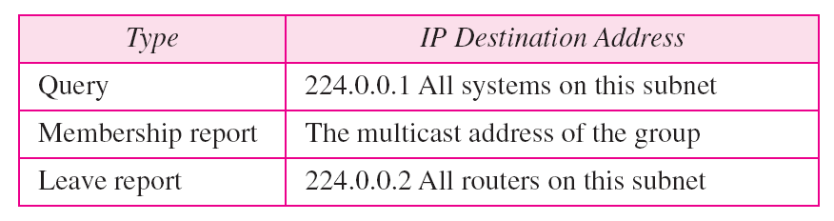
Destination IP addresses

Slide 49
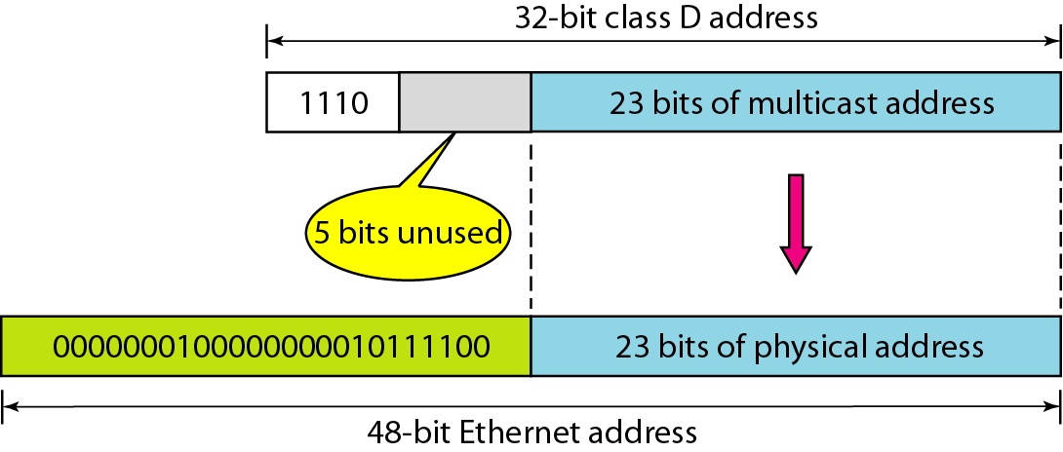
Mapping class D to Ethernet physical address

Slide 50
Note
An Ethernet multicast physical address is in the range
01:00:5E:00:00:00 to 01:00:5E:7F:FF:FF.

Slide 51
Example
Change the multicast IP address 230.43.14.7 to an Ethernet multicast physical address.
Solution
We can do this in two steps:
a. We write the rightmost 23 bits of the IP address in hexadecimal. This can be done by changing the rightmost 3 bytes to hexadecimal and then subtracting 8 from the leftmost digit if it is greater than or equal to 8. In our example, the result is 2B:0E:07.

Slide 52
Example (continued)
b. We add the result of part a to the starting Ethernet multicast address, which is 01:00:5E:00:00:00. The result is

Slide 53
Example
Change the multicast IP address 238.212.24.9 to an Ethernet multicast address.
Solution
a. The rightmost 3 bytes in hexadecimal is D4:18:09. We need to subtract 8 from the leftmost digit, resulting in 54:18:09.
b. We add the result of part a to the Ethernet multicast starting address. The result is

Slide 54
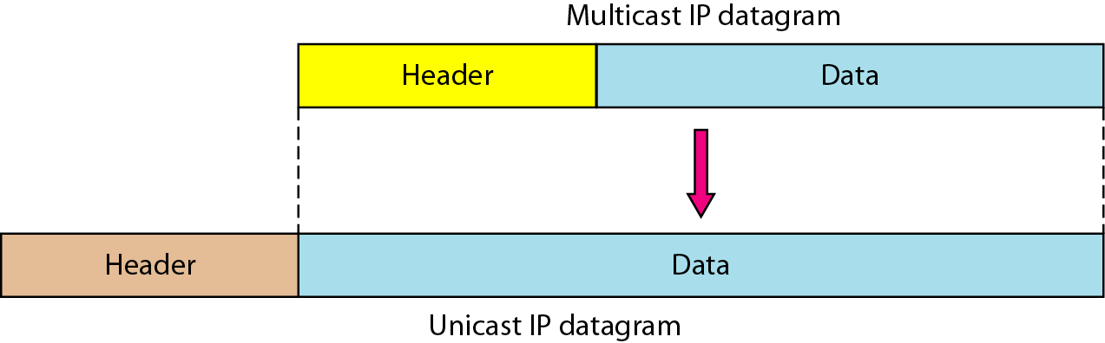
Tunneling

Slide 55
Example
We use netstat (see next slide) with three options: -n, -r, and -a. The -n option gives the numeric versions of IP addresses, the -r option gives the routing table, and the -a option gives all addresses (unicast and multicast). Note that we show only the fields relative to our discussion. “Gateway” defines the router, “Iface” defines the interface.
Note that the multicast address is shown in color. Any packet with a multicast address from 224.0.0.0 to 239.255.255.255 is masked and delivered to the Ethernet interface.

Slide 56
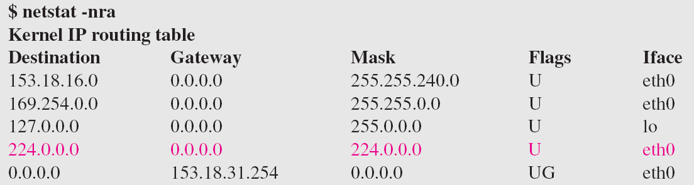
Example (continued)

Slide 57
ICMPv6
We discussed IPv6. Another protocol that has been modified in version 6 of the TCP/IP protocol suite is ICMP (ICMPv6). This new version follows the same strategy and purposes of version 4.
Topics discussed in this section:
Error Reporting
Query

Slide 58
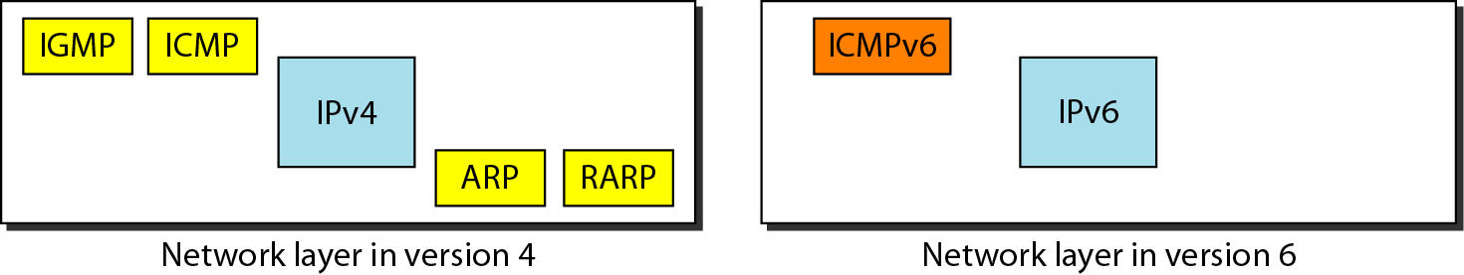
Comparison of network layers in version 4 and version 6

Slide 59
Comparison of error-reporting messages in ICMPv4 and ICMPv6

Slide 60
Comparison of query messages in ICMPv4 and ICMPv6

