Slide 1
CSE/PC/B/T/316 Computer Networks Topic 18- Application Layer DNS, Remote login, e-mail, FTP
Sarbani Roy
sarbani.roy@jadavpuruniversity.in
Office: CC-5-7
Cell: 9051639328

Slide 2
DNS

Slide 3
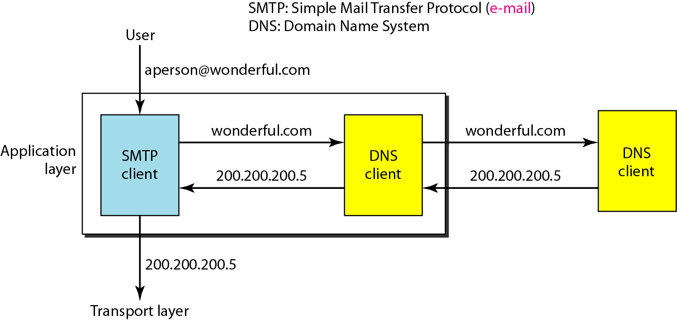
Example of using the DNS service

Slide 4
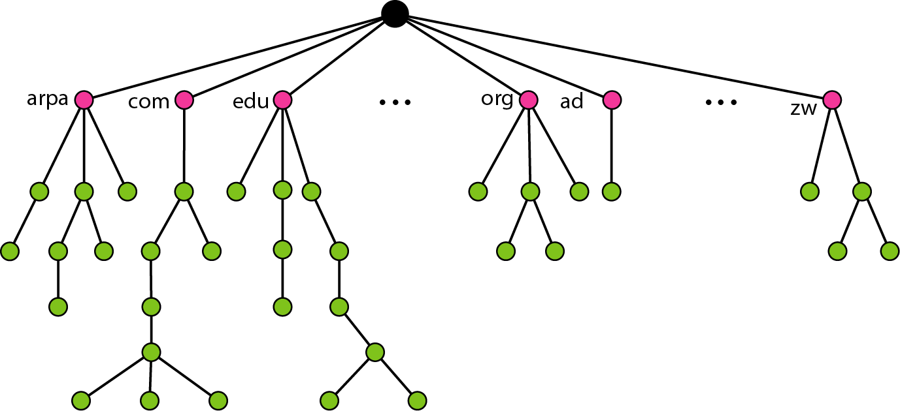
Domain name space

Slide 5
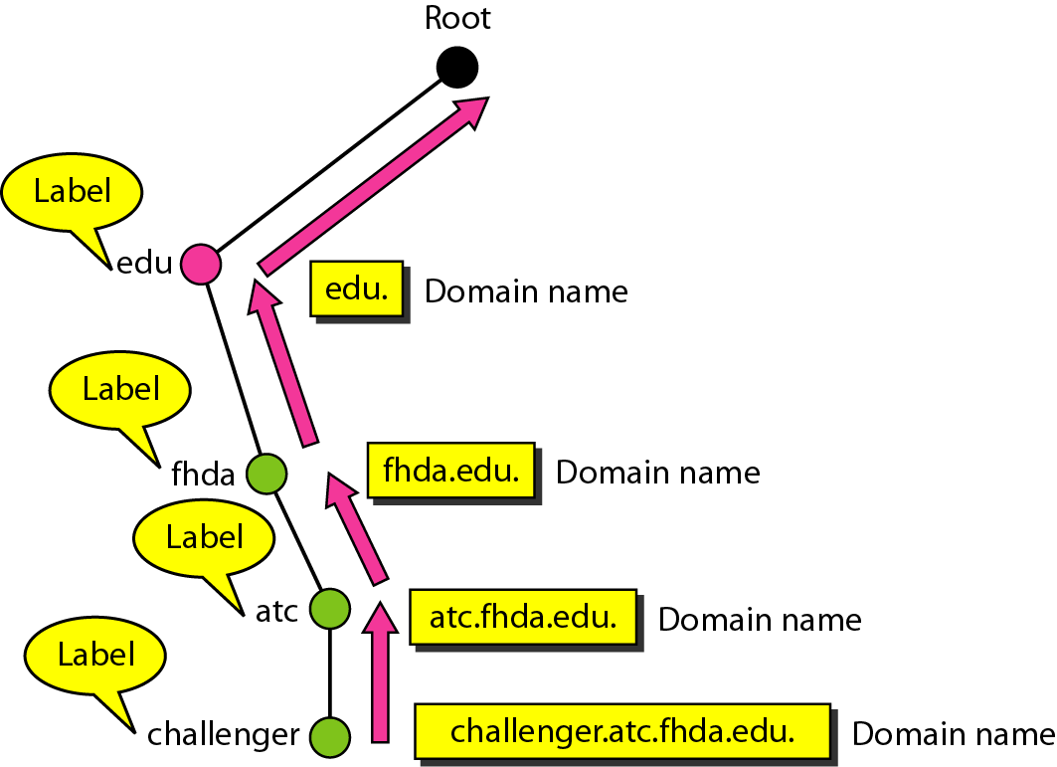
Domain names and labels

Slide 6
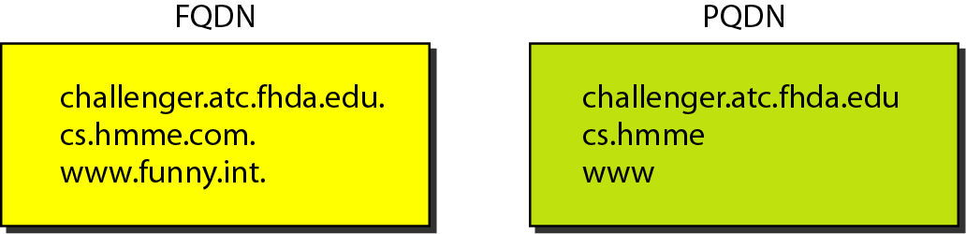
FQDN and PQDN

Slide 7
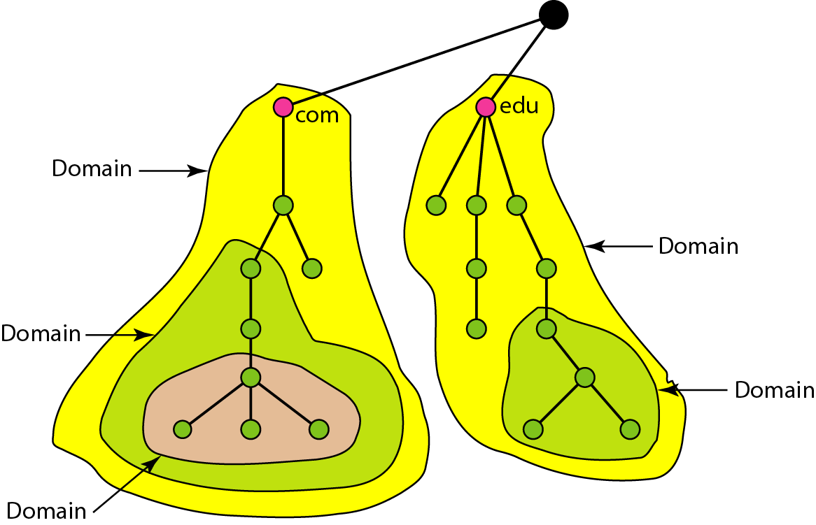
Domains

Slide 8
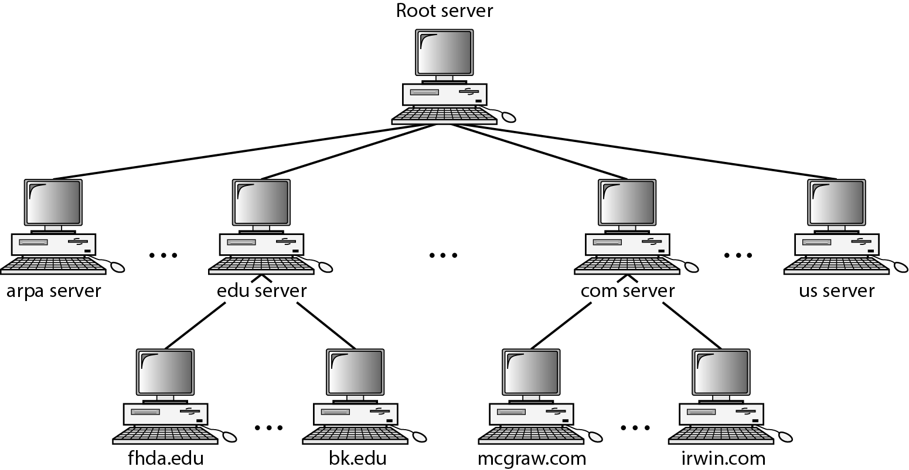
Hierarchy of name servers

Slide 9
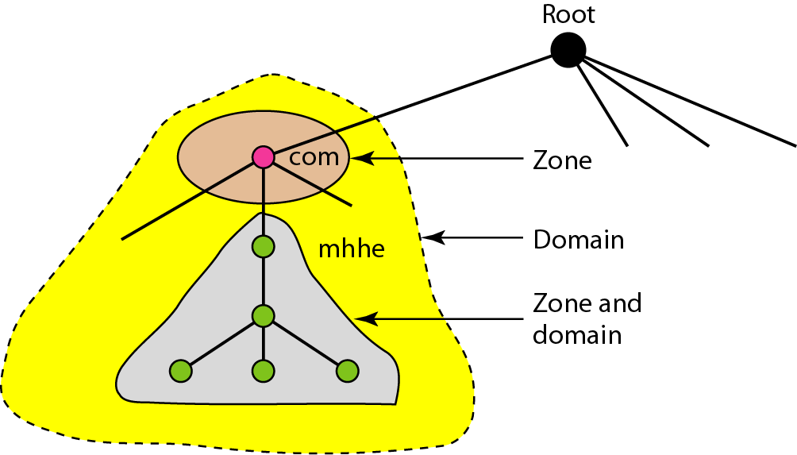
Zones and domains

Slide 10
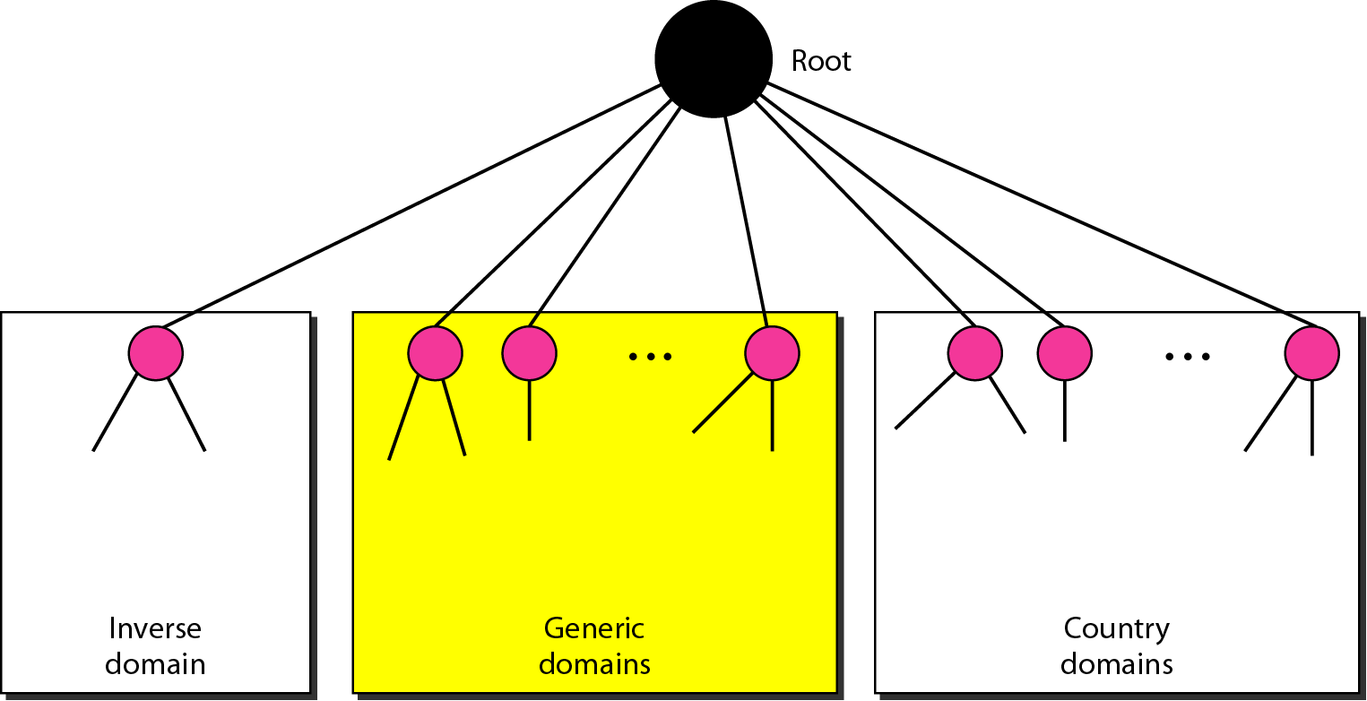
DNS IN THE INTERNET

Slide 11
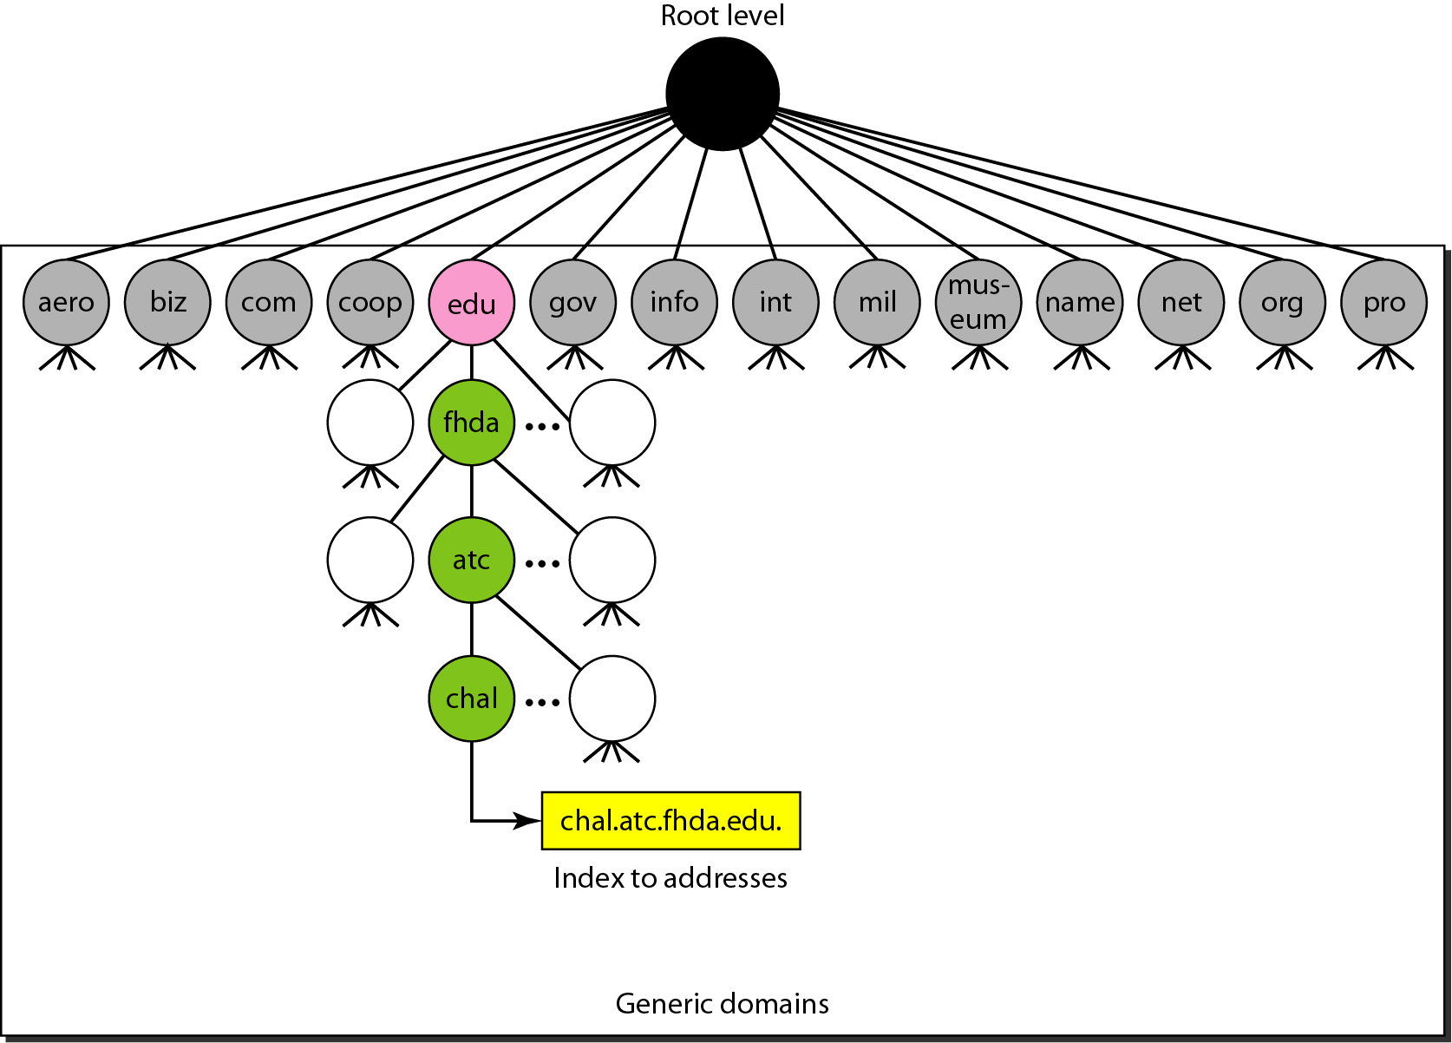
Generic domains

Slide 12
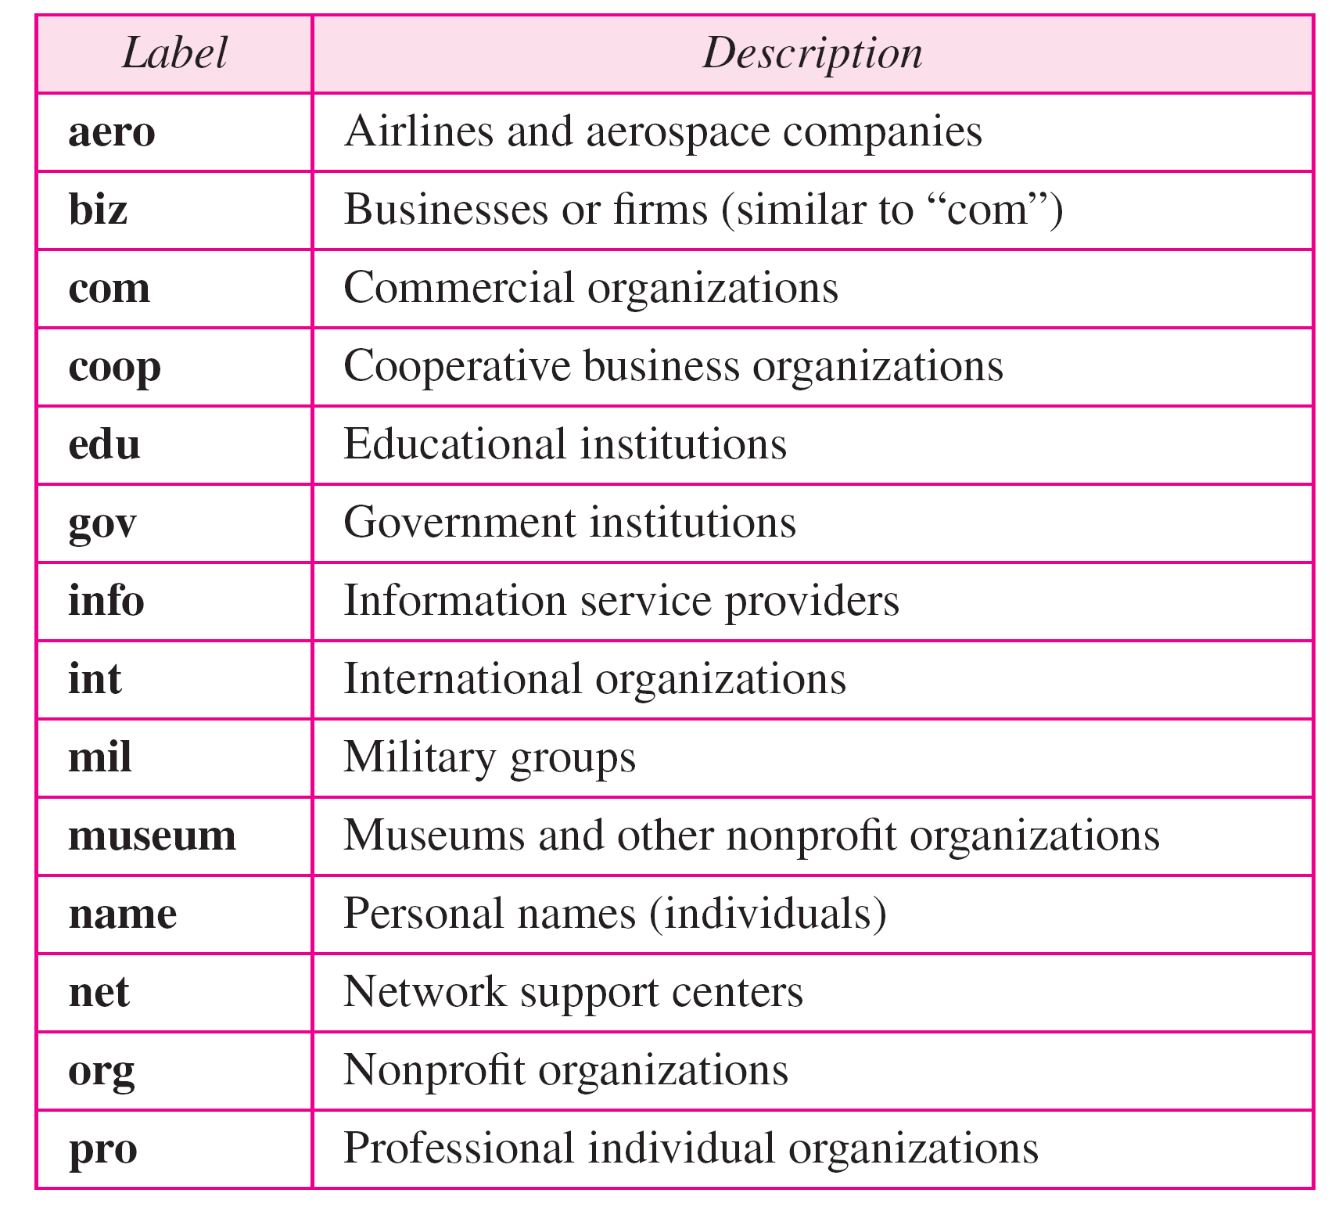
Generic domain labels

Slide 13
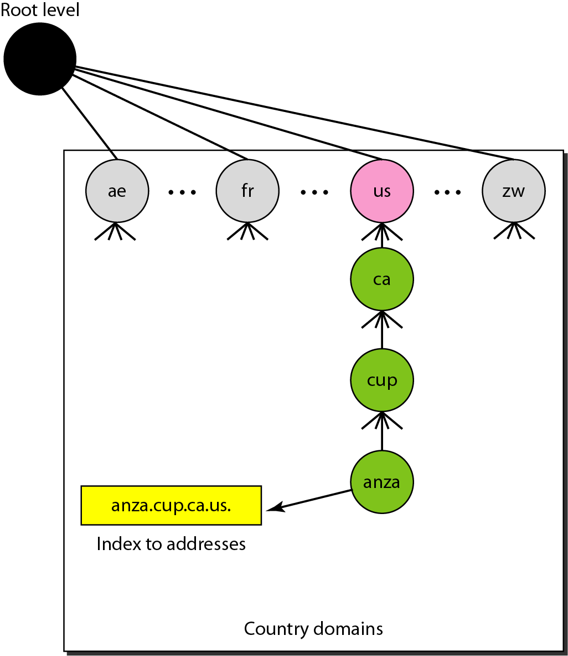
Country domains

Slide 14
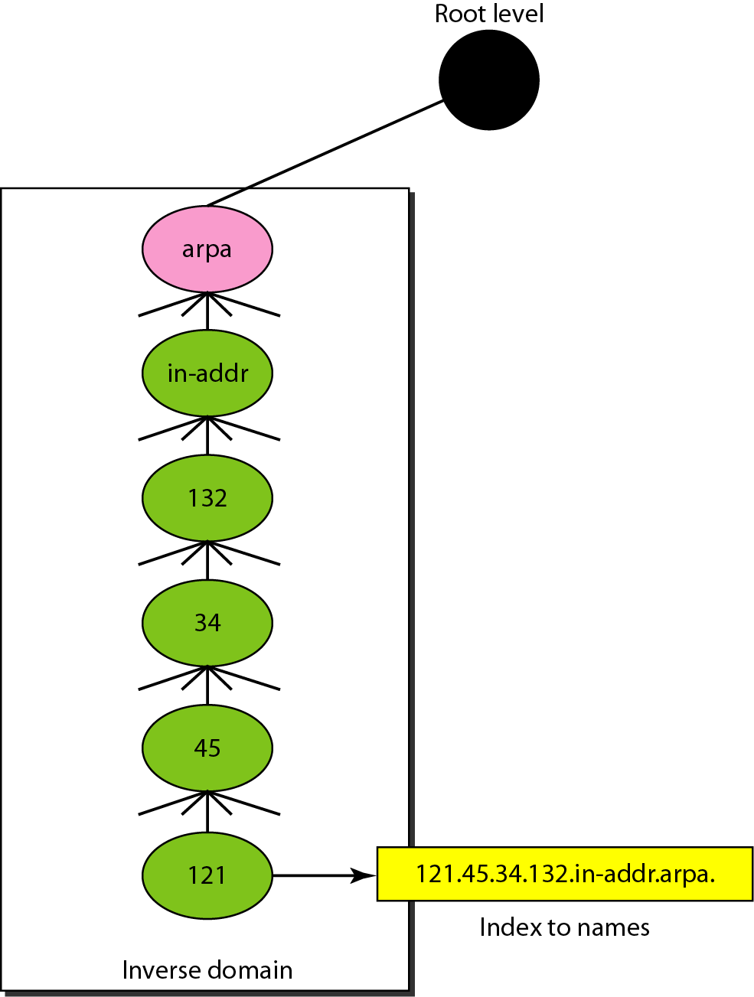
Inverse domain

Slide 15
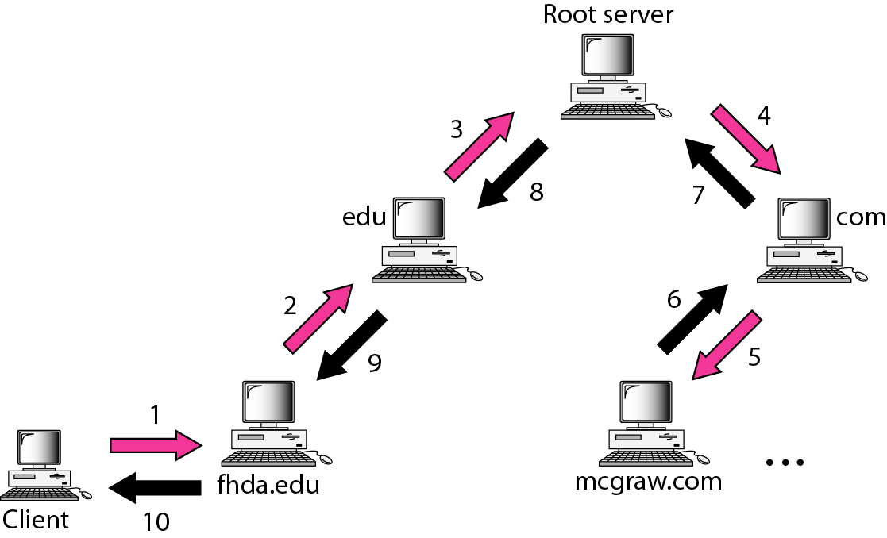
Recursive resolution

Slide 16
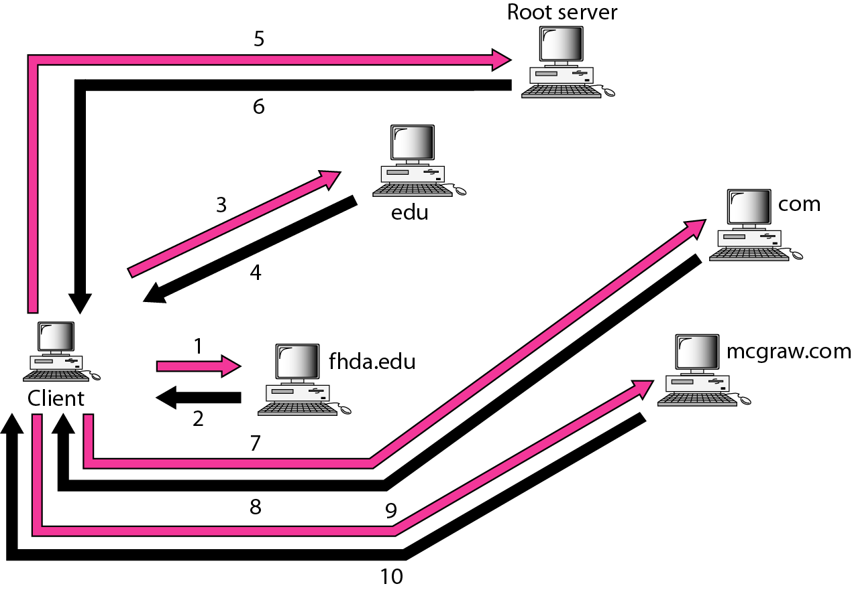
Iterative resolution

Slide 17
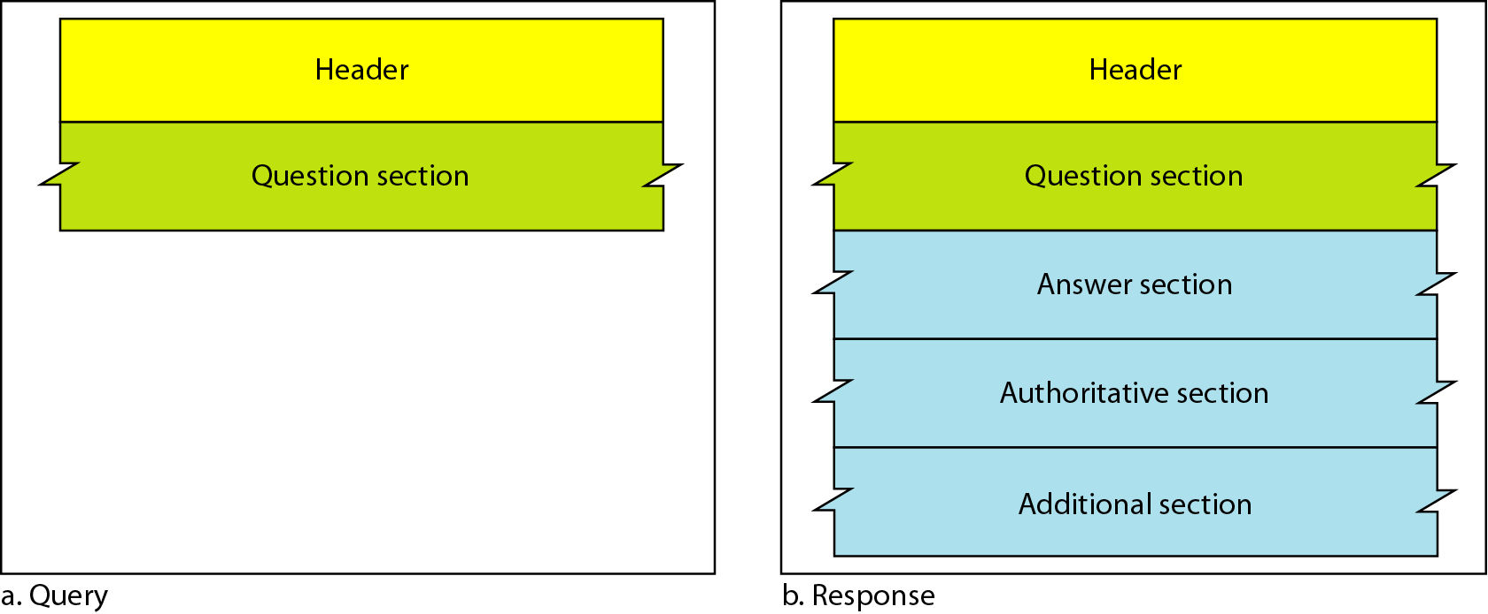
Query and response messages

Slide 18
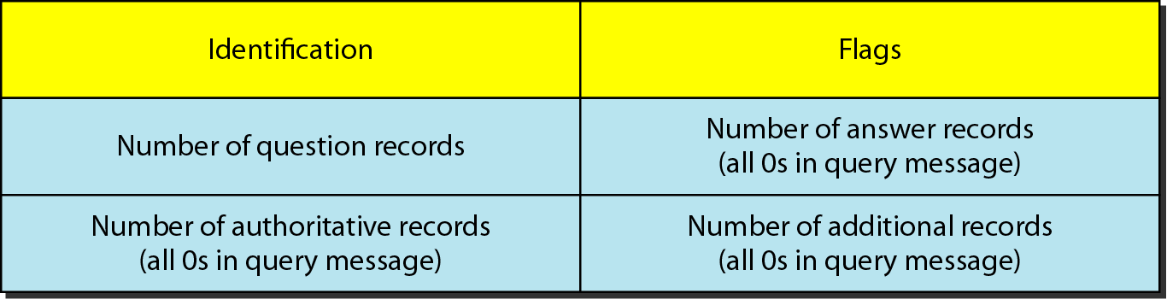
Header format

Slide 19
REGISTRARS
How are new domains added to DNS? This is done through a registrar, a commercial entity accredited by ICANN. A registrar first verifies that the requested domain name is unique and then enters it into the DNS database. A fee is charged.

Slide 20
DYNAMIC DOMAIN NAME SYSTEM (DDNS)
The DNS master file must be updated dynamically. The Dynamic Domain Name System (DDNS) therefore was devised to respond to this need. In DDNS, when a binding between a name and an address is determined, the information is sent, usually by DHCP to a primary DNS server. The primary server updates the zone. The secondary servers are notified either actively or passively.

Slide 21
ENCAPSULATION
DNS can use either UDP or TCP. In both cases the well-known port used by the server is port 53. UDP is used when the size of the response message is less than 512 bytes because most UDP packages have a 512-byte packet size limit. If the size of the response message is more than 512 bytes, a TCP connection is used.

Slide 22
TELNET
Remote Login

Slide 23
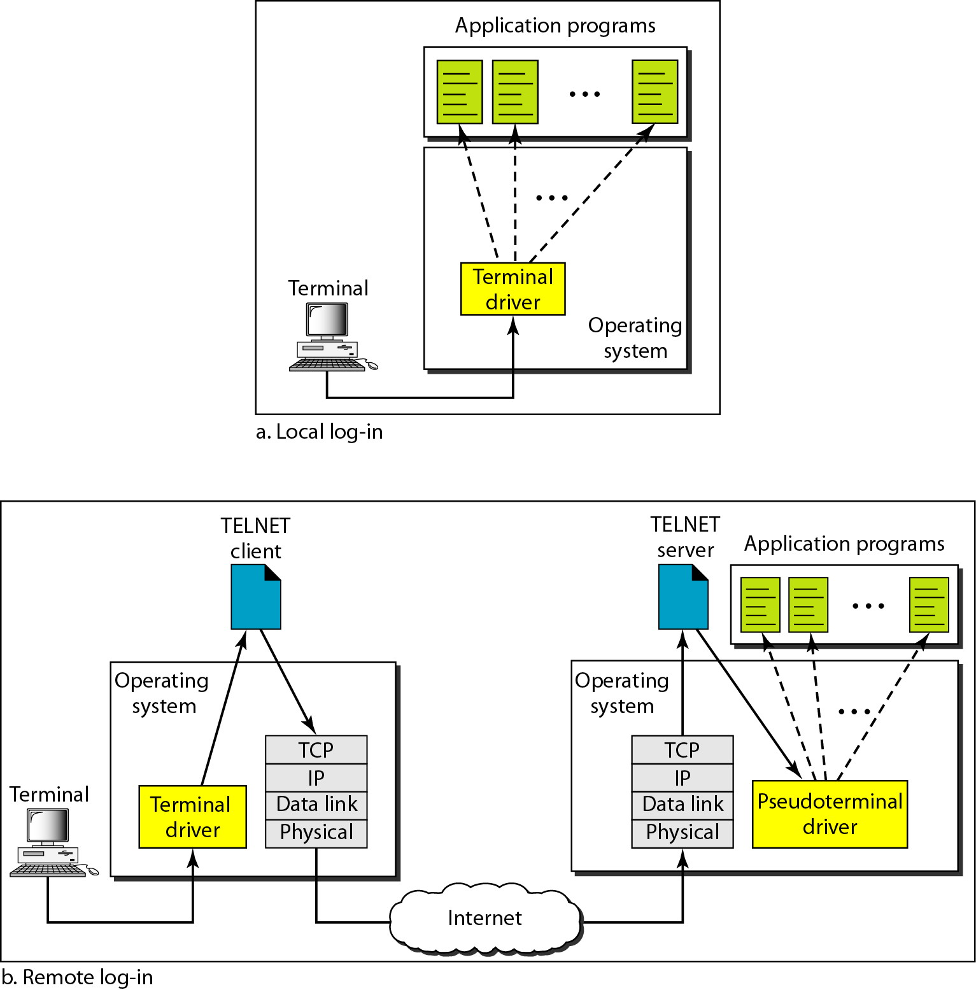
Local and remote log-in

Slide 24
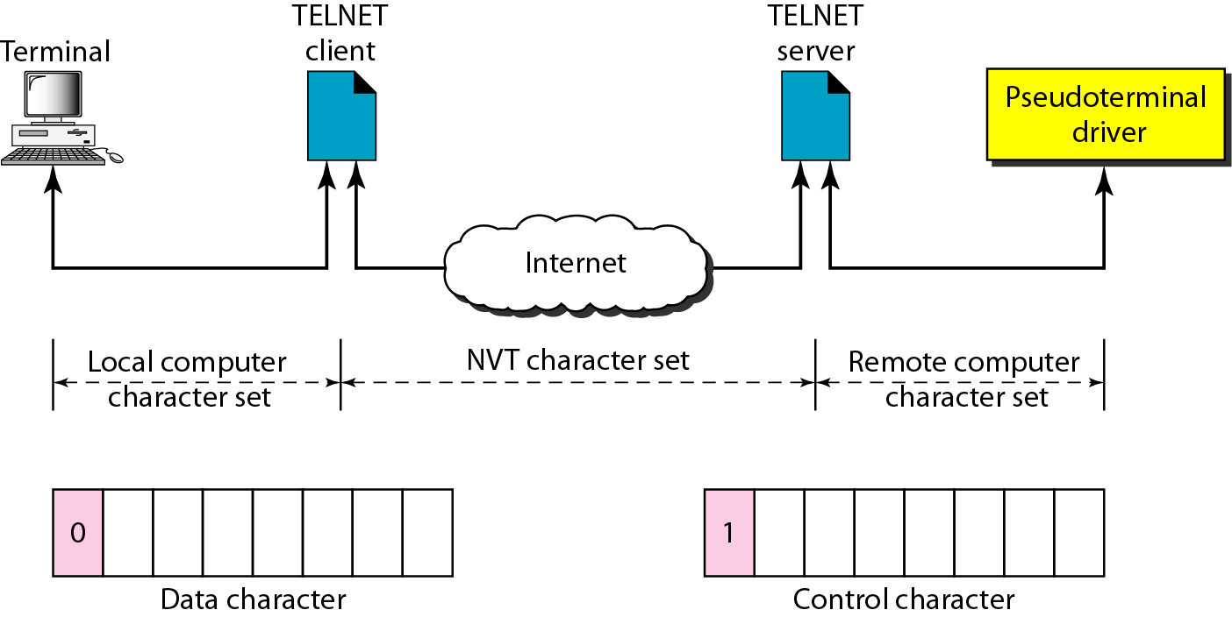
Concept of NVT

Slide 25
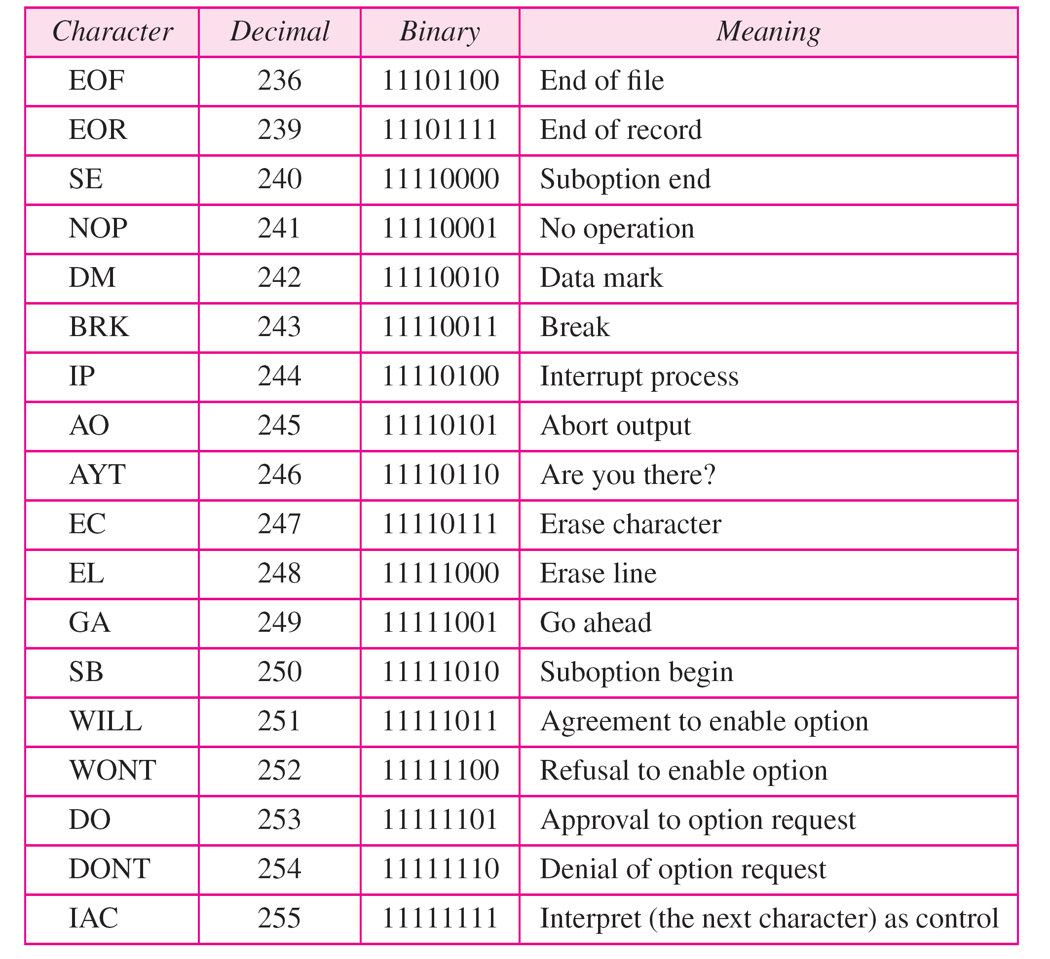
Some NVT control characters

Slide 26
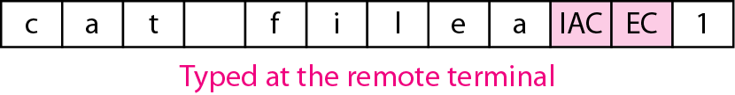
An example of embedding

Slide 27
Options

Slide 28
NVT character set for option negotiation

Slide 29
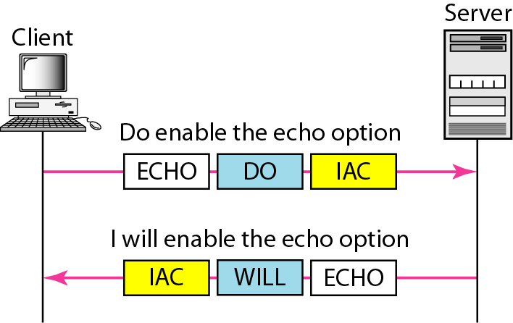
Figure Example : Echo option

Slide 30
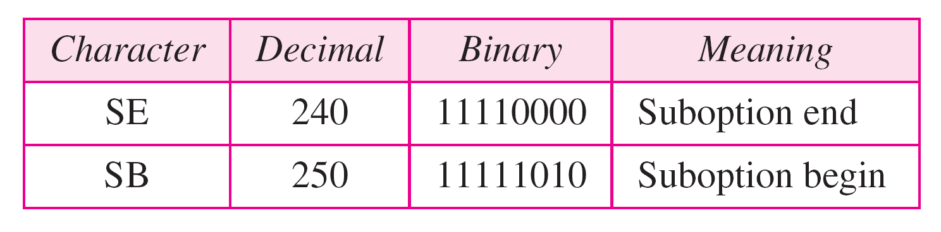
Table Character set for suboptions

Slide 31
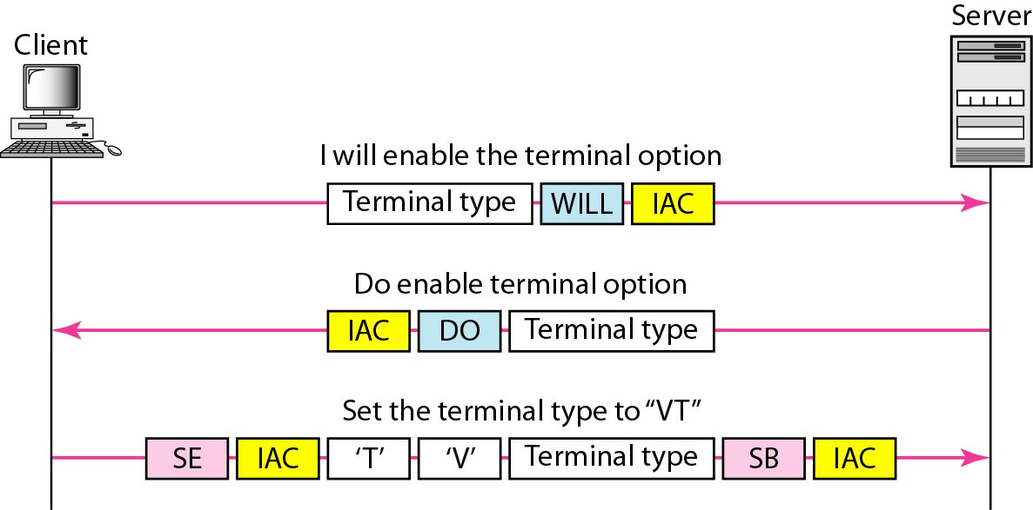
Figure Example of suboption negotiation

Slide 32
Email

Slide 33
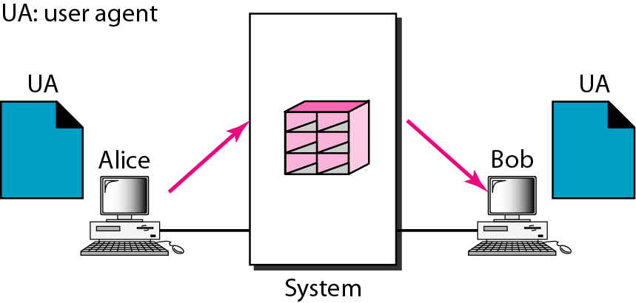
First scenario in electronic mail

Slide 34
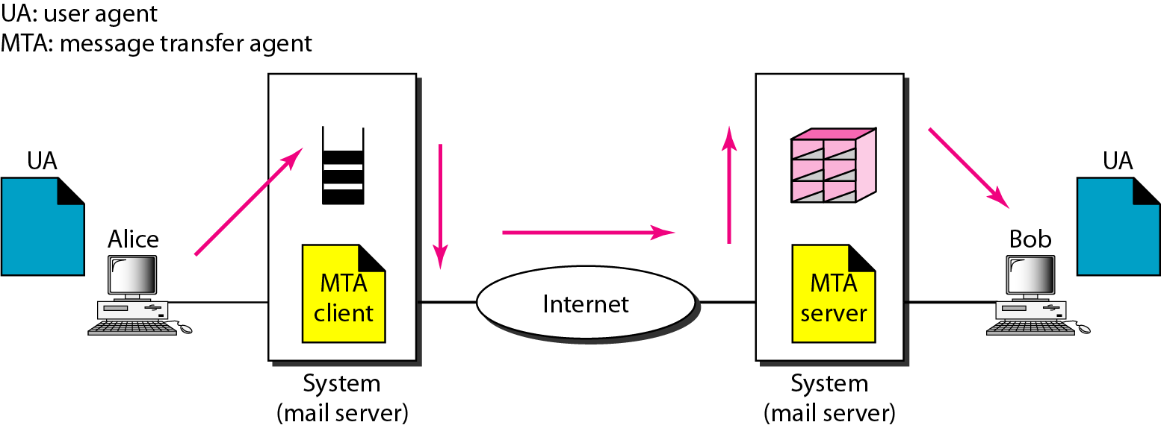
Second scenario in electronic mail

Slide 35
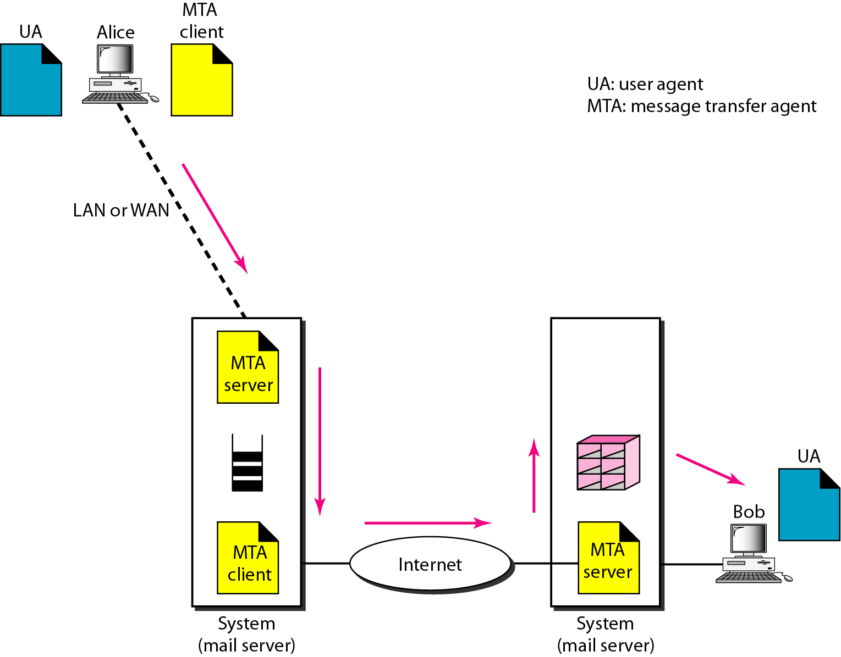
Third scenario in electronic mail

Slide 36
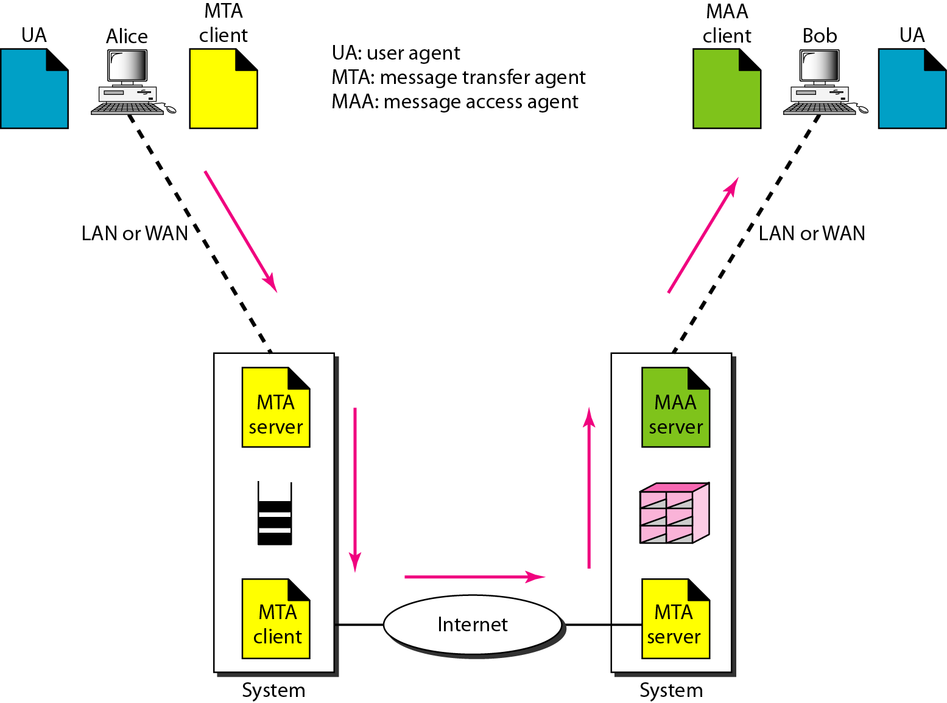
Fourth scenario in electronic mail

Slide 37
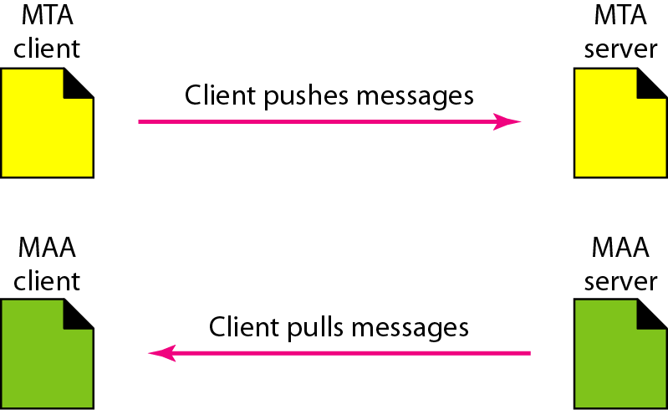
Push versus pull in electronic email

Slide 38
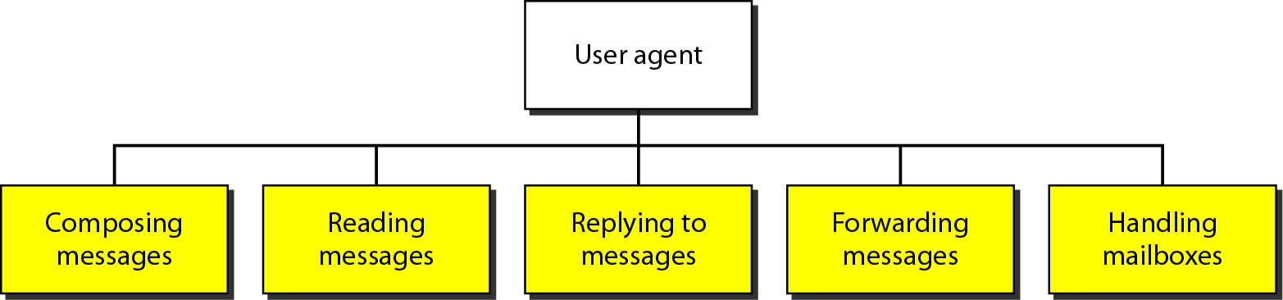
Services of user agent

Slide 39
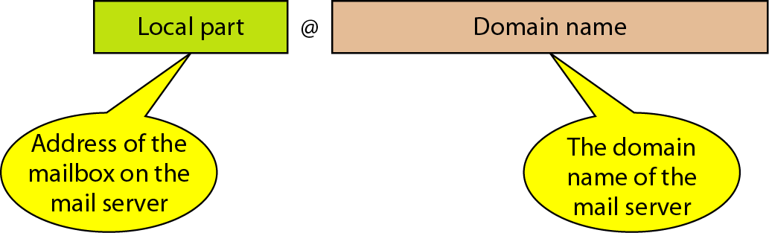
Figure 26.13 E-mail address

Slide 40
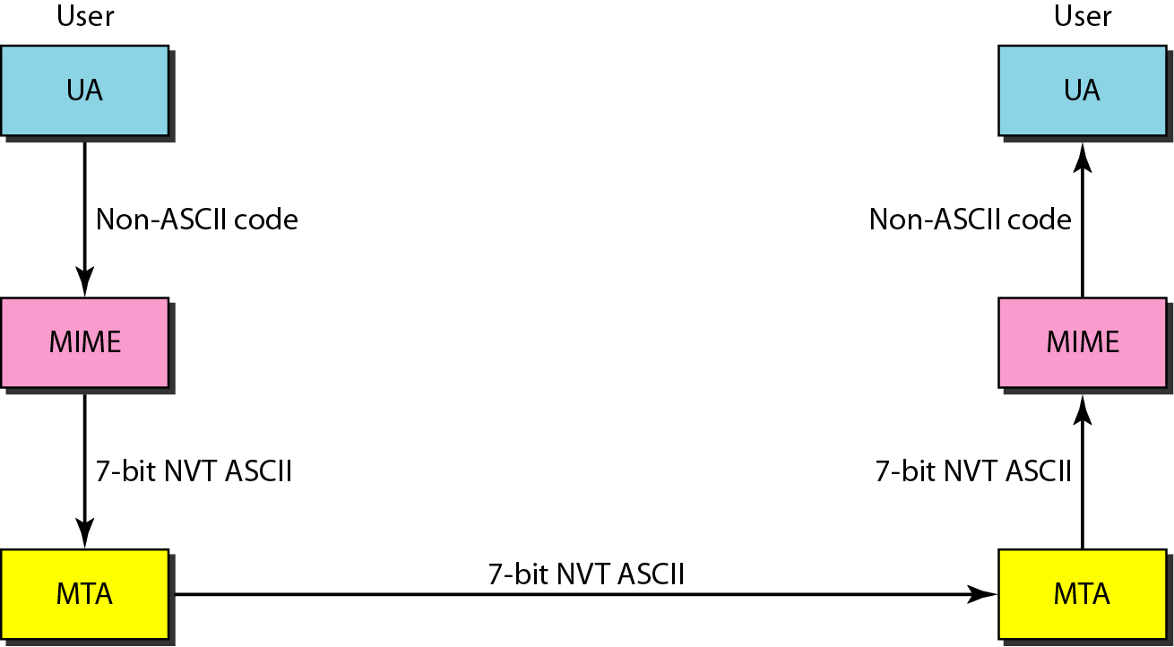
Figure: MIME

Slide 41
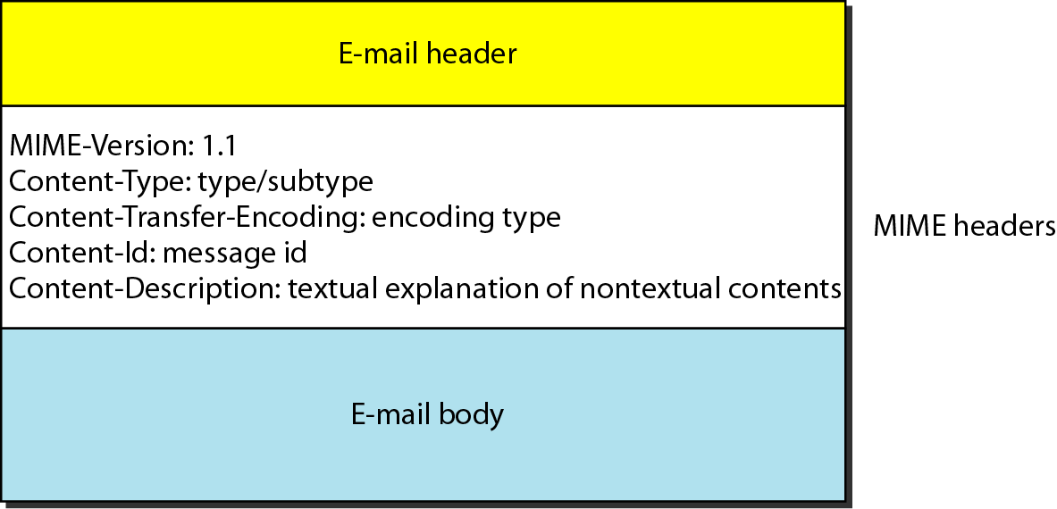
MIME header

Slide 42
Data types and subtypes in MIME

Slide 43
Content-transfer-encoding

Slide 44
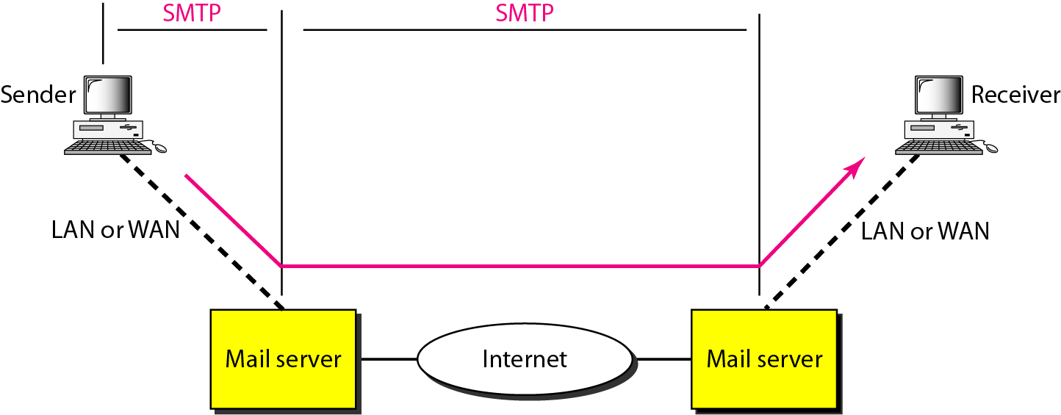
SMTP range

Slide 45
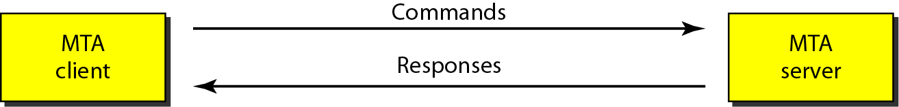
Commands and responses

Slide 46

Command format

Slide 47
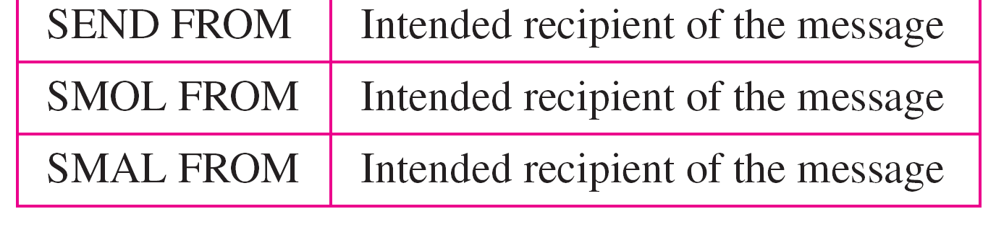
Commands

Slide 48
Responses (continued)

Slide 49
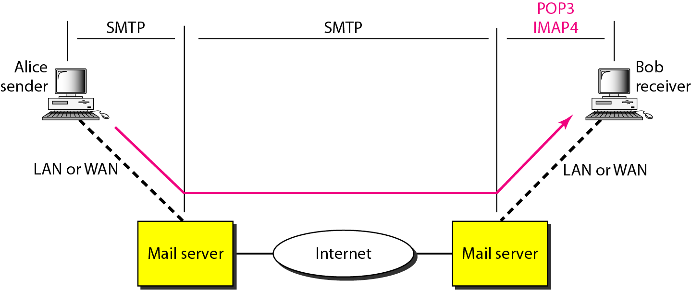
Figure POP3 and IMAP4

Slide 50
FTP

Slide 51

Note
FTP uses the services of TCP. It needs two TCP connections.
The well-known port 21 is used for the control connection and the well-known port 20 for the data connection.

Slide 52
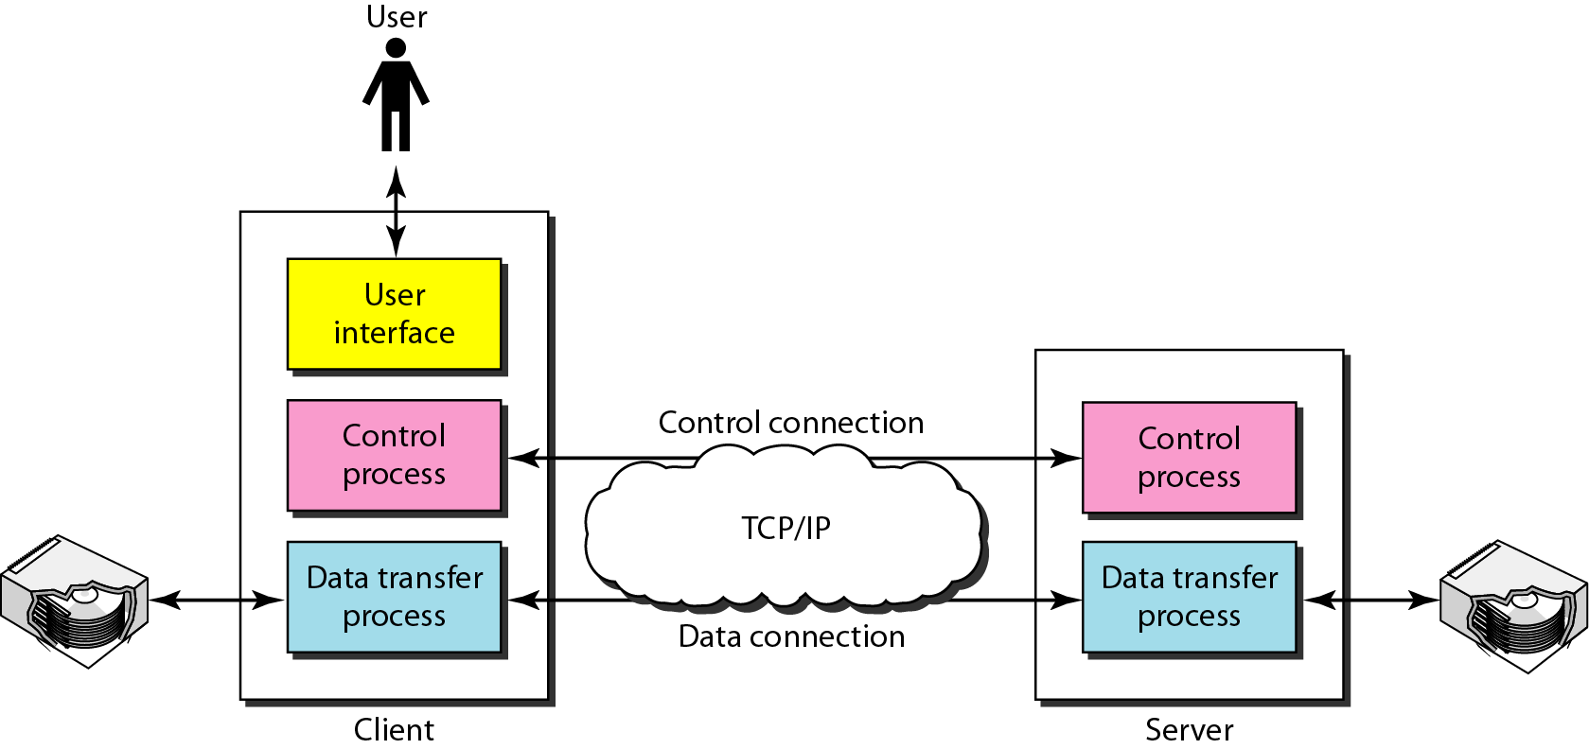
FTP

Slide 53
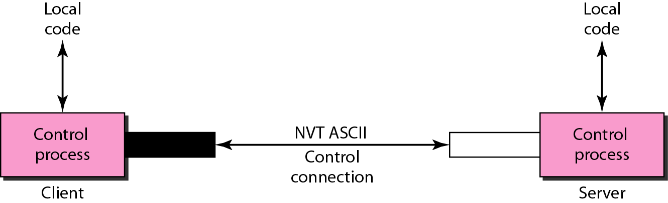
Using the control connection

Slide 54
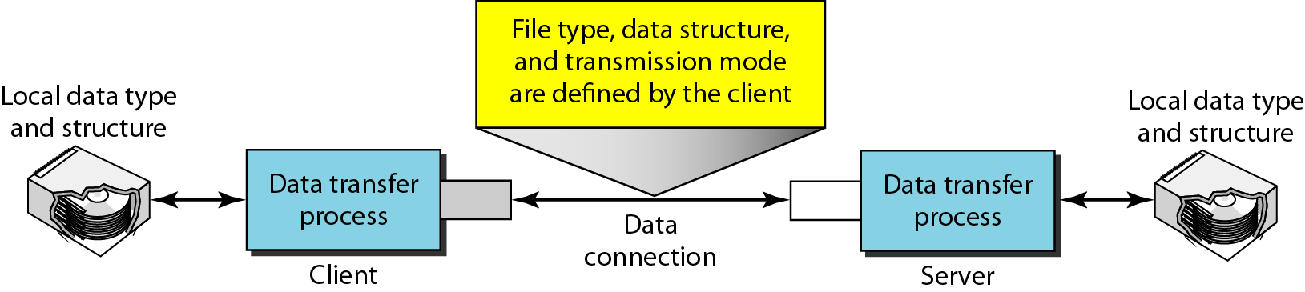
Figure Using the data connection

