Slide 1
Loaders and Linkers
Chapter 3
System Software
An introduction to systems programming
Leland L. Beck

Slide 2
Introduction
To execute an object program, we needs
  Relocation, which modifies the object program so that it can be loaded at an address different from the location originally specified
  Linking, which combines two or more separate object programs and supplies the information needed to allow references between them (Section 2.2.2)
  Loading and Allocation, which allocates memory location and brings the object program into memory for execution (Section 2.3.5)

Slide 3
Overview of Chapter 3
Type of loaders
  assemble-and-go loader
  absolute loader (bootstrap loader)
  relocating loader (relative loader)
  direct linking loader
Design options
  linkage editors
  dynamic linking
  bootstrap loaders

Slide 4
Assemble-and-go Loader
Characteristic
  the object code is stored in memory after assembly
  single JUMP instruction
Advantage
  simple, developing environment
Disadvantage
  whenever the assembly program is to be executed, it has to be assembled again
  programs have to be coded in the same language

Slide 5
Design of an Absolute Loader
Absolute Loader
  Advantage
    Simple and efficient
  Disadvantage
    the need for programmer to specify the actual address
    difficult to use subroutine libraries
Program Logic
  Next slice

Slide 6
Fig. 3.2 Algorithm for an absolute loader
Begin
read Header record
verify program name and length
read first Text record
while record type is not ‘E’ do
begin
{if object code is in character form, convert into internal representation}
move object code to specified location in memory
read next object program record
end
jump to address specified in End record
end

Slide 7
Object Code Representation
Figure 3.1 (a)
  each byte of assembled code is given using its hexadecimal representation in character form
  easy to read by human beings
In general
  each byte of object code is stored as a single byte
  most machine store object programs in a binary form
  we must be sure that our file and device conventions do not cause some of the program bytes to be interpreted as control characters

Slide 8
A Simple Bootstrap Loader
Bootstrap Loader
  When a computer is first tuned on or restarted, a special type of absolute loader, called bootstrap loader is executed
  This bootstrap loads the first program to be run by the computer -- usually an operating system
Example (SIC bootstrap loader)
  The bootstrap itself begins at address 0
  It loads the OS starting address 0x80
  No header record or control information, the object code is consecutive bytes of memory

Slide 9
Fig. 3.3 SIC Bootstrap Loader Logic
Begin
X=0x80 (the address of the next memory location to be loaded
Loop
A←GETC (and convert it from the ASCII character code to the value of the hexadecimal digit)
save the value in the high-order 4 bits of S
A←GETC
combine the value to form one byte A← (A+S)
store the value (in A) to the address in register X
X←X+1
End
0~9 : 48
A~F : 65
GETC A←read one character
if A=0x04 then jump to 0x80
if A<48 then GETC
A ← A-48 (0x30)
if A<10 then return
A ← A-7 (48+7=55)
return

Slide 10
Relocating Loaders
Motivation
  efficient sharing of the machine with larger memory and when several independent programs are to be run together
  support the use of subroutine libraries efficiently
Two methods for specifying relocation
  modification record (Fig. 3.4, 3.5)
  relocation bit (Fig. 3.6, 3.7)
    each instruction is associated with one relocation bit
    these relocation bits in a Text record is gathered into bit masks

Slide 11
Modification Record
For complex machines
Also called RLD specification
  Relocation and Linkage Directory
Modification record
  col 1: M
  col 2-7: relocation address
  col 8-9: length (halfbyte)
  col 10: flag (+/-)
  col 11-17: segment name

Slide 12
Relocation Bit
For simple machines
Relocation bit
  0: no modification is necessary
  1: modification is needed
Twelve-bit mask is used in each Text record
  since each text record contains less than 12 words
  unused words are set to 0
  any value that is to be modified during relocation must coincide with one of these 3-byte segments
    e.g. line 210
Text record
  col 1: T
  col 2-7: starting address
  col 8-9: length (byte)
  col 10-12: relocation bits
  col 13-72: object code

Slide 13
Program Linking
Goal
  Resolve the problems with EXTREF and EXTDEF from different control sections
Linking
  1. User, 2. Assembler, 3. Linking loader
Example
  Program in Fig. 3.8 and object code in Fig. 3.9
  Use modification records for both relocation and linking
    address constant
    external reference

Slide 14
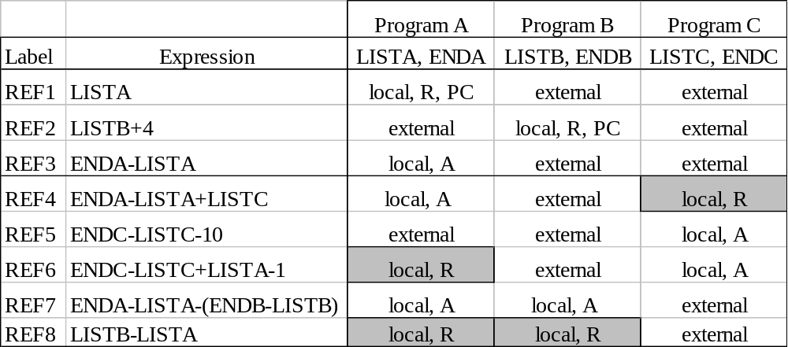
Program Linking Example

Slide 15
Program Linking Example
Fig. 3.10
Load address for control sections
  PROGA 004000 63
  PROGB 004063 7F
  PROGC 0040E2 51
Load address for symbols
  LISTA: PROGA+0040=4040
  LISTB: PROGB+0060=40C3
  LISTC: PROGC+0030=4112
REF4 in PROGA
  ENDA-LISTA+LISTC=14+4112=4126
  T0000540F000014FFFFF600003F000014FFFFC0
  M00005406+LISTC

Slide 16
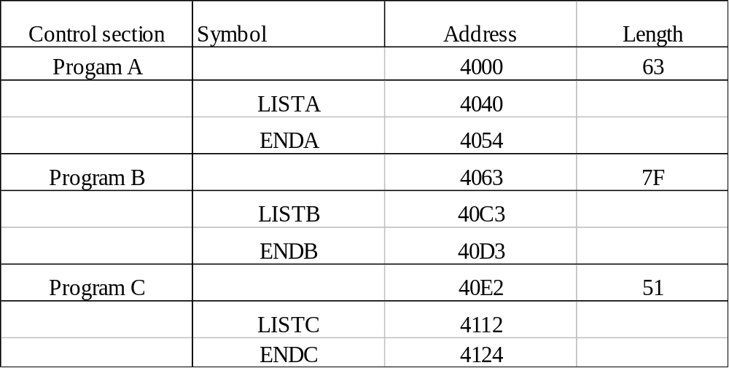
Program Logic and Data Structure
Two Passes Logic
  Pass 1: assign addresses to all external symbols
  Pass 2: perform the actual loading, relocation, and linking
ESTAB (external symbol table)

Slide 17
Pass 1 Program Logic
Pass 1:
  assign addresses to all external symbols
Variables
  PROGADDR (program load address) from OS
  CSADDR (control section address)
  CSLTH (control section length)
  ESTAB
Fig. 3.11(a)
  Process Define Record

Slide 18
Pass 2 Program Logic
Pass 2:
  perform the actual loading, relocation, and linking
Modification record
  lookup the symbol in ESTAB
End record for a main program
  transfer address
Fig. 3.11(b)
  Process Text record and Modification record

Slide 19
Improve Efficiency
Use local searching instead of multiple searches of ESTAB for the same symbol
  assign a reference number to each external symbol
  the reference number is used in Modification records
Implementation
  01: control section name
  other: external reference symbols
Example
  Fig. 3.12

Slide 20
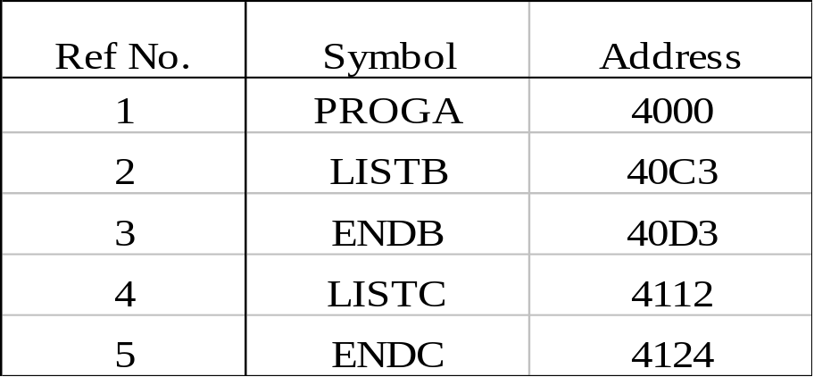
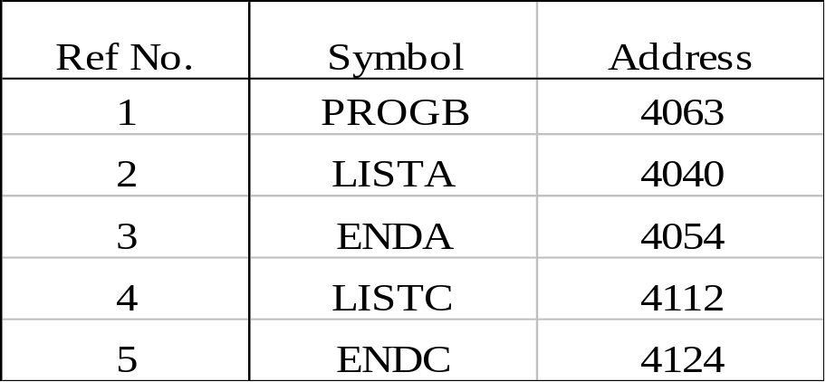
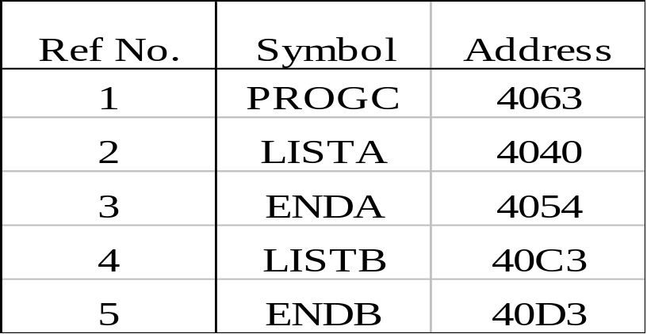
Figure 3.12
PROGA
PROGB PROGC

Slide 21
Machine-Independent Loader Features
Automatic Library Search
  Many linking loaders can automatically incorporate routines from a subprogram library into the program being loaded
    A standard library
    Other libraries may be specified by control statements or by parameters to the loader
  Also called automatic library call in some systems

Slide 22
Automatic Library Search
Implementation
  Linking loaders that support automatic library search must keep track of external symbols that are referred to , but not defined, in the primary input to the loader
  At the end of Pass 1, the symbols in ESTAB that remain undefined represented unresolved external references
  Then, the loader searches the library or libraries specified for routines that contain the definitions of these symbols
  Note that the subroutines fetched from a library in this way may themselves contain external references.
    It is therefore necessary to repeat the library search process until all reference are resolved.

Slide 23
Automatic Library Search
Implementation
  The process allows the programmer to override the standard subroutines in the library by supplying his or her own routines
The libraries to be searched by the loader ordinarily contain assembled or compiled versions of the subroutines (i.e., object programs)
  For efficient searching
    Directory
  Some operating systems can keep the directory for commonly used libraries permanently in memory
The same technique applies equally well to the resolution of external references to data items

Slide 24
Loader Options
Many loaders allow the user to specify options that modify the standard processing
Many loaders have a special command language
  A separate input file to loader
  Embedded in the primary input stream
  In source program

Slide 25
Loader Options
Examples of command language
  INCLUDE program-name(library-name)
    Direct the loader to read the designated object program from a library and treat it as if it were part of the primary loader input
  DELETE csdect-name
    Instruct the loader to delete the named control section(s) from the set of programs being loaded
  CHANGE name1, name2
    Cause the external symbol name1 to be changed to name2 wherever it appears in the object programs
INCLUDE READ(UTLIB)
INCLUDE WRITE(UTLIB)
DELETE RDREC, WRREC
CHANGE RDREC, READ
CHANGE WRREC, WRITE

Slide 26
Loader Options
Examples of command language
  LIBRARY MYLIB
    Automatic inclusion of library routines to satisfy external references
    Searched before the standard libraries
  NOCALL STDDEV, PLOT, CORREL
    To instruct the loader that these external references are to remain unsolved
  Others
    Output from the load, e.g., the map which includes control section names and adddresses
    The ability to specify the location at which execution is to begin
    Control whether or not the loader should attempt to execute the program if errors are detected during the load

Slide 27
Loader Design Options
Linkage Editor
  Perform linking prior to load time
Dynamic linking
  Linking function is performed at execution time
Bootstrap loader
  Be used to run stand-alone programs independent of the operating system or the system loader

Slide 28
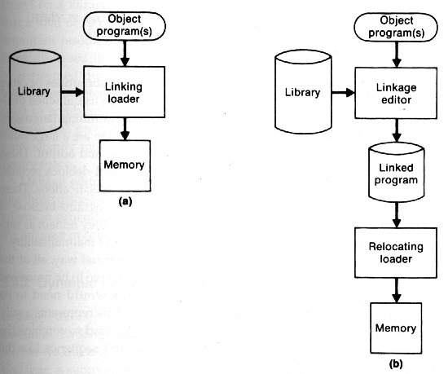
Linkage Editors
The essential difference between a linkage editor and a linking loader

Slide 29
Linkage Editors
A linking loaders performs
  All linking and relocation operations
  Automatic library search
  Loads the linked program directly into memory for execution
A linkage editor
  Produces a linked version of program (often called a load module or an executable image), which is written to a file or library for later execution
  A simple relocating loader can be used to load the linked version of program into memory
    The loading can be accomplished in one pass with no external symbol table required

Slide 30
Linkage Editors
A linkage editor
  Resolution of external references and library searching are only performed once
  In the linked version of programs
    All external references are resolved, and relocation is indicated by some mechanism such as modification records or a bit mask
  External references is often retained in the linked program
    To allow subsequent relinking of the program to replace control sections, modify external references, etc.

Slide 31
Linkage Editors
Linkage editors can perform many useful functions besides simply preparing an object program for execution
  The linkage editor can be used to replace the subroutines in the linked version
INCLUDE PLANNER(PROGLIB)
DELETE PROJECT
INCLUDE PROJECT(NEWLIB)
REPLACE PLANNER(PROGLIB)

Slide 32
Linkage Editors
  Linkage editors can also be used to build packages of subroutines or other control sections that are generally used together
    It could be used to combine the appropriate subroutines into a package with a command sequence
INCLUDE READR(FTNLIB)
INCLUDE WRITER(FTNLIB)
INCLUDE BLOCK(FTNLIB)
INCLUDE DEBLOCK(FTNLIB)
INCLUDE ENCODE(FTNLIB)
INCLUDE DECODE(FTNLIB)
.
.
.
SAVE FTNIO(SUBLIB)

Slide 33
Linkage Editors
  Linkage editors often allow the user to specify that external references are not to be resolved by automatic library search
    Only the external references between user-written routines would be resolved

Slide 34
Dynamic Linking
Postpone the linking function until execution time
  A subroutine is loaded and linked to the rest of the program when it is first called
    Dynamic linking, dynamic loading, or load on call
Allow several executing programs to share one copy of a subroutine or library
In object-oriented system, it allows the implementation of the object and its methods to be determined at the time the program is run
Dynamic linking provides the ability to load the routines only when they are needed

Slide 35
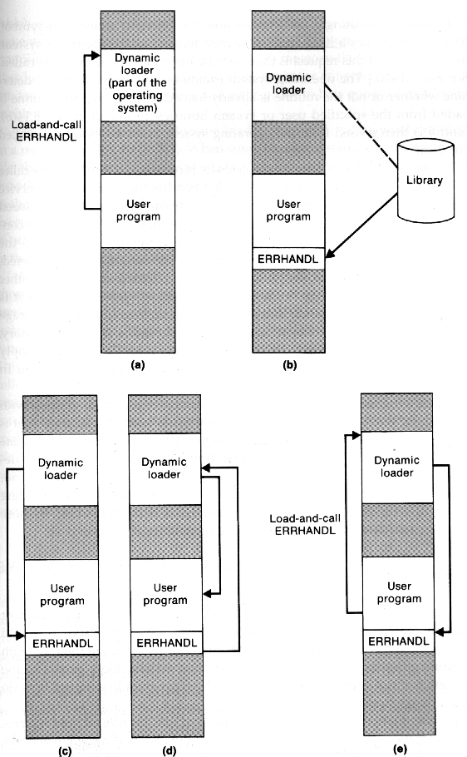
Dynamically loaded must be called via an operating system service request
Load-and-call service
  OS examines its inernal tables to determine whether or not the routine is already loaded
  Routine is loaded from library
  Control is passed from OS to the called subroutine
  Subroutine is finished
  Calling to a subroutine which is already in memory
Binding of the name to an actuall address is delayed from load time until execution time

Slide 36
Bootstrap Loaders
Given an idle computer with no program in memory, how do we get things started?
  With the machine empty and idle, there is no need for program relocation
    Some early computers required the operator to enter into memory the object code for an absolute loader, using switches on the computer console
    One some computer, an absolute loader program is permanently resident in a ROM
    A built-in hardware function that reads a fixed-length record form some device into memory at a fixed location

Slide 37
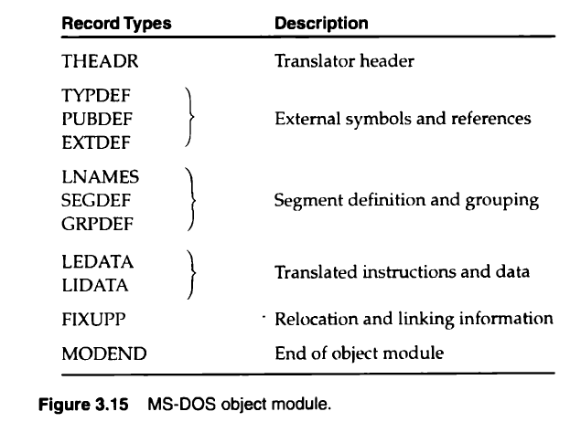
MS-DOS Linker
Pentium , other x86 systems
MASM -> object modules, non executable, .obj
MS-DOS LINK = Linkage Editor -> .exe

Slide 38
PUBDEF = Public names
EXTDEF = external symbols
TYPEDEF = External names data types
SEGDEF = segments of object modules, length
GRPDEF = Groups combining segments
LNAMES = list of all segment and class names
LEDATA=Like Text Record
LIDATA=Repeated instruction and data
FIXUPP=Modification record like, external reference, relocation

