Slide 1
System Programming
System Software, pp.1-20.
Chia-Hui Chang, Assistant Professor
Dept. of Computer Science & Information Engineering
National Central University, Taiwan

Slide 2
Introduction
Definition
  System software consists of a variety of programs that support the operation of a computer
  One characteristic in which most system software differ from application software is machine dependency
Example:
  e.g. when you took the first programming course
    text editor, compiler, loader or linker, debugger
  e.g. when you wrote assembler language
    assembler, macro processor
  e.g. you control all of these processes by interacting with the operation system

Slide 3
System Software vs. Machine Architecture
One characteristic in which most system software differ from application software is machine dependency
  e.g. assembler translate mnemonic instructions into machine code
  e.g. compilers must generate machine language code
  e.g. operating systems are directly concerned with the management of nearly all of the resources of a computing system
There are some aspects of system software that do not directly depend upon the type of computing system
  e.g. general design and logic of an assembler
  e.g. code optimization techniques

Slide 4
The Simplified Instructional Computer (SIC)
SIC is a hypothetical computer that includes the hardware features most often found on real machines
Two versions of SIC
  standard model
  XE version

Slide 5
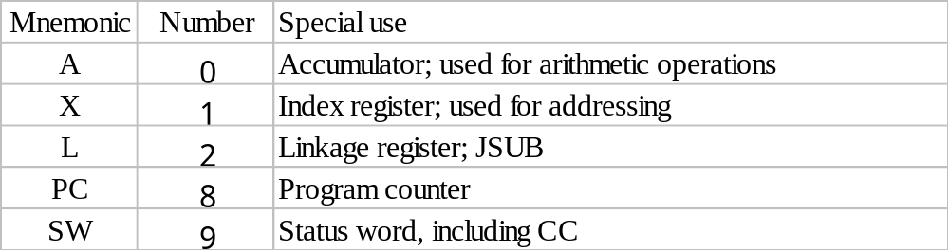
SIC Machine Architecture (1/4)
Memory
  8-bit bytes
  3 consecutive bytes form a word
  2¹⁵ bytes in the computer memory
Registers

Slide 6
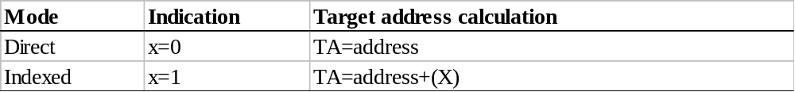
SIC Machine Architecture (2/4)
Data Formats
  Integers are stored as 24-bit binary numbers; 2’s complement representation is used for negative values
  No floating-point hardware
Instruction Formats
Addressing Modes
opcode (8)
x
address (15)

Slide 7
SIC Machine Architecture (3/4)
Instruction Set
  load and store: LDA, LDX, STA, STX, etc.
  integer arithmetic operations: ADD, SUB, MUL, DIV, etc.
    All arithmetic operations involve register A and a word in memory, with the result being left in the register
  comparison: COMP
    COMP compares the value in register A with a word in memory, this instruction sets a condition code CC to indicate the result
  conditional jump instructions: JLT, JEQ, JGT
    these instructions test the setting of CC and jump accordingly
  subroutine linkage: JSUB, RSUB
    JSUB jumps to the subroutine, placing the return address in register L
    RSUB returns by jumping to the address contained in register L

Slide 8
SIC Machine Architecture (4/4)
Input and Output
  Input and output are performed by transferring 1 byte at a time to or from the rightmost 8 bits of register A
  The Test Device (TD) instruction tests whether the addressed device is ready to send or receive a byte of data
  Read Data (RD)
  Write Data (WD)

Slide 9
SIC Programming Examples (Fig 1.2)

Slide 10
SIC Programming Examples
Data movement
  No memory-memory move instruction
  3-byte word: LDA, STA, LDL, STL, LDX, STX
  1-byte: LDCH, STCH
  Storage definition
    WORD, RESW
    BYTE, RESB

Slide 11
SIC Programming Examples (Cont.)
Arithmetic
  Arithmetic operations are performed using register A, with the result being left in register A
Looping (TIX)
  (X)=(X)+1
  compare with operand
  set CC
Break...

Slide 12
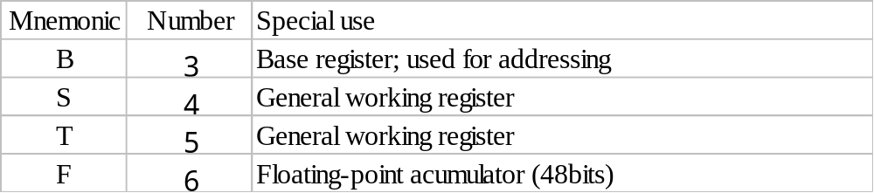
SIC/XE Machine Architecture (1/4)
Memory
  2²⁰ bytes in the computer memory
More Registers

Slide 13
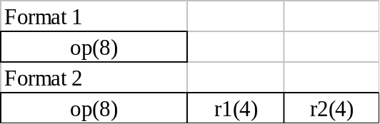

SIC/XE Machine Architecture (2/4)
Data Formats
  Floating-point data type: frac*2^{(exp-1024)}
    frac: 0~1
    exp: 0~2047
Instruction Formats
  larger memory -> extend addressing capacity
s
exponent (11)
fraction (36)

Slide 14
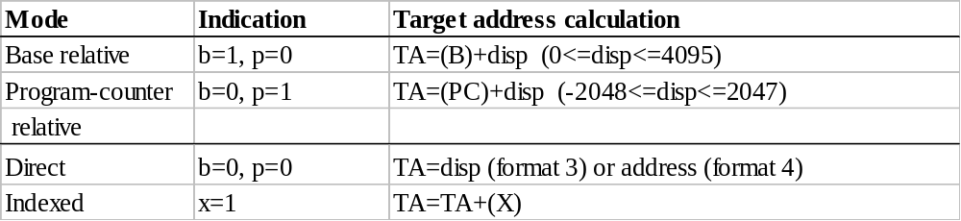
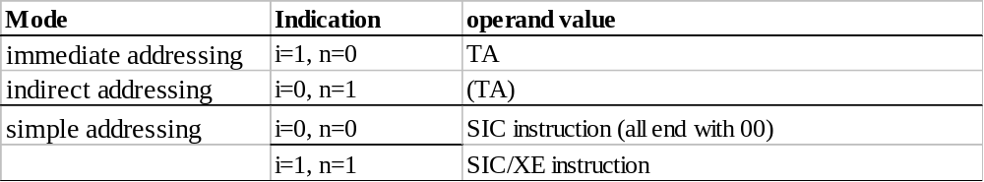
SIC/XE Machine Architecture (3/4)
Addressing Modes
  How the target address is used?
  Note: Indexing cannot be used with immediate or indirect addressing modes

Slide 15
SIC/XE Machine Architecture (4/4)
Instruction Set
  new registers: LDB, STB, etc.
  floating-point arithmetic: ADDF, SUBF, MULF, DIVF
  register move: RMO
  register-register arithmetic: ADDR, SUBR, MULR, DIVR
  supervisor call: SVC
    generates an interrupt for OS (Chap 6)
Input/Output
  SIO, TIO, HIO: start, test, halt the operation of I/O device (Chap 6)

Slide 16
SIC/XE Programming Example
data movement
  immediate addressing for SIC/XE
arithmetic
Looping (TIXR)
  (X)=(X)+1
  compare with register specified
  set CC

Slide 17
SIC Programming Example (Fig 1.3)

Slide 18
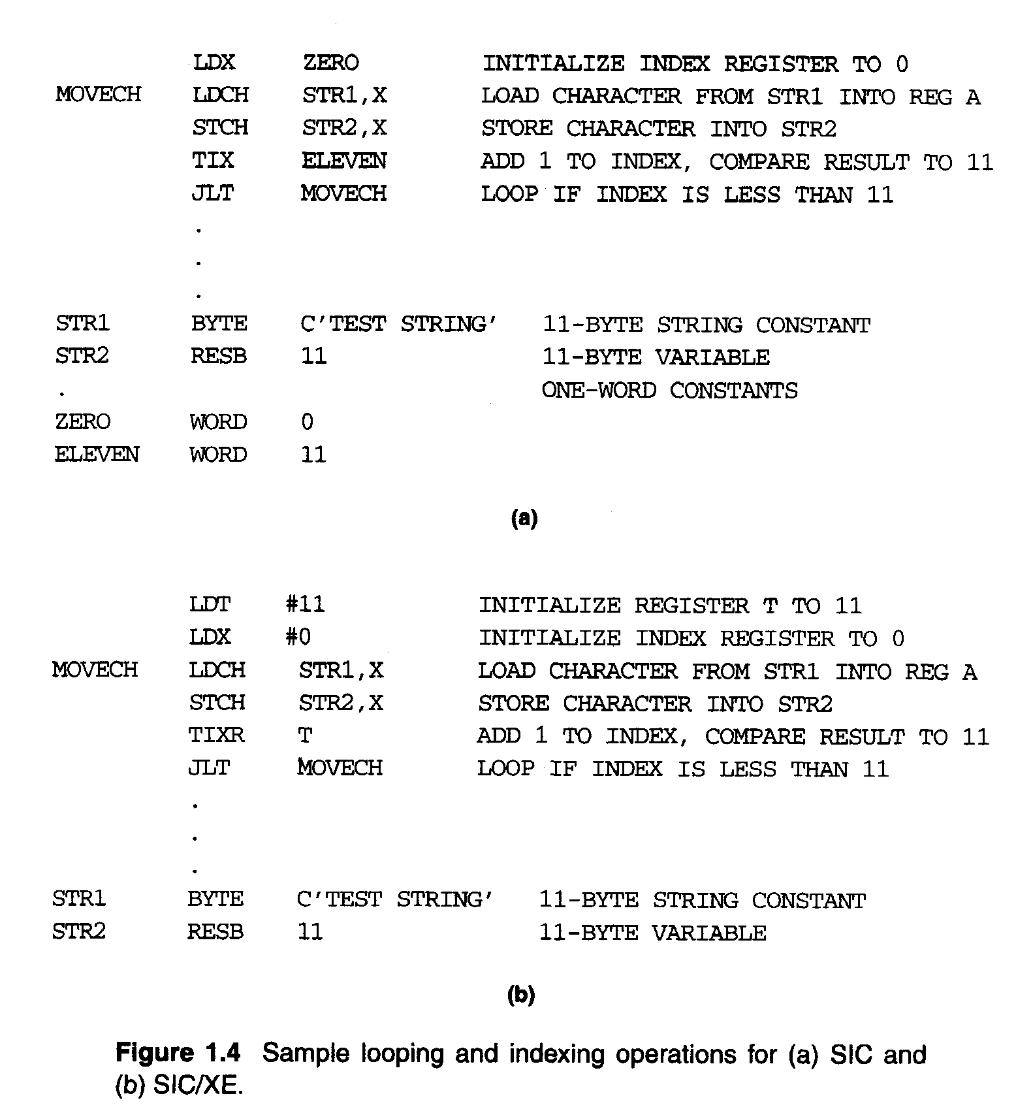
SIC Programming Example (Fig 1.4)

Slide 19
SIC Programming Example (Fig 1.5)

Slide 20
SIC Programming Example (Fig 1.6)

