Slide 1
Lecture 05

Slide 2
Evaluating the Proposal
Once the proposals are generated, they are evaluated
It is necessary to check
  Technical Feasibility
  Operational Feasibility
  Economical Feasibility
Risk Analysis
Identify the areas ( uncertain ) of high risks for which uncertainty about getting successful outcome
  Identify and Special attention take

Slide 3
Economical Feasibility
Cost Benefit Analysis
Cost : Place actual money value against any purchase or activity needed to implement the project
Benefit : Place money value against any benefits that will accure from a new system created by the project
Two steps
  Estimation of Costs and Benefits
  Determine whether a project is worthwhile or not

Slide 4
Estimation of Costs and Benefits
Goal is to produce a list of what is required to implement the project
List of the new system benefits
Evaluating Costs
  Tangible Items ( Direct value can be attached )
  Intangible Items (Direct value can’t be attached , guess )
Evaluating Benefits
  Tangible Items ( Direct value can be attached )
  Intangible Items (Direct value can’t be attached , guess )

Slide 5
Cost of Tangible Items
Equipment costs for the new system
  Computing equipments costs, accommodation costs, furniture costs etc.
Personnel Costs – Analyst, Designers, Programmers etc.
Material Costs – Stationary, manuals, documents etc.
Conversion Cost – New forms, Procedures etc.
Training Costs – Users, developers etc.
Other Costs – Consultants costs, travel, management overhead etc.
Value can’t be precisely determined & subjective judgment
  How much save to complete the project earlier
  Provide new information to the decision makers

Slide 6
Benefits of Tangible & Intangible Items
Measure by actual value
  Reduce of production cost
  Reduce the processing cost
Can’t be measure ( only subjective judgement )
  Increase the sales in the market
  Wider market of marketing data
  Maintain good business image

Slide 7
Determine whether a project is worthwhile or not
Payback method ( Forward )
Present Value method( backward )
Payback method ( Forward )
  Define time required to recover the initial cost
  We know how much a project will cost to start
  Know cost and benefits for each succeeding year
Example
  Cost at start is $50,000 ( project tenure is 5 years )
  Benefits - $10,000 at the end of 1st year
    - $20,000 at the end of 2nd year payback period is
  - $30,000 at the end of 3rd year between 2nd and 3rd
  - $10,000 at the end of 4th year year
  - $5,000 at the end of 5th year

Slide 8
Determine whether a project is worthwhile or not (Cont.)
We assume for banking system, and rate of interest is 10% per annum
Present Value method( backward )
Determine how much money it is worthwhile for investing now in order to receive a given return in some years time
Project benefits are estimated for each year from today
Then compute the present value of savings
If the present cost exceeds the present value, then it is not worthwhile

Slide 9




Determine whether a project is worthwhile or not (Cont.)
Example
  At t=0, Initial investment is $50,000
  At t=1, Benefit = $10,000 then the amount deposited in the 0th year= $10000/(1+10/100)
  At t=2, Benefit = $20,000 then the amount deposited in the 0th year= $20000/
  At t=3, Benefit = $30,000 then the amount deposited in the 0th year= $30000/
  At t=4, Benefit = $10,000 then the amount deposited in the 0th year= $10000/
  At t=5, Benefit = $5,000 then the amount deposited in the 0th year= $,5000/
Sum of the present value > Initial investment

Slide 10
COCOMO (COnstructive COst MOdel) Model
COCOMO I
Barry Boehm introduce it
Hierarchy of software estimation model
Model takes the following form :
  Model1(Basic COCOMO) : is a static single valued model that computes software development effort (and cost) as a function of program size expressed in estimated line of code
  Model2(Intermediate COCOMO) :computes software development effort as a function of program size and a set of “cost drivers” that include subjective assessments of product, hardware, personnel and project attributes

Slide 11
COCOMO (COnstructive COst MOdel) Model
  Model3(Advanced COCOMO) :incorporates all characteristics of the intermediate version with an assessment of the cost driver’s impact on each step (analysis, design etc.) of the software engineering process
COCOMO may applied to 3 classes of the software projects :
  Organic mode: Small, simple s/w project
    Ex. Tharmal analysis program
  Semi-detached mode: Intermediate size and complexity
    Ex. Transaction processing
  Embedded mode:

Slide 12

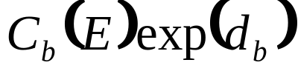
COCOMO (COnstructive COst MOdel) Model
Basic COCOMO equation take the form :
Effort= person-months
Duration= months
Cost driver attributes:
  Product attributes
    Required s/w reliability
    Size of application database
    Complexity of the product

Slide 13
COCOMO (COnstructive COst MOdel) Model
  H/W attributes
    Run-time performance constraints
    Memory constraints
    Volatility of the virtual m/c environment
    Required turnaround time
  Personnel attributes
    Analyst capability
    S/w engineer capability
    Applications experience
    Virtual m/c experience
    Programming Language experience
  Product attributes
    Use of s/w tools
    Application of S/w engineering methods
    Required development schedule

Slide 14
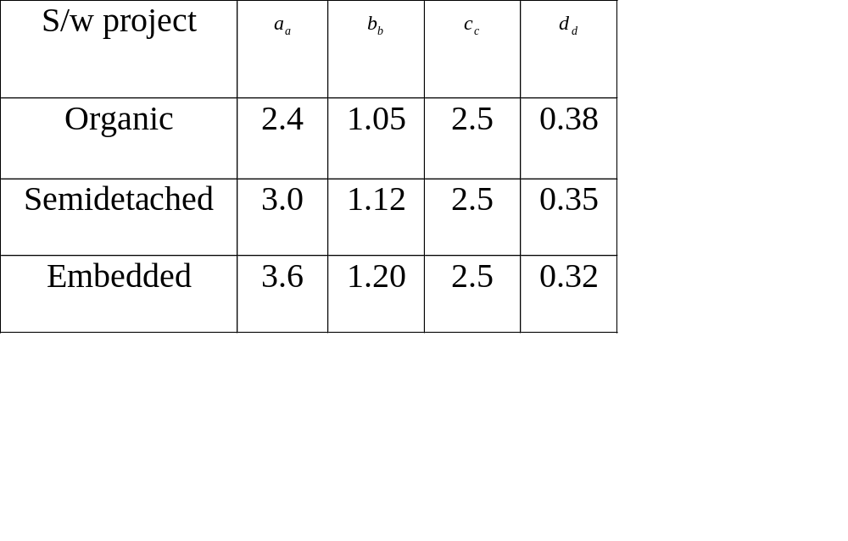
Attributes value ( Table by Boehm)

Slide 15
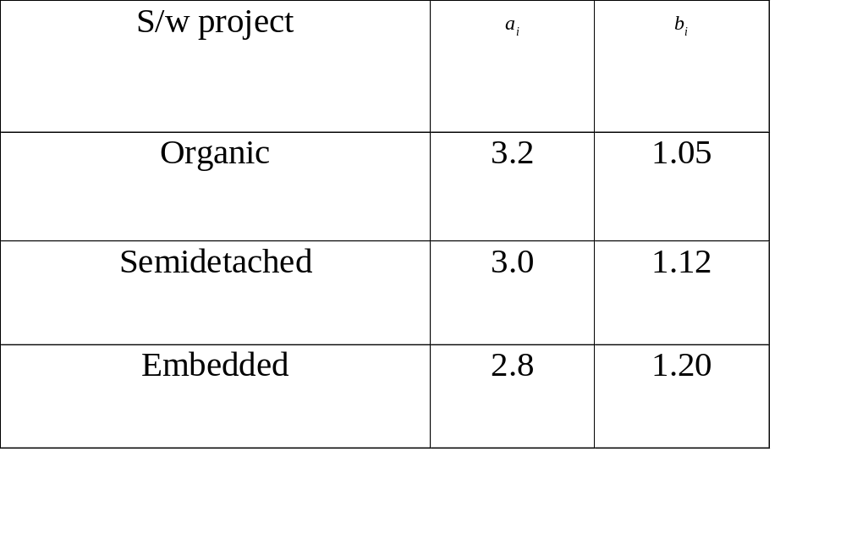
Attributes value (Table by Boehm)

Slide 16
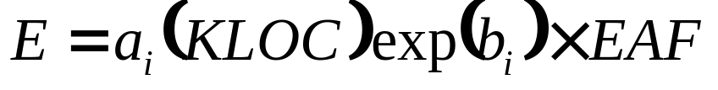
COCOMO (Cont.)
Each of the 15 attributes is rated on a 6-point scale that ranges from very low to extra high
Based on the rating effort multiplier is determined from table published by Boehm
Product of effort multipliers results is an effort adjustment factor (EAF) ranges from 0.9 to 1.4
Intermediate COCOMO Equation takes the form :

Slide 17
COCOMO II
Hierarchy of estimation models that address the following areas :
  Application composition model : used during early stage of s/w engg., when prototyping of user interfaces, consideration of s/w and system interaction, assessment of performance and evaluation of technology maturity are paramount.
  Early design stage model : used once requirements have been stabilized and basic s/w architecture has been established
  Post- architecture stage model : used during the construction of the s/w

Slide 18
COCOMO II (Cont.)
Sizing information :
  Object points
  Function points
  Lines of source code
The COCOMO II in application composition modes uses object points
An indirect s/w measure that is computed using counts of the number of (1) Screens (at the user interface), (2) Reports and (3) Components (likely to be required to build the application)

Slide 19
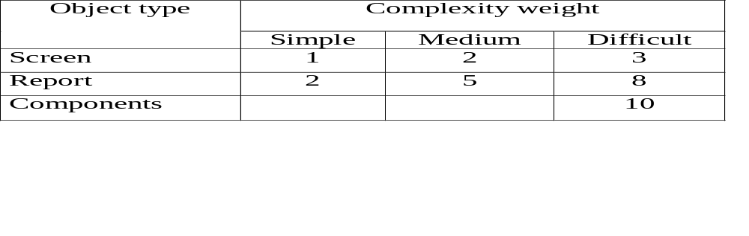
COCOMO II (Cont.)
Each object instance (screen or report) is classified into one of three complexity levels
Object point count is determine by multiplying the original number of object instances by the weighting factor in the table
Summing to obtain total object point
When component based development or general s/w reuse is to be applied, the % of reuse is estimated and the object point count is adjusted

Slide 20
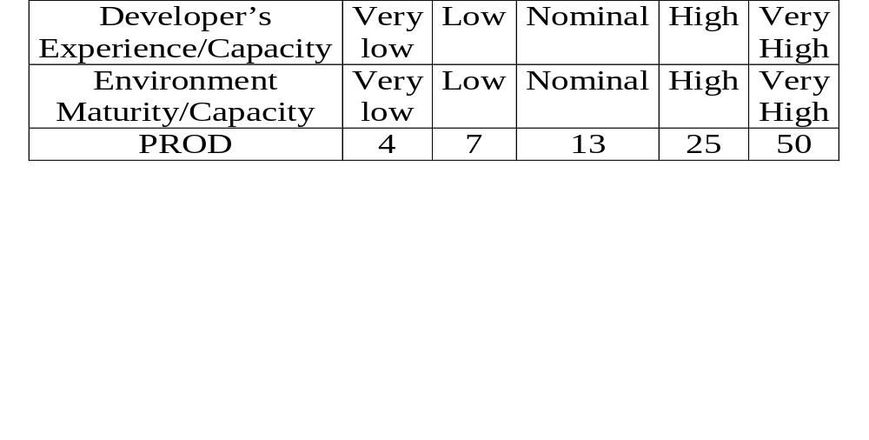
COCOMO II (Cont.)
New Object Point, NOP=(Object Point) Χ [(100-%reuse)/100]
Productivity Rate, PROD=NOP/Person-month
Estimated Effort, E= NOP/PROD
Productivity rate :

Slide 21
Function Point Analysis
Its application in non-traditional computing situations
Searching for a metric that is applicable for a broad range of software environments
The metric should be technology independent and support the need for estimating, project management, measuring quality and gathering requirements
A reliable method for measuring the size of computer software. In addition to measuring output
Function Point Analysis is extremely useful in estimating projects, managing change of scope, measuring productivity, and communicating functional requirements.

Slide 22
Function Point Analysis
There have been many misconceptions regarding the appropriateness of Function Point Analysis in evaluating emerging environments such as real time embedded code and Object Oriented programming.
Since function points express the resulting work-product in terms of functionality as seen from the user's perspective, the tools and technologies used to deliver it are independent.

Slide 23
Introduction to Function Point Analysis
One of the initial design criteria for function points was to provide a mechanism that both software developers and users could utilize to define functional requirements
One of the primary goals of Function Point Analysis is to evaluate a system's capabilities from a user's point of view
To achieve this goal, the analysis is based upon the various ways users interact with computerized systems
From a user's perspective a system assists them in doing their job by providing five (5) basic functions
Two of these address the data requirements of an end user and are referred to as Data Functions. The remaining three address the user's need to access data and are referred to as Transactional Functions.

Slide 24
The Five Components of Function Points
Data Functions
Internal Logical Files
External Interface Files
Transactional Functions
External Inputs
External Outputs
External Inquiries

Slide 25
Internal Logical Files(ILF)
The first data function allows users to utilize data they are responsible for maintaining
Logical groupings of data in a system, maintained by an end user, are referred to as Internal Logical Files (ILF).
For example,
  A pilot may enter navigational data through a display in the cockpit prior to departure. The data is stored in a file for use and can be modified during the mission. Therefore the pilot is responsible for maintaining the file that contains the navigational information.

Slide 26
External Interface Files(EIF)
The second Data Function a system provides an end user is also related to logical groupings of data
In this case the user is not responsible for maintaining the data
The data resides in another system and is maintained by another user or system
The user of the system being counted requires this data for reference purposes only
Groupings of data from another system that are used only for reference purposes are defined as External Interface Files (EIF).
For example,
  it may be necessary for a pilot to reference position data from a satellite or ground-based facility during flight. The pilot does not have the responsibility for updating data at these sites but must reference it during the flight

Slide 27
External Interface Files(EIF)
For example,
  It may be necessary for a pilot to reference position data from a satellite or ground-based facility during flight. The pilot does not have the responsibility for updating data at these sites but must reference it during the flight

Slide 28
External Input (EI)
The first Transactional Function allows a user to maintain Internal Logical Files (ILFs) through the ability to add, change and delete the data
An External Input gives the user the capability to maintain the data in ILF's through adding, changing and deleting its contents
For example,
  A pilot can add, change and delete navigational information prior to and during the mission. In this case the pilot is utilizing a transaction referred to as an External Input (EI).

Slide 29
External Output (EO)
The next Transactional Function gives the user the ability to produce outputs
For example,
  A pilot has the ability to separately display ground speed, true air speed and calibrated air speed. The results displayed are derived using data that is maintained and data that is referenced.
  In function point terminology the resulting display is called an External Output (EO).

Slide 30
External Inquiries (EQ)
The final capability provided to users through a computerized system addresses the requirement to select and display specific data from files
To accomplish this a user inputs selection information that is used to retrieve data that meets the specific criteria.
In this situation there is no manipulation of the data. It is a direct retrieval of information contained on the files
These transactions are referred to as External Inquiries (EQ).
For example,
  if a pilot displays terrain clearance data that was previously set, the resulting output is the direct retrieval of stored information

Slide 31
Adjustment Factors
Two adjustment factors that need to be considered in Function Point Analysis
  Functional Complexity
  Value Adjustment Factor
Functional Complexity :
  considers the Functional Complexity for each unique function
  Functional Complexity is determined based on the combination of data groupings and data elements of a particular function
  The number of data elements and unique groupings are counted and compared to a complexity matrix that will rate the function as low, average or high complexity

Slide 32
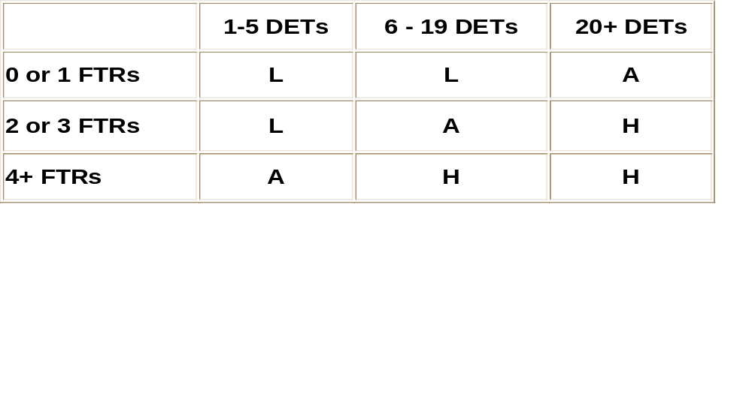
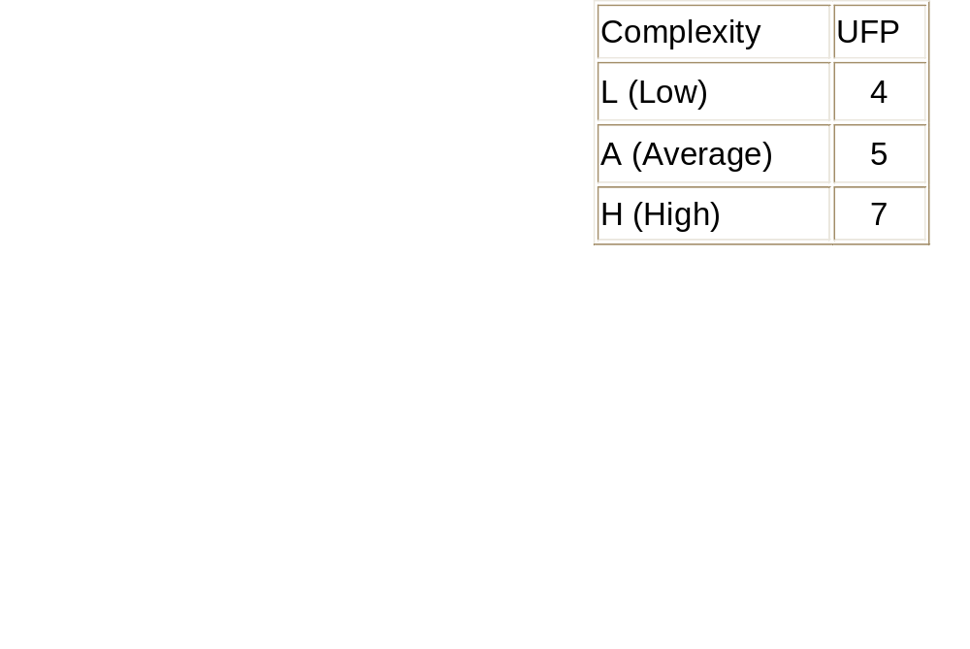
Functional Complexity
Each of the five functional components (ILF, EIF, EI, EO and EQ) has its own unique complexity matrix
The following is the complexity matrix for External Outputs

Slide 33
Example
Using the examples given above and their appropriate complexity matrices, the function point count for these functions would be:

Slide 34
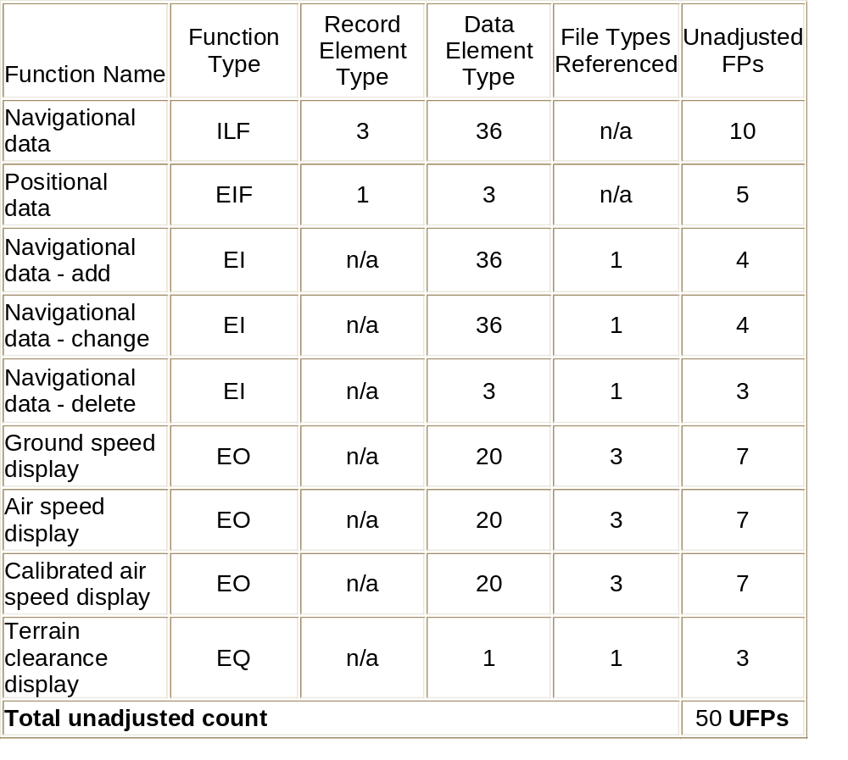
Example

Slide 35
Value Adjustment Factor
The Unadjusted Function Point count is multiplied by the second adjustment factor called the Value Adjustment Factor
This factor considers the system's technical and operational characteristics and is calculated by answering 14 questions
The factors are:
1. Data Communications
  The data and control information used in the application are sent or received over communication
  2. Distributed Data Processing
  Distributed data or processing functions are a characteristic of the application within the application boundary.

Slide 36
Value Adjustment Factor
3. Performance
  Application performance objectives, stated or approved by the user, in either response or throughput, influence (or will influence) the design, development, installation and support of the application.
4. Heavily Used Configuration
  A heavily used operational configuration, requiring special design considerations, is a characteristic of the application

Slide 37
Value Adjustment Factor
5. Transaction Rate
  The transaction rate is high and influences the design, development, installation and support.
6. On-line Data Entry
  On-line data entry and control information functions are provided in the application
7. End -User Efficiency
  The on-line functions provided emphasize a design for end-user efficiency

Slide 38
Value Adjustment Factor
8. On-line Update
  The application provides on-line update for the internal logical files.
9. Complex Processing
  Complex processing is a characteristic of the application
10. Reusability
  The application and the code in the application have been specifically designed, developed and supported to be usable in other applications

Slide 39
Value Adjustment Factor
11. Installation Ease
  Conversion and installation ease are characteristics of the application. A conversion and installation plan and/or conversion tools were provided and tested during the system test phase
12. Operational Ease
  Operational ease is a characteristic of the application. Effective start-up, backup and recovery procedures were provided and tested during the system test phase

Slide 40
Value Adjustment Factor
13. Multiple Sites
  The application has been specifically designed, developed and supported to be installed at multiple sites for multiple organizations
14. Facilitate Change
  The application has been specifically designed, developed and supported to facilitate change
Each of these factors is scored based on their influence on the system being counted. The resulting score will increase or decrease the Unadjusted Function Point count by 35%. This calculation provides us with the Adjusted Function Point count.

Slide 41
An Approach to Counting Function Points
Function point counting can be accomplished with minimal documentation. However, the accuracy and efficiency of the counting improves with appropriate documentation.
Examples of appropriate documentation are:
  Design specifications
  Display designs
  Data requirements (Internal and External)
  Description of user interfaces

Slide 42
Benefits of Function Point Analysis
Benefits including:
  improved project estimating;
  understanding project and maintenance productivity;
  managing changing project requirements;
  and
  gathering user requirements
  Roger Heller, Vice President Q/P Management Group, Inc., wrote this article. The article was originally published in the STC Crosstalk publication.
  © Copyright 2000-2002. Q/P Management Group, Inc. Proprietary and Confidential. All Rights Reserved

Slide 43
Problems
Using COCOMO I
  Determine the Effort to develop of a Software product
  Determine the Duration to develop of a Software product
  Determine the Number of People engaged to develop of a Software product.
Input of your program is Lines of Code and Effort Adjustment Factor.
Also determine the type of project (i) Organic, (ii) Semi-detached and (iii) Embedded.

Slide 44
Problems
Using COCOMO II
  Determine the Object Point to develop of a Software product
  Determine the New Object Point to develop of a Software product
  Determine the Effort to develop of a Software product
  Determine the Number of People engaged to develop Software product, if Duration of development of the software is 5 years.
If the software consist of 10 Screens, 4 Reports and 15 3GL Components. Assume component based development and 60% reuse is applied.

