Slide 1
Lecture 08
Software Repairability and Availability

Slide 2
Software Repairability
Two kind of software
  Reairable
    i.e. Batch fortran program
  Unrepairable
    i.e. Computer controlled air traffic control system
Repair of software
  Debugging
  Error correction
  Reinitialization
Down Time
Up Time

Slide 3
Software Repairability
Repairability and Availability of repairable software (any systems) is based on the concept of error correction and software reinitialization
Repair rate : is average rate measured in corrections per hour for a complete repair
Complete repair time : (i) recognition of the problem
        (ii) diagnosis of the problem
        (iii) correction of the error
        (iv) testing
        (v) reinitialization

Slide 4
Software Repairability
Effect of repair on system reliability :
Ex. Let , two computer with independent redundant program and also let, they have no repair capabilities
  In case of system failure requires the simultaneous occurrence of 3 events, (i) failure of prog1 (ii) failure of prog2 and (iii) inability to repair prog1 before prog2 fails.

Slide 5
Availability
Definition :is the probability that the program is performing successfully, according to specifications, at a given point in time.
Reliability means no failures in the interval 0 to t
Availability means only that the system is up at time t
Example of availability,
  100 identical computers, all with same operating systems (i.e. same release, configuration, h/w, s/w corrections etc.) and similar or equivalent input streams (regardless of variety, load, feature used etc.)
  Same instant we inspect all the installations, find 97 are up and 3 are down

Slide 6
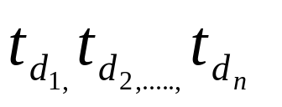
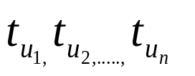


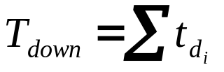
Availability
  So, Availability = 97/100
By repeating the same process, in a life testing of a software, we get correct estimation of availability
From life testing of a software (repairable)
Suppose we get downtime such as
and uptime such as
Availability, where and
So, two way availability can be defined,
  the ratio of systems up at some instant to the size of the population studied
  the ratio of observed uptime to the sum of the uptime and downtime

Slide 7
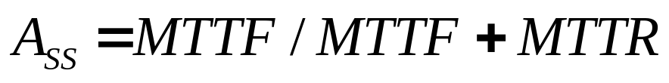
Availability
Useful needs of availability,
  to quantify the present level of availability and compare it with other systems or stated goal.
  to track the availability over a time period to see if it is increases as errors are removed or possibly decreases as more and more complex input streams are applied and excite lurking residual errors.
  planning for adequate repair personnel, facilities ( mainly test time for software and replacement parts or units for h/w ) and alternative services if necessary during downtime.
So, availability is actual time function, it has the value of unity at time zero and decreases to some steady-state value after several failure repair cycles.
To estimates the system availability during design

Slide 8
Availability Model (Markov Model)
Mathematical technique generally used to model system availability
Measure the performance of any system
Properties :
  4 kind of Markov probability models
  M(x,t) where x is state and t is time of obsrvation ; both are random variable
4 kind of combination possible
  Discrete state –discrete time (Markov chain) model
  Discrete state –continuous time (Markov process) model

Slide 9




Availability Model (Markov Model)
Any Markov model is defined by a set of probabilities, Pij (probability of transition from any state i to any state j)
Markov process (Poisson process) model
  is a stochastic process in which events occur continuously and independently of one another
Basic assumptions(which are necessary in deriving a poisson process model :
  The probability that a transition occurs from the state of n occurrences to the state of n+1 occurrences in time as . The parameter is a constant and has dimensions of occurrences per unit time. The occurrences are irreversible.
  Each occurrence is independent of all other occurrences.
  The transition probability of two or more occurrences in interval is negligible.

Slide 10





Availability Model (Markov Model)
To solve the probability of n occurrences in time t,
Case I : Zero occurrences at time
Case II : One occurrences at time
Prob. Of zero occurrences at time t
Probability that zero occurrences at time
Prob. No. of occurrences in interval

Slide 11

Availability Model (Markov Model)
Generalized,
Initial condition, t=0; n=0

Slide 12
Markov Reliability and Availability Models:
Failure and repair complicates the direct calculation of elements reliability and availability
There is three approach,
  Failure hazards (z(t)) and repair hazards (w(t)) are constant
  Using joint density function
  Using integration

Slide 13

Markov Reliability Model:
1
Continuous time and discrete state model
All mutually exclusive state
The system composed of
non-repairable element X1
Two possible states :
  S0=X1, when elements are good
  S1=X1’, when elements are bad
At t=0; initial state
equilibrium is final state
S0
S1
Z(t)
Initial State | Final State S0 S1
S0 | 1-Z(t) Z(t)
S1 | 0 1
State transition table

Slide 14



Markov Reliability Model:
The transition probability must obey the rules :
  is the transition probability at ,If Z(t)=λ constant then model is called homogeneous. Otherwise non-homogeneous ( if time function)
  Probability of more than one is neglected due to higher order of
  Probability of being in state S0 at time
Probability of being in state S1 at time t
No failure in time
Probability that the system is in state S0, at time t
Probability of repair in time

Slide 15
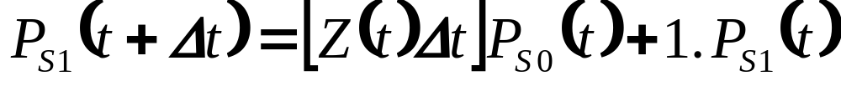
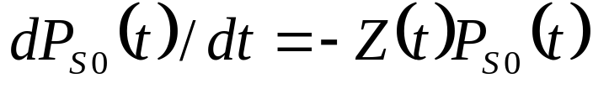
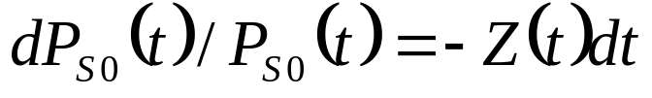
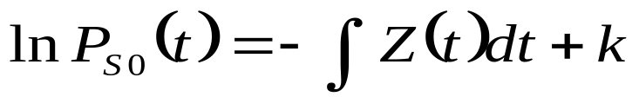
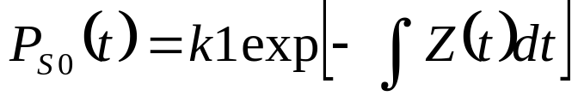
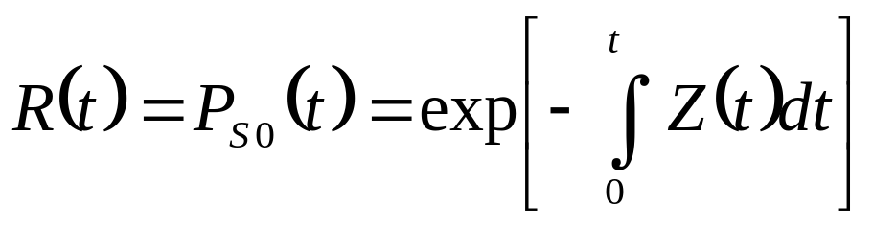
Markov Reliability Model:
Similarly, Probability of being in state S0 at time
From the first equation we get,

Slide 16
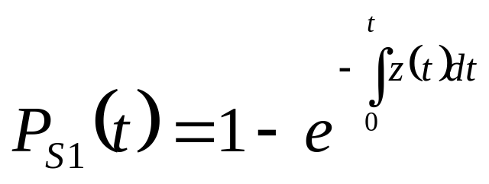

Markov Reliability Model:
Similarly,
So at any time,

Slide 17
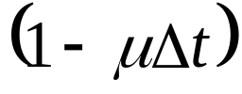






Markov Availability Model:
Availability, A(t)= Probability that the system is remain successful at a given time t / software is up at time t, regardless up or down at time t=0
Consider the system has two state up and down
  Failure rate =
  Repair rate =
  Transition probability from up→down at
  Transition probability from up→down at
  assume, →0
up
dn

Slide 18
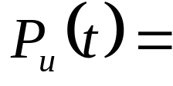
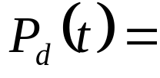
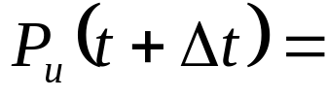


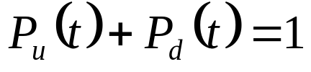
Markov Availability Model:
Probability that the system is up at time t
Probability that the system is down at time t
Probability that the system is up at time
Probability that the system is down at time
At any point of time,

Slide 19

Markov Availability Model:
From equation (1),

Slide 20
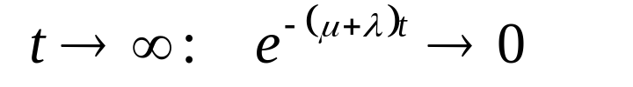
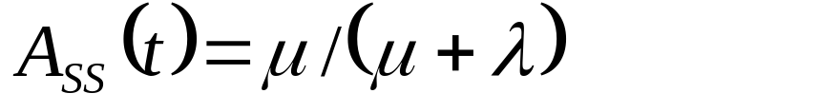
Markov Availability Model
At Steady state,

Slide 21
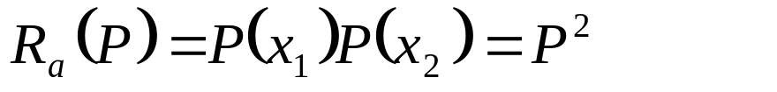
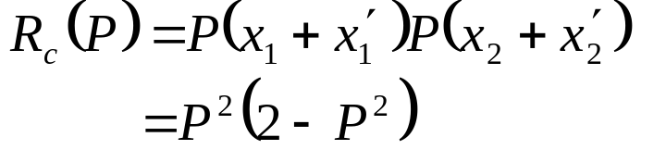

Redundancy
To improve the system reliability, creation of new parallel paths
Connect a duplicate in parallel
Ex. Automatic break system- install a duplicate set of break shoes
  Unit redundancy
  Component redundancy
x1
x2
X1
x2
x1
x2
X1’
X2’
X1’
X2’

