Slide 1
Computer Graphics 10:
3D Object
Representations

Slide 2
Contents
In today’s lecture we are going to start to look at how objects are modelled in 3D
  Polyhedra
  Quadric surfaces
  Sweep representations
  Constructive solid geometry methods

Slide 3
Polyhedra
Objects are simply a set of surface polygons that enclose an object interior
Simplest and fastest way to render objects
Often referred to as standard graphics objects
In many cases packages allow us to define objects as curved surfaces etc. but actually convert these to polygon meshes for display
To define polyhedra we simply define the vertices of the polygons required

Slide 4
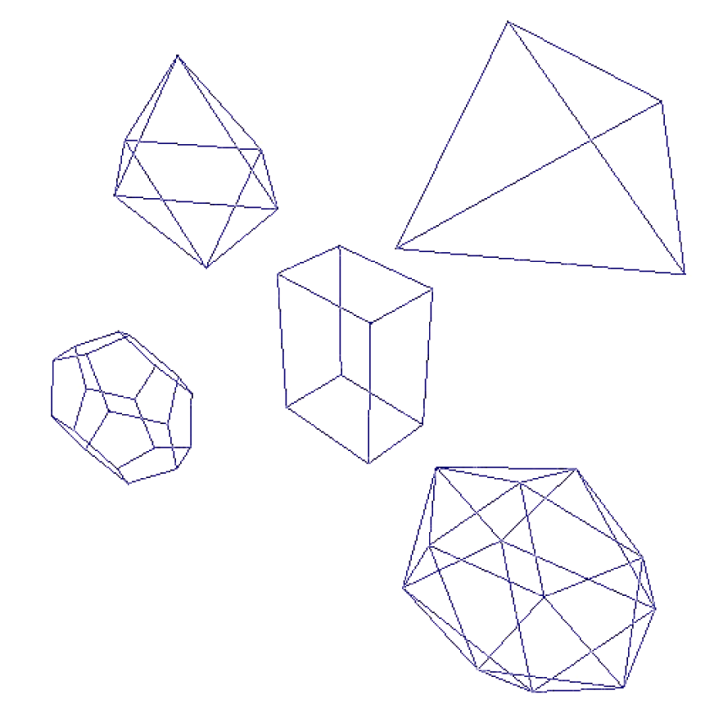
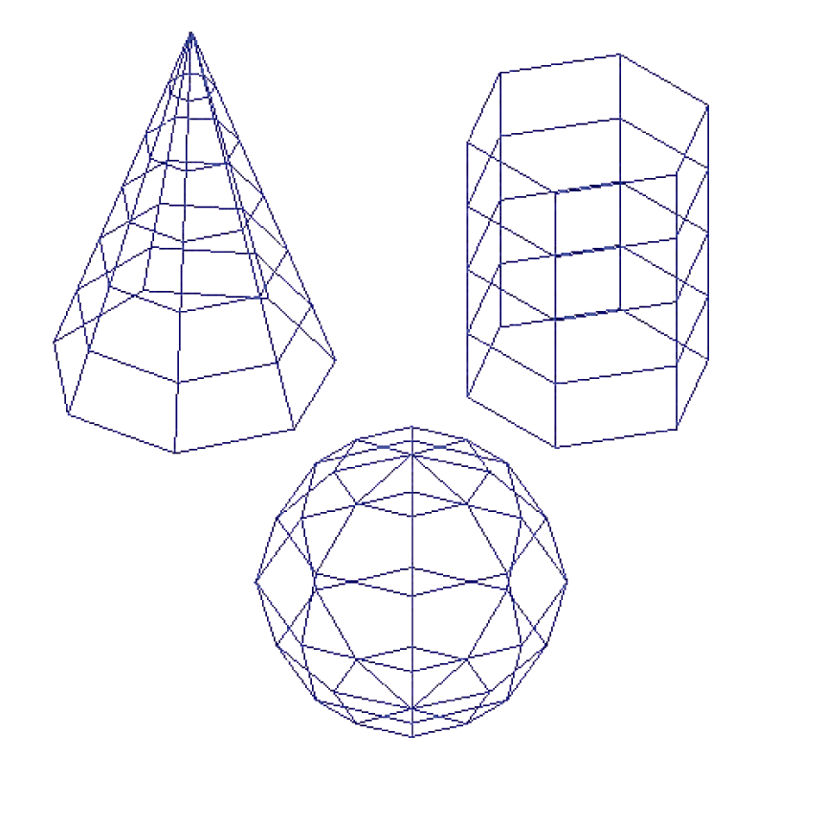
Polyhedra (cont…)

Slide 5
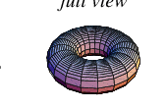
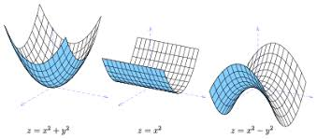
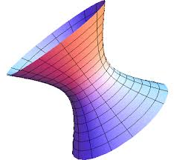
Quadric Surfaces
A frequently used class of objects are quadric surfaces
These are 3D surfaces described using quadratic equations
Quadric surfaces include:
  Spheres
  Ellipsoids
  Tori
  Paraboloids
  Hyperboloids

Slide 6
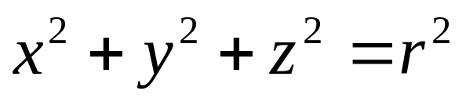
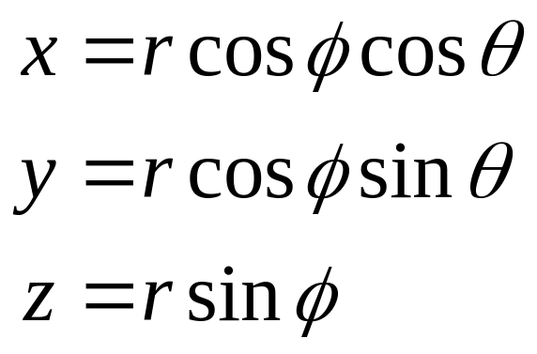
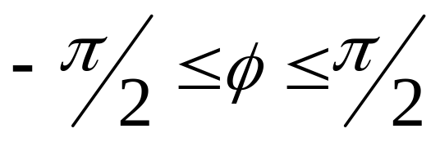
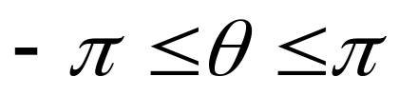
Quadric Surfaces - Spheres
A spherical surface with radius r centred on the origin is defined as the set of points (x, y, z) that satisfy the equation
This can also be done in parametric form using latitude and longitude angles

Slide 7
Quadric Surfaces – Spheres (cont…)
z axis
P ( x, y, z )
r
φ
θ
x axis
y axis

Slide 8
Sweep Representations
Sweep representations are useful for constructing 3 dimensional objects that possess translational, rotational or other symmetries
Objects are specified as a 2 dimensional shape and a sweep that moves that shape through a region of space

Slide 9
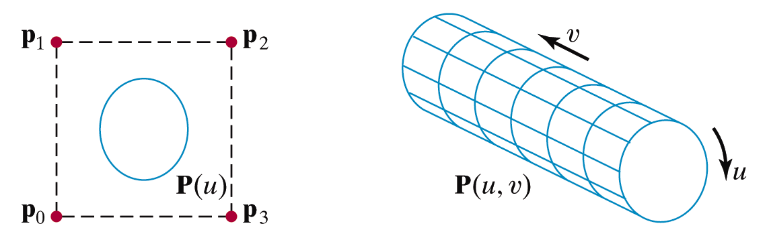
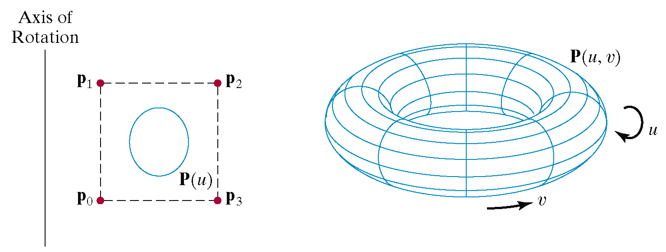
Sweep Representations - Examples

Slide 10
Constructive Solid Geometry Methods
Constructive Solid Geometry (CSG) performs solid modelling by generating a new object from two three dimensional objects using a set operation
Valid set operations include
  Union
  Intersection
  Difference

Slide 11
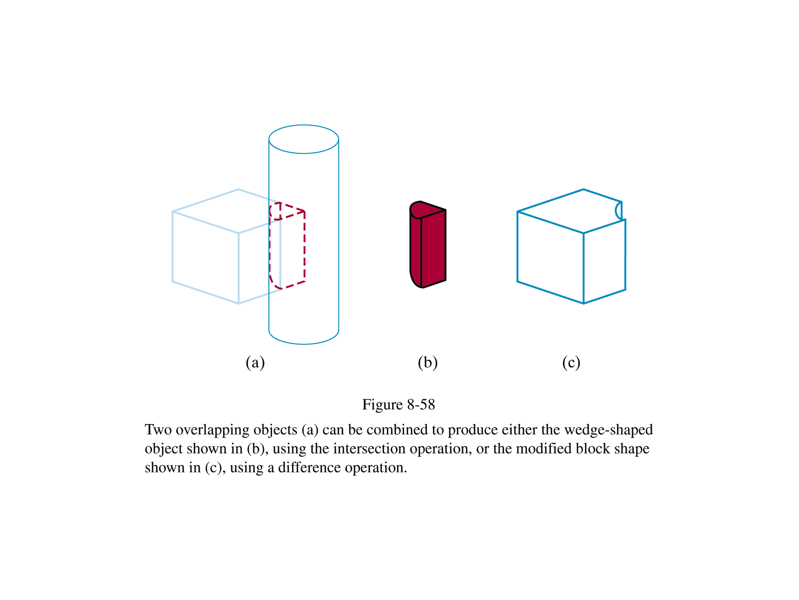
Constructive Solid Geometry Methods (cont…)
Difference
Intersection

Slide 12
Constructive Solid Geometry Methods (cont…)
CSG usually starts with a small set of primitives such as blocks, pyramids, spheres and cones
Two objects re initially created and combined using some set operation to create a new object
This object can then be combined with another primitive to make another new object
This process continues until modelling complete

Slide 13
Constructive Solid Geometry Methods (cont…)
CSG Object
CSG models are usually represented as CSG trees
oper₁
oper₃
obj₁
obj₂
obj₄
oper₂
obj₂
obj₃

Slide 14
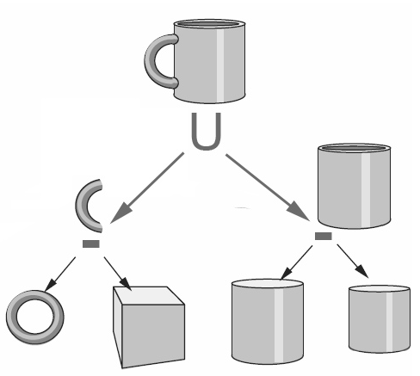
Constructive Solid Geometry Methods (cont…)

Slide 15
Ray-Casting
Ray-casting is typically used to implement CSG operators when objects are described with boundary representations
Ray casting is applied by determining the objects that are intersected by a set of parallel lines emanating from the xy plane along the z axis
The xy plane is referred to as the firing plane

Slide 16
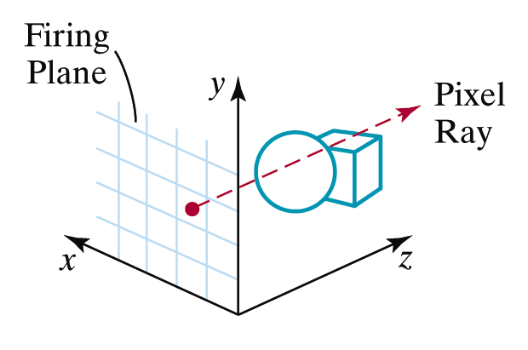

Ray-Casting (cont…)
Images taken from Hearn & Baker, “Computer Graphics with OpenGL” (2004)

Slide 17
Ray-Casting (cont…)
Surface intersections along each ray are calculated and these are sorted according to distance from the firing plane
The surface limits for the composite object are then determined by the specified set operation

Slide 18
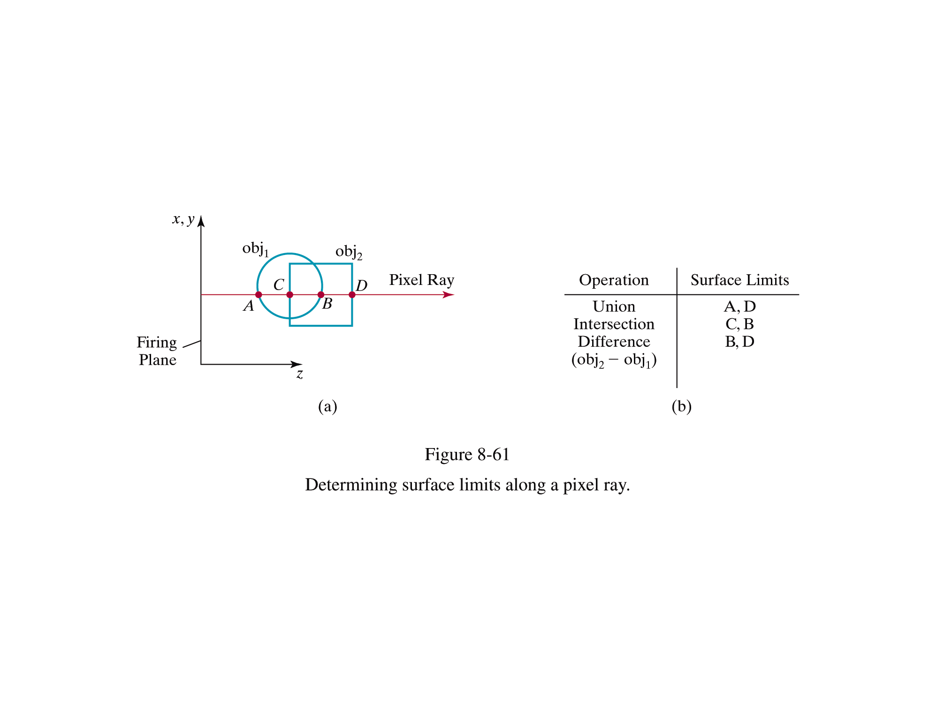
Ray Casting Example
Images taken from Hearn & Baker, “Computer Graphics with OpenGL” (2004)

Slide 19
Summary
In today’s lecture we began to look at how objects are modelled in 3D
Polyhedra are by far the most common modelling technique, but there are many others
Often more exotic modelling techniques are used in a modelling phase, but the resultant models are converted to polyhedra before rendering
Next time we will look at more modelling techniques

