Slide 1
Computer Graphics 12:
Spline Representations

Slide 2
Contents
Today we are going to look at Bézier spline curves
  Introduction to splines
  Bézier curves
  Bézier cubic splines

Slide 3
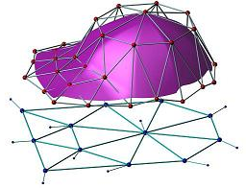
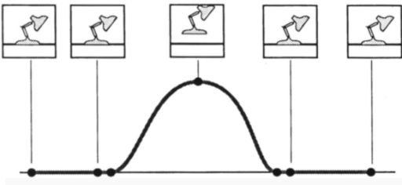
Spline Representations
A spline is a smooth curve
defined mathematically
using a set of constraints
Splines have many uses:
  2D illustration
  Fonts
  3D Modelling
  Animation
“Manifold Splines”, X. Gu, Y. He & H. Qin, Solid and Physics Modeling 2005.
ACM © 1987 “Principles of traditional animation applied to 3D computer animation”

Slide 4
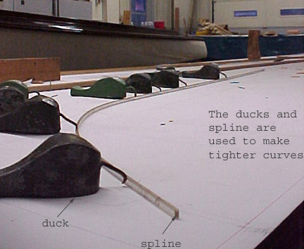
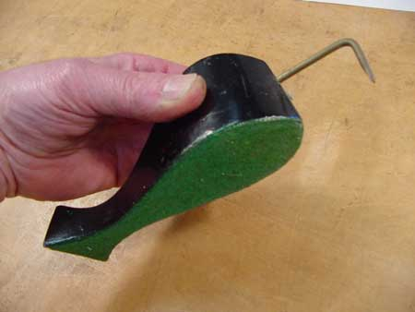
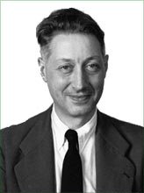
Physical Splines
Physical splines are used in car/boat design
Pierre Bézier

Slide 5
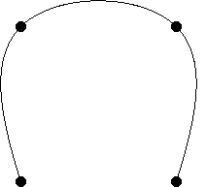
Big Idea
User specifies control points
Defines a smooth curve
Curve
Control Points
Control Points

Slide 6
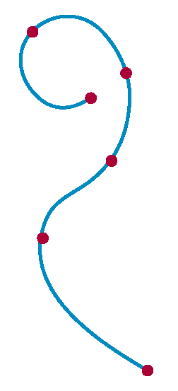
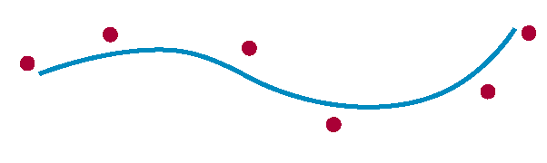
Interpolation Vs Approximation
A spline curve is specified using a
set of control points
There are two ways to fit a curve to
these points:
  Interpolation - the curve passes
  through all of the control points
  Approximation - the
  curve does not pass
  through all of the control
  points

Slide 7
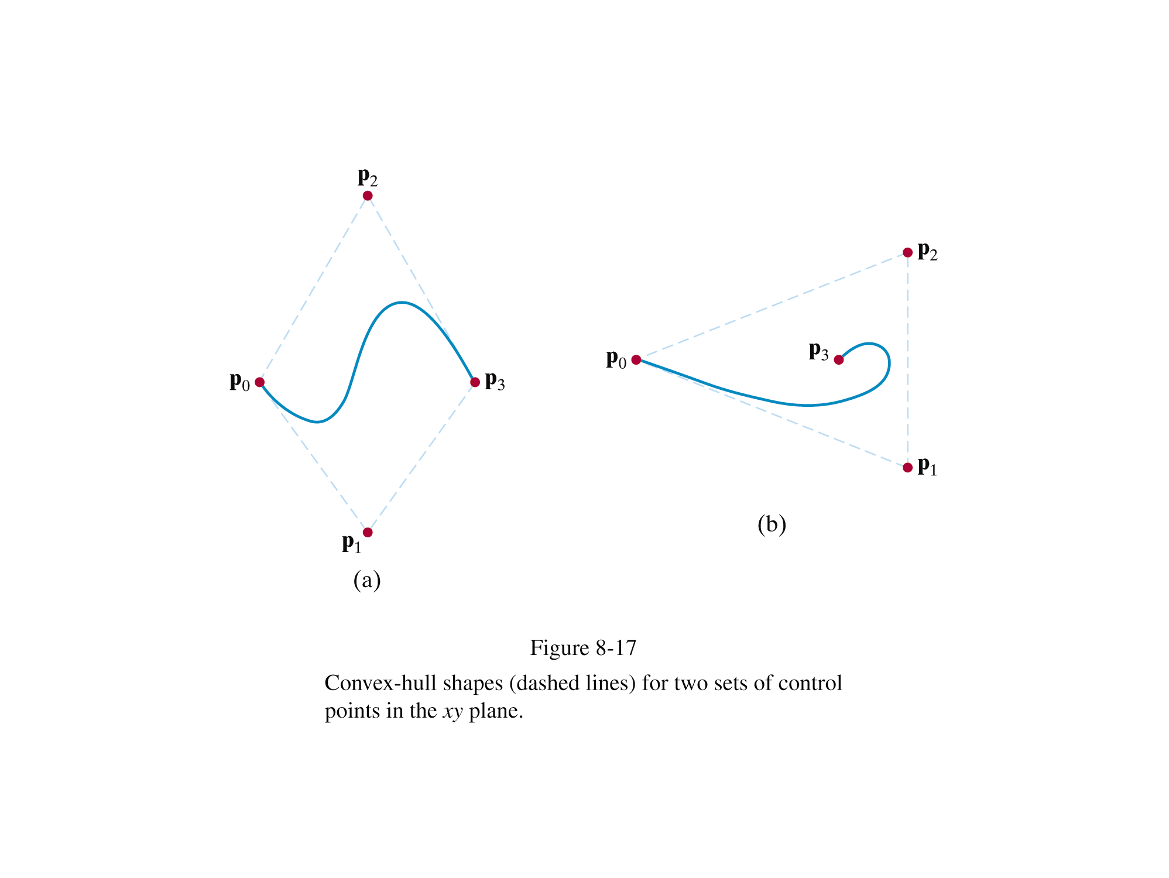
Convex Hulls
The boundary formed by the set of control points for a spline is known as a convex hull
Think of an elastic band stretched around the control points

Slide 8
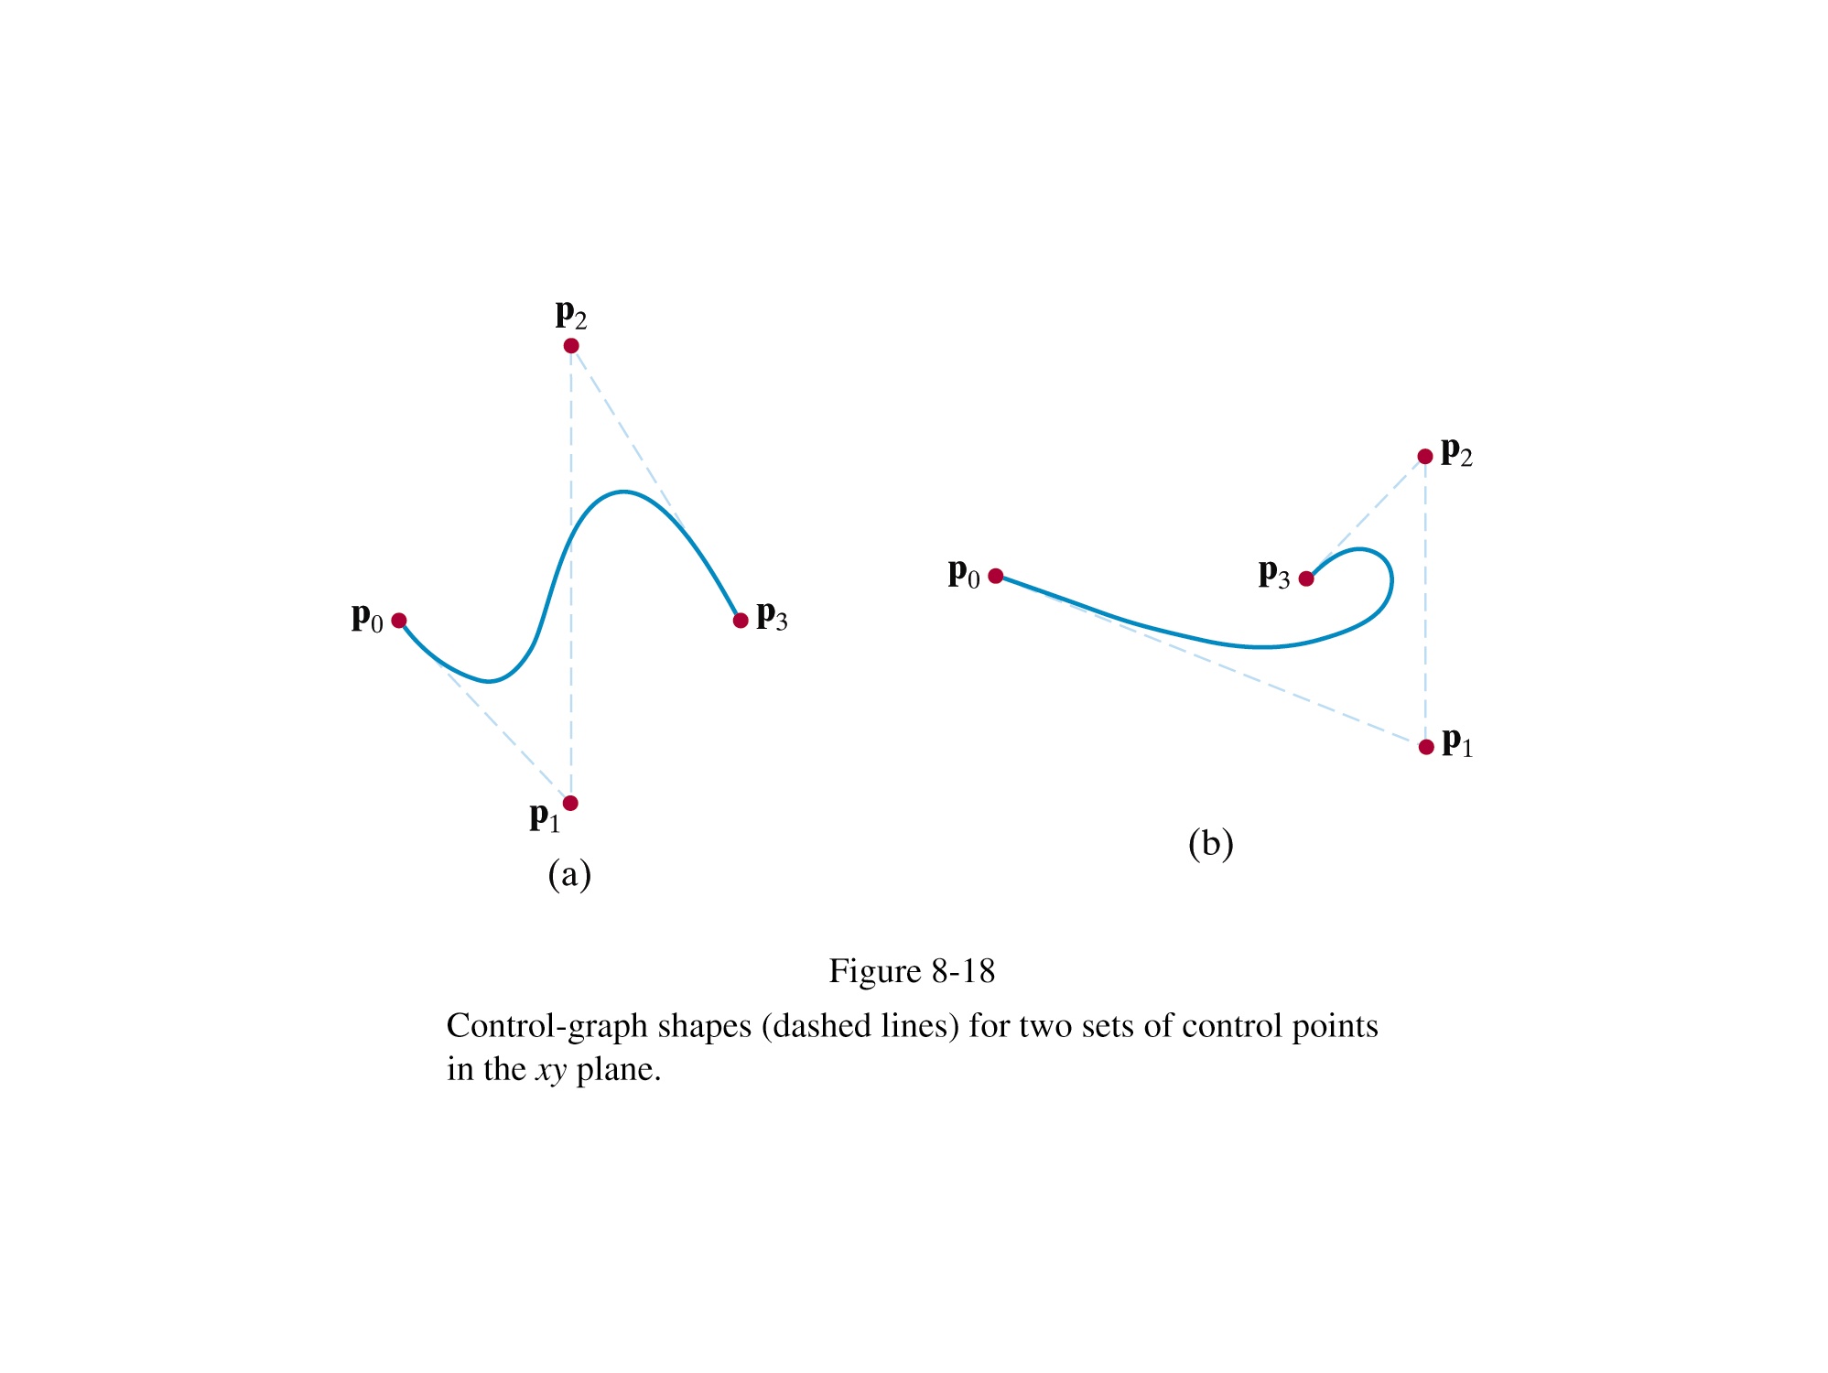
Control Graphs
A polyline connecting the control points in order is known as a control graph
Usually displayed to help designers keep track of their splines

Slide 9
Bézier Spline Curves
A spline approximation method developed by the French engineer Pierre Bézier for use in the design of Renault car bodies
A Bézier curve can be fitted to any number of control points – although usually 4 are used

Slide 10
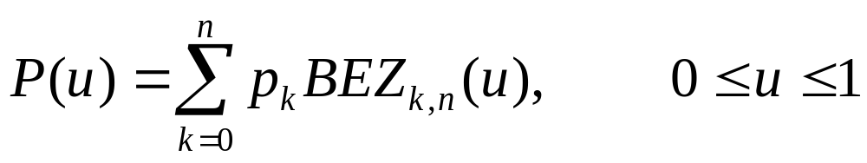
Bézier Spline Curves (cont…)
Consider the case of n+1 control points denoted as p_{k}=(x_{k}, y_{k}, z_{k}) where k varies from 0 to n
The coordinate positions are blended to produce the position vector P(u) which describes the path of the Bézier polynomial function between p₀ and p_{n}

Slide 11
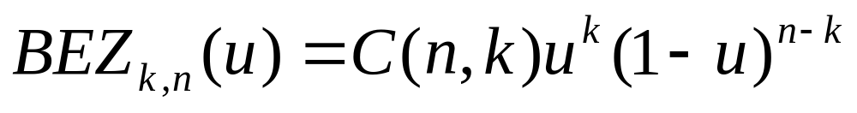
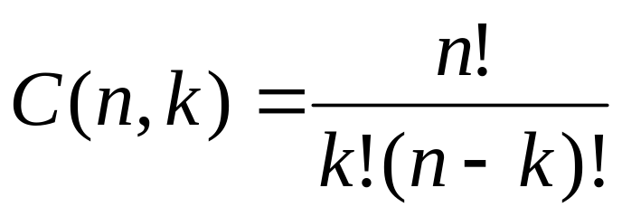
Bézier Spline Curves (cont…)
The Bézier blending functions BEZ_{k,n}(u) are the Bernstein polynomials (basis function)
where parameters C(n,k) are the binomial coefficients

Slide 12
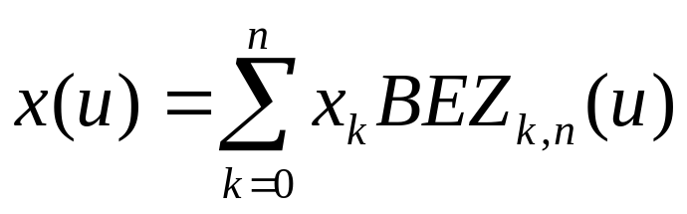
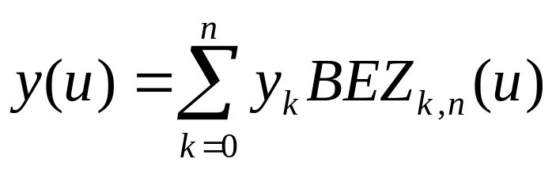
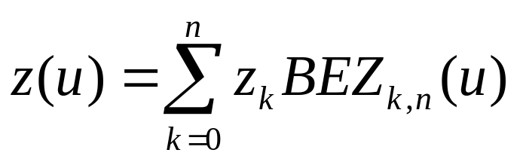
Bézier Spline Curves (cont…)
So, the individual curve coordinates can be given as follows

Slide 13
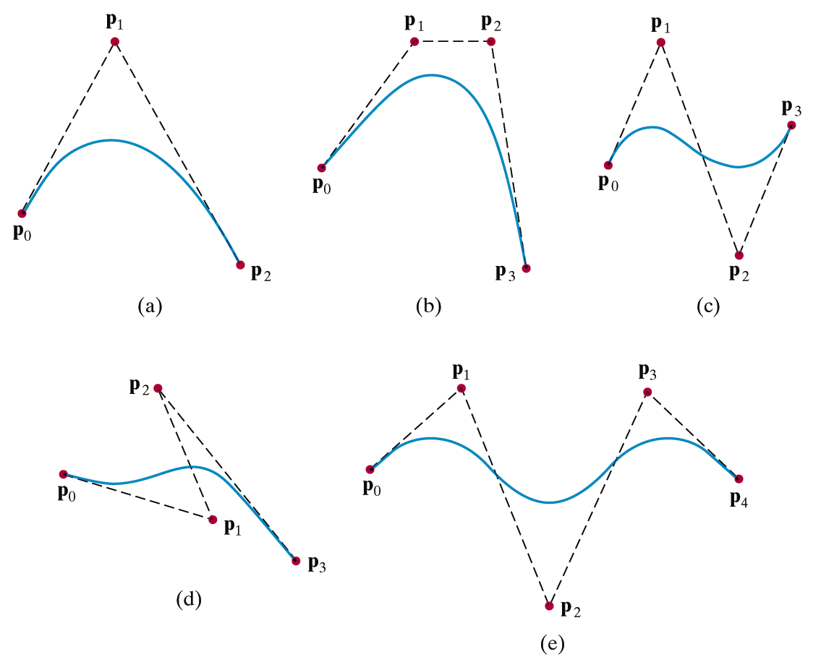
Bézier Spline Curves (cont…)

Slide 14
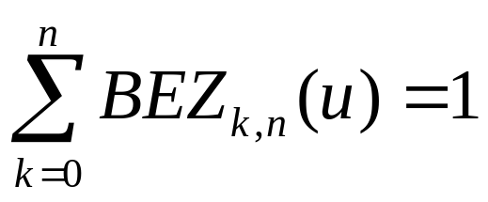
Important Properties Of Bézier Curves
The first and last control points are the first and last point on the curve
  P(0) = p₀
  P(1) = p_{n}
The curve lies within the convex hull as the Bézier blending functions are all positive and sum to 1
The slope at the beginning and end of the curve are along the along the first two and the last two points respectively

Slide 15
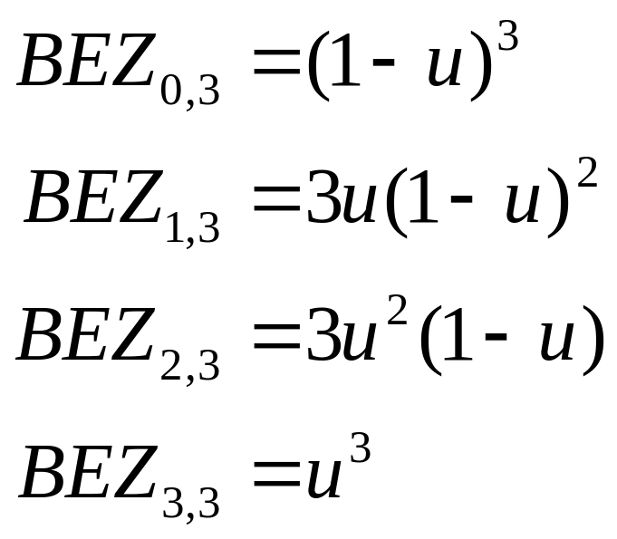
Cubic Bézier Curve
Many graphics packages restrict Bézier curves to have only 4 control points (i.e. n = 3)
The blending functions when n = 3 are simplified as follows:

Slide 16
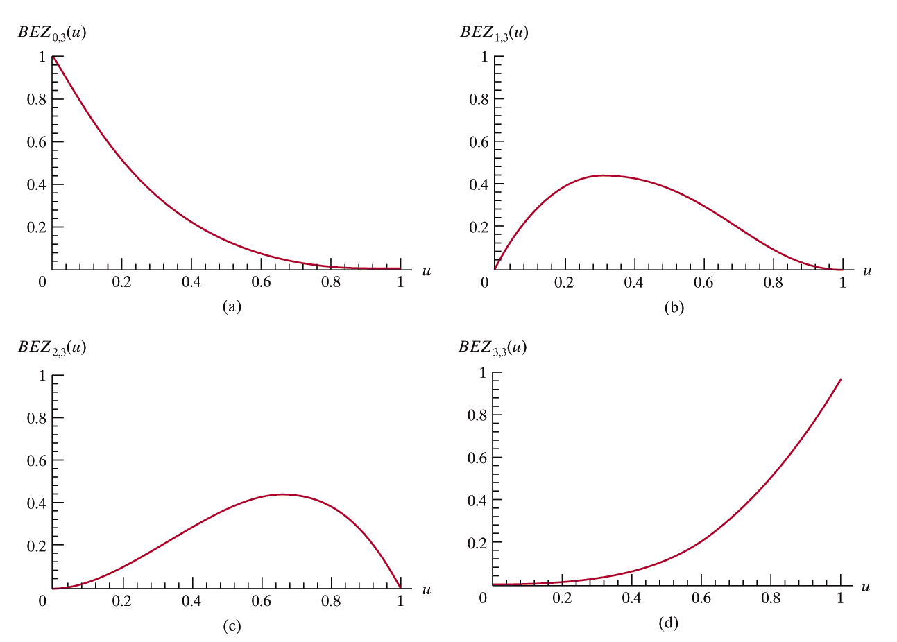
Cubic Bézier Blending Functions

Slide 17
Bézier Spline Curve Exercise
y
(3, 7)
(11, 5)
(1, 4)
(7, 1)
x

Slide 18

Bézier surface
P₃₃
P₃₀
P₀₃
P₂₀
P₁₀
P₀₀

Slide 19
Limitations of Bézier Curve
Two characteristics of the Bernstein basis limit the flexibility of the Bezier curves
  First the number of specified polygon vertices fixes the order of the resulting polynomial which defines the curve.
  Second the global nature of the Bernstein basis limits the ability to produce a local change within a curve.

Slide 20
B-spline curves
Composed of a series of m-2 curve segments, Q₃,Q₄,…,Q_{m}
controlled by (m + 1) control points P₀, P₁, ..., P_{m}
each curve segment is controlled by 4 control points over a given knot intervals:
    P₀, P₁, P₂, P₃ --->Q₃ defined on [u₃, u₄]
    P₁, P₂, P₃, P₄ --->Q₄ defined on [u₄, u₅]
    ...
    P_{m-3}, P_{m-2}, P_{m-1}, P_{m} --->Q_{m} defined on [u_{m}, u_{m+1}]
each control point influences four curve segments. (local control property)

Slide 21
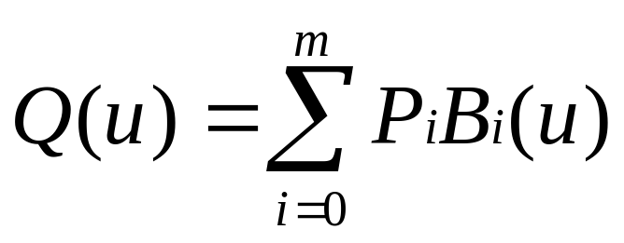
B-spline curves
Entire set of curve segments as one B-spline curve in u:
  i=[0,m], the non-local control point number
  u=[3, m+1], global parameter

Slide 22
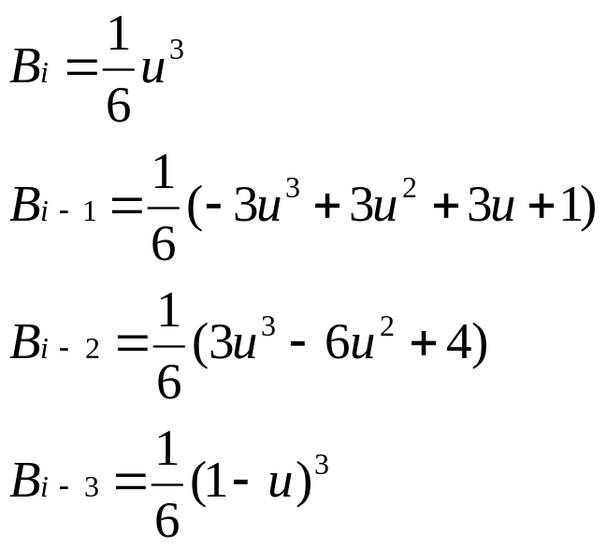
Uniform B-splines
(Basis functions and curve computation)
Basis function for Qi(u): (0≤u≤1)
It is important to note that this definition gives a single segment from each of the 4 B-spline basis functions over the range 0≤u≤1.

Slide 23
Uniform B-splines
The joint point on the value of u between segments is called the knot value.
Uniform B-spline means that knots are spaced at equal intervals of the parameter u.
Basis functions are defined over 4 successive knot intervals:
  B₀(u): [u₀, u₁, u₂, u₃, u₄]
  B₁(u): [u₁, u₂, u₃, u₄, u₅ ]
  ...
  B_{m}(u): [u_{m-3}, u_{m-2}, u_{m-1}, u_{m}, u_{m+1}]
(m-2) curve segments
  Q3: P0,P1,P2,P3 u = [3,4]
  Q4: P1,P2,P3,P4u = [4,5]
  ……
  Qm: P_{m-3},P_{m-2},_{Pm-1},P_{m}u = [m,m+1]

Slide 24
Summary
Today we had a look at spline curves and in particular Bézier & B-Spline curves
The whole point is that the spline functions give us an approximation to a smooth curve

