Slide 1
Vendor Performance
Agentic AI — Modular Solution
Score suppliers • Detect underperformance • Recommend proactive interventions
Python | Streamlit | FastAPI | scikit-learn | ChromaDB | Optional OpenAI
Persona-based access • Synthetic data • No MCP • No LangChain

Slide 2
Business Context & Problem Statement
Move from reactive supplier reviews to proactive, evidence-based supplier performance management.
Current challenges
Business opportunity
Target outcomes
Supplier KPIs are spread across systems
Delivery delays discovered too late
Quality defects and invoice variance are costly
Supplier reviews can be inconsistent
Combine delivery, quality, cost and lead-time signals
Create a consistent weighted score
Flag underperforming suppliers early
Recommend targeted corrective actions
Earlier operational intervention
More transparent supplier comparisons
Better sourcing and negotiation decisions
Trackable corrective-action outcomes
Primary users: Procurement Manager, Operations Manager, Business Admin and Auditor.
Recommendations are decision support; supplier sanctions, contract changes and sourcing decisions remain human-approved.
Prototype uses synthetic data and requires business validation before production.
Vendor Performance Agentic AI | Modular Python solution | 2

Slide 3
Personas, Goals & MVP Scope
Different roles see only the screens and supplier data authorized for their responsibilities.
Procurement Manager
Operations Manager
Business Admin
Auditor
Compare supplier scores
Review cost and quality trends
Generate supplier recommendations
Prioritize corrective actions
Monitor delivery reliability
Investigate lead-time variance
Review operational exceptions
Track improvement plans
Manage demo users and access
View all authorized dashboards
Monitor application and LLM usage
Read-only dashboards
Review audit trail
Inspect model and usage logs
MVP: supplier scorecards, risk bands, alternate supplier insights, evidence retrieval and a conversational assistant.
Authorization is enforced by backend endpoints as well as frontend navigation.
Vendor Performance Agentic AI | Modular Python solution | 3

Slide 4
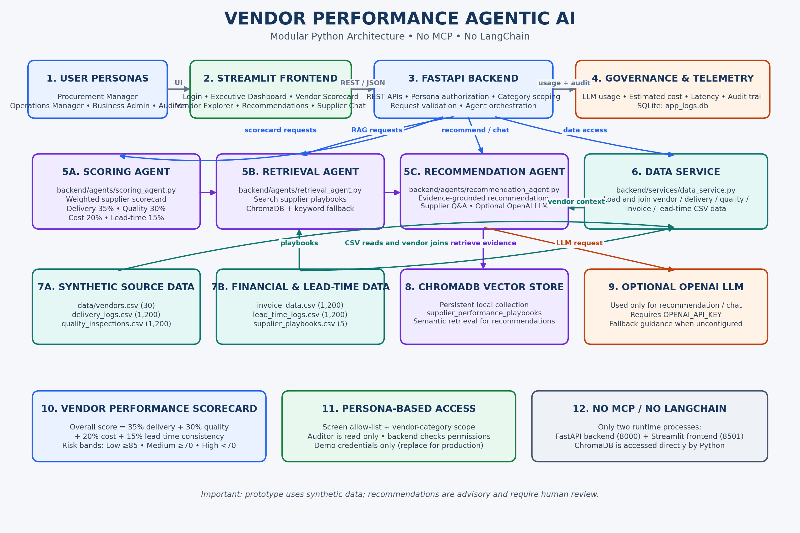
Modular Solution Architecture
Separate UI, API, agents, data services and cross-cutting controls — no MCP or LangChain.
Vendor Performance Agentic AI | Modular Python solution | 4

Slide 5
Supplier Scoring Model
A transparent weighted score combines the four performance dimensions from the use case.
Delivery timeliness
35%
Score interpretation
Overall score: 0–100
Higher score = stronger performance
Risk bands configurable by business
Explain component scores and evidence
Quality / defect rate
30%
Cost variance
20%
Lead-time consistency
15%
Scores support prioritization; thresholds and weight calibration should be agreed with procurement and supply-chain stakeholders.
Vendor Performance Agentic AI | Modular Python solution | 5

Slide 6
Agent Design & Workflow
Specialized Python agents coordinate through direct module calls and backend orchestration.
1. Scoring Agent
2. Retrieval Agent
3. Recommendation Agent
4. Chat Assistant
Join supplier KPI data
Normalize metrics
Calculate weighted score
Assign performance band
Search supplier playbooks
Use ChromaDB vector search
Keyword fallback if unavailable
Return relevant evidence
Explain score drivers
Suggest corrective actions
Compare alternate suppliers
Use optional OpenAI LLM
Natural-language supplier Q&A
Summarize trends
Answer from scoped evidence
Log usage and latency
Flow: request → authorize persona and supplier scope → load data → score → retrieve evidence → recommend → log activity.
LLM is used for explanation and narrative recommendations, not as the source of the weighted numerical score.
Vendor Performance Agentic AI | Modular Python solution | 6

Slide 7
Synthetic Data & Retrieval Layer
Reproducible demo data supports an end-to-end prototype without requiring access to enterprise supplier systems.
Supplier master
Operational / financial records
Knowledge and storage
vendors.csv — 30 vendors
Supplier identity and category
Region and supplier attributes
Performance grouping
delivery_logs.csv — 1,200 rows
quality_inspections.csv — 1,200 rows
invoice_data.csv — 1,200 rows
lead_time_logs.csv — 1,200 rows
supplier_playbooks.csv — 5 playbooks
ChromaDB: persistent vector collection
SQLite: usage and audit records
CSV fallback remains inspectable
Potential enterprise sources: ERP purchase orders, delivery events, quality inspections, invoices and lead-time history.
Use consistent vendor IDs, event timestamps, units and data-quality checks when replacing synthetic data.
Vendor Performance Agentic AI | Modular Python solution | 7

Slide 8
Persona Security, Governance & Audit
Frontend screen restrictions improve usability; backend checks provide the enforcement boundary.
Authentication & authorization
LLM usage dashboard
Operational audit
Demo accounts by persona
Backend screen allow-list checks
Supplier/category scope filtering
Auditor is read-only
Request count and status
Input/output tokens
Estimated cost and latency
User/model/purpose breakdown
Login and agent action records
Errors and performance metrics
Supplier recommendation trace
Retention and access policies
Demo credentials and username headers are for local development only.
Production: verified Entra ID/OIDC tokens, secrets management, TLS, least privilege, input validation and controlled log retention.
Vendor Performance Agentic AI | Modular Python solution | 8

Slide 9
Deployment & Runbook
Two application processes communicate over local REST APIs; ChromaDB is accessed directly from Python.
Frontend process
Backend process
Local persistence
Streamlit app
Port 8501
Persona-specific navigation
Calls FastAPI with JSON
FastAPI / Uvicorn
Port 8000
Scoring, retrieval and recommendation modules
Swagger docs at /docs
Synthetic CSV files
ChromaDB persistent store
SQLite app_logs.db
Optional OPENAI_API_KEY
Install from requirements.txt; start backend with uvicorn, then run Streamlit frontend.
No separate MCP process, no LangChain runtime dependency.
Vendor Performance Agentic AI | Modular Python solution | 9

Slide 10
Expected Business Value & Next Steps
Prioritize
Act earlier
Improve continuously
Focus attention on suppliers with the weakest score components and highest operational risk.
Use evidence-backed corrective actions before delivery or quality issues escalate.
Track actions and outcomes; recalibrate weights and thresholds with business owners.
Prototype guidance only: human review remains required for supplier escalation, sourcing and contract decisions.
Vendor Performance Agentic AI | Modular Python solution | 10

