Slide 1
Customer Lifetime Value (CLV)
Agentic AI — Modular Solution
Predict customer value • Identify churn risk • Recommend retention actions
Python | Streamlit | FastAPI | scikit-learn | ChromaDB | Optional OpenAI
Modular architecture • Persona-based access • No MCP • No LangChain

Slide 2
Business Context & Problem Statement
Move from reactive customer campaigns to value-led, evidence-based retention.
Current challenges
Business opportunity
Target outcomes
• Customer value is difficult to estimate
• Churn signals are spread across datasets
• Campaigns can be broad and discount-heavy
• Impact is not consistently measured
• Estimate future 12-month CLV
• Prioritize customers by churn risk
• Match actions to customer context
• Measure incremental margin and retention
• Better retention prioritization
• More relevant customer engagement
• Reduced unnecessary incentives
• Transparent, auditable recommendations
Primary users: CRM Manager, Retention Analyst, Regional Marketing Manager, Auditor and Administrator.
Decision support only: predictions are estimates; campaign execution remains subject to human approval.
Prototype data is synthetic and must be replaced and validated before production.
Customer Lifetime Value Agentic AI | Modular Python solution | 2

Slide 3
Solution Overview
A modular Python application with independently deployable UI, API and agent modules.
1. Streamlit UI
2. FastAPI backend
3. AI agents
4. Data & services
Persona-aware navigation
Executive KPIs
Customer explorer
CLV & churn views
LLM usage dashboard
REST endpoints
Authorization checks
Regional data scoping
Orchestrates agents
Audit and telemetry
CLV prediction
Churn risk scoring
Retention recommendations
Conversational assistant
Synthetic CSV data
scikit-learn models
ChromaDB playbooks
Optional OpenAI
SQLite telemetry
REST communication between Streamlit and FastAPI over JSON.
No MCP server and no LangChain dependency.
Fallback retention guidance keeps core flows usable without an OpenAI API key.
Customer Lifetime Value Agentic AI | Modular Python solution | 3

Slide 4
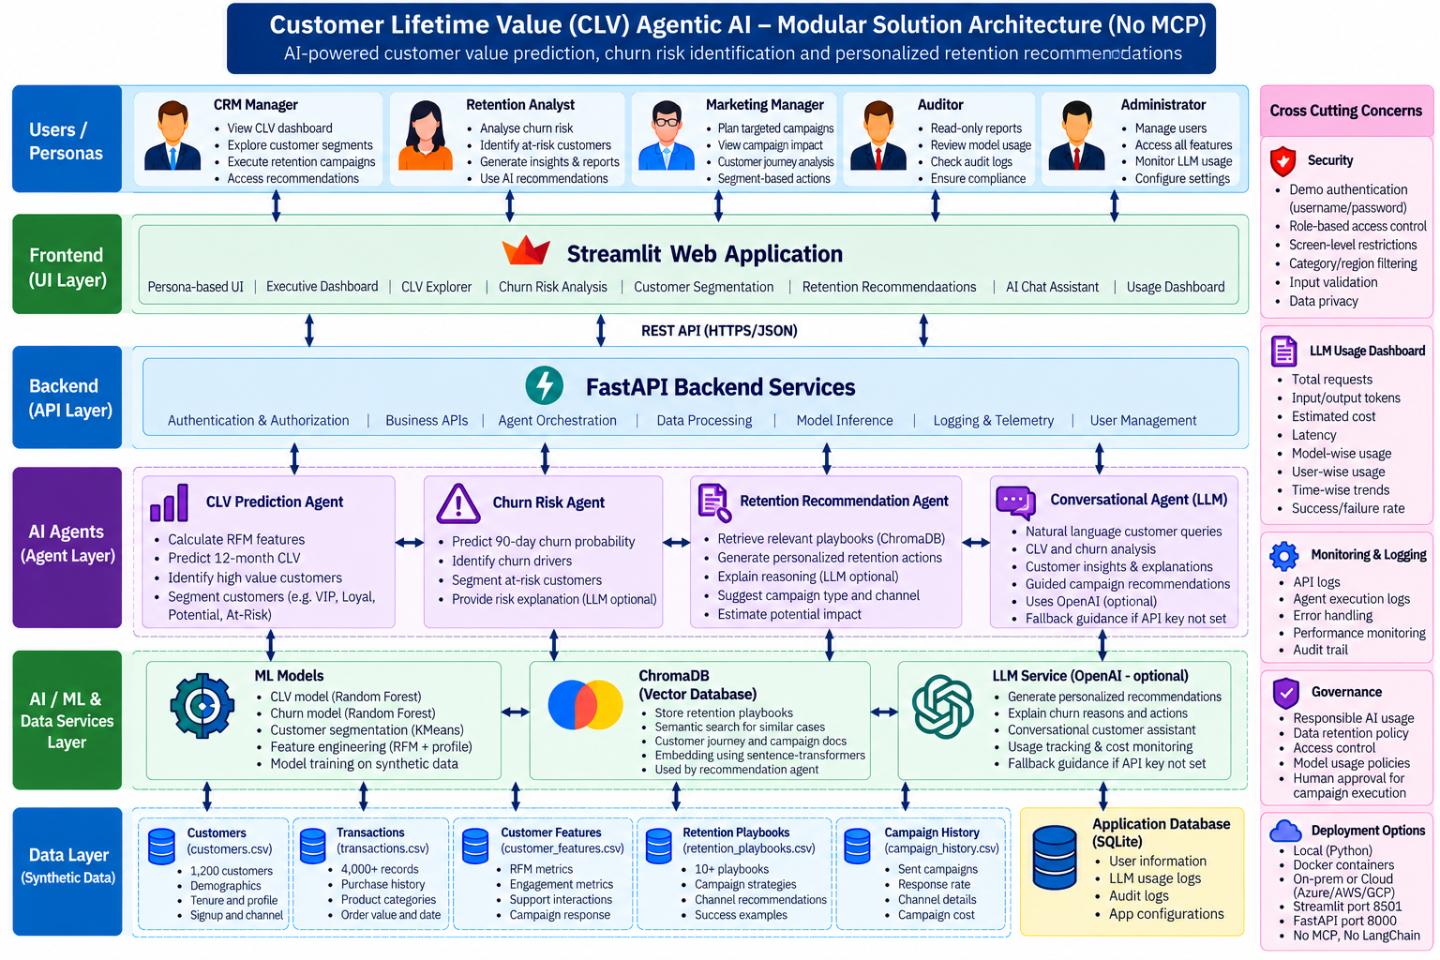
Modular Solution Architecture
Logical layers, agent responsibilities, data stores and cross-cutting controls.
Customer Lifetime Value Agentic AI | Modular Python solution | 4

Slide 5
Data & Machine Learning Design
Synthetic data supports an end-to-end demo; production models require representative historical outcomes.
Data inputs
CLV prediction
Churn risk
customers.csv — 1,200 customers
transactions.csv — purchase history
retention_playbooks.csv — guidance
Optional future: campaign outcomes, returns, service contacts
RandomForestRegressor
Target: synthetic future 12-month value
Features: tenure, frequency, AOV, recency, loyalty, returns, engagement
Output: predicted 12-month value
RandomForestClassifier
Target: synthetic churn within 90 days
Features: purchase and engagement signals
Output: churn probability and Low/Medium/High band
Holdout MAE and ROC-AUC are demo metrics only; they do not establish production model quality.
Recommended next step: time-based validation, calibration, cohort monitoring and bias/privacy review.
Customer Lifetime Value Agentic AI | Modular Python solution | 5

Slide 6
Agent Workflow & Retention Decisioning
Agents coordinate through explicit Python modules—not through MCP or LangChain.
1. Request
2. Score
3. Retrieve
4. Recommend
5. Review
6. Measure
User opens CLV or churn view
ML agent estimates CLV and churn risk
ChromaDB finds relevant retention playbooks
Rule-based or optional LLM guidance is generated
Human validates action, consent and contact limits
Campaign outcomes feed future evaluation
Recommendation outputs should explain the reason, suggested channel, test design and success measures.
Use holdout groups and incremental contribution margin to avoid mistaking correlation for campaign impact.
Customer Lifetime Value Agentic AI | Modular Python solution | 6

Slide 7
Persona-Based Access & Governance
The UI hides unauthorized screens and the API independently enforces screen permissions and region scope.
CRM Manager
Retention / Regional Analyst
Auditor / Administrator
All customer and recommendation screens
LLM usage dashboard
All demo regions
Retention Analyst: India + UK scope
Regional Manager: India scope
No admin or usage dashboard
Auditor: read-only screens and audit views
Administrator: access and audit management
Sensitive actions logged
Demo authentication uses static credentials and an X-Username header; this is not production-grade authentication.
Production hardening: Entra ID/OIDC, verified JWTs, secret manager, TLS, least privilege and retention policies.
Honor consent, unsubscribe requests, contact frequency caps and applicable privacy laws.
Customer Lifetime Value Agentic AI | Modular Python solution | 7

Slide 8
LLM Usage, Audit & Operational Monitoring
SQLite provides lightweight prototype telemetry; extend to centralized observability for production.
LLM usage dashboard
Audit trail
Operational controls
Request count and status
Input/output token totals
Estimated cost and latency
Model, user and purpose breakdown
Login events
Recommendation and chat actions
User/persona context
Access-denied events should be added
API health endpoint
Timeouts and error handling
Structured logs
Model drift and quality checks
Estimated LLM prices in the demo are illustrative; update them to the selected provider/model rates.
Never log API keys or unnecessary personal data; define access and retention for telemetry.
Customer Lifetime Value Agentic AI | Modular Python solution | 8

Slide 9
Deployment & Implementation Roadmap
Local prototype first; production readiness depends on security, data quality and model validation.
Local deployment
Production prerequisites
Suggested phases
Streamlit: port 8501
FastAPI: port 8000
CSV synthetic data
Persistent ChromaDB directory
SQLite usage/audit database
Enterprise identity and secrets
Database/data platform integration
PII minimization and consent
Monitoring and alerting
Validated model registry
1. Run synthetic demo
2. Validate business definitions
3. Integrate historical data
4. Backtest and review models
5. Pilot with human approval
Source package: customer_clv_agentic_no_mcp_project_v2.zip
Start API with uvicorn; start UI with Streamlit; see README for Windows commands and demo accounts.
Customer Lifetime Value Agentic AI | Modular Python solution | 9

Slide 10
Expected Business Value
Prioritize
Personalize
Measure
Focus retention effort on customers with a combination of high value and high churn risk.
Use relevant playbooks and optional LLM explanations to guide suitable actions.
Use holdout experiments, retention lift and incremental contribution margin.
CLV is a decision-support estimate—not a guarantee. Human review and responsible customer engagement remain essential.
Customer Lifetime Value Agentic AI | Modular Python solution | 10

