Slide 1

Introductory Data Science Instruction: Early Findings
And experimental procedure for misconception investigations
*Karl R. B. Schmitt, Valparaiso University
Katherine M. Kinnaird, Smith College
Ruth E. H. Wertz, Valparaiso University
Bjorn Sandstede, Brown University
Funded by the National Science Foundation
DMS #1839257, 1839259, 1839270

Slide 2
Outline
Research Objectives
Planned Investigation
Existing Bodies of Knowledge
Survey to Validate Body of Knowledge
Preliminary Survey Results
Preliminary Catalog Analysis Results
Next Steps
Slides will be available at:
https://blogs.valpo.edu/datadesk/2019/05/29/sdss-2019-recap/

Slide 3
Long Term Objective:
Protocol For Developing A Concept Inventory
Lay the groundwork for developing a “Data Science Concept Inventory” for introductory data science courses.
Establish Topics. Determine topics important to faculty/practitioners through self-reflection and discussion
Identify Student Thinking. Observe and interview students to understand how their thinking deviates from expert thinking
Create open-ended survey questions. Administer these questions to entire classes of students in order to further examine issues raised in the interviews
Create forced-answer test.
Validate test questions through interviews
Administer and statistically analyze test.

Slide 4
Long Term Objective:
Short Term Objectives:
Lay the groundwork for developing a “Data Science Concept Inventory” for introductory data science courses.
Identify student misconceptions, difficulties, and non-expert thinking about data science
Identify data science concepts that students develop in courses outside of data science
Identify courses (outside of data science) that develop knowledge in data science concepts
Identify disconnects between data science curricula and early career practitioners
Evaluate the quality of previous knowledge and provide formative feedback for refining data concept instruction

Slide 5
Planned Investigations
Survey of Instructors and Practitioners
Course Catalogs and Syllabi Analysis for coverage of Data Science Concepts
“Crowd-Sourced” course observations of data science instruction
Survey/Pre-test of students entering data science courses
Interviews of students about misconceptions
Record students taking a survey of “Think-Out-Loud” open-ended questions on data science topics

Slide 6
Existing Bodies of Knowledge
Primary: The EDISON Project
http://edison-project.eu
Excerpts (Tables) can be found directly here:
https://blogs.valpo.edu/datadesk/data-science-body-of-knowledge/
Additional References:
De Veaux, Richard D., et al. "Curriculum guidelines for undergraduate programs in data science." Annual Review of Statistics and Its Application 4 (2017): 15-30.
American Statistical Association 2014. Curriculum guidelines for undergraduate programs in statistical science. Retreived from http://www. amstat. org/education/curriculumguidelines. cfm. (2014).
For a Longer Discussion of Various background reports see:
ACM Data Science Curriculum Draft Recommendations: http://www.cs.williams.edu/~andrea/DSReportInitialFull.pdf
Discussion of Data Science Curriculum Resources at: https://blogs.valpo.edu/datadesk/data-science-curriculum-design-resources/

Slide 7
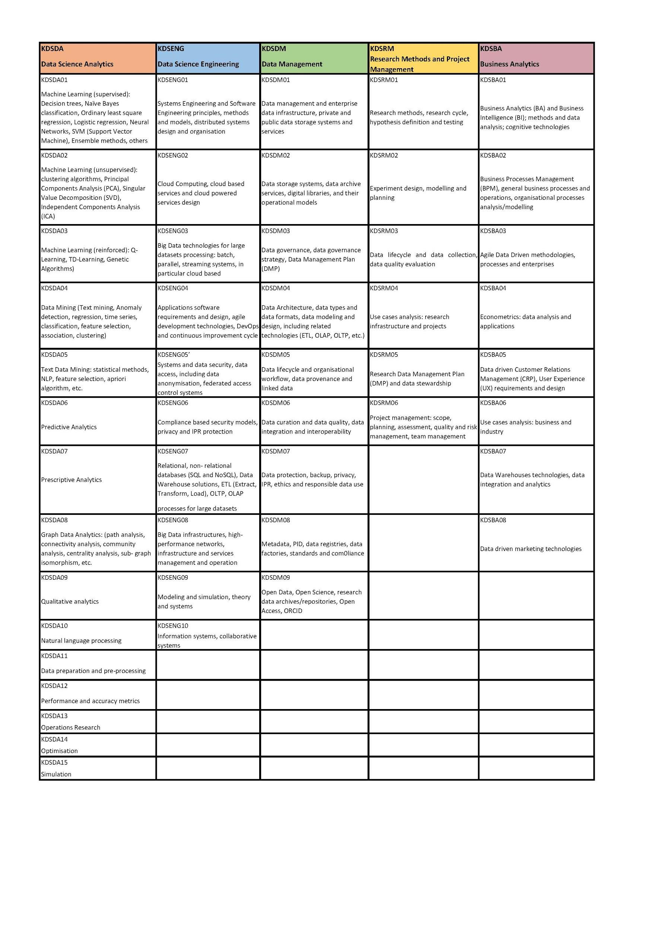
Sample from EDISON BoK

Slide 8
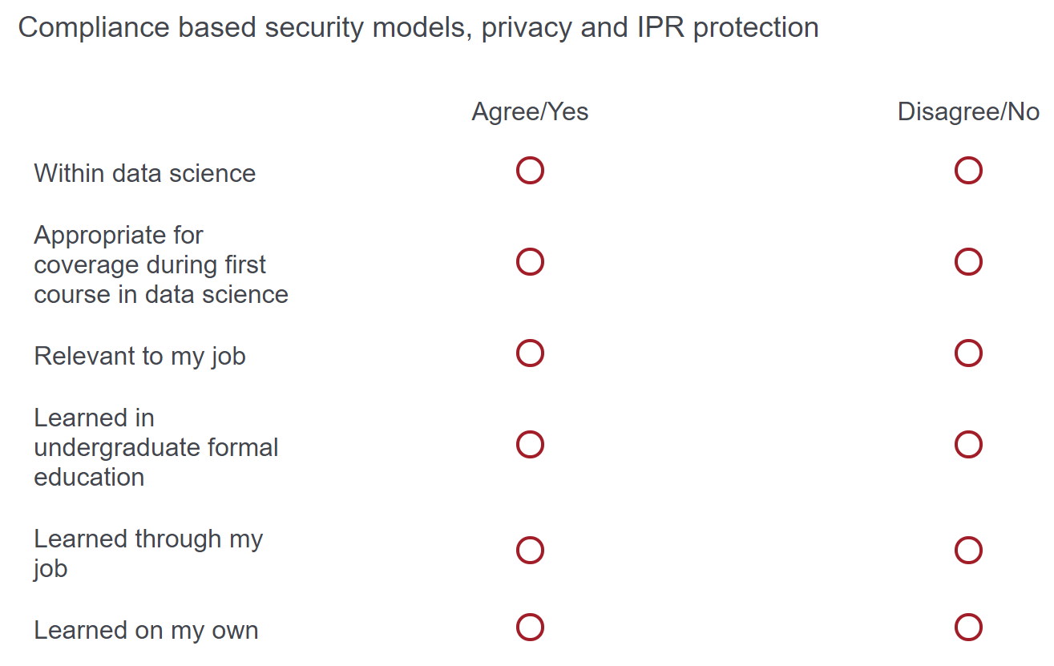
Survey of Instructors and Practitioners
Survey Presents 10 (of 80)** Concepts/Skills:
** Randomly, but evenly to keep survey length reasonable

Slide 9
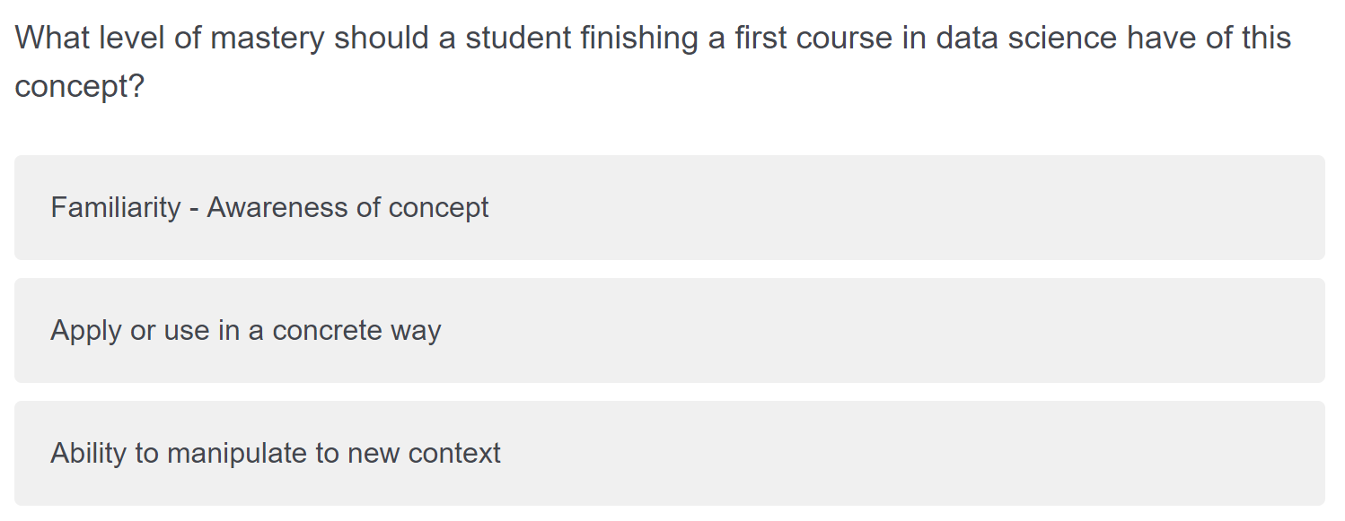
Survey of Instructors and Practitioners
Survey Presents 10 (of 80)** Concepts/Skills:
Follow-Up Question:
** Randomly, but evenly to keep survey length reasonable

Slide 10
Preliminary Survey Results
Open Data Collection Started:
May 22nd
As of Noon, 5/29: 47 responses

Slide 11
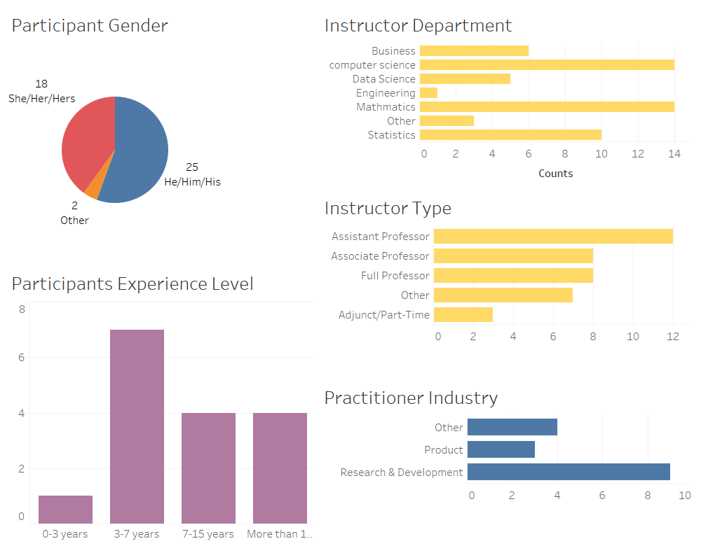

Slide 12
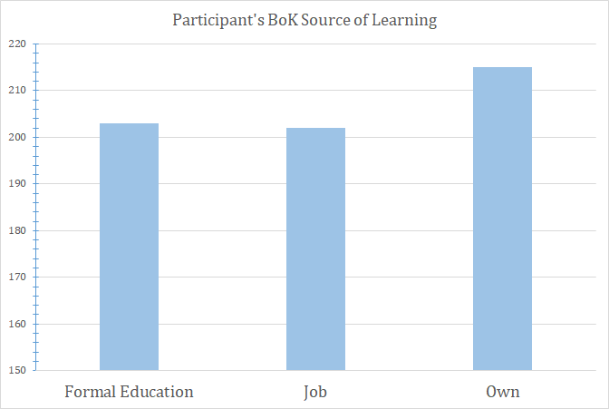
Preliminary Survey Results
24 out of 80 topics labeled as not in Data Science:
50% or more of respondents did not believe it belonged.
5 - 7 Respondents per item

Slide 13
Topics Labeled as
“Not in Data Science”
Business Processes Management (BPM)
Data driven marketing technologies
Data Warehouses technologies
Organisational Information systems, collaborative systems
Apply structured approach to use cases analysis
Hybrid data management infrastructure
data architecture, data types, and data formats
Project management: scope, planning, assessment, quality and risk management, team management
Recommender or Ranking system
Text Data Mining techniques
DevOps and continuous improvement cycle
Optimisation
Business Analytics and Business Intelligence
Data driven Customer Relations (CRP),
User Experience (UX)
Mechanism Design
Latent Dirichlet Allocation
Research Data Management Plan (DMP)
Operations Research
Research Data Management Plan (DMP),
Agile Data Driven methodologies
Business Processes Management (BPM)
Data driven marketing technologies
Data Warehouses technologies
Notes:
50% or greater “Disagreed” that it should be in data science
Red, bold are total disagreement

Slide 14
Text Mining of Course Catalogs
Digitize course catalogs:
Descriptions
Course Prefixes/Numbers
Keyword search based on BoK items/sub-sets
Build self-learning keyword tree
Potentially use FP-Growth Style analysis

Slide 15
Sample from EDISON BoK

Slide 16
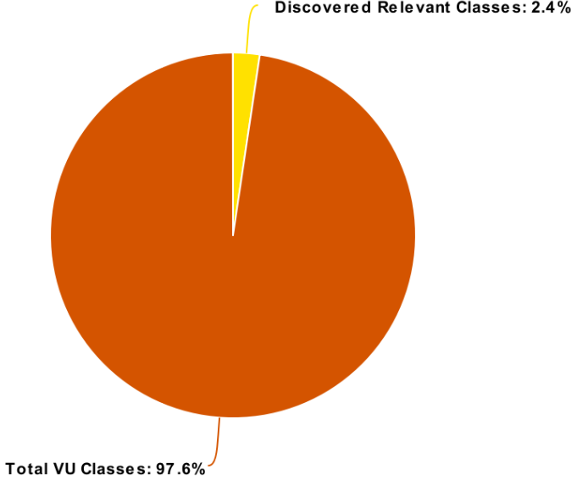
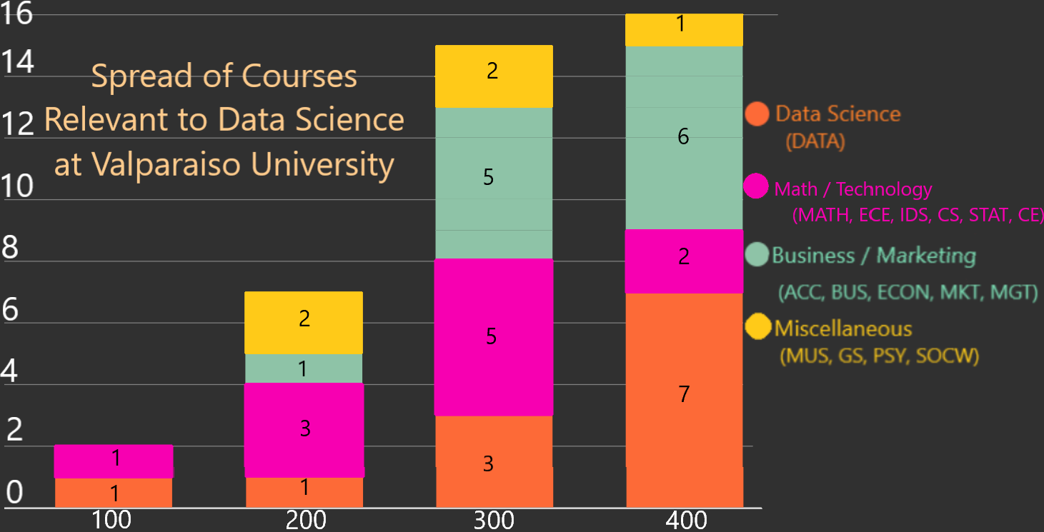
(Draft) Text Mining of Course Catalogs
1
2
6
5
2
2
5
1
7
3
1
3
1
1
100
200
300
400
Notes:
Talk about how this is very preliminary text mining. We _KNOW_ there are relevant courses missing! -- And maybe some mis-classifications. This slide is really just meant as a “this is feasible”.

Slide 17
Up Next:
Getting Into the Classroom

Slide 18
Research Road-Block:
Course Observations
Major Challenges:
Course observations for educational research are:
VERY time-intensive
Require travel to collection sites
Conducted only on a small sub-set of contact hours
Required to provide grounding and prompts for interview protocols and open-ended questions

Slide 19
Research Innovation:
Crowd-Source Course Observations
Key Observations:
Instructors, TAs and Students are always in-class
Class participants hear (and interpret) more than external observers can sometimes see, especially if limited points of recording are done.
Solution:
Train classroom participants to collect the data needed for the educational research!

Slide 20
Reflections and Difficulties Survey
What topics were covered this week (in-class or in discussions?)
What activities or deliverables did the students work on this week?
What questions did the students raise this week?
Based on your observations, what concepts or processes did the students struggle with the most?
Which student questions were surprising to you and why?

Slide 21
Our Next Steps:
Improve and expand our course-catalog analysis
Identify topics of interest (and difficulty):
From course observations
From instructor/practitioner survey
Conduct student interviews to clarify misconceptions identified
Create and administer open-ended surveys
Disseminate results

Slide 22
Thank You for Listening!
And Thanks to our research students:
Nathan Randle
Cody Packer
Terry Wade
And Thanks to my Collaborators:
Katie Kinnaird -- Co-Conspirator
Ruth Wertz -- The Educational Sanity
Bjorn Sandstede -- The ‘Adult’
Finally, Thanks to the National Science Foundation for funding this project and our students.

Slide 23
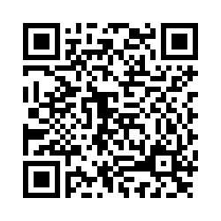
Please take our Survey!
https://tinyurl.com/data-misconceptions

Slide 24
