Slide 1
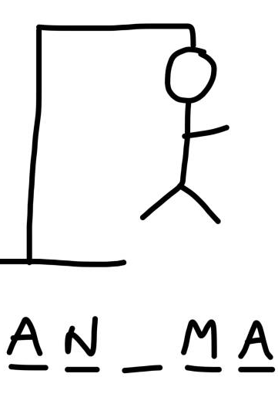
Hangman: The Game
Developed By: Aaron Wood
Guess Correctly & Save Your Stick Friend Before It’s Too Late!
https://github.com/ksu-is/Hangman-Game-1

