Slide 1
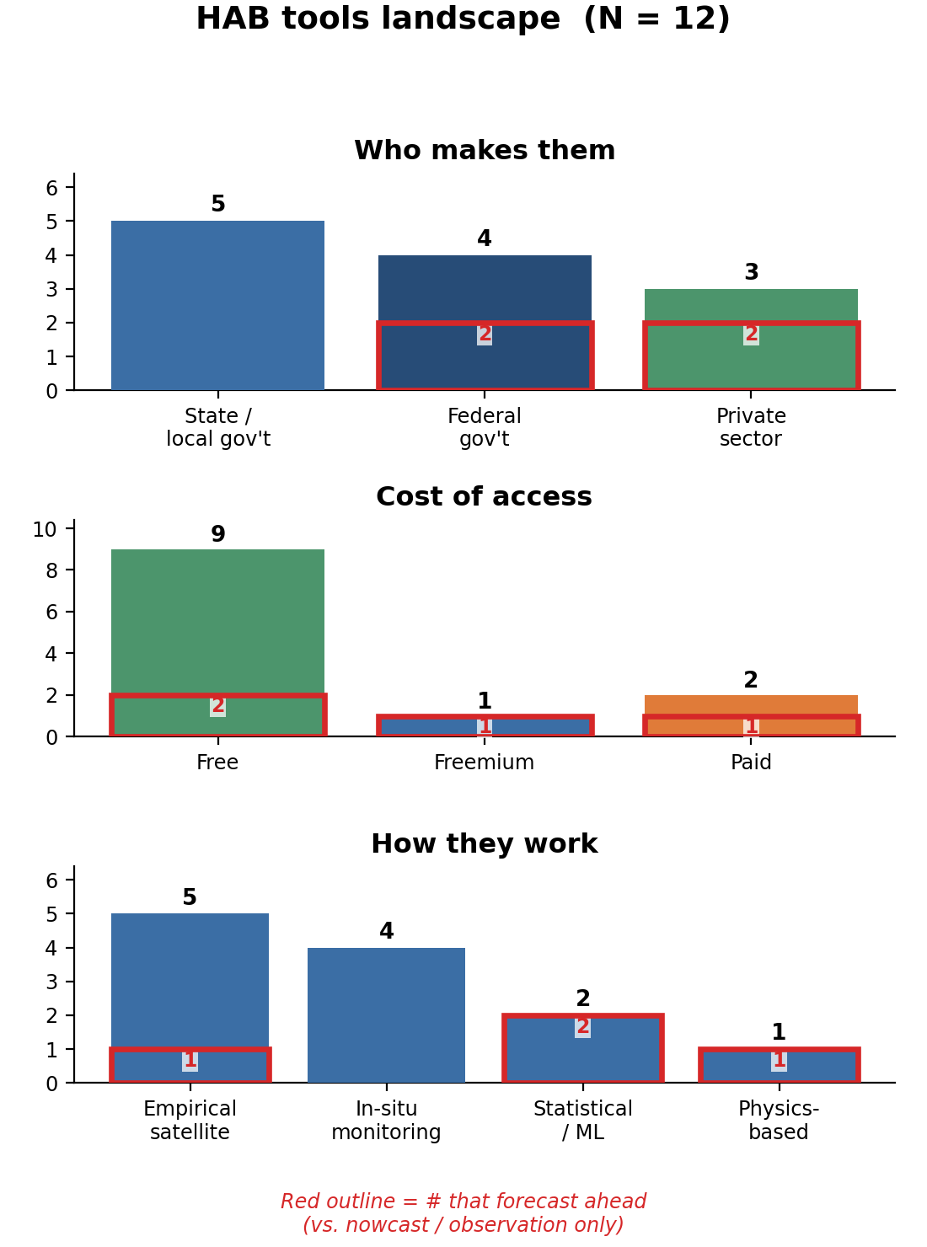
SLIDE 1 · WHAT'S AVAILABLE TODAY
HAB monitoring & forecasting tools you can use now
What to take away
• 12 freshwater tools surveyed — 9 are free & public; all are US federal + state programs + a few private services. No NGO or international operational freshwater tools exist.
• Only 4 of the 12 forecast ahead (red outline) — every forecaster is federal (EPA, NOAA) or private; all state / local tools are nowcast / observation only.
• The forecasters split by cost: EPA's 7-day forecast is free; the private forecasters (BlueGreen, CyanoLakes) are paid and publish no validation.
• Satellite (EPA CyAN) is the only near-national signal — but it sees biomass, not toxin, and can't resolve small lakes or shoreline scums.
• Methods span satellite indices, in-situ monitoring, a physics model and ML. 'Data fusion' (satellite + in-situ + weather, used by EPA, NOAA & BlueGreen) is a data strategy run by one of these methods — not a method of its own.
The 4 forward-looking (forecast) tools — details
Tool | Method | Refresh | Coverage | Spatial res.
EPA 7-day forecast | Statistical/ML | Weekly | USA (2,000+ lakes) | 300 m
NOAA Lake Erie | Physics | 2x/wk (season) | USA (Lake Erie) | 300 m
BlueGreen BGi | Statistical/ML | n/r | Global | n/r
CyanoLakes | Satellite | n/r | Global | 10-300 m
Freshwater cyanobacteria only. Every tool traces to a cited source (appendix + Research/REFERENCES.md). Raw counts, small N — orientation, not statistics.
Notes:
Slide 1 orients the panel to what exists TODAY. The three barplots: who makes them (state+federal dominate; no NGO/intl), cost (9 of 12 free), and method. The bottom-right table isolates the only 4 forward-looking (forecast) tools — EPA's free 7-day product plus three paid/vendor services (two unvalidated). Most other tools only nowcast. Satellite CyAN is the only near-national signal but detects biomass (not toxin) and can't resolve small lakes — motivating a fused approach. No NGO/international operational freshwater tool surfaced in our 261-source review.

Slide 2
SLIDE 1 · APPENDIX
Full tool inventory — all dimensions
Tool | Org | Method | Horizon | Refresh | Spatial res. | Access | Year | Quality tier | Src
EPA CyAN / CyANWeb | Federal | Satellite | Nowcast | daily + 7-day max-value… | ~300 m (Sentinel-3 OLCI); resolves… | Free | 2015 | Established / operational | FED-008, FED-009…
EPA 7-day forecast | Federal | Statistical/ML | Forecast 7‑day | weekly | ~300 m; 2,000+ lakes | Free | 2024 (beta) | Established / operational | FED-060, FED-012…
NOAA Lake Erie HAB Forecast | Federal | Physics | Nowcast + forecast 96‑hr | twice-weekly bulletins (bloom… | hydrodynamic model grid + satellite… | Free | ~2008 (3-D sub-surface model added 2020) | Operational (unbenchmarked) | FED-024, FED-025…
NOAA HAB Monitoring System | Federal | Satellite | Nowcast | n/r | n/r | Free | n/r | Operational (unbenchmarked) | FED-061
Florida DEP Algal Bloom Dashboard | State/local | In-situ | Nowcast | ~weekly / as-sampled | point / sampling-site | Free | n/r | Operational (unbenchmarked) | SLG-001, SLG-007
NY NYHABS notifications & map | State/local | In-situ | Nowcast | as-reported | point / sampling-site | Free | 2019 | Operational (unbenchmarked) | SLG-003
California SWAMP FHAB + satellite screening | State/local | Satellite | Nowcast | n/r | satellite screening + point sampling | Free | ~2014 (program) | Operational (unbenchmarked) | SLG-012, SLG-006
Ohio HAB response (Lake Erie region) | State/local | In-situ | Nowcast | as-sampled | point / public-water-system intake | Free | 2016 | Operational (unbenchmarked) | SLG-004, SLG-005
Utah / Oregon recreational advisory systems | State/local | In-situ | Nowcast | as-sampled (seasonal) | point / waterbody | Free | n/r | Operational (unbenchmarked) | SLG-002, SLG-008
BlueGreen BGi Water Health Intelligence | Private | Statistical/ML | Forecast | n/r | n/r | Paid | 2025 | Vendor self-report | PVT-001
CyanoLakes | Private | Satellite | Nowcast + forecast 3week | n/r | ~300 m / 10 m (Sentinel) | Freemium | n/r (~2014) | Vendor self-report | PVT-003
EOMAP water-quality service | Private | Satellite | Nowcast | n/r | ~10 m | Paid | n/r | Vendor self-report | PVT-008
Quality tiers are evidence-anchored — the cited evidence basis for each is in presentation/data/tools.json & the source dossiers; rubric on final slide. 'n/r' = not reported. Src → Research/REFERENCES.md.
Notes:
Full tool reference. Evidence basis behind each quality tier (read if challenged):
- EPA CyAN / CyANWeb: [Established / operational] Operational; Cyanobacteria Index validated 84% accuracy / 87% precision / 90% recall vs combined toxin+cell ground truth [ACAD-045]; 60%/69% true-positive vs state events/advisories [ACAD-006]
- EPA experimental 7-day cyanoHAB forecast: [Established / operational] Underlying model peer-reviewed & tested on a fully out-of-sample year (2021): 90% accuracy, AUC 0.95, but only 49% precision (overpredicts — health-protective bias) [ACAD-050]
- NOAA Lake Erie HAB Forecast + bulletin: [Operational (unbenchmarked)] Long-running operational product; no accuracy/skill figure stated anywhere in the corpus (n/r). Underlying transport models compared vs satellite bloom fields [ACAD-024]
- NOAA HAB Monitoring System: [Operational (unbenchmarked)] Operational monitoring/short-term products; no skill metric in corpus
- Florida DEP Algal Bloom Dashboard: [Operational (unbenchmarked)] Sampling + citizen-report dashboard; not a predictive model (no skill metric)
- NY NYHABS notifications & map: [Operational (unbenchmarked)] Citizen-science + agency reporting/mapping; not predictive
- California SWAMP FHAB + satellite screening: [Operational (unbenchmarked)] Statewide program pairing satellite remote screening for larger waterbodies with ambient monitoring; no skill metric in corpus
- Ohio HAB response (Lake Erie region): [Operational (unbenchmarked)] Mature state advisory program implementing federal cyanotoxin thresholds; satellite-imagery-supported; not predictive
- Utah / Oregon recreational advisory systems: [Operational (unbenchmarked)] Toxin-confirmed tiered advisories; explicitly note only a fraction of waterbodies are monitored [SLG-008]
- BlueGreen BGi Water Health Intelligence: [Vendor self-report] Commercial platform fusing satellite + in-situ + weather (5+ yr); no disclosed validation or baseline
- CyanoLakes: [Vendor self-report] Commercial satellite subscription; accuracy figures are vendor self-report with no disclosed baseline
- EOMAP water-quality service: [Vendor self-report] Physics-based commercial retrieval (chlorophyll/CDOM/turbidity); no disclosed HAB-specific validation in corpus

Slide 3
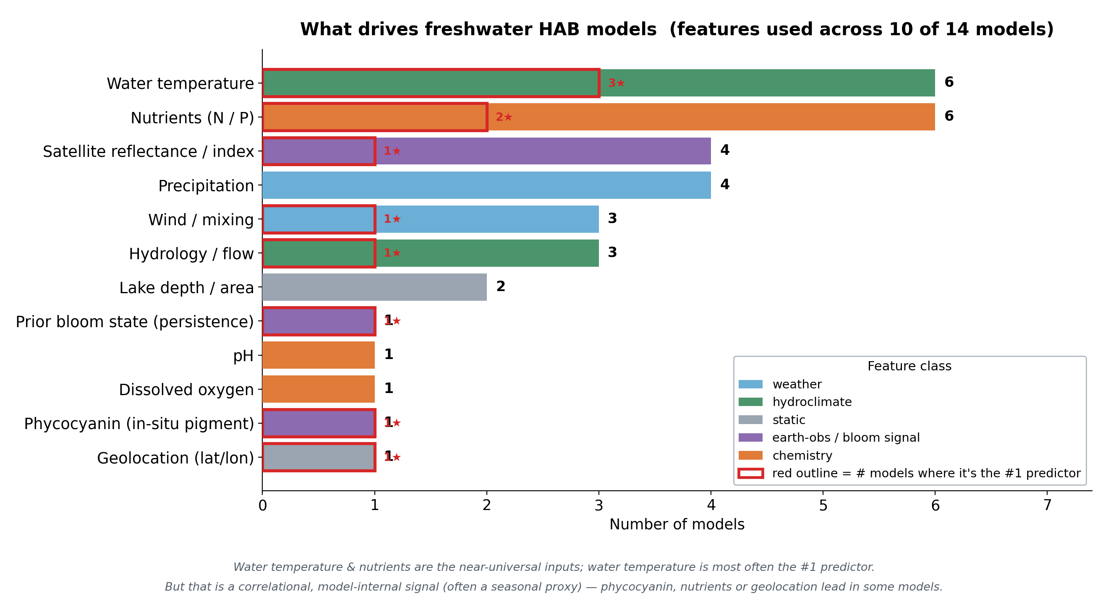
SLIDE 2 · THE RESEARCH FRONTIER
Cutting-edge HAB models — and what actually drives them
What to take away
• Water temperature & nutrients are the near-universal inputs; water temperature is most often the #1 predictor — but that's a correlational, model-internal signal (often a seasonal proxy), not a proven cause.
• Exceptions matter: some models rank phycocyanin or nutrients first, and one fusion model's top 'feature' was geolocation — a non-transferable artifact.
• Most of the 14 frontier models are simple & explainable (tree/boosting) and in-situ-driven; deep learning leads only in aggregate reviews.
• Persistence is a stiff baseline (week-to-week autocorrelation ≈0.90) — a real tool must beat it.
Flagship models & their #1 predictor
Model | Top predictor
Bayesian spatiotemporal… | satellite reflec
Gradient-boosting +… | water temperatur
Intelligible ML… | phycocyanin sign
NOAA Lake Erie 3-D… | wind mixing
Multi-source fusion… | geolocation
Feature 'importance' = how often a feature is a model's top-ranked predictor (correlational, not causal). 10 of the 14 models report a feature list; the 168-study review (ACAD-068) is context, not counted as a model.
Notes:
Slide 2 answers 'what does the frontier look like and what drives it.' The hero chart: water temperature & nutrients are near-universal; water temperature is most often the #1 predictor, BUT stress this is correlational/model-internal (often a season proxy) and has real exceptions (phycocyanin in Müggelsee; geolocation in the Sentinel-2 fusion model — an explicitly non-transferable artifact). Bottom-left: frontier ML is mostly simple tree/boosting methods and in-situ-driven (Korea/China/Germany dominate); deep learning only leads in aggregate reviews. The persistence baseline (AR1≈0.90) is the number any PoC must beat — this directly frames our modeling choices.

Slide 4
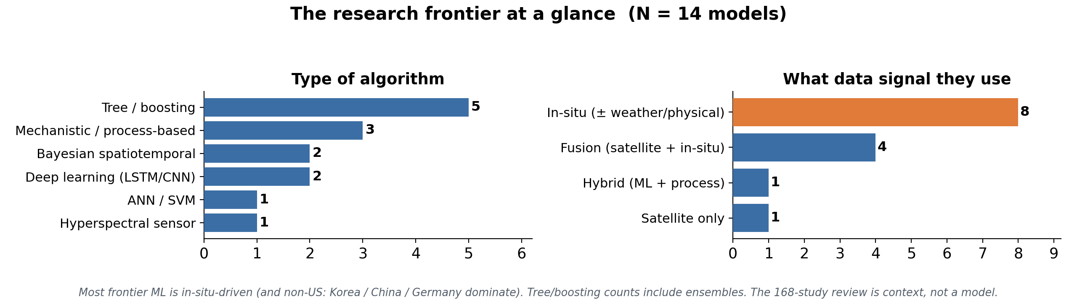
SLIDE 2 · APPENDIX
Full model inventory (14 models + 1 review) — features emphasised
Model | Org | Algorithm | Forecasts | Mode | Signal | Features used (→ TOP predictor in bold text) | Src
Bayesian spatiotemporal… | Fed/Acad | Bayesian hierarchical… | bloom occurrence… | forecast | Fusion | satellite reflectance, water temperature, precipitation, lake morphology → TOP: satellite… | ACAD-050, FED-017
R-INLA spatial (SPDE) + AR1 | Acad | Bayesian spatiotemporal… | microcystin… | forecast | Fusion | satellite reflectance, prior bloom state → TOP: prior bloom state | ACAD-092, ACAD-093
Gradient-boosting + attention… | Acad | XGBoost/LightGBM/CatBoost +… | cyanobacteria cell… | forecast | In-situ | water temperature, pH, dissolved oxygen, nutrients, precipitation → TOP: water temperature | ACAD-043
Explainable LSTM + SHAP | Acad | LSTM (deep learning) + SHAP… | chlorophyll / bloom | forecast | In-situ+wx | water temperature, nutrients, precipitation → TOP: water temperature | ACAD-048
Interpretable CatBoost + SHAP | Acad | CatBoost (gradient boosting) +… | bloom likelihood | forecast | In-situ | nutrients, water temperature → TOP: nutrients | ACAD-060
Intelligible ML early-warning | Acad | XGBoost + evolutionary… | bloom occurrence… | forecast | In-situ | phycocyanin (in-situ), water temperature, nutrients → TOP: phycocyanin (in-situ) | ACAD-037
ANN vs SVM reservoir… | Acad | Artificial neural network /… | algae alert level | forecast | In-situ | n/r | ACAD-001
RF + boosting ensemble vs… | Acad | Random forest + boosting… | alert level | forecast | In-situ | n/r | ACAD-117
NOAA Lake Erie 3-D transport… | Fed | 3-D Lagrangian / Eulerian /… | Microcystis bloom… | forecast | Fusion | satellite reflectance, wind mixing, hydrology flow → TOP: wind mixing, hydrology flow | ACAD-024, ACAD-051…
Coupled hydrodynamic-algal… | Acad | Coupled… | bloom biomass | forecast | In-situ+phys | nutrients, hydrology flow, wind mixing | ACAD-052
Multi-source fusion severity… | Acad | Random forest + LightGBM +… | bloom severity class… | nowcast | Fusion | satellite reflectance, geolocation, water temperature, precipitation, wind mixing, lake… | ACAD-008
WASP eutrophication process… | Acad | WASP mechanistic eutrophication… | phytoplankton biomass… | simulation | In-situ+loads | nutrients, hydrology flow → TOP: nutrients | ACAD-108
Frontier synthesis: 168-study… | Acad | review (all model families) | n/a (survey) | review | Review | n/r | ACAD-068
Deep-learning surrogate of a… | Acad | modular deep-learning surrogate… | process-model… | forecast | Hybrid | n/r | ACAD-104
NASA PACE hyperspectral… | Fed | hyperspectral retrieval (Ocean… | cyanobacteria cell… | nowcast | Satellite | satellite reflectance | ACAD-106
The 168-study REVIEW (mode='review') is context, not counted among the 14 models. Feature importance is correlational / model-internal (not causal). 'n/r' = not reported. Skill metrics in each dossier & data/models.json. Src → Research/REFERENCES.md.
Notes:
Full model table; the features column is the brief's emphasis. Reported skill per model (read if asked):
- Bayesian spatiotemporal fusion (INLA), 2,192 US lakes: Out-of-sample 2021: 90% acc, AUC 0.95, 88% sens, 91% spec, but 49% precision (overpredicts). Note: source has an unresolved internal sample-count discrepancy
- R-INLA spatial (SPDE) + AR1, 103 Florida lakes: AUC 0.95 holdout -> 0.89 true 1-week forecast; spatial structure gave the largest fit gain; AR1 alpha=0.90 (strong persistence)
- Gradient-boosting + attention CNN-LSTM ensemble: R^2 = 0.89-0.93
- Explainable LSTM + SHAP, 102 sites: mean NSE 0.48 (median 0.52), beat 8 ML baselines; but 30% of sites 'poor' (NSE<0.3) - highly site-dependent
- Interpretable CatBoost + SHAP, Yilong Lake: AUC = 0.948 (best of 10 models compared)
- Intelligible ML early-warning, Lake Müggelsee: Tree/rule models generalized; LSTM failed to generalize on daily data. NOTE: under a published Comment/rebuttal [ACAD-110]
- ANN vs SVM reservoir alert-level: ANN outperformed SVM (abstract-only; no metric)
- RF + boosting ensemble vs CNN/ANN: 78.7% test accuracy; beat 1D-CNN and ANN
- NOAA Lake Erie 3-D transport (mechanistic): Transport formulations compared vs satellite bloom fields over multiple seasons
- Coupled hydrodynamic-algal biomass, Lake Taihu: n/r (operational forecast system)
- Multi-source fusion severity classifier (Sentinel-2 + DEM + climate): 6th of field (RA-RMSE 0.81 vs 0.76 winner); 62.8% exact-class, 89.5% severe-case accuracy
- WASP eutrophication process model, Lake Winnipeg: calibration/validation study
- Frontier synthesis: 168-study cross-review (1997-2025): Reports deep learning (esp. LSTM) strongest median (R^2 0.89, >90% acc in many apps); hybrids highest accuracy; flags limited transferability across water bodies
- Deep-learning surrogate of a process model (hybrid): NSE 0.644 -> 0.930 vs the process model it emulates
- NASA PACE hyperspectral cyanoHAB validation: R^2 0.84 vs operational CyAN benchmark; ~halved chl-a retrieval error (NRMSE 21.6% vs 38.7%)
Flag M11's longitude top-feature as a non-transferable proxy, and M1's 49%-precision / sample-count caveat.

Slide 5
HOW TO READ THESE SLIDES
Method, quality rubric & provenance
Where this comes from
• Built entirely from a 261-source public-literature review (peer-reviewed, federal, state, NGO/WHO, private).
• Every tool/model attribute traces to a citation key that resolves in Research/REFERENCES.md; unknowns are marked 'n/r', never guessed.
• Freshwater cyanobacteria scope; marine systems excluded (a few tools' marine parents are footnoted).
• Counts are raw (small N) — orientation, not statistics.
Feature 'importance' caveat
‘Most important’ = most often a model's top-ranked predictor. This is a correlational, model-internal signal (often a seasonal proxy) — NOT a demonstrated cause. Rankings differ across models.
Evidence-anchored quality tiers
Tier | What it means
Established / operational | Public product with peer-reviewed AND out-of-sample validation + baseline (e.g. CyAN, EPA 7-day)
Operational (unbenchmarked) | Deployed/public but no skill metric stated in the sources (e.g. NOAA Erie, state dashboards)
Vendor self-report | Commercial; validation claimed but no disclosed baseline/peer review (BlueGreen, CyanoLakes, EOMAP)
Research-grade | Peer-reviewed model with reported skill; not an operational public product
Reproducible
Figures & tables regenerate from presentation/data/*.json via build_figures.py + build_deck.py. Data JSON carries the source keys for every cell.
SePRO Lead Data Scientist case study · HAB landscape orientation · generated 2026-07-01 · freshwater cyanobacteria scope.
Notes:
Reference slide. Use if the panel asks 'how do you know' or 'what does cutting-edge mean here'. The tier rubric makes the subjective 'quality' call defensible; the feature-importance caveat pre-empts a correlation-vs-causation challenge.

