Slide 1

Optimization for Deep Learning
Sun, R. (2019). Optimization for deep learning: theory and algorithms. ArXiv, abs/1912.08957.
Seminar: Mathematics of Data Science, WS 23-24
Notes:
Hi everyone, I am going to present the article of ‘Optimization for Deep Learning’. The paper has published by Professor Ruoyu Sun in 2019 from Chinese University of Hong Kong, Shenzhen.
Let me start quickly with the outline of the presentation.

Slide 2
Presentation Outline
Introduction & Problem Formulation
Gradient Descent Neural-net Specific Tricks
General Optimization Algorithms for Training Neural Nets
Global Optimization of Neural Nets (GON)
Implementation on MNIST Dataset – Choose Among Algorithms
Conclusion (1 min)
Seminar: Mathematics of Data Science, WS 23-24
Notes:
Outlines of the presentation and the paper indeed are parallel.
It starts with the Introduction and Problem formulation.
I will talk about the famous Gradient Descent then continue with the tricks that are applied to fix the issues of optimization algorithms.
Then we will analyze some algorithms in depth to see their differences. Moreover I will mention about the model landscapes in Global Optimization of Neural Nets part.
At the end, I will present some implementation on MNIST dataset to grasp the different landscapes of these algorithms.
Let us start with the Introduction.

Slide 3
Introduction
Q: When and why can a neural network be successfully trained?
A: a proper neural network, a proper training algorithm, and proper training tricks.
*Focus on supervised learning problem with feedforward neural networks.
Seminar: Mathematics of Data Science, WS 23-24
Notes:
The article is opened with this question: When and why can a neural network be successfully trained?
And it is answered as when these three matters meet:
-a proper neural network, a proper training algorithm, and proper training tricks.
-Proper neural network means choosing the right neural architecture such as the depth and the number of the layers and using the reasonable activation functions.
-a proper training algorithm represents choosing among the optimization algorithms which are as all you probably heard SGD, Adam, RMSprop etc. and identifying the learning-rate.
-and the last one as the author defined: proper training tricks are some tricks that are utilized to escape some training issues such as exploding/vanishing gradients. Initialization and normalization strategies are two most important tricks.
I should state that: The paper only focuses on supervised learning problem with feedforward neural networks excluding more complicated formulations such as generative adversarial networks and recurrent neural networks for simplicity.
Now, we can continue with the problem formulation.

Slide 4
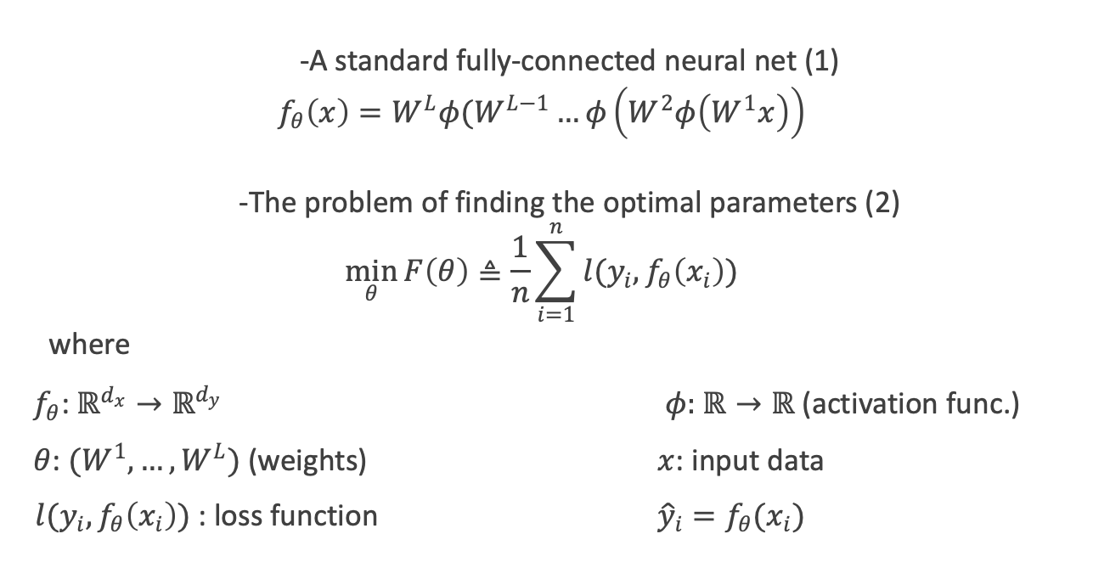
Problem Formulation
-A standard fully-connected neural net (1)
$$f_{θ}\left(x\right)=W^{L}φ(W^{L−1}…φ\left(W^{2}φ\left(W^{1}x\right)\right)$$
-The problem of finding the optimal parameters (2)
$$\min_{θ}{F\left(θ\right)≜\frac{1}{n}\sum_{i=1}^{n}{l(y_{i},f_{θ}\left(x_{i}\right))}}$$
where
$f_{θ}$: $ℝ^{d_{x}}→ℝ^{d_{y}}$ $φ:$ $ℝ→ℝ$ (activation func.)
$θ$: $(W^{1},…,W^{L})$ (weights) $x$: input data
$l(y_{i},f_{θ}\left(x_{i}\right))$: loss function ${\hat{y}}_{i}=f_{θ}(x_{i})$
Seminar: Mathematics of Data Science, WS 23-24
Notes:
In this section, the optimization problem formula for a supervised learning problem is presented.
First, we need to define the mapping, which is called neural network. A standard fully-connected neural network is represented by equation 1, here x is the input data that is multiplied by weights and ɸ is the activation function. $f_{θ}\left(x\right)$ is the mapping function which is equal to predicted $\hat{y}$ value. And the second equation defines the optimization problem. Here we want to minimize the loss function, which is roughly the difference between predicted value and the truth value by tuning the weights.
The next part is the famous Gradient Descent.

Slide 5
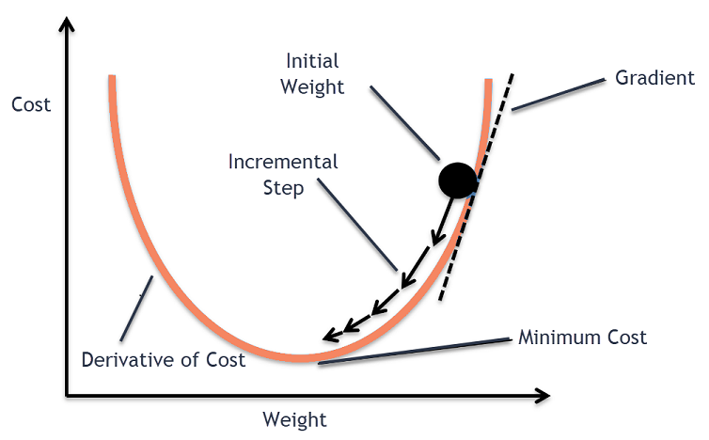
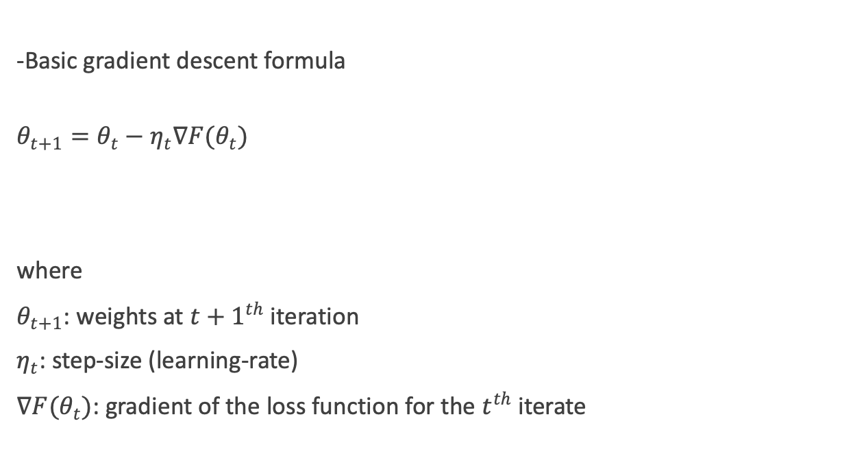
Gradient Descent
-Basic gradient descent formula
$$θ_{t+1}=θ_{t}−η_{t}∇F(θ_{t})$$
where
$θ_{t+1}$: weights at ${t+1}^{th}$ iteration
$η_{t}$: step-size (learning-rate)
$∇F(θ_{t})$: gradient of the loss function for the $t^{th}$ iterate
https://www.analyticsvidhya.com/blog/2020/10/
how-does-the-gradient-descent-algorithm-work-in-machine-learning/
Seminar: Mathematics of Data Science, WS 23-24
Notes:
A large class of optimization algorithms are based on Gradient Descent. As you know, $∇F(θ_{t})$ here is the gradient of the loss function with respect to $θ$, representing the direction of the steepest ascent.
$η_{t}$ (eta t) is the step-size as known as learning rate which determines the step size of the steps taken during optimization and $θ$ represents the model parameters. As you can see from the graph, by updating the weights, it reaches the minimum cost in theory.
But I should also refer that it is not guaranteed to reach the global minimum, the gradients have to converge to zero by iterations to reach a minima, but the function value might not be lower bounded. or the function might have multiple minimas. In these cases, we have some methods and strategies. Now, we will refer these issues and the ways to avoid them.

Slide 6
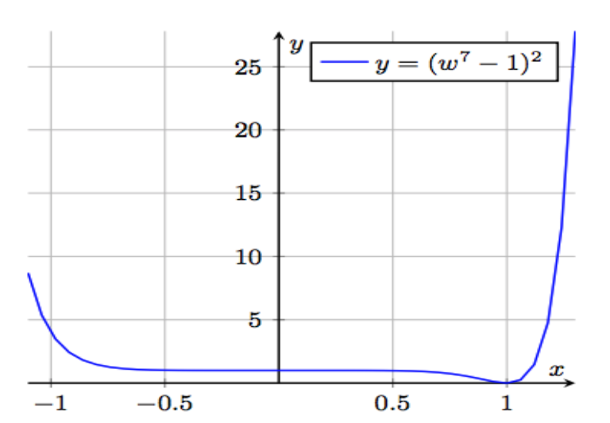
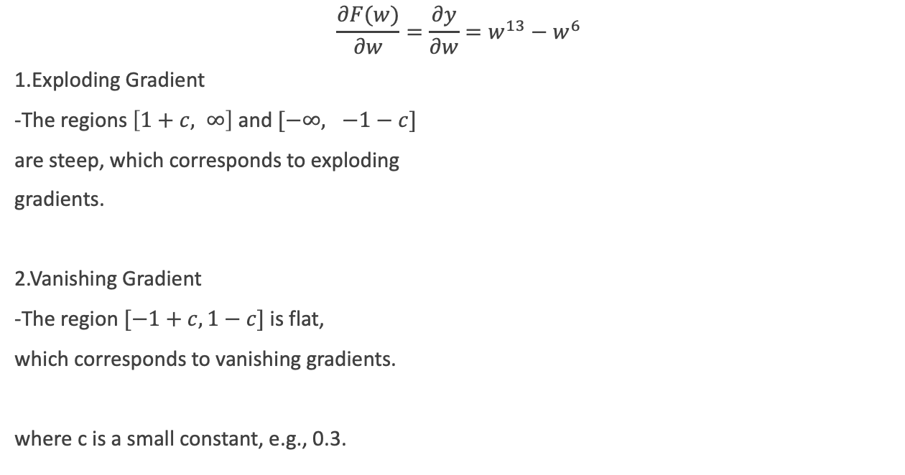
Neural-net Specific Tricks (Issues)
$$\frac{∂F(w)}{∂w}=\frac{∂y}{∂w}=w^{13}−w^{6}$$
1.Exploding Gradient
-The regions $\left[1+c, ∞\right]$ and $[−∞, −1−c]$
are steep, which corresponds to exploding
gradients.
2.Vanishing Gradient
-The region $[−1+c, 1−c]$ is flat,
which corresponds to vanishing gradients.
where c is a small constant, e.g., 0.3.
Seminar: Mathematics of Data Science, WS 23-24
Notes:
In the paper, it is stated that the most well-known difficulty of training deep neural nets is gradient explosion and vanishing. The author describes these issues with a simple and clear example.
I will also utilize this example.
Let’s say this function is our cost function. We need to find its gradients with respect to w.
Here c is a small constant for example 0.3. Derivative of the cost function is as shown at the top.
We need to choose a starting point to compute the gradient and if we choose in the interval [1+c, $∞$], let’s say 2. Then if we put 2 to the w, the gradient becomes a large number and we call it exploding gradient.
Conversely, if we choose the starting point in the interval of [-1+c, 1-c], which is the flat area, let’s say 0.5. Then if we put 0.5 to the w, the gradient becomes a small number and we call it vanishing gradient.
I should also state that because we use backpropagation algorithm, there are many gradient computations and these are multiplied to update all the weights between the layers. When we multiply them multiple times these gradients becomes more and more smaller in the beginning layers. This process is similar in the gradient explosion.
There are some tricks to fix these issues. For example, Initialization strategy is really important. The idea is to choose an initial point in a nice region for example the basin in the interval of [1-c, 1+c].Let’s talk about the initialization methods that are suitable to fix that issue.

Slide 7
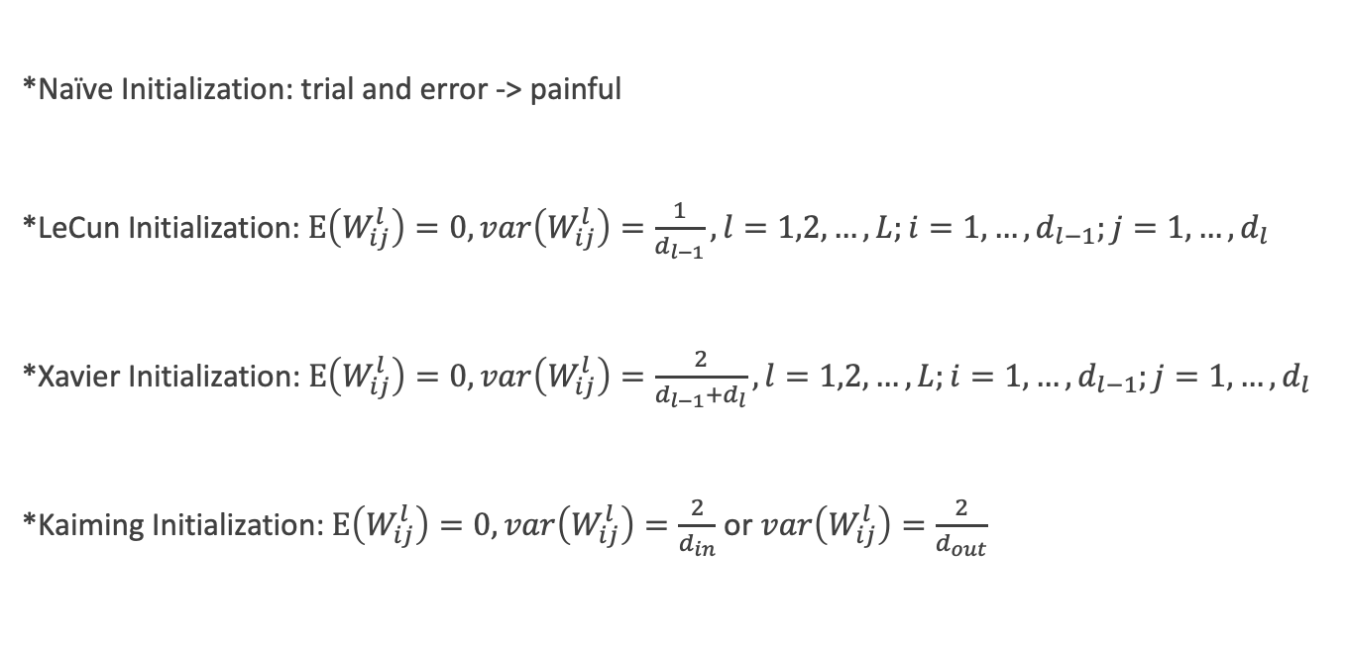
Neural-net Specific Tricks (Initialization)
*Naïve Initialization: trial and error -> painful
*LeCun Initialization: $Ε\left(W_{ij}^{l}\right)=0, var\left(W_{ij}^{l}\right)=\frac{1}{d_{l−1}}, l=1,2,…,L;i=1,…,d_{l−1};j=1,…,d_{l}$
*Xavier Initialization: $Ε\left(W_{ij}^{l}\right)=0, var\left(W_{ij}^{l}\right)=\frac{2}{d_{l−1}+d_{l}},l=1,2,…,L;i=1,…,d_{l−1};j=1,…,d_{l}$
*Kaiming Initialization: $Ε\left(W_{ij}^{l}\right)=0, var\left(W_{ij}^{l}\right)=\frac{2}{d_{in}}$ or $var\left(W_{ij}^{l}\right)=\frac{2}{d_{out}}$
Seminar: Mathematics of Data Science, WS 23-24
Notes:
The paper in fact focuses on several methods, but I will explain 4 of them. These are the most famous ones.
One of the methods is Naïve Initialization. Naïve initialization depends on trial and error approach such as initializing all the weights from zero, or to choose a sparse initial point that only a small portion of the weights are non-zero. However, this method is painful since one method could fit successfully in one problem but might not fit for others. So, a principled initialization method is needed.
The other one is LeCun initialization. It is developed by Professor Yann Lecun (yann lekun) from NYU. It is published in the paper of ‘Efficient Backprop’ in Springer in 1998. Here the idea based on setting the initial weights of the neurons in a layer according to a specific distribution. For a layer with n input units and m output units, we initialize the weights that connect input and output units by drawing a random number from Gaussian distribution with a mean of 0 and variance of 1/number of input nodes.
The other most known initialization method is Xavier initialization. It is also called Glorot initialization. Here the variance of the weight that connect input neurons and output neurons is equal to 2 divided by number of input neurons plus number of output neurons.
And the other method is called Kaiming initialization. LeCun (lekun) and Xavier initializations were designed for Sigmoid activation functions but after 2010s ReLU activation function became popular And it He et. al. noticed that this derivation of initialization method serves better to ReLU. The reason is that ReLU cuts half of the signal on average.
Now, we will see the other trick which is called normalization.

Slide 8

Neural-net Specific Tricks (Normalization)
$${BN}_{γ,β}\left(α_{1}, {…, α}_{N}\right)≜(γ\frac{α_{1}−μ}{σ+ε}+β, …, γ\frac{α_{N}−μ}{σ+ε}+β)$$
where
$μ=\frac{1}{N}(α_{1}+…+α_{N})$, $α_{1},α_{2}, …,α_{N}$: input instances,
$σ=\sqrt{\frac{1}{N}{(α_{i}−μ)}^{2}}$, $γ∈ℝ^{+}$ and $β∈ℝ$ are parameters to be learned and $ε$ is a fixed small constant.
Seminar: Mathematics of Data Science, WS 23-24
Notes:
Normalization is another method to improve the training process and model performance. As I explained in the previous chapters, gradient explosion and vanishing is the main issue of the training process since the gradients are multiplied multiple times. We saw how to initialize weights to obtain stable gradients, but it is also needed to control the input data to have stable gradients.
There are different kinds of normalization methods.
Batch Normalization is the most known one which aims to reduce internal covariate shift, which is the change in the distribution of the network's activations due to parameter updates during training. Batch normalization normalizes the input of each layer by subtracting the batch mean and dividing by the batch standard deviation as you can see in the formulation. This is followed by scaling and shifting using learnable parameters (gamma and beta). The normalization is applied independently to each feature in the mini-batch.
Batch normalization have several benefits such as stabilizing training, mitigating vanishing and exploding gradients, improving generalization and facilitating faster convergence.
Now, we can go on with the optimization algorithms.

Slide 9
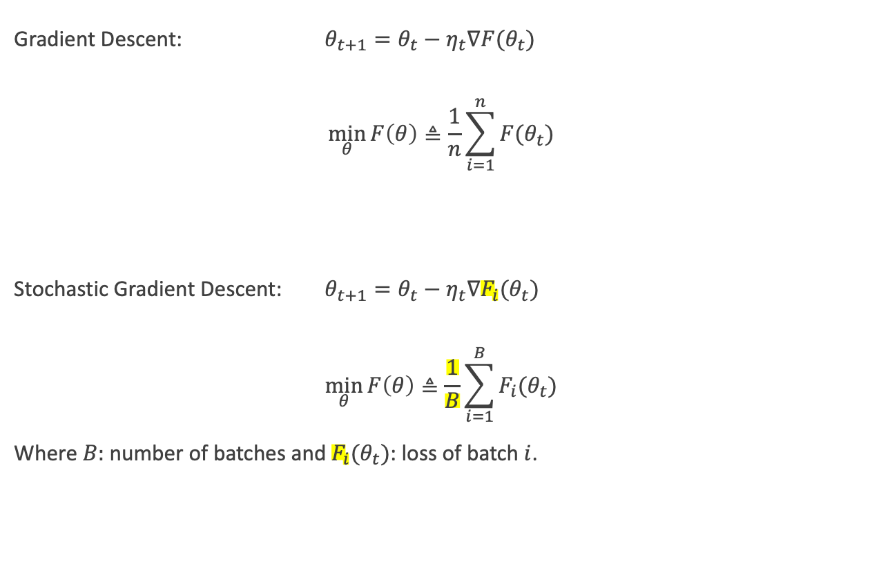
General Optimization Algorithms for Training Neural Nets (Stochastic Gradient Descent-SGD)
Gradient Descent: $θ_{t+1}=θ_{t}−η_{t}∇F(θ_{t})$
$$\min_{θ}{F\left(θ\right)≜\frac{1}{n}\sum_{i=1}^{n}{F(θ_{t})}}$$
Stochastic Gradient Descent: $θ_{t+1}=θ_{t}−η_{t}∇F_{i}(θ_{t})$
$$\min_{θ}{F\left(θ\right)≜\frac{1}{B}\sum_{i=1}^{B}{F_{i}(θ_{t})}}$$
Where $B:$ number of batches and $F_{i}(θ_{t})$: loss of batch $i$.
Seminar: Mathematics of Data Science, WS 23-24
Notes:
First optimization algorithm that we will see is the Stochastic Gradient descent. One may ask what is the difference between basic gradient descent and stochastic gradient descent.
The main difference is that unlike traditional Gradient Descent, which computes the gradient of the entire dataset to update model parameters, SGD updates the parameters using the gradient of the loss computed on a randomly selected subset of the data, often referred to as a mini-batch.
Here in the formula F_i represents the loss of the batch and B represents the number of the batches.
And the other question might be what is the reason for using SGD over GD? And the answers are memory constraints and the faster convergence. A single GPU or CPU cannot load all samples into its memory for computing the full gradient, so, loading a mini-batch of samples at each iteration is a reasonable choice. This random selection introduces a stochastic (random) element into the optimization process. And in terms of convergence, SGD tends to converge faster than traditional Gradient Descent, especially for large datasets, because it updates the parameters more frequently.
The other optimization algorithm is Momentum.

Slide 10
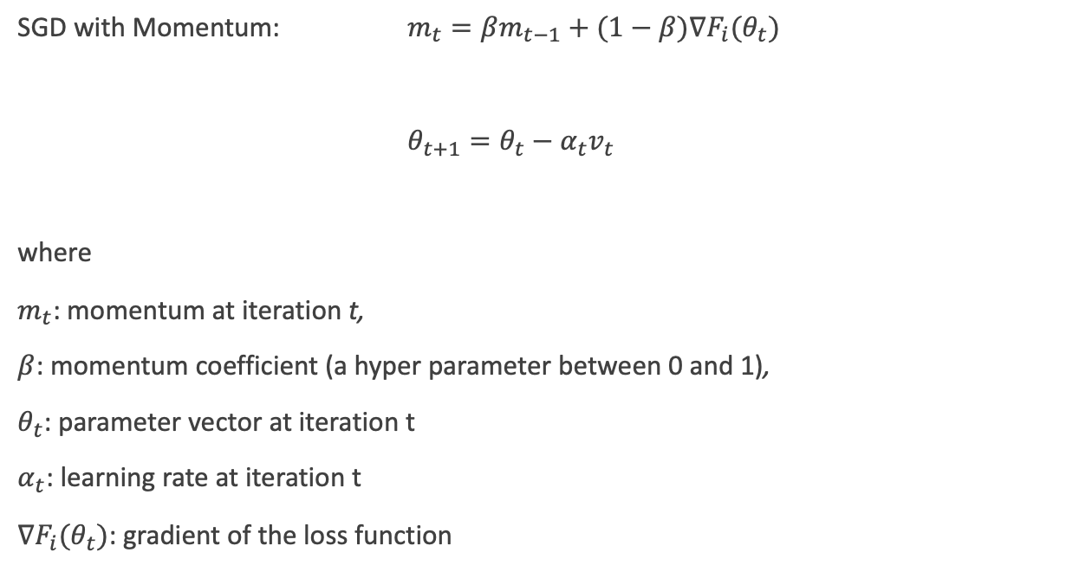
General Optimization Algorithms for Training Neural Nets (SGD with Momentum)
SGD with Momentum: $m_{t}=βm_{t−1}+(1−β)∇F_{i}(θ_{t})$
$θ_{t+1}=θ_{t}−α_{t}v_{t}$
where
$m_{t}$: momentum at iteration t,
$β$: momentum coefficient (a hyper parameter between 0 and 1),
$θ_{t}$: parameter vector at iteration t
$α_{t}$: learning rate at iteration t
$∇F_{i}(θ_{t})$: gradient of the loss function
Seminar: Mathematics of Data Science, WS 23-24
Notes:
Momentum can be thought of as giving the optimization algorithm a "memory" of past gradients to influence the direction of future updates. The basic idea is to maintain a moving average of the past gradients and use this accumulated information to update the parameters.
Momentum overcomes some of the challenges associated with standard gradient descent methods. It helps to smooth out the updates to the model parameters, allowing the optimization process to navigate through flat or shallow regions more efficiently.
To figure out the mathematics behind it, you can see the first equation that the momentum term is introduced to the parameter update rule. The term $βm_{t−1}$ represents the accumulated momentum from the previous iteration. And the term $(1−β)∇F_{i}(θ_{t})$ represents the current gradient scaled by (1−β).
And in the second formulation, the parameter update $θ_{t+1}$ is determined by subtracting the scaled momentum $α_{t}v_{t}$ from the current parameters $θ_{t}$.
The use of momentum helps the optimization process to move faster in directions where the gradients have been consistent and to dampen oscillations in directions where the gradients have been changing rapidly. This can be particularly beneficial in overcoming challenges like oscillations or slow convergence associated with certain geometries of the loss surface.
Lets see the other types of optimization algorithms which are Adaptive gradient methods.

Slide 11
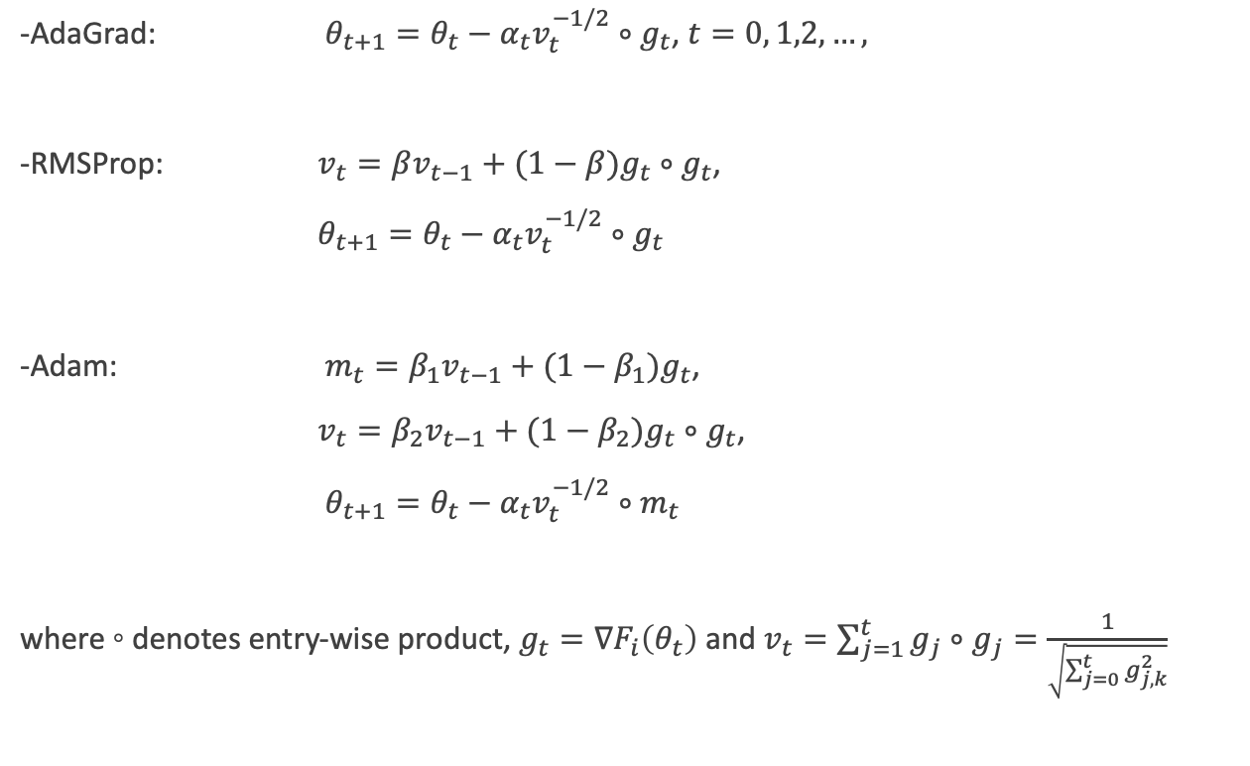
General Optimization Algorithms for Training Neural Nets (Adaptive Gradient Methods)
-AdaGrad: $θ_{t+1}=θ_{t}−α_{t}v_{t}^{−1/2}∘g_{t}$, $t=0, 1,2, …,$
-RMSProp: $v_{t}=βv_{t−1}+(1−β)g_{t}∘g_{t}$,
$θ_{t+1}=θ_{t}−α_{t}v_{t}^{−1/2}∘g_{t}$
-Adam: $m_{t}=β_{1}v_{t−1}+(1−β_{1})g_{t}$,
$v_{t}=β_{2}v_{t−1}+(1−β_{2})g_{t}∘g_{t}$,
$θ_{t+1}=θ_{t}−α_{t}v_{t}^{−1/2}∘m_{t}$
where ◦ denotes entry-wise product, $g_{t}=∇F_{i}\left(θ_{t}\right)$ and $v_{t}=\sum_{j=1}^{t}{g_{j}∘g_{j}}=\frac{1}{\sqrt{\sum_{j=0}^{t}{g_{j,k}^{2}}}}$
Seminar: Mathematics of Data Science, WS 23-24
Notes:
Adaptive gradient methods dynamically adjust the learning rates for different parameters during the training process. The paper mentions these three algorithms in detail:
First one is AdaGrad. The idea behind AdaGrad is to adapt the learning rates of individual parameters based on the historical sum of squared gradients. It is well-suited for sparse data as it assigns larger learning rates to less frequently updated parameters. Here the operation denotes entry-wise product and g_t is equal to the loss of the current batch. And v_t is as shown at the bottom where g_j,k denotes the k-th entry of g_j.
One drawback of AdaGrad is that it treats all past gradients equally, and it is thus natural to use exponentially decaying weights for the past gradients. This idea brings the RMSProp algorithm which is an extension of AdaGrad that addresses the problem of rapidly decreasing learning rates. It uses an exponentially decaying average of squared gradients to scale the learning rates.
And the last one is Adam, which is the combination of RMSProp and momentum optimization. Maintains a moving average of both gradients ​with the notation m_t and squared gradients with v_t. here the moving averages are bias-corrected, making the algorithm particularly effective in the early stages of training and adaptive learning rates for individual parameters and momentum-like effects for smoothing the optimization path.
Now, one can ask which algorithm is the best? We will investigate that with implementation part but I should say that it completely depends on the specific characteristics of the problem. First, we will see the global optimization part.

Slide 12
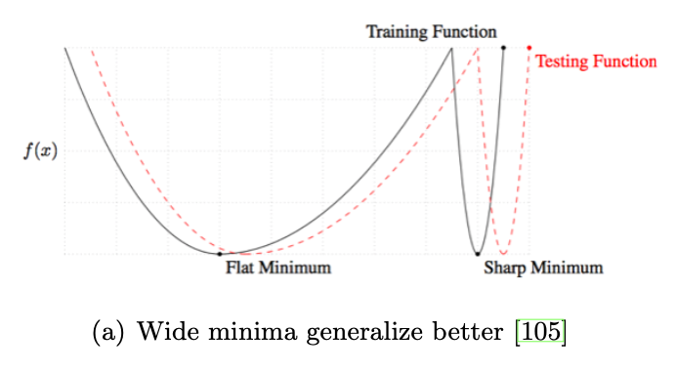
Global Optimization of Neural Nets (GON)
Seminar: Mathematics of Data Science, WS 23-24
Notes:
Global optimization of neural nets refers to the task of finding the set of parameters that minimize a given loss function, across the entire parameter space. It's a challenging problem due to the non-convex and high-dimensional nature of the optimization landscape for neural networks.
To overcome these issues, there are ongoing researches such as Mode connectivity which independently founded by Draxler et al. and Garipov et al. is identified as a property for deep neural networks where two global minima can be connected by an (almost) equal-value path.
and
Model compression and lottery ticket hypothesis is another research area on training smaller neural networks, also known as "efficient deep learning," is closely related to the optimization landscape.
And
Landscape has long been considered to be related to the generalization error. A common conjecture is that flat and wide minima generalize better than sharp minima, with numerical evidence.
Here you see the intuition is illustrated in figure from the paper, the test loss function and the training loss function have a small difference, and that difference has a small effect on wide minima and thus they generalize well; in contrast, this small difference has a large effect on sharp minima and thus they do not generalize well.
Now, we can quickly review my implementations and see the differences of optimization algorithms.

Slide 13
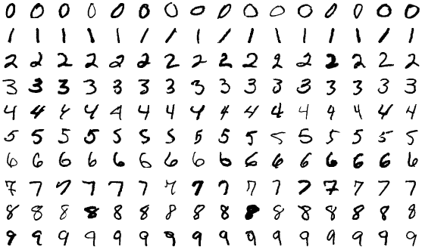
Implementation on MNIST Dataset – Choose Among Algorithms (1)
Seminar: Mathematics of Data Science, WS 23-24
Notes:
For the implementation part, I have used the MNIST Dtaset. Mnist dataset stands for Modified National Institute of Standards and Technology. It is a large database of handwritten digits that is commonly used for training various image processing systems. Furthermore, the black and white images from NIST were normalized to fit into a 28x28 pixel bounding box and anti-aliased, which introduced grayscale levels. The MNIST database contains 60,000 training images and 10,000 testing images.
It is a good database for people who want to try learning techniques and pattern recognition methods on real-world data while spending minimal efforts on preprocessing and formatting. Within this scope, I have decided to use Mnist dataset. The goal of the implementation is to set up a neural network model that classifies the handwritten digit images.
I have trained the model with different optimization algorithms and same hyperparameters which we investigated. Then I chose the best performance algorithm and see the differences in training process.
Let’s view the performances of the algorithms.

Slide 14
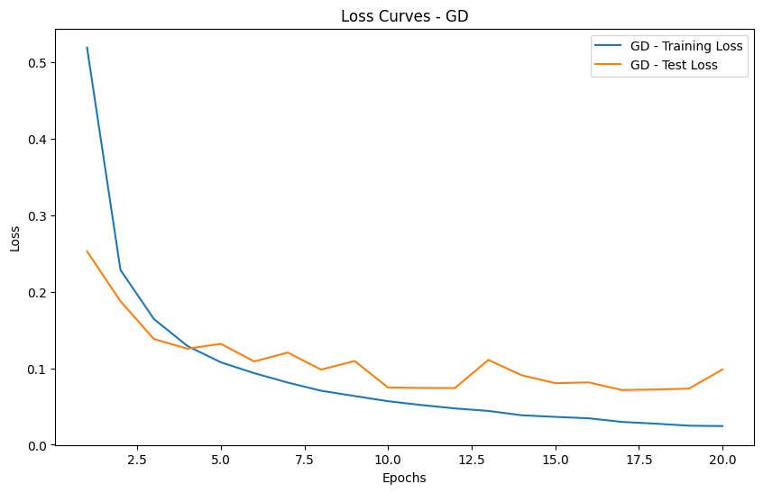
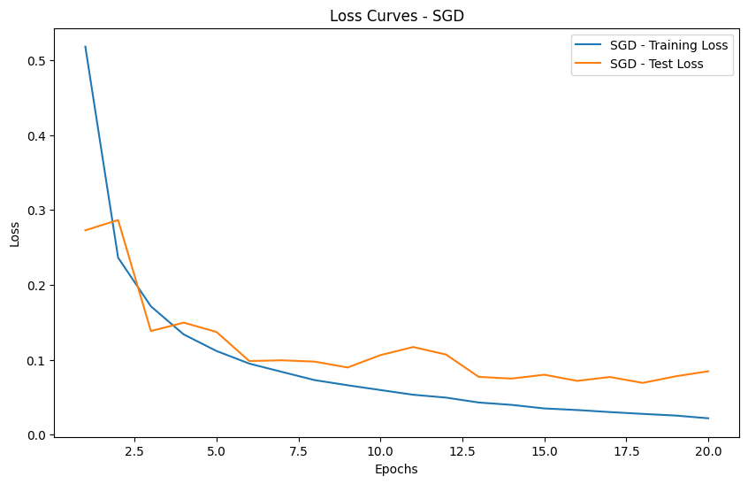
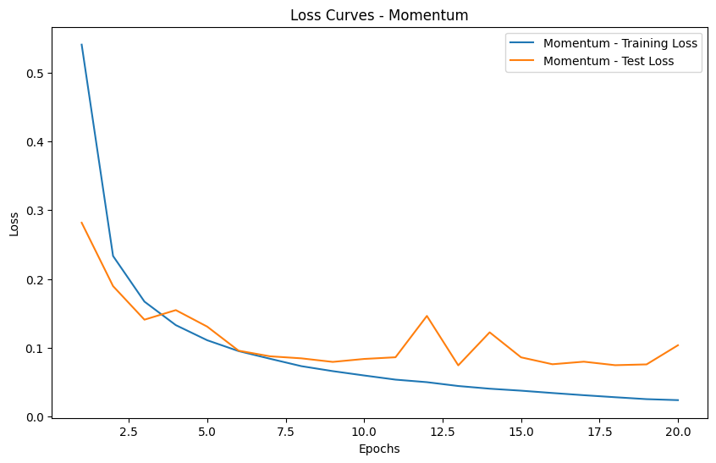
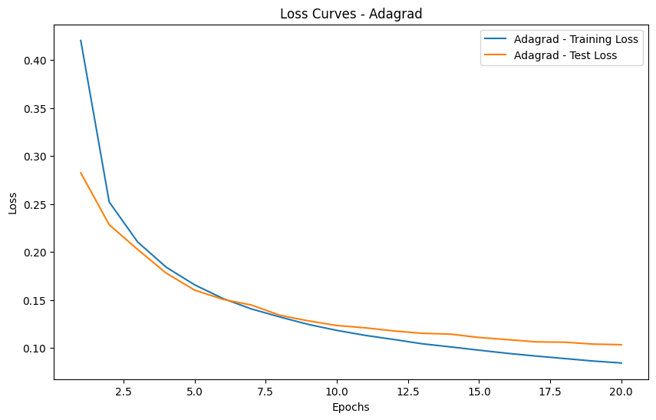
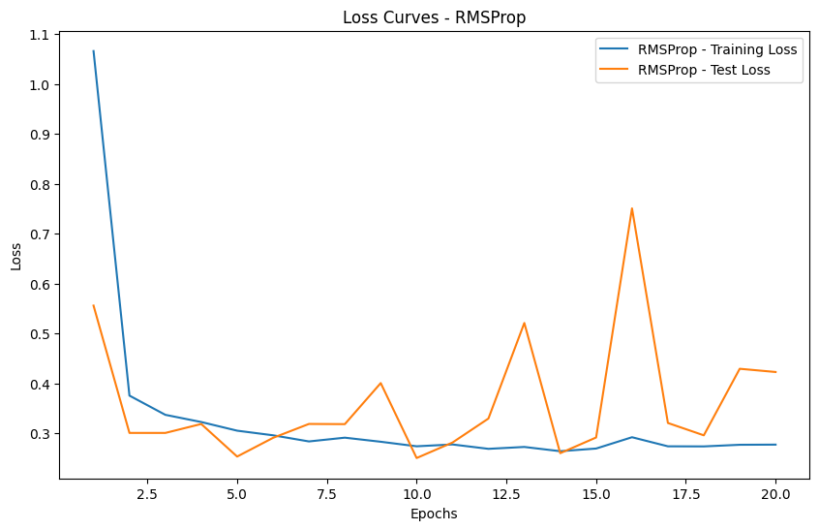
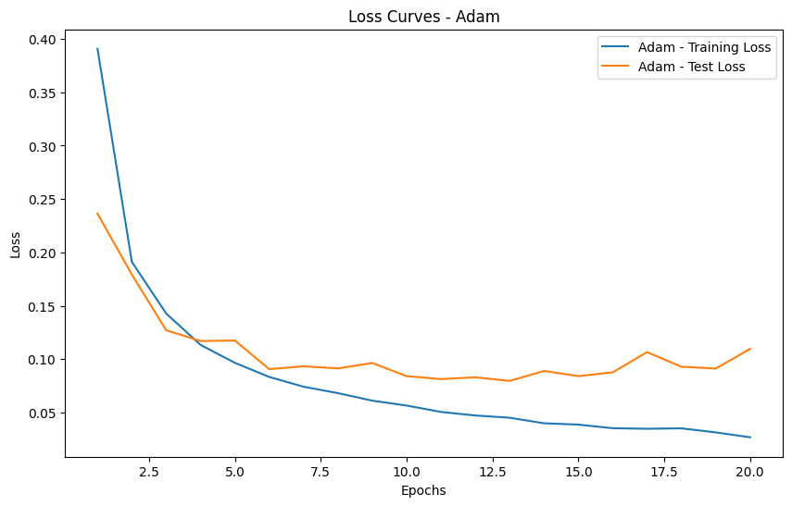
Implementation on MNIST Dataset – Choose Among Algorithms (2)
Seminar: Mathematics of Data Science, WS 23-24
Notes:
I have trained the model with 6 different algorithms which we have talked about. Looks like all of them have similar performances. However, Adagrad looks smoother than the others. This might stem from that the data is sparse.
Another observation might be that there is not much difference between the performances of Gradient descent and Stochastic Gradient descent. Typically, SGD converges faster than GD but here, the convergence rates are very similar. This might originate from several reasons.
For instance, For certain datasets, especially those with smooth and convex optimization landscapes, the advantages of stochasticity in SGD may not be as pronounced. GD might perform similarly in such cases.
Or
The size of the mini-batch used in SGD can impact its performance. If the batch size is too large, SGD may behave similarly to GD. Conversely, a very small batch size may introduce noise that hinders convergence.
We can also observe that RMSProp converges faster than Adagrad in training loss. This might be the result of adaptive learning rates. Both RMSProp and Adagrad adapt learning rates for each parameter individually. However, Adagrad uses the cumulative sum of squared gradients over all time steps, leading to a monotonically increasing denominator in the learning rate update formula. This can result in very small learning rates for frequently occurring parameters, slowing down convergence.
RMSProp addresses this issue by using a decaying average of squared gradients. The moving average prevents the denominator from growing without bound, allowing the algorithm to adapt more quickly to changing conditions.
As you can see, the dataset and the problem characteristics are the most important factors for choosing the algorithm.

Slide 15
Conclusion
Seminar: Mathematics of Data Science, WS 23-24
Notes:
To sum up, the paper explored various theoretical aspects related to optimizing neural networks, focusing primarily on feedforward neural network training. While our understanding has improved, particularly in areas like initialization and over-parameterization effects on the landscape challenges remain. Theoretical insights have significantly contributed to algorithm design, evident in schemes like initialization methods, batch normalization, and Adam optimizer.
Overall, progress has been made in theoretical understanding of neural network optimization, yet significant challenges and opportunities for future exploration remain.

Slide 16
Ata Yigit Vice, MSc. Mathematics in Data Science
Thank you for listening.
For implementation, see
https://github.com/atavice/seminar
Seminar: Mathematics of Data Science, WS 23-24
Notes:
Thanks for listening me, you can see the implementation from my Github account.

