Slide 1


TUTOR 24 X 7

Slide 2
TUTOR 24 X 7
Imagine a student of class 9th or 10th - constantly under pressure of board exam, intense competition, every mark counts, attending school, running to coaching class, prep exams, homework.
Students prioritize problem-solving subjects such as Mathematics and Science during their focused study hours. Reading-intensive subjects, like History, Geography, Environment Science etc., are often pushed to the end of the schedule, despite contributing significantly to final examination scores.
Tutor24X7 is here to address this gap. Textbook lessons of these ‘reading subjects’ are converted to short audio podcasts. Student can listen to them while :
🚌 Travelling to school
🚶 Walking
🍽️ Having meals
🧹 Doing household chores
😌 Relaxing before sleep
Instead of finding extra study time, they reuse otherwise unproductive time.

Slide 3
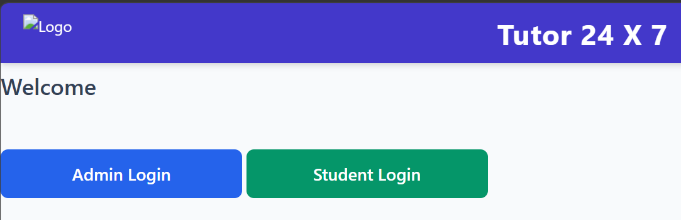
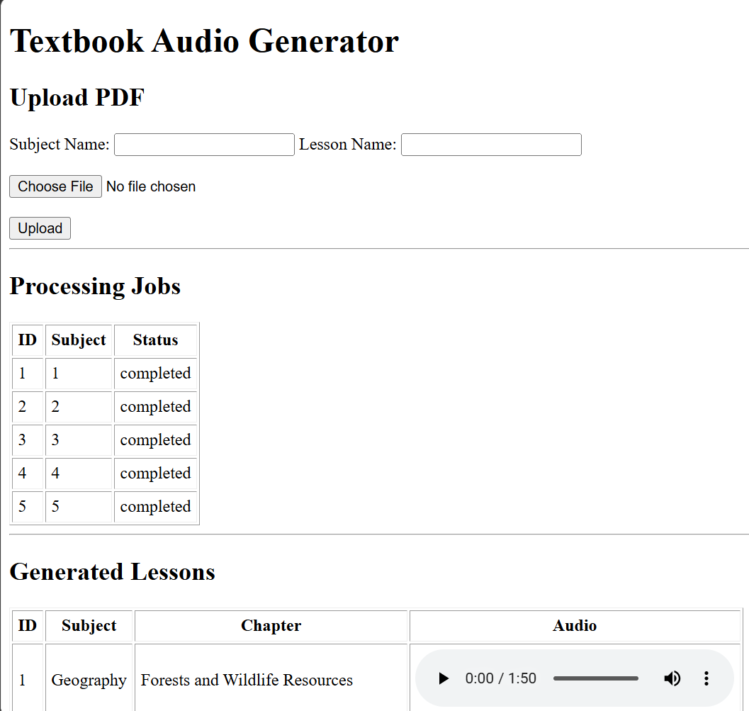
TUTOR 24 X 7
ADMIN Workflow
Admin Logs in
Admin Uploads pdf for a Subject & Lesson
He can also check status of previously submitted jobs
And check the audio created for earlier jobs
No manual recording
No studio cost
No voice artists
New editions generated in minutes

Slide 4
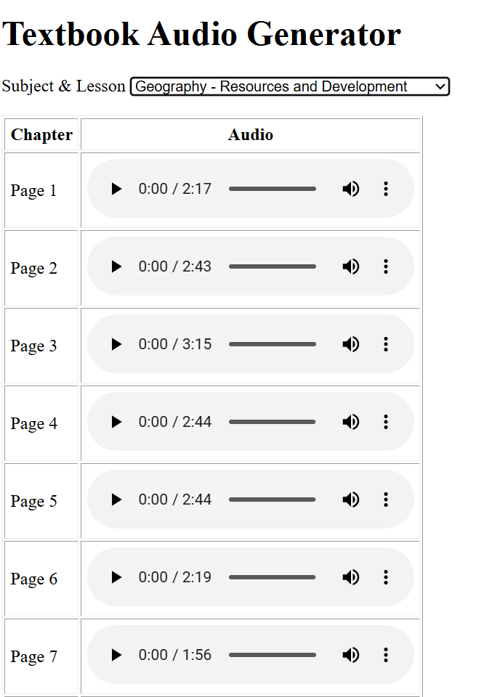

TUTOR 24 X 7
Student Workflow
Student Logs in
Selects the Subject & Lesson from drop down
Either listens to a particular section of the lesson or
Plays all available audios in sequence.
Study on the go
Affordable pricing
…
…
Sample Geography lesson narration

Slide 5
TUTOR 24 X 7
Business Opportunity
Revenue Model
Subscription
School licensing
EdTech platform integration
White-labelled solution
Why Now?
Growing adoption of audio learning
Students already consume educational content on mobile devices
AI enables rapid, low-cost content generation at scale
Every commute becomes a classroom.

