Slide 1
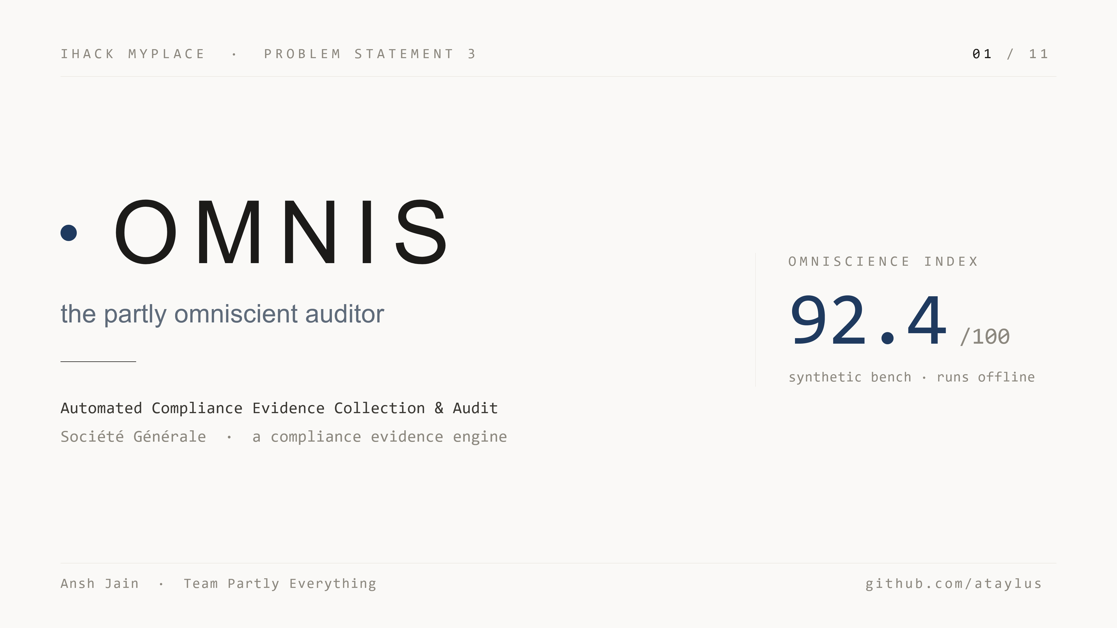
Notes:
This is OMNIS — the partly omniscient auditor. My entry for Problem Statement 3, automated compliance evidence collection and audit. I'm Ansh Jain, team Partly Everything. In five minutes I'll show you what it does, how it works, and why an auditor would accept it.

Slide 2
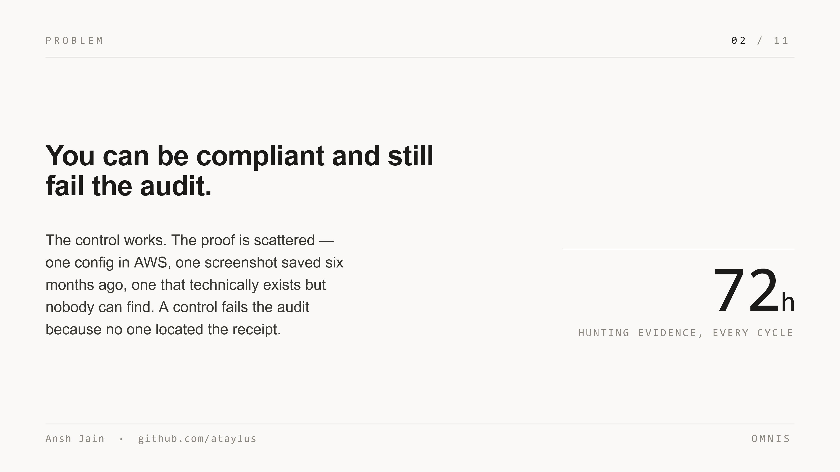
Notes:
A bank doesn't just have to follow its own rules — it has to prove it, several times a year, to an auditor who wants the actual receipt. The control can be working perfectly and still fail the audit because nobody found the paperwork. Compliance teams burn seventy-plus hours an audit cycle as professional receipt-hunters. You can be compliant and still lose.

Slide 3
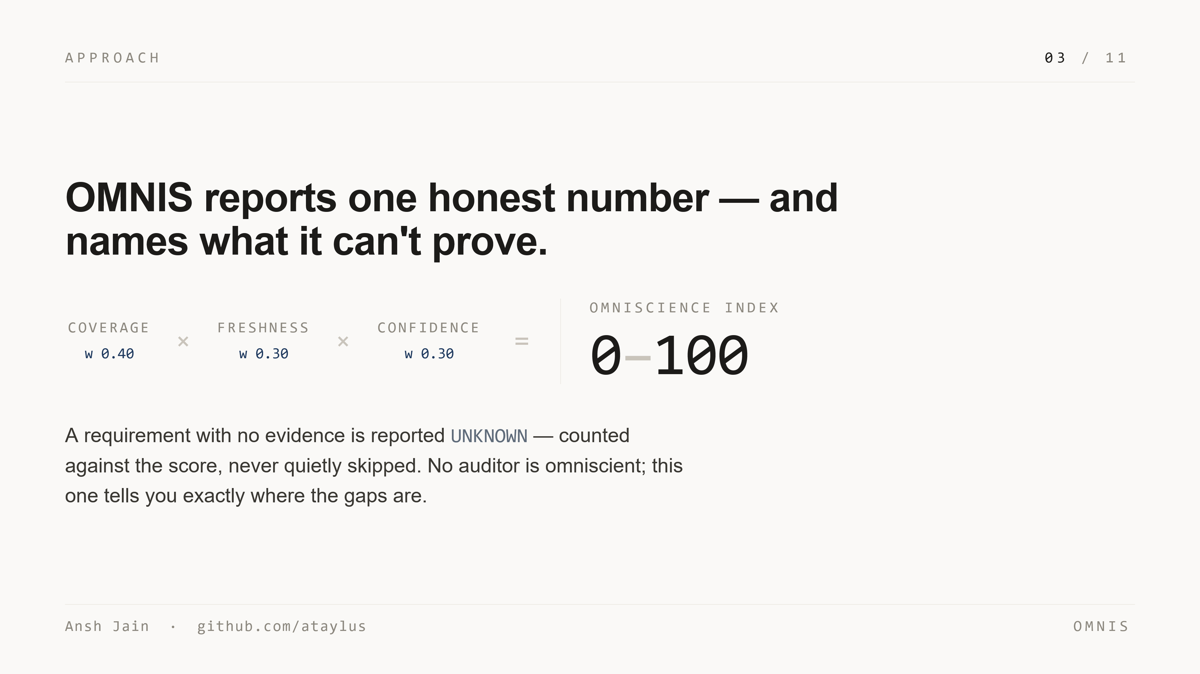
Notes:
OMNIS does that hunt in under a second, and reports one honest number. Point it at the policies and the evidence pile; it pulls out every requirement, links each to its proof, and rolls coverage, freshness, and confidence into the Omniscience Index — nought to a hundred. The philosophy is the difference: a requirement with no evidence is reported UNKNOWN and counted against the score. It quantifies what it doesn't know instead of hiding it.

Slide 4
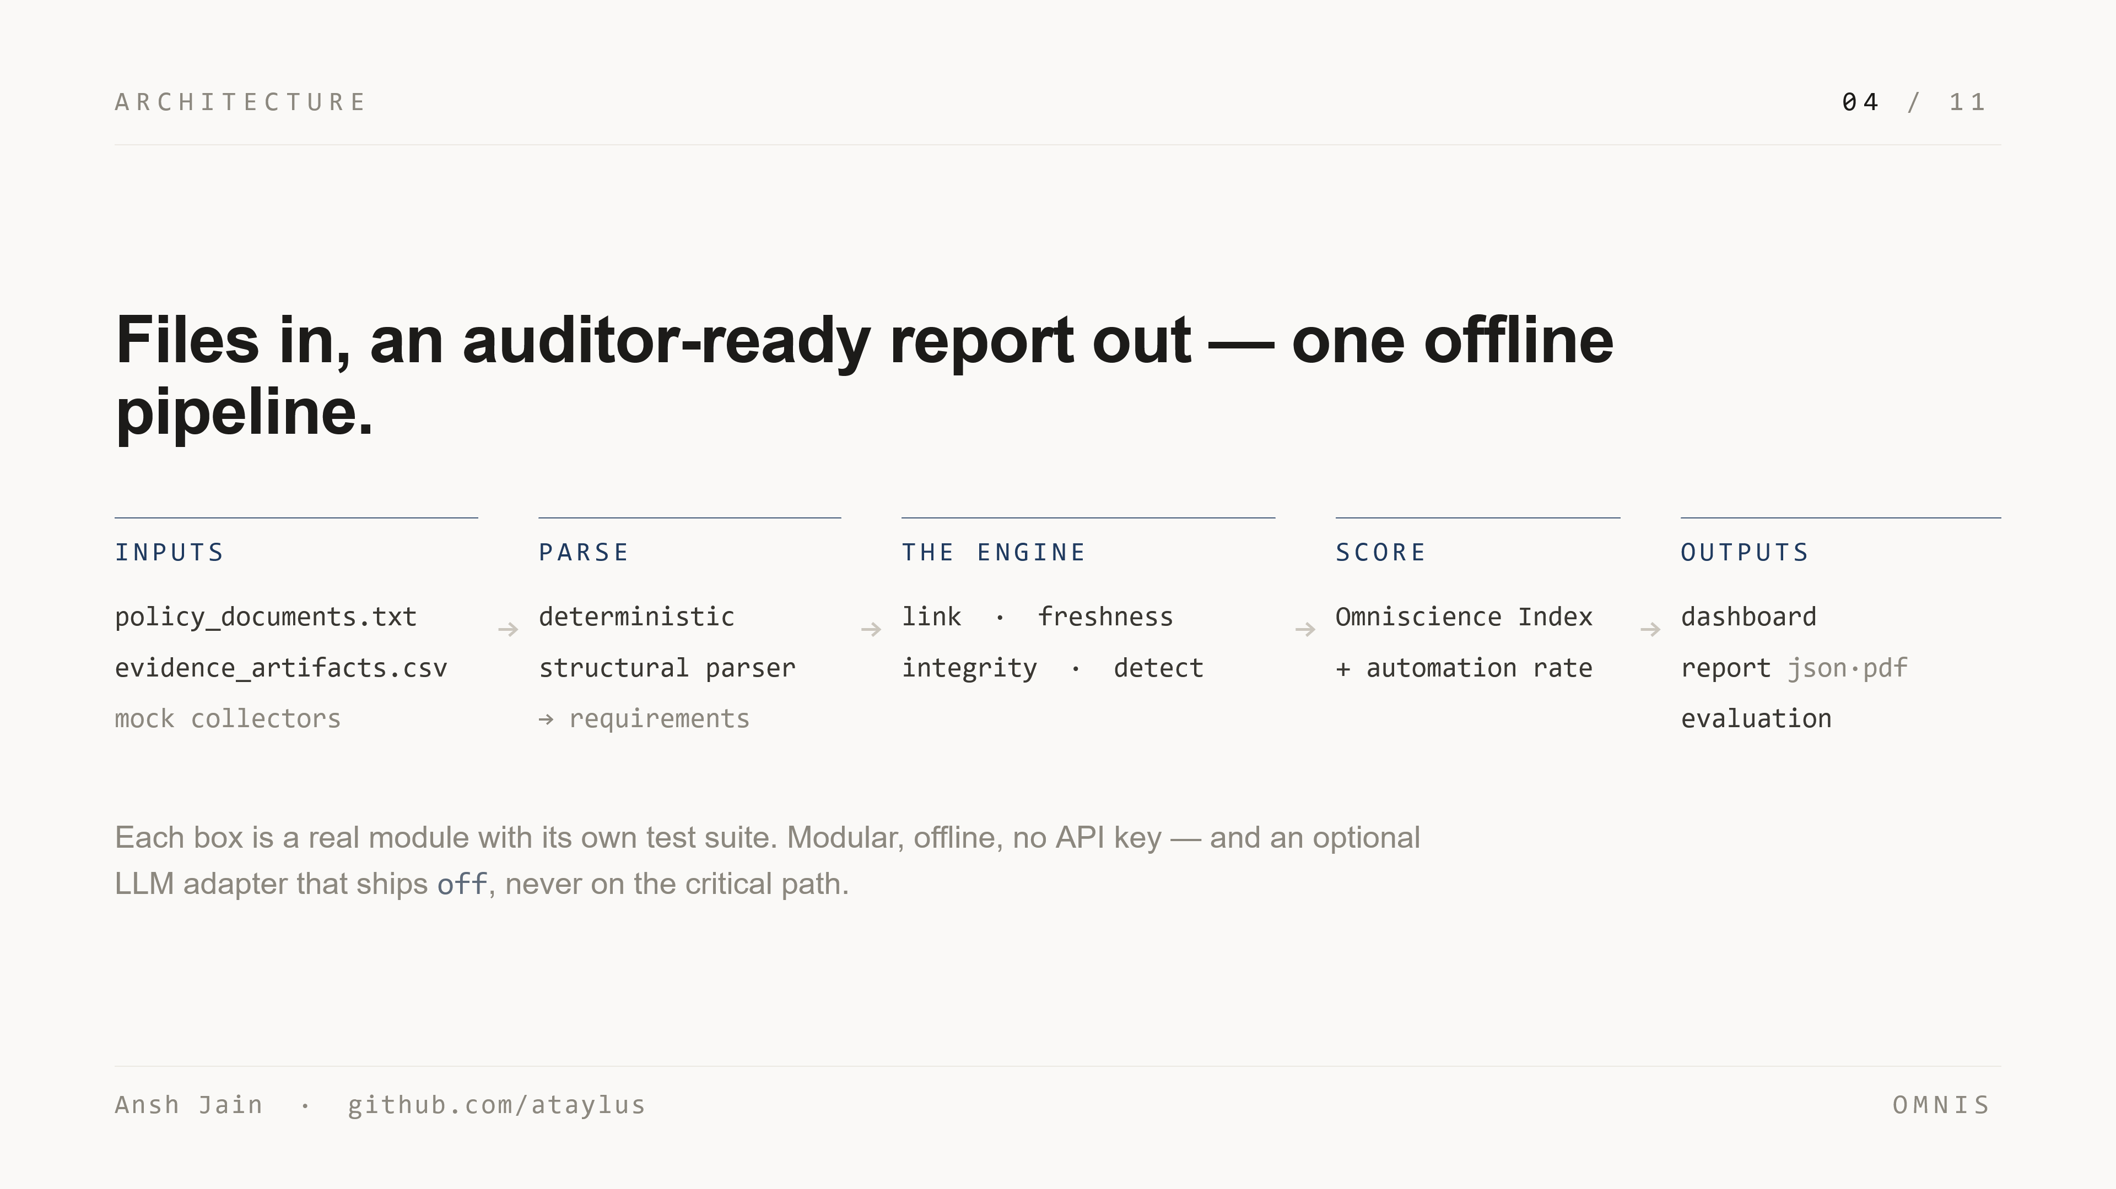
Notes:
Architecturally it's one pipeline, files in and an auditor-ready report out. Policies and evidence are parsed deterministically. The engine then links evidence to requirements, computes freshness, audits corpus integrity, and detects anomalies. Scoring rolls it into the Index and an automation rate, and three surfaces come out: a dashboard, a typeset report, and an evaluation. Each box is a real module with its own test suite. It's modular, offline, and needs no API key.

Slide 5
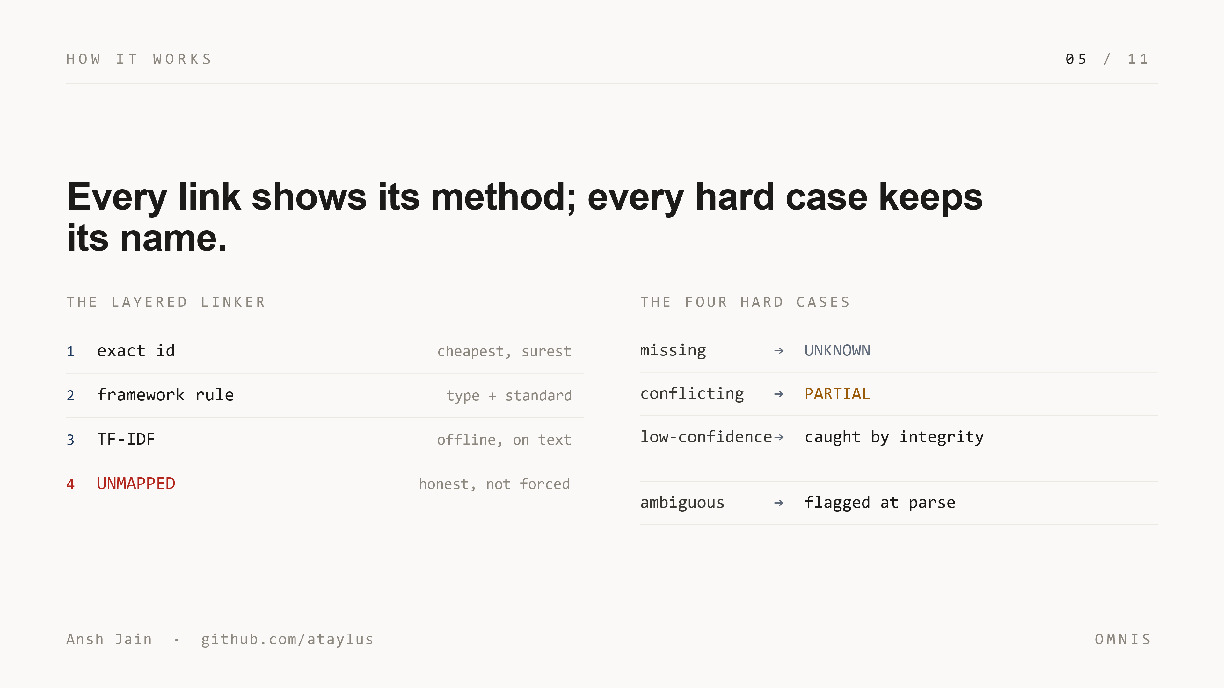
Notes:
The intelligence is in showing its work. Linking is layered: try the exact ID, then framework and type rules, then offline TF-IDF on the text — and if nothing fits, it says UNMAPPED rather than guessing. Every link carries the method that found it and a confidence. And the four hard cases the brief names each keep their name: missing becomes UNKNOWN, conflicting becomes PARTIAL, low-confidence evidence is caught by the integrity auditor, and ambiguous requirements are flagged at parse time, before any evidence is even considered.

Slide 6
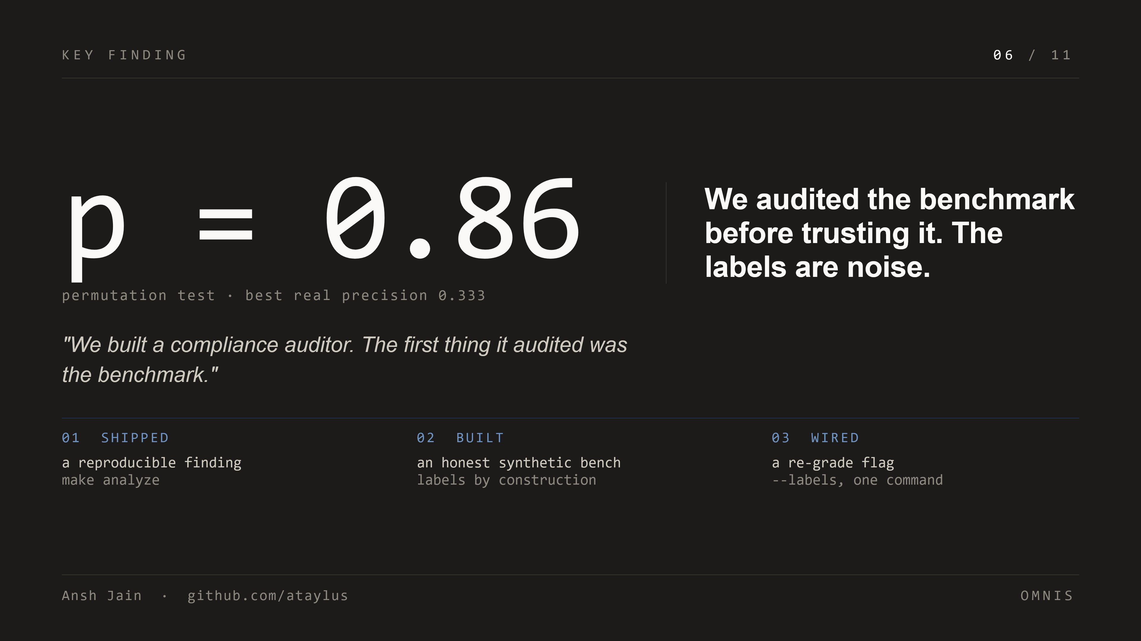
Notes:
Here's the thing I'm proudest of. The provided dataset has an anomaly_marker column — the supposed answer key for which records are bad. Before building against it, I tested it. A permutation test against every feature: p-value of 0.86. The labels predict nothing better than chance. The answer key was filled in with dice. So I shipped the finding as a reproducible script, built an honest synthetic bench, and wired a flag to re-grade the moment real labels arrive. I built a compliance auditor; the first thing it audited was the benchmark.

Slide 7
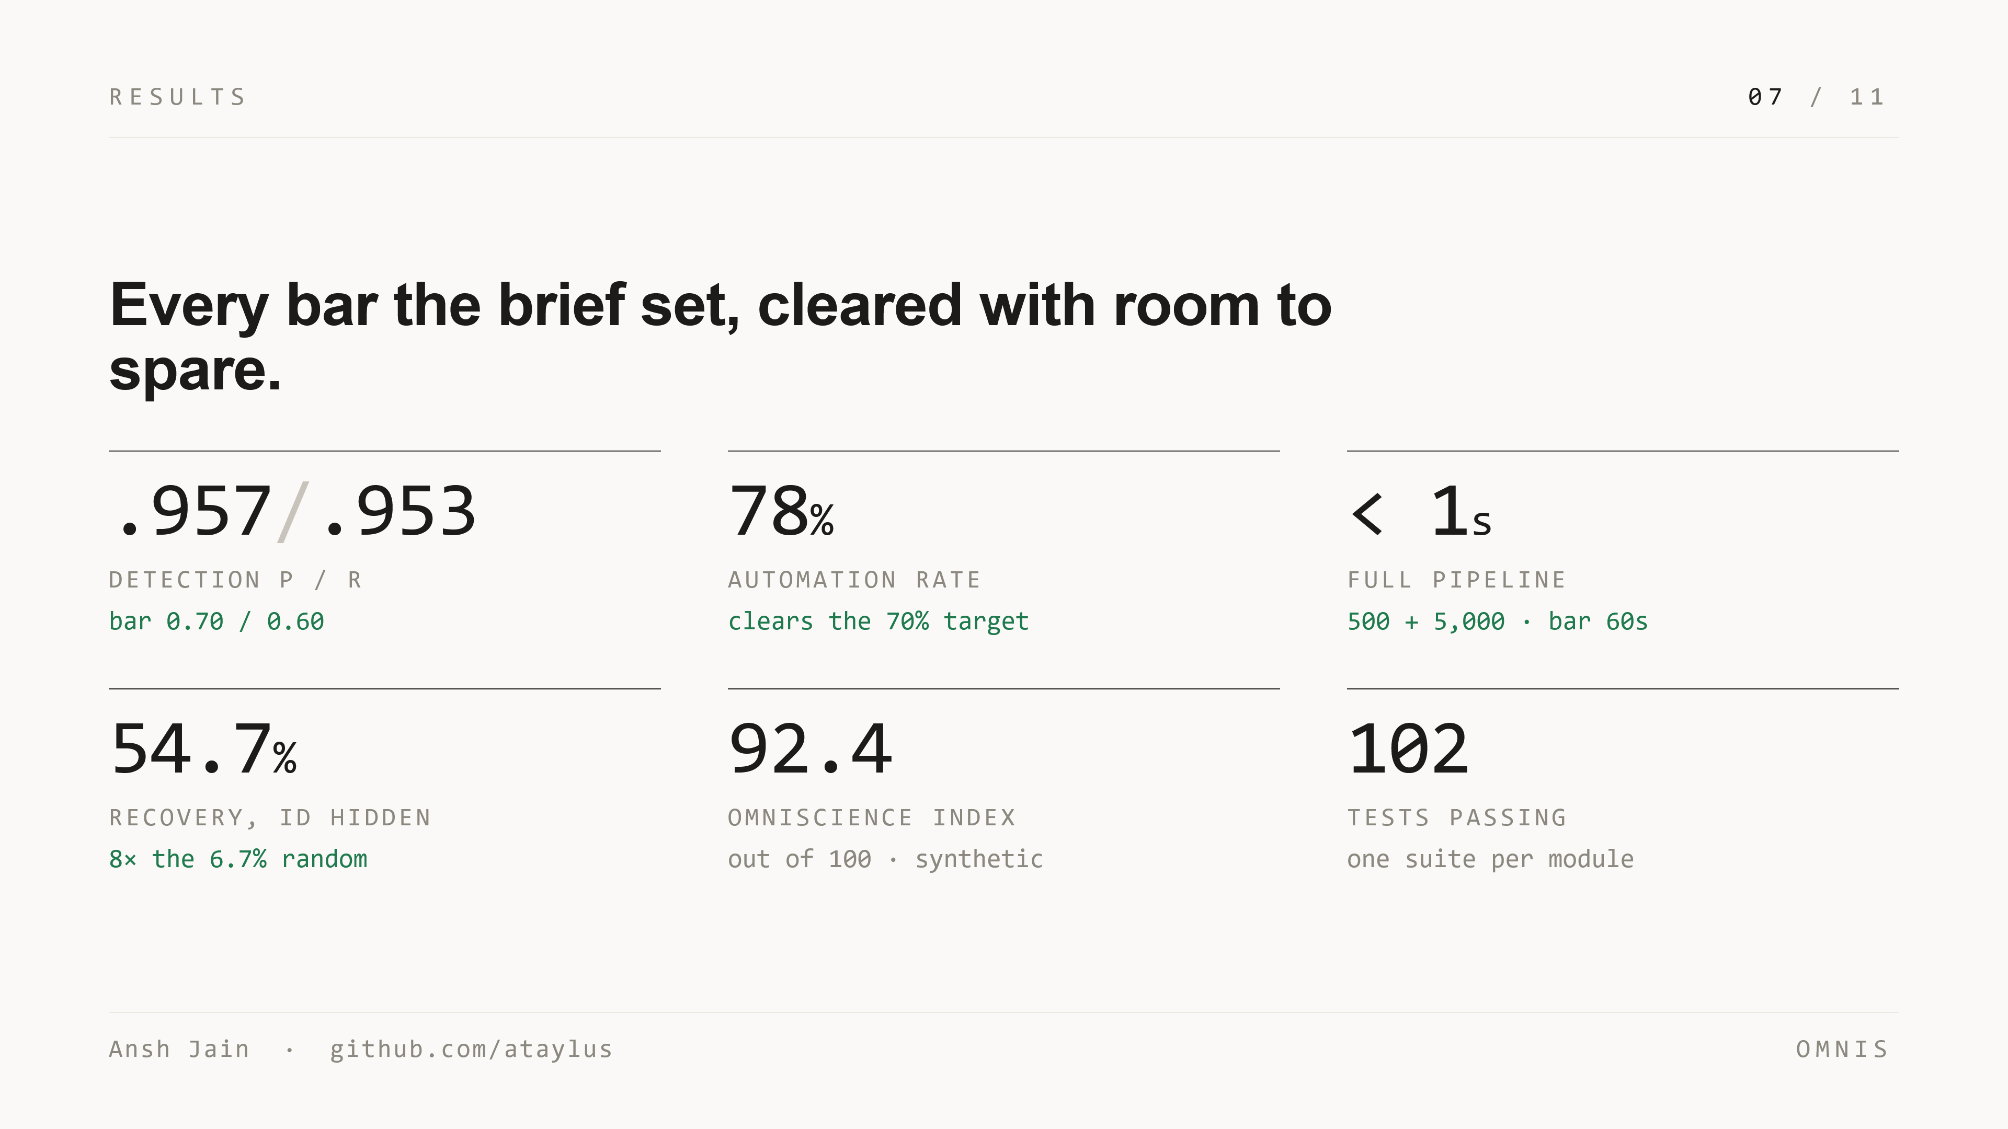
Notes:
Now the proof. Anomaly detection: precision 0.957, recall 0.953 — the bars were 0.70 and 0.60. With the requirement ID hidden, the content layers recover the right requirement 54.7% of the time, eight times the random baseline. Automation 78%, clearing the 70% target. The Omniscience Index 92.4. The full pipeline runs 500 requirements and 5,000 evidence records in under a second — the bar was sixty. And a hundred and two tests, all passing, one suite per module.

Slide 8
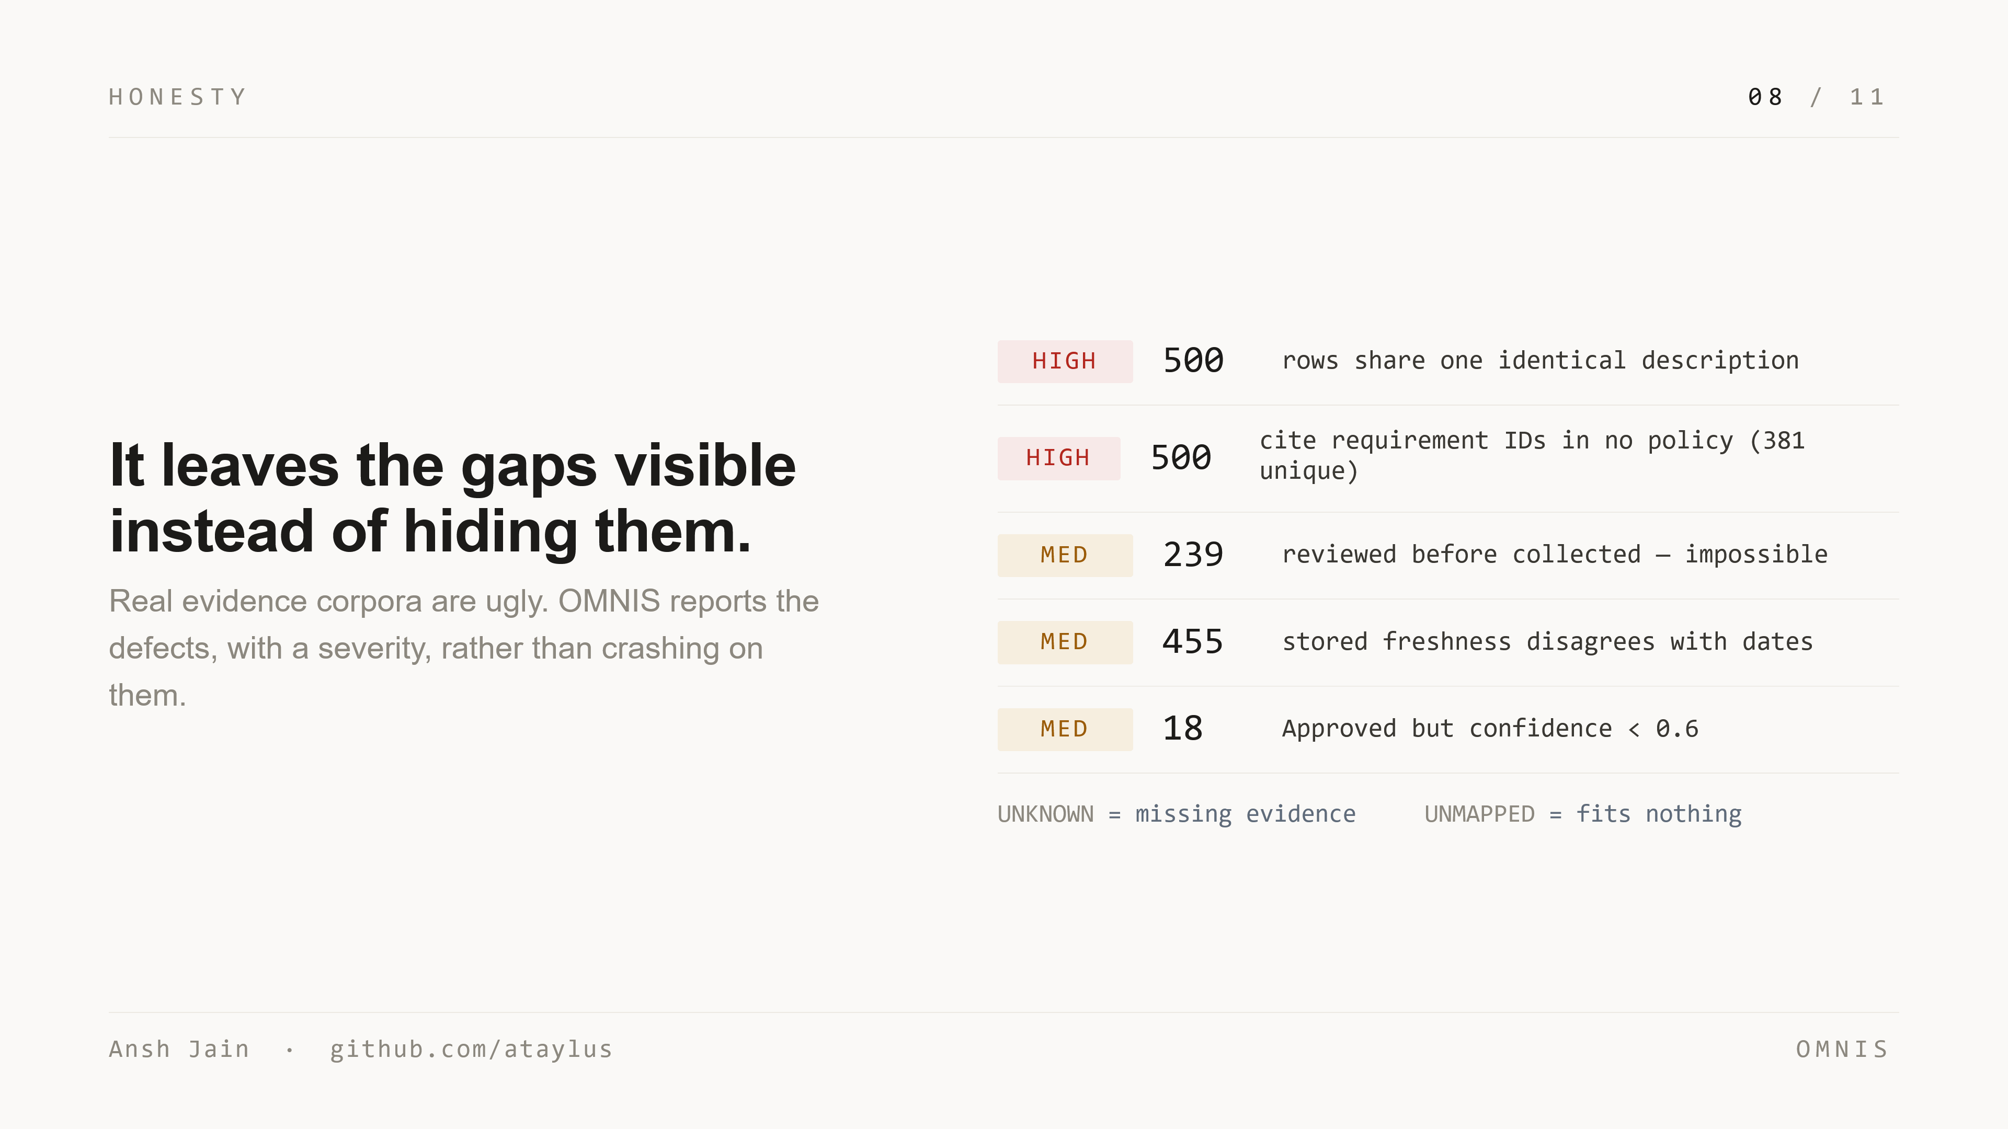
Notes:
And it's honest about ugliness. The provided corpus is deliberately broken — and a tool for real audits has to expect that. All 500 rows share one identical description. Hundreds cite requirement IDs in no policy. 239 were reviewed before they were collected — an impossible date order. 455 carry a stored freshness value that disagrees with their own dates. 18 are approved but low-confidence. A fragile tool dies on this. OMNIS tags each defect with a severity and reports it as a data-quality finding instead of crashing.

Slide 9
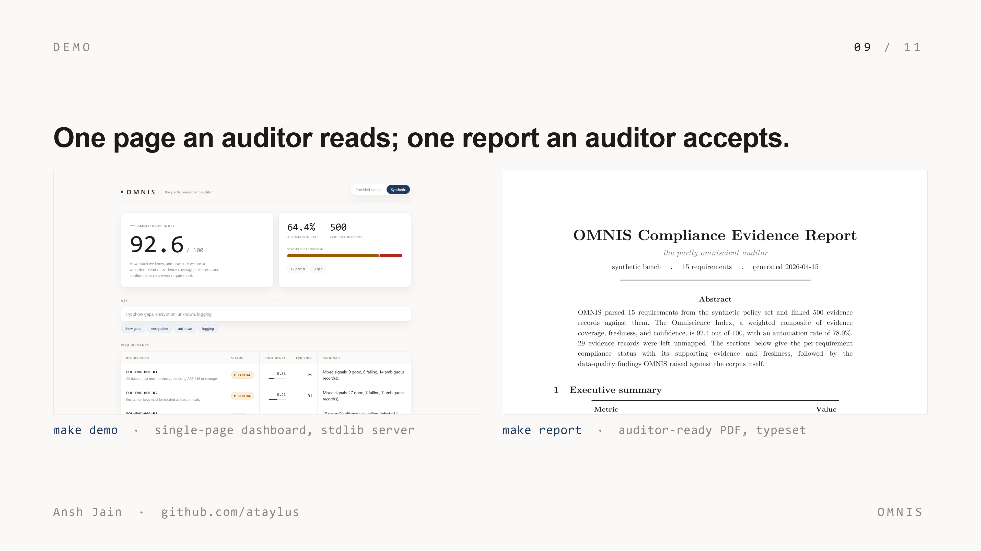
Notes:
Here's what an auditor actually touches. On the left, the single-page dashboard — one Omniscience Index, the status of every requirement, the linked evidence, and the data-quality findings, served from one stdlib HTML file with no build step. On the right, the auditor-ready report, typeset in the LaTeX typeface: executive summary, a section per requirement, and an integrity appendix. Both are shown live in the video.

Slide 10
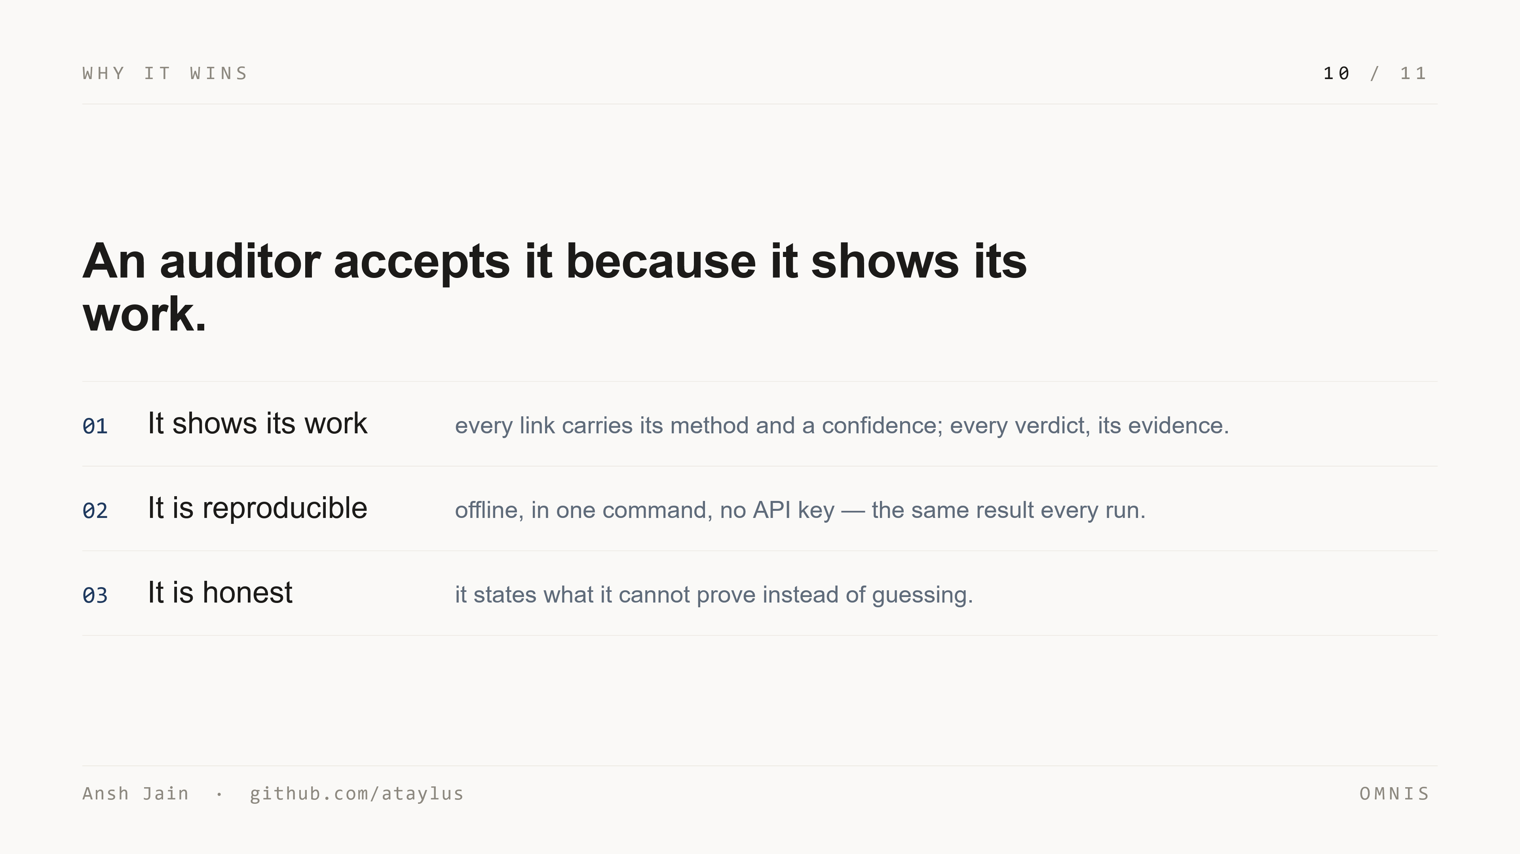
Notes:
So why would an auditor accept this. Three reasons. It shows its work — every link carries its method and a confidence, every verdict its evidence. It's reproducible — offline, in one command, no API key, the same result every run. And it's honest — it states plainly what it cannot prove rather than guessing. Quietly, that's why it should win.

Slide 11
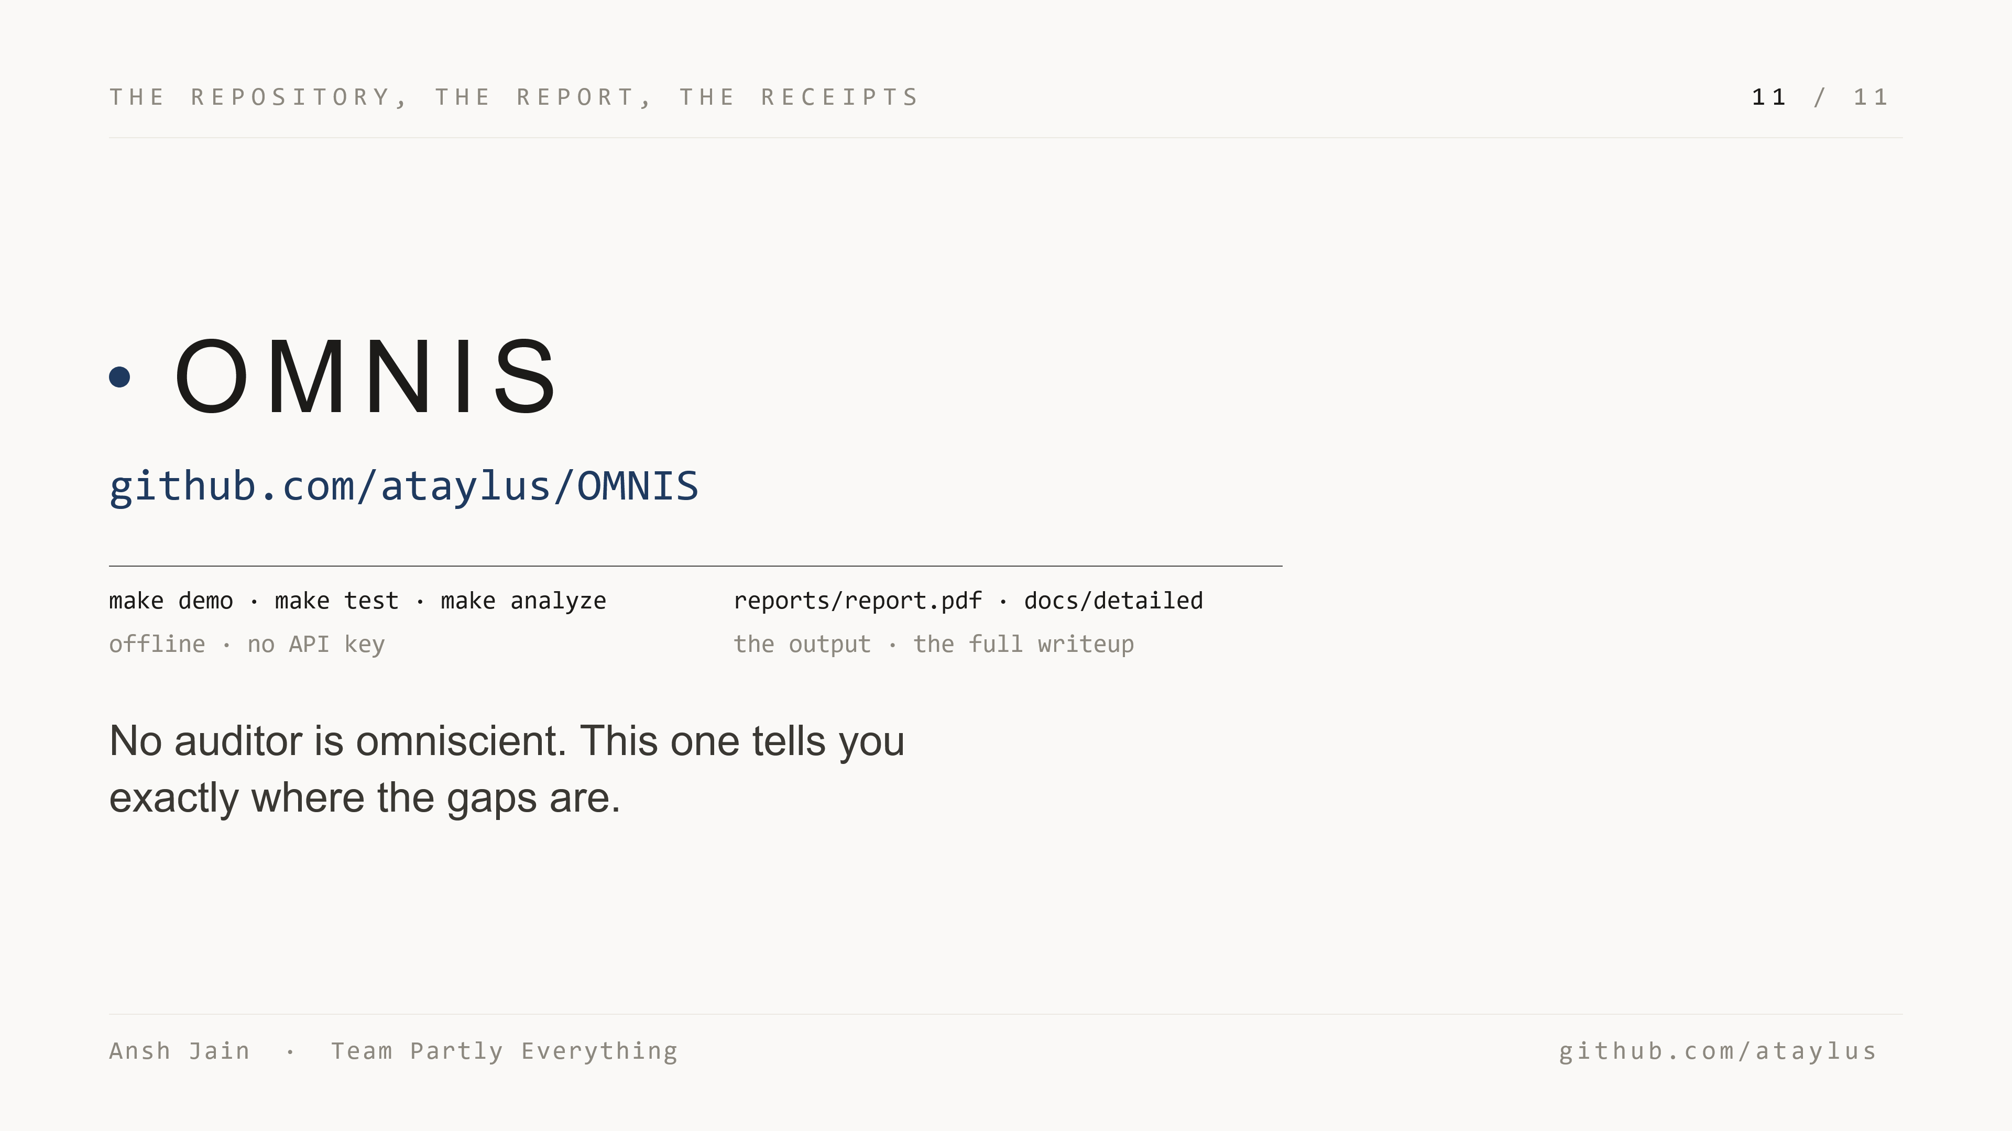
Notes:
It's all in the repository — clone it, then make demo, make test, make analyze. The committed report PDF is the auditor-ready output, and the detailed docs are the full design writeup. Everything runs offline, no API key. I'm Ansh Jain, team Partly Everything. No auditor is omniscient — this one tells you exactly where the gaps are. Thank you.

