Slide 1
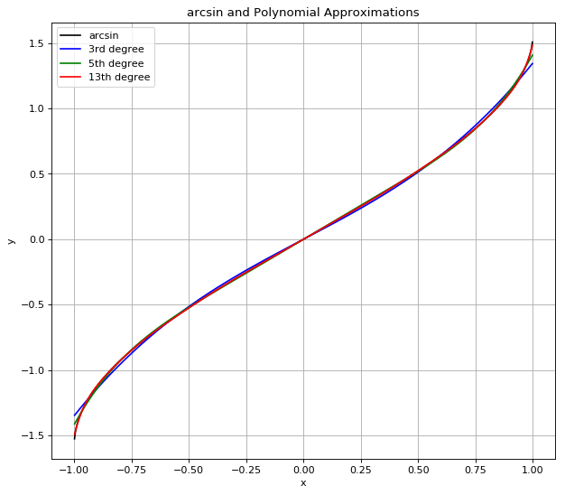
Where To Use Scinet?
Short Answer: with functions where interpolations usually work, like arcsin.

Slide 2
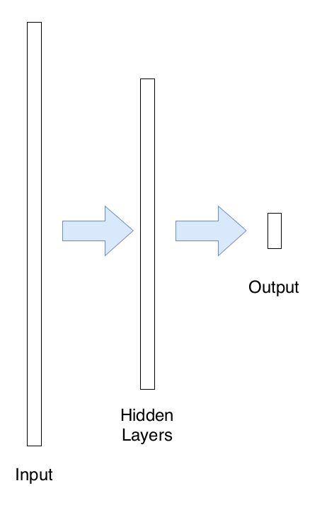
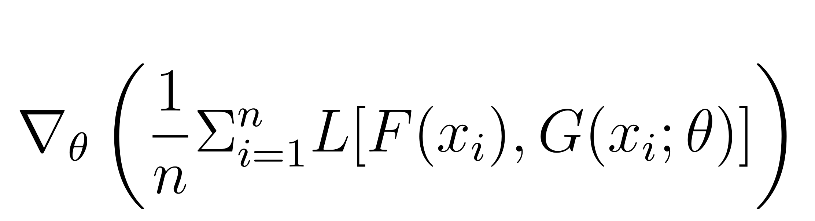
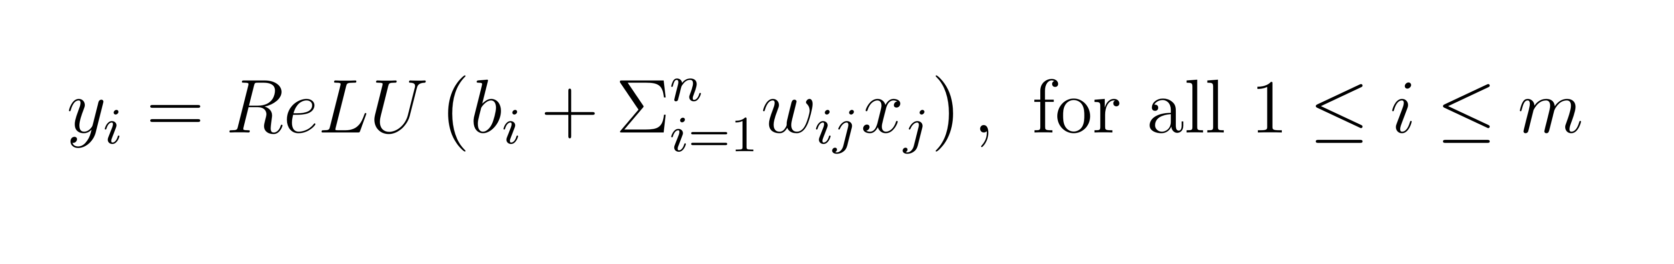
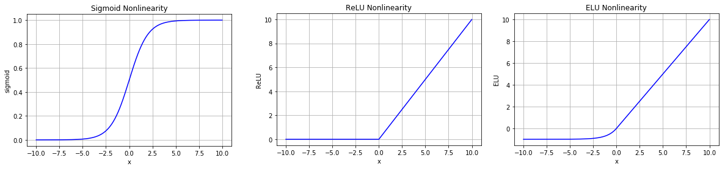
Neural Nets
Gradient Descent, samples x_i
Output of 1 f.c. layer, ReLU nonlinearities
Sample NN architecture

Slide 3
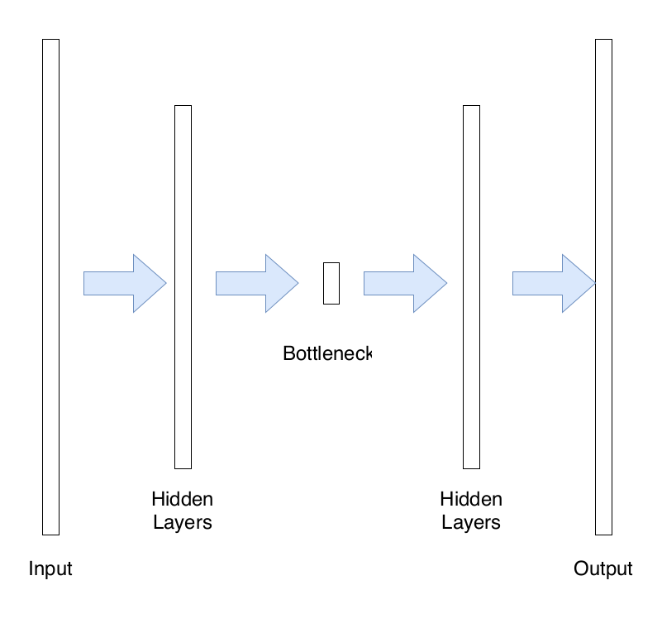
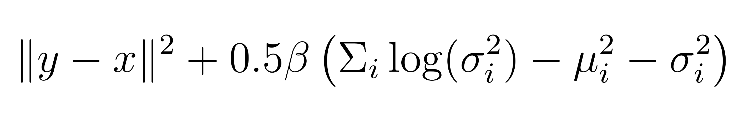
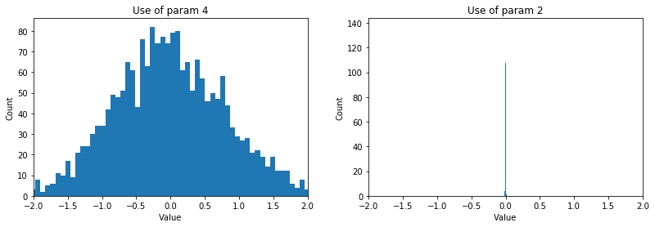
βVAE Architecture
Loss Function
Autoencoder

Slide 4
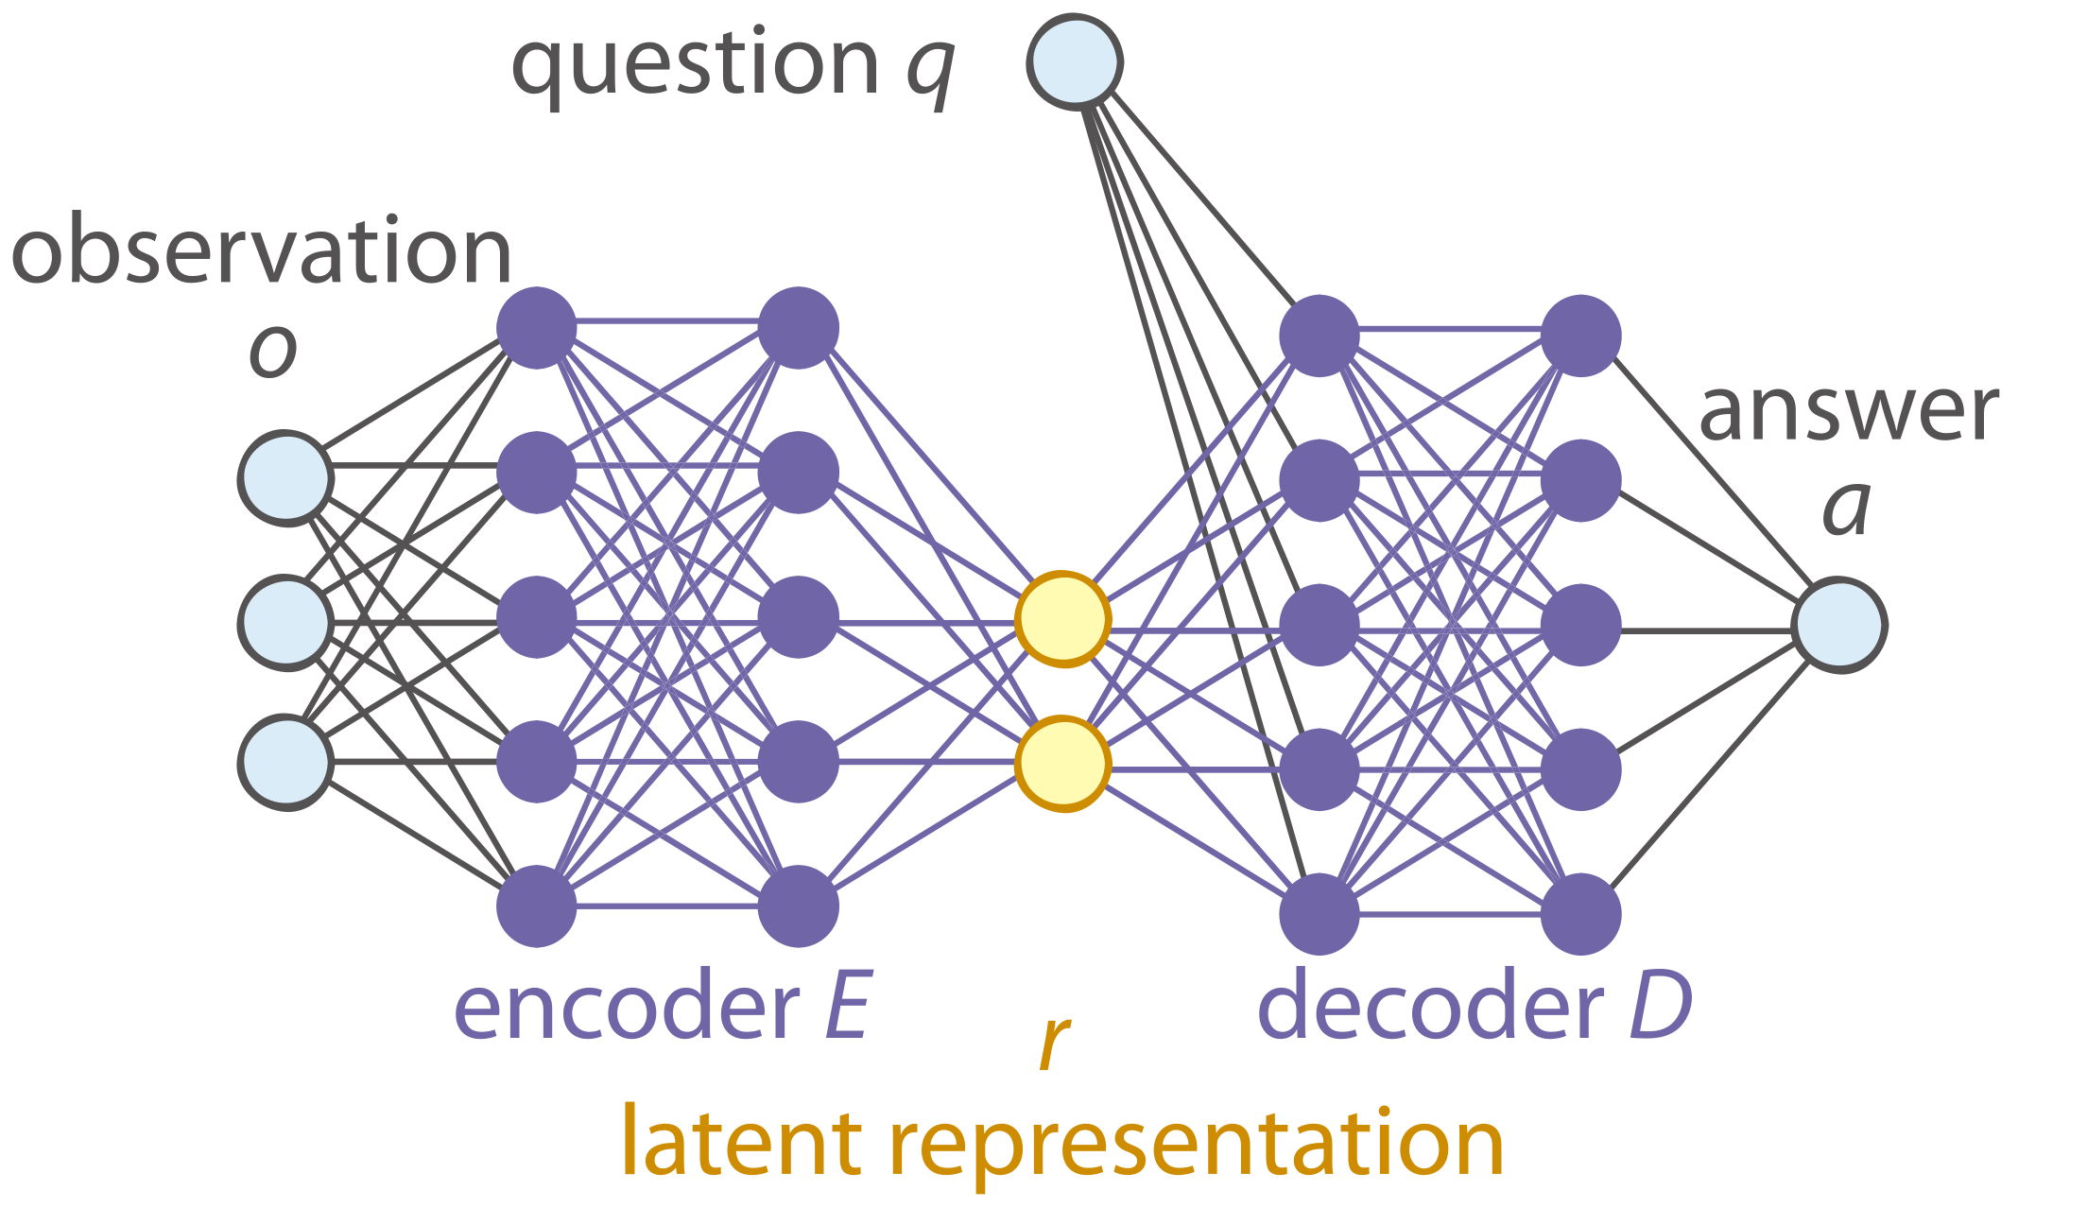
SciNet Architecture

Slide 5
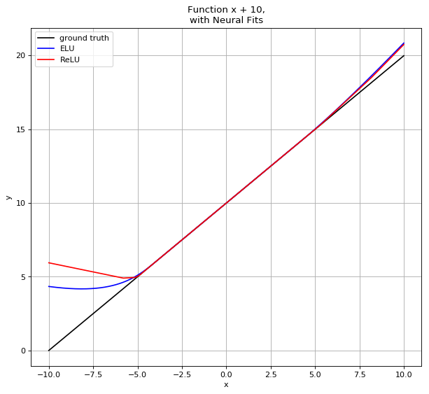
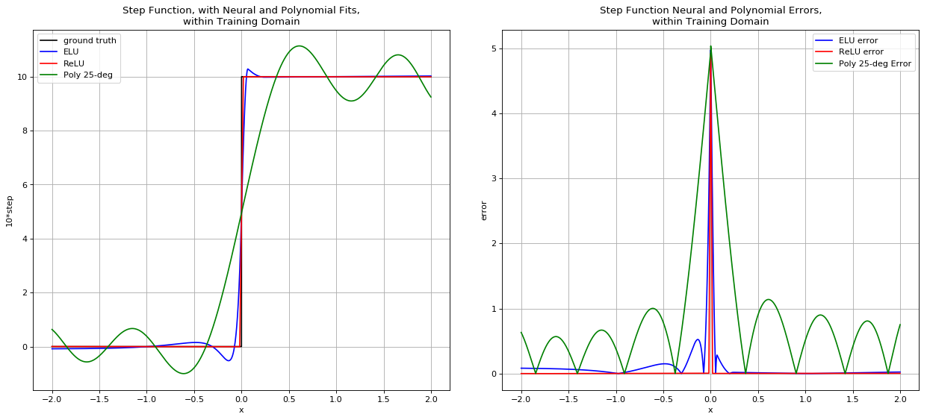
Neural vs Polynomial Fits

Slide 6
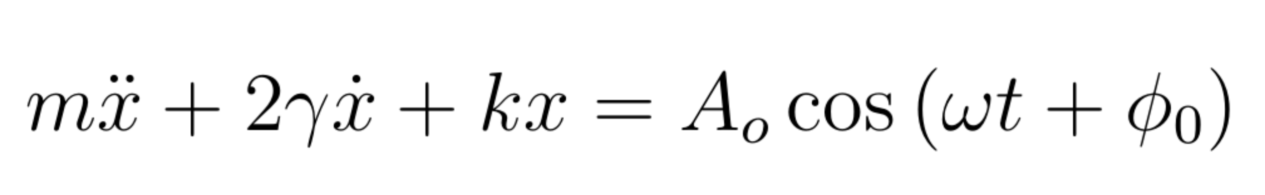
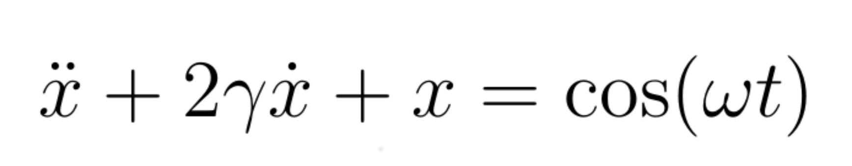
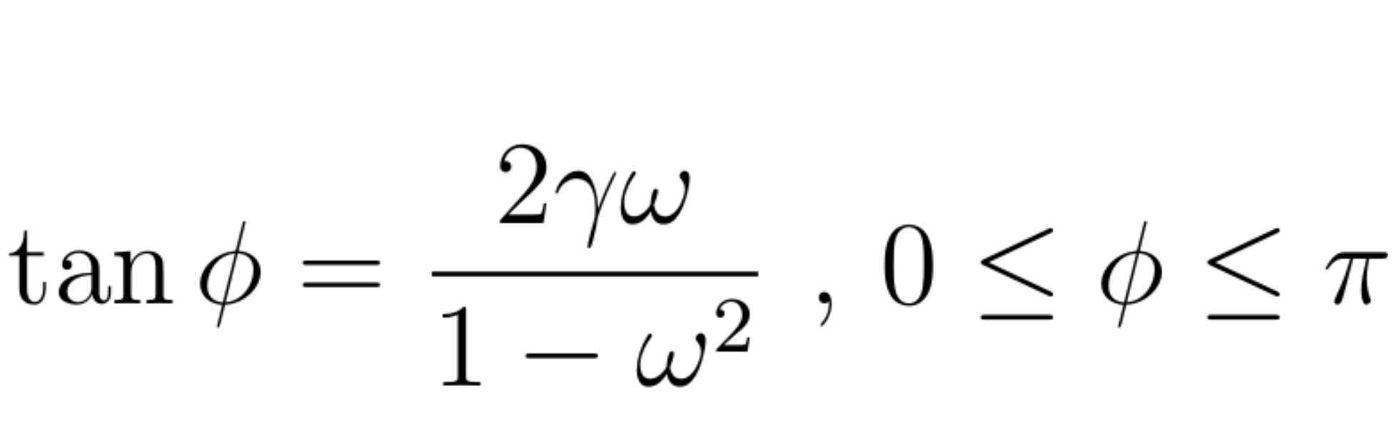
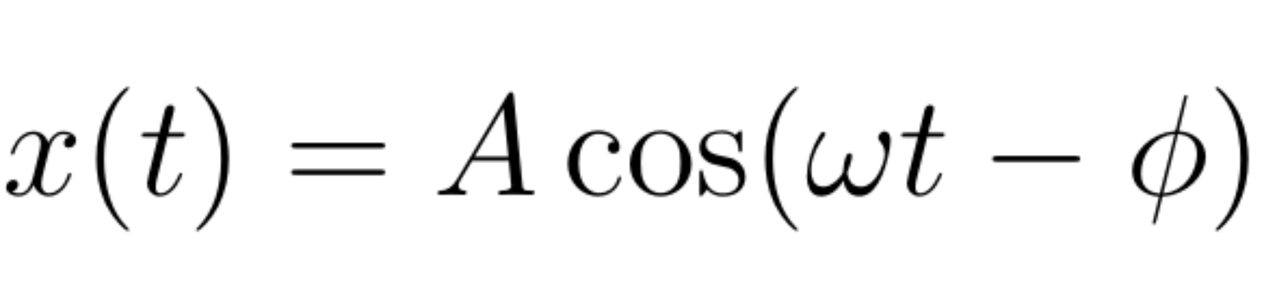
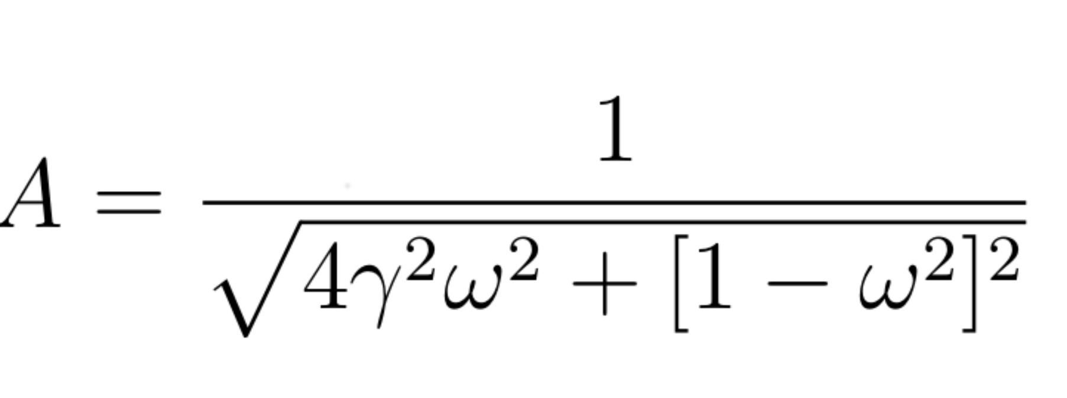
The Driven Damped Oscillator
Original Equation
Simplified Equation
Stable Solution

Slide 7
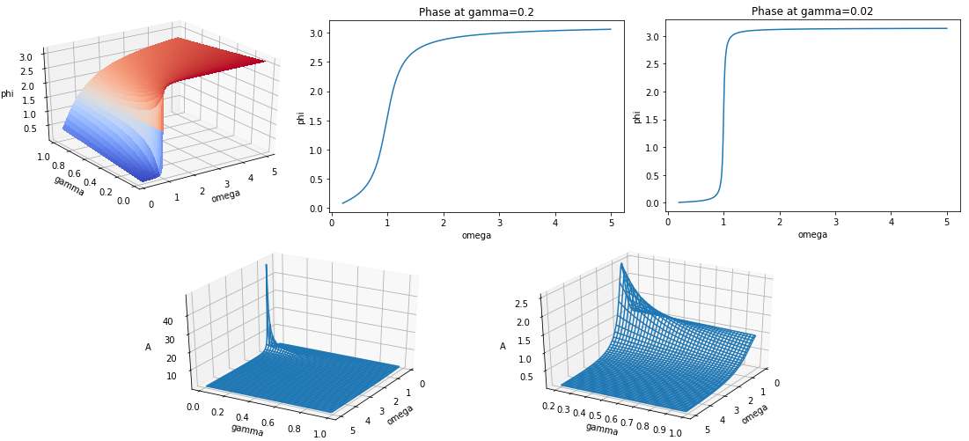
Ground Truth Functions

Slide 8
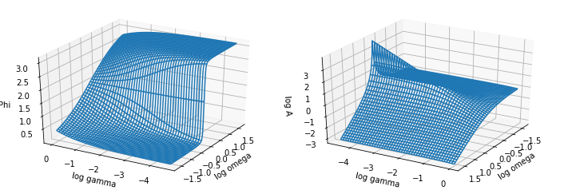
Ground Truth Functions, Logspace

Slide 9
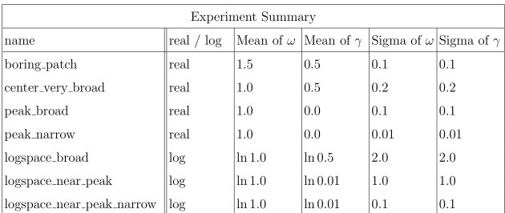
Table of Experiments

Slide 10
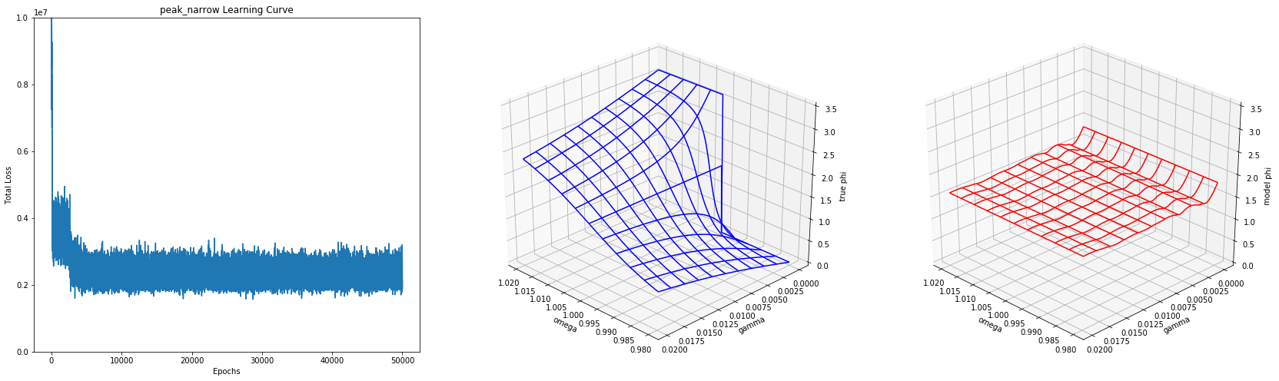
peak_narrow

Slide 11
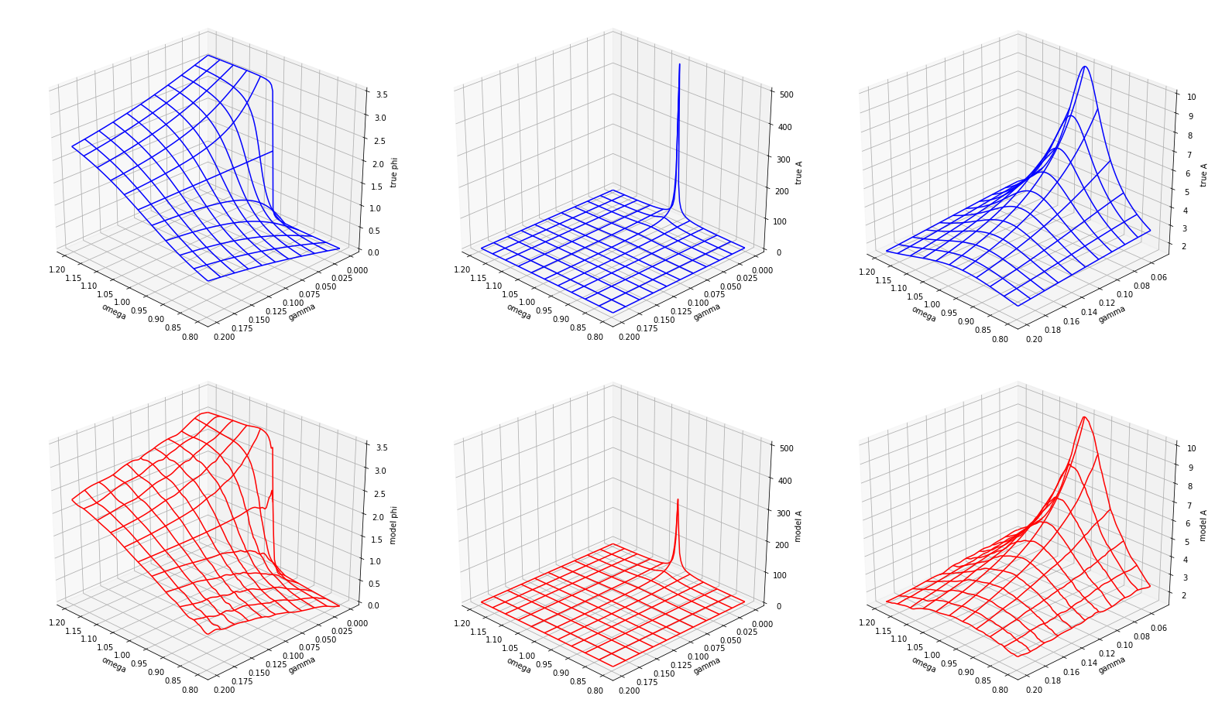
peak_broad

Slide 12
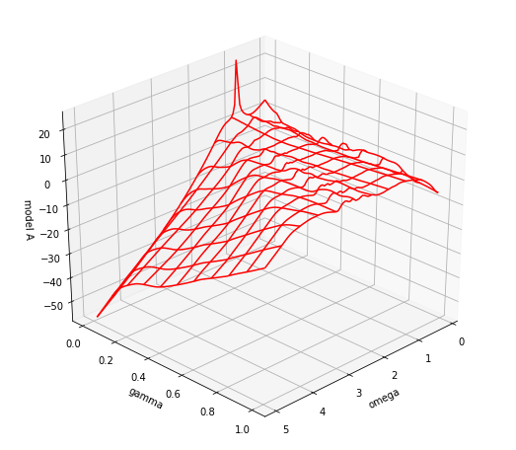
peak_broad Extrapolation

Slide 13
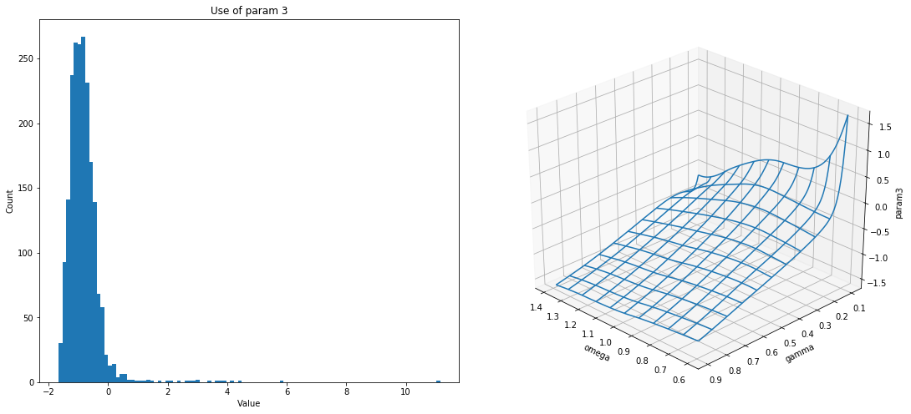
Typical Parameters (center_very_broad param3)

Slide 14
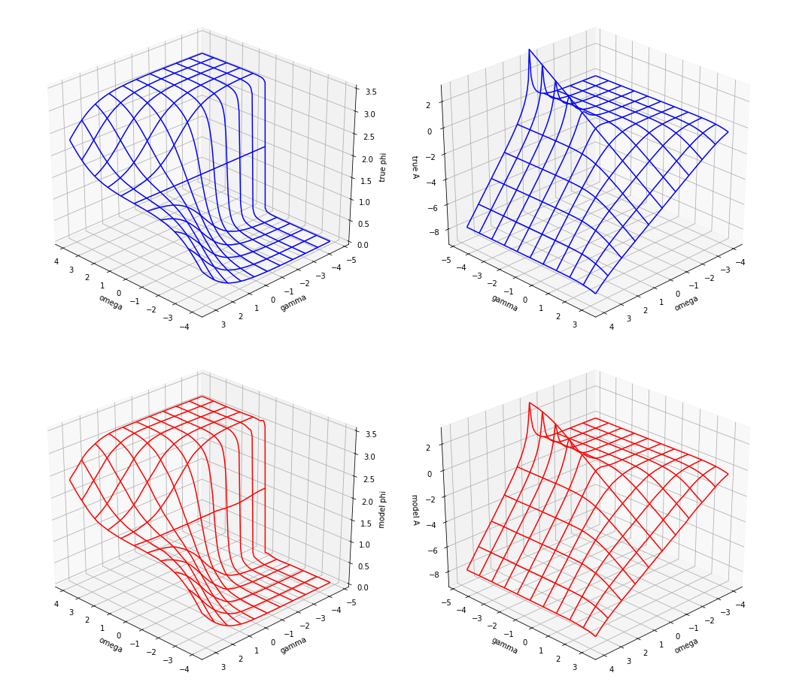
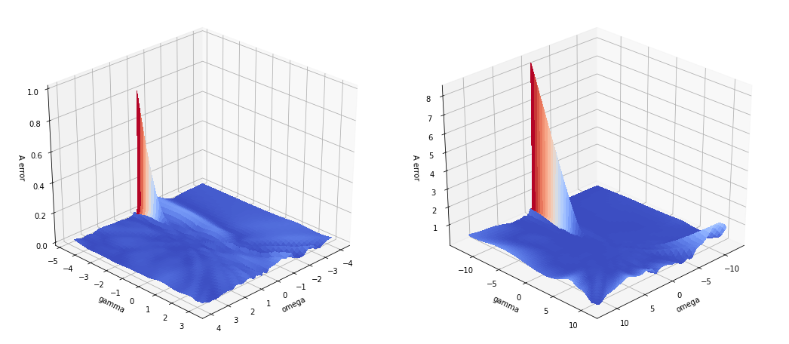
No Ridge for log_broad
logspace_broad errors in ln A
On-domain (left)
Extrapolation (right)
logspace_broad, ground truth and model output

Slide 15
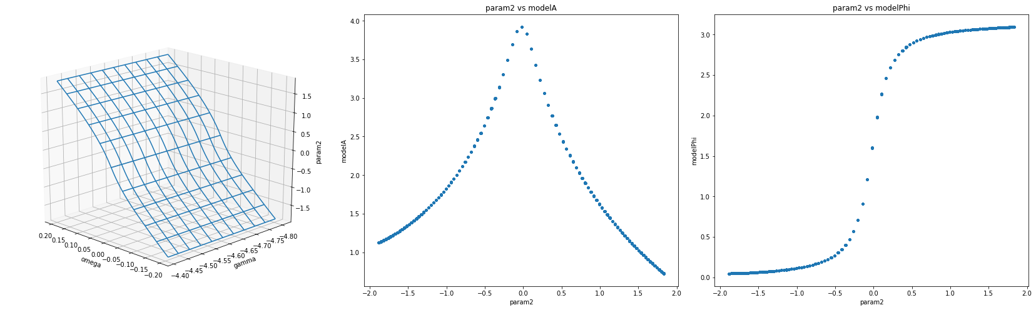
Too Few Latent Parameters logspace_near_peak_narrow

Slide 16
Conclusion
Neural Networks generally, and SciNet specifically, are powerful curve-fitting tools. Given time, they might become as ubiquitous and useful as polynomials and Fourier fits.
The authors are certainly not “Discovering Physical Concepts with Neural Networks.” Their curve-fitting technique, like all curve-fitting techniques, has many drawbacks.
A researcher with a good understanding of both these drawbacks and physics theory can alleviate some of these difficulties with intelliegent pre-processing.

Slide 17
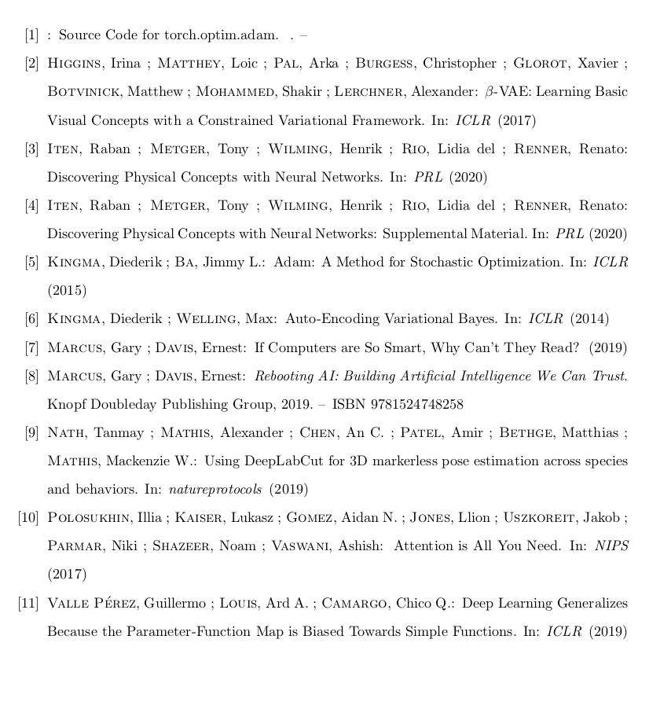
References

