Slide 1
Comparing Zebra Finch Song Learning to Generative Adversarial Imitiation Learning

Slide 2
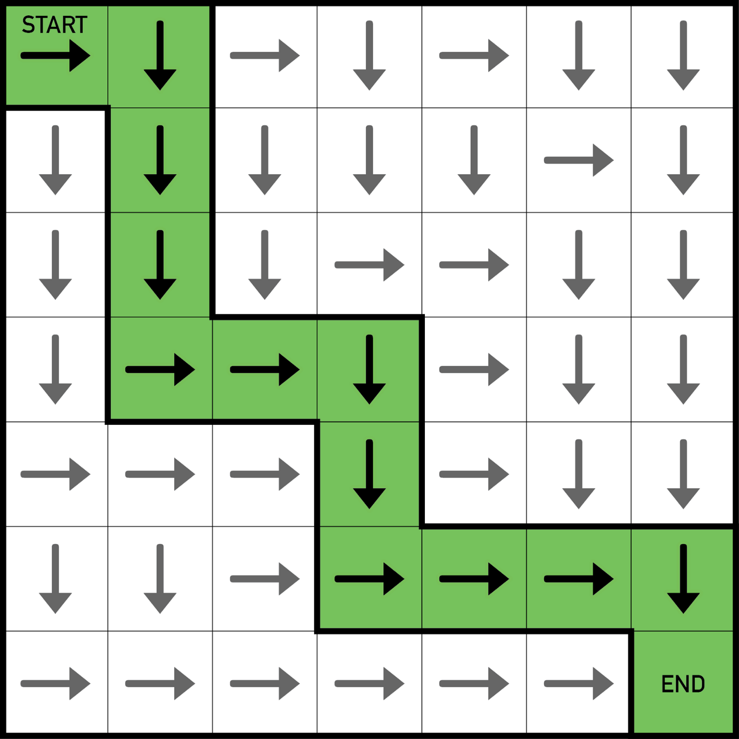
Reinforcement Learning
It’s a problem with a collection of states S, initial state s₀ ∈ S, actions A, a reward function r(s, a), a transition function that measures the probability of being in s’ after action a in state s (written p(s’ |s, a) ), and a discount rate γ. The goal is to choose a policy that always takes actions that maximize discounted future reward.
Below: a gridworld, from https://towardsdatascience.com/training-an-agent-to-beat-grid-world-fac8a48109a8

Slide 3
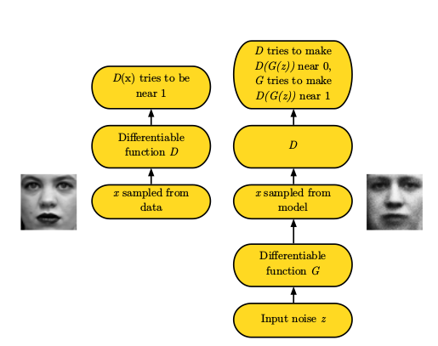
Generative Adversarial Networks

Slide 4
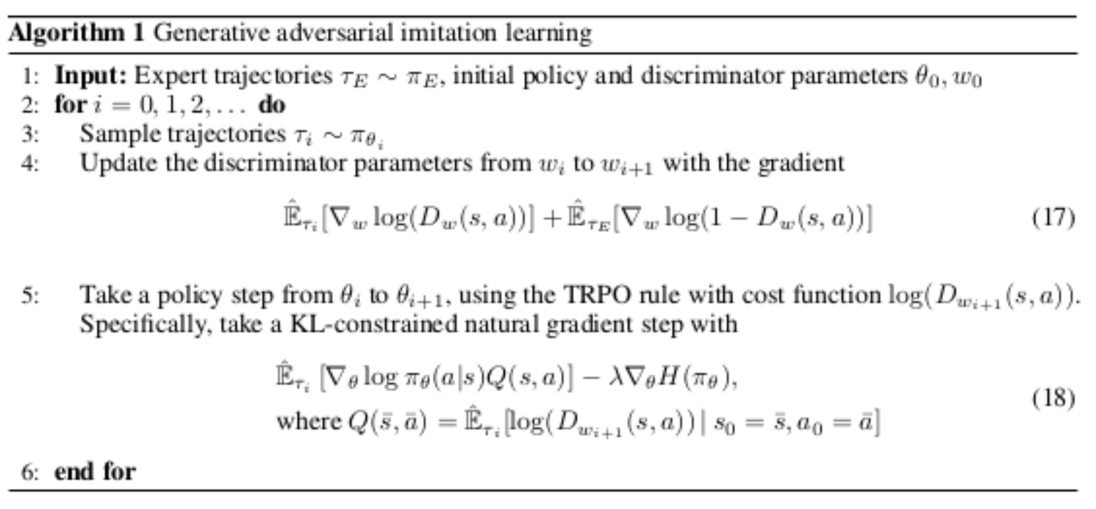
Inverse Reinforcement Learning and GAIL

Slide 5
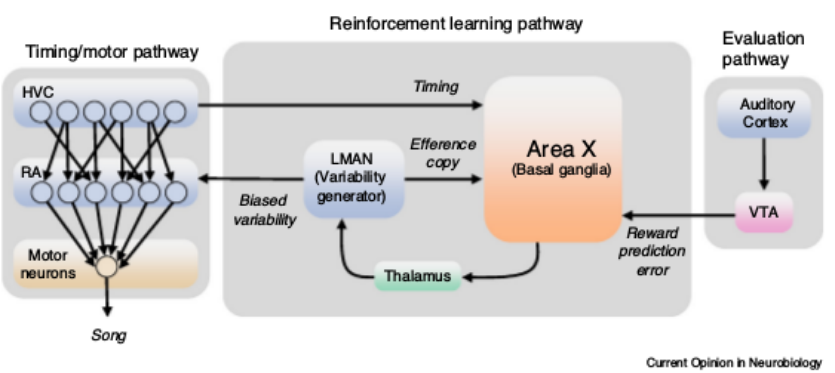
Zebra Finch Vocal Behavior and Neurology

Slide 6
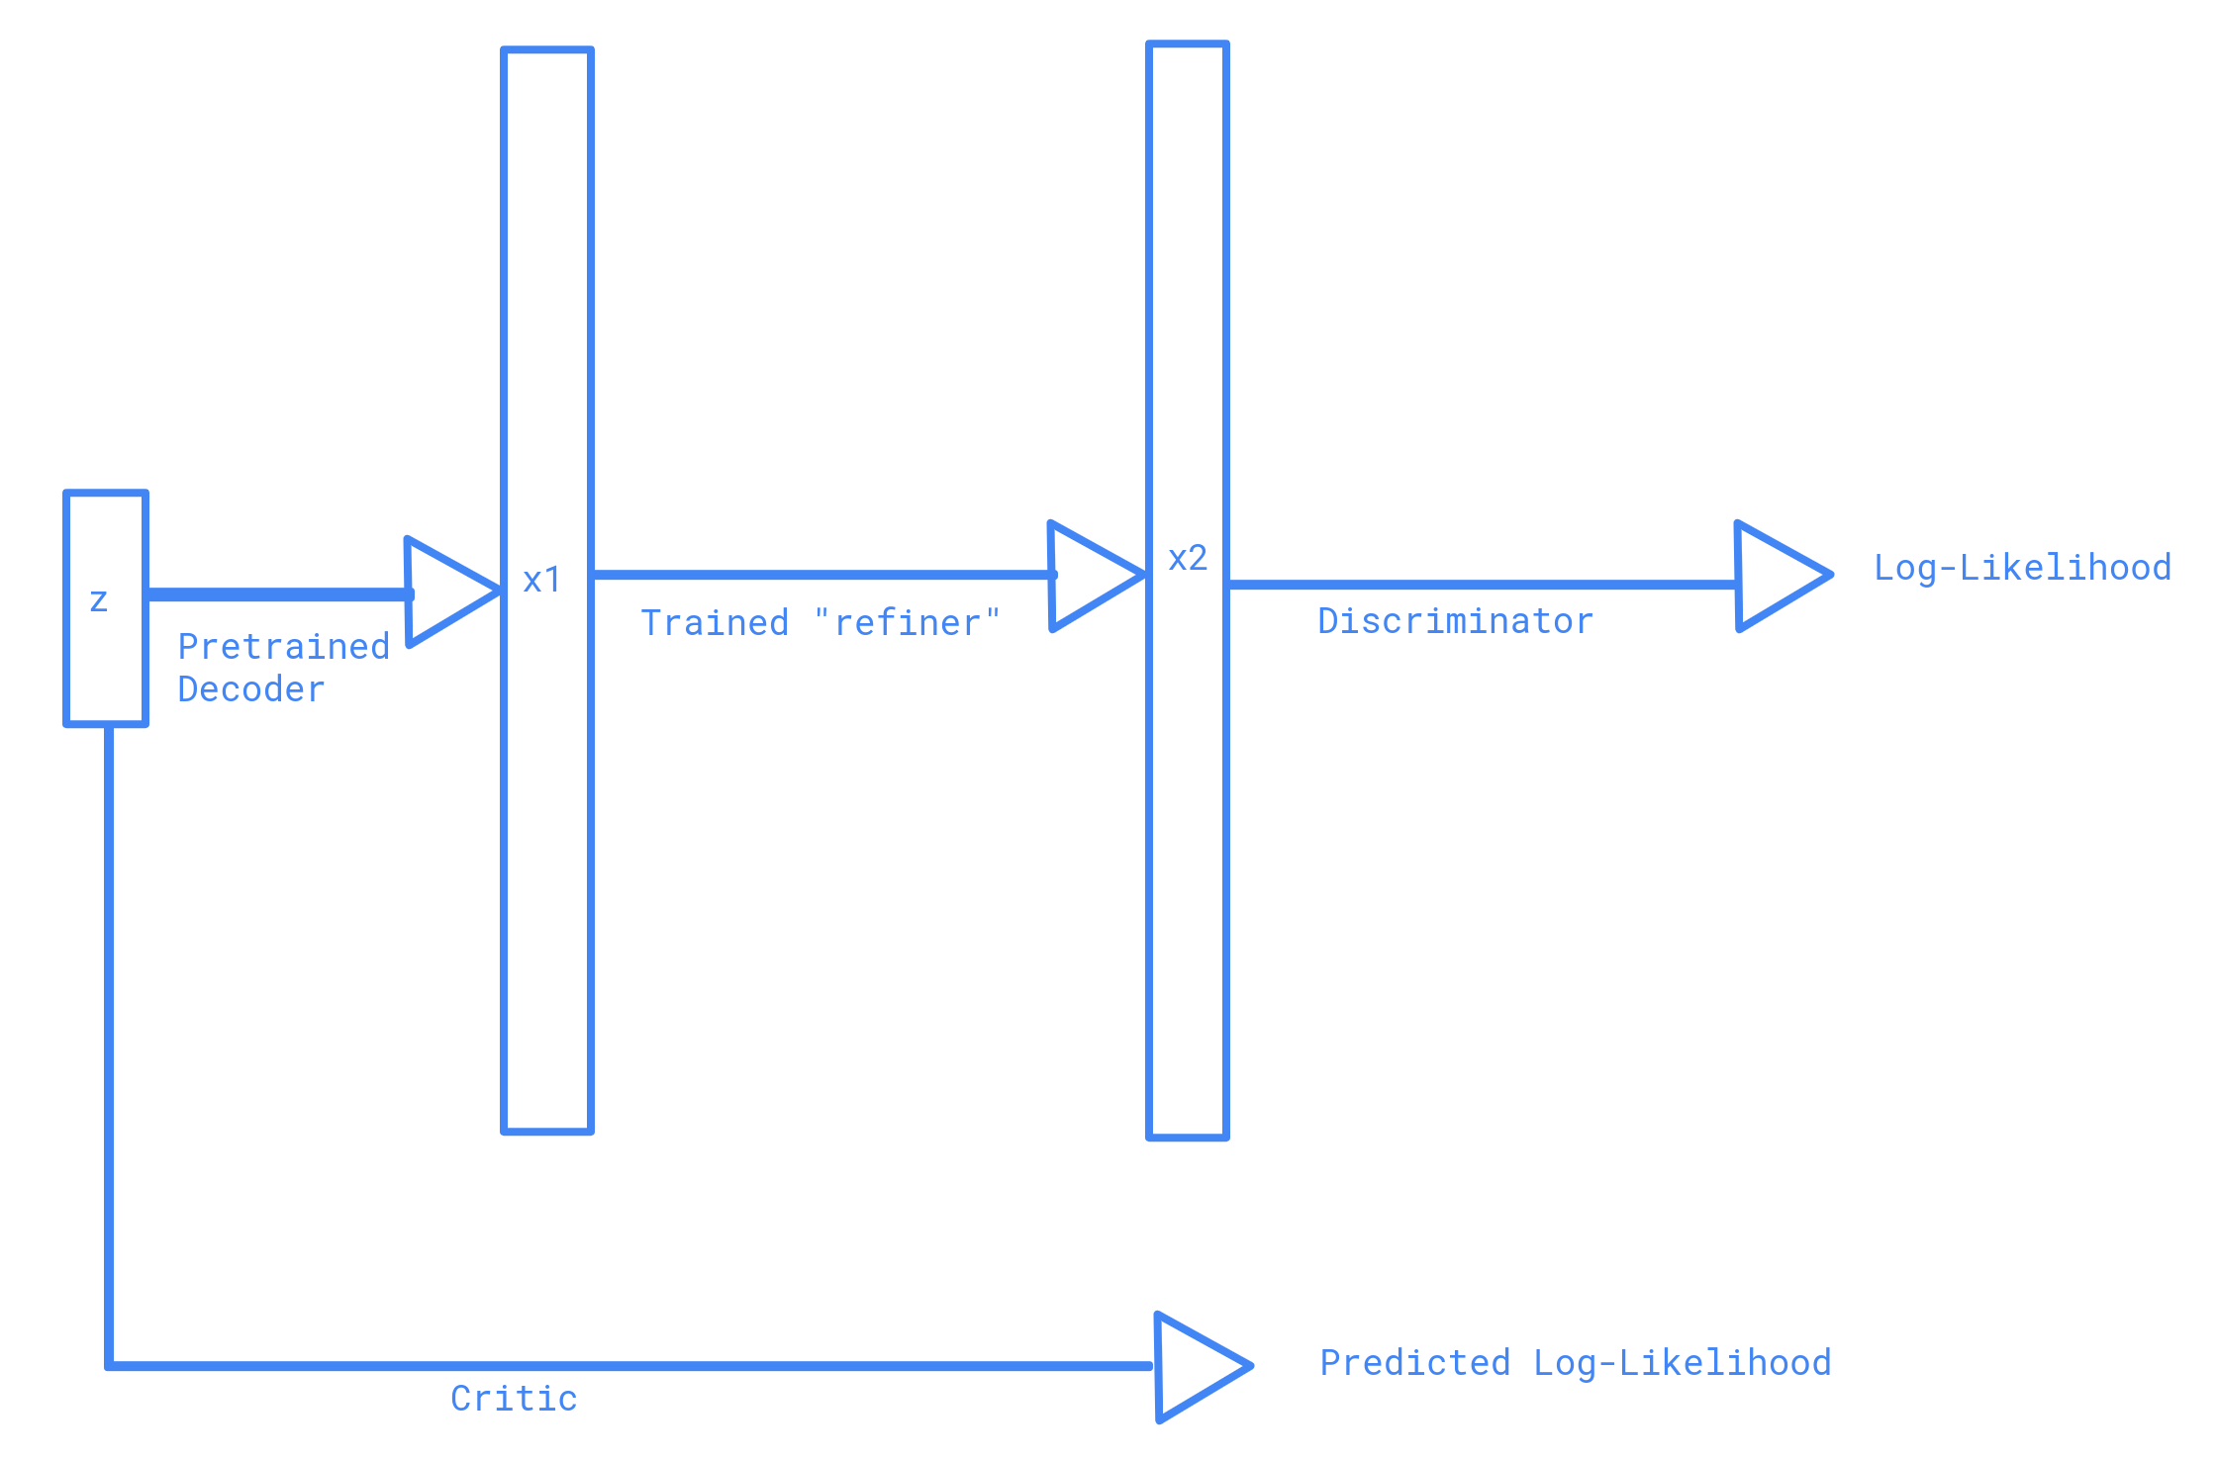
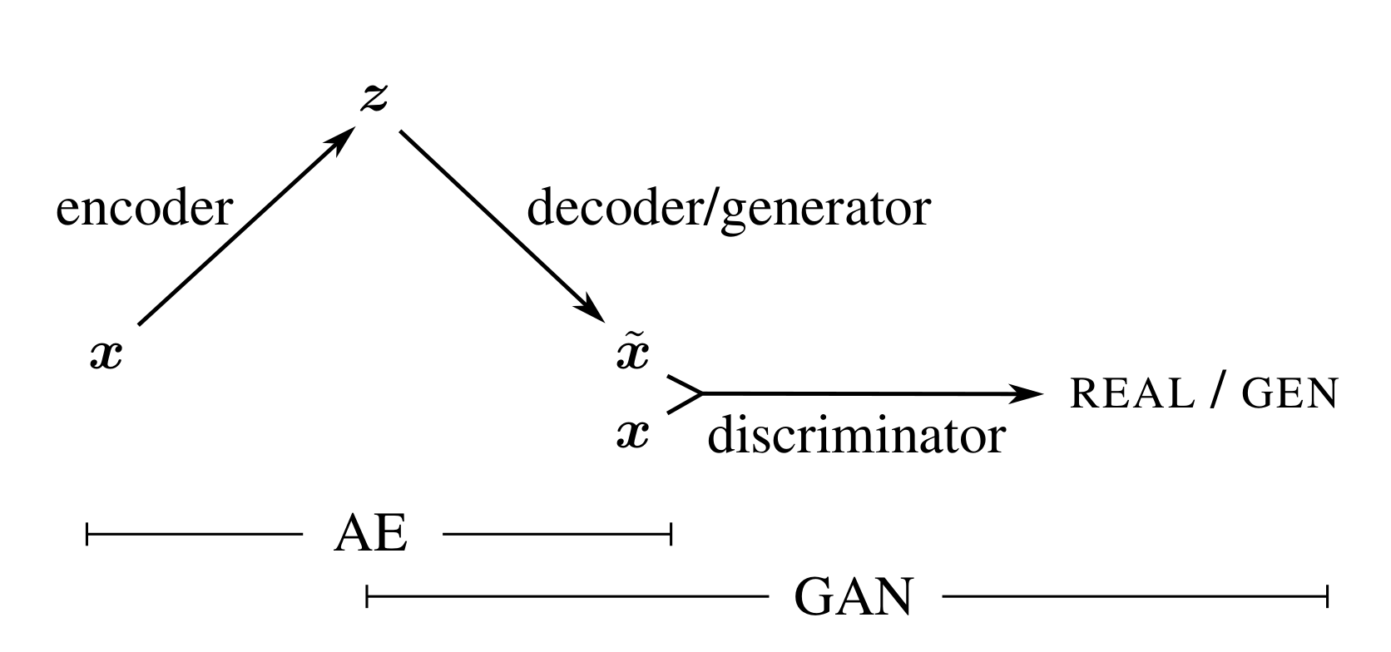
Conclusions
Ultimately, GAIL is too specific an algorithm to be a good analogy for the finch, although parallels from IRL are very worthwhile. More work needs to be done to verify whether any neural system is analogous to a Discriminator.
Parallels in the other direction are easier to draw; not only is the more informative reinforcement error a good explanation for the VAE GAN, the actor-critic framework suggests an additional GAN improvement, which is worth exploring in the future.

Slide 7
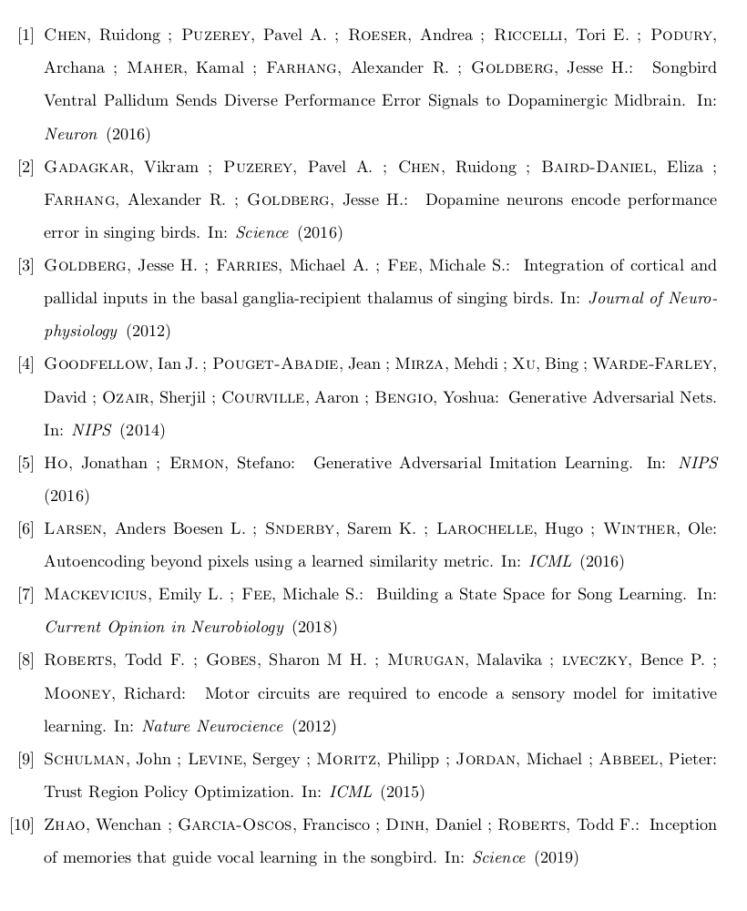
References

