Slide 1

LocalOT
By Azlaan Shafi, Aidan Casimir, Lance Miller, Josh Sebastian, Kayla Burks, Satish Parajuli, and Venkatasai Gudisa

Slide 2
Contents
Objective of LocalOT
Requirements
Cost Estimation
Diagrams
Project Timeline
Architectural Design
01
04
02
05
03
06
LocalOT

Slide 3
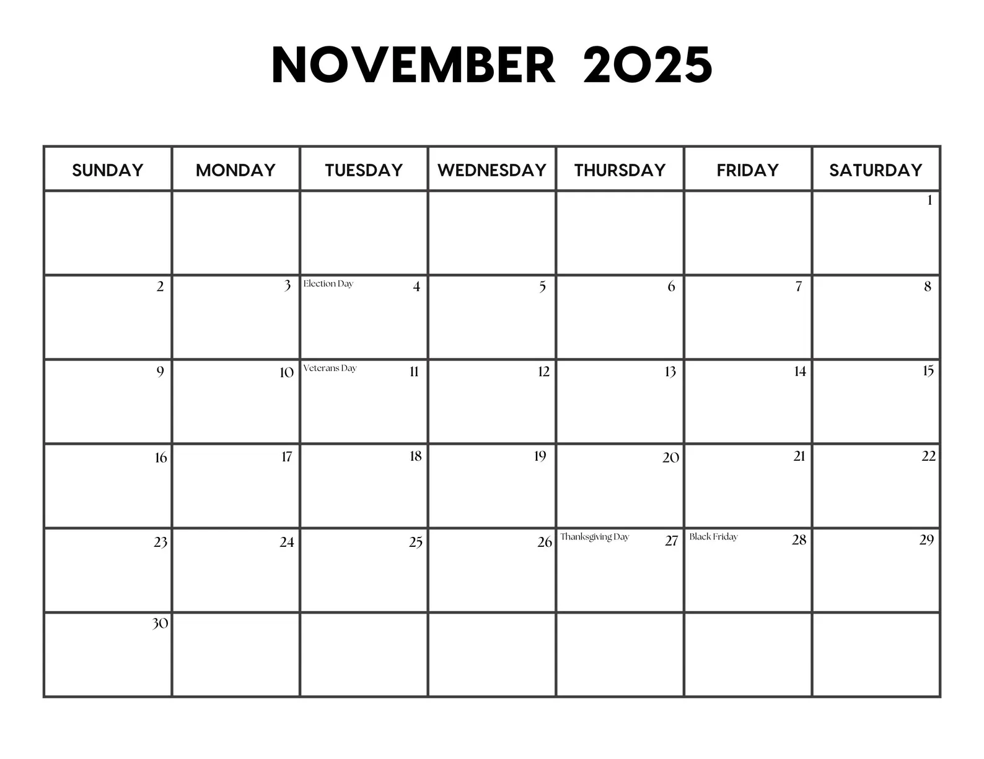
Objective of LocalOT
To provide a free, open source and locally run calendar, fully void of any data tracking or selling.
In a world where data rights are essentially non-existent and are taken as a suggestion by most companies, the ability to utilize free commonplace software is paramount
Minimalistic and hands-off approach to digital calendars, providing the user with the tools to create the vibe they want.
LocalOT

Slide 4
Cost Estimation - ACEM
$$
    Screens:
      Home calendar - 5
        Month view - 3
        Week View - 1
        Day View - 1
      Adding Events - 5
      User settings - 5
    Reports:
      Event scheduling output - 6
      Event alterations confirmation - 6
    Object Points = 3 * 5 + 2 * 6 = 27
    New Object Points = [(27) * (100 - 35 (% reuse))/100] = 17.55
    Developers Experience & Capability aka PROD = 4
    Effort = 17.55 / 4 = 4.3875 Person-Months
Cost of Software Products = $0
Cost of Hardware Products = $0
Cost of Personnel:
1 senior dev - $85,000 salary
2 interns - $20/hours
Therefore, under a maximum 6 week project timeline, the total cost would be $14,607.69
LocalOT

Slide 5
Project Timeline
Timeline:
Database/Framework research and selection, feature planning, process development, architecture planning (1-2 weeks)
Building database, prototyping different pages/views, drafting MVC foundation (1 week)
Build View component with all screen variations (1 week)
Build Controller component to interface with database prototype (1 week)
Finalize Model component to complete MVC relations (1 week)
We predict that LocalOT would take roughly 4.3875 person months of work:
The features to implement are relatively simple, simplicity is key
Incremental process model
Allows flexibility to roll out features after open source v1.0 release
Estimated Time | Activity
1-2 weeks | Research and Development, Process/Arch. Planning
1 week | Defining database structure, prototype page views
1 week | Build View component w/ screen variations
1 week | Build Controller component to interface with view
1 week | Debugging and Polishing
LocalOT

Slide 6
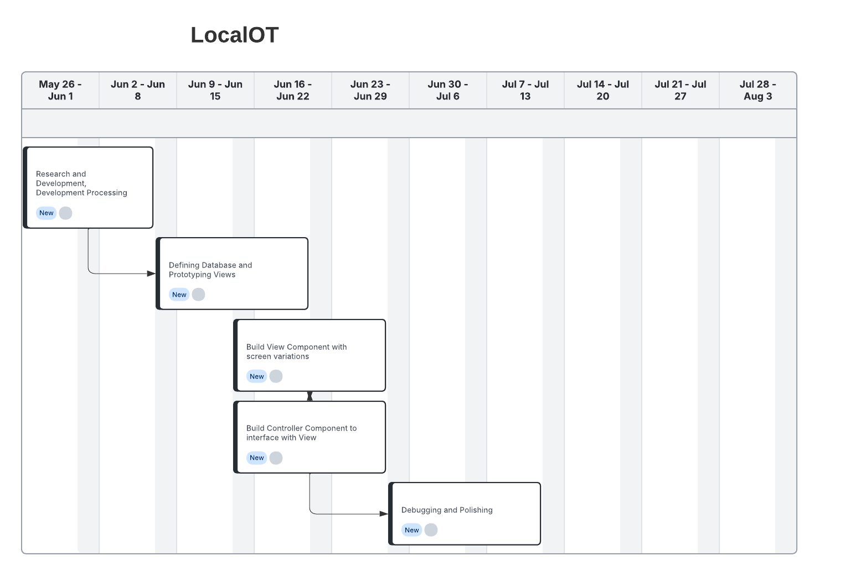
Project Timeline Gantt Chart View
LocalOT

Slide 7
Functional Requirements
The system must allow users to add an event.
The system must allow users to edit an existing event.
The system must allow users to delete an event.
The system must detect scheduling conflicts when a new event is added.
The system must display a daily calendar view.
The system must display a weekly and monthly calendar view.
The system must highlight holidays and weekends in distinct colors.
LocalOT

Slide 8
Non-Functional Requirements
Usability
The system should be learnable by new users within 30 minutes.
Performance
A change to an event must appear within 1 second.
Space
The system must need 100MB or less of local storage.
Dependability
All data must be saved automatically in the event that an unexpected event occurs.
Security
The system must lock a user account after five failed login attempts.
Environmental
The system must work on the major browsers including Google Chrome, Microsoft Edge, and Apple Safari.
Operational
The system should be operational within 3 seconds of being opened.
Development
The system should be made using Java or Python for the backend.
Ethical
The system must allow users to delete all of their data at any time.
Accounting
The system must record any log-ins and actions made by users.
Safety/Security
The system must comply with relevant laws and regulations concerning data and user protection.
LocalOT

Slide 9

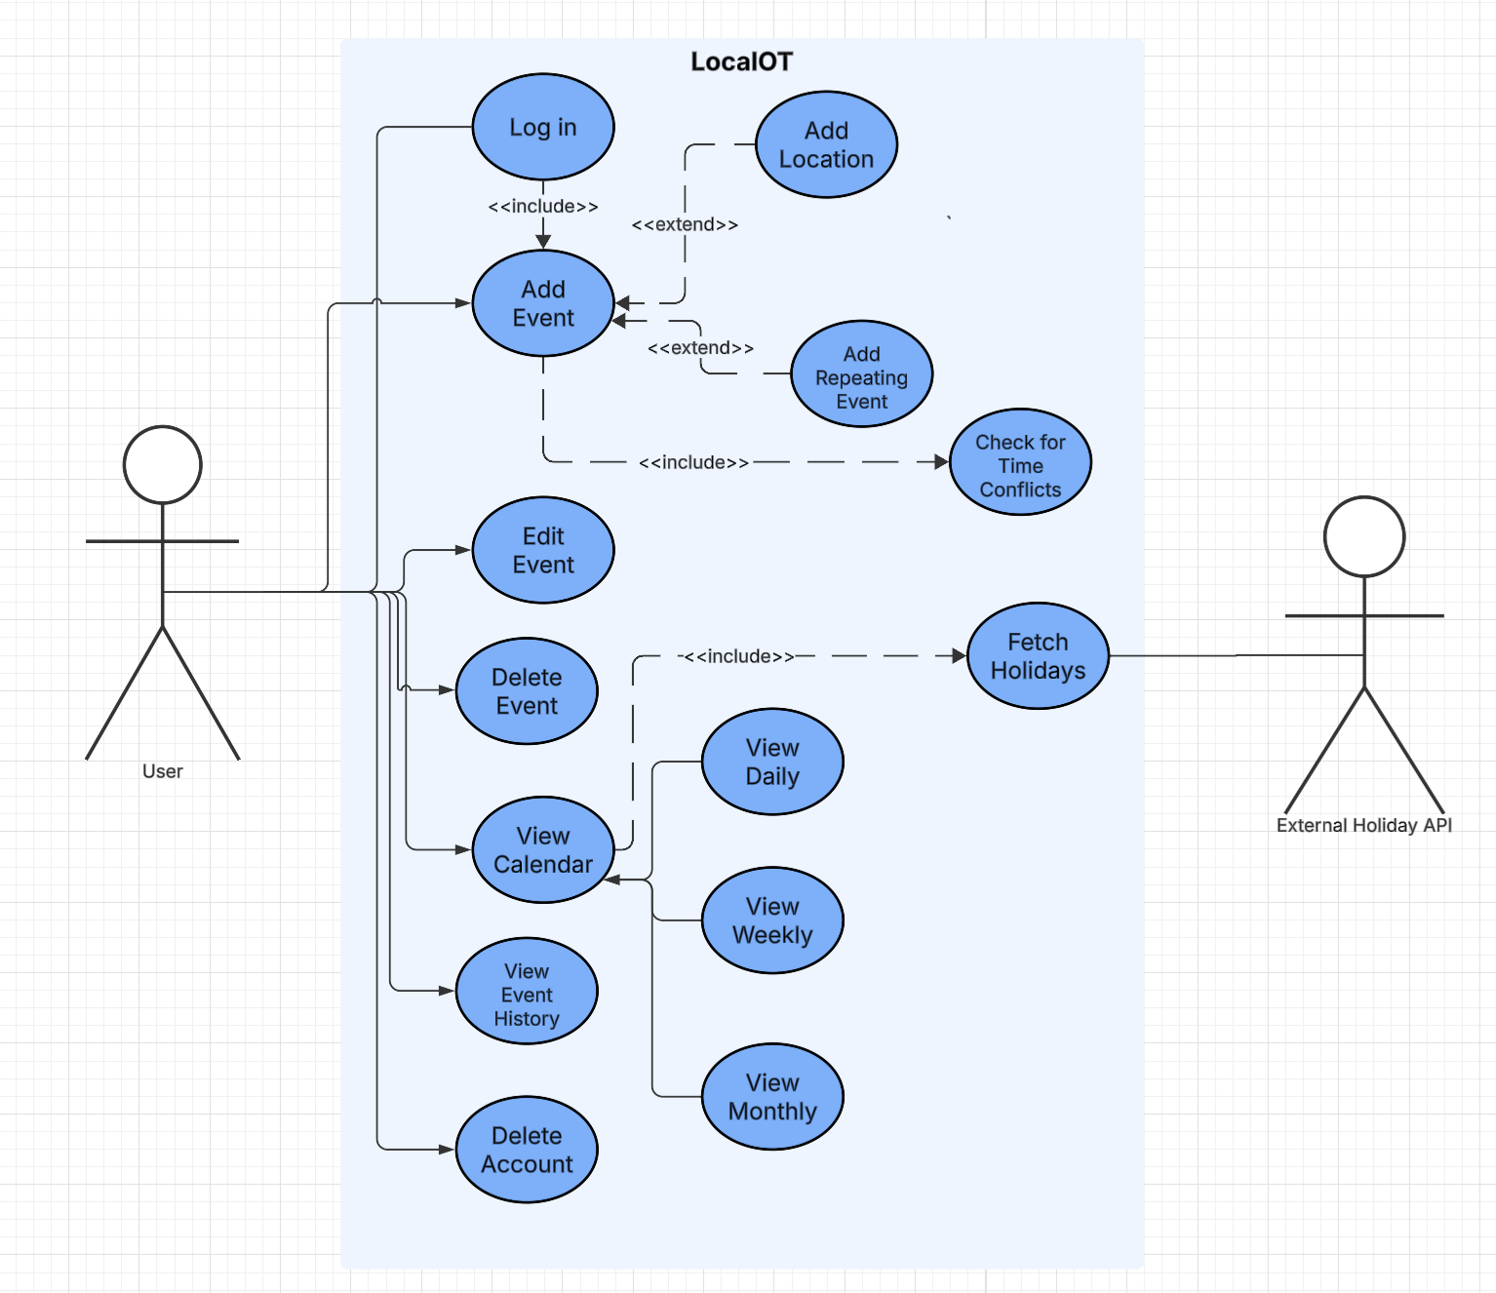
Use Case Diagram
The User can perform all fundamental calendar operations such as:
Log In
View Calendar
manage events (which includes Add, Edit, and Delete Event).
The diagram shows relationships to specify functionality.
LocalOT

Slide 10

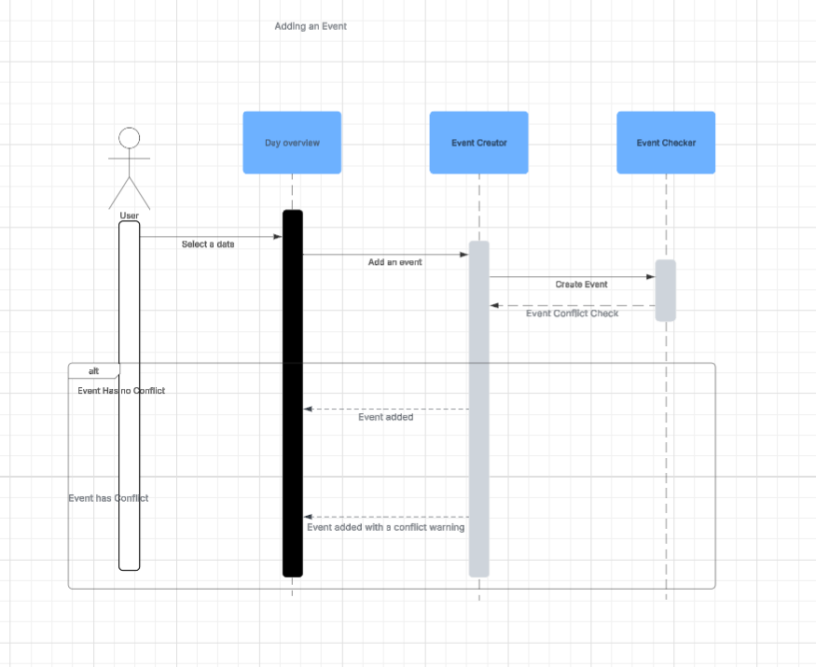
Sequence Diagram
Here is a sequence diagram for adding an event in LocalOT.
This set up shows the steps a user would normally take to add an event in our app.
This diagram also shows the checks the app would make when an event is being added and any actions it would take depending on these checks.
Sequence Diagram (Add Event) (made using Lucidchart)
LocalOT

Slide 11

Sequence Diagram
This example involves editing an event.
It will follow the protocol of checking for conflict.
Sequence Diagram (Edit Event) (made using Lucidchart)
LocalOT

Slide 12

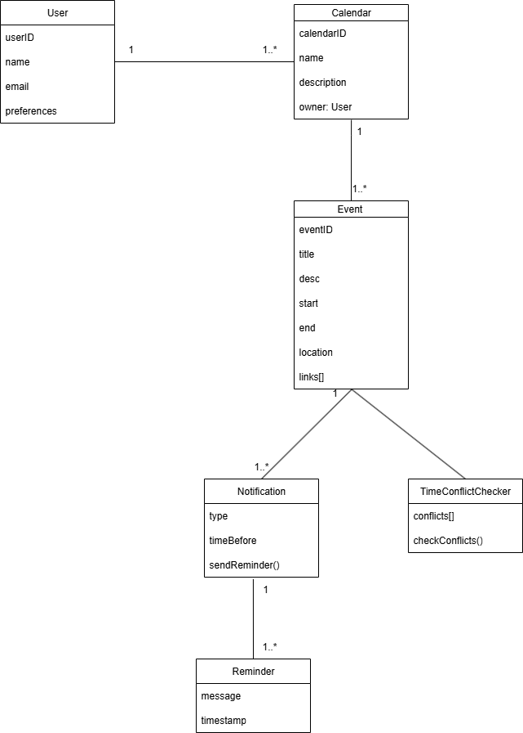
Class Diagram
This diagram shows the classes involved in the LocalOT app.
This entails all the components those classes are likely to require as well.
The classes are connected with relations between them which will be at least one but some have more than one relation.
LocalOT

Slide 13

Architecture
MVC Structure

Slide 14


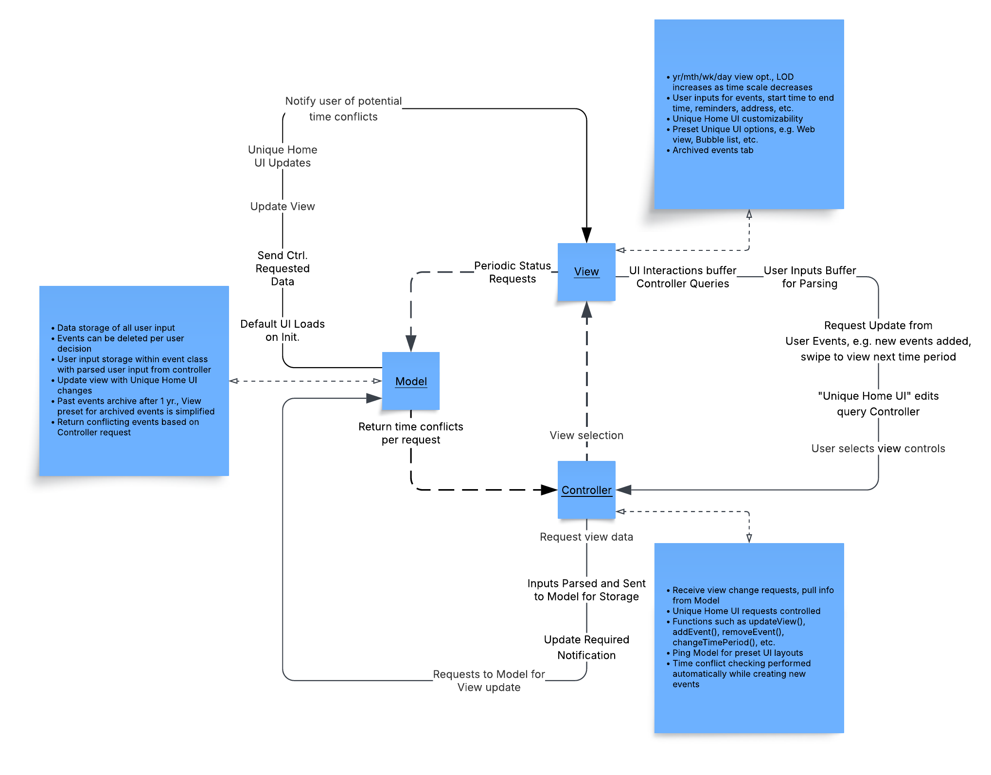
Project Architecture
Model
View
Controller
- Data storage abstraction control
- Saving user input
- Update View with requested info
- Loads UI on init.
- Provides data per Controller requests during user input sequences
- Displaying all relevant content
- Front end look and feel
- Visual presentation, layout, design, etc.
- Responds to supplied data from Model
- Periodic “heartbeat” pings to Model for up-to-date info.
- Bridge gap between Model and View
- Embedded functionality
- User interactivity
- Modularity and seamless experience
- Requests View updates from Model
LocalOT

Slide 15

Any questions?
LocalOT

