Slide 1
Financial Machine Learning Workshop
Developers' Club x ETHSG x Data Science & Technology Club

Slide 2
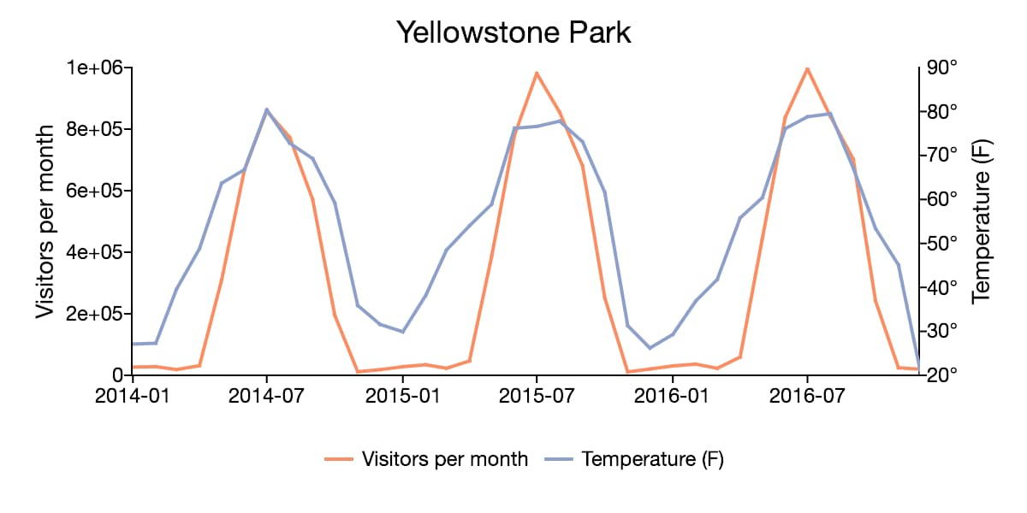
What are Time Series
"In mathematics, a time series is a series of data points indexed (or listed or graphed) in time order." (Ex. heights of ocean tides, counts of sunspots, and the daily closing value of the Dow Jones Industrial Average…)

Slide 3
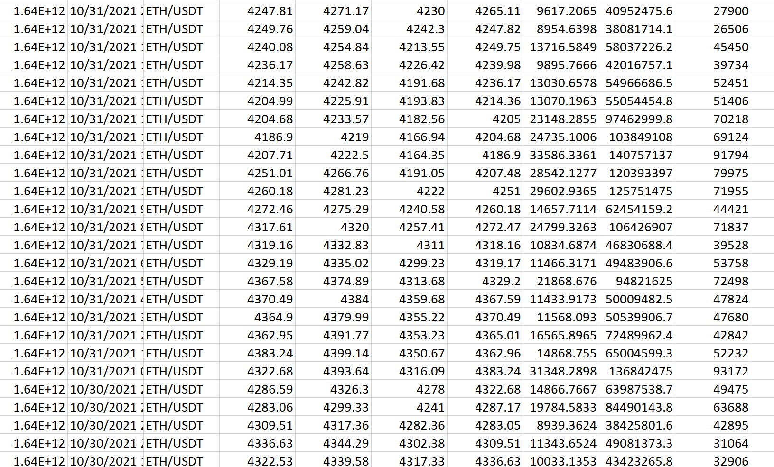

Slide 4
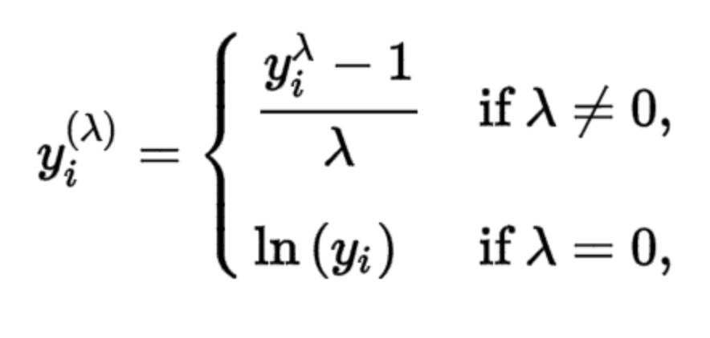
Transformations on Time Series
Square-root Transformation
Log-Transformation
Box-Cox Transformation
Difference Transformation
Normalization
Standardization

Slide 5
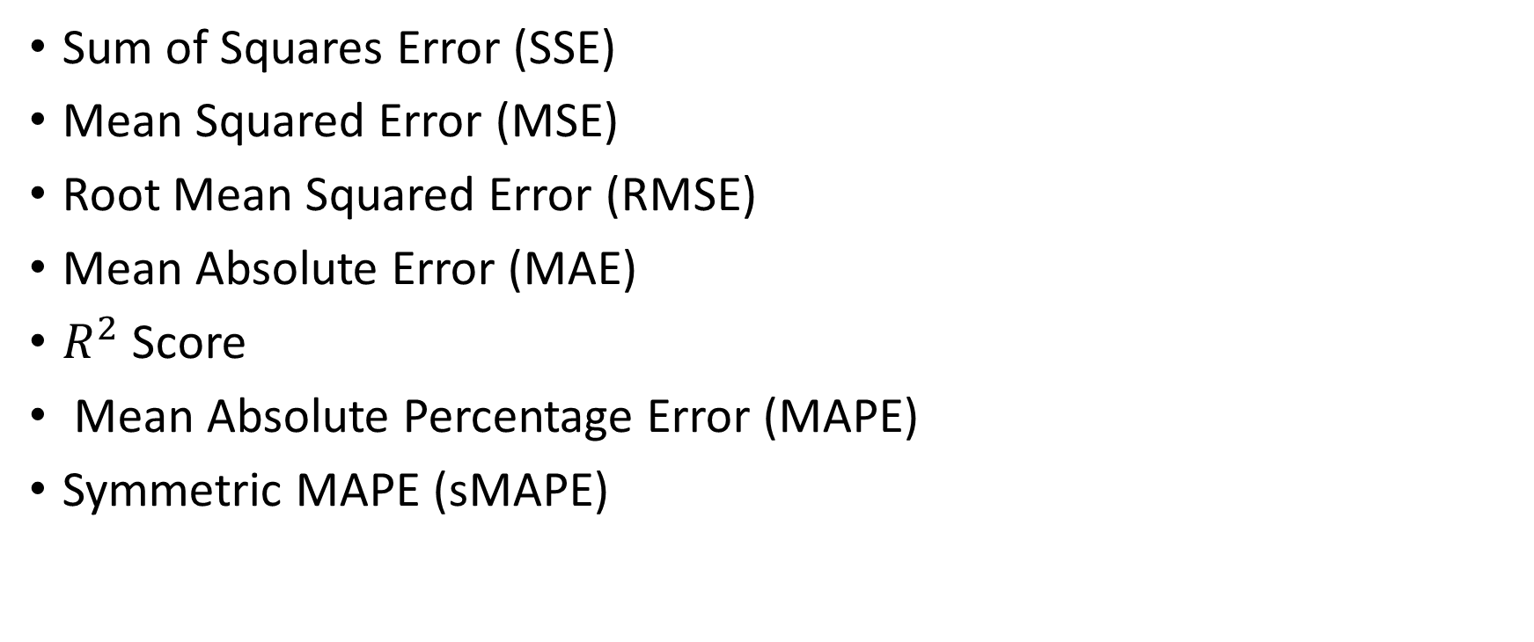
Metrics on Time Series
Sum of Squares Error (SSE)
Mean Squared Error (MSE)
Root Mean Squared Error (RMSE)
Mean Absolute Error (MAE)
$R^{2}$ Score
Mean Absolute Percentage Error (MAPE)
Symmetric MAPE (sMAPE)

Slide 6
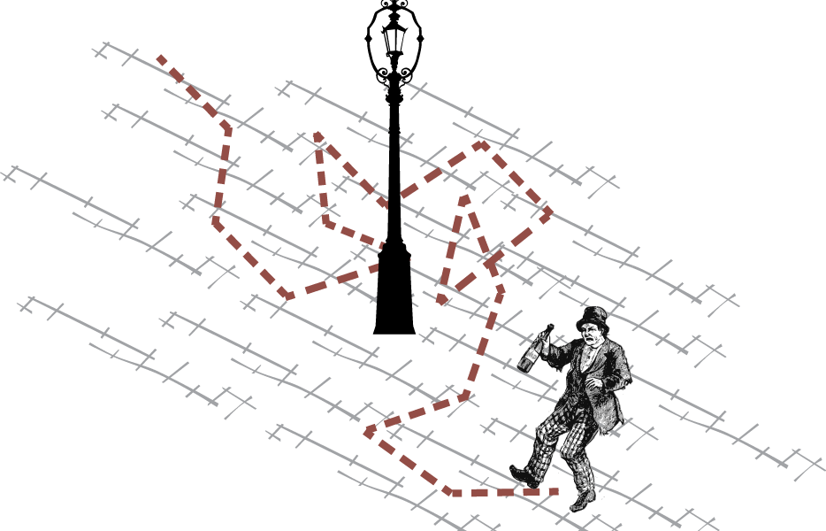
Random Walk Theorem

Slide 7
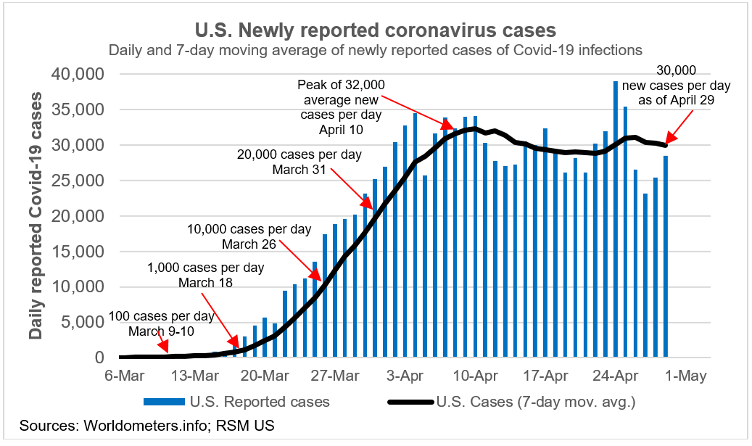
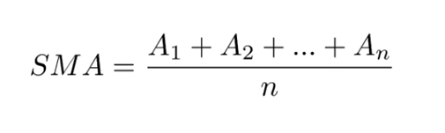
Simple Moving Average (SMA)
Instead of taking the last value for our forecast, we take an average of the last "n" values as the forecast:

Slide 8
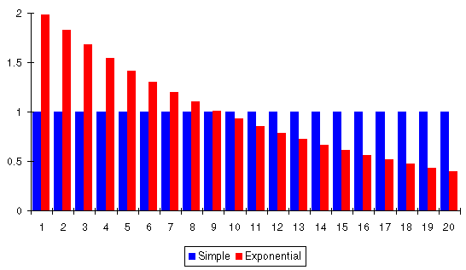
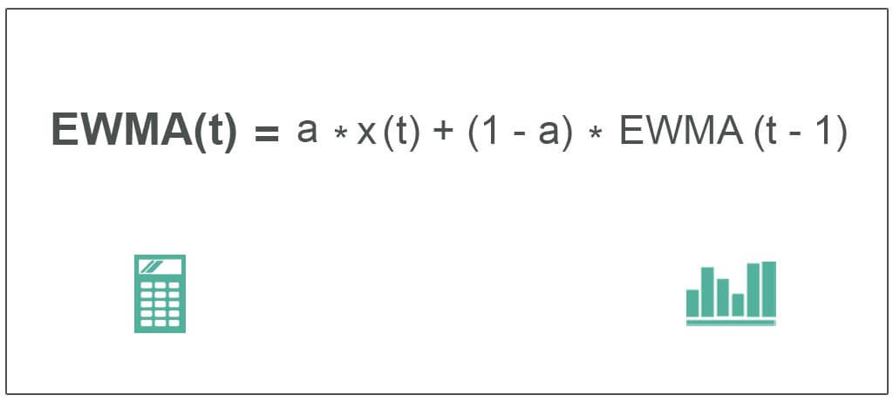
Exponentially-Weighted Moving Average (EWMA)

Slide 9
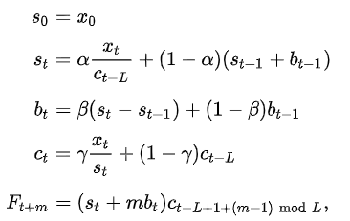
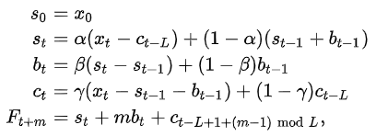
Holt-Winters Model
Additive
Multiplicative
Level
Trend
Seasonality

Slide 10
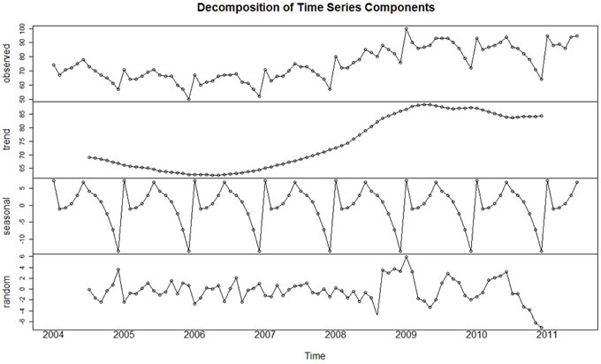
ARIMA

Slide 11
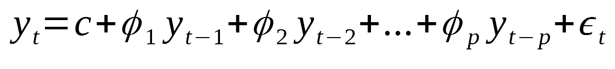
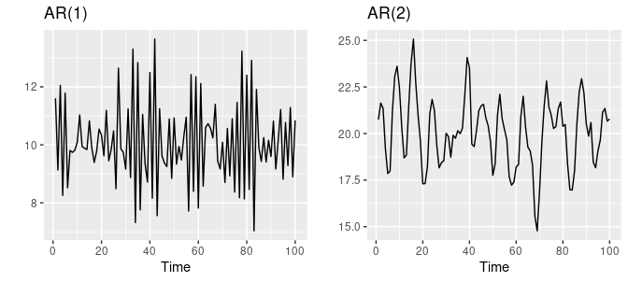
Autoregressive Models (AR)
It is just Linear Regression
We use the past time values to predict the next time value
Plus some noise
Autoregressive model of order "p"

Slide 12
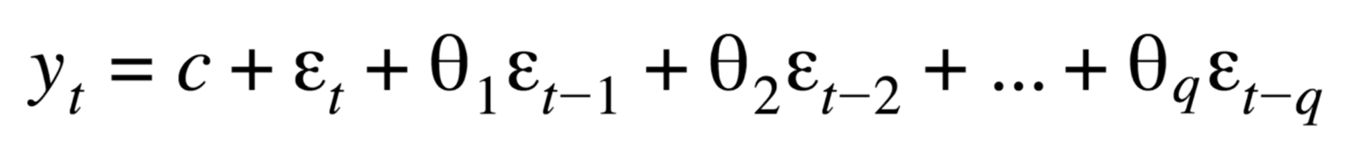
Moving Average Models (MA)
Not to confuse with EWMA or SMA
In comparison to the other Moving Average models, our predictors are the error terms from the past time points:

Slide 13
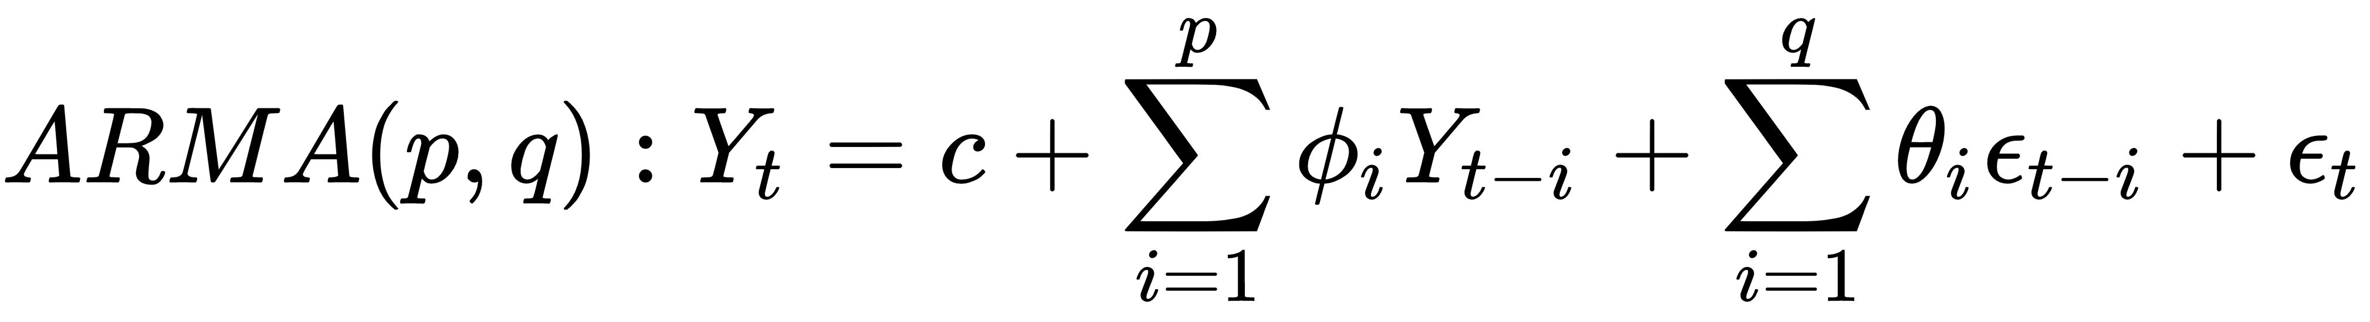
ARMA model (AR+MA)

Slide 14
ARIMA(p, d, q) model (Integrated ARMA)
The ARIMA model differences the time series "d" before feeding it into the ARMA model
Question: What does it mean that the best ARIMA model you can find for your time series is ARIMA(0,1,0) or ARIMA(0,2,0)?

Slide 15
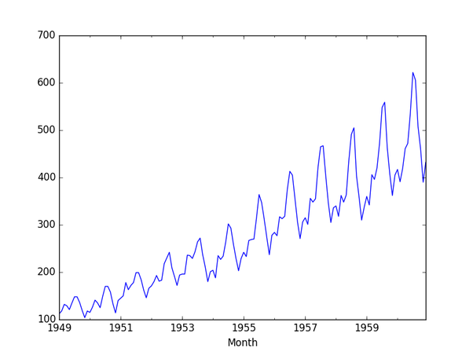
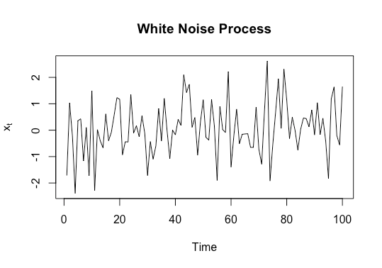
Stationarity
Same mean and same variance throughout the time series

Slide 16
Augmented Dickey-Fuller Test
Tests whether a given time series is stationary or not:
Null Hypothesis: The time series is not stationary
Alternative Hypothesis: The time series is stationary
If the p-value of the ADF test is lower than the significance level of 5%, we reject the Null Hypothesis -> The time series is stationary!

Slide 17

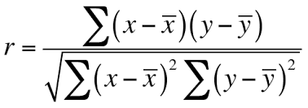
Autocorrelation Function
For "n" observations, the Autocorrelation Function can be calculated with:
Pearson Correlation

Slide 18
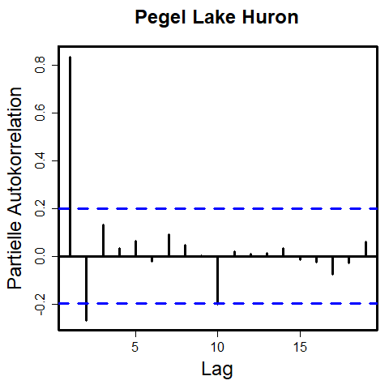
Partial Autocorrelation Function

Slide 19
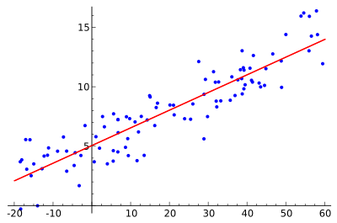
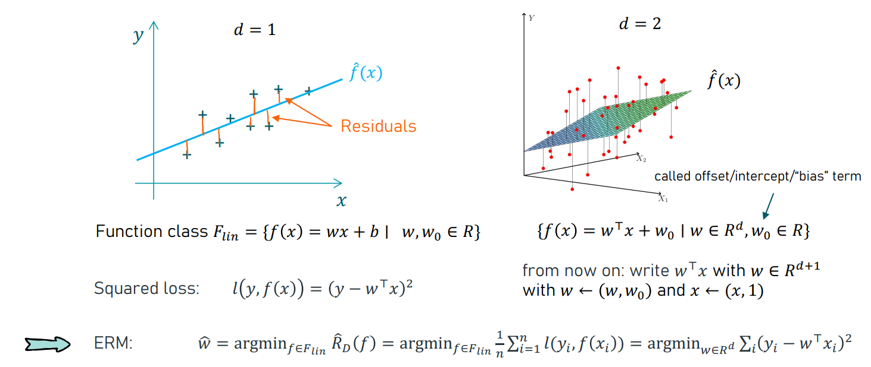
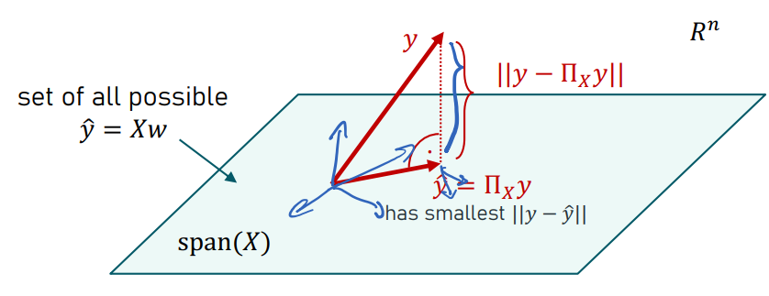
Linear Regression

Slide 20
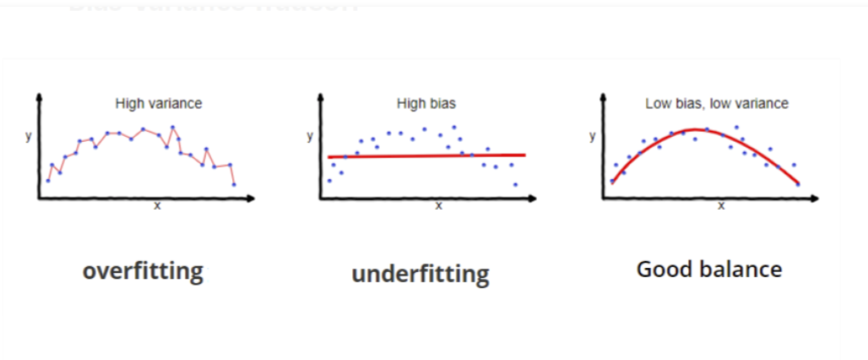


Ridge and Lasso Regression
Ridge Regression
Lasso Regression

Slide 21
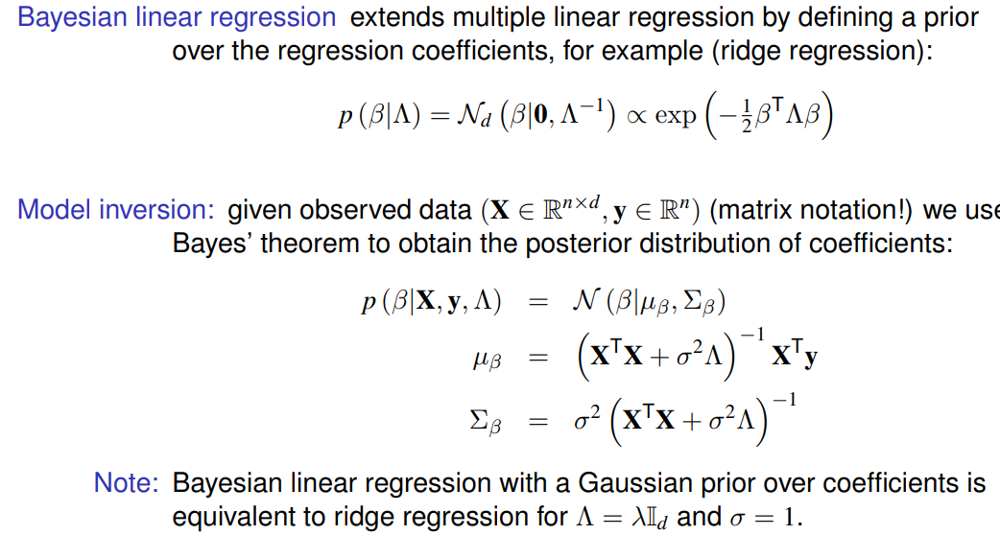
Gaussian Process Regression

Slide 22
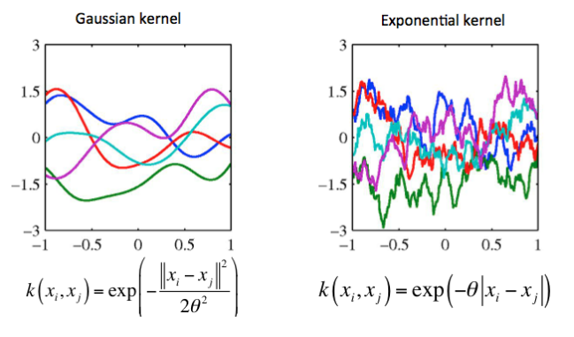
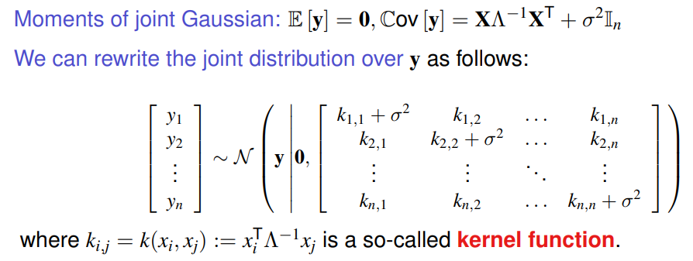
Gaussian Process Regression

Slide 23
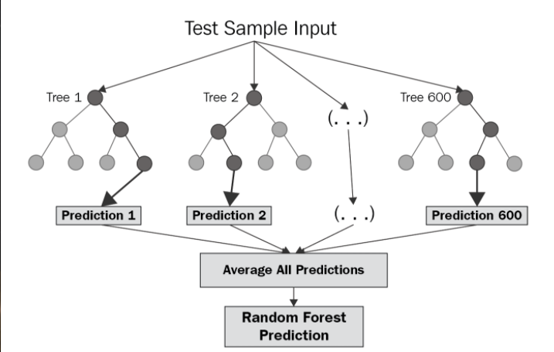
Random Forest Regression

Slide 24
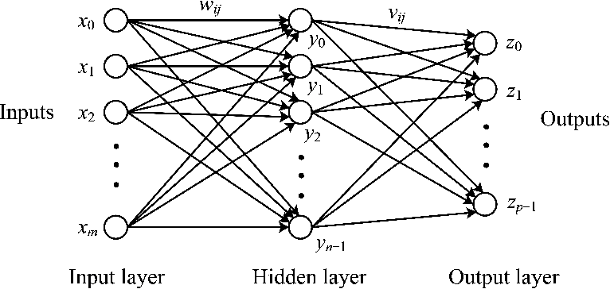
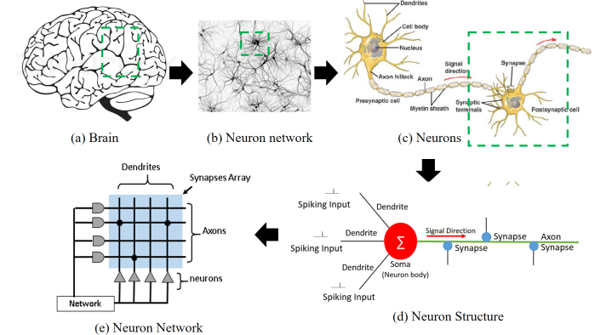
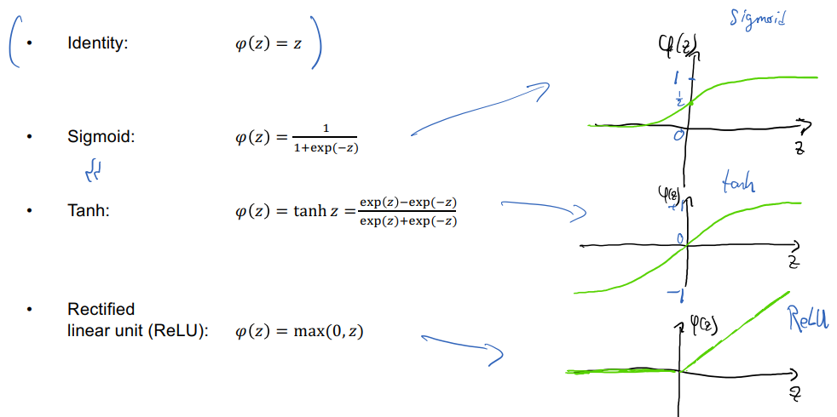
Multilayer Perceptron

Slide 25
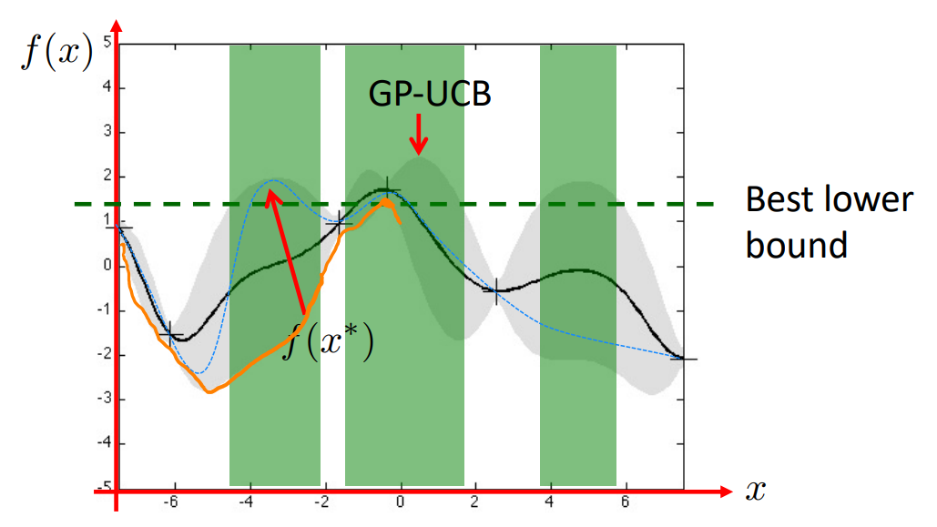
Bayesian Optimization

