Slide 1

Augmented Reality & Location Services
Ben Bahrenburg
Appcelerator Titan
E-Mail: ben.bahrenburg@gmail.com
Twitter: @benCoding

Slide 2
Agenda
Why Augmented Reality?
The basics
The plumbing
CommonJS + Web Service + Camera = Awesome
Where to get the code

Slide 3
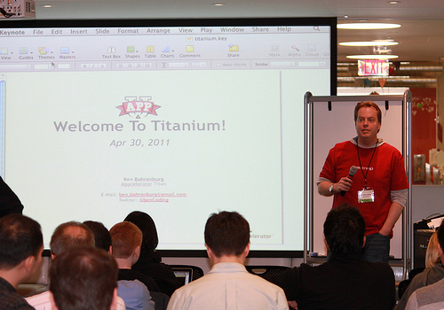
Who the heck am I?
Titanium Titan
Geolocation addict
Does a lot of Enterprise stuff
Using Ti since 0.4
Twitter: @benCoding
Email: ben.bahrenburg@gmail.com
On Git: tiny.cc/barkdemo

Slide 4
Why Augmented Reality?
Augmented Reality provides a context to your content. The user now interacts to the content instead of simply consuming it.

Slide 5


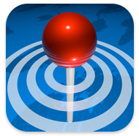


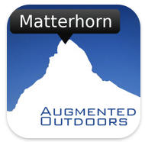

Some Examples
Layar
AroundMe
Wikitude
NY Nearest Subway
Cheap Gas
Peaks

Slide 6
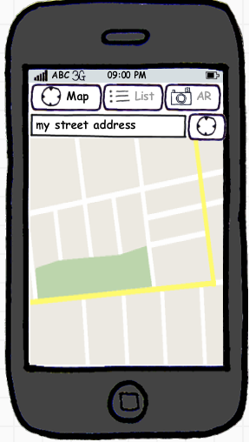
Common IU Components
Search Box
List of Attractions (Tableview)
Attractions on a map (mapview)
AR View ( Camera overlay)

Slide 7
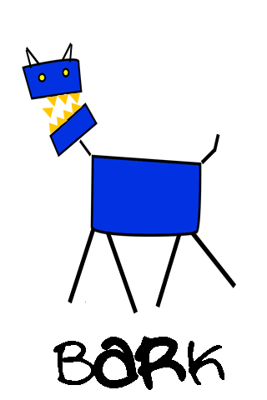
Introducing….

Slide 8
What is bARk?
Cross Platform ( thanks Titanium )
On Github
Altas / Soup Frameworks
Plug-in model, with built in examples
FourSquare
Yelp!
Yahoo Local
Twitter

Slide 9







The Architecture
Formatters
Map
List
CameraView
App Interaction
Broker Requests/Cache Data
Soup content provider framework
(CommonJS)
Atlas Geo Location framework
(CommonJS)
Providers

Slide 10
Download it now
Cross Platform ( thanks Titanium )
On Github
Altas / Soup Frameworks
Plug-in model, with built in examples
FourSquare
Yelp!
Yahoo Local
Twitter

Slide 11
Tiny.cc/barkdemo
bARk on github
@
*Case matters … all lower case

Slide 12
The demo

Slide 13
Questions?
On github : tiny.cc/barkdemo
*Case matters … all lower case

