Slide 1

NETFLIX DATA ANALYSIS
Atchayaa I
APPLY_175566032468a54024aee70

Slide 2

PROBLEM STATEMENT
Netflix has become one of the most prominent global streaming platforms, continuously expanding its library with a mix of original productions and licensed content. However, with growing competition from platforms like Amazon Prime, Disney+, and regional OTT providers, Netflix must strategically analyze its content catalog to identify strengths, gaps, and opportunities.
The specific problem to be addressed in this project is 'Content Trends Analysis for Strategic Recommendations'. The aim is to uncover how Netflix’s content distribution (Movies vs. TV Shows, genres, and country contributions) has evolved over the years. This will enable the identification of key genres, audience preferences, and strategic insights into global content expansion.

Slide 3
This project uses the Netflix Movies and TV Shows dataset from Kaggle.
A complete Exploratory Data Analysis (EDA) was performed to identify insights about Netflix’s catalog:
• Data Cleaning: Removing duplicates, handling null values, and formatting date fields.
• Feature Analysis: Examining columns like type, country, rating, release_year, and listed_in.
• Visualization: Using charts to interpret patterns in content distribution and popularity.
• Goal: To derive actionable insights for viewers, content creators, and business strategists.
PROJECT DESCRIPTION

Slide 4

WHO ARE THE END USERS?
DATA ANALYST
To understand viewer preferences and trends.
CONTENT STRATEGIST
To identify which genres or countries are under/overrepresented.
PRODUCERS & FILMMAKERS
To decide what type of content to pitch or produce.
VIEWERS
To gain awareness of Netflix’s evolving content catalog.

Slide 5

Programming Languages
Python
Libraries
Pandas
Numpy
Matplotlib
Seaborn
Environment
Jupyter Notebook
Dataset
Netflix Dataset
Visualization tools
Data cleaning, EDA, Data visualization, Trend & Pattern analysis.
TECHNOLOGY USED

Slide 6
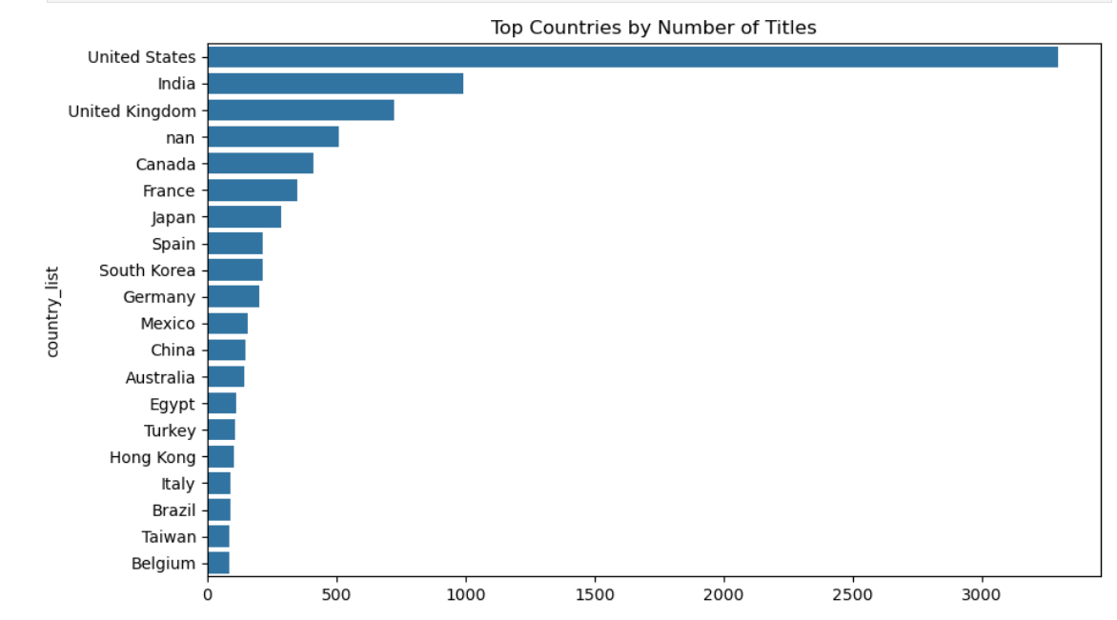
RESULTS-1

Slide 7
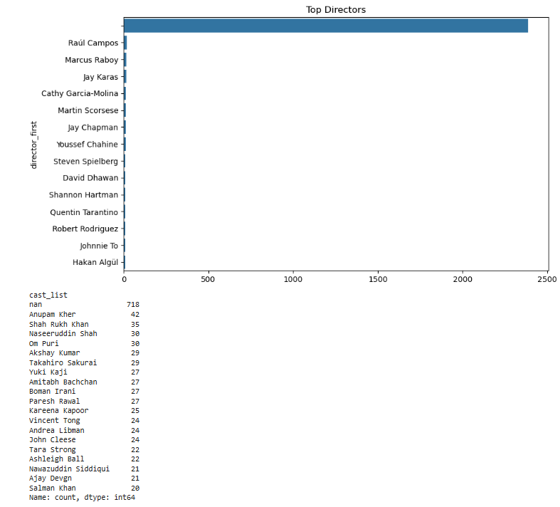
RESULTS-2

Slide 8
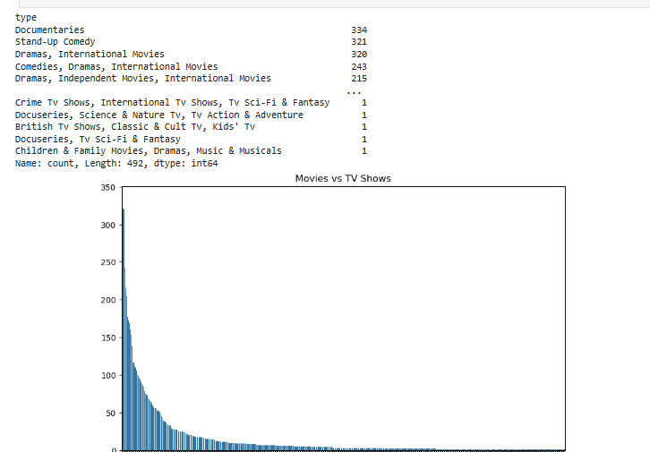
RESULTS-3

Slide 9
GITHUB REPOSITORY
URL : https://github.com/atchayaah/VOIS_AICTE_Oct2025_MajorProject_Atchayaa-I

Slide 10

GETTING STARTED WITH BASICS OF PYTHON CERTIFICATE
.
.

Slide 11
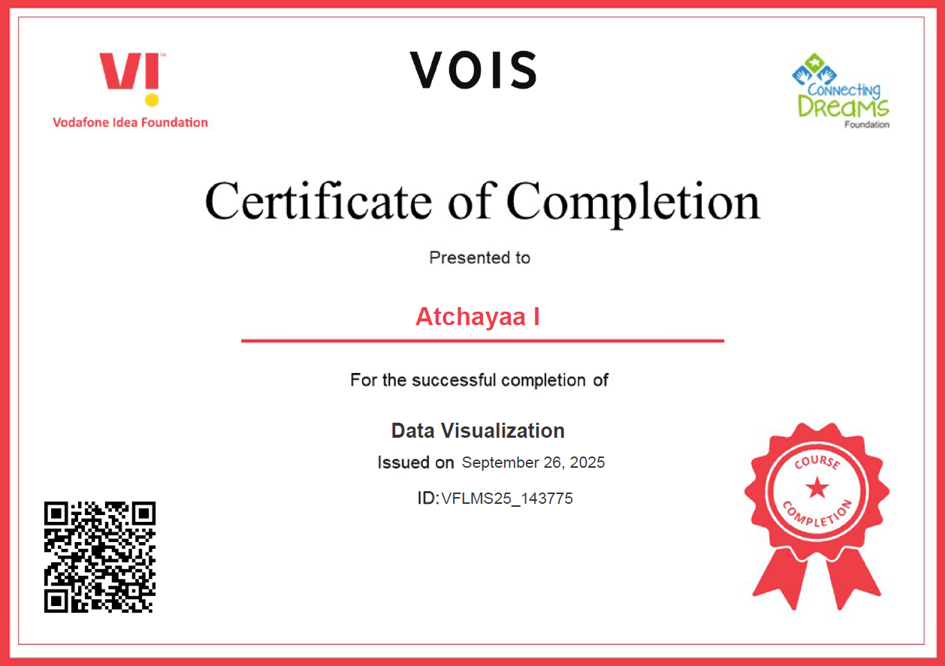
DATA VISUALIZATION CERTIFICATE
.
.

Slide 12
THANK YOU
.
.

