Slide 1


K.RAMAKRISHNAN COLLEGE OF ENGINEERING
(AUTONOMOUS)
STUDENT RECORD MANAGEMENT SYSTEM
Presented by,
Name : ATCHAYA D
Register No : 8115U25IT014
Reg No : F2508
Year and Sec : 1 IT F
27/02/2026
Notes:
1

Slide 2
PRESENTATION OVERVIEW
  Project Introduction
  Objective
  Problem Statement
  Technologies Used
  Flow chart
  Modules
  Modules Explanation
  Codetantra Implementation
  Output
27/02/2026
Notes:
2

Slide 3
PROJECT INTRODUCTION
The Student Record Management System (SRMS) is used to store and manage student information efficiently. It helps to organize details like student ID, name, and marks in an easy way. This system uses Linked List and Structures for flexible and efficient data management.
27/02/2026
Notes:
3

Slide 4
OBJECTIVE
To store student records efficiently
To add, delete, and search student details
To manage student data using linked list and structures
To demonstrate data structure concepts in real application
27/02/2026
Notes:
4

Slide 5
PROBLEM STATEMENT
The Student Record Management System (SRMS) is designed to manage and maintain student information efficiently. It helps to store, organize, and access student records easily using linked list and structures.
27/02/2026
Notes:
5

Slide 6
TECHNOLOGIES USED
• C Programming : Used to create the program
• Structures : Used to store student details
• Linked List : Used to store student records
• Pointers : Used to connect student records
27/02/2026
Notes:
6

Slide 7
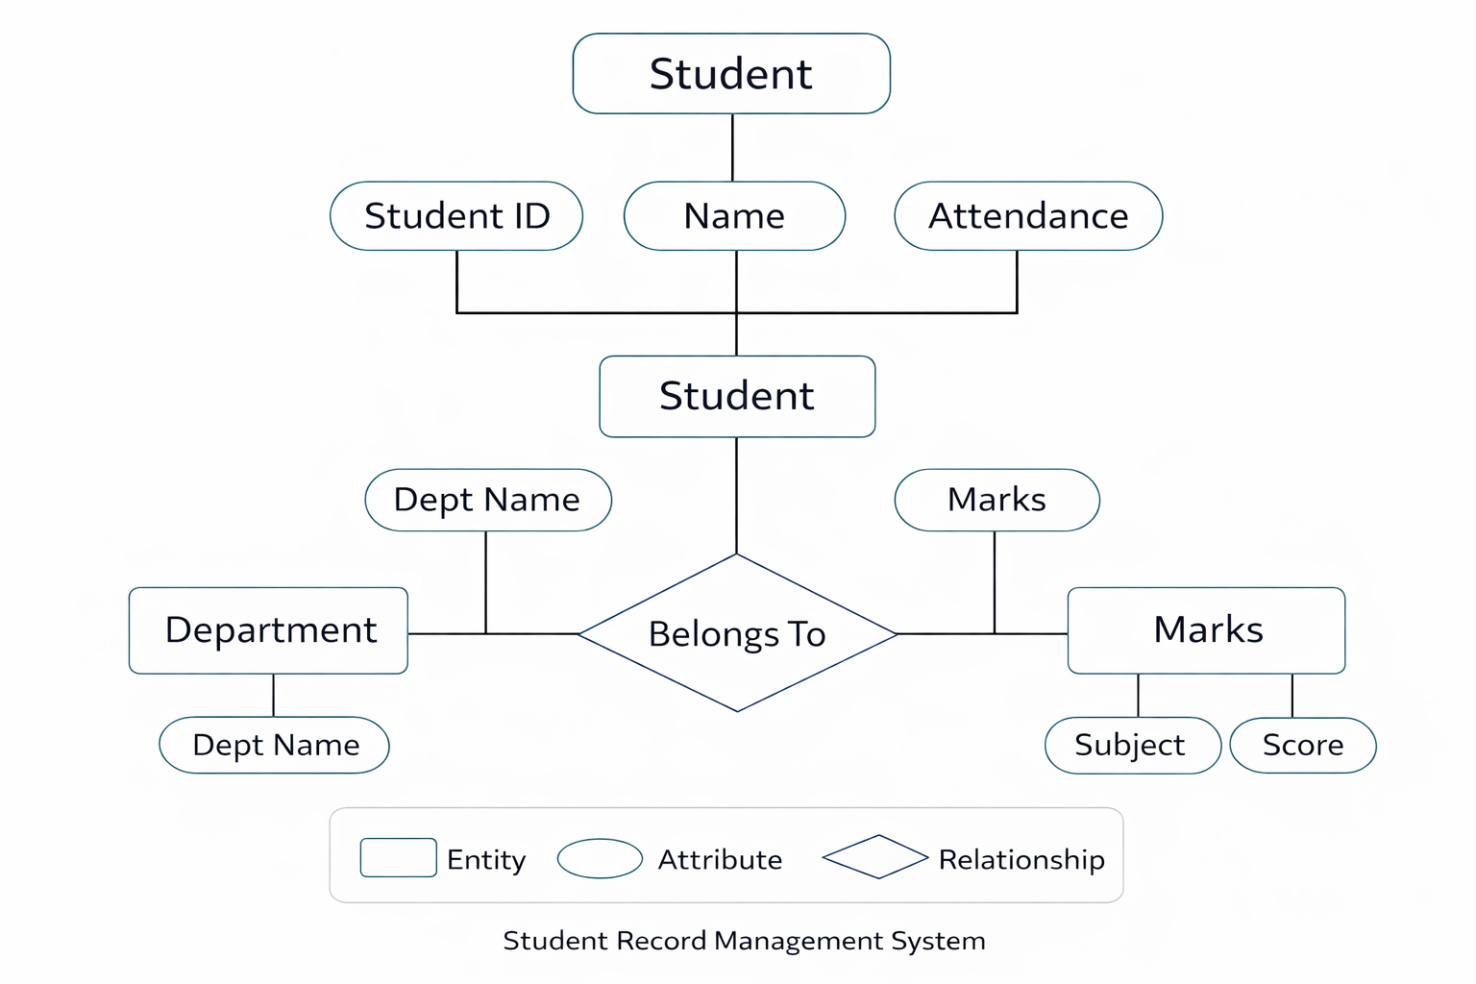
FLOW CHART
27/02/2026
Notes:
7

Slide 8
MODULES
• Student Management Module
• Add Student Module
• Delete Student Module
• Search Student Module
. Display student Module
27/02/2026
Notes:
8

Slide 9
MODULE 1: STUDENT MANAGEMENT MODULE
The Student Management Module is used to manage student records. It helps to add, delete, search, and display student information such as student ID, name, and marks. This module uses linked list to store and manage student data efficiently.
27/02/2026
Notes:
9

Slide 10
MODULE 2: ADD STUDENT MODULE
The Add Student Module is used to insert new student records into the system. It allows the user to enter details like student ID, name, department, and marks. Each record is stored using structures, and a new node is added to the linked list for efficient data management.
27/02/2026

Slide 11
MODULE 3: DELETE STUDENT MODULE
The Delete Student Module is used to remove a student’s record from the system. The user can delete a record using Student ID. The linked list is updated by removing the corresponding node, and the memory is freed. This module helps to keep the student records accurate and up-to-date.
27/02/2026

Slide 12
MODULE 4: SEARCH STUDENT MODULE
The Search Student Module is used to find a student’s record in the system. The user can search by Student ID or Name. The linked list is checked node by node, and if the record is found, the student details are displayed. This module helps to quickly access required student information.
27/02/2026

Slide 13
MODULE 5: DISPLAY STUDENT MODULE
The Display Student Module is used to show all student records stored in the system. It goes through the linked list and displays details like Student ID, Name, Department, and Marks. This module helps to view all student information easily and keeps data organized.
27/02/2026

Slide 14
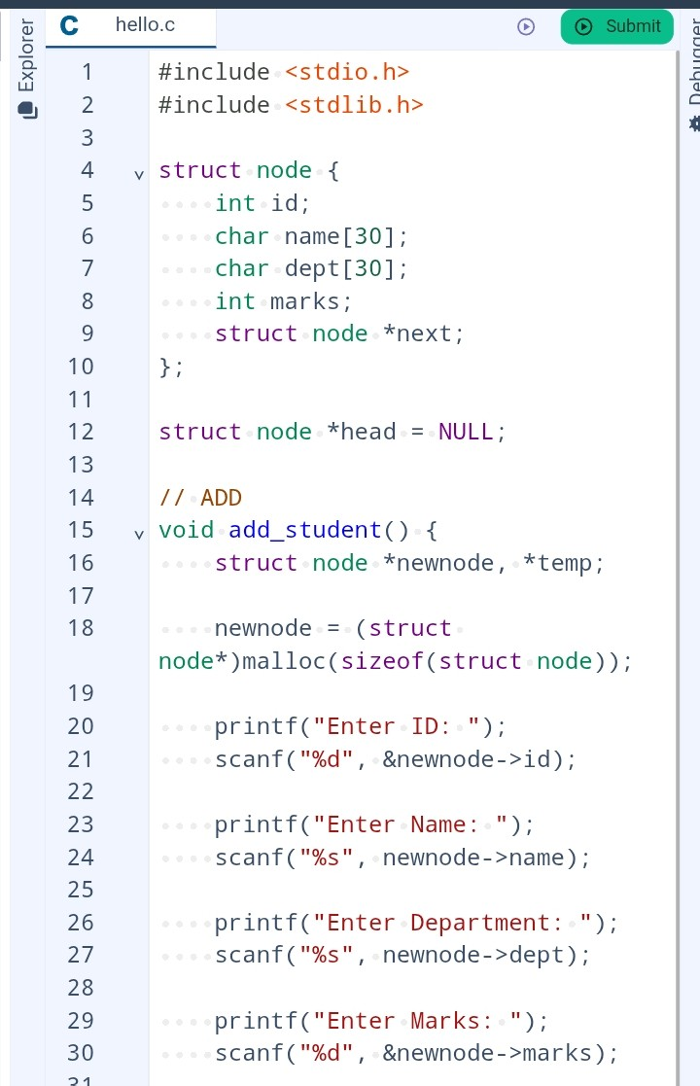
CODETANTRA IMPLEMENTATION

Slide 15
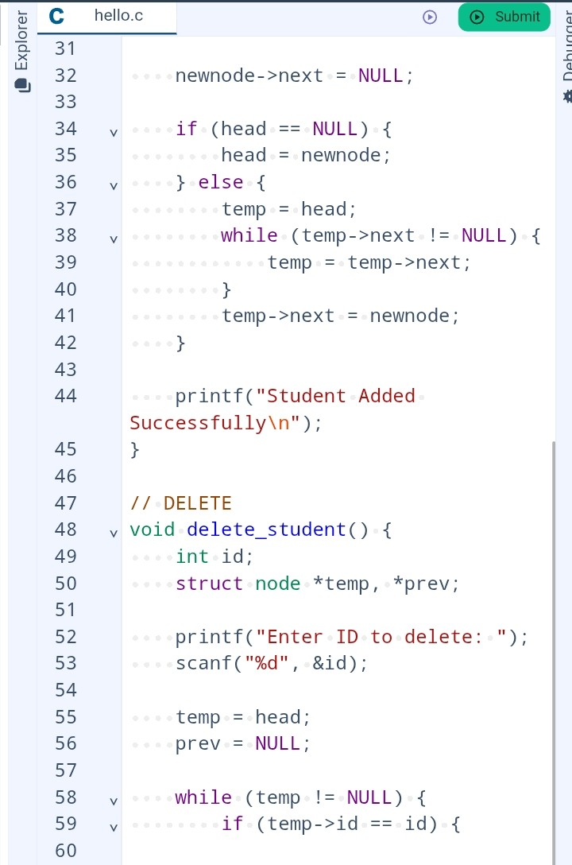

Slide 16
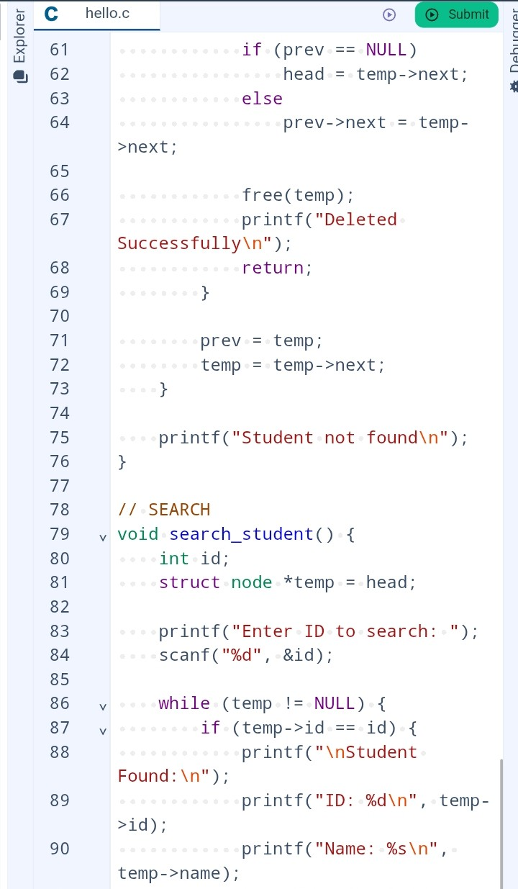

Slide 17
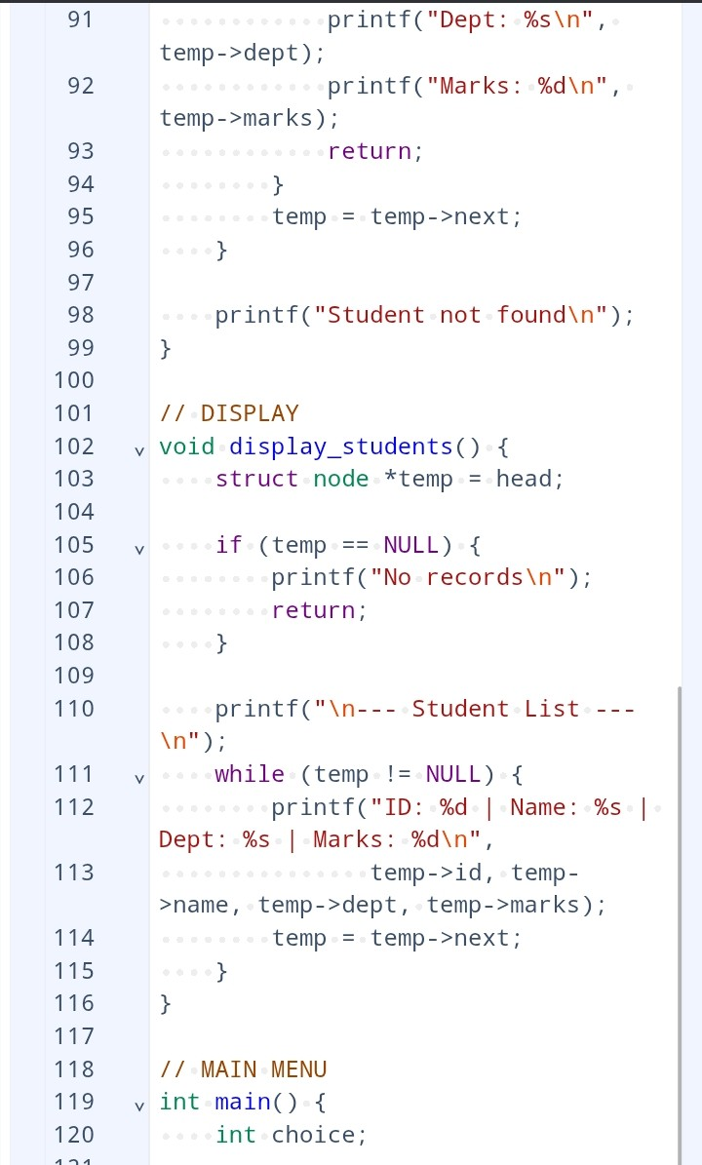

Slide 18
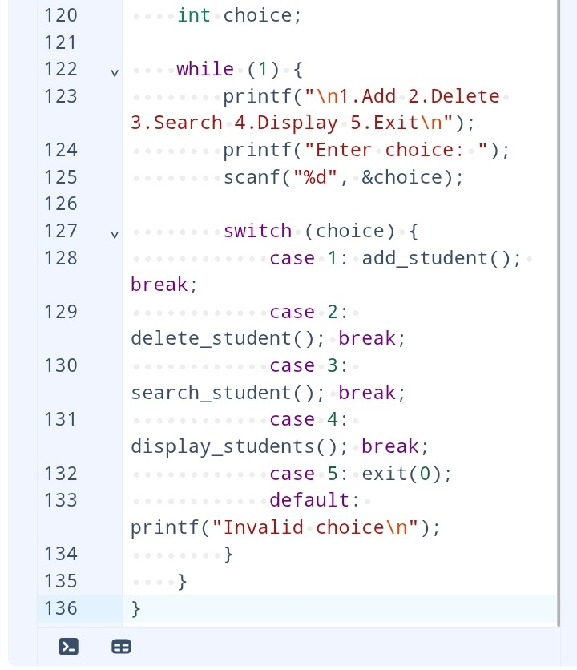

Slide 19
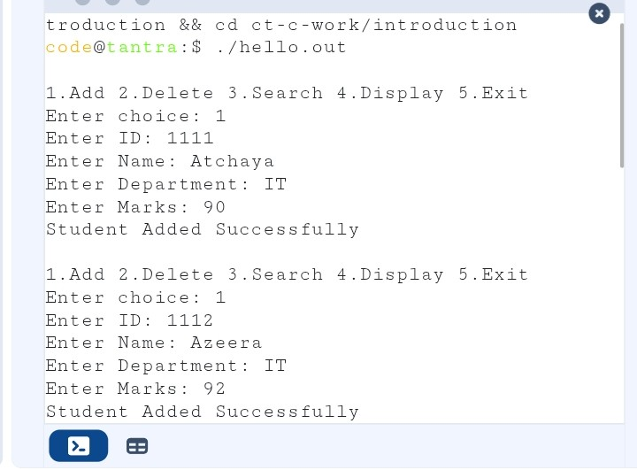
OUTPUT

Slide 20
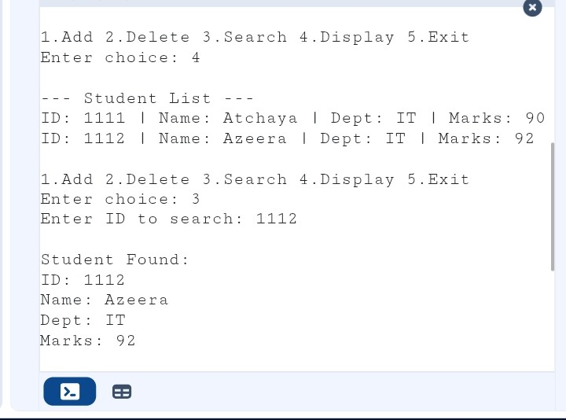

Slide 21
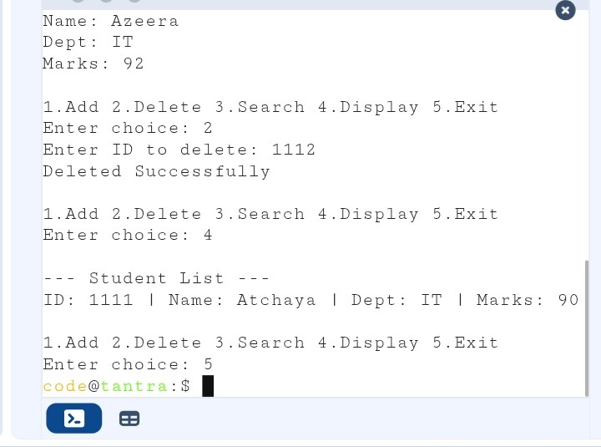

Slide 22
THANK YOU

