Slide 1


Artificial Intelligence and Data Science
24ADI204 Data Science and Visualization
DATA-VIZ HACK-A-BIT (2026-2027)
PROJECT TITLE: Youth Smoking and Drug Consumption Analysis
Team Number:
1. ATCHAYA S 25BAD016
2. LAKSHMI PRABHA M M 25BAD049 3. ANIREETHA M 25BAD009
4. MADHUMITHA S 25BAD053

Slide 2

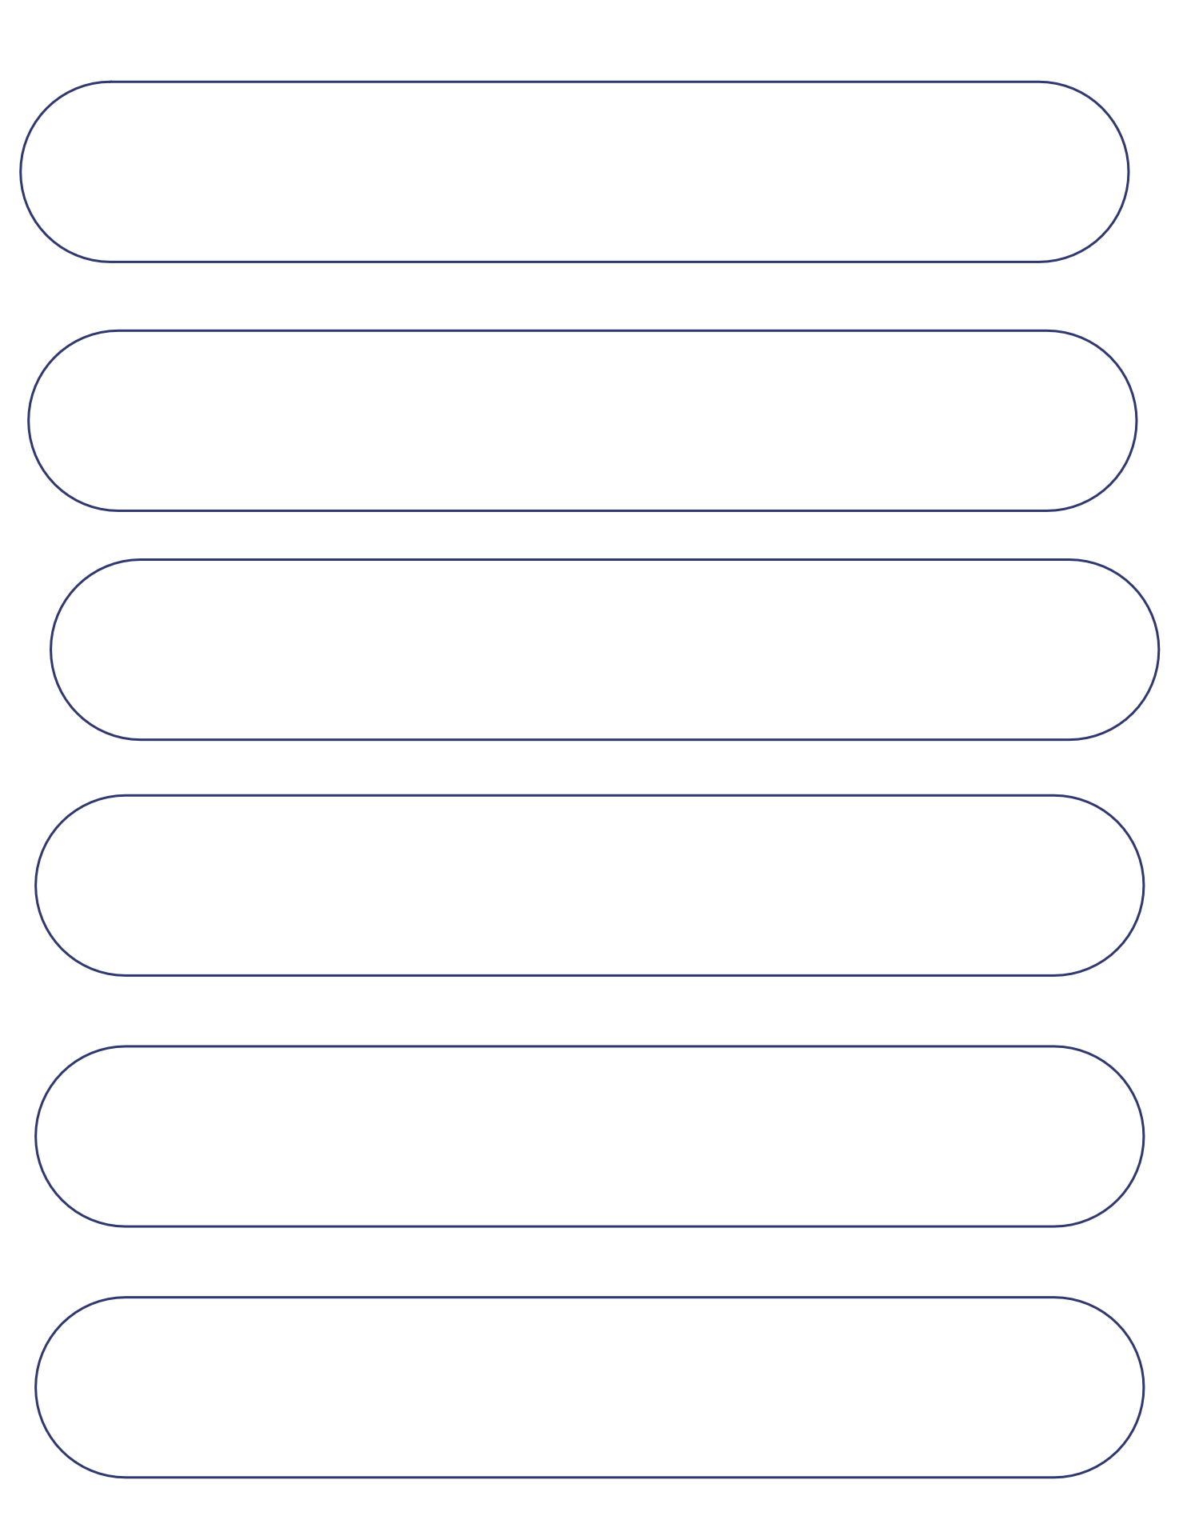
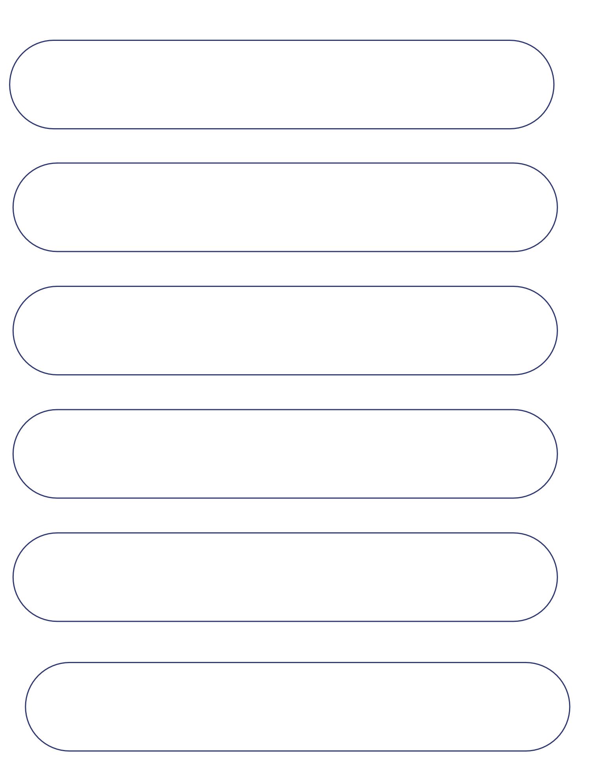
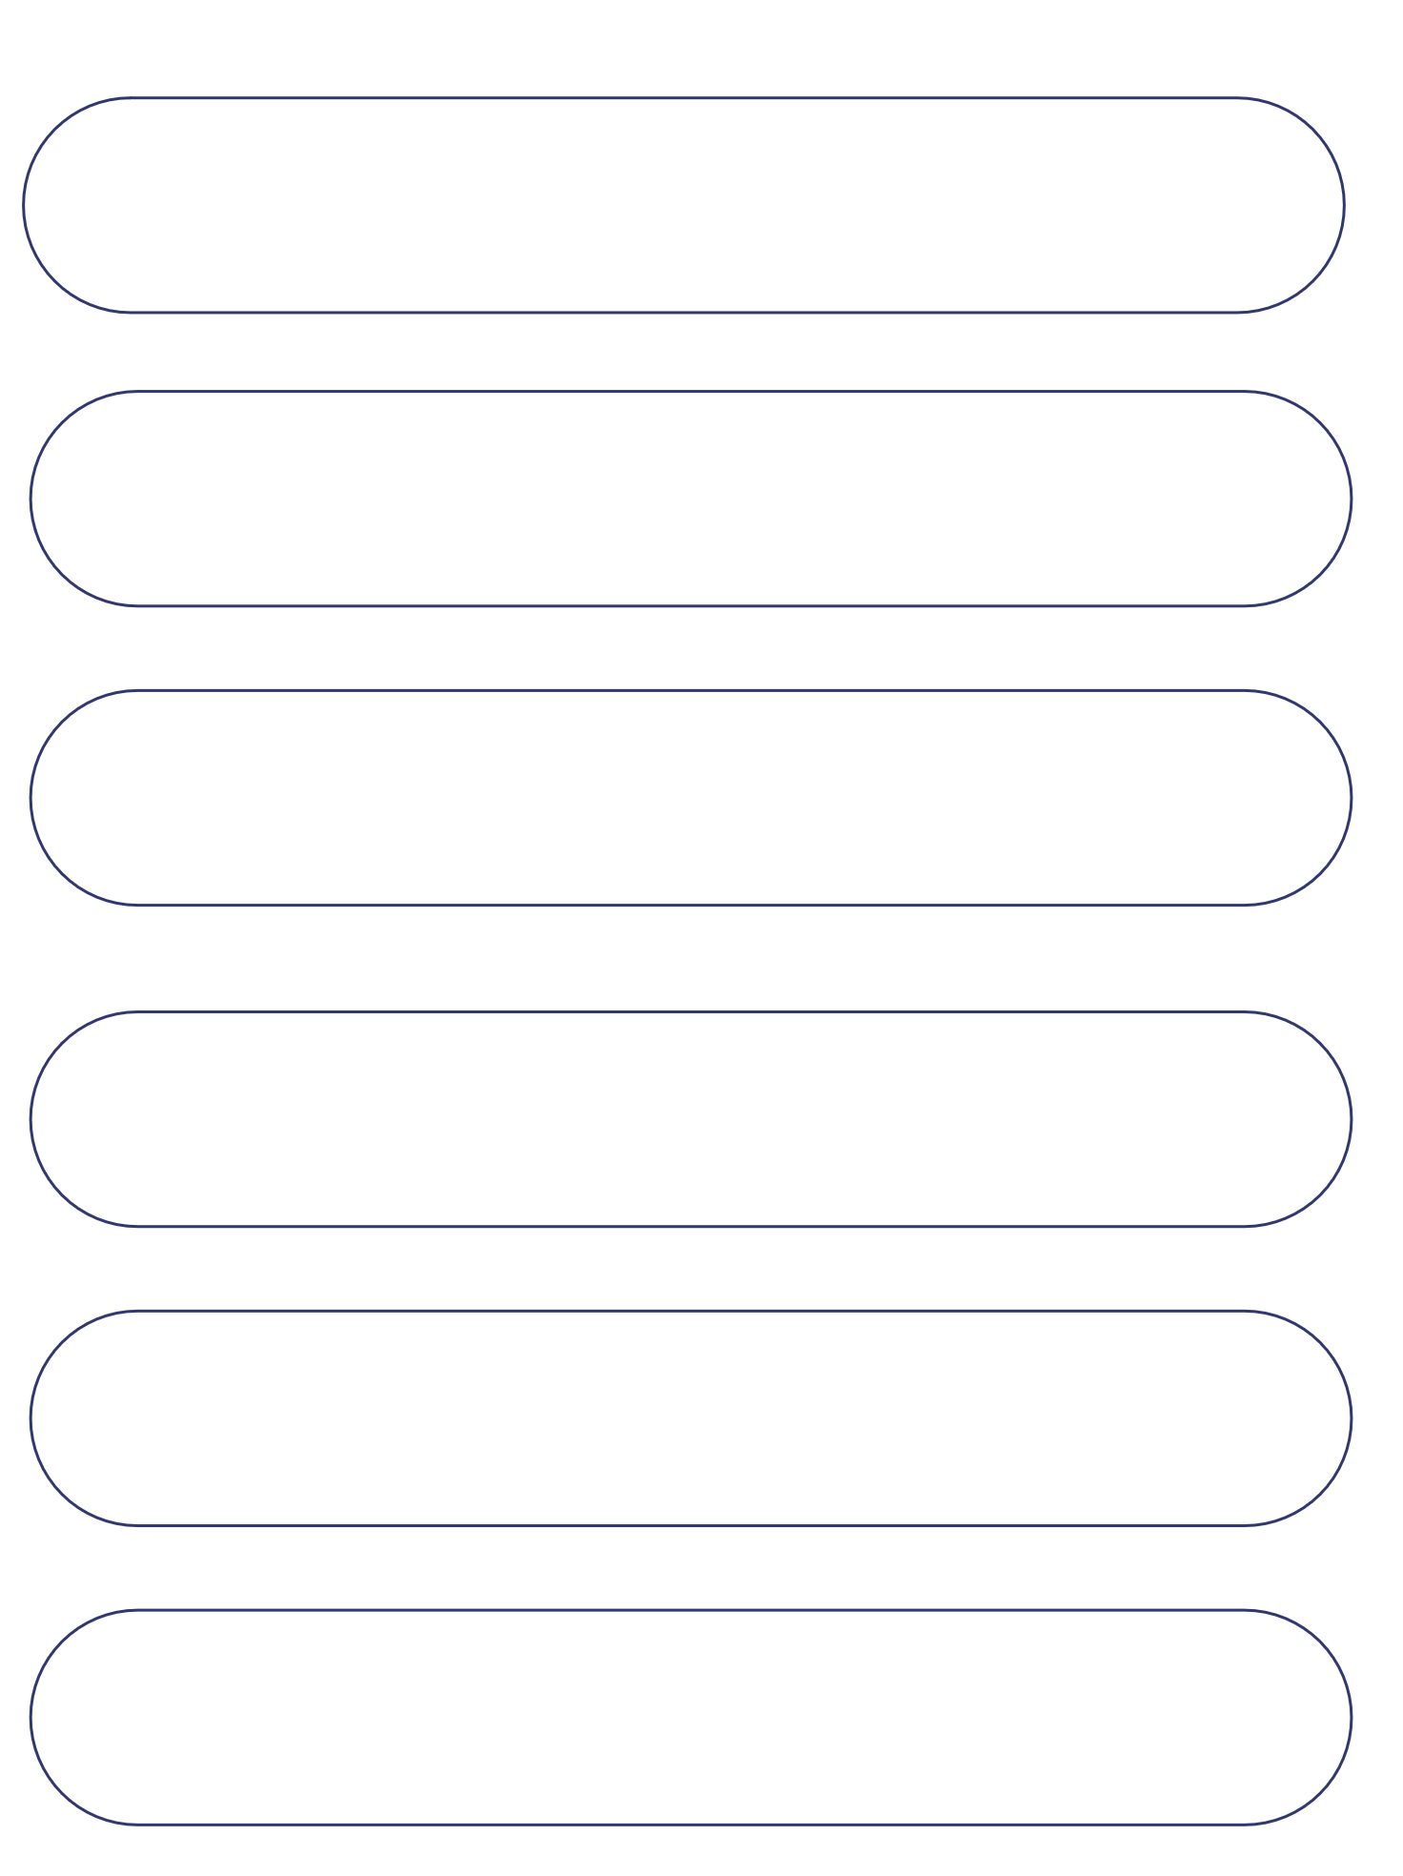
Project Walkthrough
01. Project Scope
07. DataCleaning
13.KeyInsights /Results
02.Problem Statement
08. Outlier Handling
14.Dashboard
03. Objectives
09. EDA
15.Demo Video
04. Project Workflow
10. Correlation Analysis
16.Future Enhancements
05. Dataset Overview
11. Feature Engineering
17.Team Contribution
06. Target Variable
12. PCA
18.Conclusion/Reference

Slide 3


Project Scope
What does our project cover?
Our project focuses on exploring demographic characteristics, substance-consumption responses and personality-related features in the selected Drug Consumption dataset. We analyse patterns across different age groups and genders, with special attention to the 18–24 age group, which we define as the youth segment in this project.
  Analysis of demographic characteristics.
  Exploration of 19 substance-consumption variables.
  Study of seven personality-related features.
  Comparison of patterns across age groups and gender.
  Focused analysis of participants aged 18–24.
  Interactive presentation of findings using Power BI.

Slide 4
Problem Statement
Substance consumption is a complex issue that may be associated with different demographic and personality-related factors. However, raw datasets are difficult to interpret directly. Our project aims to clean and analyse the Drug Consumption dataset, explore patterns in substance-consumption responses and identify relationships with demographic and personality features. The findings are presented through visualizations and an interactive Power BI dashboard to make the information easier to understand.

Slide 5
Objectives
Our main objectives are:
1. To understand the structure and characteristics of the selected dataset.
2. To identify and handle missing values in the dataset.
3. To inspect potential outliers and understand their impact.
4. To perform univariate and bivariate exploratory data analysis.
5. To study relationships between demographic, substance and personality variables.
6. To apply suitable feature engineering techniques.
7. To perform dimensionality reduction using Principal Component Analysis (PCA).
8. To develop an interactive dashboard for presenting the findings.

Slide 6
Project Workflow
*Dataset Collection*
↓
*Data Understanding*
↓
*Data Cleaning*
↓
*Outlier Detection*
↓
*Exploratory Data Analysis*
↓
*Correlation Analysis*
↓
*Feature Engineering*
↓
*Dimensionality Reduction (PCA)* ↓
*Power BI Dashboard*
↓
*Insights and Conclusion*

Slide 7

Dataset Overview
* Dataset Name: Drug Consumption UCI
* Source: Kaggle
* Total Records: 1,885
* Total Columns: 32
* Data Type: Structured / Tabular
* Age Group: 18–24 years (Youth)
* Main Variables: Demographic, Personality and Drug Consumption.
* Purpose: To identify youth drug-consumption patterns and relationships.

Slide 8
Target Variable
Our project does not use a single target variable because the main aim is exploratory analysis rather than predicting a particular outcome. Instead, we study demographic characteristics, 19 substance-consumption response variables and seven personality features to understand patterns and relationships in the dataset.
S.No | Variable Group | Variables Analysed
1 | Demographic | Age, Gender, Education, Country, Ethnicity
2 | Substance Consumption | 19 Substance-Response Variables
3 | Personality | Nscore, Escore, Oscore, Ascore, Cscore, Impulsive, SS

Slide 9
Data Cleaning
Data cleaning was performed to improve the quality and reliability of the dataset before analysis. During the initial inspection, missing values were identified in four columns. The dataset was cleaned and checked to ensure that the final dataset contained no missing values.
S.Nos | Data Quality Measure | Original Dataset | Cleaned Dataset
1 | Records | 1,885 | 1,885
2 | Columns | 32 | 35
3 | Missing Values | 452 | 0
4 | Duplicate Rows | 0 | 0

Slide 10
Outlier Handling
Outlier analysis was considered as part of the data-quality process. We reviewed how extreme observations can affect statistical measures and explored methods such as boxplots and Z-score analysis to identify potential outliers. An observation identified as an outlier should be investigated before deciding whether it needs to be removed.
  Used boxplot-based inspection to understand extreme values.
  Studied Z-score as a method for identifying unusual observations.
  Considered the effect of extreme values on mean and standard deviation.
  Avoided treating every unusual value as an error.

Slide 11
Exploratory Data Analysis
Exploratory Data Analysis was performed to understand the distribution of variables and examine relationships between selected features. Univariate analysis helped us study individual variables, while bivariate analysis helped us compare two variables and identify visible patterns.
Univariate analysis:
- Age-group distribution.
- Gender distribution.
- Education-level distribution.
- Personality-score distributions.
- Substance-response category frequencies.
Bivariate analysis
- Age Group vs Gender.
- Gender vs Alcohol.
- Age Group vs Alcohol.
- Education vs Alcohol.
- Nscore vs Escore.
- Nscore vs Oscore.

Slide 12
Correlation Analysis
Purpose:
Correlation analysis was used to understand the strength and direction of relationships between the seven personality features. It also helped us examine whether any features were strongly related to one another.
S.No | Analysis | Result
1 | Highest Reported Correlation | Impulsive and SS
2 | Correlation Coefficient | 0.623
3 | Strong-Correlation Threshold Used | 0.80
4 | Feature Pairs Crossing 0.80 | None
Key Observation:
The highest reported correlation was between Impulsive and SS, with a coefficient of 0.623. However, no pair of personality features crossed the project's 0.80 threshold. This suggests that no pair met the threshold used to flag strong correlation in our analysis.

Slide 13
Feature Engineering
Feature engineering was performed to prepare the dataset for further analysis and visualization. We identified the personality and substance-related variables, created additional demographic features and examined the distributions of the personality scores.
Techniques and work:
Identified seven personality features.
Treated 19 substance variables as categorical response variables.
Created Age_Group, Gender_Label and Education_Level.
Applied One-Hot Encoding to Gender.
Divided Nscore into bins for grouped analysis.
Examined the skewness of personality features.
Considered scaling and encoding for analysis.

Slide 14
Dimensionality Reduction
Principal Component Analysis (PCA) was applied to the seven personality features to reduce the dimensionality of the data while retaining most of the information. The analysis reduced the seven original features into six principal components, retaining approximately 95.07% of the total variance.
S.No | Measure | Result
1 | Original Features | 7
2 | Principal Components Retained | 6
3 | Variance Retained | 95.07%
What this means:
PCA represents the information from the original personality features using fewer components. The
six retained components preserve approximately 95.07% of the variance in the original seven features.

Slide 15
Key Insights / Results
* Dataset contains
1,885 participant records.
* Youth age group(18–24):
605 participants.
* Youth percentage
: 32.1%.
* Female participants
: 1,006.
* Male participants:
879.
* Missing values after cleaning:
0.
* PCA
retained 95.07% variance using six components.

Slide 16
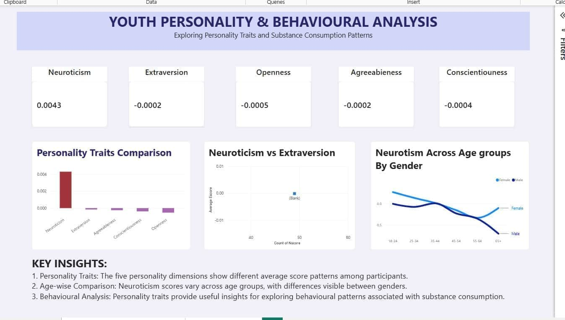
Visualization Dashboard

Slide 17
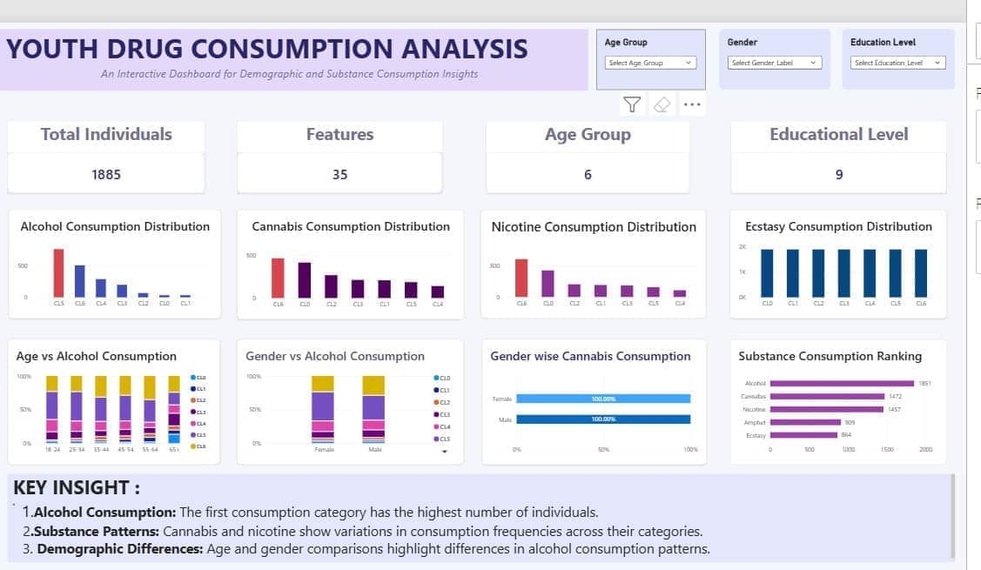
Visualization Dashboard

Slide 18
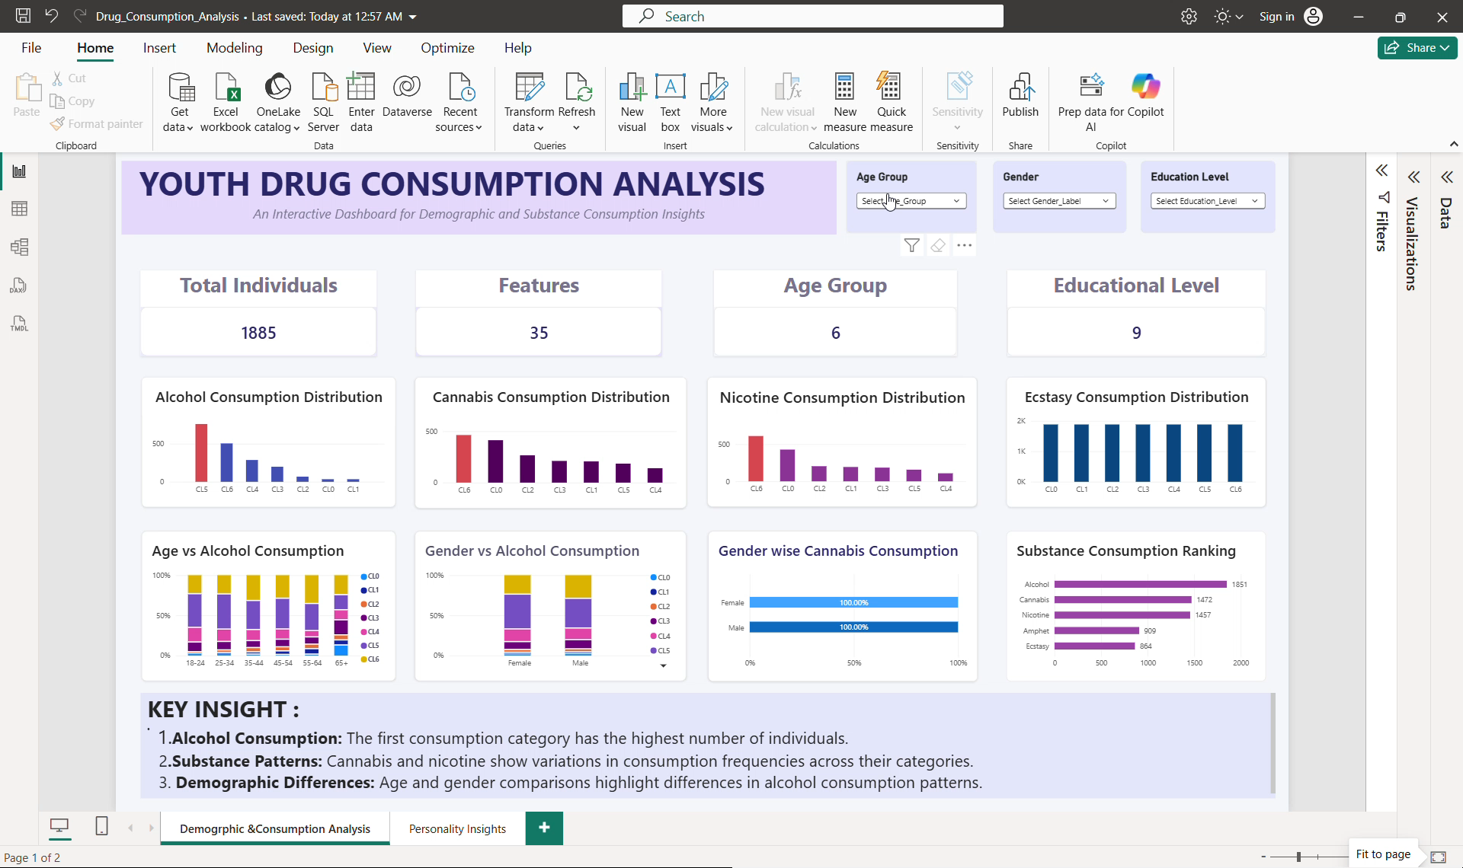
Demo Video

Slide 19
Conclusion and References
Through this project, we explored the Drug Consumption dataset and transformed the raw data into a cleaned and structured dataset suitable for analysis. We performed exploratory data analysis, examined relationships between personality features, applied feature engineering and used PCA for dimensionality reduction. Finally, we presented the findings through an interactive Power BI dashboard. This project helped us understand how data cleaning, statistical analysis and visualization can be combined to communicate meaningful insights.

Slide 20
Conclusion and References
References:
1. Kaggle – [Drug Consumption UCI (Missing Values)](https://www.kaggle.com/datasets/thelonestar033/drug-consumption-uci-missing-values?)
2. Python documentation – [Python](https://docs.python.org/3/?)
3. Pandas documentation – [Pandas](https://pandas.pydata.org/docs/?)
4. Scikit-learn documentation – [Scikit-learn](https://scikit-learn.org/stable/?)
5. Microsoft Power BI – [Power BI](https://learn.microsoft.com/en-us/power-bi/?)

