Slide 1


Lecture 1: Floating Point and ODEs
Sasha Tchekhovskoy atchekho@northwestern.edu
Thanks K. Hahn for some slides!

Slide 2

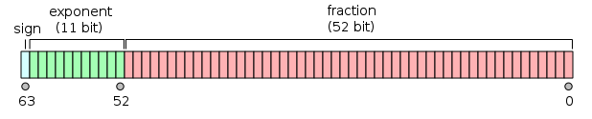
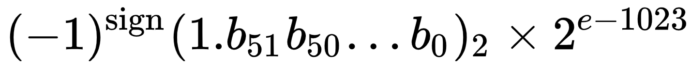


What’s Floating? Point!
How does computer represent the number $π$? Floating point!
binary32 (IEEE 754)
float32 (python)
$$=1.25×2^{124−127}=0.15625$$
binary64 (IEEE 754)
float64 (python)
Source: Wikipedia

Slide 3
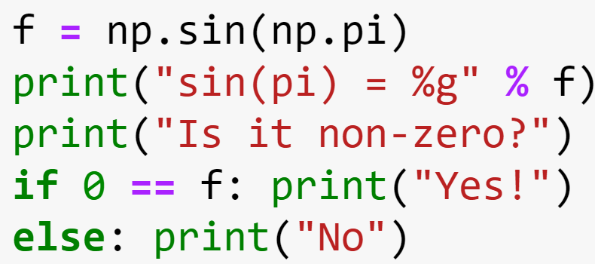
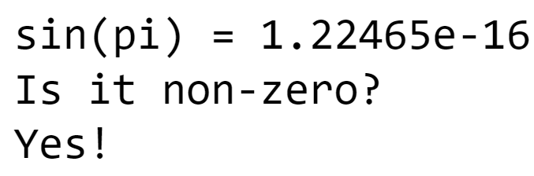
Is sin(π) zero?
Comparing floating point numbers is dangerous
Always leave room for round-off error:
bad: a == b
good: fabs(a - b) < 10*eps
epsm = np.finfo(np.float64).eps
On my machine, it is 2.220446e-16
Defined as the smallest number resolvable relative to unity: (1.0 + eps) != 1.0 and (1.0 + eps/2) == 1.0
How would you compute it?
$ ./test2.exe
sin(pi) = 1.224647e-16
Is it non-zero? Yes!

Slide 4
Let us compute eps for np.float64! Can you do it inside your jupyter notebook? Jupyter notebook: atchekho/cofi
(1.0 + epsm) != 1.0 (1.0 + epsm/2) == 1.0

Slide 5
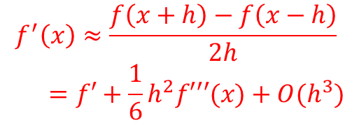
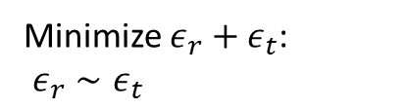


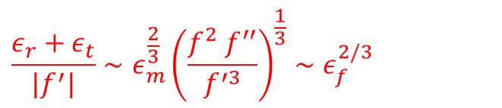
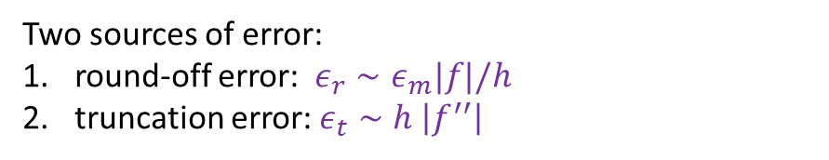





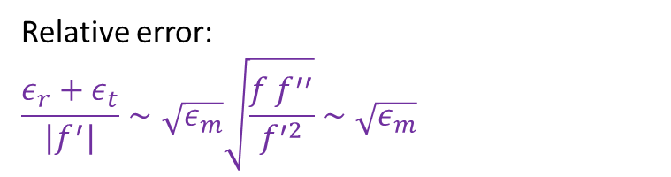
Let’s compute a derivative!
Forward difference:
1st order truncation error
Central difference:
$$f^{′}\left(x\right)≈\frac{f\left(x+h\right)−f\left(x\right)}{h}$$
$$=f^{′}+\frac{1}{2}hf^{′′}+O(h^{2})$$
$$f^{′}\left(x\right)≈\frac{f\left(x+h\right)−f\left(x−h\right)}{2h}$$
$$=f′+\frac{1}{6}h^{2}f′′′(x)+O(h^{3})$$
$$f\left(x+h\right)=f\left(x\right)+hf^{′}\left(x\right)+\frac{1}{2}h^{2}f^{′′}\left(x\right)+\frac{1}{6}h^{3}f′′′(x)+O(h^{3})$$
2nd order truncation error
Two sources of error:
round-off error: $ε_{r}∼ε_{m}|f|/h$
truncation error: $ε_{t}∼h \left|f^{′′}\right|$
$$ε_{r}∼ε_{m}|f|/h$$
$$ε_{t}∼h^{2}f′′′$$
Minimize $ε_{r}+ε_{t}$: $ε_{r}∼ε_{t}$
$$→h∼\sqrt{\frac{ε_{m}f}{f^{′′}}}≈\sqrt{ε_{m}}x_{c}$$
$$h∼ε_{m}^{1/3}x_{c}$$
$(x_{c}=\sqrt{f/f′′}$ = “curvature scale”)
Relative error:
$$\frac{ε_{r}+ε_{t}}{|f^{′}|}∼\sqrt{ε_{m}}\sqrt{\frac{f f^{′′}}{f^{′2}}}∼\sqrt{ε_{m}}$$
$$\frac{ε_{r}+ε_{t}}{|f^{′}|}∼ε_{m}^{\frac{2}{3}}{\left(\frac{f^{2} f^{′′}}{f^{′3}}\right)}^{\frac{1}{3}}∼ε_{f}^{2/3}$$
(Numerical recipes)

Slide 6
Let us compute derivatives for sin(x) and compute the error!

Slide 7
Let’s compute a derivative on a grid!
Use central difference:
$$f^{′}\left(x\right)≈\frac{f\left(x+h\right)−f\left(x−h\right)}{2h}=f^{′}+\frac{1}{6}h^{2}f′′′(x)+O(h^{3})$$

Slide 8
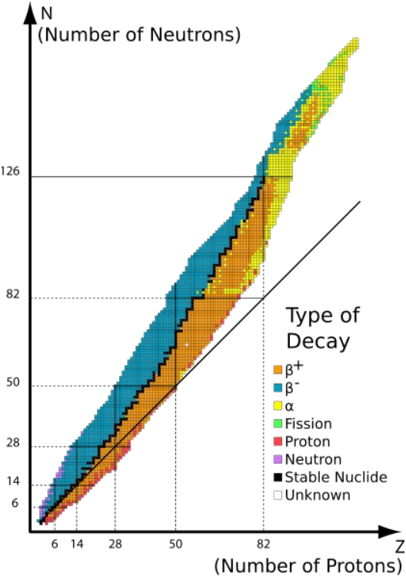
Radioactive Decay
● Several types of
Radioactive decay,
categorized by decay
products
– Different forces at work
● Alpha & gamma (fission) :
interplay of electrostatic and
residual strong nuclear
● Beta : the weak force
● Elements with >82 protons
have no stable isotopes
– U235 has 92p, 146n
Slides courtesy K.Hahn

Slide 9
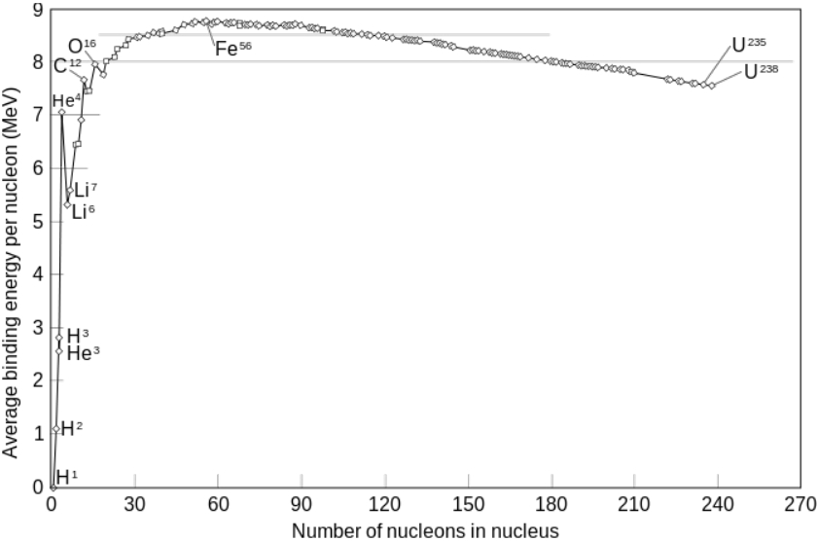
Why 82?
● Specific binding energy starts to decrease
– Nucleus too large for residual strong force to hold
together, electrostatic repulsion dominates
– Energetically favorable to split into lighter daughters

Slide 10
Universal Law of Radioactive Decay
● All types of decay follow the same statistical
behavior
dN/dt = -N/τ
N(t) = N(0)e^{-t/τ}
– Mean lifetime of a nucleus is 1/τ = λ
● Applicable to any process with a probability of
change proportional to instantaneous value
– Capacitor discharge, heat transfer, etc

Slide 11
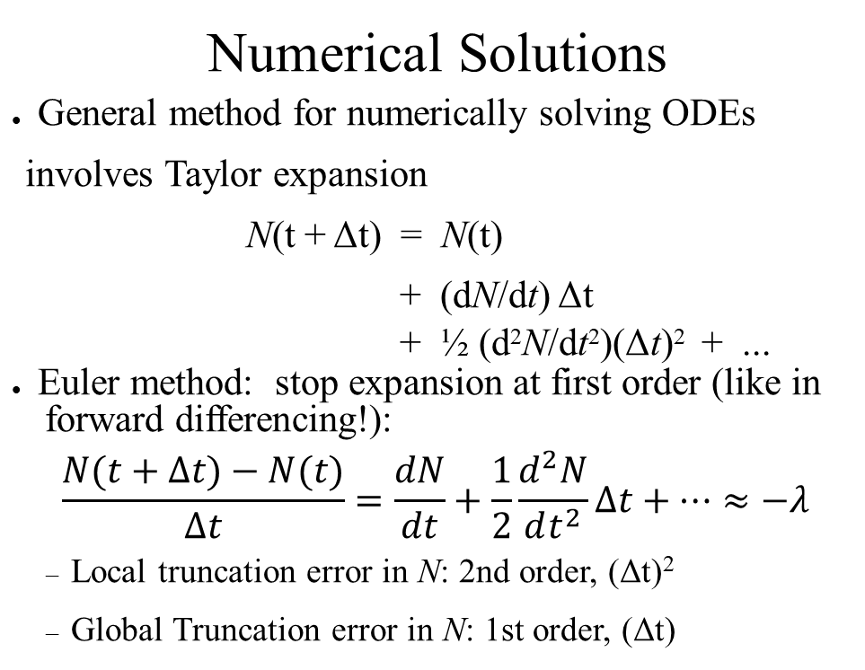
Numerical Solutions
● General method for numerically solving ODEs
involves Taylor expansion
N(t + Δt) = N(t)
+ (dN/dt) Δt
+ ½ (d²N/dt²)(Δt)² + ...
● Euler method: stop expansion at first order (like in forward differencing!):
$$\frac{N(t+Δt)−N(t)}{Δt}=\frac{dN}{dt}+\frac{1}{2}\frac{d^{2}N}{dt^{2}}Δt+…≈−λ$$
– Local truncation error in N: 2nd order, (Δt)²
– Global Truncation error in N: 1st order, (Δt)

Slide 12
Runge-Kutta Methods
● The more general class of explicit ODE solvers
– Euler method is a first order RK approach
– Actually, “ODEs” means ODE initial value problems at t
moment
● Re-statement of the problem:
dx(t)/dt = f(x,t)
x(t+ Δt) = x(t)
+ (dx/dt) Δt
+ (½)(d²x/dt²)(Δt)² + ...
Euler says:
x(ti+1) ≈ x(ti) + f(x(ti),ti) Δt

Slide 13
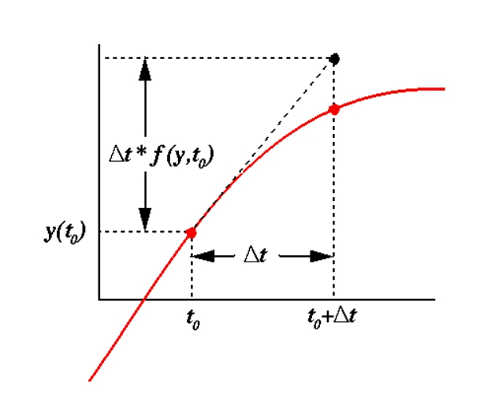
● The (local) error in our projection is 2nd order
and related to the curvature of the function
x(t) between the steps

Slide 14
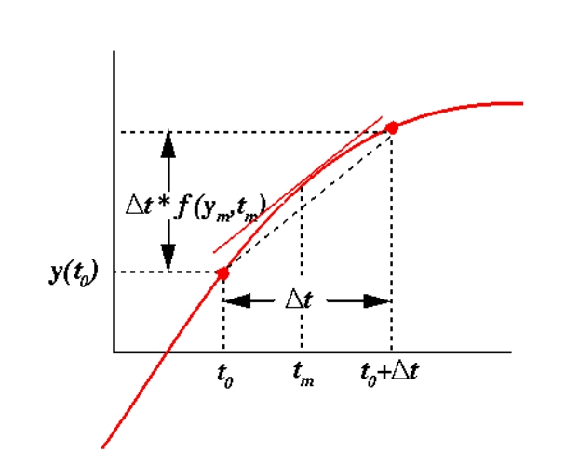
● We could get the exact solution if we knew just
the right point (tm) at which to evaluate the
slope
● RK methods are iterative approaches that try
to zero-in on the solution

Slide 15
O(2) Runge-Kutta
t' = t + (1/2) Δt
x ' = x(t) + (1/2)f(x(t),t) Δt
x(t+ Δt) = x(t) + f(x',t') Δt
where
– t' is the midpoint of the interval
– x' is the Euler approximation of x(t) at t'
● Computational costs increase by ~2x
– But LTE, GTE goes as Δt³ , Δt² !

Slide 16
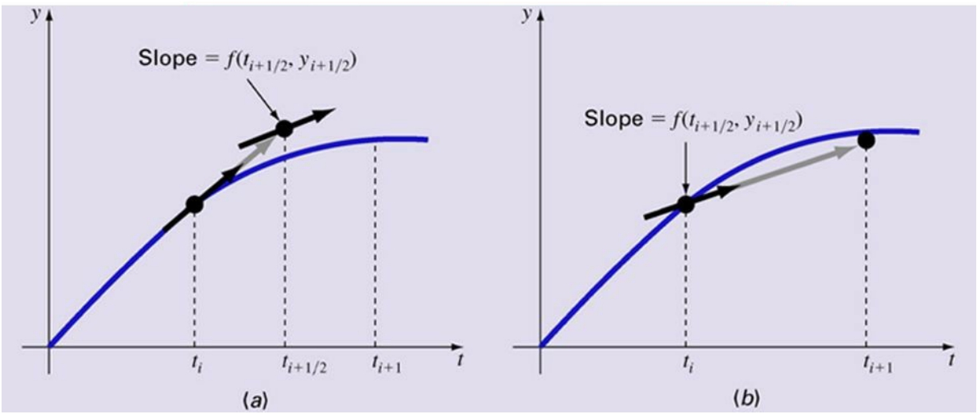

Slide 17
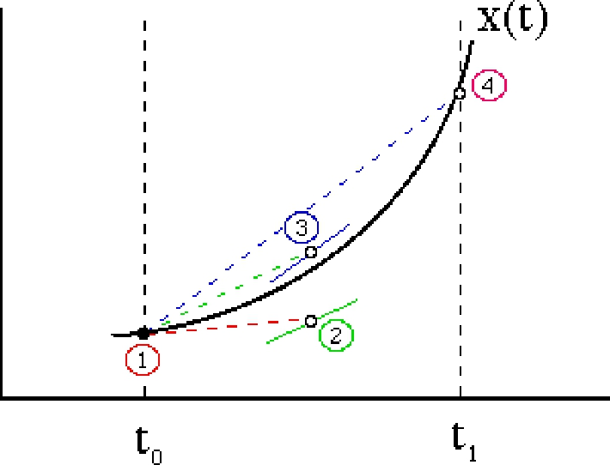
O(4) Runge-Kutta
x1' = x(t) t1' = t
x2' = x(t) + (1/2)f(x1',t1')Δt t2' = t + (1/2) Δt
x3' = x(t) + (1/2)f(x2',t2')Δt t3' = t + (1/2) Δt
x4' = x(t) + f(x3',t3')Δt t4' = t + Δt
x(t+ Δt) = x(t)
+ (1/6)[f(x1',t1')
+ 2f(x2',t2')
+ 2f(x3',t3')
+ f(x4',t4')] Δt

Slide 18
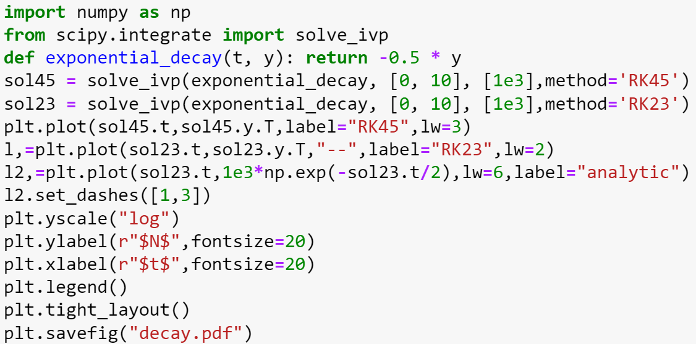
● Radioactive decay code in python
Source: scipy manual

Slide 19
Let’s compare RK23 and RK45 method solutions against the analytic one: which one is more accurate? How can you control the accuracy of the method (see scipy manual)?

