Slide 1


While you are waiting for the workshop to begin, please launch Spyder.
All code and slides covered today are on my Github: https://github.com/atchen/python_workshop_part2
Introduction to Python for
Biological Data Analysis: Part 2
Ann Chen
PhD student in BME
August 8, 2018

Slide 2

Acknowledgements
This workshop is an extremely condensed version of the various Python courses he teaches.
I highly recommend visiting his website (bois.caltech.edu) and checking out BE/Bi/NB 203 and BE/Bi 103.
Most lessons are open-access.
Justin Bois
Lecturer, Division of Biology
and Biological Engineering at Caltech

Slide 3
Review of part 1
Data type | Definition | Called by | Mutable?
integer | any whole number | an integer | no
float | any real, non-whole number | a float | no
string | a sequence of characters | single, double, or triple quotes | no
list | a sequence of objects | [ ] | yes
tuple | a sequence of objects | ( ) | no
3

Slide 4
Review of part 1
my_list = [1, 3.49, 'apple', (1,'orange')]
print('the type of my_list is', type(my_list))
print('the type of my_list[0] is', type(my_list[0]))
print('the type of my_list[1] is', type(my_list[1]))
print('the type of my_list[2] is', type(my_list[2]))
print('the type of my_list[3] is', type(my_list[3]))
#lists are mutable
my_list[0] = 5
print(my_list)
#tuples are immutable
my_tuple = (1, 2)
my_tuple[0] = 2 #this will result in an error
my_list[3][0] = 2 #this will also result in an error
4

Slide 5
Review of part 1
def append_a(test_list):
'''
Adds the str 'a' after each element in a user-defined list.
ex: input = [1, 2]. output = [1, 'a', 2, 'a']
'''
new_list = []
for i in test_list:
new_list.append(i)
new_list.append('a')
return new_list
print(append_a(my_list))
5

Slide 6
Today’s agenda
Today, we will use what we learned to analyze datasets from published articles using the Pandas package.
In addition, we will go over how to plot our data using two different packages: seaborn and matplotlib.
We will be covering three datasets from Grant PR, et al, Kleinteich T, et al., and Darmanis S, et al., respectively.

Slide 7
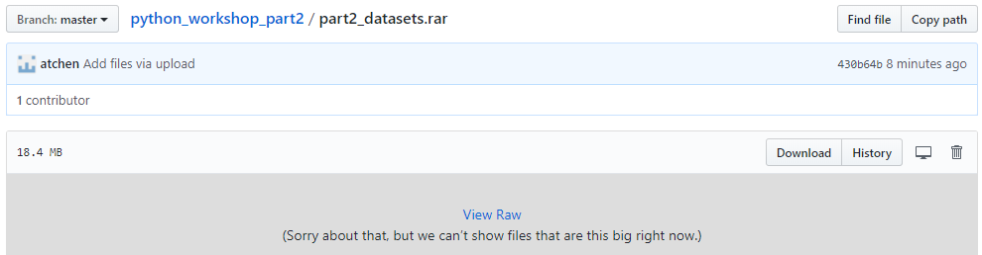
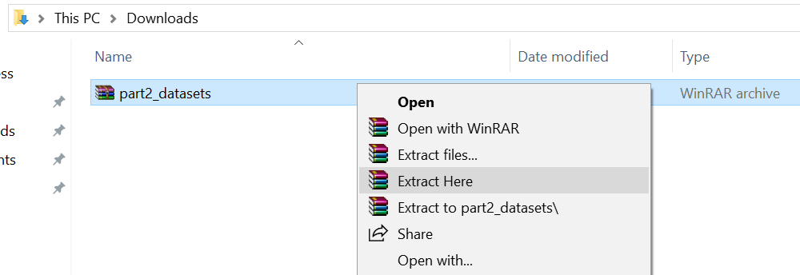
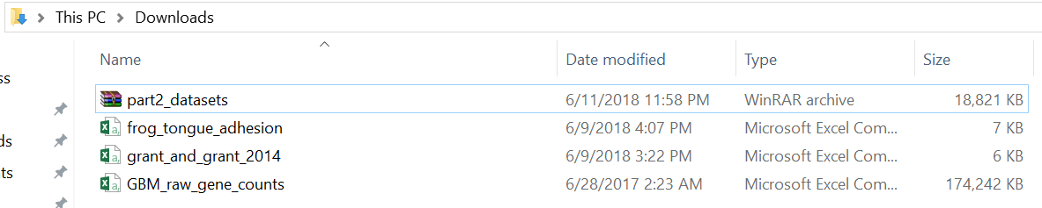
Download and extract files from Github
1.
2.
3.

Slide 8
Loading a CSV file
Download the file grant_and_grant_2014.csv and load it
import pandas as pd
import numpy as np
import matplotlib.pyplot as plt
#use pd.read_csv() to read in the data and store in a DataFrame
df = pd.read_csv('C:/Users/Ann/Downloads/grant_and_grant_2014.csv', comment='#')
df.head()
The data is stored in a dataframe, a data type that Panda uses for convenient data analysis.
This dataset investigates the heritability of beak depth. It includes the maternal beak depth, paternal beak depth, and mean offspring beak depth.
Grant, PR, Grant, BR (2014) 40 years of evolution: Darwin's finches on Daphne Major Island. Princeton: Princeton University Press. http://www.worldcat.org/oclc/854285415

Slide 9
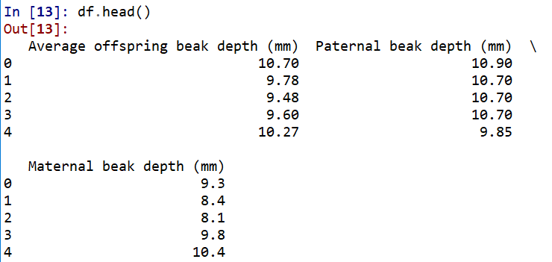
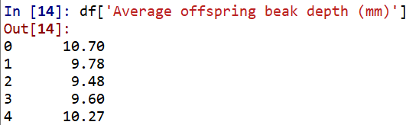
Dataframe columns
To access a column in a dataframe, use the following syntax
#slicing a column out of a dataframe by using the column name
df['Average offspring beak depth (mm)']

Slide 10
Slicing dataframes with Booleans
Let’s say we only want rows with average offspring beak depth ≥ 11 mm. Pandas dataframes can be conveniently sliced with Booleans.
#only want indices with offspring beak depth >= to 11 mm
inds = df['Average offspring beak depth (mm)'] >= 11
inds
inds is an array of Booleans that is the same length of the dataframe.
It is True when the condition is met and False if it is not.
#slice out rows we want
df_big_offspring_bd = df.loc[inds]
df_big_offspring_bd
Indexing of rows is preserved.

Slide 11
Indexing with loc
Using .loc allows us to index by row. We put an array of Booleans and get back a dataframe containing rows associated with True in the arrays of Booleans.
Notice, the original indexing of rows is preserved.
For example, there is no index 2.
#this will result in an error
df_big_offspring_bd.loc[2]
To get around this, use .iloc which gives indexing with sequential integers.
#this will return the third row
df_big_offspring_bd.iloc[2]

Slide 12
Renaming columns
Pandas has a nice method for renaming column headers.
Let’s rename the columns to
‘Average offspring beak depth (mm)’ → ‘avg_offspring_bd’
‘Paternal beak depth (mm) → ‘paternal_bd’
‘Maternal beak depth (mm) → ‘maternal_bd’
rename_dict = {'Average offspring beak depth (mm)' : 'avg_offspring_bd', \
'Paternal beak depth (mm)' : 'paternal_bd', \
'Maternal beak depth (mm)' : 'maternal_bd'}
df = df.rename(columns=rename_dict)
df.head()

Slide 13
NumPy arrays from dataframe columns
offspring_bd = df['avg_offspring_bd'].values
paternal_bd = df['paternal_bd'].values
maternal_bd = df['maternal_bd'].values
Now the values of the column are stored in a NumPy array (uses same notation for indexing as a list)
Let’s calculate the mean parental beak depth. Conveniently, we don’t need to use a for loop for each parent pair.
parental_bd = (paternal_bd + maternal_bd) / 2

Slide 14
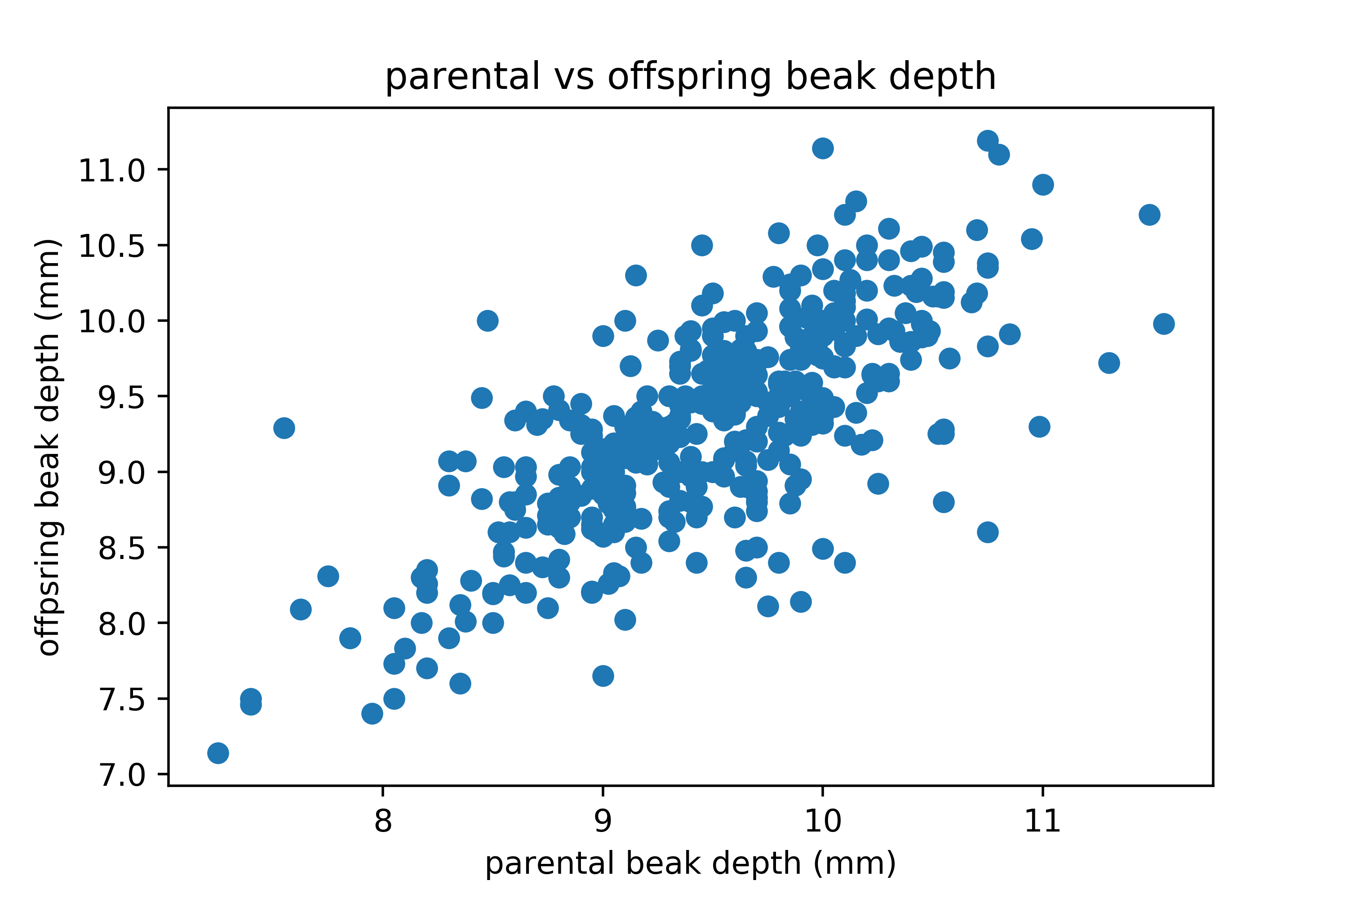
Scatterplots
#plot mean parental beak depth vs mean offspring beak depth
plt.scatter(parental_bd, offspring_bd)
plt.xlabel('parental beak depth (mm)')
plt.ylabel('offpsring beak depth (mm)')
plt.title('parental vs offspring beak depth')
plt.savefig('scatter.png', dpi=500)

Slide 15
Linear regression with SciPy
Let’s perform a linear regression to get the slope and intercept of the data.
scipy.optimize.curve_fit() takes a set of data and returns the parameters of the model function that best describes the data.
import scipy.optimize
def linear_fun(x, slope, intercept):
return slope * x + intercept
#compute the curve fit (guess is unit slope and zero intercept)
popt, covar = scipy.optimize.curve_fit(linear_fun, parental_bd, offspring_bd,
p0=[1,0])
scipy.optimize.curve_fit(model function, x-data, y-data, guess for parameters). Read the documentation for more information about this function.

Slide 16
Linear regression with SciPy
scipy.optimize.curve_fit() returns two arrays. The first contains the optimal set of parameters for the curve fit. The second is a 2D array with the covariance of the parameters.
#parse the results
slope, intercept = popt
#print the results
print('slope =', slope)
print('intercept = ', intercept, 'mm')
slope = 0.722905188545
intercept = 2.44841830979 mm

Slide 17
Scatterplot with line of best fit
#define range for line
x = np.array([7, 12])
y = linear_fun(x, slope, intercept)
plt.scatter(parental_bd, offspring_bd)
plt.plot(x, y, color='red', linewidth=2)
plt.xlabel('parental beak depth (mm)')
plt.ylabel('offpsring beak depth (mm)')
plt.title('parental vs offspring beak depth')
plt.text(10.5, 8, 'y=%.2fx + %.2f' %(slope, intercept), fontsize=10)
plt.savefig('scatter_w_line.png', dpi=500)

Slide 18
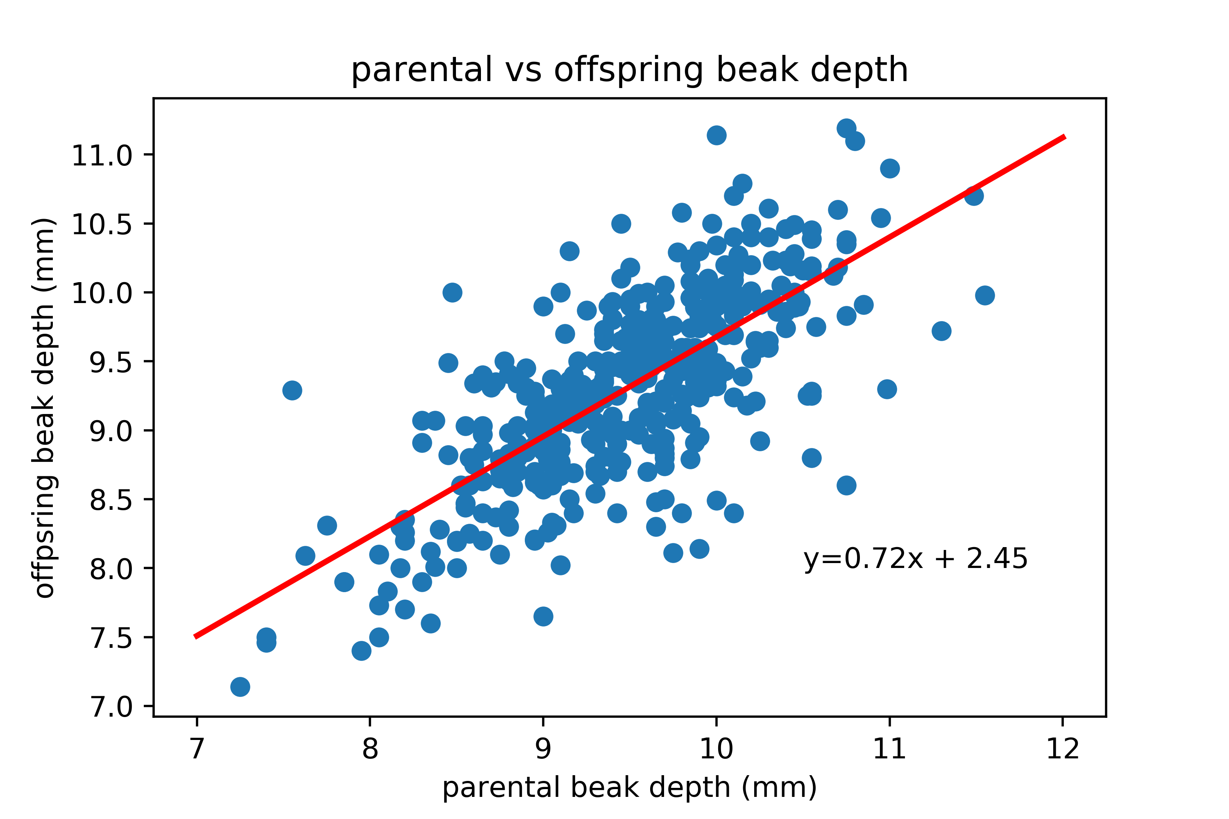
Scatterplot with line of best fit

Slide 19
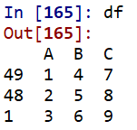
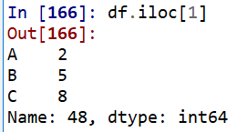
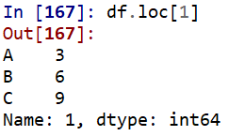
Making a dataframe
#use a dictionary to make a dataframe
data_dictionary = {'A': [1, 2, 3], 'B': [4, 5, 6], 'C': [7, 8, 9]}
df = pd.DataFrame(data=data_dictionary, index=[49, 48, 1])
More practice with loc and iloc:
#returns the second row
df.iloc[1]
#returns the row with the index 1 (third row in this dataframe)
df.loc[1]

Slide 20
Frog tongue adhesion
In this dataset, the authors looked at the adhesive strength of the tongue for South American horned frogs. Each row is an experiment where they recorded different metrics.
#read dataset and store in dataframe
df = pd.read_csv('C:/Users/Ann/Downloads/frog_tongue_adhesion.csv', comment='#')
df.head()
 | date | ID | trial number | impact force (mN) | impact time (ms) | impact force / body weight | adhesive force (mN) | time frog pulls on target (ms) | adhesive force / body weight | adhesive impulse (N-s) | total contact area (mm2) | contact area without mucus (mm2) | contact area with mucus / contact area without mucus | contact pressure (Pa) | adhesive strength (Pa)
0 | 2013_02_26 | I | 3 | 1205 | 46 | 1.95 | -785 | 884 | 1.27 | -0.290 | 387 | 70 | 0.82 | 3117 | -2030
1 | 2013_02_26 | I | 4 | 2527 | 44 | 4.08 | -983 | 248 | 1.59 | -0.181 | 101 | 94 | 0.07 | 24923 | -9695
2 | 2013_03_01 | I | 1 | 1745 | 34 | 2.82 | -850 | 211 | 1.37 | -0.157 | 83 | 79 | 0.05 | 21020 | -10239
3 | 2013_03_01 | I | 2 | 1556 | 41 | 2.51 | -455 | 1025 | 0.74 | -0.170 | 330 | 158 | 0.52 | 4718 | -1381
4 | 2013_03_01 | I | 3 | 493 | 36 | 0.80 | -974 | 499 | 1.57 | -0.423 | 245 | 216 | 0.12 | 2012 | -3975
Kleinteich T, Gorb SN (2014) Tongue adhesion in the horned frog Ceratophrys sp. Sci Rep. 2014 Jun 12;4:5225. doi: 10.1038/srep05225.

Slide 21
Data extraction
Let’s extraction the experiment with index 42.
#extract experiment with index 42
df.loc[42]
We can also use Boolean slicing to extract data.
Let’s say we want to look at trial number 3 on May 27, 2013 of frog III.
This is a more common and meaningful case.
#set up boolean slicing
date = df['date'] == '2013_05_27'
trial = df['trial number'] == 3
ID = df['ID'] == 'III'
#slice out the row
df_slice = df.loc[date & trial & ID]

Slide 22
Computing with dataframes and inserting columns
Let’s make a new column with impact force in Newtons. We can divide the impact force (mN) column elementwise by 1000, just as with arrays.
#add a new columns with impact force in units of newtons
df['impact force (N)'] = df['impact force (mN)'] / 1000
df.head()

Slide 23
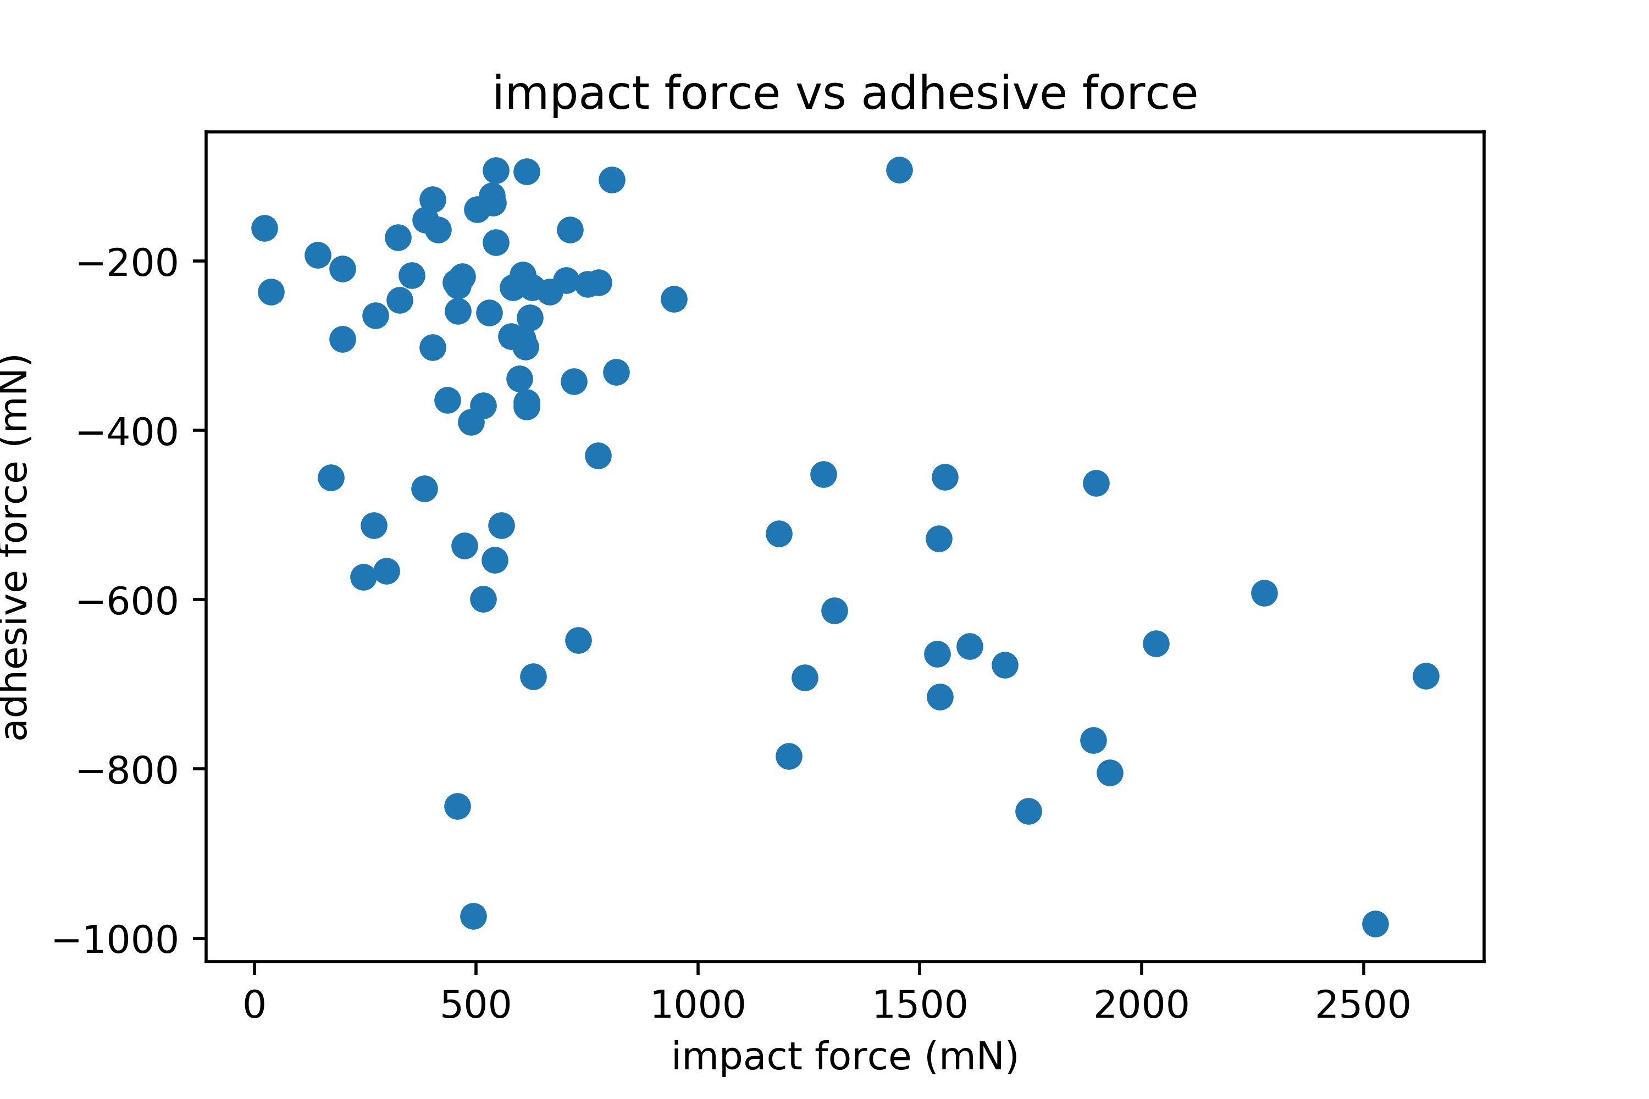
Plotting how impact force correlates with other metrics
plt.scatter(df['impact force (mN)'], df['adhesive force (mN)'])
plt.xlabel('impact force (mN)')
plt.ylabel('adhesive force (mN)')
plt.title('impact force vs adhesive force')
plt.savefig('frog_scatter.png', dpi=500)

Slide 24
Making subplots
Let's say we want to plot the adhesive force, total contact area, impact time, and contact pressure against impact force.
# set figure = fig and subplots = ax
fig, ax = plt.subplots(4, sharex=True)
plt.xlabel('impact force (mN)')
ax[0].scatter(df['impact force (mN)'], df['impact time (ms)'])
ax[1].scatter(df['impact force (mN)'], df['adhesive force (mN)'])
ax[2].scatter(df['impact force (mN)'], df['total contact area (mm2)'])
ax[3].scatter(df['impact force (mN)'], df['contact pressure (Pa)'])
fig.savefig('frog_subplots.png',dpi=500)

Slide 25
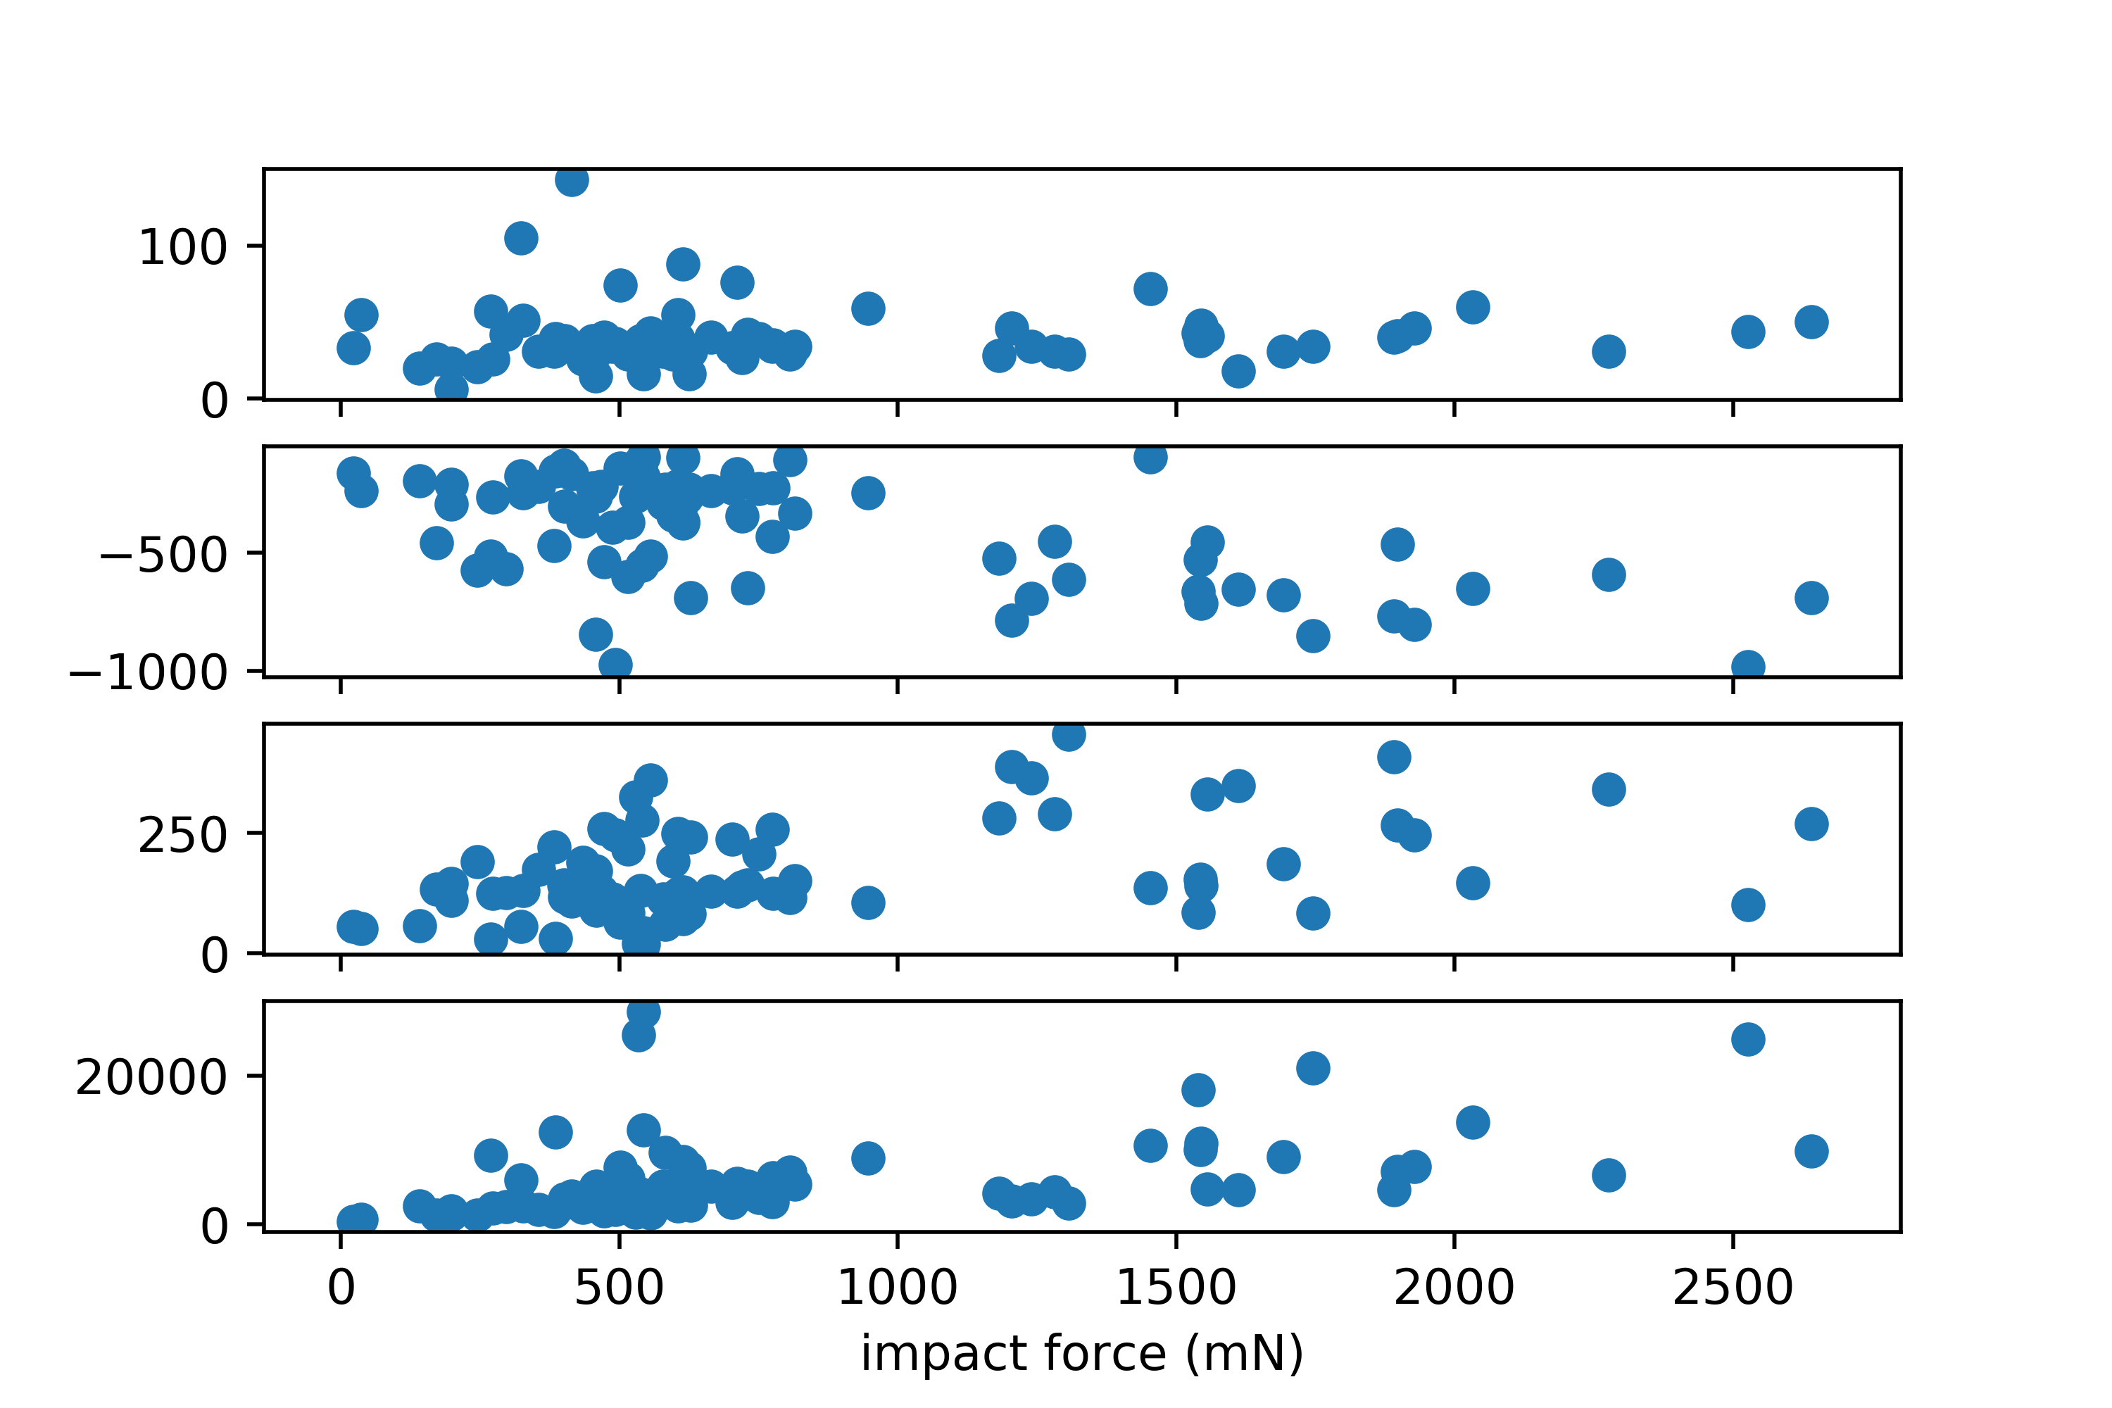
Making subplots
Figure seems a bit stretched out, and there are no y-axis labels.

Slide 26
Subplot parameters
fig, ax = plt.subplots(4, sharex=True, figsize=(7,10))
plt.xlabel('impact force (mN)')
ax[0].scatter(df['impact force (mN)'], df['impact time (ms)'])
ax[0].set_ylabel('impact time (ms)')
ax[0].get_yaxis().set_label_coords(-0.15, 0.5)
ax[1].scatter(df['impact force (mN)'], df['adhesive force (mN)'])
ax[1].set_ylabel('adhesive force (mN)')
ax[1].get_yaxis().set_label_coords(-0.15, 0.5)
ax[2].scatter(df['impact force (mN)'], df['total contact area (mm2)'])
ax[2].set_ylabel('total contact area ($mm^2$)')
ax[2].get_yaxis().set_label_coords(-0.15, 0.5)
ax[3].scatter(df['impact force (mN)'], df['contact pressure (Pa)'])
ax[3].set_ylabel('contact pressure (Pa)')
ax[3].get_yaxis().set_label_coords(-0.15, 0.5)
plt.tight_layout()
fig.savefig('frog_subplots.png',dpi=500)

Slide 27
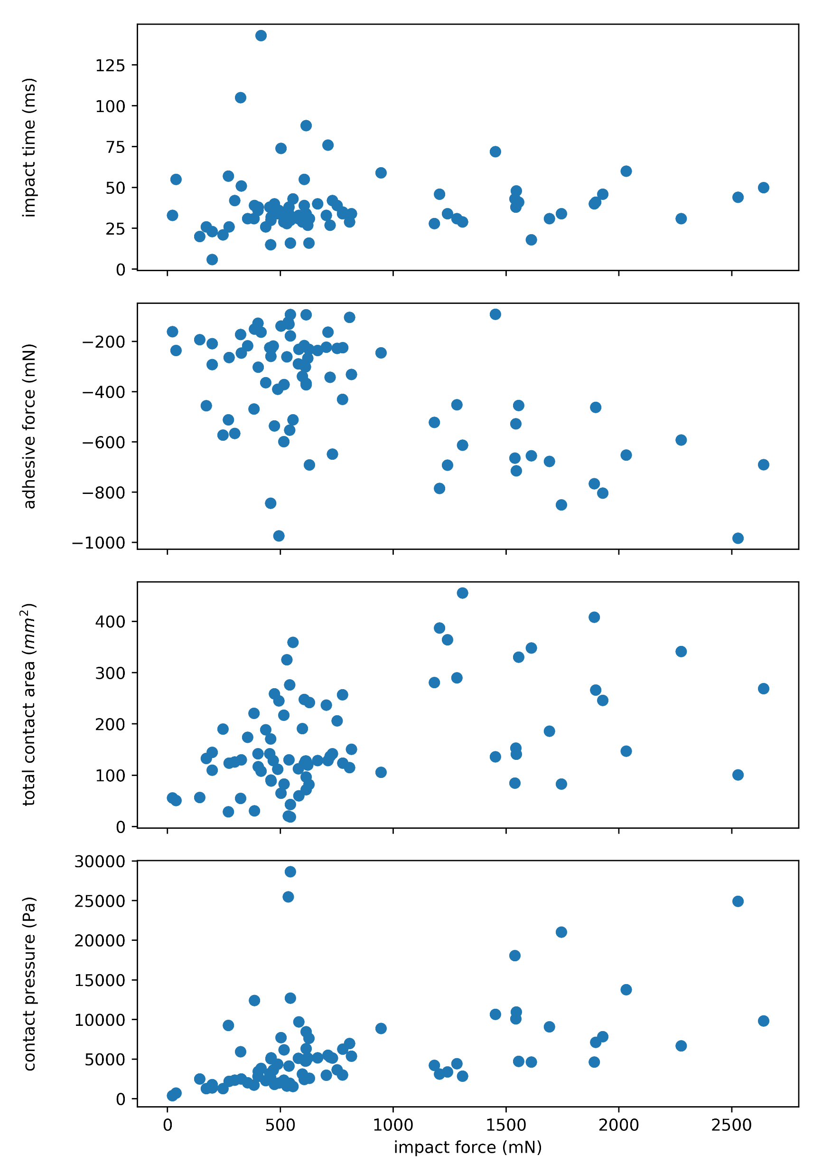
Subplot parameters
Summary of what was changed:
Set y-axis labels for subplots
Change figure size
Align y-axis labels for subplots
Improve spacing with plt.tightlayout()

Slide 28
enumerate() as a tool for plotting
subplot_list = ['impact time (ms)', 'adhesive force (mN)', \
'total contact area (mm2)', 'contact pressure (Pa)']
#enumerate function example
for i,e in enumerate(subplot_list):
print(i)
print(e)
It allows us to loop over something and have an automatic counter.

Slide 29
Subplots with enumerate()
#same as before
fig, ax = plt.subplots(4, sharex=True, figsize=(7,10))
plt.xlabel('impact force (mN)')
#instead of typing out each subplot individually, use a for loop
for i,e in enumerate(subplot_list):
ax[i].scatter(df['impact force (mN)'], df[e])
ax[i].set_ylabel(e)
ax[i].get_yaxis().set_label_coords(-0.15, 0.5)
plt.tight_layout()
plt.xlabel('impact force (mN)')
fig.savefig('frog_subplots_looped.png',dpi=500)
ax[0].scatter(df['impact force (mN)'], df['impact time (ms)'])
ax[0].set_ylabel('impact time (ms)')
ax[0].get_yaxis().set_label_coords(-0.15, 0.5)
ax[1].scatter(df['impact force (mN)'], df['adhesive force (mN)'])
ax[1].set_ylabel('adhesive force (mN)')
ax[1].get_yaxis().set_label_coords(-0.15, 0.5)
ax[2].scatter(df['impact force (mN)'], df['total contact area (mm2)'])
ax[2].set_ylabel('total contact area ($mm^2$)')
ax[2].get_yaxis().set_label_coords(-0.15, 0.5)
ax[3].scatter(df['impact force (mN)'], df['contact pressure (Pa)'])
ax[3].set_ylabel('contact pressure (Pa)')
ax[3].get_yaxis().set_label_coords(-0.15, 0.5)
for i,e in enumerate(subplot_list):
ax[i].scatter(df['impact force (mN)'], df[e])
ax[i].set_ylabel(e)
ax[i].get_yaxis().set_label_coords(-0.15, 0.5)

Slide 30
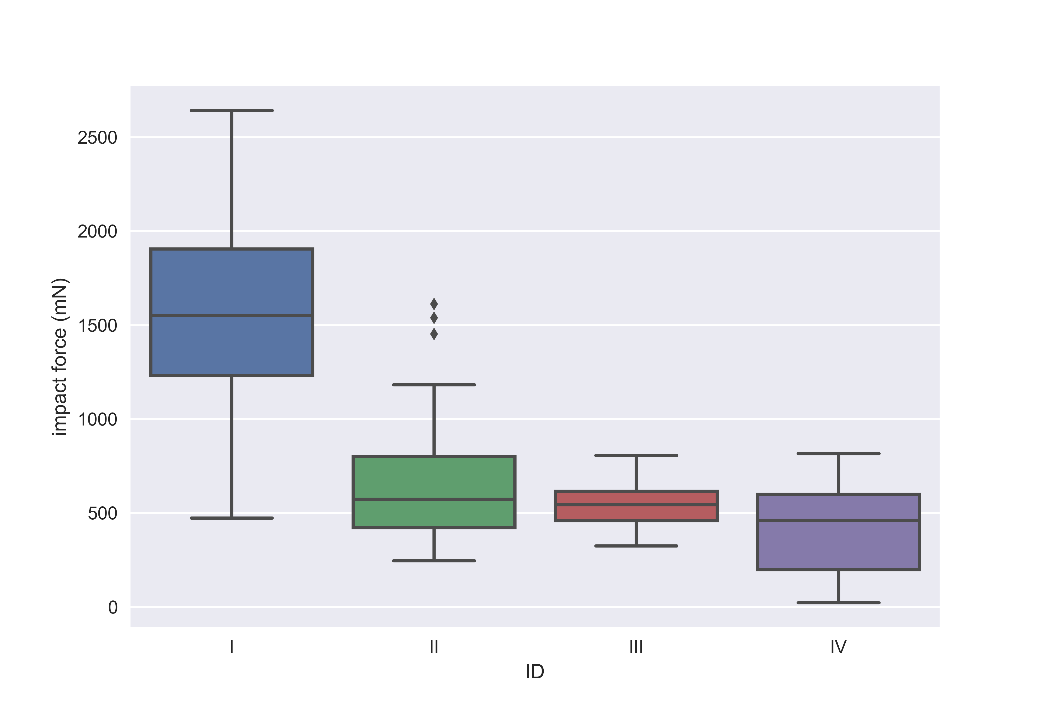
Seaborn: a high level plotting package for Matplotlib
Let’s make a box plot of the impact force sorted by frog ID.
import seaborn as sns
#box plot
sns.boxplot(data=df, x='ID', y='impact force (mN)')
plt.savefig('boxplot.png', dpi=500)

Slide 31
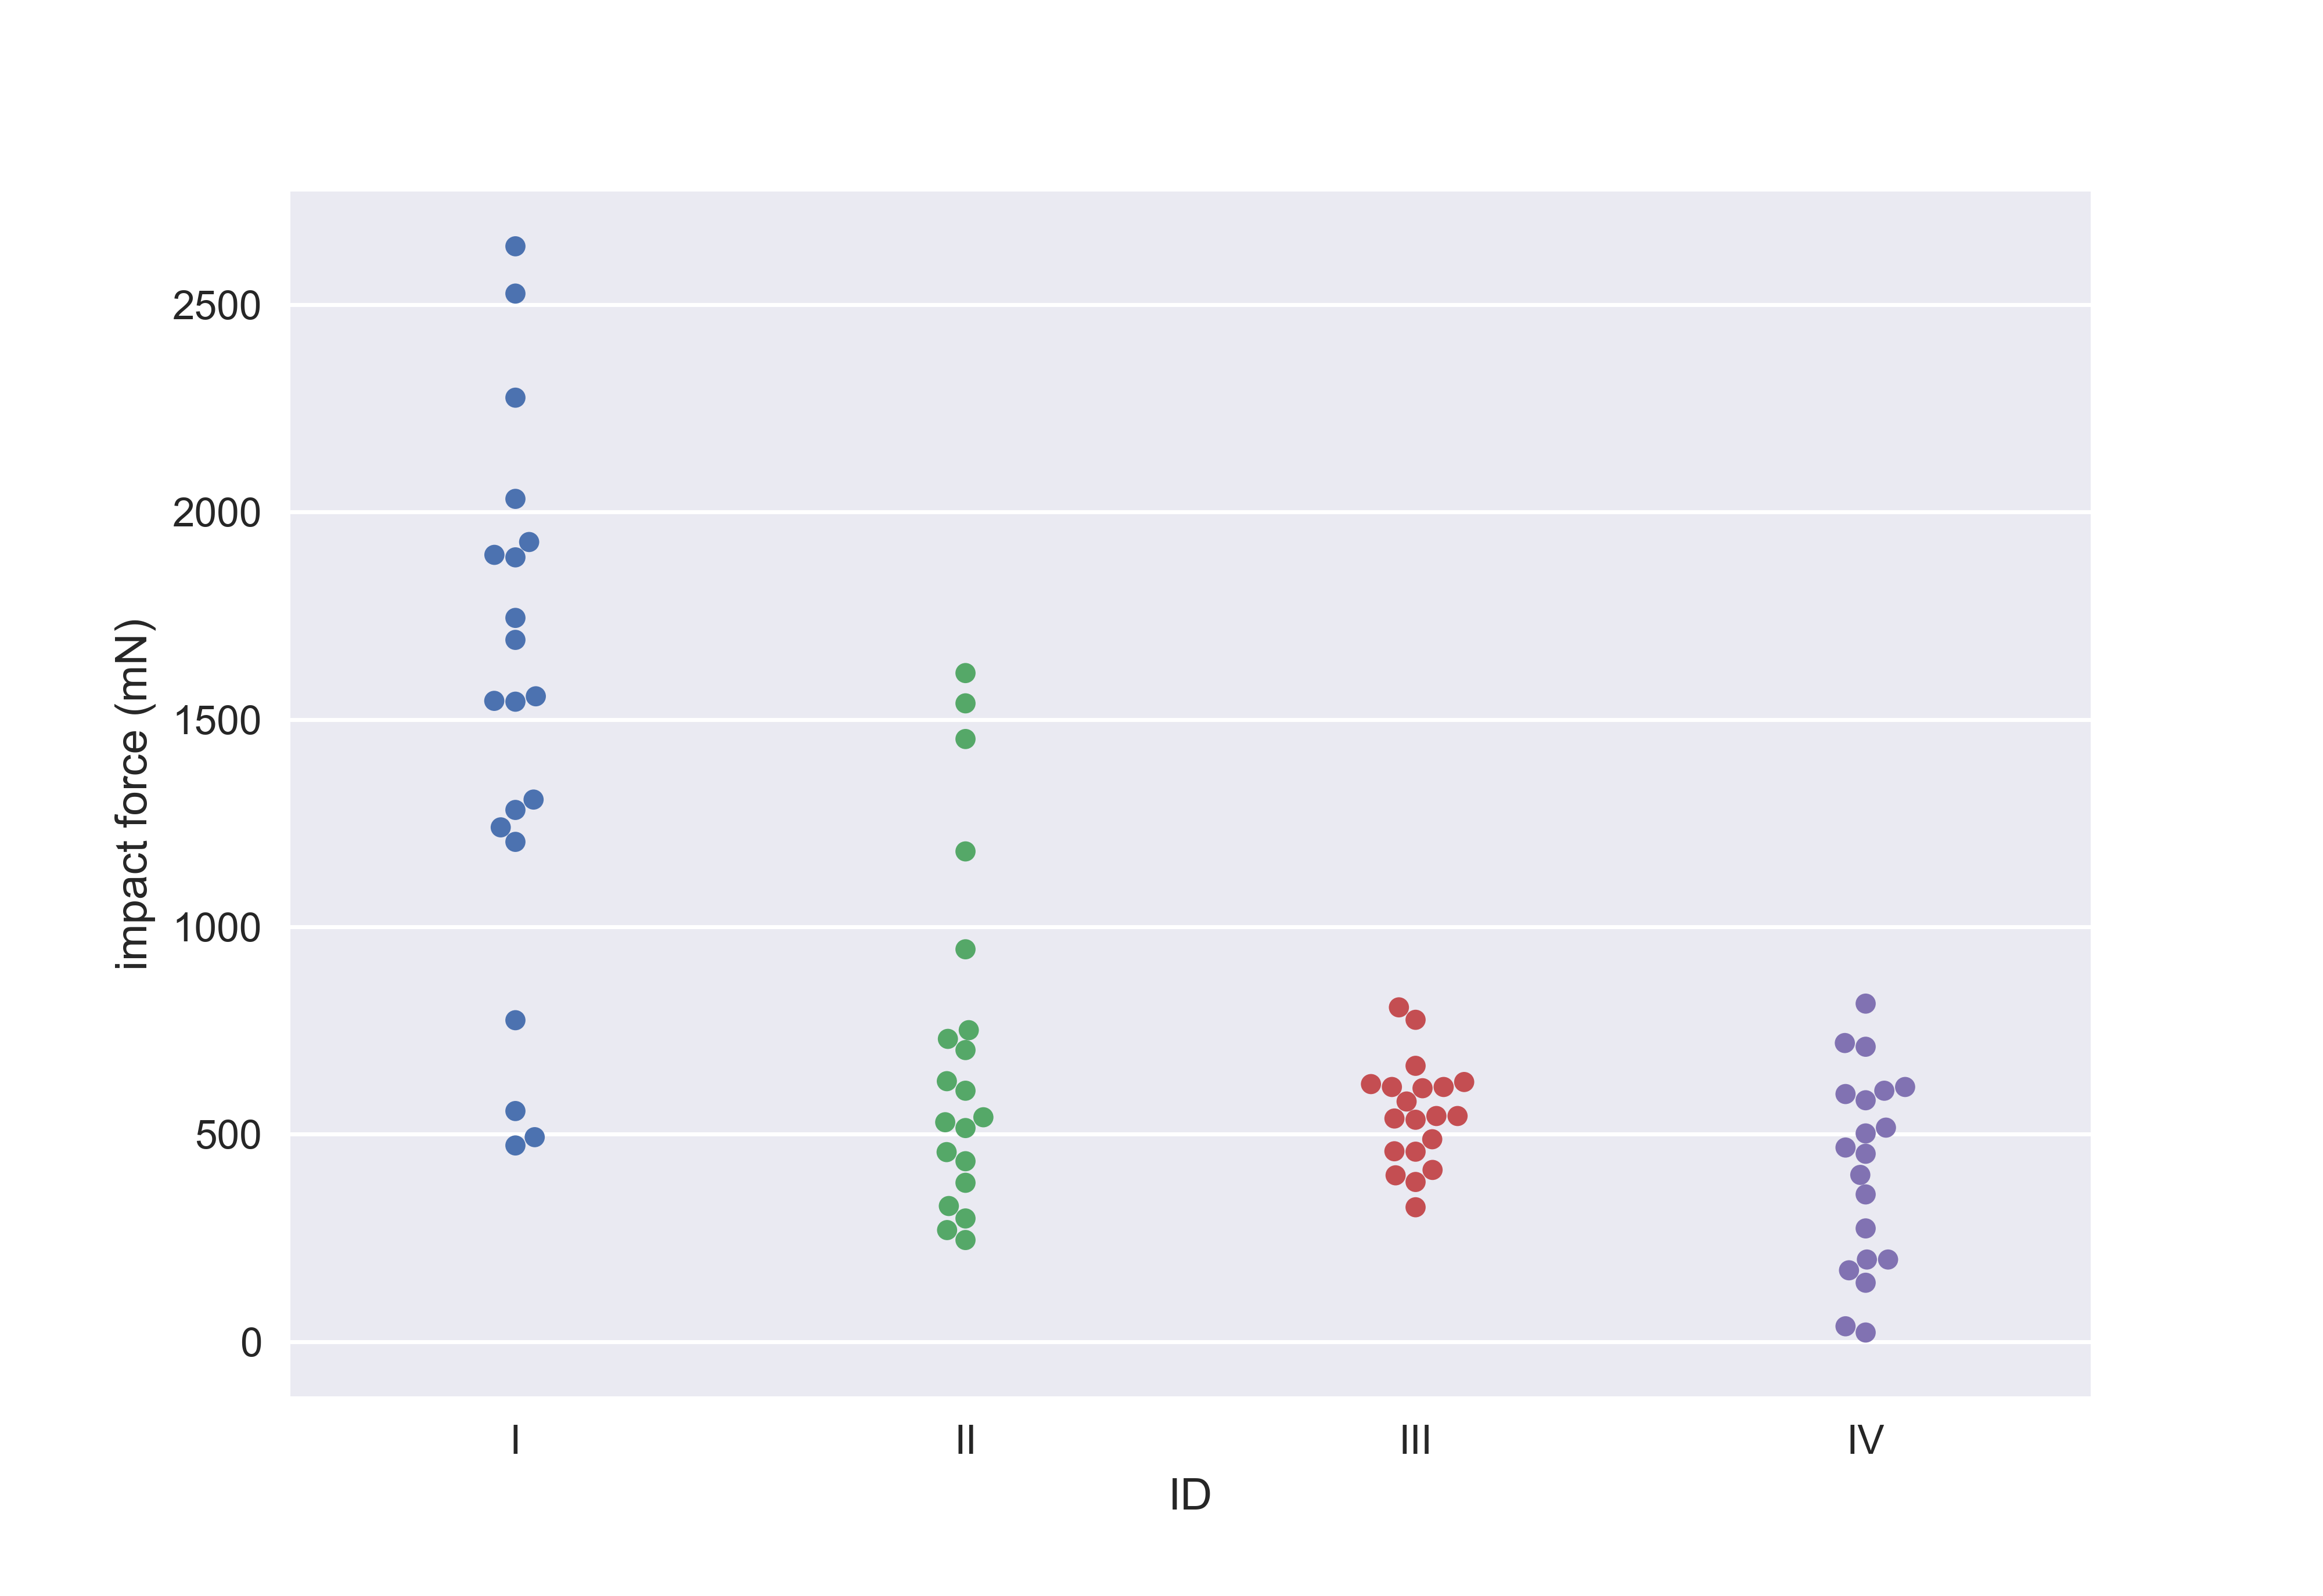
Seaborn: a high level plotting package for Matplotlib
Now, let’s make a beeswarm plot of the impact force sorted by frog ID.
#beeswarm plot
sns.swarmplot(data=df, x='ID', y='impact force (mN)')
plt.savefig('beeswarm.png', dpi=500)

Slide 32
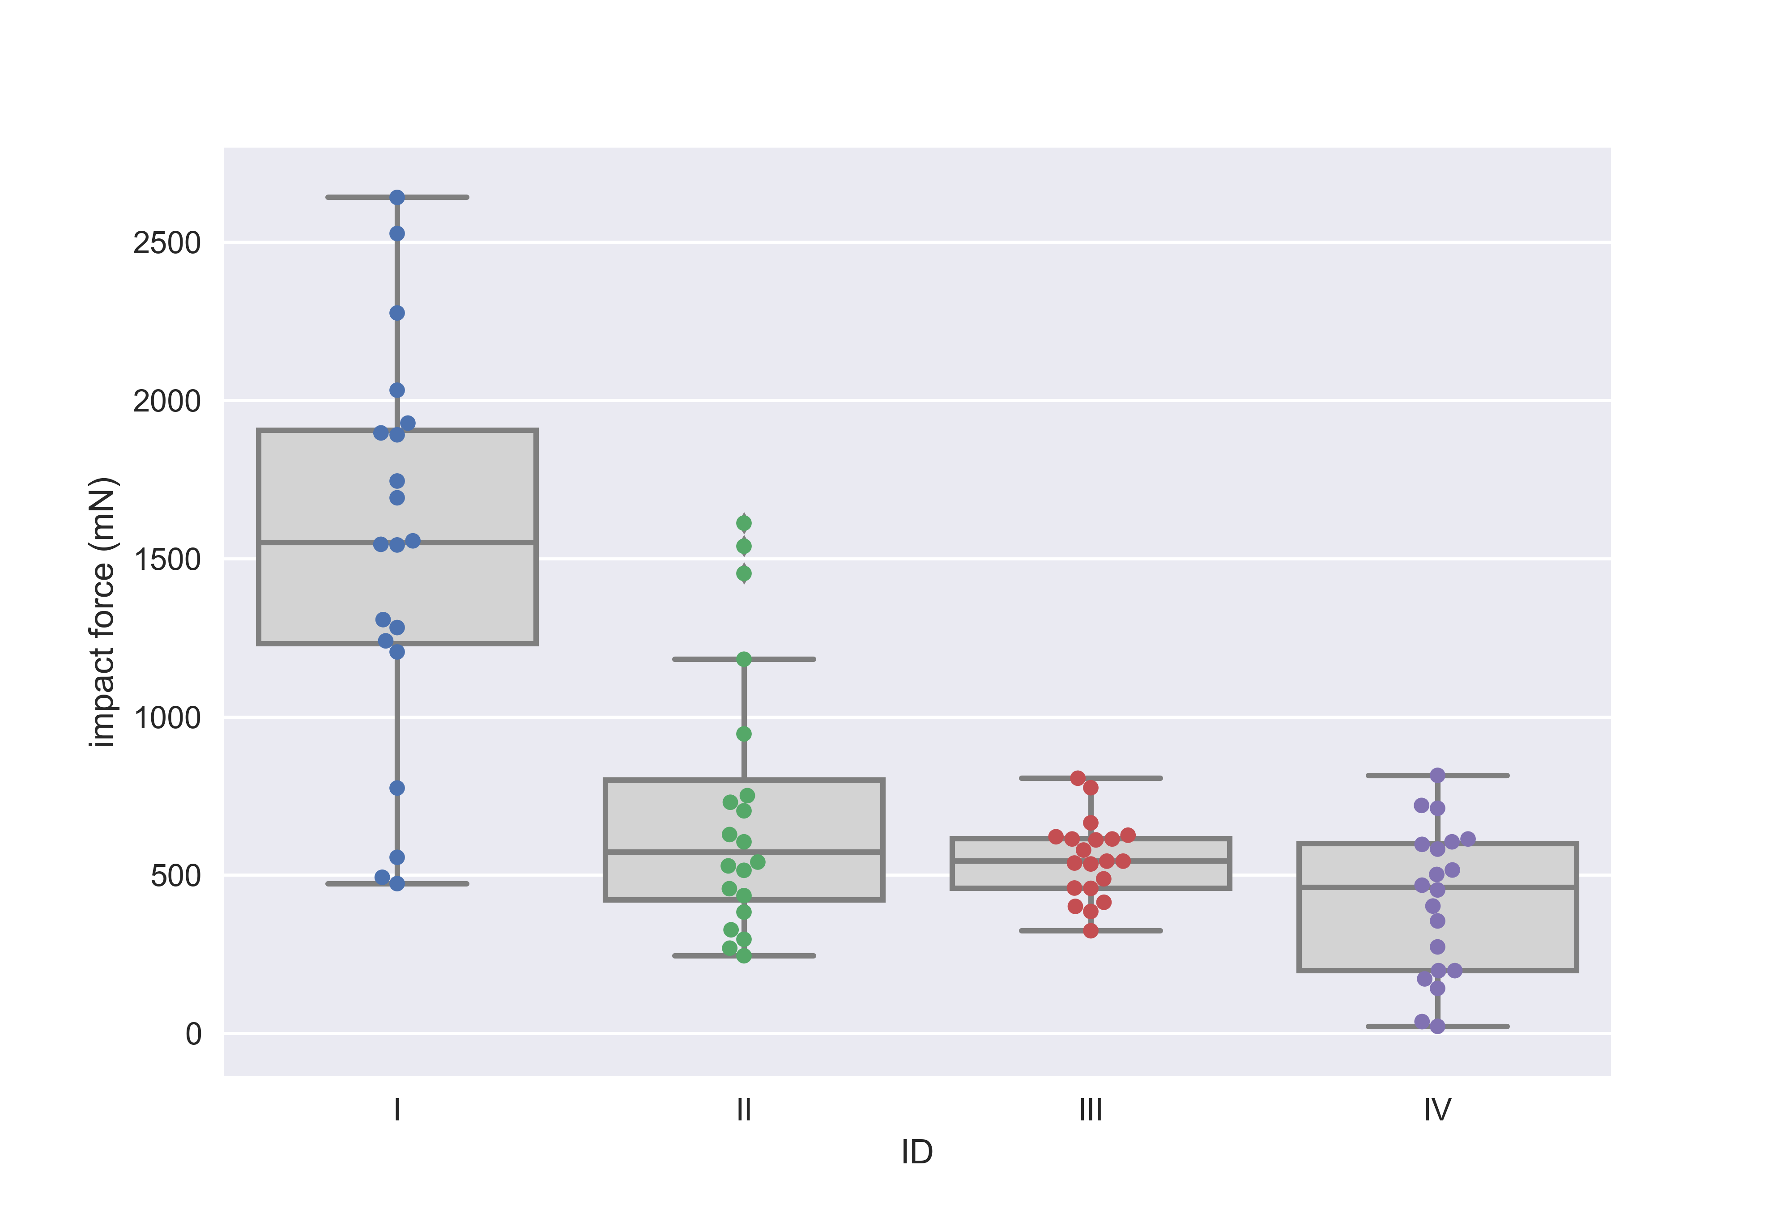
Seaborn: a high level plotting package for Matplotlib
Lastly, let’s overlay the boxplot and the beeswarm plot.
#overlay box plot and beeswarm plot
sns.boxplot(data=df, x='ID', y='impact force (mN)', color='lightgray')
sns.swarmplot(data=df, x='ID', y='impact force (mN)')
plt.savefig('boxbeeplot.png', dpi=500)

Slide 33
Working with gene expression datasets
Pandas is useful for analyzing extremely large datasets – like single-cell RNA-seq data.
Load in the gene expression matrix. In this case, it is space-delimited.
Be patient. It will take a few seconds to load.
#read in the scrna-seq dataset. this will take a few seconds
df = pd.read_csv('C:/Users/Ann/Downloads/GBM_raw_gene_counts.csv', sep=' ')
This dataset is 25,000x larger than the other datasets we’ve been using!
It is a 23386 x 3589 dataframe. Each row is a gene, and each column is a cell. so this dataset contains information for 23386 genes in 3589 cells.
Darmanis, S., et al. Single-Cell RNAseq analysis of infiltrating neoplastic cells at the migrating front of human glioblastoma (2017). Cell Rep. 2017 Oct 31;21(5):1399-1410.

Slide 34
Non-integer index column
#let's look at the index column
df.index
For this dataset, the index column contains the gene names
#df.loc must contain a gene name
df.loc['A2MP1']
If you want an integer index column, can use the function df.reset_index() or set index_col=False in read_csv().

Slide 35
Checking if a gene is in the dataset
#can do this manually
'TP53' in df.index
Will return True if in the gene is in the dataset and False if it is not.
What if we have a list of genes we want to check? We can write a function.
def gene_in_df(gene_list):
"""
This function takes in a list of gene names and
returns the names of genes that are not in the dataset.
"""
genes_in_df = []
for i in gene_list:
if i in df.index:
genes_in_df.append(i)
print('Gene(s) not in dataset', set(gene_list) - set(genes_in_df))
return set(gene_list) - set(genes_in_df)

Slide 36
Checking if a gene is in the dataset
Let’s test the function out.
gene_list = ['ETNPPL', 'FGFR3', 'AQP4', 'GJA1', 'AGT', 'MGST1', 'SLC39A12', \
'SLC25A18', 'GPR98', 'SLCO1C1', 'SDC4', 'GPR37L1', 'ACSBG1', \
'SFXN5', 'BMPR1B', 'ATP13A4', 'RANBP3L', 'GJB6', 'GFAP', \
'PRODH', 'SLC4A4', 'TMEM130', 'GABRB2', 'VSNL1', 'GABRA1', \
'SYNPR', 'THY1', 'CAMK2A', 'MEG3', 'GABRG2', 'CKMT1B', 'CCK', \
'CHGB', 'SCG2', 'DNM1', 'MAP7D2', 'CELF4', 'CIT', 'UNC80', \
'NRXN3', 'SCN2A', 'SNAP25']
gene_in_df(gene_list)

Slide 37
Gene expression correlation using Pearsonr
scipy.stats.pearsonr(x,y)
Calculate a Pearson correlation coefficient and its corresponding p-value
The Pearson correlation coefficient measures the linear relationship between two datasets. Coefficient will vary between -1 and +1, with 0 implying no correlation and -1/+1 implying an exact linear relationship.
from scipy.stats import pearsonr
#measure the correlation between TP53 and DERL1
coef, pval = pearsonr(df.loc['TP53'], df.loc['DERL1'])
print('the coefficient is %0.3f' %coef)
print('the p-value is %0.3f' %pval)

Slide 38
Gene correlation matrix
pandas.DataFrame.corr
Computes pairwise correlation of columns. Default is Pearsonr correlation.
gene_list = ['CRIP1', 'S100A8', 'S100A9', 'ANXA1', 'CD14']
#make a new dataframe with your genes of interest
coef_df = df.loc[gene_list]
coef_df.head()
#transpose the dataframe first so genes are in columns
#then calculate pairwise correlation
corr = coef_df.transpose().corr()
#set color palette where low coefs are blue and high coefs are red
#center the color bar at 0
plt.subplots(figsize=(10, 8))
sns.heatmap(corr, cmap='RdBu_r', center=0)
plt.savefig('correlation_heatmap.png', dpi=500)

Slide 39
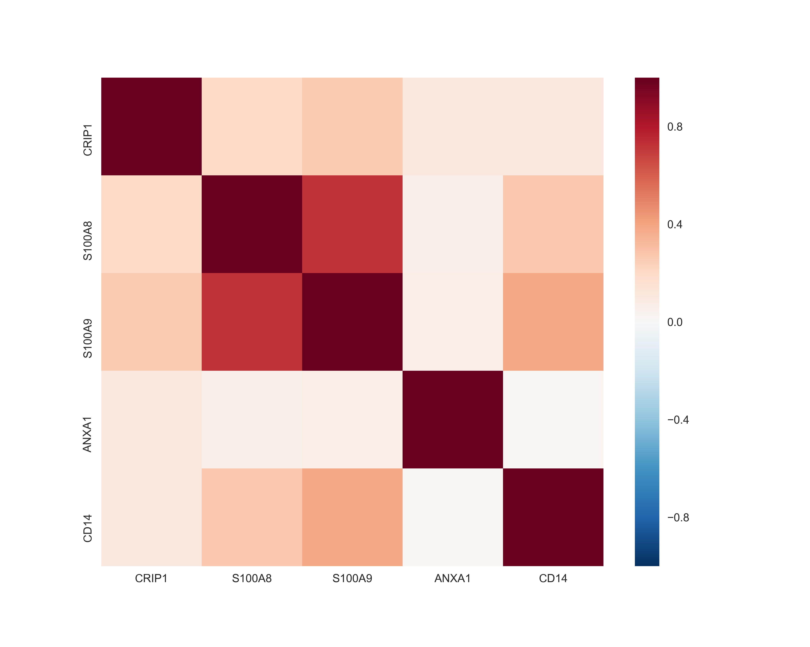
Gene correlation matrix

Slide 40
Fraction of cells expressing a gene
gene_list = ['TMEM119', 'P2RY12', 'GPR34', 'OLFML3', 'SLC2A5', 'SALL1', 'ADORA3']
def gene_frac_df(gene_list):
'''
This function takes in a list of gene names and returns the fraction of
cells that express each gene.
'''
#list to store the fraction for each gene
gene_frac_list = []
for i in gene_list:
if i in df.index:
#if the gene is in the dataset
#sum the number of cells that have 0 expression
gene_0 = (df.loc[i]==0).sum()
#(total number of cells - cells with 0 expression) / total
gene_frac = (len(df.columns) - gene_0) / len(df.columns)
#add the fraction to the gene_frac_list
gene_frac_list.append(gene_frac)
else:
#if the gene is not in the dataset, append 0 to the list
gene_frac_list.append(0)
return gene_frac_list
Lastly, let’s write a function that calculates the fraction of cells that express specific genes and plot it in a horizontal bar graph.

Slide 41
Fraction of expressing genes
gene_frac_list = gene_frac_df(gene_list)
#array containing the number of genes
y_pos = np.arange(len(gene_list))
#barh = horizontal bar graph
plt.barh(y_pos, gene_frac_list)
plt.xlim(0,1)
plt.yticks(y_pos, tuple(gene_list))
plt.xlabel('fraction of expressing cells')
plt.savefig('frac_gene.png', facecolor='white', dpi=500)

Slide 42
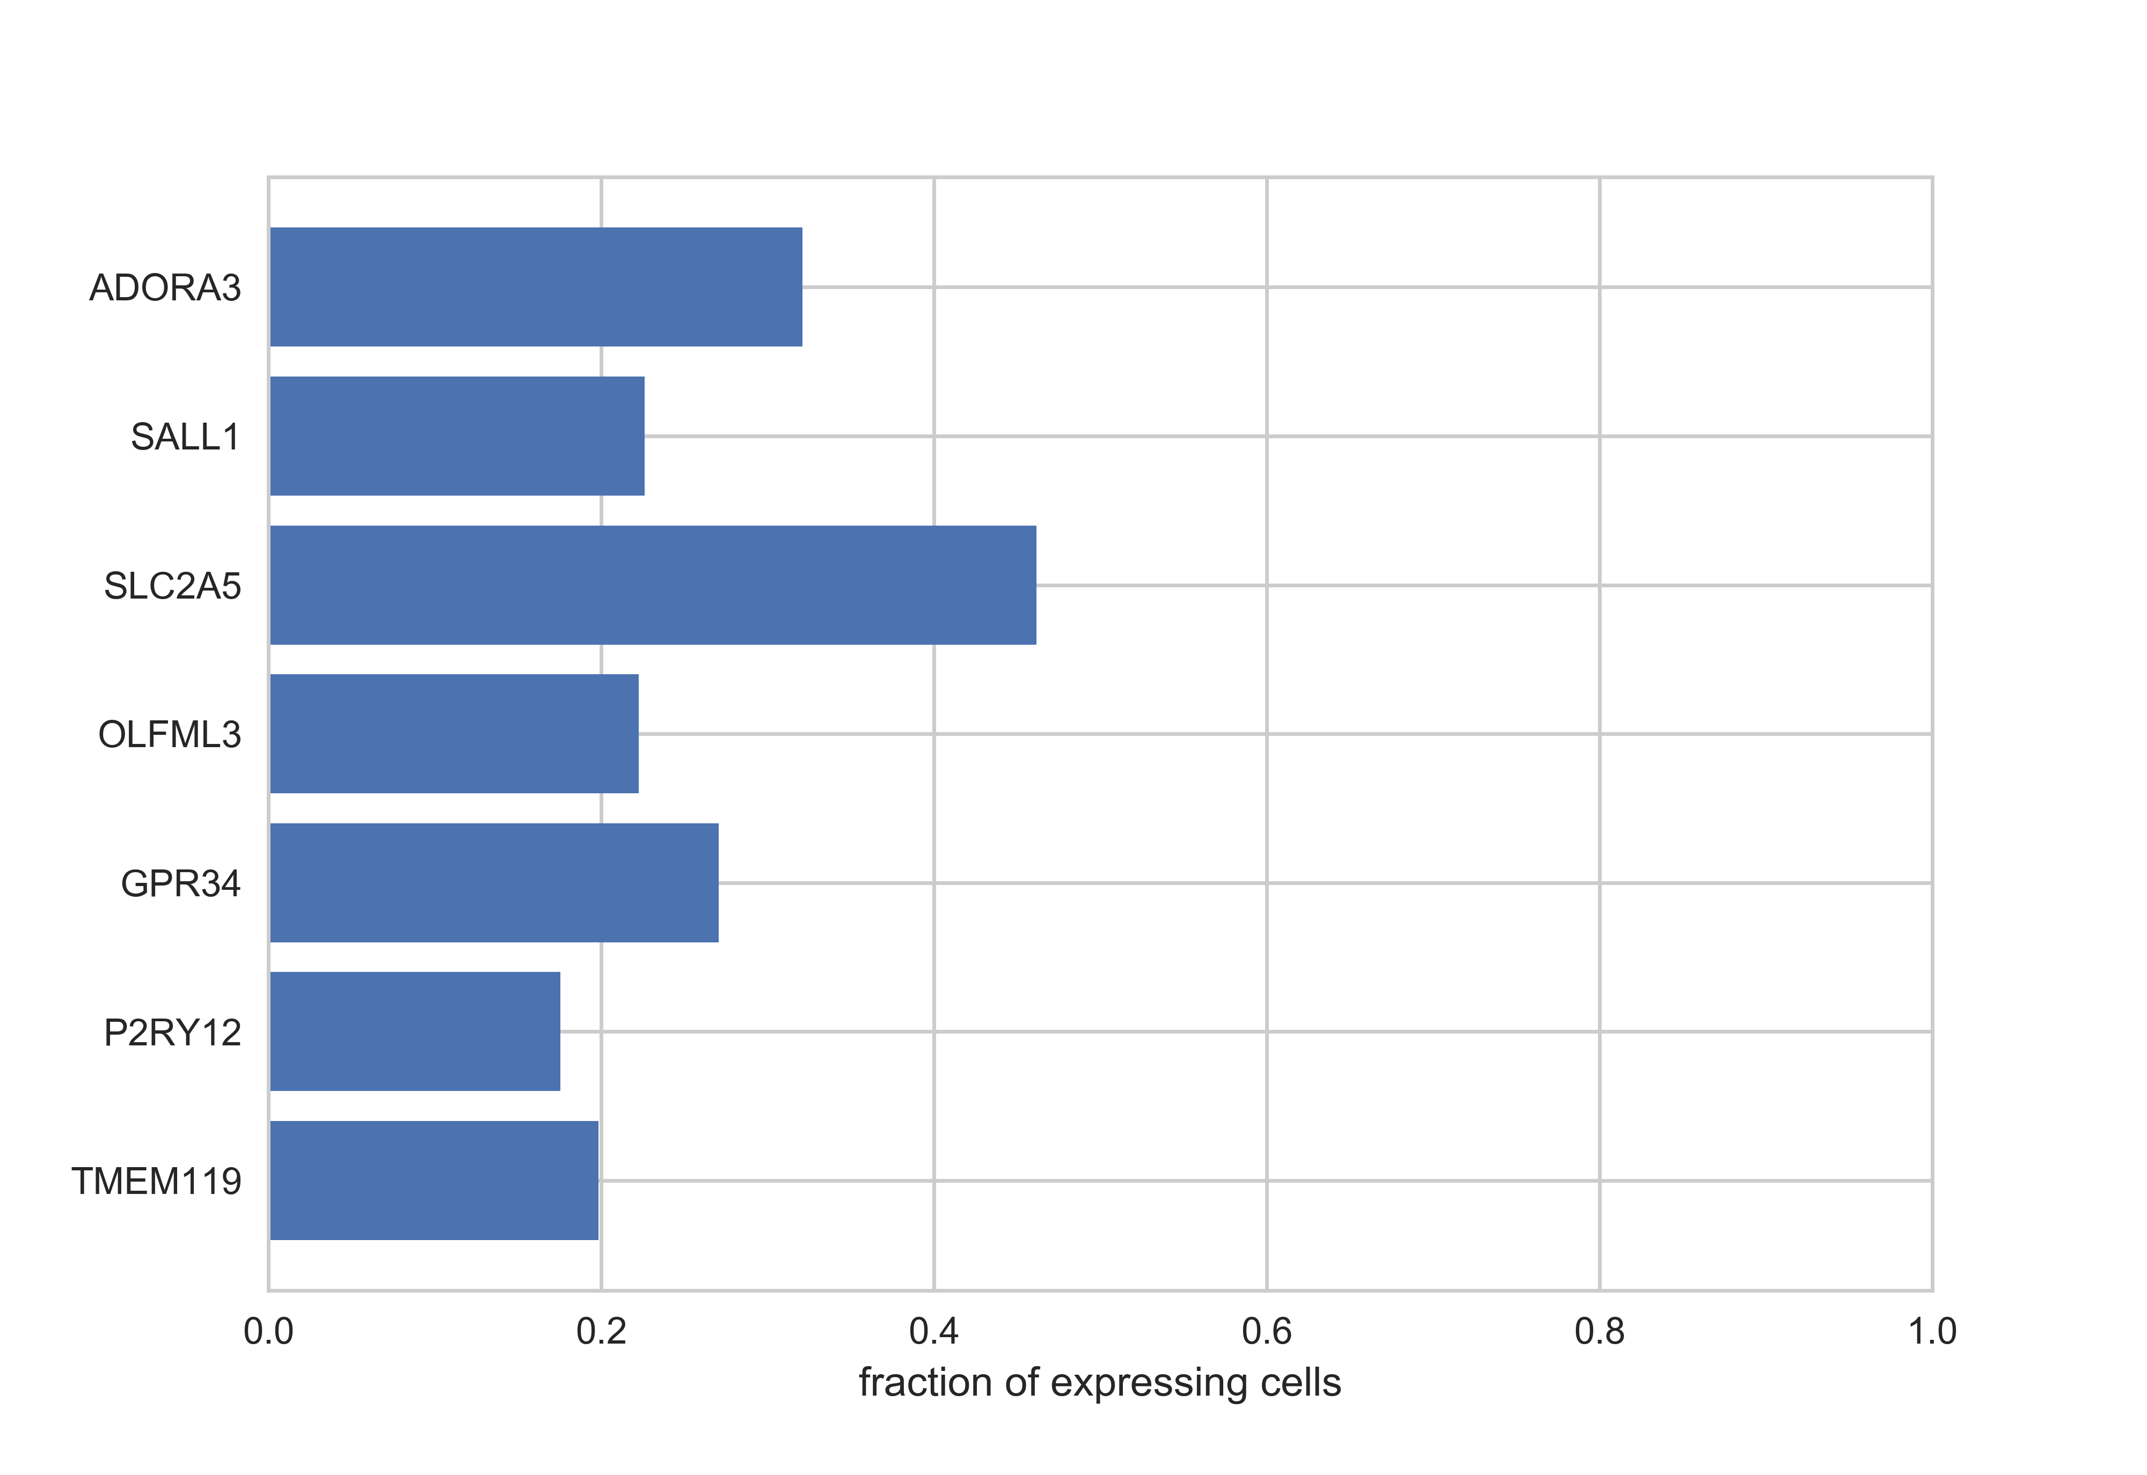
Fraction of expressing genes

Slide 43
4 general rules to follow
You can never over-comment your code.
Write functions that do simple tasks.
There might be a package for it. It doesn’t hurt to check.
If you have a question, someone has probably asked it online.
Thank you for attending!

