Slide 1
A Comparative Illustration of Trip- and Activity-Based Modelling Techniques
Hayden Atchley
Committee:
Greg Macfarlane (chair)
Grant Schultz
Gustavious Williams

Slide 2



Travel Demand Models
2 main types:
Trip-based
Aggregate
Trips happen
Activity-based
Synthetic population
Trips result from decisions
Travel Demand Model
Trips | Vehicle-miles traveled
Volumes | Level of service

Slide 3
Advantages of Activity-Based Models
Activity-based models thought to be superior:
Information on individuals
Trip chaining (tours)
Conceptually closer to reality
More detailed analysis
Equity analyses

Slide 4
Difficulties with Activity-Based Models
Computational complexity
Complicated design
Lack of interoperability
Staff training
Things may be changing
Open-source models (ActivitySim)
General maturity/familiarity

Slide 5
Research Gap
Comparisons focus on theoretical benefits
Cited difficulties may be outdated
Practicality of activity-based models
Ease of use
Types of analyses
Ease of interpretation

Slide 6
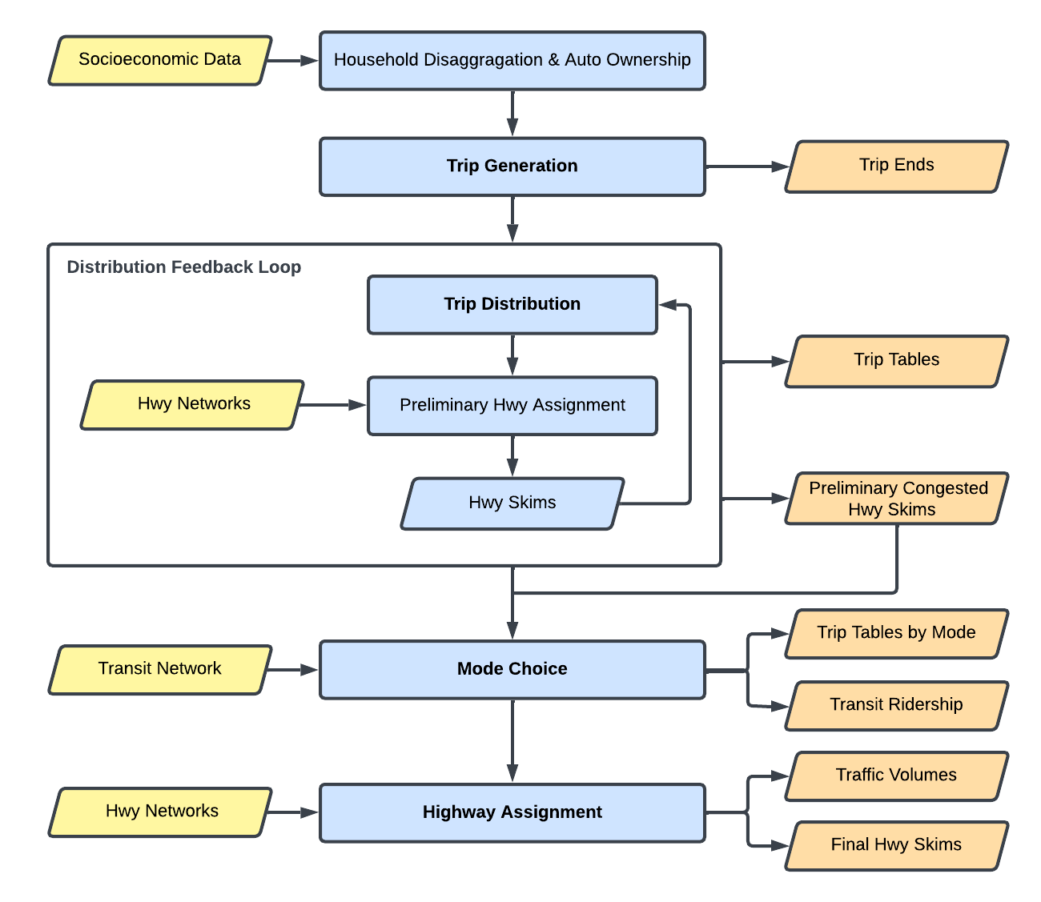
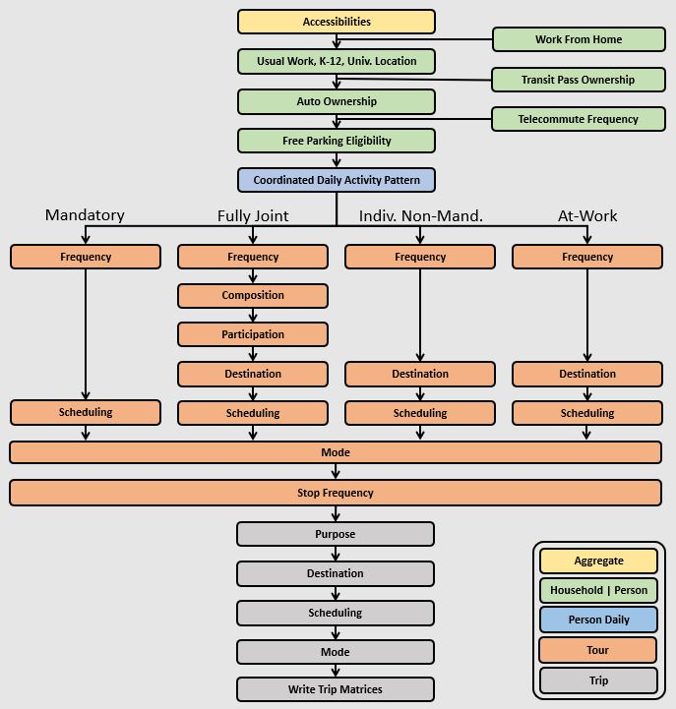
Two Models
WFRC Model (trip-based)
ActivitySim (activity-based)
Notes:
Introduce validation/calibration

Slide 7
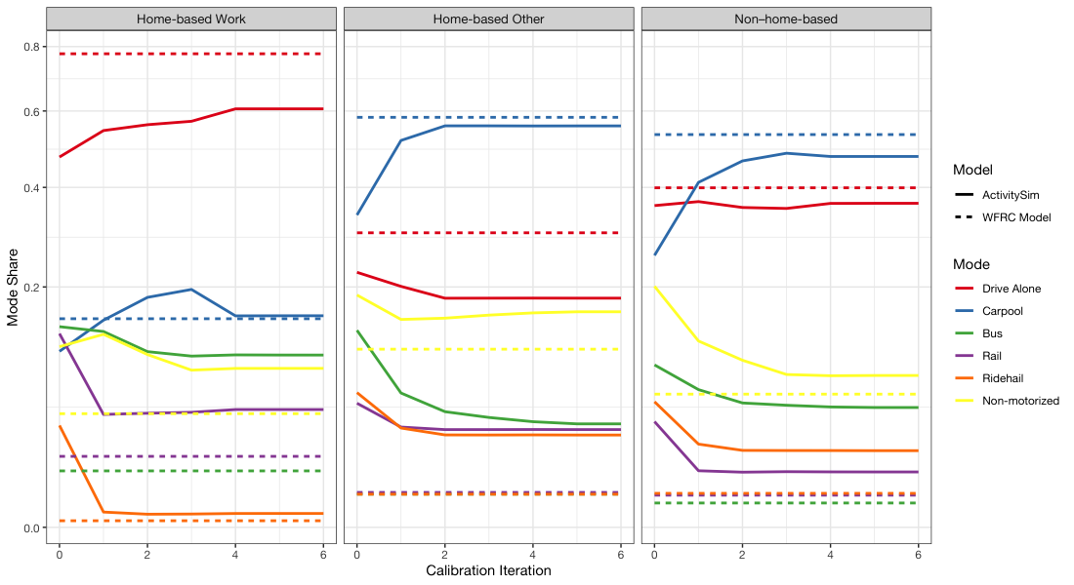
Model Calibration
Population
Household size
Income
Trips
Mode choice
Remote work
Trip length distribution
Notes:
We used Iteration 4.
We also validated on district population, income, TLFD, and remote work.

Slide 8
Scenarios Overview
Land Use Scenario | Transit Scenario | Remote Work Scenario
New development at old Draper prison site Projected 2050 data for The Point development | Increase frequency and speeds of FrontRunner New Frontrunner stations Based on WFRC 2050 plan | Higher work-from-home and telecommute Calibrated to WFRC 2050 projections

Slide 9
Land Use Scenario New development (The Point)
WFRC Model:
Change land use data for The Point area
Match 2050 data
7,430 new households
22,200 new jobs
ActivitySim:
New synthetic population for The Point area
Population modeled on Gateway area (SLC)
Joined with baseline scenario population

Slide 10
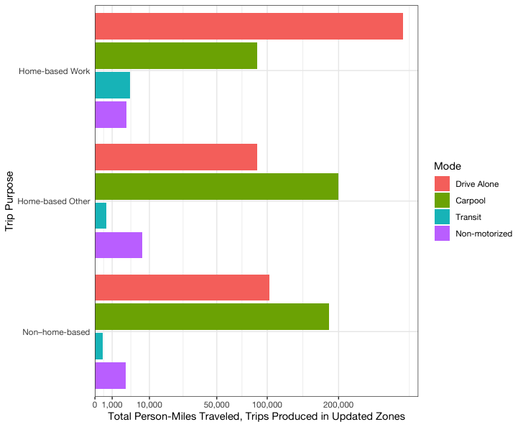
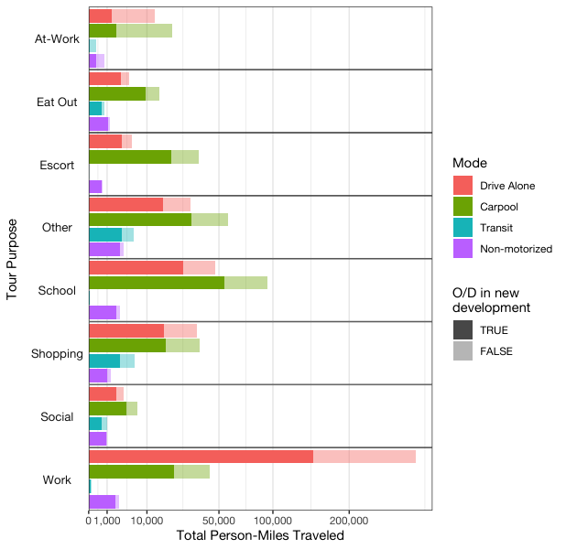
New Trips
WFRC Model
ActivitySim

Slide 11
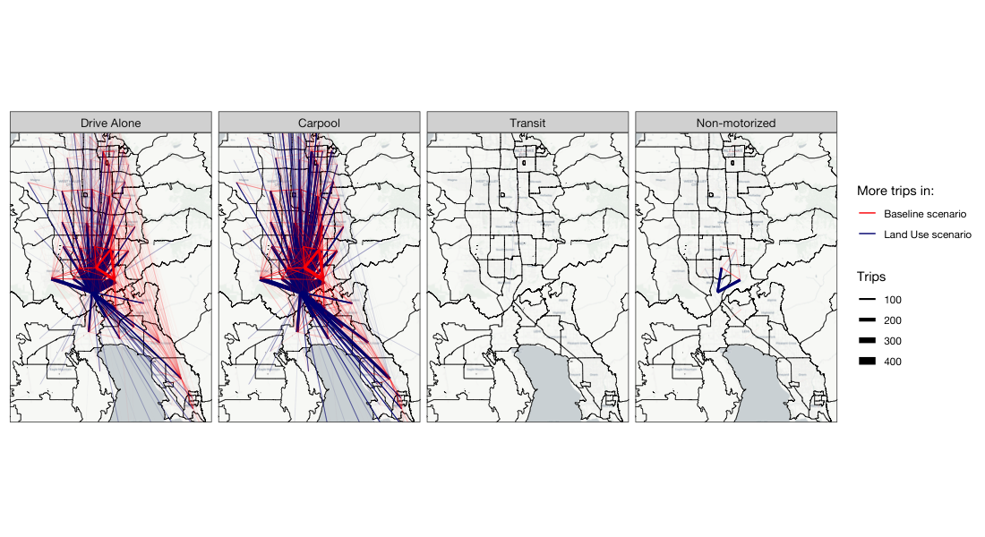
WFRC: Non–Home-Based Trips

Slide 12
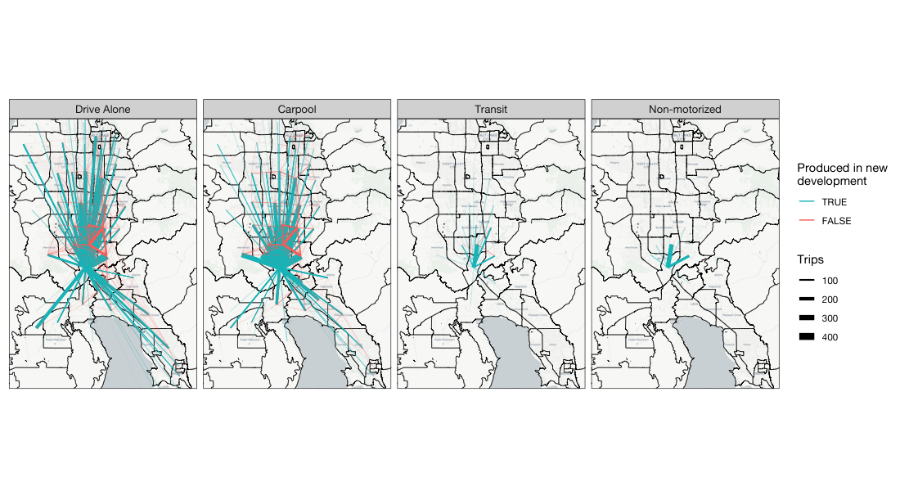
ActivitySim: New Resident Trips

Slide 13
Transit Scenario Improved FrontRunner
WFRC Model:
Doubled train frequency
Peak: 2 → 4 trains per hour
Off-peak: 1 → 2 trains per hour
Used future speed and track extensions
Additional stations in Vineyard, Springville, Spanish Fork, and Payson
ActivitySim
New transit skims from WFRC model

Slide 14
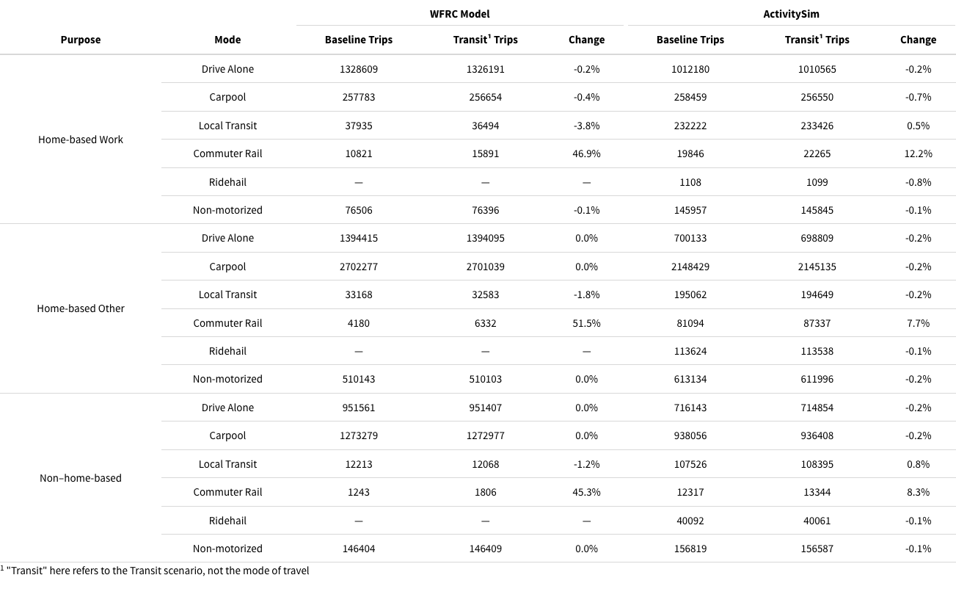
Change in Mode Split

Slide 15
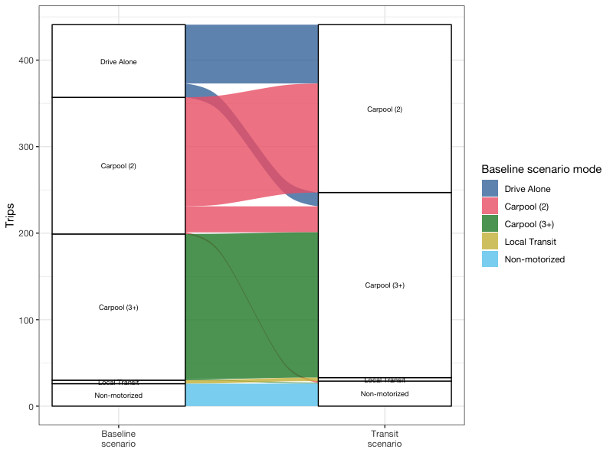
At-Work Mode Switching
Notes:
At-work trip modes of those who switched away from Drive Alone for work tours

Slide 16
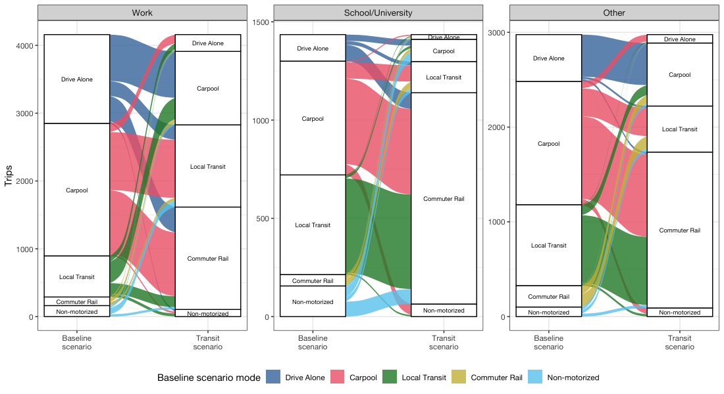
Daily Mode Switching

Slide 17
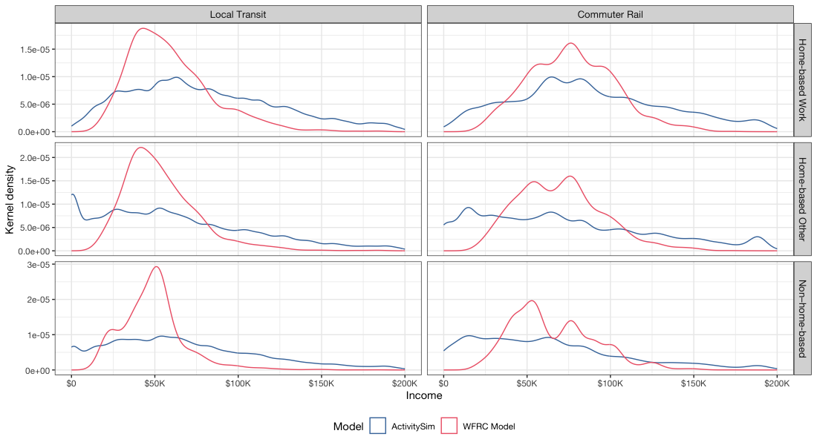
Transit Riders Income Distribution
Notes:
The WFRC Model is a distribution of (weighted) medians, and ActivitySim is a distribution of actual individual incomes.

Slide 18
Remote Work Scenario Increased remote work rates
WFRC Model:
Used 2050 remote work rates
Work-from-home average increase from 2.9% to 3.5%
Telecommute average increase from 3.7% to 10.2%
ActivitySim:
Recalibrated remote work to WFRC 2050 rates
Work-from-home matches WFRC data
Telecommute matches % by job type

Slide 19
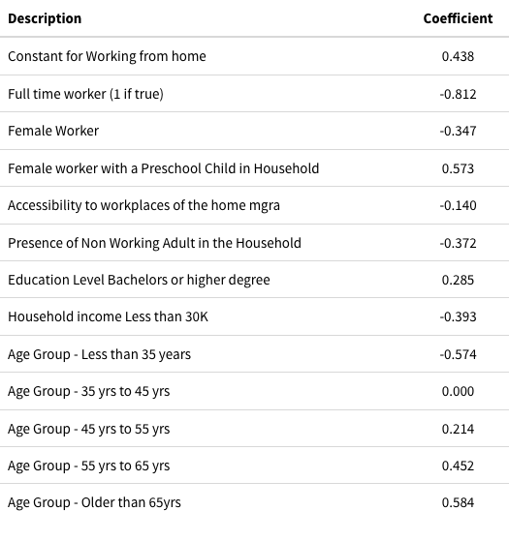
Remote Work Considerations
“Rebound effect”
Fewer work trips may cause more non-work trips
Trip length
Longer commute more likely to work remotely
Household structure
Single- vs. dual-parent
Age of children
ActivitySim Work-From-Home Model

Slide 20
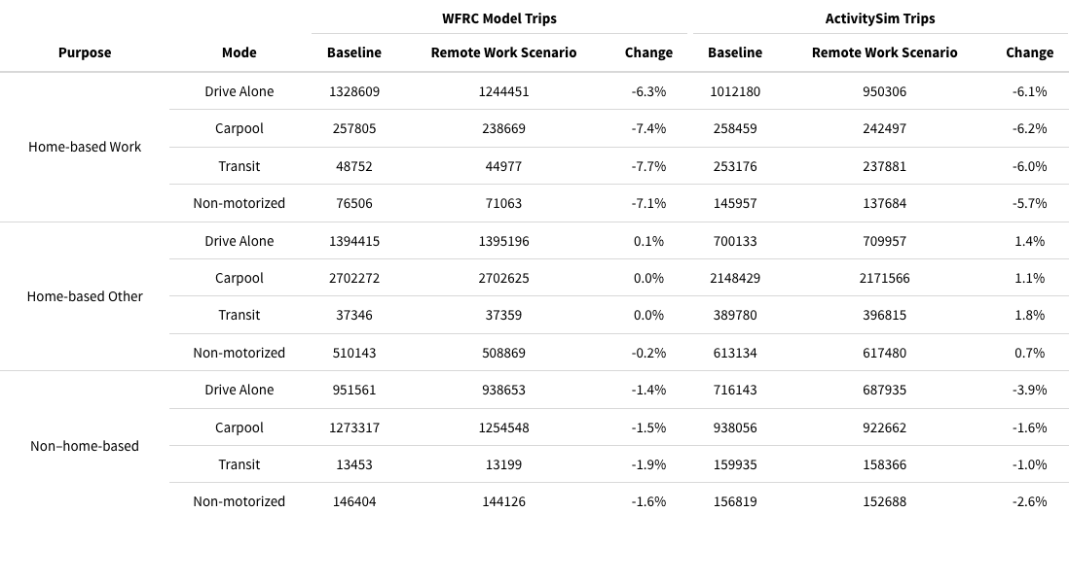
Change in Number of Trips
Notes:
The ABM has a “rebound effect” where there are mode HBO trips as a result of the increased remote work

Slide 21
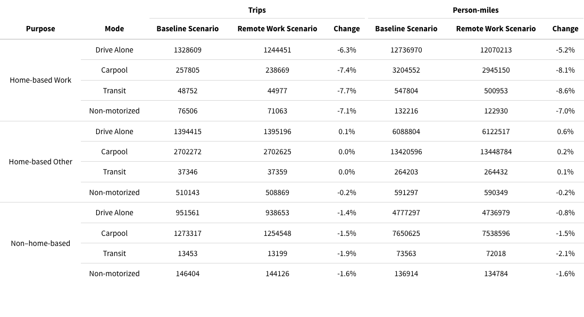
WFRC: Trip Count vs Length
Notes:
For drive alone HBW trips, the % decrease in number was greater than in distance. This shows that on average shorter HBW trips were “dropped” with increased remote work.

Slide 22
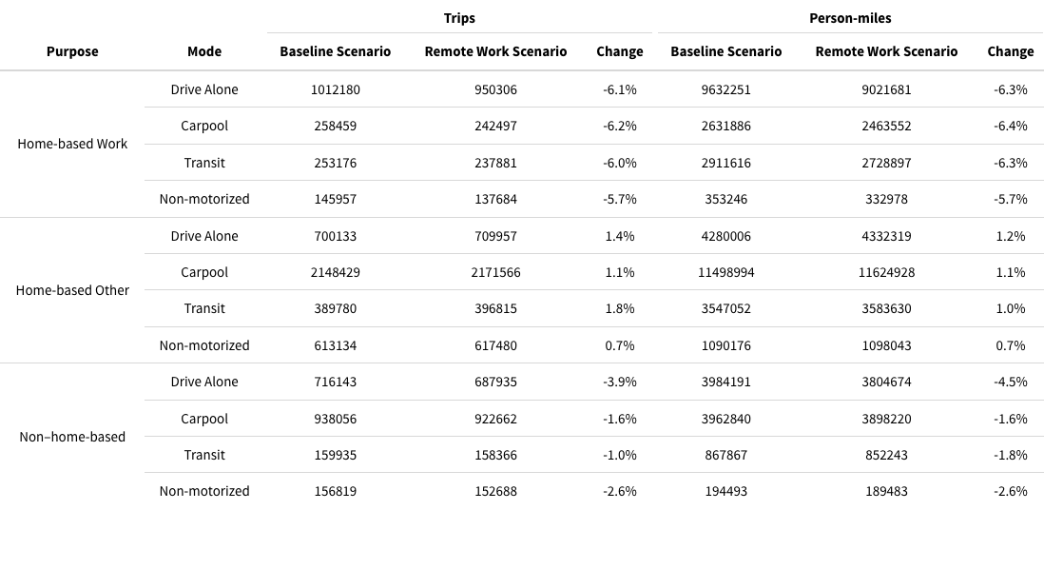
ActivitySim: Trip Count vs Length
Notes:
Work trips show more decrease in length than in number of trips. This shows that longer work trips are being “dropped”, perhaps in exchange for shorter HBO trips.

Slide 23
Conclusions
Cited difficulties with activity-based model:
Computational complexity
Complicated design
Lack of interoperability
Staff training
Notes:
Limitless number of analyses, these are only examples. But for the same effort, more in-depth analysis with ActivitySim

Slide 24
Conclusions
Computational complexity
Similar runtime on same hardware
Complicated design
Easier interpretation with activity-based
Lack of interoperability
ActivitySim remote work sub-models taken from SEMCOG
Simple to add/edit parameters
Staff training
Similar time/effort between models
Cited difficulties may not be applicable!
Notes:
Limitless number of analyses, these are only examples. But for the same effort, more in-depth analysis with ActivitySim

