Slide 1
DATA LIFECYCLE
Create
Destroy
Store
Use
Archive
Share

Slide 5
GED CONTENT MODEL
GED Editable Document object
GED Archived Document object

Slide 6
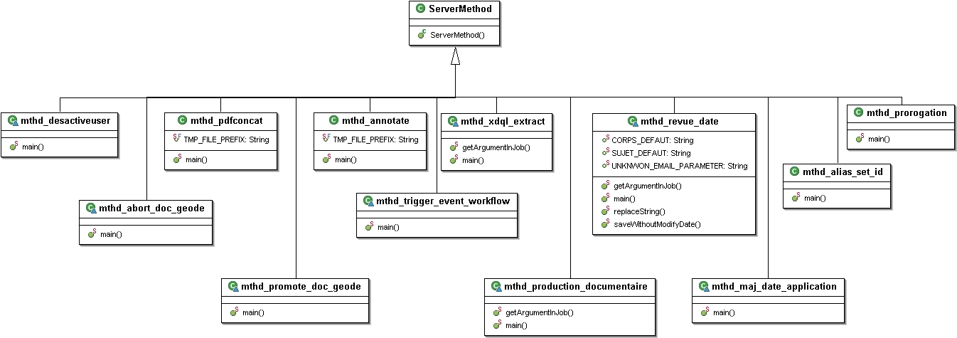
GED METHODE OBJECT STANDARIZATION

Slide 7
ALFRESCO CONTENT MODEL
JAR | FILE | NAMESPACES | PREFIX | IMPORTS
alfresco-data-model-[version].jar | dictionaryModel.xml | model/dictionary/1.0 | d | None
alfresco-repository-[version].jar | systemModel.xml | model/system/1.0 | sys | d
 |  | system/registry/1.0 | reg
 |  | system/modules/1.0 | module
alfresco-repository-[version].jar | contentModel.xml | model/content/1.0 | cm | d, sys
 |  | model/rendition/1.0 | rn
 |  | model/exif/1.0 | exif
 |  | model/audio/1.0 | audio
 |  | model/webdav/1.0 | webdav
alfresco-repository-[version].jar | bpmModel.xml | model/bpm/1.0 | bpm | d, sys, cm, usr
alfresco-repository-[version].jar | forumModel.xml | model/forum/1.0 | fm | d, cm

Slide 8
DOCUMENT PROCESSING ACTIVITIES
Create
Capture
Indexing
Metadata
Publishing
Store
Integration
Security
Storage
Retrieval
Searching
Use
Collaborate
Workflow
Versioning
Share
Distribution
Archive
Reproduction
Destroy

Slide 9
DATA PROCESSING ROLES & SECURITY
Approver
ROLE | CREATION | APPROVE | ARCHIVE
Creator | X
Writer | X
Verificator | X
Approver |  | X
Reader | X | X | X
Verificator
Writer
Creator
USER PROFILES (System actors)
Reader
ACL (Access Control List)

Slide 10
 |  | dm_owner | dm_world | Créateurs (role_createur) | Integrators (role_integrateur) | Manageurs (grp_manageurs) | admingroup
Basic Permissions | None | X
 | Attributes
 | Read |  | X
 | Annotate
 | Version
 | Write |  |  | X | X | X | X
 | Delete
Extends Permissions | Carry out procedure |  |  |  |  | X | X
 | Change Location |  |  |  |  | X | X
 | Change object state |  |  |  |  | X | X
 | Change permissions |  |  |  |  | X | X
 | Change owner |  |  |  |  | X | X

Slide 11
ALFRESCO DIGITAL BUSINESS PLATFORM
Application Layer
Engaging Ux,UI,
Mobile,
Application Developpment Framework
Integration Layer
OPEN API‘s -
Integration,Extension
Intelligence & Analytoics,
Service Layer
CONTENT SERVICES
(ECM)
PROCESS SERVICES
(BPM)
Governance Layer
GOVERNANCE SERVICES,
Regulatory
Information Policy (Retention),
Deployment Layer
Open Premise,
HYBRID
CLOUD,

Slide 12
PROJECT INITIATION
Document Name | Version | Origin | Comments
Afriland GED - Cahier des Charges - version 1.0.pdf | 1.0 | AFB
AFB-Cahier des specs V2.1-12102016.docx | 2.1 | AYD | Le degree de detail non satisfesant pour un passage au developpement. - Il n‘est clairement visible si la contribution de AYD se limite au parametrage ou alors s‘il ya eu customisation de la platforme Alfresco destinée aux besoins de AFB
Guide de formation Averroes.pdf | ? | AYD
Configuration IMAP sur Averroès.pdf | ? | AYD
BackupAFB.pdf | ? | AYD
CIFS.pdf | ? | AYD

Slide 13
SOLUTION PROPOSE PAR AYD

Slide 14
APLICATION ARCHITECTURE OVERVIEW
Inconvenian
A - il faut necessaiement separer les serveur
HTTP des serveur d‘application,
JSP engine TOMCAT
B-les couches metiers doivent egalement
Etre séparées physiquement des modeles

Slide 15
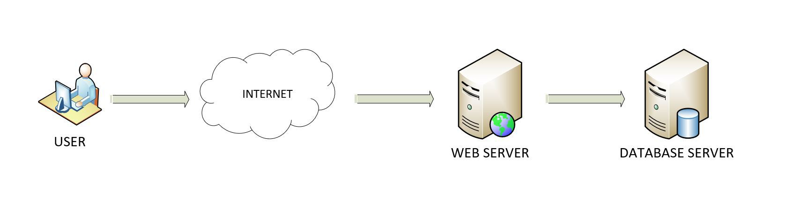
WEAK PERFORMANCE : OVERLOAD SINGLE SERVER
Current Architecture implementation

Slide 16
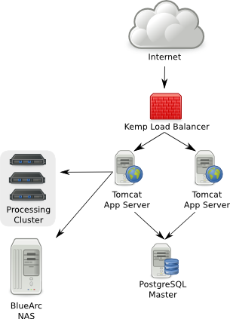
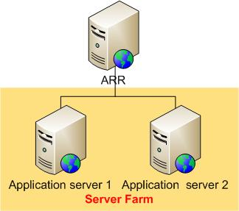

Slide 17
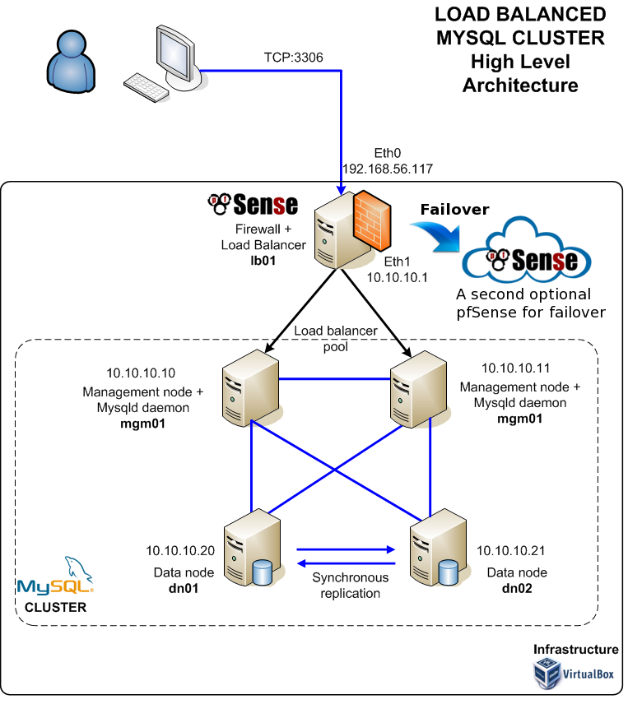

Slide 18
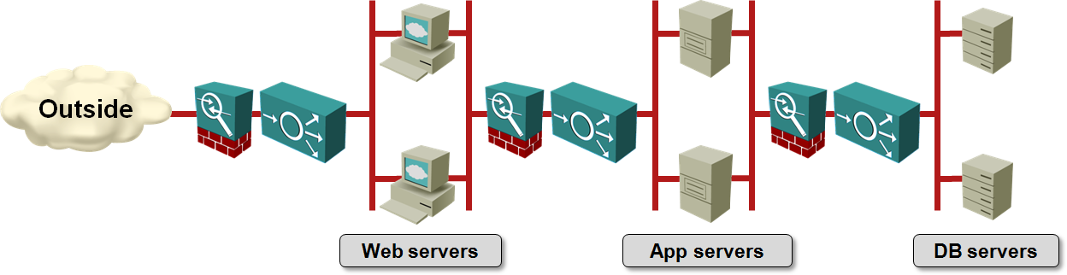

Slide 19
SOFTWARE DEVELOPMENT CYCLE
1
Requirement Analysis
2
Design
3
Development
4
Testing
5
Maintenance

Slide 20
Hardware application Development Stack
APPS
APPS
APPSn
BinLibs
BinLibs
BinLibs
Distinguisch Server
Application Environments
RUN TIME ENGINE
RUN TIME ENGINE
RUN TIME ENGINE
HOST OS
HOST OS
HOST OS
SERVER HARDWARE1
SERVER HARDWARE2
SERVER HARDWAREn

Slide 21
Virtual Application Development Stacks
APPS
APPS
APPS
APPS
APPS
APPS
BinLibs
BinLibs
BinLibs
Container
BinLibs
BinLibs
VMs
OS1
OS2
OS3
ContainerManager
DOCKER ENGINE
VM Manager
HYPERVISOR
Host Operating System
HOST Operating System
SERVER HARDWARE
SERVER HARDWARE
Virtual Machine Stack
Vdocker Container Stack

Slide 22
Classical Automated Development Environment
Git Server
afrilandfirst/projects/ged/65024ce….
New Code
Build passes
PG
Dj
N
Dj
PG
Dj
PG
CFG
Development Machine
Build Server
Production Environment

Slide 23
Docker Automated Development Environment
Git Server
Docker Registry
afrilandfirst/projects/ged/65024ce….
New Code
Deployment
Docker Image
dj
PG
dj
PG
PG
dj
CFG
N
CFG
N
N
CFG
Development Machine
Build Server
Production Environment

