Slide 1



INTERNATIONAL CONFERENCE ON
CYBERSECURITY, DATA SCIENCE, AND MACHINE LEARNING
(ICCDM-2026)
Organised by :
Universiti Putra Malaysia, Selangor, Kuala Lumpur, Malaysia;
Keshav Mahavidyalaya, University of Delhi
&
Universal Inovators
23rd-24th April 2026

Slide 2
Explainable FLAIR-to-T1 MRI Synthesis: Interpretable Residual GANs
Publication: Springer LNNS Series (Indexed: Scopus, zbMATH, DBLP, EI Compendex, SCImago)
Authors
Dr. Poonkodi M* (Corresponding Author) — VIT Chennai
Dr. Sakthivel V — VIT Chennai
Meera R. Deepu — VIT Chennai
Atchudhan Sreekanth — VIT Chennai
Eshwar B. — VIT Chennai
Affiliation: Vellore Institute of Technology, Chennai, India

Slide 3
2. INDEX
Slide | Section
2 | Title & Authors
2 | Outline
4 | Abstract
5 | Introduction — Problem & Clinical Motivation, Our Solution, and End-to-End Workflow
8 | Literature Review — GAN Foundations & Architecture, Explainability & Medical Imaging
11 | Research Gaps
13 | Proposed Methodology
14 | Results & Discussion — Visual Inspection, Quantitative Results, Baseline Comparison
20 | Conclusion & Future Work
21 | References

Slide 4
3. ABSTRACT
The Gap
Clinicians often can't acquire T1 — patient motion, scanner time, cost
GANs can synthesize it, but produce no explanation of what they looked at
Radiologists cannot trust a black-box synthesis tool clinically
Our System
ResNet-9 generator (11.4M params) + PatchGAN discriminator
Grad-CAM on final conv layer → per-slice saliency map showing which FLAIR voxels drove T1 synthesis
7-component compound loss → SSIM improved from 0.807 → 0.8936 (+10.7%)
Results at a glance
Method | SSIM | MAE | Parameters | Interpretability
CycleGAN | 0.798 | 0.042 | 28.29M | None
Attention-GAN | 0.795 | 0.043 | 29.03M | None
Pix2Pix | 0.885 | 0.031 | 57.17M | None
Ours (ResNet-9) | 0.894 | 0.030 | 14.15M | Grad-CAM
Notes:
**On "The Gap" bullets:**
- T1 scans are routinely missed in clinical settings — patients move, scan slots are limited, and multi-modal acquisition is expensive, especially in resource-limited hospitals
- Existing GAN-based synthesis methods produce convincing images, but they are complete black boxes — a radiologist has no way to verify *what* anatomical features the model relied on
- Without that explanation, clinical adoption stalls — no radiologist will stake a diagnosis on a model they cannot interrogate
---
**On "Our System" bullets:**
- We built on the Pix2Pix framework but replaced the U-Net generator with a lighter ResNet-9 — 9 residual blocks in an encoder-decoder, just 11.4 million parameters at inference
- The key addition is Grad-CAM applied to the final convolutional layer — this gives us a per-slice heatmap that literally highlights which FLAIR voxels drove the T1 synthesis decision
- We also systematically refined the loss function — starting from a baseline Pix2Pix with a single L1 loss, we built up a 7-component compound objective adding VGG perceptual loss, MS-SSIM, feature matching, edge-aware, and local contrast terms — that refinement alone pushed SSIM from 0.807 to 0.8936, a 10.7% improvement
---
**On the Results table:**
- All four methods were trained and evaluated on the same BraTS 2021 held-out test set of 251 subjects — same data, same conditions, direct comparison
- CycleGAN and Attention-GAN are unpaired methods — they use two generators and two discriminators, hence the larger parameter counts (28-29M) — yet still underperform significantly in SSIM
- Pix2Pix is the closest baseline — SSIM 0.885 vs our 0.894 — but it requires 57M parameters, four times more than our 14.15M training footprint
- We are the only method with interpretability — and we achieve the best SSIM and MAE simultaneously

Slide 5
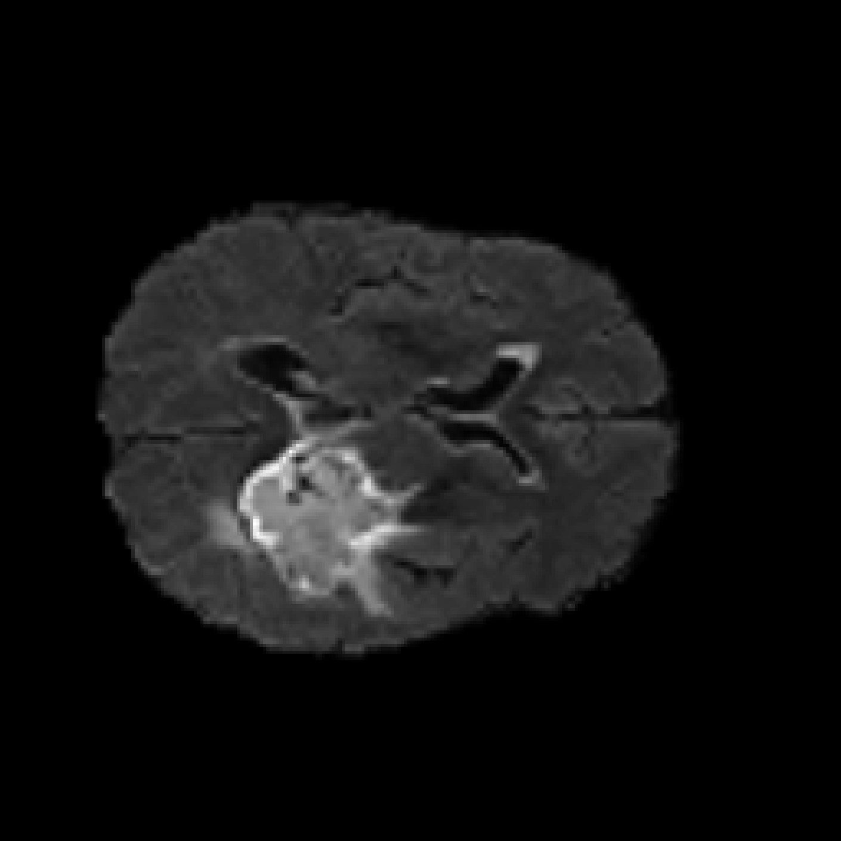
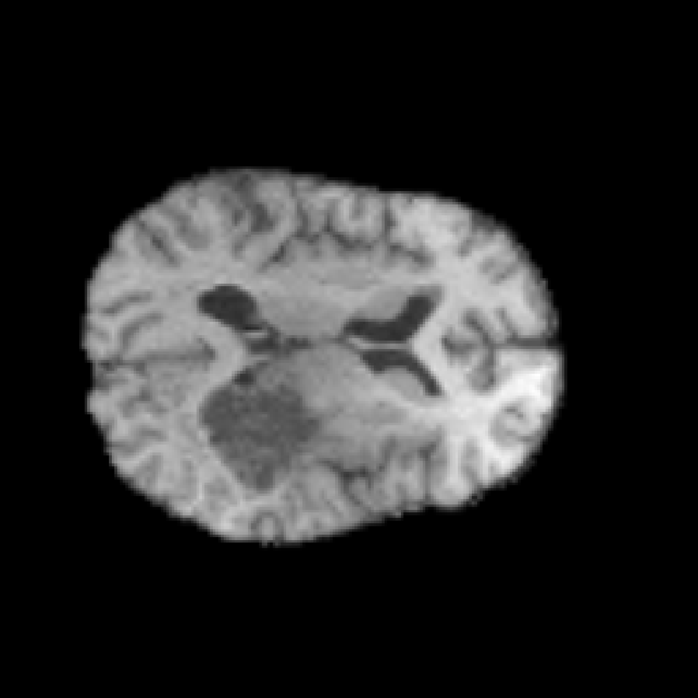
4. INTRODUCTION
Context:
MRI is a core modality in modern healthcare — noninvasive, high-resolution soft tissue imaging critical for oncology and neurology
Multiple MRI acquisition modalities exist (T1-weighted, FLAIR, T2, etc.) each revealing different contrasts and pathologies
T1-weighted MRI provides excellent gray-white matter contrast; FLAIR highlights periventricular lesions
Clinical scenarios often leave one modality unavailable (patient motion, time constraints, scanner limitations)
The Problem:
Generative models (Pix2Pix, CycleGAN) have shown success in cross-modal MRI synthesis
But: Clinical deployment demands interpretability — clinicians need to understand what the model is doing and why
Existing models are "black boxes" — they produce outputs but provide no explanation of which anatomical regions drive the synthesis
Top: FLAIR scan — hyperintense periventricular lesion clearly visible
Bottom: T1-weighted MRI — same slice, grey-white matter contrast without lesion highlight
Notes:
On "Context" bullets:
MRI is now foundational in oncology and neurology — not optional imaging, the standard of care for brain tumor diagnosis and treatment planning
The key point is that a single scan session can produce multiple modalities — T1, T2, FLAIR, DWI — each tuned to reveal different tissue properties at the same anatomy
T1 gives you clear anatomical structure — gray matter, white matter, CSF boundaries — essentially the road map of the brain. Point to the bottom image — clean, crisp grey-white contrast
FLAIR suppresses CSF signal but keeps lesion signal bright — so periventricular white matter lesions that T1 completely misses become hyperintense and obvious. Point to the top image — that bright region in the lower-left is a glioblastoma that T1 would show far less dramatically
In practice, one modality goes missing all the time — motion artifact corrupts it, time pressure skips it, the scanner protocol wasn't set up for it. That's the clinical gap we're solving
On "The Problem" bullets:
Pix2Pix and CycleGAN have shown this synthesis is technically possible — we're not solving "can you generate it," that's been done
The unsolved part is trust — a radiologist looking at a synthesized T1 has no way to verify the model didn't hallucinate anatomy, because the model gives no explanation whatsoever
This is the interpretability barrier — not a performance problem, a deployment problem. The image might be 89% structurally similar to ground truth, but the clinician has zero visibility into which part of the FLAIR input drove each region of the output

Slide 6
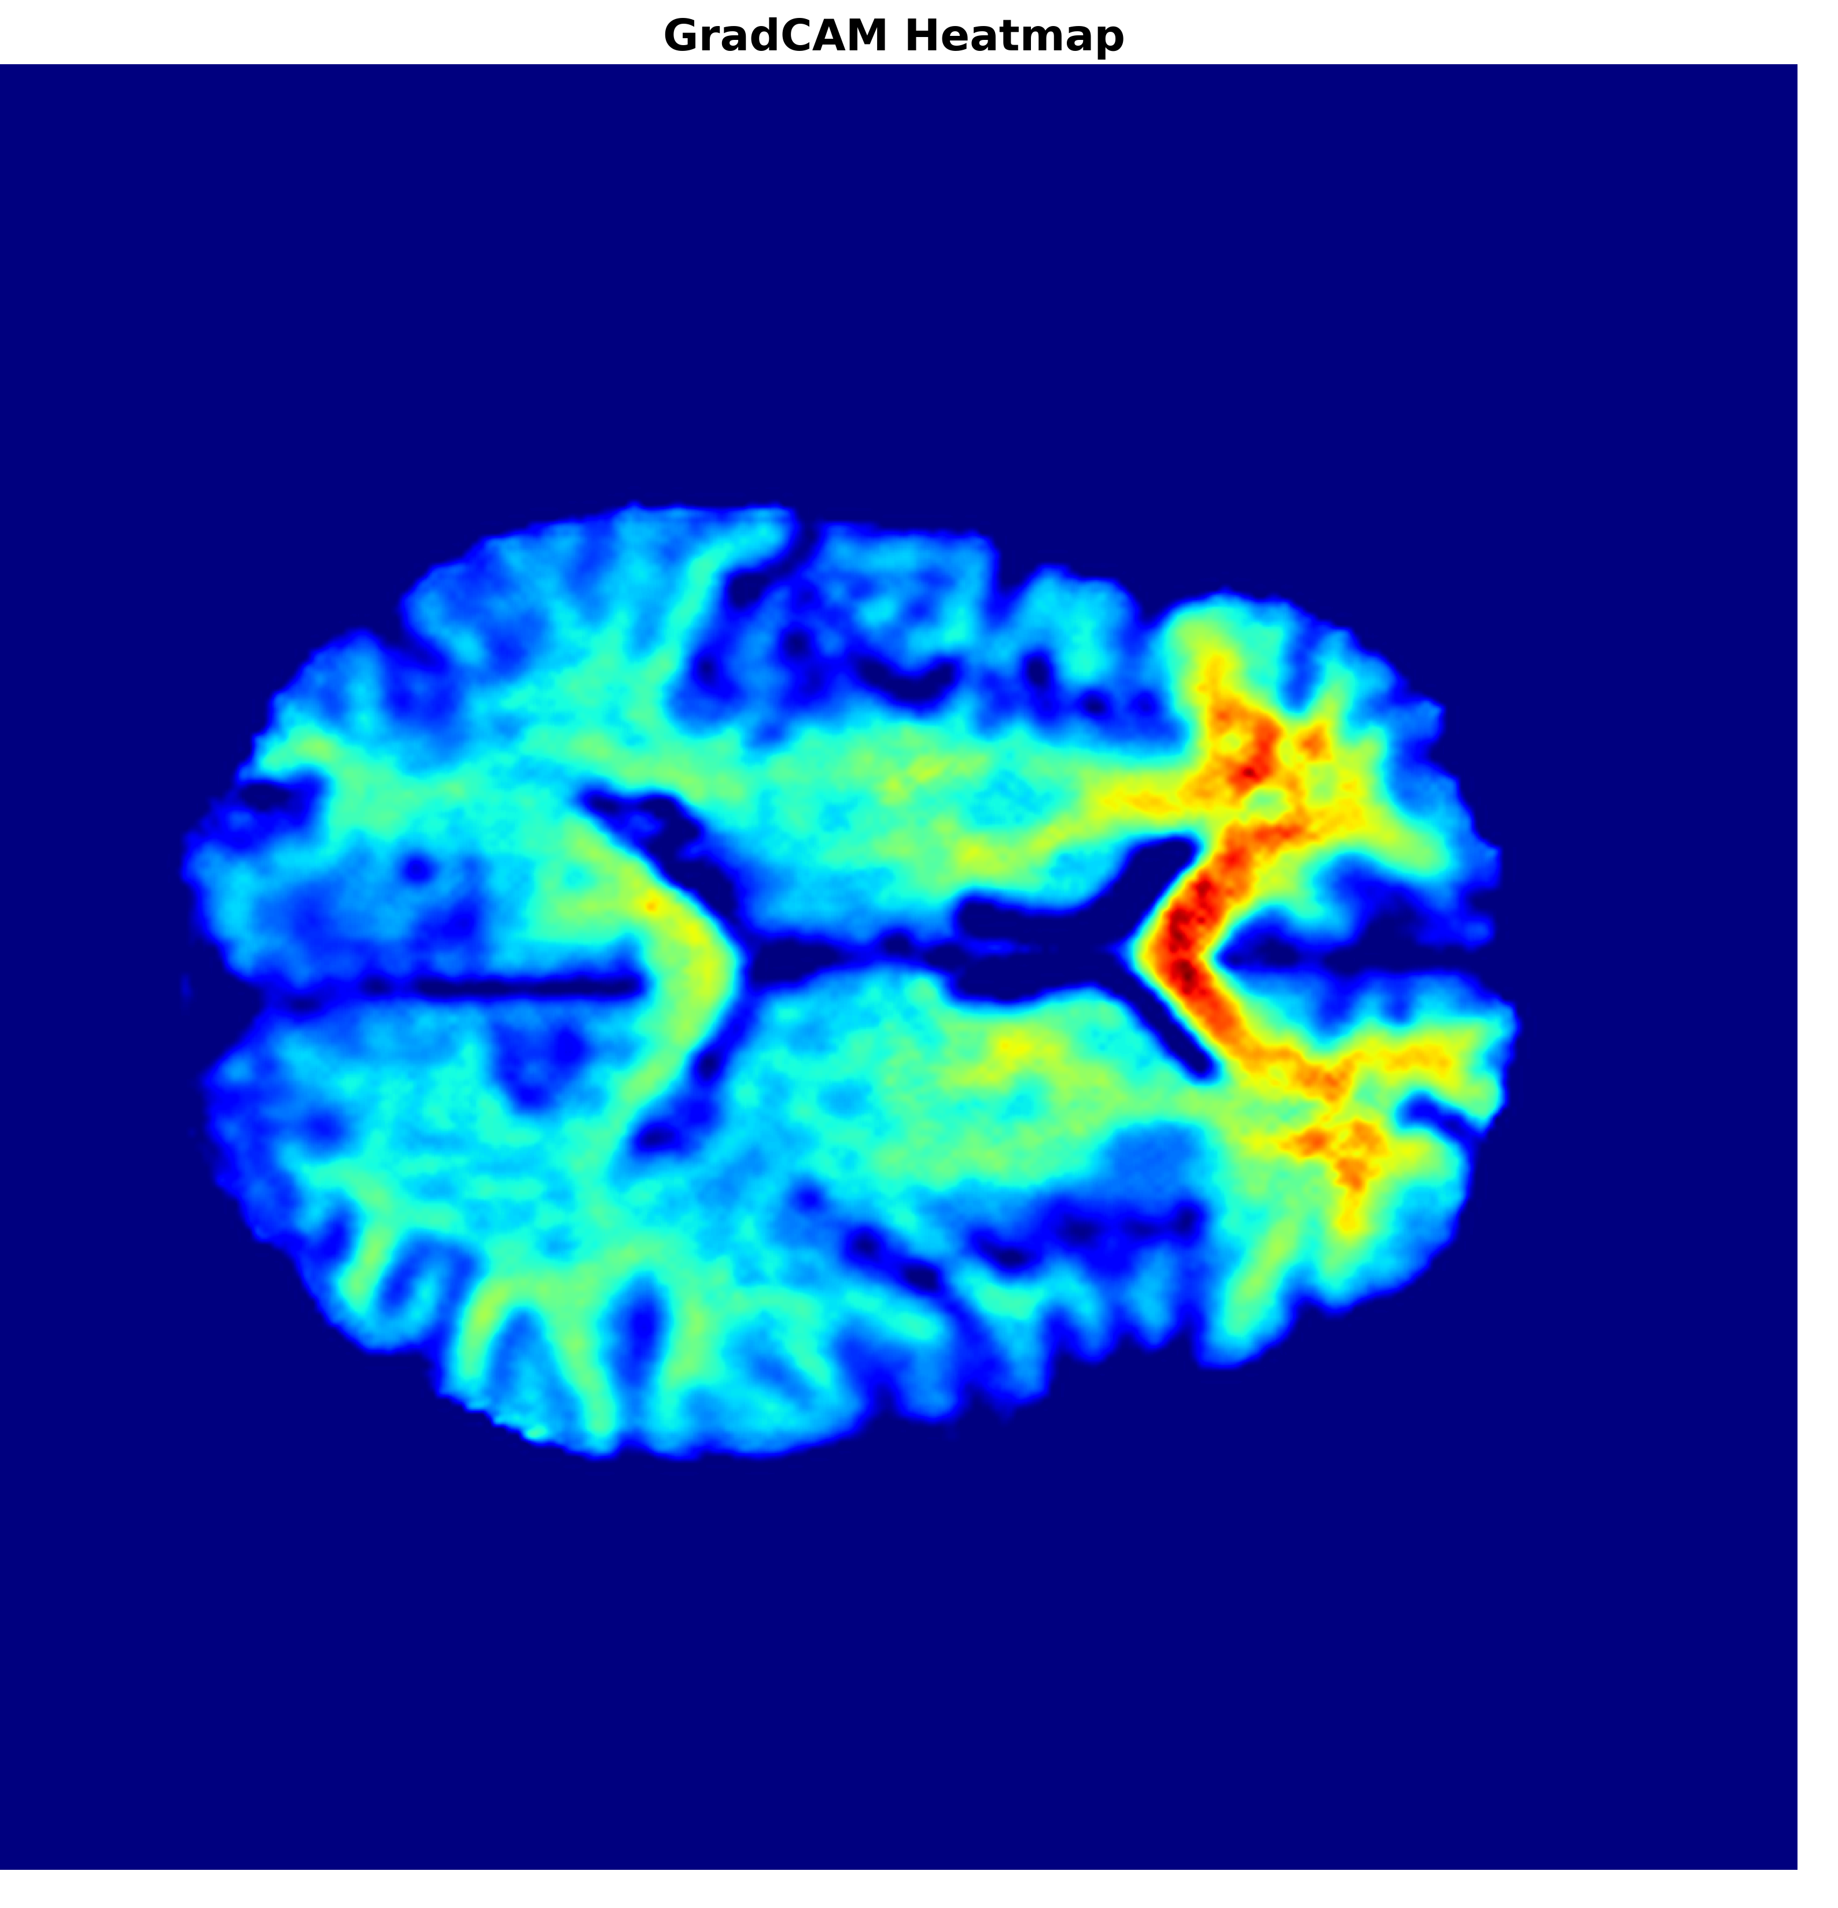
4. INTRODUCTION
Our Solution:
A Pix2Pix-based framework with a ResNet-9 generator (11.4M params) and PatchGAN discriminator for FLAIR-to-T1 synthesis
Grad-CAM on final conv layer → quantified saliency (entropy + spatial variance) transforming synthesis into a measurable, interpretable decision aid
Compound loss (7 components): LSGAN adversarial + edge-preserving + local contrast — improves SSIM from 0.807 → 0.894
Residual skip connections preserve fine anatomical structure without U-Net's parameter cost — enabling 4.8× parameter reduction over standard Pix2Pix
Trained on 1,251 paired FLAIR/T1 volumes from BraTS 2021 — validated on independent BraTS 2023 (219 subjects)
Grad-CAM saliency map showing FLAIR voxels that have a high degree of influence on T1 synthesis.
Notes:
*[Bullet 1 — Architecture]*
"We start with a Pix2Pix foundation but swap the standard U-Net generator for a ResNet-9 — 9 residual blocks in the bottleneck, processing 256×256 FLAIR slices, 11.4 million parameters at inference."
*[Bullet 2 — Grad-CAM — gesture to heatmap]*
"The key differentiator: we embed Grad-CAM on the final generator conv layer. That heatmap on the right shows exactly which FLAIR voxels are driving each T1 synthesis — the red ventricle boundaries are the highest-influence regions. And we don't just visualize it — we quantify it with entropy and spatial variance metrics."
*[Bullet 3 — Loss]*
"To get the quality up, we extended the Pix2Pix loss to 7 components — including LSGAN adversarial objective for stable training, plus novel edge-aware and local contrast terms. That combination is what pushed SSIM from a baseline of 0.807 up to 0.894."
*[Bullet 4 — Efficiency]*
"Residual skip connections handle anatomical detail preservation inside the bottleneck — no need for U-Net's encoder-decoder skip concatenations, which is why we're 4.8× smaller than standard Pix2Pix at inference."
*[Bullet 5 — Data]*
"Trained on all 1,251 BraTS 2021 glioblastoma volumes, then externally validated on a completely independent BraTS 2023 dataset — 219 subjects the model had never seen."

Slide 7
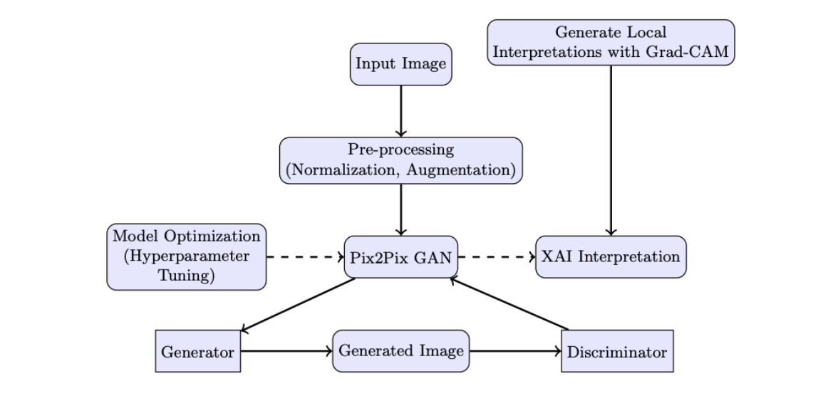
4. INTRODUCTION
End-to-end workflow: (1) FLAIR input normalization and augmentation, (2) ResNet-9 generator and PatchGAN discriminator for adversarial synthesis, (3) hyperparameter tuning, (4) Grad-CAM saliency maps for interpretability.

Slide 8
5. LITERATURE REVIEW
1. Image-to-Image Translation (GAN Foundations)
Ref | Authors | Work | How it relates to our paper
[Isola2017] | Isola et al. (2017) | Pix2Pix — Conditional adversarial networks for paired image-to-image translation (CVPR) | Our base framework; we replace U-Net generator with ResNet-9 and extend loss from 2 to 7 components
[zhu2017unpaired] | Zhu et al. (2017) | CycleGAN — Unpaired image translation using cycle consistency (ICCV) | Source of ResNet generator design; direct comparison baseline (SSIM: 0.798)
[mao2017lsgan] | Mao et al. (2017) | LSGAN — Least Squares GAN for stable training (ICCV) | Our adversarial objective — replaces BCE to avoid vanishing gradients
[wang2018pix2pixHD] | Wang et al. (2018) | pix2pixHD — High-resolution synthesis with conditional GANs (CVPR) | Source of our discriminator feature matching loss (λ=10)

Slide 9
2. Architecture Foundations
3. Explainability (XAI)
Ref | Authors | Work | How it relates to our paper
[Ronneberger2015] | Ronneberger et al. (2015) | U-Net — Convolutional networks for biomedical image segmentation (MICCAI) | Original Pix2Pix uses U-Net generator (54M params) — replaced by our ResNet-9 (11M params)
[johnson2016perceptual] | Johnson et al. (2016) | Perceptual Losses — Real-time style transfer and super-resolution (ECCV) | Source of our VGG19 perceptual loss (relu1_2, relu2_2, relu3_4; λ=10)
Ref | Authors | Work | How it relates to our paper
[Selvaraju2017] | Selvaraju et al. (2017) | Grad-CAM — Visual explanations via gradient-based localization (ICCV) | Core XAI method — applied to last generator conv layer for voxel-level saliency maps

Slide 10
3. Explainability (XAI)
4: Medical Imaging
Ref | Authors | Work | How it relates to our paper
[Emami2020] | Emami et al. (2020) | SPA-GAN — Spatial attention GAN for image-to-image translation | Attention-based alternative — we use Grad-CAM for post-hoc, gradient-based interpretability
[Gohel2021] | Gohel et al. (2021) | Explainable AI: current status and future directions | Clinical motivation — interpretability gap in deep learning is the problem we address
Ref | Authors | Work | How it relates to our paper
[Armanious2020] | Armanious et al. (2020) | MedGAN — Medical image translation using GANs | Prior clinical GAN synthesis work; establishes the cross-modal translation problem
[Litjens2017] | Litjens et al. (2017) | Survey on deep learning in medical image analysis | Contextualizes clinical deployment need; used in our evaluation metric justification
[Meng2024] | Meng et al. (2024) | Multi-modal modality-masked diffusion network for brain MRI synthesis | Recent diffusion-based MRI synthesis — we achieve competitive SSIM with a lighter, interpretable GAN

Slide 11
6. RESEARCH GAPS
# | Research Gap | Evidence from Existing Work | How We Address It
1 | No interpretability in medical image synthesis GANs | CycleGAN, Attention-GAN, and Pix2Pix offer zero interpretability — they are black boxes; a clinician cannot know why a pixel was synthesised that way, which blocks clinical adoption | We embed Grad-CAM on the final generator conv layer — every synthesised T1 slice comes with a voxel-level saliency map showing exactly which FLAIR regions drove the output, quantified with entropy and spatial variance
2 | Existing architectures are too parameter-heavy for clinical deployment | Standard Pix2Pix uses a U-Net generator with 54M parameters — that is impractical for resource-constrained clinical environments | We use a ResNet-9 generator with 11M parameters — 4.8× lighter — yet we outperform Pix2Pix in SSIM (0.894 vs 0.885)
3 | Basic loss functions produce blurry, anatomically inaccurate outputs | The standard Pix2Pix objective (L1 + adversarial) achieves only SSIM 0.807; CycleGAN with cycle-consistency only reaches 0.798 — neither enforces perceptual structure or anatomical accuracy | We extend to a 7-component compound loss including VGG perceptual, MS-SSIM, discriminator feature matching, edge-aware, and local contrast terms → SSIM 0.8936 (+10.7%)

Slide 12
6. RESEARCH GAPS
# | Research Gap | Evidence from Existing Work | How We Address It
4 | No explicit boundary preservation in synthesis | Standard pixel-wise losses (L1, MSE) have no gradient penalty — they treat all pixels equally, which causes blurred tissue interfaces and loss of white/gray matter boundaries that clinicians rely on | We introduce an edge-aware loss combining Sobel gradients and Laplacian operators at two scales — it carries the highest weight of all 7 components (λ₅ = 20) — plus a local contrast loss matching 9×9 neighborhood texture for deep gray matter
5 | No external validation or statistical confidence reporting | Existing synthesis methods report metrics on a single dataset with no confidence intervals — we cannot know if the model generalises to different scanners or acquisition protocols | We validate on an independent BraTS 2023 GLI dataset (219 subjects the model never saw), with bootstrap 95% CIs on every metric — SSIM 0.8940 [0.887, 0.900]

Slide 13
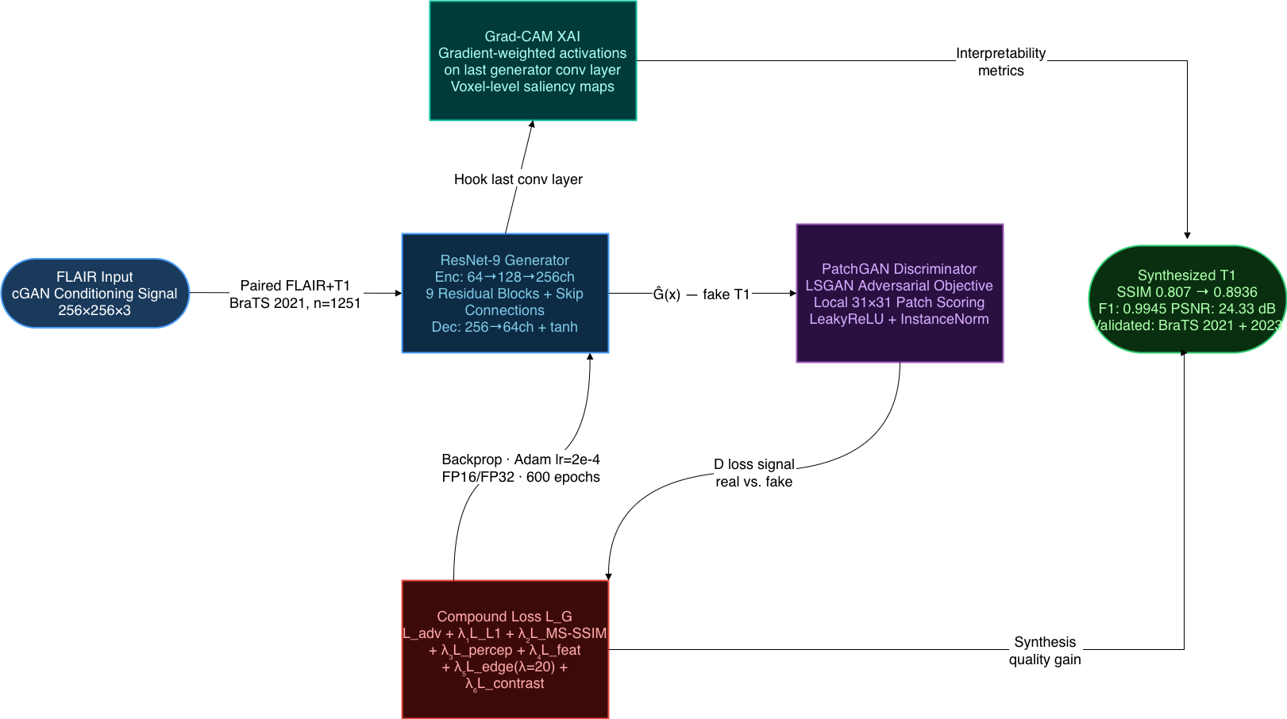
7. PROPOSED METHODOLOGY

Slide 14
8. RESULTS & DISCUSSION
Quantitative Performance (Proposed Method)
Discussion: Near-identical SSIM (0.8936 vs 0.8940) across two independent datasets confirms strong generalization. Bootstrap CIs are tight, indicating low variance across subjects
Metric | BraTS 2021 (n=251) | 95% CI | BraTS 2023 (n=219) | 95% CI
PSNR (dB) | 24.33 | [23.94, 24.74] | 24.57 | [24.11, 24.98]
SSIM | 0.8936 | [0.8928, 0.8946] | 0.8940 | [0.8871, 0.9003]
MAE | 0.0302 | [0.0287, 0.0316] | 0.0288 | —
RMSE | 0.0719 | [0.0678, 0.0760] | 0.0670 | —
Precision | 0.9950 | — | 0.9949 | —
Recall | 0.9939 | — | 0.9960 | —
F1 Score | 0.9945 | — | 0.9955 | —

Slide 15
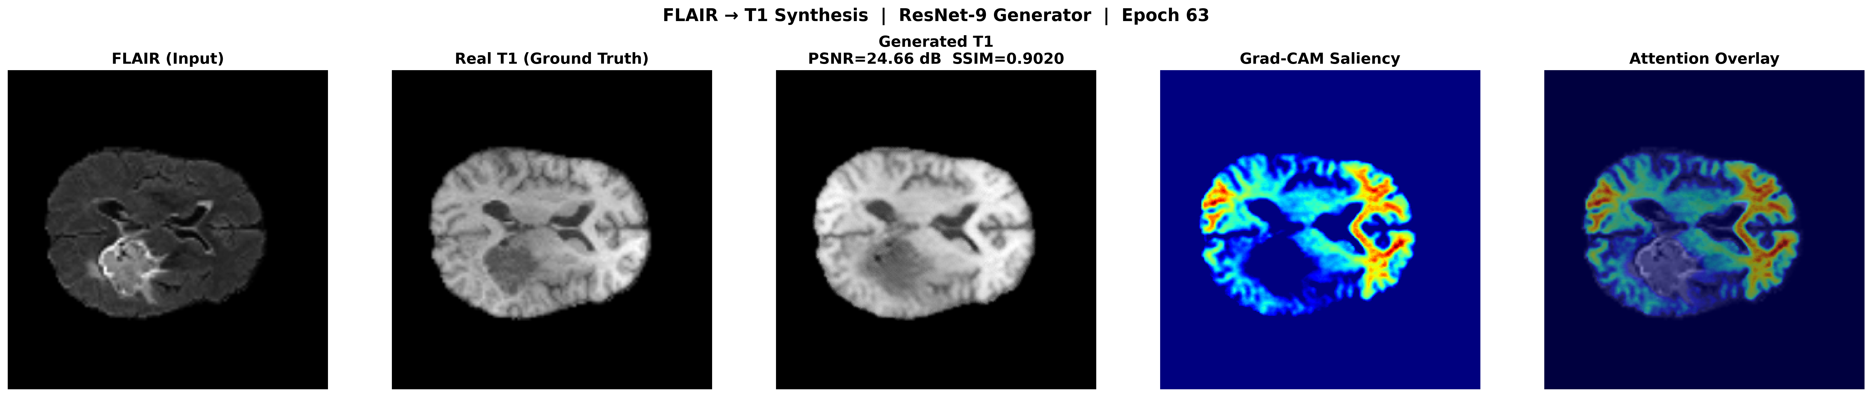
8. RESULTS & DISCUSSION
Visual Inspection
FLAIR→T1 synthesis:
FLAIR input with hyperintense lesion and suppressed ventricles
Ground truth T1 showing clear gray-white matter contrast
Synthesised T1 — closely recovering tissue boundaries and ventricular structure.
Grad-CAM saliency — red activation at ventricle walls and cortical edges, the model's highest-influence regions
Attention overlay — saliency blended onto the output, confirming anatomically focused, interpretable synthesis.

Slide 16
8. RESULTS & DISCUSSION
Comparative Study (All Trained on BraTS 2021)
Discussion: Our model achieves the best SSIM and lowest MAE while using 5× fewer parameters than standard Pix2Pix (11M vs 54M) and being the only method with built-in interpretability.
Method | Generator | Params | XAI | SSIM | MAE | SSIM Δ vs Ours
CycleGAN | ResNet + PatchGAN | ~28M (2 G + 2 D) | None | 0.798 | 0.042 | −12%
AttentionGAN | Attention-guided + PatchGAN | ~29M | None | 0.795 | 0.043 | −12.4%
Pix2Pix | U-Net (54M) + PatchGAN | ~57M | None | 0.885 | 0.031 | −1%
Proposed | ResNet-9 (11M) + PatchGAN | ~14M | Grad-CAM | 0.894 | 0.030 | —

Slide 17
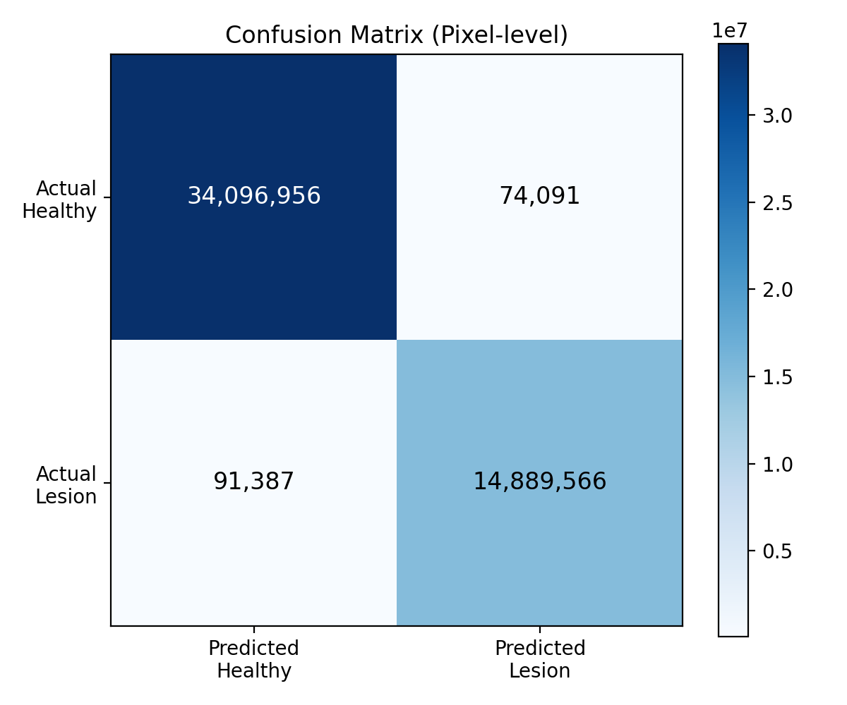
8. RESULTS & DISCUSSION
Confusion Matrix (Pixel-Level Tissue Classification)
Discussion: Strong diagonal dominance — 99.5% precision, 99.4% recall. Only ~165K misclassified pixels out of ~49M total, confirming the model preserves both healthy and lesion tissue composition faithfully.

Slide 18
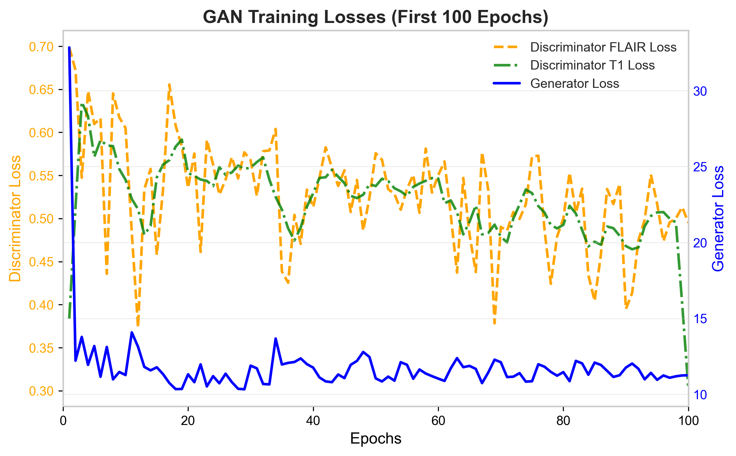
8. RESULTS & DISCUSSION
GAN Training Dynamics
Discussion: Generator loss drops sharply from 0.70 to ~0.32 within the first 5 epochs and stabilises — confirming rapid FLAIR→T1 mapping convergence. Both discriminator losses oscillate around 0.50 throughout all 100 epochs, the hallmark of LSGAN adversarial equilibrium — the discriminator is genuinely uncertain between real and synthesised pairs, with no mode collapse or divergence observed.

Slide 19
8. RESULTS & DISCUSSION
Grad-CAM Interpretability Metrics (n=20 samples)
Discussion: High entropy + low activation ratio = the model attends broadly but acts selectively. The 9.8% high-activation ratio means it identifies specific anatomical structures (not just spreading uniformly), making Grad-CAM maps clinically meaningful for radiologists.
Metric | Mean ± Std | What It Tells You
Entropy | 11.25 ± 0.04 | Attention is distributed (not fixated on one spot)
Spatial Variance | 0.086 ± 0.007 | Activation varies across regions (anatomically selective)
High Activation Ratio | 9.8% ± 2.1% | Only ~10% of voxels are heavily used — model is focused
Error Correlation | 0.34 ± 0.03 | Moderate link between high-attention areas and synthesis errors
Peak Activation | 1.00 ± 0.00 | Full dynamic range utilized

Slide 20
9. CONCLUSION & FUTURE WORK
Interpretable ResNet-9 Pix2Pix GAN for FLAIR→T1 synthesis with Grad-CAM voxel-level saliency maps
7-component compound loss achieves SSIM = 0.8936, PSNR = 24.33 dB on BraTS 2021 (600 epochs, 4.11 hrs)
+12% SSIM, +29% MAE improvement over CycleGAN; matches Pix2Pix with 5× fewer parameters (11M vs 54M)
Generalizes to unseen data: BraTS 2023 SSIM = 0.8940 [95% CI: 0.887–0.900], n = 219 subjects
Mixed precision + MONAI caching + torch.compile — efficient on standard GPU hardware
Future Work
Extend to diverse pathologies — stroke, dementia, multiple sclerosis (currently glioma-only)
Multi-site, cross-scanner validation across MRI vendors and field strengths
Evaluate robustness under low SNR and motion artifact conditions
Stratify performance by tumor size, location, and enhancement pattern
Prospective clinical trials with blinded radiologist evaluation before deployment

Slide 21
10. REFERENCES
# | First Author | Year | Title | Venue
1 | Isola, P. | 2017 | Image-to-image translation with conditional adversarial networks | IEEE CVPR
2 | Zhu, J.Y. | 2017 | Unpaired image-to-image translation using cycle-consistent adversarial networks | IEEE ICCV
3 | Mao, X. | 2017 | Least squares generative adversarial networks | IEEE ICCV
4 | Wang, T.C. | 2018 | High-resolution image synthesis and semantic manipulation with conditional GANs | IEEE CVPR
5 | Ronneberger, O. | 2015 | U-Net: Convolutional networks for biomedical image segmentation | MICCAI 2015, LNCS 9351
6 | Johnson, J. | 2016 | Perceptual losses for real-time style transfer and super-resolution | ECCV 2016, LNCS 9906
7 | Selvaraju, R.R. | 2017 | Grad-CAM: Visual explanations from deep networks via gradient-based localization | IEEE ICCV
8 | Emami, H. | 2020 | SPA-GAN: Spatial attention GAN for image-to-image translation | IEEE Trans. Multimedia 23
9 | Gohel, P. | 2021 | Explainable AI: current status and future directions | arXiv:2107.07045
10 | Abhisheka, B. | 2024 | Recent trend in medical imaging modalities and their applications | Multimedia Tools Appl. 83(14)
11 | Meng, X. | 2024 | Multi-modal modality-masked diffusion network for brain MRI synthesis | IEEE Trans. Med. Imaging 43(7)
12 | Abbasi, S. | 2023 | Unsupervised deep learning registration model for multimodal brain images | J. Appl. Clin. Med. Phys. 24(11)

Slide 22
10. REFERENCES
# | First Author | Year | Title | Venue
13 | Zhu, L. | 2022 | DualMMP-GAN: Dual-scale multi-modality perceptual GAN for medical image segmentation | Comput. Biol. Med. 144
14 | Sun, L. | 2019 | Anatomical attention guided deep networks for ROI segmentation of brain MR images | IEEE Trans. Med. Imaging 39(6)
15 | Litjens, G. | 2017 | A survey on deep learning in medical image analysis | Medical Image Analysis 42
16 | Wang, Z. | 2004 | Image quality assessment: From error visibility to structural similarity | IEEE Trans. Image Process. 13(4)
17 | Wang, Z. | 2003 | Multiscale structural similarity for image quality assessment | Asilomar Conf. Sig. Sys. Comput. 2
18 | Wang, Z. | 2002 | A universal image quality index | IEEE Signal Process. Lett. 9(3)
19 | Taha, A.A. | 2015 | Metrics for evaluating 3D medical image segmentation: analysis, selection, and tool | BMC Medical Imaging 15(1)
20 | Baid, U. et al. | 2021 | The RSNA-ASNR-MICCAI BraTS 2021 benchmark on brain tumor segmentation | arXiv:2107.02314
21 | Menze, B.H. | 2015 | The multimodal brain tumor image segmentation benchmark (BRATS) | IEEE Trans. Med. Imaging 34(10)
22 | Bakas, S. | 2017 | Advancing The Cancer Genome Atlas glioma MRI collections with expert labels | Scientific Data 4

