Slide 1



MACHINE LEARNING-BASED CLASSIFICATION OF OBESITY LEVELS FROM LIFESTYLE INDICATORS IN ADULT

Slide 2

TEAM MEMBERS:
Sai Manikanta
Vivek Atchutanna
Mahender Tanniru
01

Slide 3
INTRODUCTION
A major influence on physical health and a burden on healthcare systems, obesity has emerged as a global public health emergency. The purpose of this study is to investigate the relationship between lifestyle factors—specifically, screen time, physical activity, smoking, and alcohol consumption—and the prediction of obesity and associated health outcomes, including body weight and Body Mass Index (BMI). We aim to address important questions regarding the relationship between smoking and alcohol use and the risk of obesity, the role of screen time and physical activity in weight classification, and whether weight or BMI can be predicted from a person's height and lifestyle choices by using machine learning techniques on a large dataset. The results are intended to advance behavioral epidemiology and guide tailored health interventions.
02

Slide 4
MOTIVATION
The rising prevalence of obesity globally is a major public health concern, with far-reaching implications for people's health and healthcare systems. Since obesity is linked to multiple chronic conditions, including diabetes, heart disease, and various forms of cancer, its underlying causes must be identified and addressed. In addition to genetics, a number of lifestyle factors, such as alcohol usage, smoking, physical inactivity, and screen time, contribute to the obesity pandemic. This study uses machine learning to analyze these characteristics in order to find patterns and factors that contribute to obesity. Important data for developing tailored health interventions and targeted prevention strategies will be obtained from this.
03

Slide 5
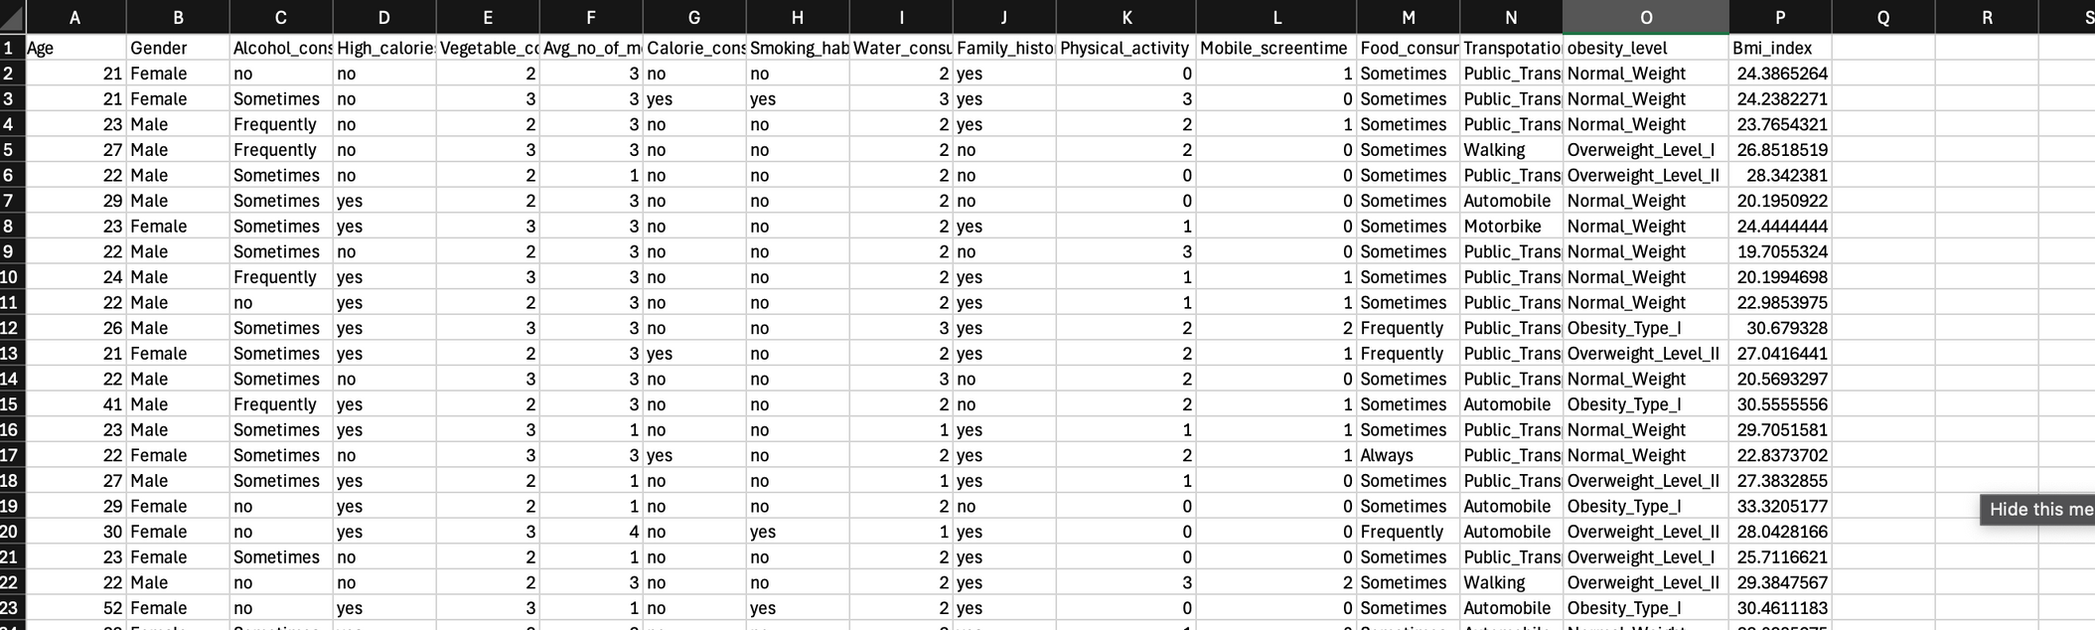
DATA DESCRIPTION
The data is taken from openml. 2087 entries and 16 attributes make up the dataset used in this project, which captures a variety of behavioral, lifestyle, and health aspects important for predicting obesity levels. It contains both qualitative and numerical data, with a person represented by each row.
03

Slide 6

DATA CLEANING
To guarantee accurate analysis and trustworthy outcomes, data cleaning is an essential step. We started this process by employing abbreviations to change long, ambiguous column names into shorter, easier-to-understand labels. We discovered and fixed discrepancies in the age field, where certain decimal values were changed to integers for validity. We determined the Body Mass Index (BMI), a crucial metric for forecasting obesity levels, because the dataset contained height and weight. After that, we eliminated the original height and weight columns. We also interpolated a column with completely missing values using the mean of other columns. We also eliminated duplicate items to prevent redundancy and preserve data integrity. Together, these actions enhanced the dataset's accuracy and quality for subsequent study.
05

Slide 7
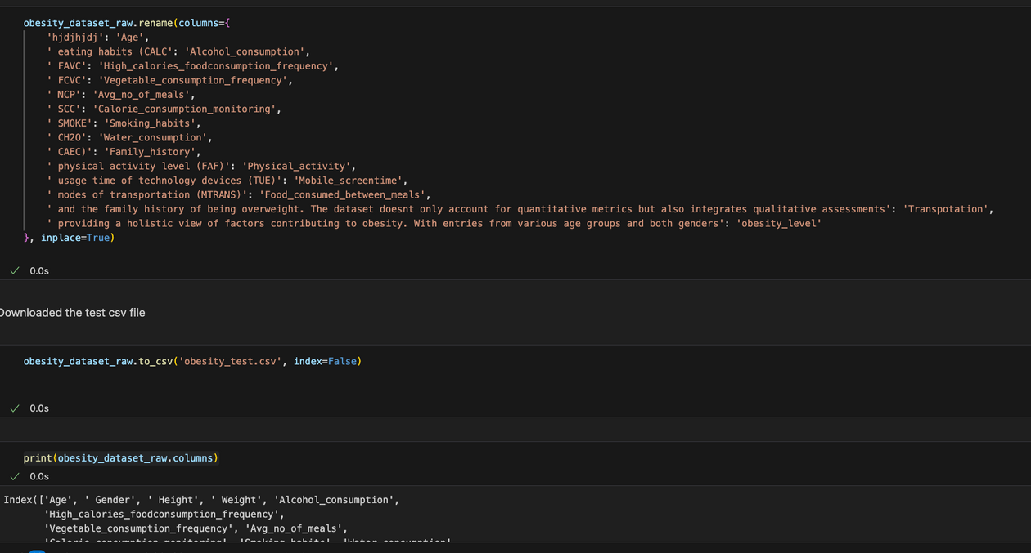
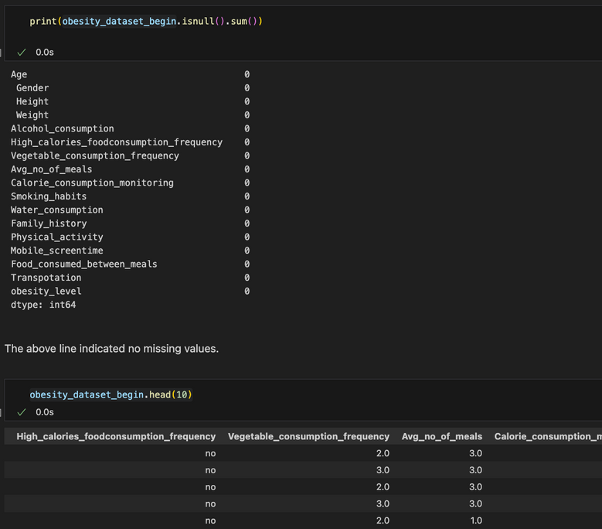
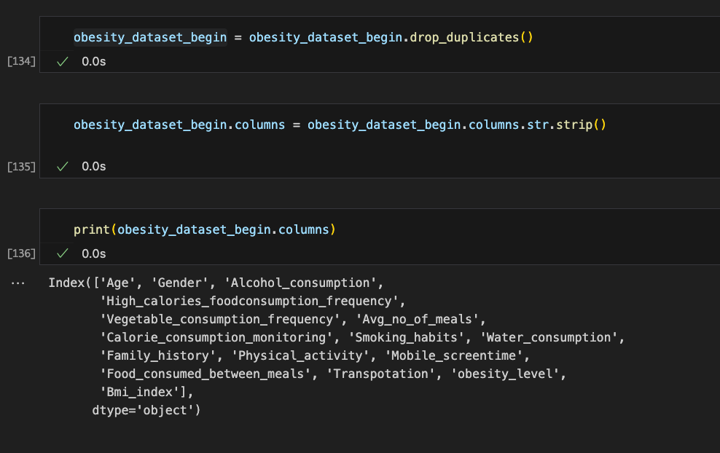
SCREEN SHOTS
03

Slide 8
RESEARCH QUESTIONS
1.
Can smoking and alcohol habits analyze obesity level ?
2.
To what extent do screen time and physical activity affect a person's weight?
3.
Can we predict a person's obesity level based on their lifestyle factors?"
02

Slide 9
RESEARCH QUESTIONS 1
In order to conduct a comprehensive analysis of obesity and the lifestyle factors that contribute to it, we used the data to formulate three primary study questions. The first research subject examines the relationship between an individual's risk of obesity and their drinking and smoking behaviors. For this study, we focus on the variables that represent the frequency of smoking and alcohol consumption. We use statistical techniques and graphical tools to examine the link between these behavioral traits and obesity levels in order to determine whether substance-related behaviors can be significant predictors of obesity.
We used linear regression and random forest to analysis
04

Slide 10
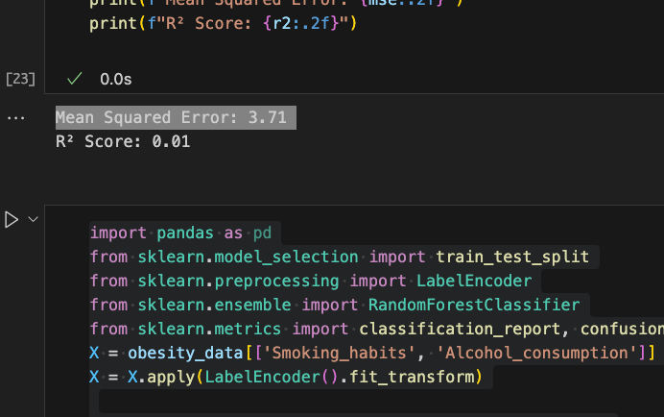
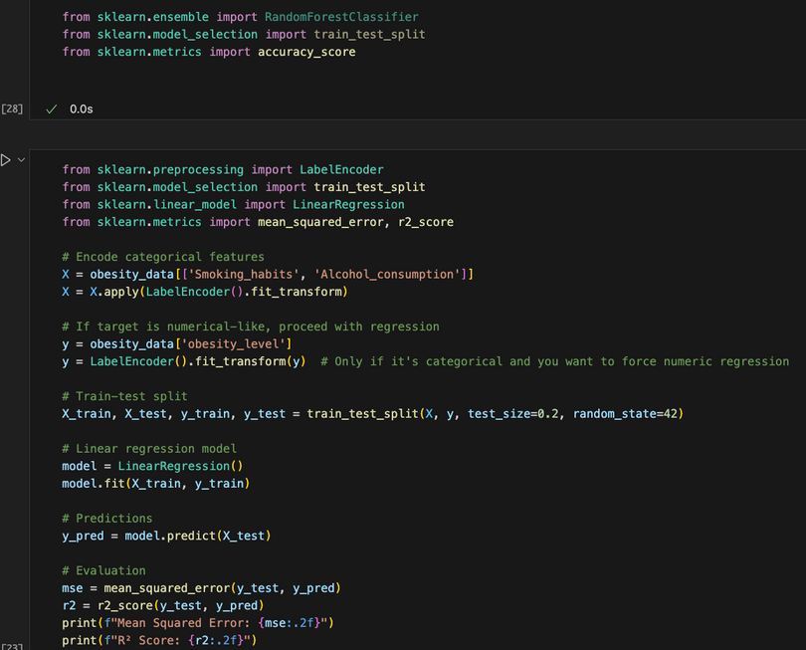
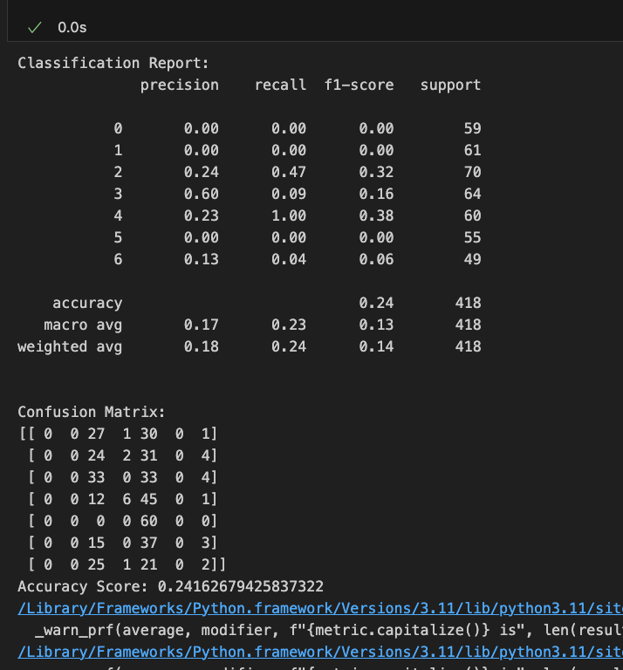
SCREEN SHOTS
03

Slide 11
RESEARCH QUESTIONS 2
The second question focuses on how exercise and screen time affect a person's weight. We utilize the dataset's attributes that characterize the frequency of daily mobile screen usage and physical exercise. These variables are analyzed and shown to understand their respective impacts on weight categories and BMI. Our objective is to determine whether excessive screen time, a symptom of sedentary behavior, increases the prevalence of obesity and has a negative relationship with physical fitness.
We have used visualization and correlation matrix
04

Slide 12
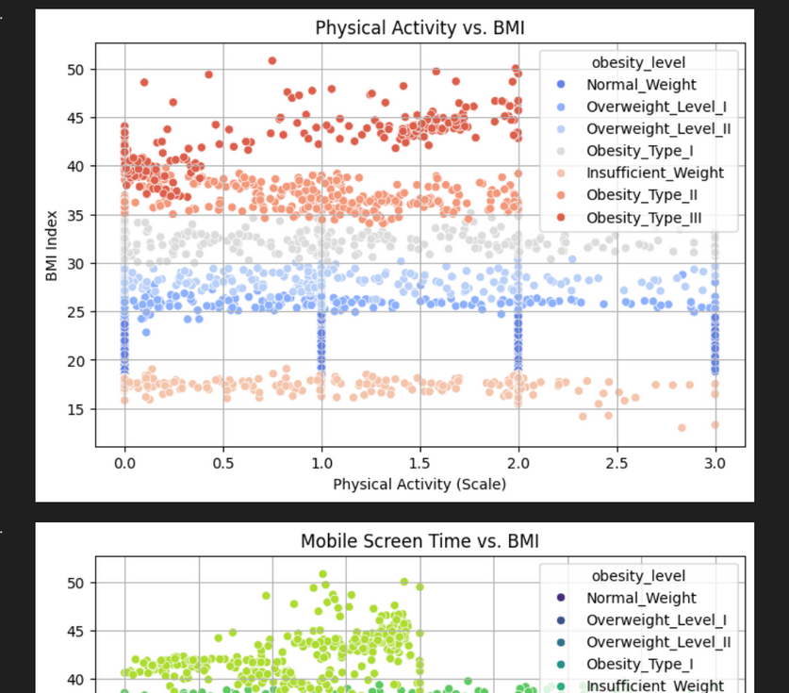
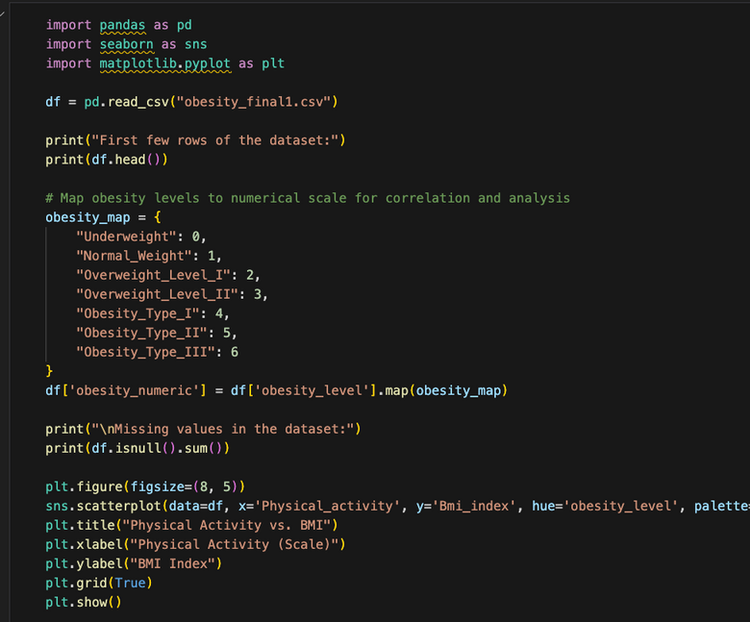
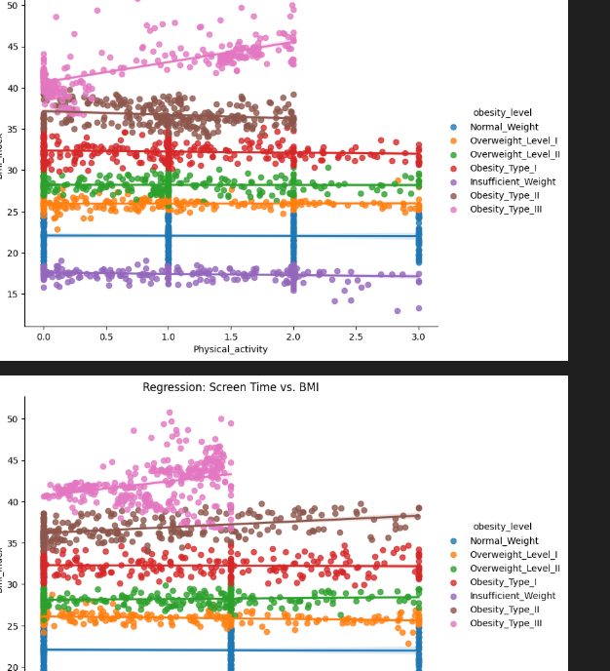
SCREEN SHOTS
03

Slide 13
RESEARCH QUESTIONS 3
Lastly, the final and more general objective of this study is to ascertain how an individual's overall lifestyle choices impact their obesity state. The dataset includes a range of lifestyle traits, including eating habits, activity levels, and behavioral patterns, that are used as input variables for predictive modeling. Our goal is to use machine learning techniques to identify the lifestyle characteristics that are most strongly associated with obesity. By taking a holistic approach, we can extract important information that can be used to develop tailored weight-management programs and targeted public health initiatives.
We have used Svms and liner regression
04

Slide 14
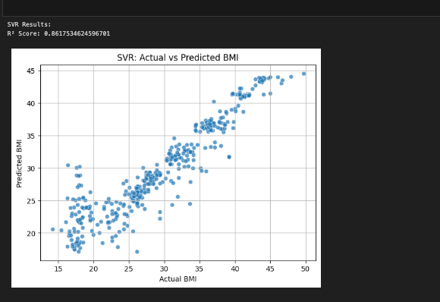
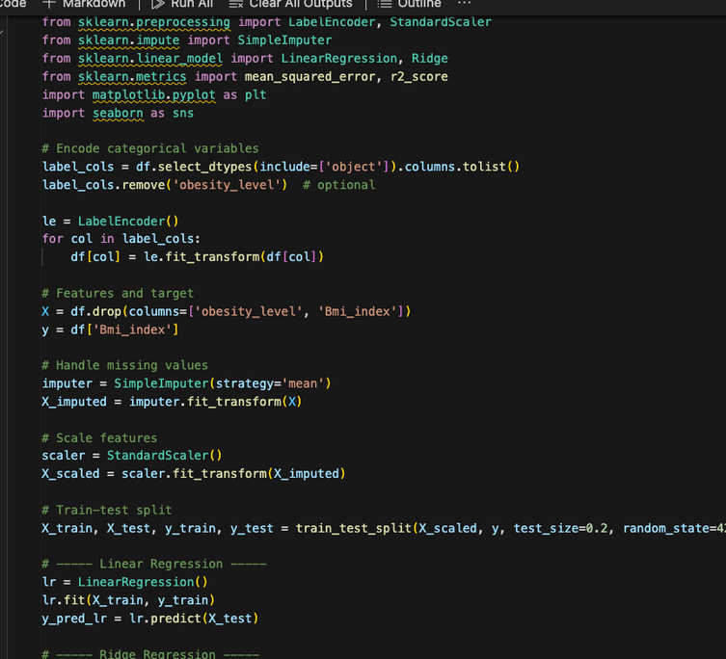
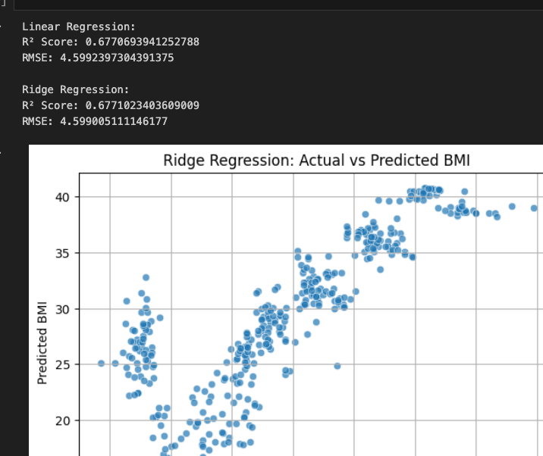
SCREEN SHOTS
03

Slide 15
CONCLUSION
This experiment shows how machine learning can use behavioral and lifestyle data to accurately predict BMI and identify obesity levels. Combining several markers produces more accurate results, even when individual criteria like screen time or physical exercise have little predictive potential on their own. Using a comprehensive collection of features improved the performance of models like Random Forest and SVM. These results highlight how crucial data-driven methods are for directing focused public health initiatives and individualized obesity prevention plans.
09

