Slide 1
Accelerator Toolbox Training
L.Carver, S.Liuzzo

Slide 2
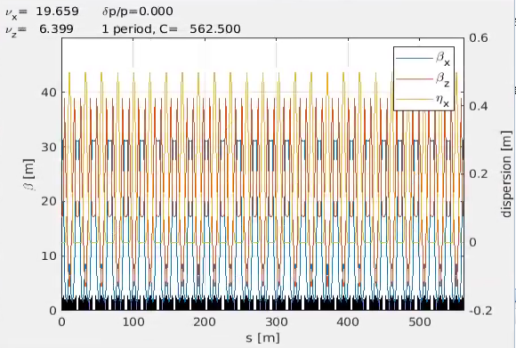
From FODO lattice to Double Bend Achromat lattice
Objective:
Design a fully functional low emittance lattice
Build a FODO lattice
Introduce dipoles
Compute emittance
Move dipoles
Introduce straight sections
Match dispersion to zero at straight sections
Match periodic cell, verify total angle
Introduce sextupoles and correct chromaticity
Introduce an RF cavity
Match tune
Tracking and plot of phase space
transverse dynamic aperture

Slide 3
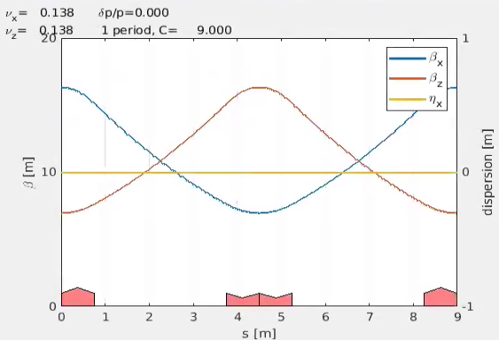
1) Build a FODO Lattice
Use:
atdrift
atquadrupole
L = 3m
K = 0.1*sqrt(2)
L_drift = L
L_quad = L/4
Do the beta functions behave as you would expect?
What is the natural emittance of this lattice?

Slide 4
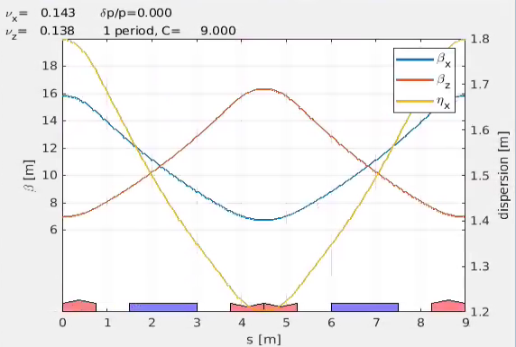
Introduce dipoles
Use above +:
atsbend
L = 3m
Ncells = 50;
K = 0.1*sqrt(2)
L_drift = L/4
L_bend = L/2
Ang_bend = ???
L_quad = L/4

Slide 5
Introduce dipoles
Use above +:
atsbend
L = 3m
Ncells = 50;
K = 0.1*sqrt(2)
L_drift = L/4
L_bend = L/2
Ang_bend = 2pi/ Ncells /2
L_quad = L/4

Slide 6
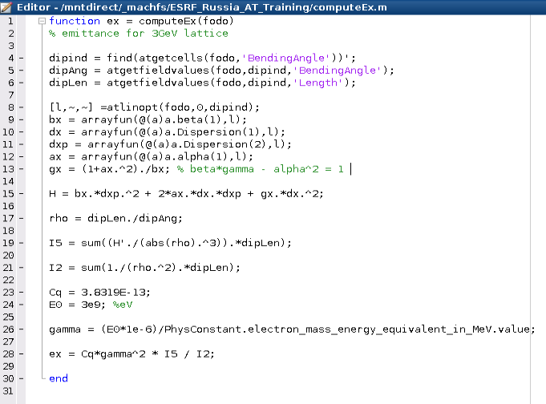
3) Compute emittance
bx= beta_x
dx = Dispersion x
dxp = Disperison x’
ax = alpha_x
dipAng = dipole angle
dipLen = dipole length
Use atgetcells, atgetfieldvalues, atlinopt, arrayfun (optional), to get the relevant quantities
Write this function and compute emittance for the above lattice.
Should be around 115 nm.rad
How to reduce the emittance?

Slide 7
3) Compute emittance
bx= beta_x
dx = Dispersion x
dxp = Disperison x’
ax = alpha_x
dipAng = dipole angle
dipLen = dipole length
Use atgetcells, atgetfieldvalues, atlinopt, arrayfun (optional), to get the relevant quantities
Write this function and compute emittance for the above lattice.
Should be around 115 nm.rad
How to reduce the emittance?
Place dipoles in low beta and low dispersion regions.

Slide 8
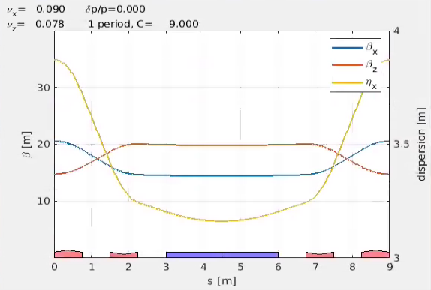
4) Move dipole to low horizontal beta region
Use:
atdrift
atsbend
atquadrupole
L = 3m
K = 0.1*sqrt(2)
L_drift = L/4
L_quad = L/4
compute emittance for this lattice.
Should be around 392 nm.rad (!)
Why?

Slide 9
4) Move dipole to low horizontal beta region
Use:
atdrift
atsbend
atquadrupole
L = 3m
K = 0.1*sqrt(2)
L_drift = L/4
L_quad = L/4
compute emittance for this lattice.
Should be around 392 nm.rad (!)
Why? The dispersion function is now much bigger than before.

Slide 10
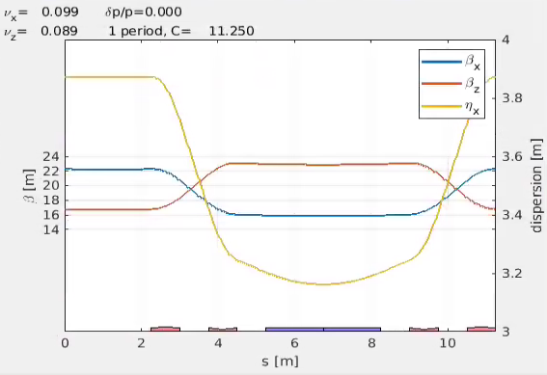
5) Introduce straight section
Use:
atdrift
atsbend
atquadrupole
L = 3m
K = 0.1*sqrt(2)
L_drift = L/4
L_quad = L/4
L_straight = 3 * L/4
compute emittance for this lattice.

Slide 11
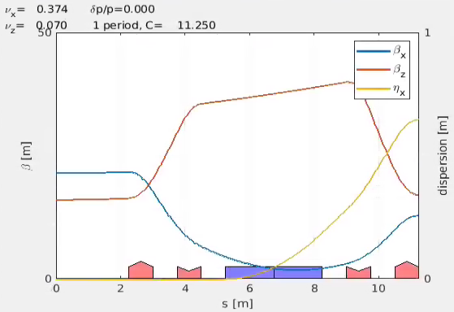
lattice matching
Define magnetic fields to obtain wished parameters:
Ex : vary QUADRUPOLES
obtain wished tunes, or anything else
Can be
transferline : need input Twiss parameters
periodic : will enforce initial and final Twiss parameters to be identical. Good for symmetric cells.
An optimizer (ex: fminsearch) is run to find (if it exist) the optimal set of quadrupole strengths that best match the wished requirements.
same magnets layout, different gradients!

Slide 12
6) Match lattice optics
Is this lattice acceptable for synchrotron Radiation production?
Dispersion is large at the straight sections (SS), and at the dipoles!
Let’s set the dispersion at the SS to zero and see it’s evolution.
Use
[TwissStart,~,~]=atlinopt(…,0,1)
and
atplot(…,’inputtwiss’,TwissStart)
to observe the dispersion evolution in the cell
undulator

Slide 13
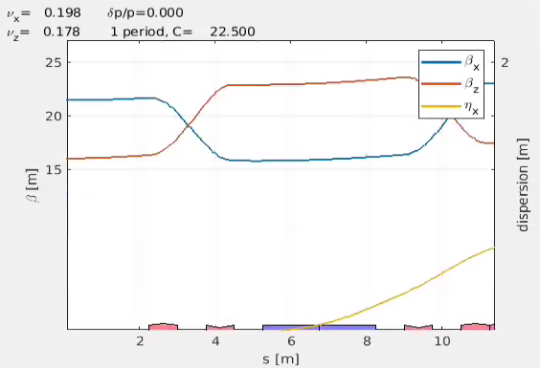
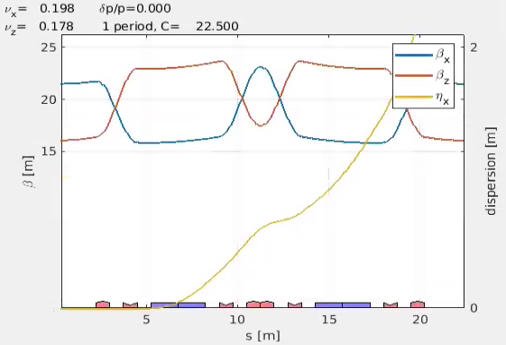
Evolution of dispersion
One cell
2 cells : [arc ; arc (end:-1:1)]
[TwissStart,~,~]=atlinopt(…,0,1)
atplot(…,’inputtwiss’,TwissStart)
Dispersion increases at each dipole

Slide 14
6) Match dispersion at straight sections to zero
Use above +:
atlinopt
atmatch
atVariableBuilder
atlinconstraints
dispersion_x’ = 0
Rename quadrupoles: QF1, QD2, QD3, QF4.
Twiss input: from atlinopt modified Dispersion = [0 0 0 0];
Requirements @end of cell:
Alpha_x, alpha_y, dispersion_x’ = 0
Beta_y all over the cell < 40m
1000 calls
Tolerance = 1e-15
alpha_y = 0
alpha_x = 0

Slide 15
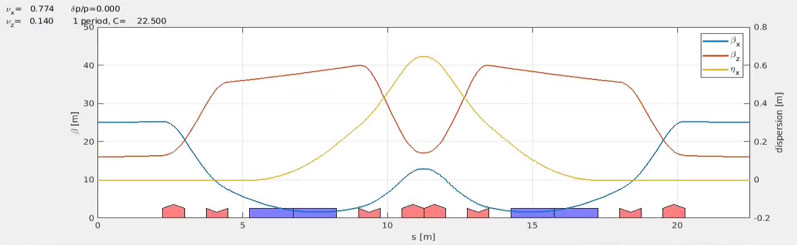
Build a symmetric cell
Use matlab array slicing
To build a symmetric cell.
Compute the emittance.

Slide 16
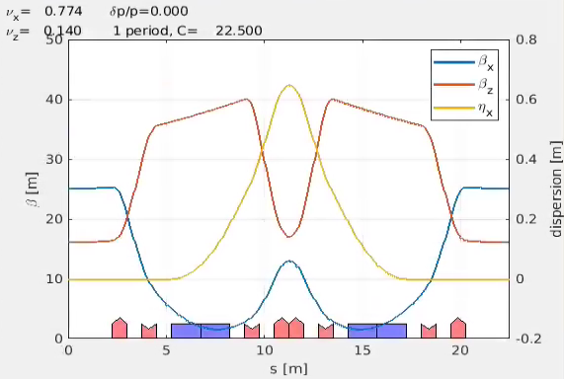
Match periodic cell
Cell center
Cell end
Store quadrupole gradients from previous matching.
Match full cell (DBA) as periodic cell, without any input optics.
Use as constraints:
Beta_x < 60m
Beta_y < 60m
Dispersion_x’ @ cell center =0
Dispersion x @ end of cell = 0
Get emittance of this lattice

Slide 17
7) Introduce sextupoles
Use: atsextupole, atlinopt
What is the best location for sextupoles?
Add sextupoles to the lattice (without changing the length of the lattice)
Rematch optics if needed.
Correct chromaticity either from scratch or using atfitchrom
Compare initial chromaticity to final chromaticity.

Slide 18
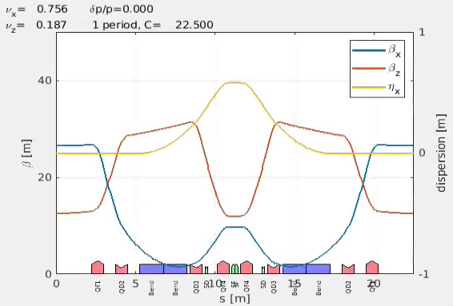
7) Introduce sextupoles
Use: atsextupole, atlinopt
Find best location for sextupoles
Add sextupoles to the lattice (without changing the length of the lattice)
Rematch optics if needed.
Correct chromaticity either from scratch or using atfitchrom
Compare initial chromaticity to final chromaticity.

Slide 19
8) Add an RF cavity
Use atrfcavity and atsetcavity to add an RF cavity
Compute emittance
Compute emittance using atx
Compute emittance using ringpara
Use atgeometry to
verify total angle is correct
Verify lattice geometry (full ring)

Slide 20
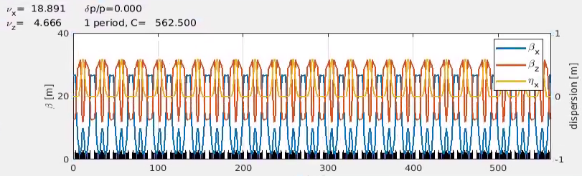
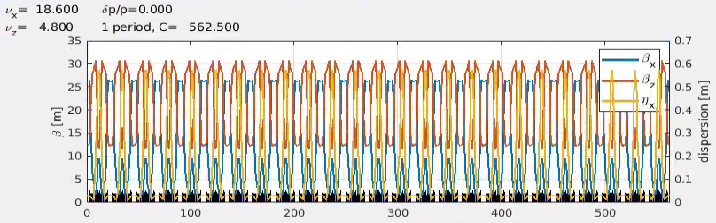
9) match tune
Use atfittune
Match tune to some value
ex [.44 .39]
Compare ringpara outputs
Compare quadrupole gradients

Slide 21
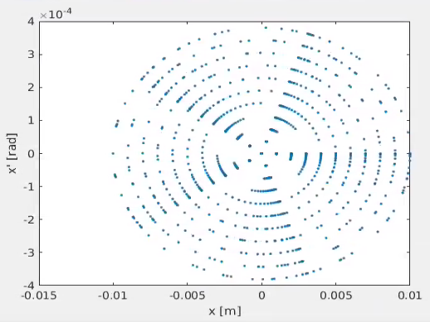
10) tracking
Use:
ringpass
Track 10 particles with initial amplitudes at
1 - 10 mm for 4000 turns
Plot phase space x-x’, y-y’, ct-delta
Same with:
Turn on radiation atradon
Sextupoles off atgetcells atsetfieldvalues
Larger initial amplitudes
What differences do you notice?

Slide 22
10) tracking
Use:
linepass
Track 10 particles with initial amplitudes at
1 - 10 mm for 4000 turns
No radiation
Plot phase space x-x’, y-y’, ct-delta
At QF1 center,
QD2 center,
Lattice entrance
Sext. entrance

Slide 23
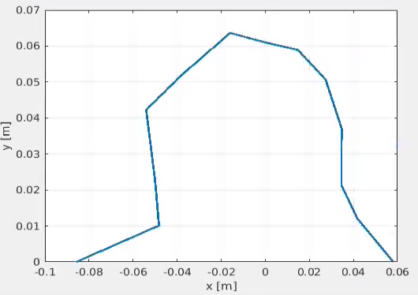
11) Dynamic aperture
Use atdynap for a rough computation of transverse D.A.
Compute for 2 different tunes and compare also natural emittances.
Compute sextupoles off

Slide 24
Further exercises

Slide 25
outline
Install AT
AT concepts: integrators, coordinate system
Build a lattice: lattice elements, tune, chrom, compute and plot optics (periodic and open line)
Tracking, phase space, single turn with initial conditions
DA, MA
Cavity setting
Lattice geometry
Exercises:
Build a FODO: 2 quads + dip + sext + bpm/corr
Phase space: linear lattice, lattice with sextupoles, lattice with RF, lattice with radiation
Compute detuning with amplitude and momentum
Compute DA
Injection efficiency (atbeam)
Tune scan (DA@inj vs tunes)

Slide 26
Outline
MATCHING
Exercises:
Match beta functions in FODO lattice
Match dispersion suppressor
Match with initial conditions
Optimize dipole field profile to minimize effective emittance

Slide 27
Outline
Errors and correction: set errors, look at orbit, dispersion, beta-beating, coupling
Exercises:
Produce a closed orbit bump
Measure dispersion
Correct orbit: measure orbit, simulate/measure RM, correct. Compare simulated/measured
Set gradient quad errors, correct tune. Same with sextupole misalignments.
Several error seeds, look at distribution of emittances.
DA evolution increasing errors.

Slide 28
Outline
MATCHING
Exercises:
Match beta functions in FODO lattice
Match dispersion suppressor
Match with initial conditions
Optimize dipole field profile to minimize effective emittance

Slide 29
Real work
In December we had an open list of topics to study:
- 8 bend achromat option
- short bend in the middle of the cell for Bending Magnet beamlines
- long straight section of 10-15m for large beta at injection, symmetric on both sides of the ring.
Should we work on this topics?
If we have sufficient time and manpower we could also include:
- error tolerance studies
- dynamic aperture/ lifetime/ injection efficiency estimates (cluster computing)
- booster lattice optics
- transfer line optics

Slide 30
Conclusion
You know how to use AT.

