Slide 1
Matlab AT tutorial

Slide 2
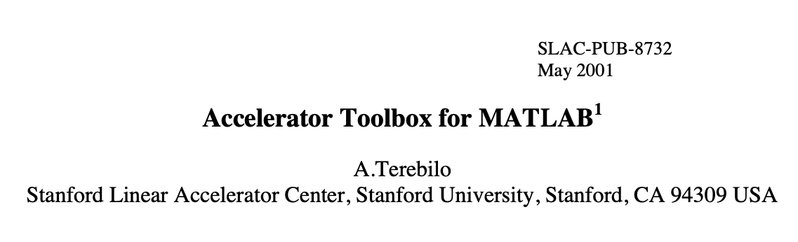
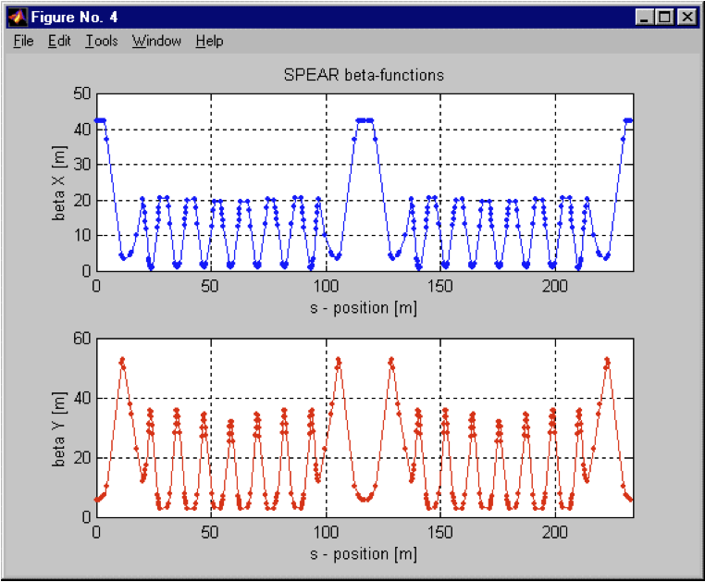
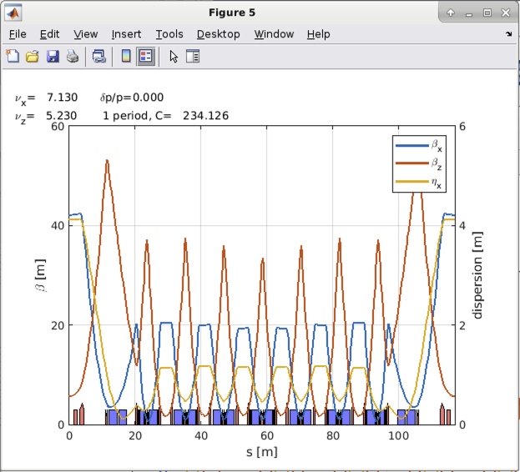
Introduction
AT is a code developed in early 2000 by Andrei Terebilo at SLAC.
Here we talk about the MATLAB version, if you are interested on the new pyAT go to the other presentation.
Installation
Normal users
Developers
Code structure
PassMethod example
https://atcollab.github.io/at/index.html
2001
2023

Slide 3
System Requirements
AT is compatible with Matlab release 2016b (Matlab 9.1) or newer.
AT runs on Linux, Windows or MacOS.
AT needs a C/C++ compiler compatible with the Matlab version used. For more information, visit Mathworks support and look for supported and compatible C/C++ compilers.

Slide 4
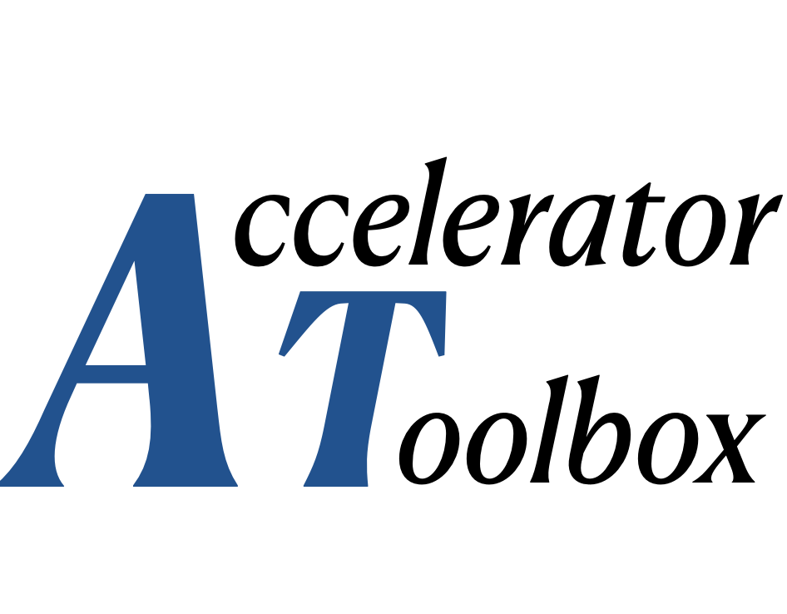
How to get the code: for not developers
If you don’t want to be a developer:
From Matlab Central
This is the recommended method which lets you install the last stable version.
From the "Environment" tab of the Matlab command window, in the "Add-Ons" menu, select "Manage Add-Ons". The in the Add-On Manager window, click in "Get Add-Ons". Search for "particle accelerators" and look for:
Click on "Add". You can also download the toolbox from the Matlab Web site.

Slide 5
How to get the code: for developers
From GitHub
This lets you install the last updated version.
1. Install git on your computer
2. Download the latest version of AT:
$ git clone https://github.com/atcollab/
3. Set the Matlab path
Insert recursively the directories <at_installation>/atmat and <at_installation>/atintegrators in the Matlab path. This can be done by:
Using the GUI: Open the "Set Path" window, press "Add with subfolders", select <at_installation>/atmat; repeat the operation for <at_installation>/atintegrators.
Using the startup.m file: Insert a line addpath(genpath(<at_installation>/atmat)) and a similar one for atintegrators.
Temporarily modifying the path by running:
>> cd <at_installation>/atmat
>> atpath

Slide 6
Compiling the C/C++ integrators
The compilation of all the components is performed by running:
>> atmexall
This is needed for developers and normal users.

Slide 7
Overview of AT code
The core of accelerator toolbox is the PassMethod.
A PassMethod takes a set of input particle coordinates and modifies them. All PassMethods are written in C.
Python and Matlab AT are actually both environments that are wrappers for the PassMethods.
Both Python and Matlab share the same PassMethods in the directory at/atintegrators
Main passmethods are:
DriftPass.c
BendMPoleSymplectic4Pass.c
StrMPoleSymplectic4Pass.c
RFCavityPass.c
Each PassMethod is initialised with a needed set of parameters (e.g. for a Quadrupole it needs a length and a strength, for a drift it needs only a length). Then you can pass to it an array of particles of shape (6,N), and it will perform the necessary transformation.
All of the AT computations are done with tracking. (Unless specifically mentioned).

Slide 8
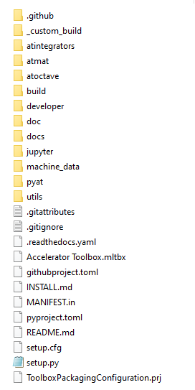
at/atintegrators contains the PassMethods
at/atmat contains the matlab code
at/machine_data contains some example lattices
at/pyat contains the python code

Slide 9
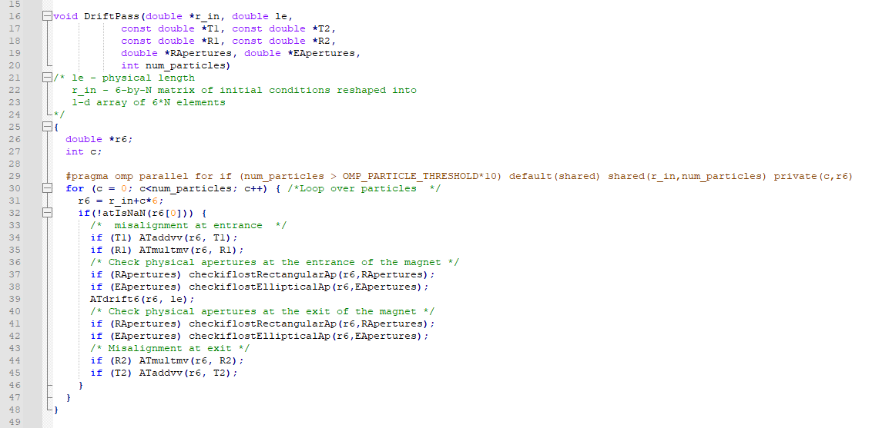
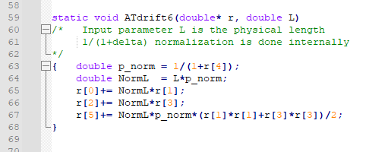
A passmethod example: DriftPass.c
Lets look at DriftPass.c to get a feeling for how it works.
In conclusion, 6d array of particles is squashed into (x0,xp0,y0,yp0,delta0,ct0, x1,xp1,...), and this is given to PassMethod as r_in.
Arithmetic of pointers is used to loop through each particle. (line 30 and 31). Each particle is iterated in the function ATdrift6.

