Slide 1
PyAT Introduction

Slide 2
INSTALLATION
PyAT Website: https://atcollab.github.io/at/p/index.html
Detailed installation instructions can be found there.
Needed (see website for full list of requirements and dependencies):
python
numpy , scipy, setuptools, matplotlib (optional)
git
Microsoft Build Tools (windows only): https://visualstudio.microsoft.com/visual-cpp-build-tools/
Download installer, click ‘modify’ and install ‘Desktop development with C++’, then add to path.
mpi4py (for parallelised collective effects)

Slide 3
INSTALLATION ON LINUX
If you have no intention of doing any development:
pip install accelerator-toolbox
If you would like to do some development:
git clone https://github.com/atcollab/at
cd at
pip install -e
If you want to install with mpi4py for collective effects simulations
pip install mpi4py
git clone https://github.com/atcollab/at
cd at
pip install - -config-settings mpi=1 “.[mpi]”
Note: there is no space between the dashes.
If you do not have root privileges, follow the instructions “Installation (All Platforms)” in order to create a virtual environment.

Slide 4
OVERVIEW
The core of accelerator toolbox is the PassMethod.
A PassMethod takes a set of input particle coordinates and modifies them.
All PassMethods written in C (although python PassMethods are now possible).
Python and MatLab AT are actually both environments that are wrappers for the PassMethods.
Both Python and Matlab share the same PassMethods.
There is a different PassMethod for each machine element: (for example, DriftPass, CavityPass).
Each PassMethod is initialised with a needed set of parameters (e.g. for a Quadrupole it needs a length and a strength, for a drift it needs only a length). Then you can pass to it an array of particles of shape (6,N), and it will perform the necessary transformation.
All of the AT computations are done with tracking. (Unless specifically mentioned).
When you install at, the PassMethods are compiled and stored in ‘at/build/dist/at/integrators’. The source of each PassMethod is in ‘at/atintegrators’

Slide 5
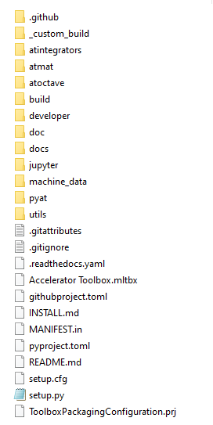
INSTALLATION
atintegrators contains the source files of the PassMethods. machine_data contains a few example lattices that can be imported.
pyat contains all of the wrapper functions for PyAT.

Slide 6
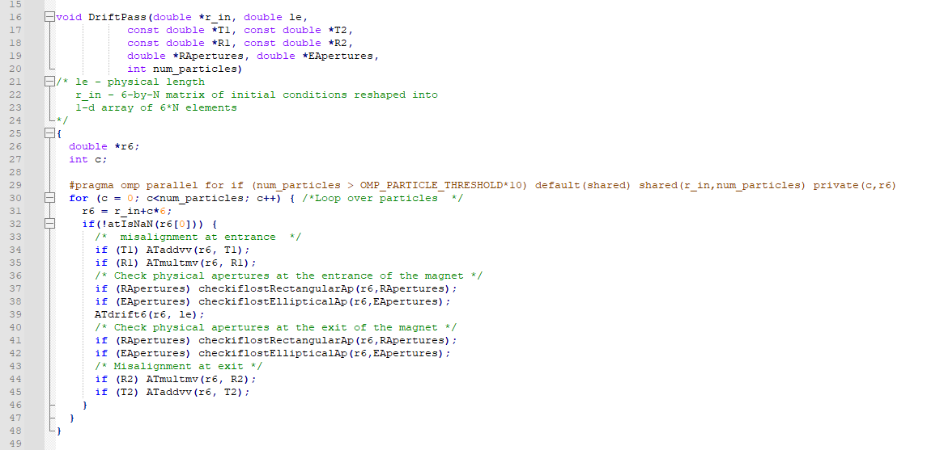
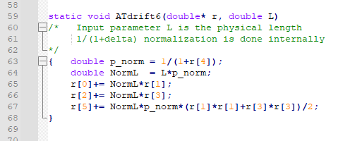
A SIMPLE PASSMETHOD EXAMPLE
Lets look at DriftPass.c to get a feeling for how it works.
In conclusion, 6d array of particles is squashed into (x0,xp0,y0,yp0,delta0,ct0, x1,xp1,...), and this is given to PassMethod as r_in.
Arithmetic pointers are used to loop through each particle. (line 30 and 31). Each particle is iterated in the function ATdrift6.
atintegrators/DriftPass.c
atintegrators/atlalib.c

Slide 7
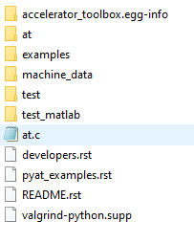
AT/PYAT
at contains all of the functions and classes for PyAT.
examples contains a few examples, (only CollectiveEffects for now).
test is run after each commit to ensure compatibility.

Slide 8
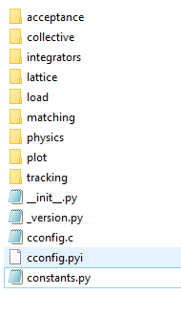
AT/PYAT/AT
This now contains all of the python functions for all of the different features of PyAT.
We will see how to use PyAT, and the help functions will be pointing back to files found in this directory.

